Slide 1
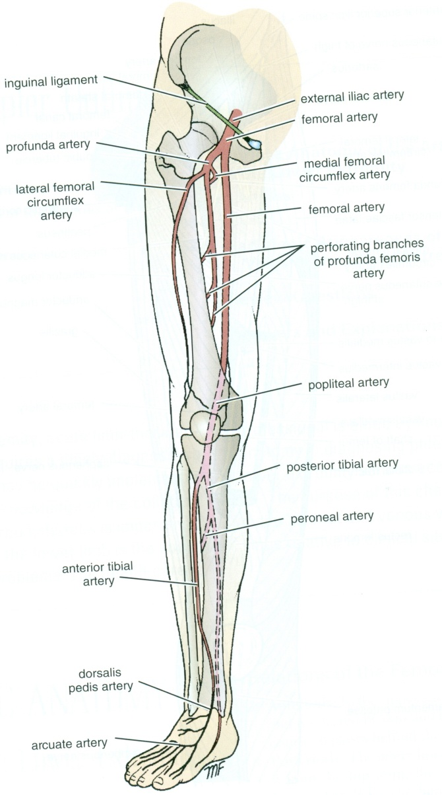
Vasculature of LL
Dr ESSAM
ELDIN
Dr JAMILA ELMEDANY

Slide 2
Objectives
At the end of the lecture, students should be able to:
List the main arteries of the lower limb.
Describe their origin, course distribution & branches.
List the main arterial anastomosis.
List the sites where you feel the arterial pulse.
Differentiate the veins of LL into superficial & deep
Describe their origin, course & termination and tributaries

Slide 3
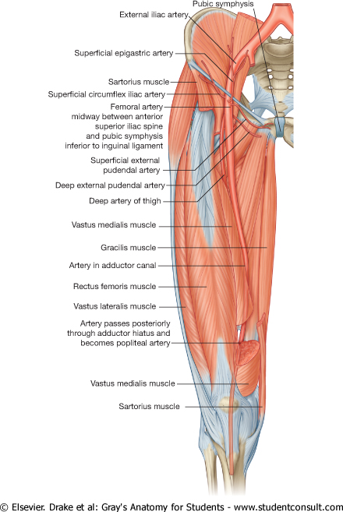
Femoral Artery
It is the main arterial supply to the lower limb.
Origin:
It is the continuation of the External iliac artery.
How it enters the thigh?
Behind the inguinal ligament, midway between the anterior superior iliac spine and the symphysis pubis.

Slide 4
Relations
Anterior:
Upper part: Skin & fascia.
Lower part: Sartorius.
Posterior:
Psoas (separates it from the hip joint), Pectineus & Addcutor longus
Medial:
Femoral vein.
Lateral :
Femoral nerve and its branches.

Slide 5
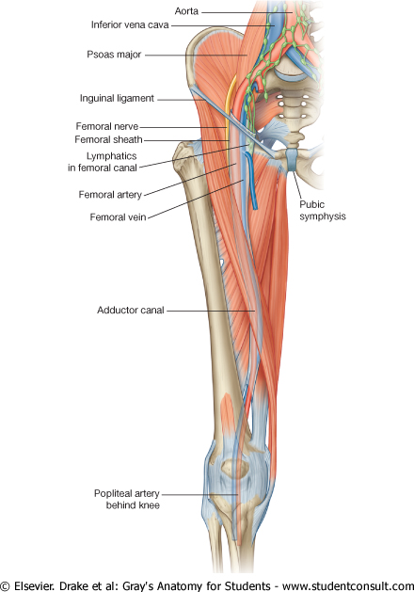
Femoral Artery & femoral Vein
At the inguinal ligament:
The vein lies medial to the artery.
At the apex of the femoral triangle:
The vein lies posterior to the artery.
At the opening in the adductor magnus:
The vein lies lateral to the artery.

Slide 6
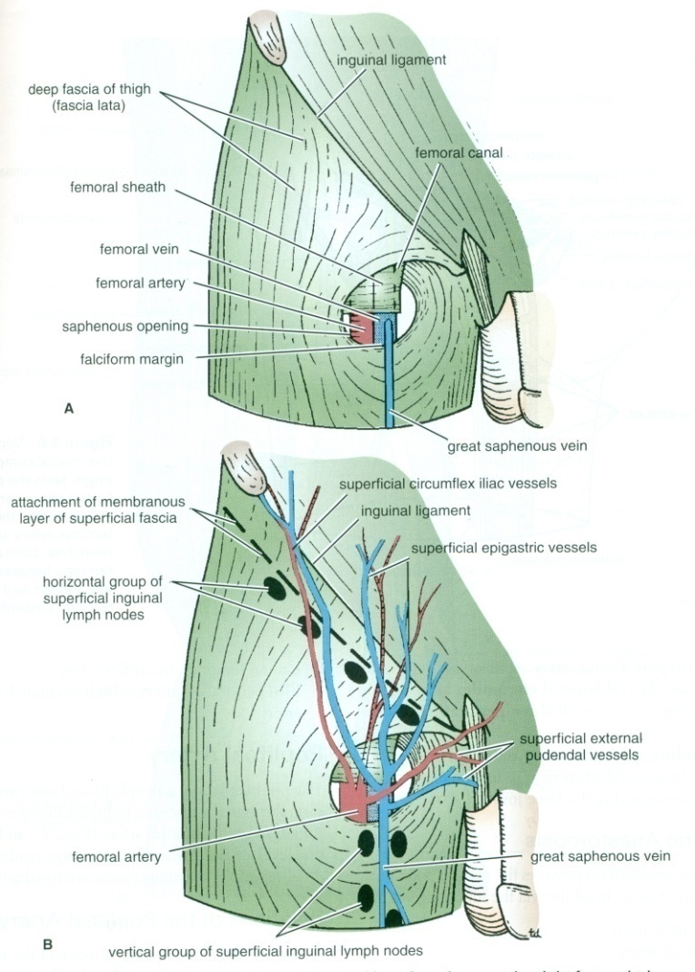
Branches of Femoral Artery
1. Superficial Epigastric.
2. Superficial Circumflex iliac.
3. Superficial External Pudendal.
4. Deep External Pudendal.
5. Profunda Femoris

Slide 7
Profunda Femoris Artery
It is an important, large artery to the medial compartment of the thigh.
Arises from the lateral side of the femoral artery(4cm below the inguinal ligament).
It Passes medially behind the femoral vessels.

Slide 8
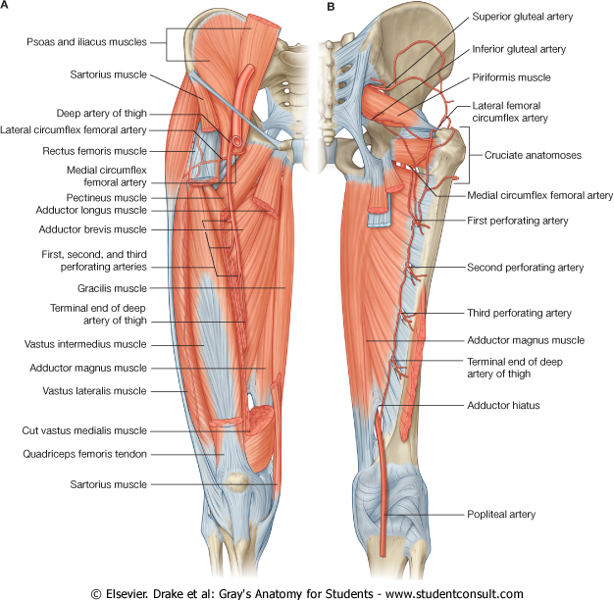
Branches
Medial & Lateral circumflex femoral arteries.
Three Perforating arteries.
It ends by becoming the 4th perforating artery.

Slide 9
Popliteal Artery
It is the continuation of Femoral artery.
It enters the Popliteal fossa through an opening in the Adductor magnus.

Slide 10
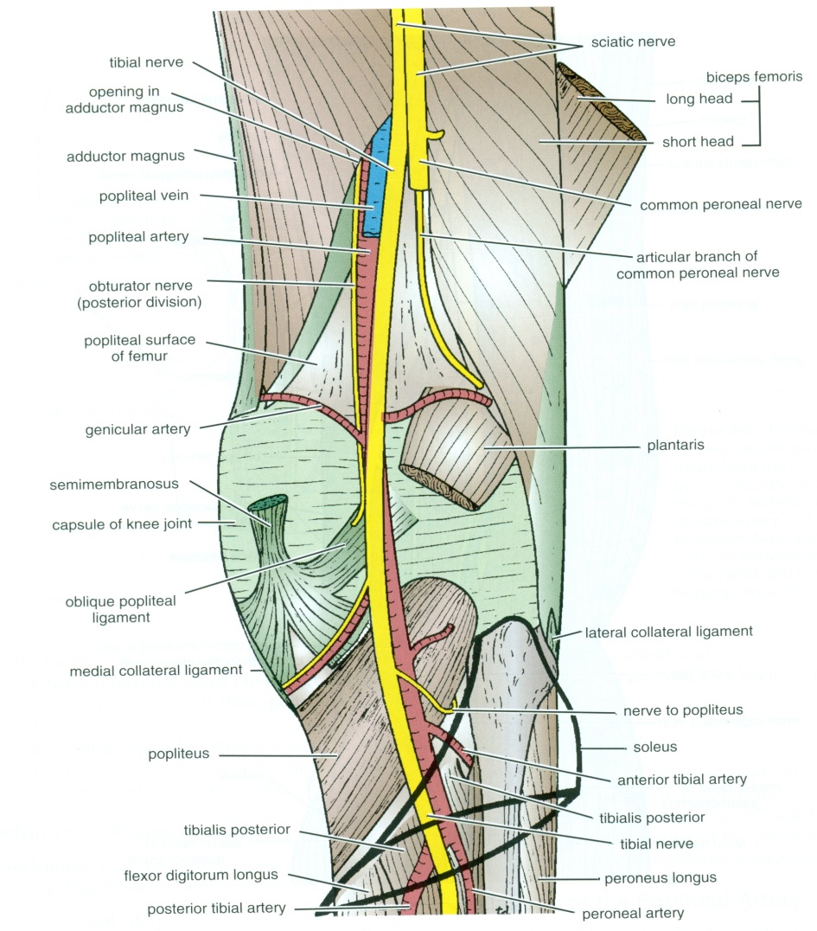
Relations & Branches
Anterior:
Popliteal surface of the femur.
Knee joint.
Popliteus muscle.
Posterior:
Popliteal vein, Tibial nerve
skin and fascia.
Branches:
Muscular & Articular to the knee joint.
Termination:
At the lower border of Popliteus muscle, it dividies into:
Anterior and Posterior Tibial Arteries.
.

Slide 11
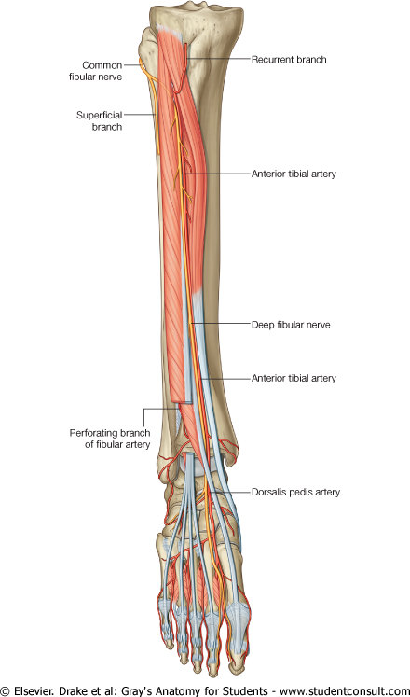
Anterior Tibial Artery
It is the smaller of the two terminal branches of the popliteal artery.
It enters the anterior compartment of the leg through an opening in the upper part of the interosseous membrane.
It descends with the Deep Peroneal nerve.
In its upper part, it is Deep.
In its lower part, it is Superficial (in front of the lower end of the tibia)
Branches:
Muscular& Anastomotic

Slide 12
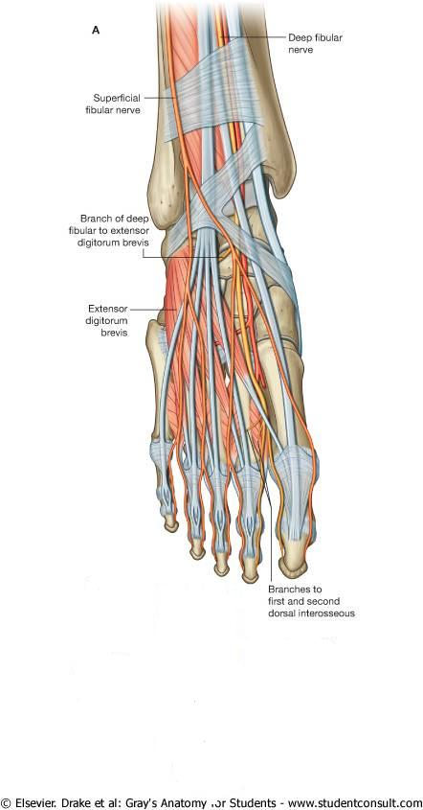
Dorsalis Pedis Artery
Begins in front of ankle joint as a continuation of the Anterior Tibial artery.
It is superficial in position.
Crossed by the inferior extensor retinaculum and the first tendon of extensor digitorum brevis.
Medially:
Tendon of extensor hallucis longus.
Laterally:
Deep peroneal nerve& extensor digitorum longus

Slide 13
Dorsalis Pedis Artery
It Terminates by passing between the two heads of the 1st dorsal interosseous muscle.
It joins the Lateral plantar artery to complete the Plantar Arch.
Branches:
Lateral tarsal artery.
Arcuate artery.
1st dorsal metatarsal artery.

Slide 14
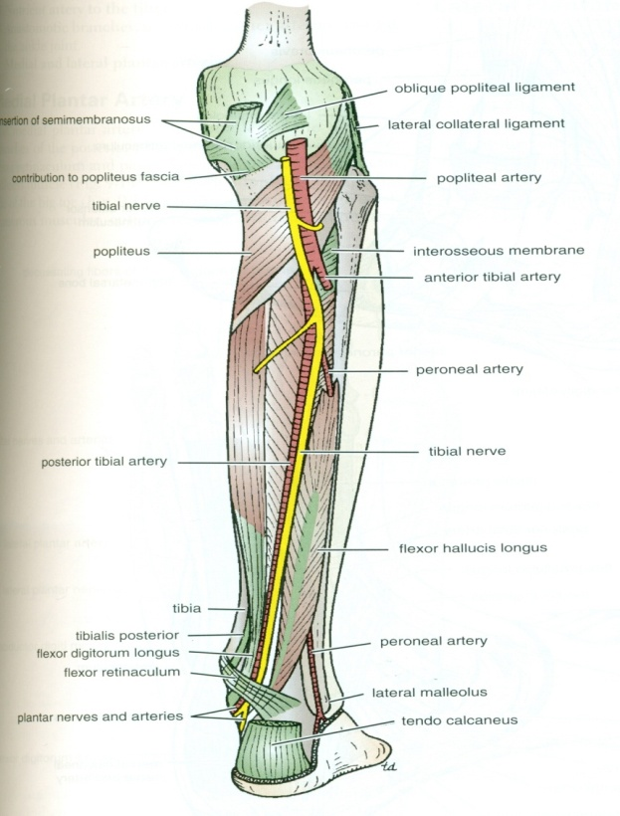
PosteriorTibial Artery
The larger terminal branch of the popliteal A.
Above ,lies on the posterior surface of Tibialis Posterior.
Below on the posterior surface of Tibia.
Its lower part is covered by Skin & Fascia.
Passes Behind Medial Malleolus , Deep to Flexor Retinaculm.

Slide 15
PosteriorTibial Artery
Terminates by dividing into: Medial & Lateral plantar arteries.
Branches:
1. Peroneal (Fibular) artery:
A large artery, descends behind the fibula (the artery of the lateral compartment of the leg).
It gives :
A. Nutrient artery to the fibula.
B. Muscular branches.
C. Perforating branch to lower part of front of leg.
D. Shares in the Anastomosis around the ankle joint.

Slide 16
Branches of PTA
2.Nutrient artery to the tibia.
3. Anastomotic branches to anastomosis around ankle joint.
4. Medial & Lateral plantar arteries.

Slide 17
Medial Plantar Artery
The smaller terminal branche of the posterior tibial artery.
Arises beneath the Flexor Retinaculum.
Branches:
Muscular, Articular and Cutaneous.
Ends by supplying the medial side of the big toe.

Slide 18
Lateral Plantar Artery
The larger
terminal branche.
At the base of the 5th metatarsal bone, it curves medially to form
the Plantar Arch.
Joins the Dorsalis pedis artery at the proximal end of the 1st intermetatarsal space.
Branches:
Muscular, Articular & Cutaneous branches.
The Plantar Arch gives Plantar Digital Arteries.

Slide 19
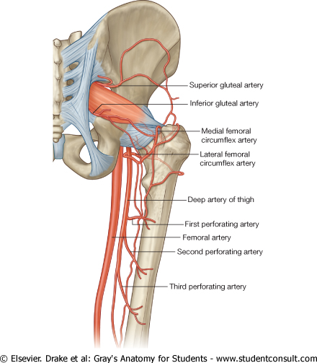
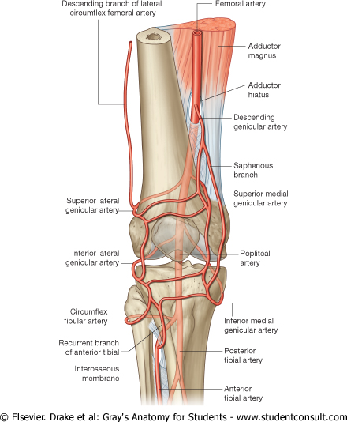
Arterial Anastomosis
Superior gluteal.
Inferior gluteal.
Medial circumflex femoral.
Lateral circumflex femoral
TROCHANTERIC (supplies the head of femur)
AROUND THE KNEE

Slide 20
Cruciate
Inferior gluteal.
Medial circumflex femoral.
Lateral circumflex femoral.
First perforating
Provides connection between Internal iliac and Femoral arteries

Slide 21
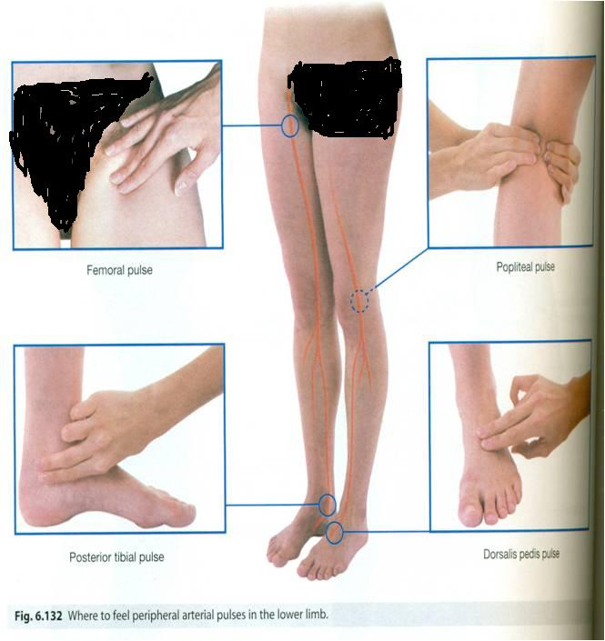
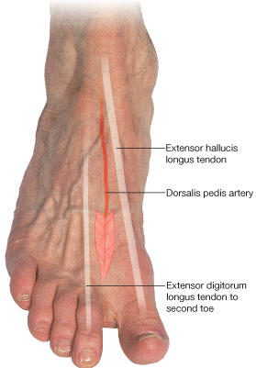
Where to Feel the Peripheral Arterial Pulse ?
Femoral :
Inferior to the lingual ligament and midway between the anterior superior iliac spine and symphysis pubis.
Popliteal :
Deep in the popliteal fossa medial to the midline.
Posterior tibial :
Posteroinferior to the medial malleolus in the groove between the malleolus and the heel.
Dorsalis pedis:
Over the tarsal bones between the tendons of extensor hallucis longus and extensor digitorum

Slide 22
Veins of LL
The veins of the lower limb are classified into:
Superficial&
Deep.

Slide 23
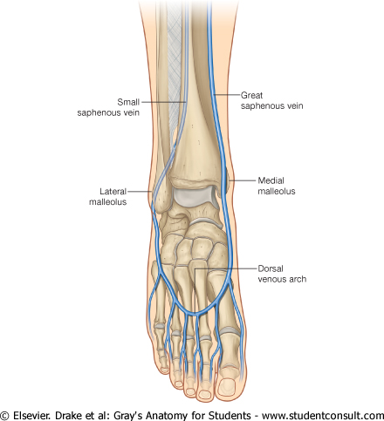
Superficial veins
Dorsal Venous arch (network):
Receives most of the blood of the foot through Digital and
Communicating veins.
Drained on:
Medial side by the Great Saphenous vein.
Lateral side by the Small saphenous vein

Slide 24
Great Saphenous Vein
The Longest Superficial vein of the body.
Begins from the medial end of the dorsal venous arch (as the medial marginal vein).
Ascends:
In front of the Medial Malleolus accompanied by the (Saphenous nerve).
Posterior the Medial Condyle of the femur.
Passes through the Saphenous Opening (2.5-3.25) cm below and lateral to the pubic tubercle.
Terminates in: Femoral Vein.

Slide 25
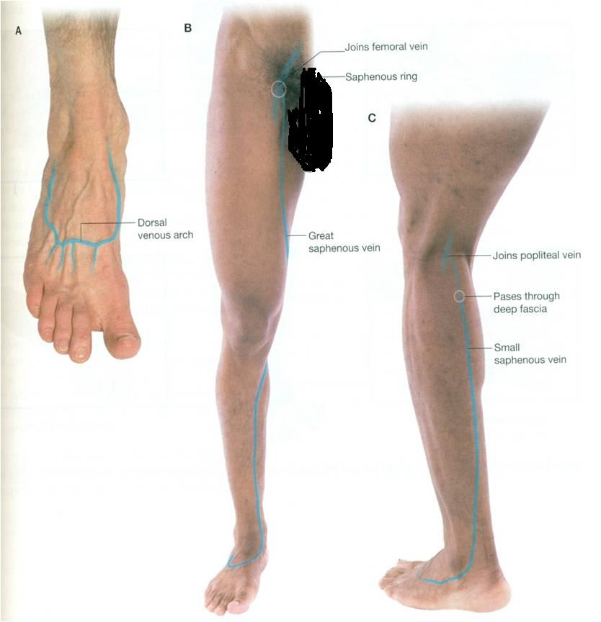
Small Saphenous Vein
Originates from the lateral end of the dorsal venous arch.
Ascends:
Behind the lateral Malleolus in company with the Sural nerve.
Along the middle of the back leg.
Termination :
1. It may join the Great Saphenous vein.
2. Or Bifurcates:
One branch joins the Great saphenous and the other joins the Popliteal vein.

Slide 26
Deep Veins
Popliteal vein
Formed by the union of venae comitantes around the anterior & posterior tibial arteries.
lies posterior to
popliteal artery.
Femoral vein
It enters the thigh by passing through the opening in the adductor magnus .
It leaves the thigh in the intermediate compartment of the femoral sheath.
Passes behind the inguinal ligament to become the External iliac vein

Slide 27
Venae Comitantes
Deep veins, accompany all the major arteries and their branches.
Usually paired.
They are contained within the vascular sheath of the artery, whose pulsations help to compress and move blood in the veins.

Slide 28
Perforating Veins
Connect the superficial veins (Great Saphenous vein) with the deep veins along the medial side of the calf.
Their valves only allow blood to flow from the superficial to the deep veins.

Slide 29
THANK YOU

