Slide 2
Thoracolumbar Spine
Dr.Vohra

Slide 3
OBJECTIVES
At the end of the lecture, students should be able to:
Distinguish the thoracic and lumbar vertebrae from each other and from vertebrae of the cervical region
Describe the characteristic features of a thoracic and a lumbar vertebra.
Compare the movements occurring in thoracic and lumbar regions.
Describe the joints between the vertebral bodies and the vertebral arches.
List and identify the ligaments of the intervertebral joints.

Slide 4
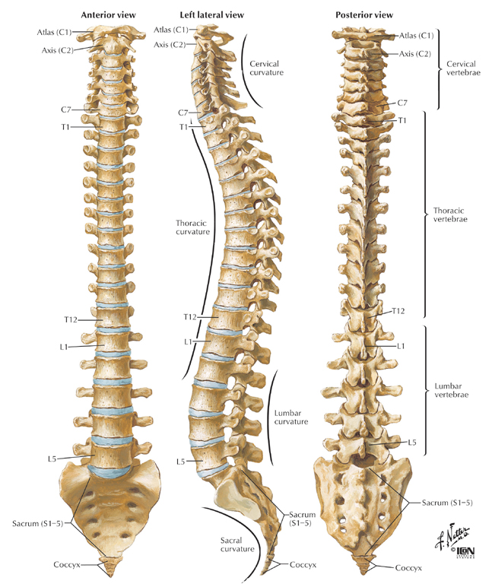
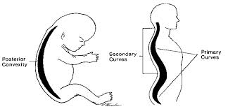
Note the curvatures in thoracic and lumbar spine.
Curves of vertebral column can be divided into :
Primary curves : Thoracic & pelvic.
Secondary curves : Cervical & lumbar.

Slide 5
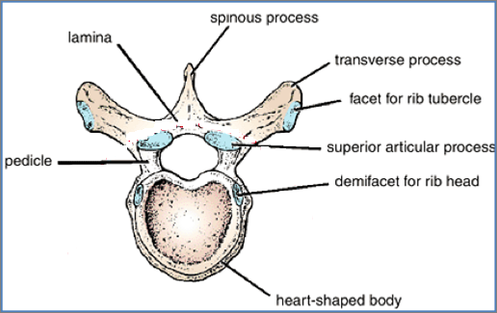
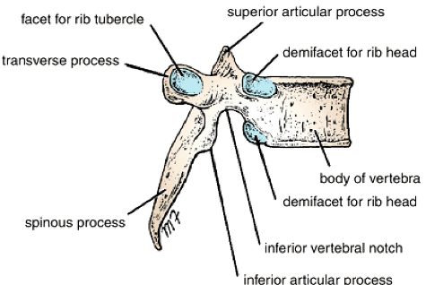
THORACIC VERTEBRAE
Most thoracic vertebrae are typical, have bodies, vertebral arches, and seven processes for muscular and articular connections.

Slide 6
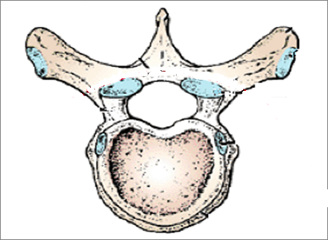
CHARACTERISTICS OF TYPICAL THORACIC VERTEBRA
Costal facets are present on the transverse processes for articulation with the tubercles of the ribs (T11 and 12 have no facets on the transverse processes).
The spines are long and inclined downward.
The vertebral foramen is small and circular
Costal facets are present on the sides of the bodies for articulation with the heads of the ribs.
The body is medium size and heart shaped.
The superior articular processes bear facets that face backward and laterally, whereas the facets on the inferior articular processes face forward and medially. The inferior articular processes of the 12th vertebra face laterally, as do those of the lumbar vertebrae.

Slide 7
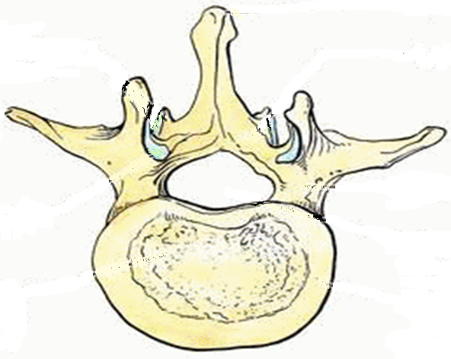
CHARACTERISTICS OF TYPICAL LUMBAR VERTEBRA
The spinous processes are short, flat, & quadrangular and project backward.
The laminae are thick.
The transverse processes are long and slender.
The vertebral foramina are triangular.
The body is large and kidney shaped.
The pedicles are strong and directed backward.
The articular surfaces of the superior articular processes face medially, and those of the inferior articular processes face laterally.

Slide 8
Lumbar vertebra
Thoracic vertebra
Lumbar vertebra
Thoracic vertebra

Slide 9
JOINTS BETWEEN TWO VERTEBRAL BODIES
It is a cartilagenous joint.
The upper and lower surfaces of the bodies of adjacent vertebrae are covered by thin plates of hyaline cartilage.
Sandwiched between the plates of hyaline cartilage is an intervertebral disc of fibrocartilage
The collagen fibers of the disc strongly unite the bodies of the two vertebrae.

Slide 10
INTERVERTEBRAL DISCS
The intervertebral discs are responsible for one fourth of the length of the vertebral column
They are thickest in the cervical and lumbar regions, where the movements of the vertebral column are greatest.
Each disc consists of a:
Peripheral part, the anulus fibrosus, composed of fibrocartilage,
Central part, the nucleus pulposus, a mass of gelatinous material containing a large amount of water, a small number of collagen fibers, and a few cartilage cells.
No discs are found between the first & second cervical vertebrae or in the sacrum or coccyx.

Slide 11
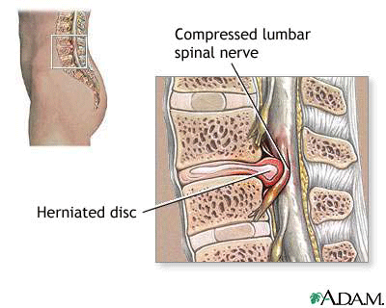
FUNCTION OF THE INTERVERTEBRAL DISCS
Allow one vertebra to rock forward or backward on another, as in flexion and extension of the vertebral column.
Serve as shock absorbers when the load on the vertebral column is suddenly increased, as when one is jumping from a height.
Sometimes, the annulus fibrosus ruptures, allowing the nucleus pulposus to herniate and protrude into the vertebral canal, where it may press on the spinal nerve roots, the spinal nerve, or even the spinal cord.

Slide 12
JOINTS BETWEEN TWO VERTEBRAL ARCHES
Consist of synovial joints between the superior and inferior articular processes of adjacent vertebrae.

Slide 13
LIGAMENTS
The anterior and posterior longitudinal ligaments run as continuous bands down the anterior and posterior surfaces of the vertebral column from the skull to the sacrum
The anterior longitudinal ligament is wide and is strongly attached to the front and sides of the vertebral bodies and to the intervertebral discs.
The posterior longitudinal ligament is weak and narrow and is attached to the posterior borders of the discs.
These ligaments hold the vertebrae firmly together but at the same time permit a small amount of movement to take place between them.

Slide 14
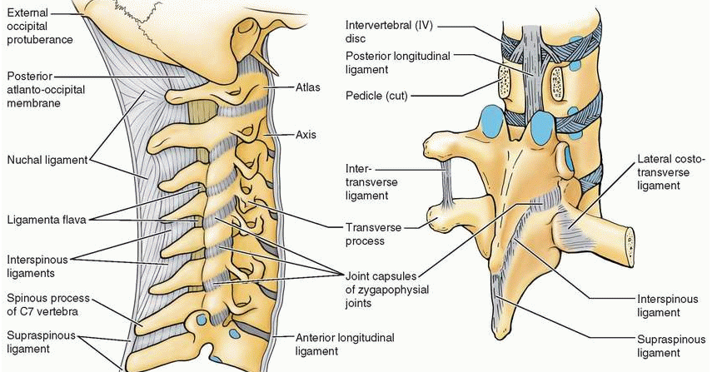
LIGAMENTS
Ligamentum flavum: connects the laminae of adjacent vertebrae
Interspinous ligament: connects adjacent spines
Supraspinous ligament: runs between the tips of adjacent spines
Intertransverse ligaments: run between adjacent transverse processes

Slide 15
MOVEMENTS OF THE THORACOLUMBAR SPINE
The following movements are possible on the spine: flexion, extension, lateral flexion, rotation, and circumduction.
The type and range of movements possible in each region of the vertebral column largely depend on the:
Thickness of the intervertebral discs and the
Shape and direction of the articular processes.
In the thoracic region, the ribs, the costal cartilages, and the sternum severely restrict the range of movement.
Flexion, extension and lateral flexion are extensive in the lumbar regions but restricted in the thoracic region.
Rotation is least extensive in the lumbar region.

Slide 16
MUSCLES PRODUCING MOVEMENTS
In the thoracic region, rotation is produced by the semispinalis and rotator muscles, assisted by the oblique muscles of the anterolateral abdominal wall.
In the lumbar region:
Flexion is produced by the rectus abdominis and the psoas muscles.
Extension is produced by the postvertebral muscles.
Lateral flexion is produced by the postvertebral muscles, the quadratus lumborum, and the oblique muscles of the anterolateral abdominal wall. The psoas may also play a part in this movement.
Rotation is produced by the rotator muscles and the oblique muscles of the anterolateral abdominal wall.

Slide 17
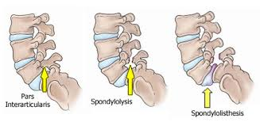
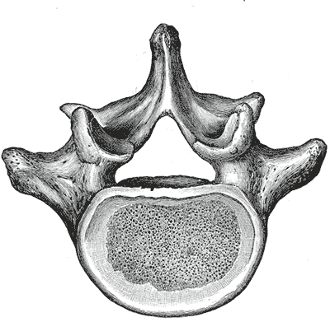
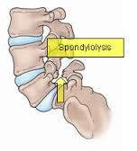
Vertebra L5
Is the largest of all movable vertebrae.
Is distinguished by its massive body and thick transverse processes
It carries the weight of the whole upper body.
The L5 body is largely responsible for the lumbosacral angle between the long axis of the lumbar region of the vertebral column and that of the sacrum
Body weight is transmitted from L5 vertebra to the base of the sacrum, formed by the superior surface of S1 vertebra
The fifth lumbar vertebra is by far the most common site of spondylolysis(defect in the pars interarticularis of the vertebral arch) and Spondylolisthesis (the forward displacement of a vertebra).

Slide 18
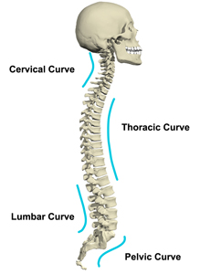
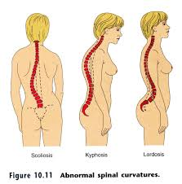
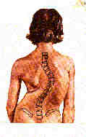
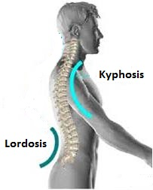
Normal Curvatures in Spine
Primary (Thoracic & Pelvic)
Secondary (Cervical & Lumbar)
Abnormal Curvatures of spine :
Exaggerated Thoracic curvatures (Kyphosis)
Exaggerated lumbar curvature (Lordosis)
Lateral curvature of spine. (Scoliosis)
Scoliosis

Slide 19
Thank You

