Slide 1
Aerobic and anaerobic
metabolism in muscle
Musculoskeletal Block | 1 Lecture | Dr. Usman Ghani
Three systems of energy transfer
ATP as energy source
Aerobic metabolism: red muscle fibers
Anaerobic metabolism: white muscle fibers
Cori cycle
Glucose-alanine cycle
Muscle fatigue and endurance in athletes

Slide 2
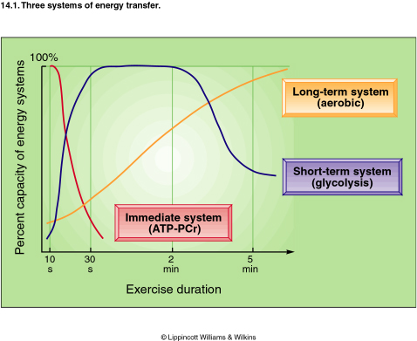
Three systems of energy transfer
Aerobic
Fatty acids
Continuous exercise
Hours
Anaerobic
Glucose
High intensity exercise
15 sec. to 2 min.
Anaerobic
Phosphocreatine (PCr)
High intensity exercise
3-15 sec.

Slide 3
ATP as energy source
The nucleotide coenzyme adenosine triphosphate (ATP) is the most important form of chemical energy stored in cells
Breakdown of ATP into ADP+PO₄ releases energy
This energy is used for all body functions (biosynthesis, membrane transport, muscle contraction, etc.)

Slide 4
ATP as energy source
The main pathway for ATP synthesis is oxidative phosphorylation catalyzed by the respiratory chain
ATP synthase catalyzes the synthesis of ATP
ADP + Pi → ATP

Slide 5
Energy metabolism in muscle
Muscle contraction requires high level of ATP consumption
Without constant resynthesis, the amount of ATP is used up in less than 1 sec. of contraction

Slide 6
Energy metabolism in muscle
Skeletal Muscle
Red Fibers
(Type I)
White Fibers
(Type II)
Suitable For
Prolonged effort
Suitable for fast,
strong contractions
Aerobic metabolism
(With O₂ supply)
Anaerobic metabolism
(Without O₂ supply)

Slide 7
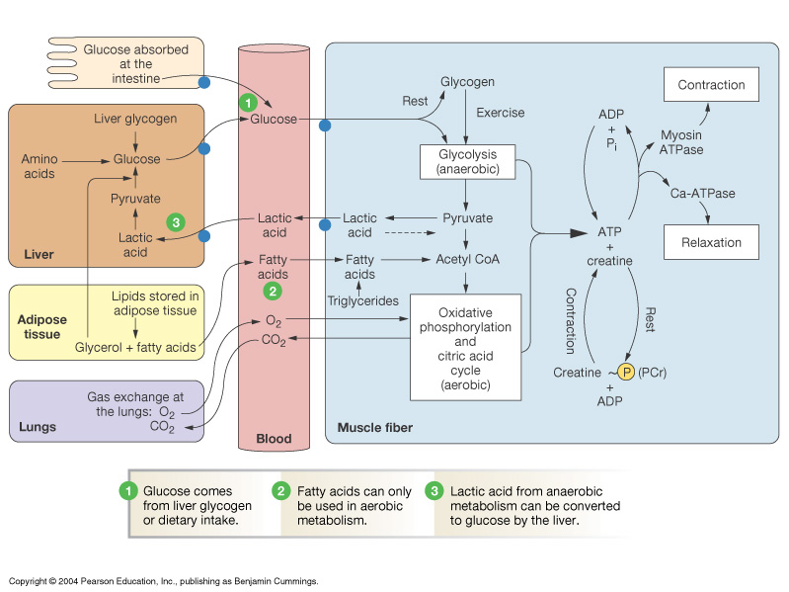
Overview of Energy Metabolism in Skeletal Muscle

Slide 8
Aerobic metabolism in red fibers
Suitable for prolonged effort
Red fibers obtain their ATP mainly from fatty acids
Fatty acids are broken down by β-oxidation, TCA cycle, and the respiratory chain
Red color is due to myoglobin
Higher O₂ affinity than hemoglobin
Releases O₂ when O₂ level drops

Slide 9
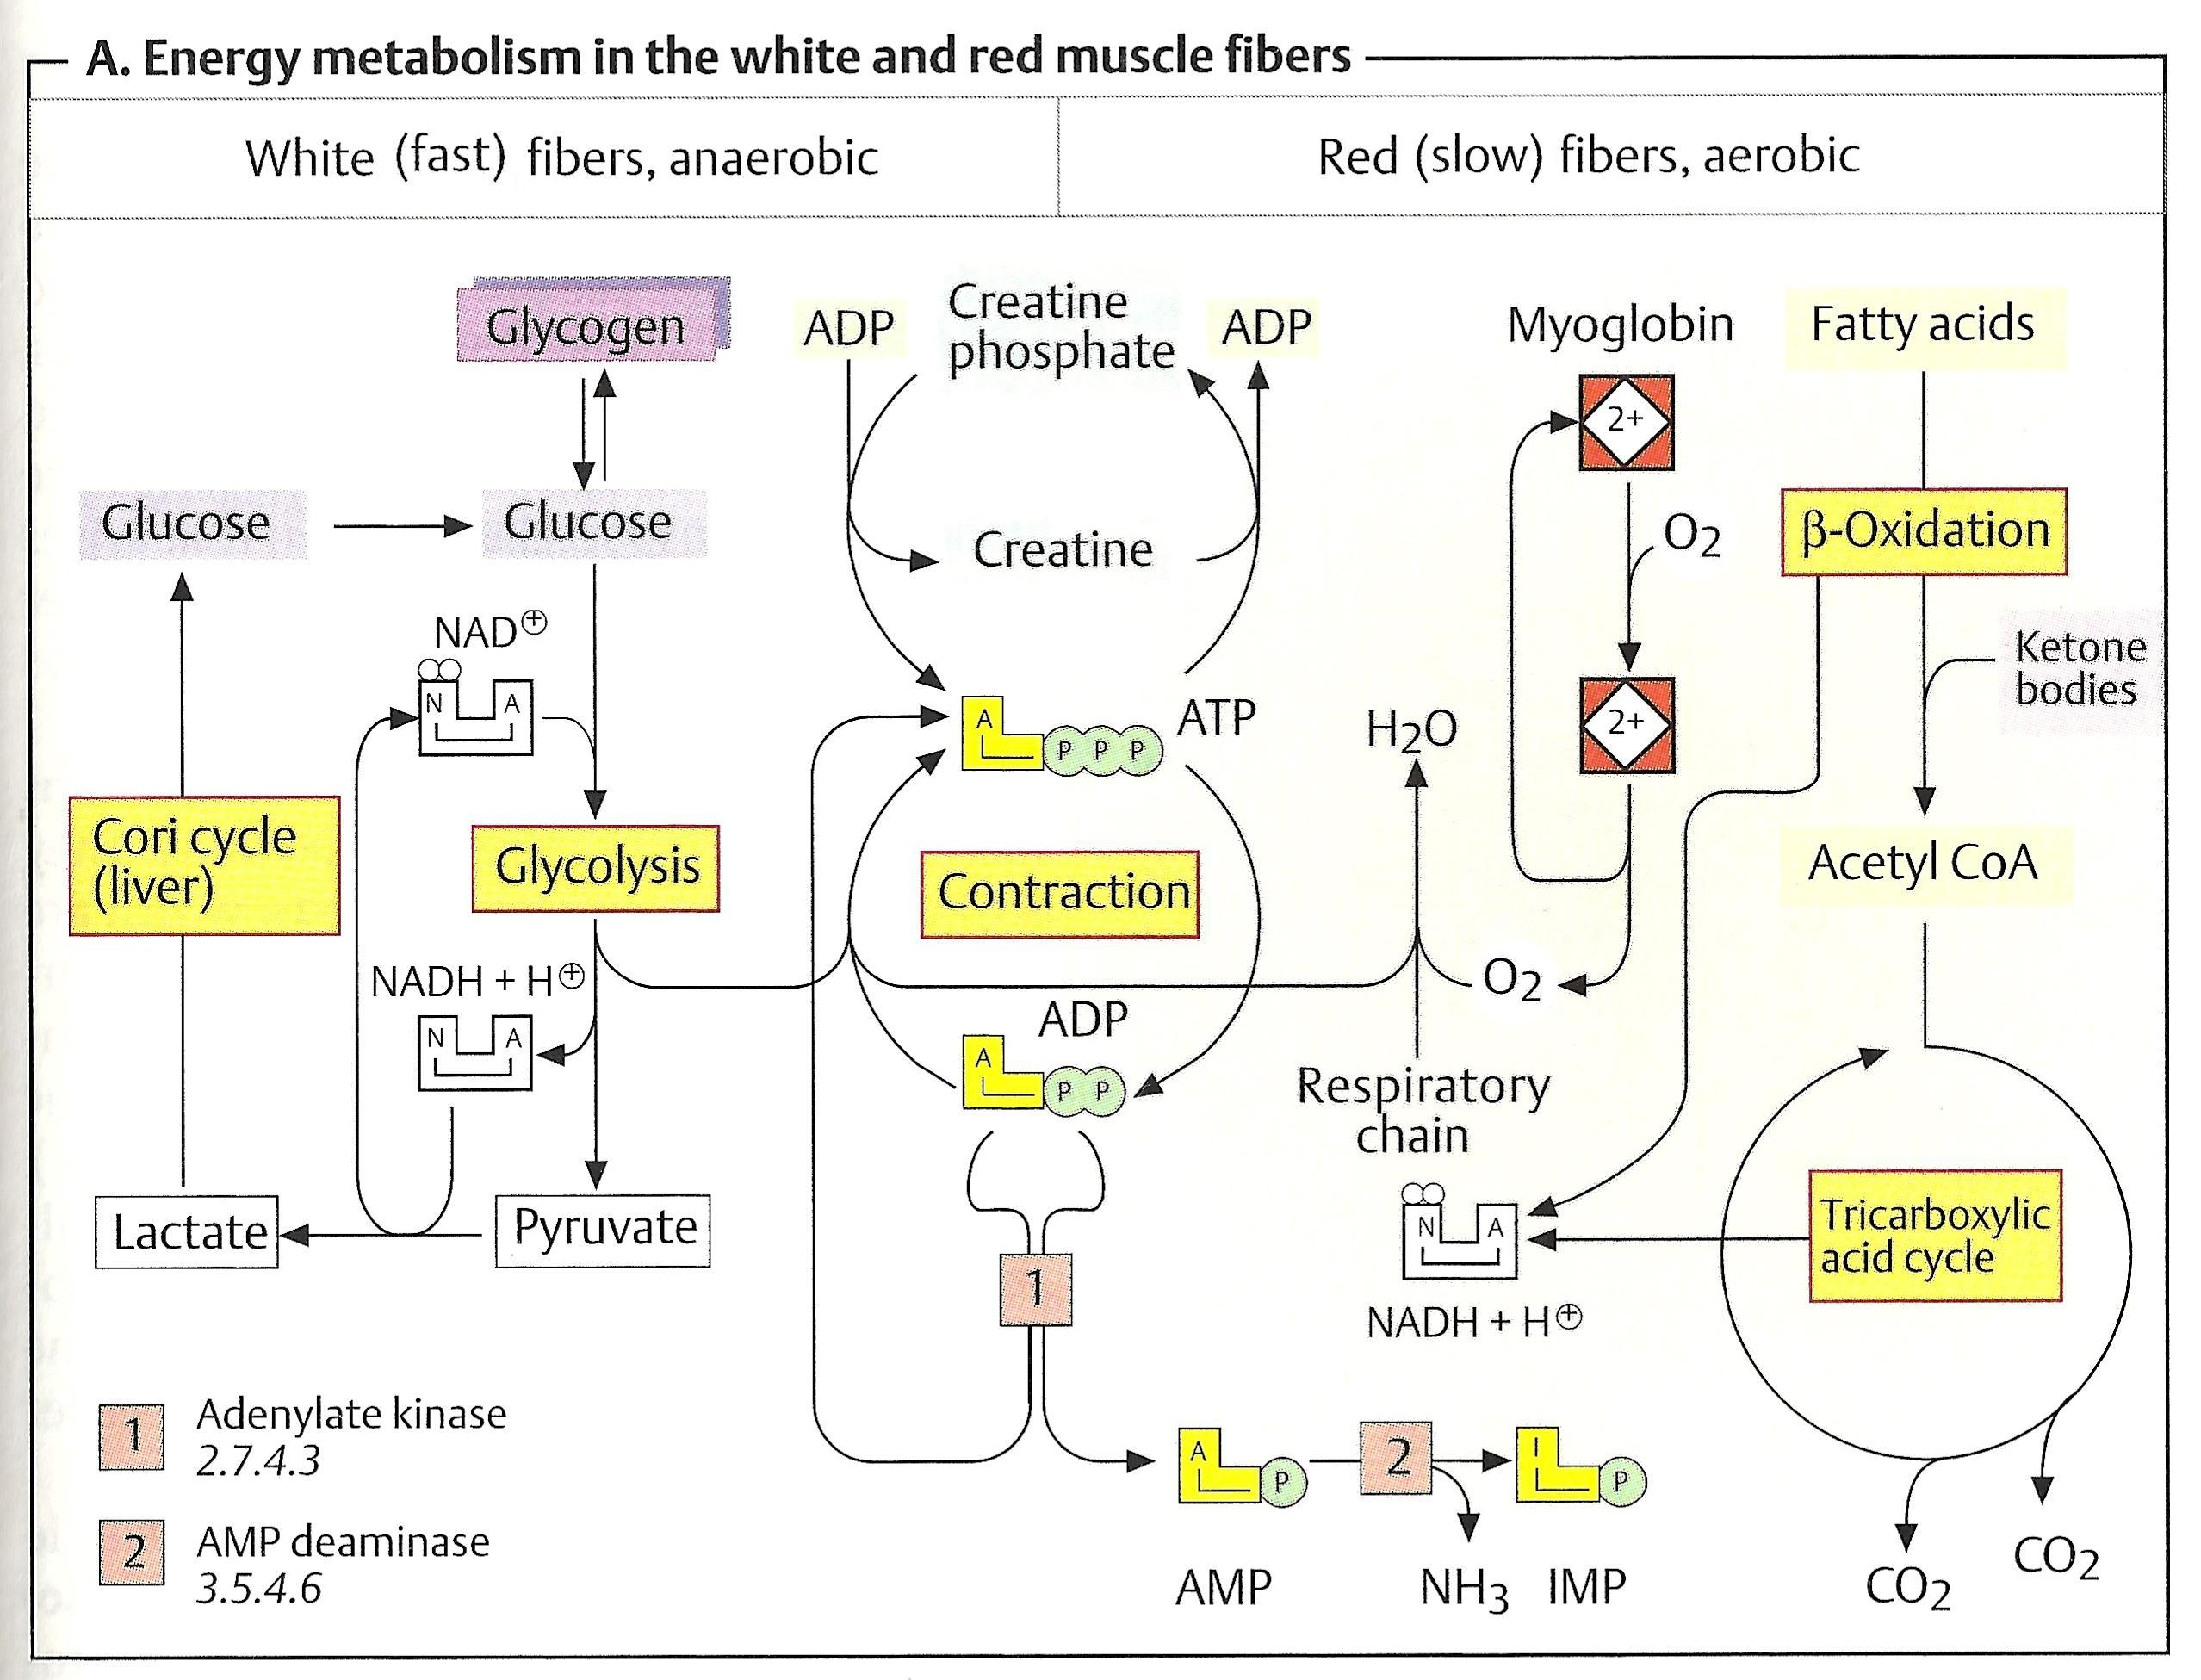

Slide 10
Anaerobic metabolism in white fibers
Suitable for fast, strong contractions
During intense muscle activity (weightlifting, etc.) O₂ supply from blood quickly drops
White fibers mainly obtain ATP from anaerobic glycolysis
Glycogen → glucose-1-PO₄ → glucose-6-PO₄ → glycolysis → ATP

Slide 12
Anaerobic metabolism in white fibers
NADH+H⁺ is reoxidized to maintain glucose degradation and ATP formation
Lactate is formed and converted to glucose in liver (Cori cycle)

Slide 13
The Cori Cycle
White muscle fibers obtain ATP from anaerobic glycolysis
In anaerobic glycolysis, the glucose is converted to lactate
Lactate in muscle is released into blood
Transported to the liver

Slide 14
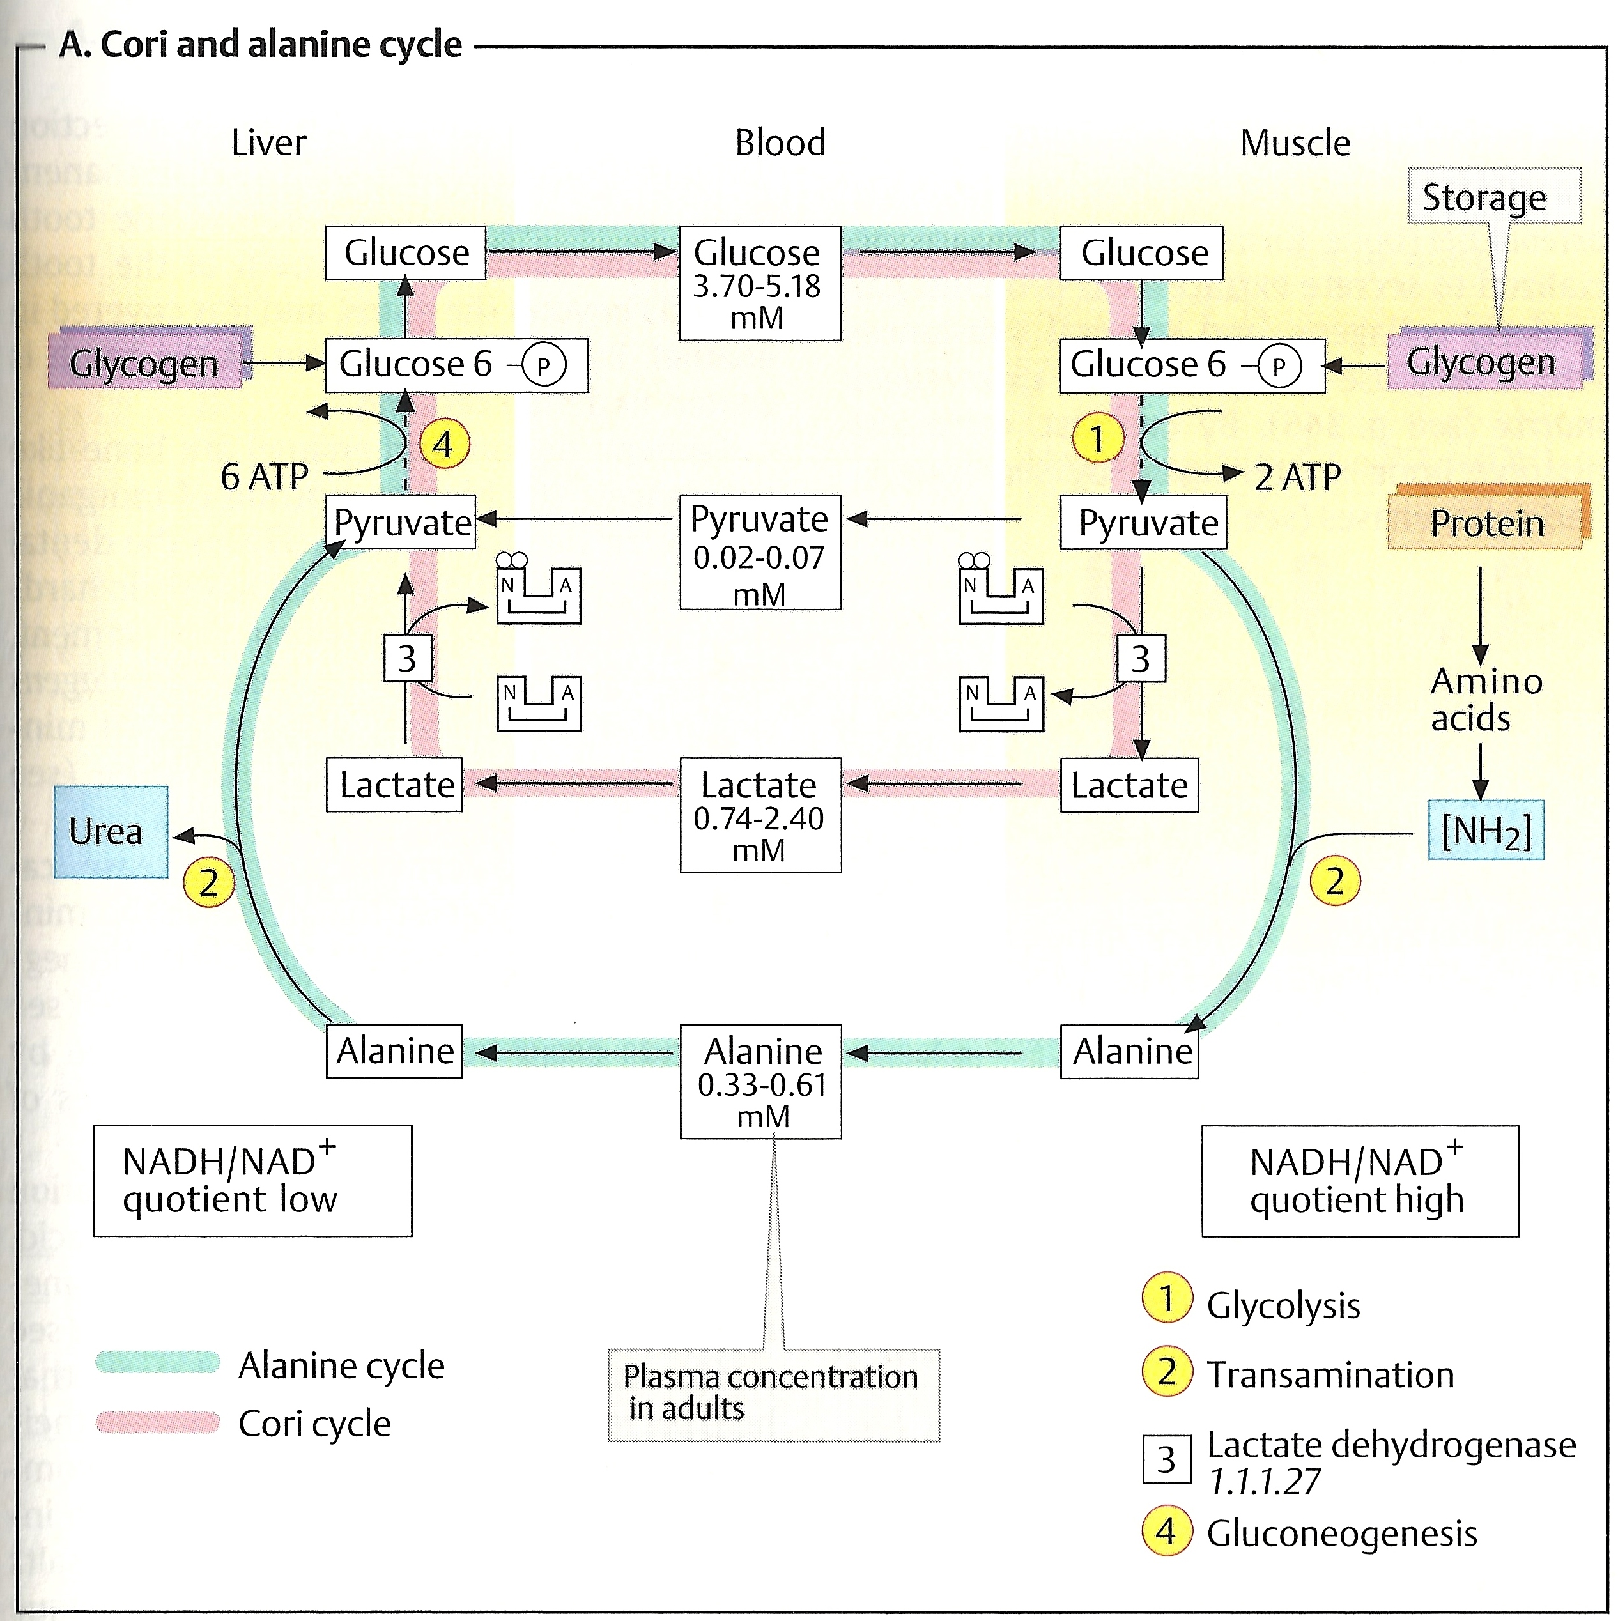

Slide 15
The Cori cycle
Liver converts lactate into glucose via gluconeogenesis
The newly formed glucose is transported to muscle to be used for energy again

Slide 17
The Cori Cycle
Why muscle can’t produce new glucose from lactate?
Because:
Gluconeogenesis requires much more ATP than is supplied by glycolysis in muscle
O₂ deficiencies do not arise in the liver even during intense exercise
Therefore, liver always has sufficient ATP for gluconeogenesis

Slide 18
The glucose-alanine cycle
Muscles produce:
Pyruvate from glycolysis during exercise and
Amino nitrogen (NH₂) from normal protein degradation
Pyruvate is converted to alanine in muscle
Pyruvate + NH₂ → Alanine

Slide 20
The glucose-alanine cycle
This alanine is transported to liver
Liver converts alanine back to pyruvate
Alanine – NH₂ = Pyruvate
Pyruvate is used in gluconeogenesis
The newly formed glucose is transported to muscle to be used for energy again

Slide 22
The glucose–alanine cycle
Page 988

Slide 24
Muscle fatigue and endurance in athletes
Muscle fatigue: Inability of muscle to maintain a particular strength of contraction over time
Causes: muscle damage, accumulation of lactic acid? (new study shows the opposite)
Athletes are trained to achieve high endurance and delayed fatigue

