Slide 1
Musculoskeletal Block
Pathology of
Musculoskeletal System
Practical Classes
Prof. Ammar Al Rikabi
Dr. Sayed Al Esawy
Dr. Marie Mukhashin
Dr. Shaesta Zaidi
Prepared by:
Head of Pathology Department: Dr. Abdulmalik Al Sheikh

Slide 2
Anatomy and Histology
Path. Dept , KSU
Ms-Sk Block

Slide 3
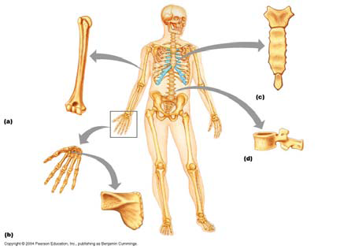
Body Skeleton
Path. Dept , KSU
Ms-Sk Block

Slide 4
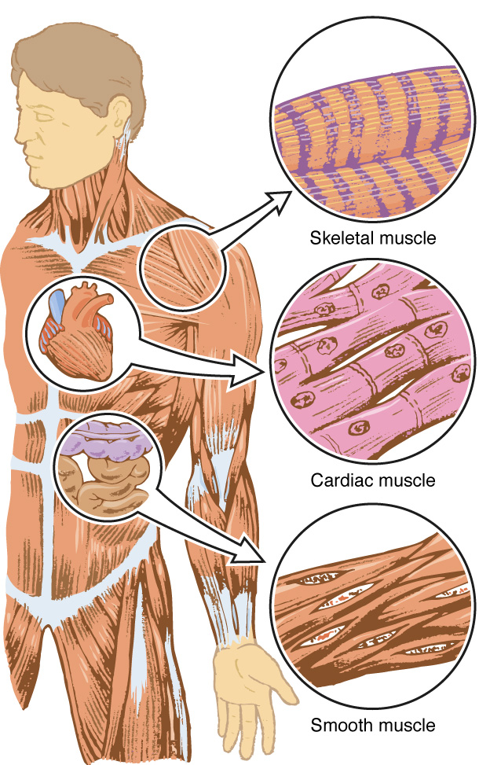
Types of muscles
Path. Dept , KSU
Ms-Sk Block

Slide 5
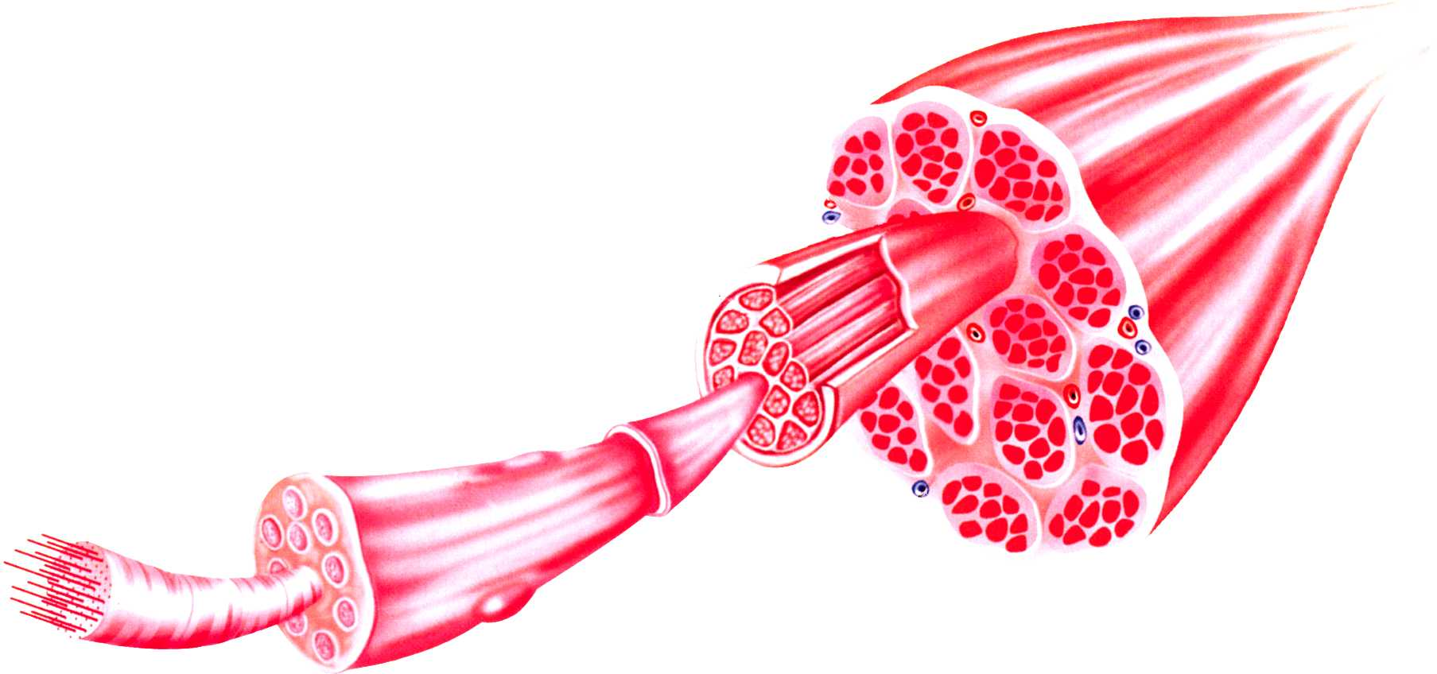
Components of skeletal muscle
d) myofibril c) muscle fiber b) muscle fiber bundle a) Muscle belly
Path. Dept , KSU
Ms-Sk Block

Slide 6
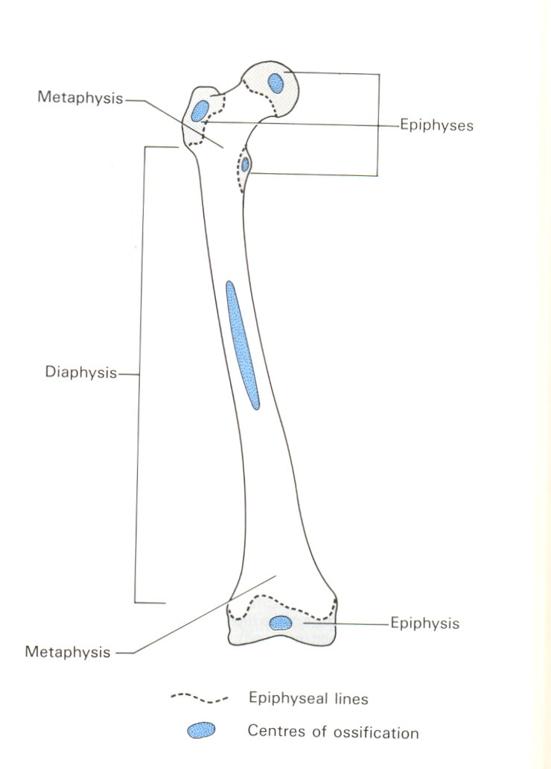
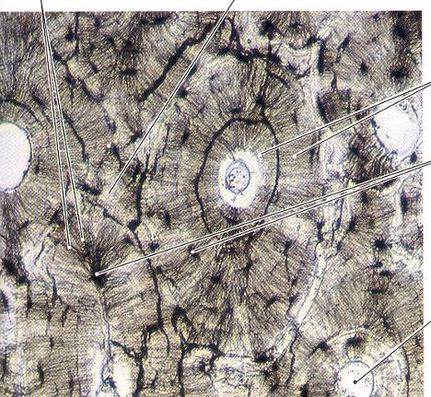
Structure of a long bone
Thin Section of Compact Bone
Path. Dept , KSU
Ms-Sk Block

Slide 7
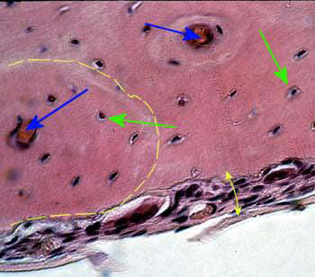
BONE STRUCTURE - LPF
Path. Dept , KSU
Ms-Sk Block

Slide 8
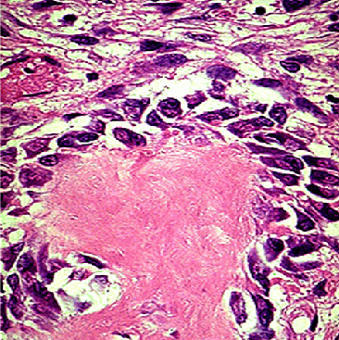
BONE STRUCTURE - HPF
Active osteoblasts synthesizing bone matrix. The surrounding spindle cells represent osteoprogenitor cells
Path. Dept , KSU
Ms-Sk Block

Slide 9
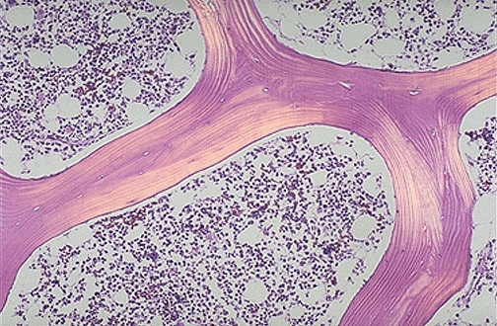
Normal Cancellous Bone - LPF
Normal cancellous bone as seen under polarized light microscopy, which highlights the lamellar structure. The bony spicules are even, with occasional lacunae containing osteocytes. Cellular marrow is seen between the spicules of bone.
Path. Dept , KSU
Ms-Sk Block

Slide 10
Muscular Dystrophies
Path. Dept , KSU
Ms-Sk Block

Slide 11
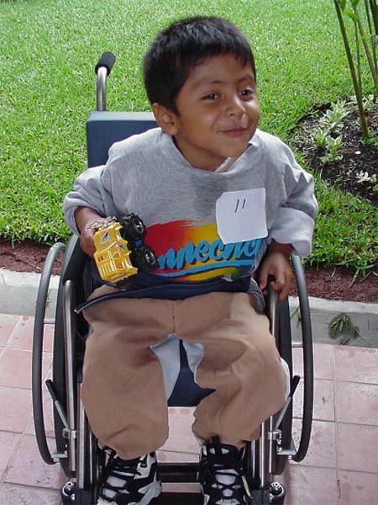
Duchenne Muscular Dystrophy (DMD)
Path. Dept , KSU
Ms-Sk Block

Slide 12
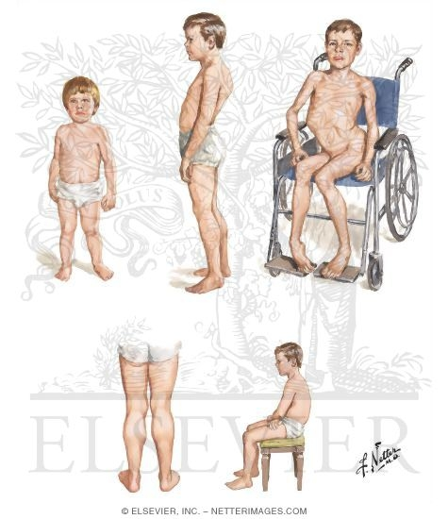
Case # 1
A 3 - year- old boy presented to his pediatrician with complaint of his parents from difficulty in walking , poor balance , and frequent falls .
Laboratory investigation shows elevated creatine kinase .
Muscle biopsy show absence of dystrophin by western blot analysis
What is your provisional diagnosis?
Path. Dept , KSU
Ms-Sk Block

Slide 13
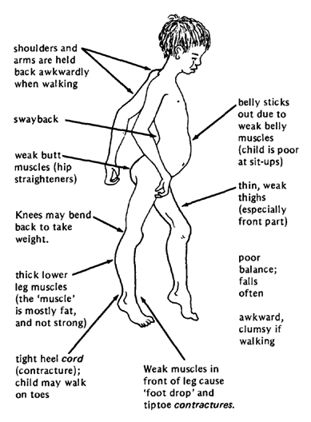
Duchenne Muscular Dystrophy (DMD)
DMD is the most severe and common type of muscular dystrophy.
DMD is characterized by the wasting away of muscles.
DMD affects mostly males at a rate of 1 in 3,500 births
Diagnosis in boys usually occurs between 16 months and 8 years.
Death from DMD usually occurs by age of 30.
Path. Dept , KSU
Ms-Sk Block

Slide 14
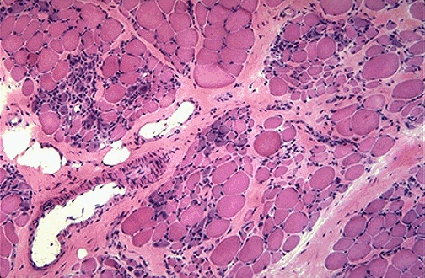
Duchenne Muscular Dystrophy - LPF
Duchenne muscular dystrophy showing variations in muscle fiber size , increased endomysial connective tissue , and regenerating fibers (blue tint)
Path. Dept , KSU
Ms-Sk Block

Slide 15
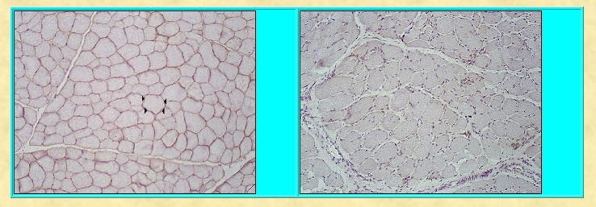
NORMAL Ms
DMD
1
2
In DMD : Dystrophin, an intracellular protein, forms an interface between the cytoskeletal proteins and a group of transmembrane proteins
Path. Dept , KSU
Ms-Sk Block

Slide 16
Dermatomyositis
Path. Dept , KSU
Ms-Sk Block

Slide 17
Case # 2
A 52-year-old woman presents with 6-month history of progressive muscle weakness and a skin rash.
Physical examination is remarkable for a diffuse purple/red discoloration of the skin over her cheeks, nose, and eyelids. Examination confirms proximal muscle weakness.
Laboratory findings show an increase in creatine kinase (10 times the normal).
Path. Dept , KSU
Ms-Sk Block

Slide 18
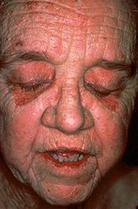
Dermatomyositis
is an inflammatory myopathy characterized by inflammation of muscle tissue and a skin rash.
Occurs more frequently in women.
Purple/red colored discoloration mainly around eyelids
Anti nuclear antibodies (ANA) and Creatinine kinase (CK) levels are useful lab test to diagnose this disease.
Path. Dept , KSU
Ms-Sk Block

Slide 19
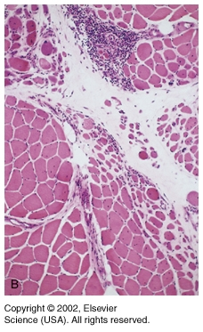
Dermatomyositis
Perifascicular atrophy of muscle fibers and chronic inflammation .
Path. Dept , KSU
Ms-Sk Block

Slide 20
NON INFECTIOUS ARTHRITIS
Path. Dept , KSU
Ms-Sk Block

Slide 21
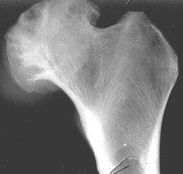
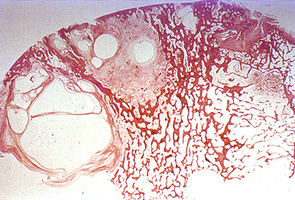
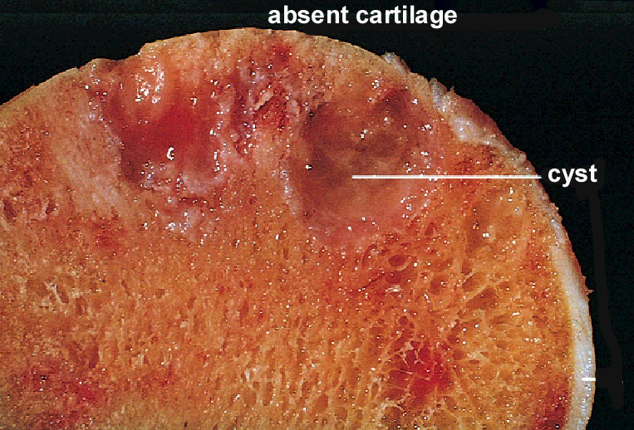
Osteoarthritis
Path. Dept , KSU
Ms-Sk Block

Slide 22
Case # 3
An obese 56-year-old woman presented with bilateral localized pain to her knees, hands and difficulty in walking .
Path. Dept , KSU
Ms-Sk Block

Slide 23
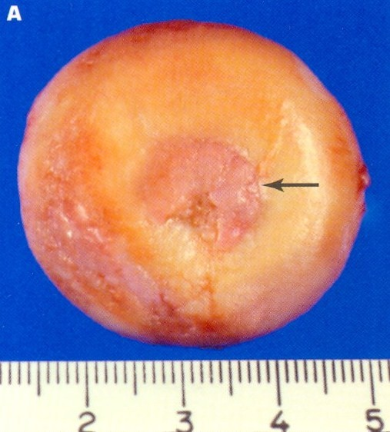
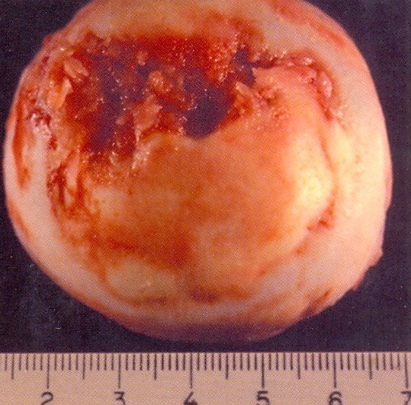
Osteoarthritis - Gross
Progressive erosion of articular cartilage, eburnated articular surface , subchondral cyst and residual articular cartilage (Osteoarthritis)
Path. Dept , KSU
Ms-Sk Block

Slide 24
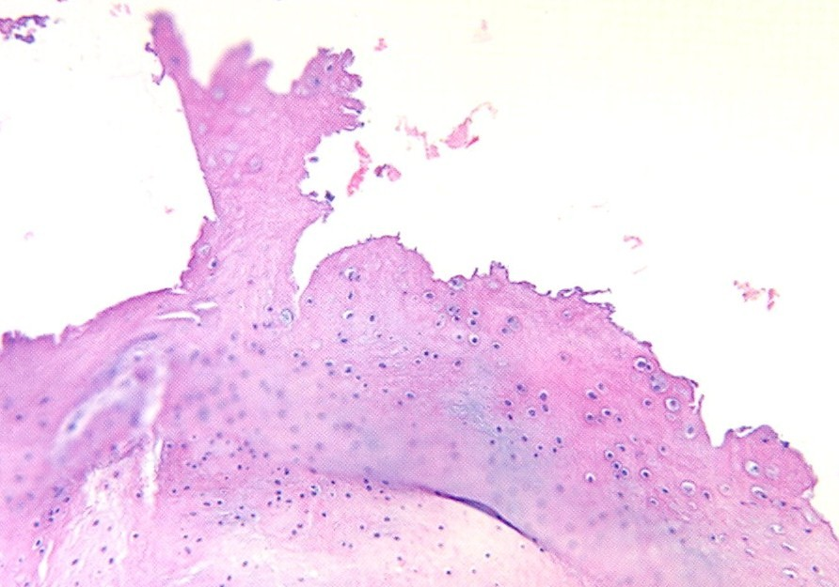
Osteoarthritis - LPF
Mushroom-shaped osteophytes (bony outgrowths ) develop at the margins of the articular surface and are capped by fibrocartilage and hyaline cartilage that gradually ossify . Note the absence of inflammation . (Osteoarthritis)
Path. Dept , KSU
Ms-Sk Block

Slide 25
Case # 4
A 45 -year- old woman complains of low grade fever , malaise and stiffness in her joints each morning .
Path. Dept , KSU
Ms-Sk Block

Slide 26
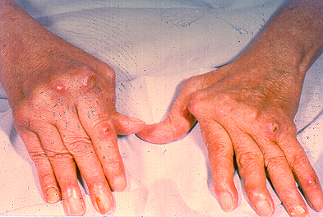
Rheumatoid Arthritis
Serological tests which are somewhat specific for this disease:
1- Rheumatoid factor (RF)
2- Antibodies to citrullinated peptides in the serum
3- C-Reactive protein (CRP) and ESR (Non specific)
Path. Dept , KSU
Ms-Sk Block

Slide 27
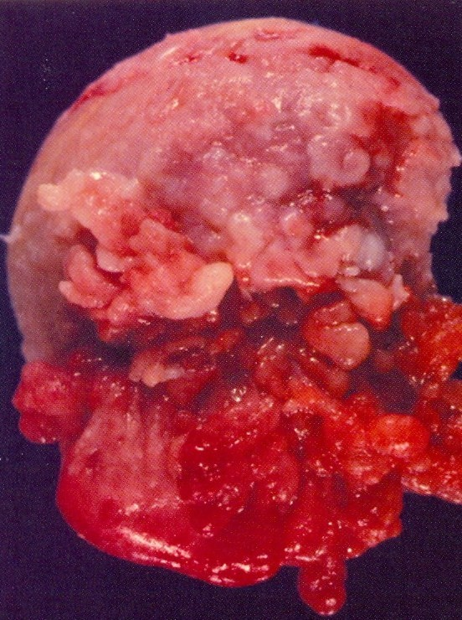
Rheumatoid arthritis affecting the head of the femur.
The synovium becomes
Congested , hyperplastic
Eroded bone and cartilage
Path. Dept , KSU
Ms-Sk Block

Slide 28
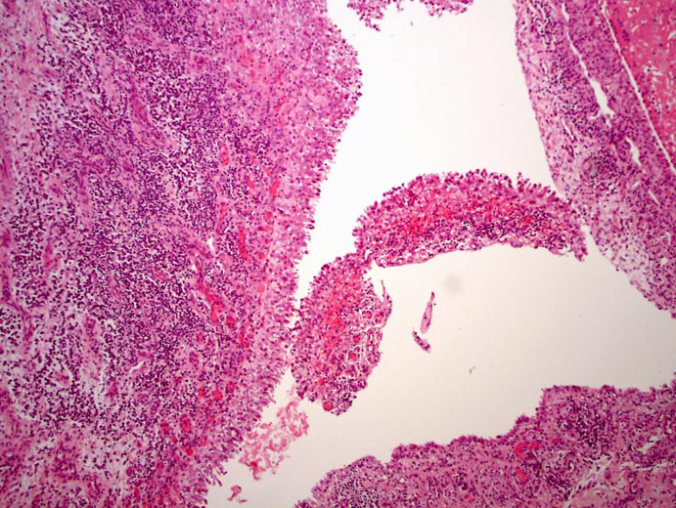
Hyperplastic Synovium - LPF
Hyperplastic synovial lining with villous like projections , underlying dense lymphocytic infiltration and vascular congestion
Path. Dept , KSU
Ms-Sk Block

Slide 29
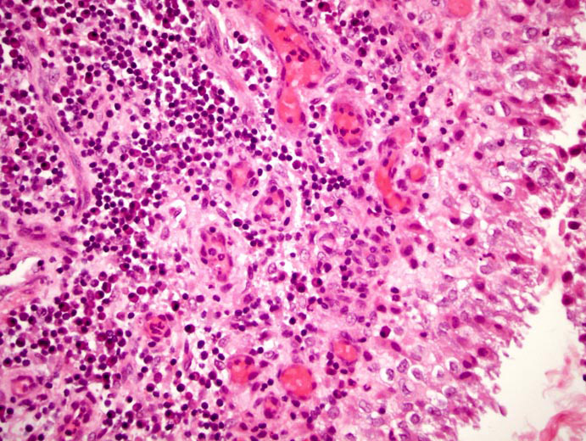
Hyperplastic Synovium - HPF
Hyperplastic synovium with underlying plasma cells and lymphocytes including many congested blood vessels in Rheumatoid arthritis
Path. Dept , KSU
Ms-Sk Block

Slide 30
Osteomyelitis
Path. Dept , KSU
Ms-Sk Block

Slide 31
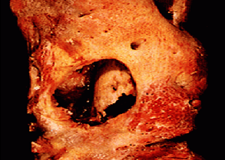
Osteomyelitis
Direct infection of bone.
Bacterial most often
Staphylococcus
Salmonella
Sickle Cell Disease
Tuberculosis
Spine first
Resected femur in a patient with draining osteomyelitis. The drainage tract in the subosteal shell of viable new bone (involucrum) reveals the inner native necrotic cortex (sequestrum)
Path. Dept , KSU
Ms-Sk Block

Slide 32
Case # 5
A 22- year- old male presented with localized pain above his right knee joint with recurrent fever. Later, he had a discharging sinuses from the skin overlying the right knee.
What is the most likely diagnosis ?
Path. Dept , KSU
Ms-Sk Block

Slide 33
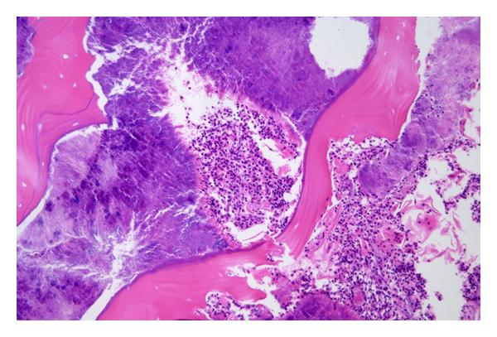
Acute Osteomyelitis - LPF
Acute Osteomyelitis. Bony sequestrae are surrounded by colonies of bacteria as well as purulent infiltrate.
Path. Dept , KSU
Ms-Sk Block

Slide 34
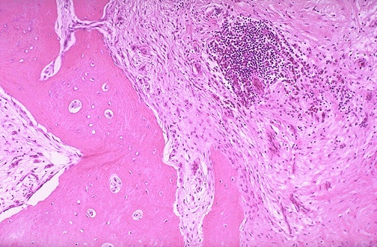
Chronic Osteomyelitis - LPF
Chronic Osteomyelitis. Note the fibrosis of the marrow space accompanied by chronic inflammatory cells. There can be bone destruction with remodeling.
Path. Dept , KSU
Ms-Sk Block

Slide 35
Spinal TB – Pott’s Disease
(Tuberculous Osteomyelitis)
Path. Dept , KSU
Ms-Sk Block

Slide 36
Case # 6
A 30 -year-old debilitated man presented to the orthopedic clinic with back pain, low grade fever, marked elevation of sedimentation rate and recent kyphosis and scoliosis .
The patient has a history of coughing up blood, fever, chills, night sweats, weight loss, pallor, and often a tendency to fatigue very easily.
Path. Dept , KSU
Ms-Sk Block

Slide 37
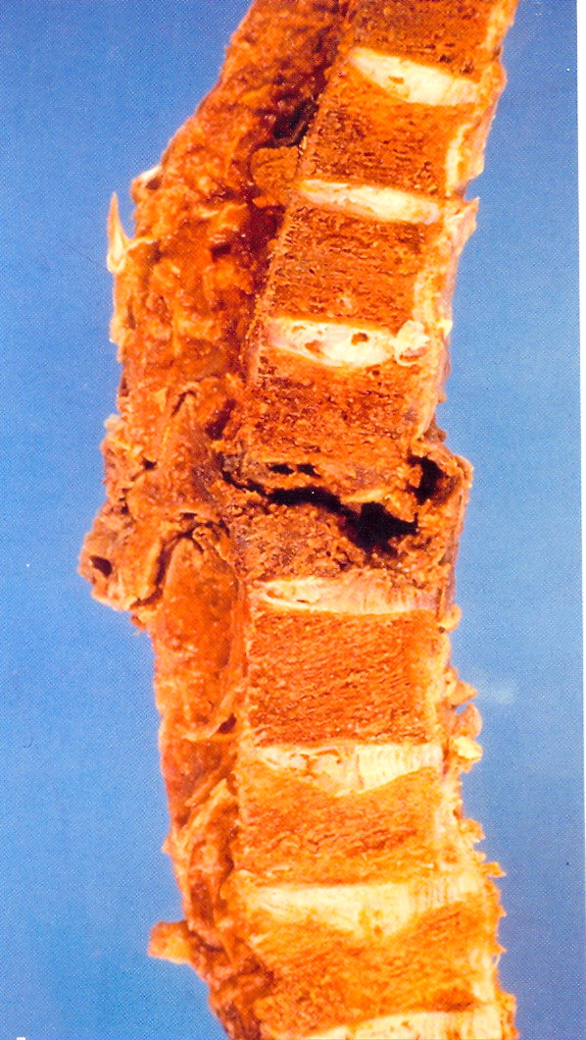
Gross pathology of T.B Osteomyelitis
of the vertebral Column (Pott’s Disease)
Granulomatous necrosis of vertebral column
Path. Dept , KSU
Ms-Sk Block

Slide 38
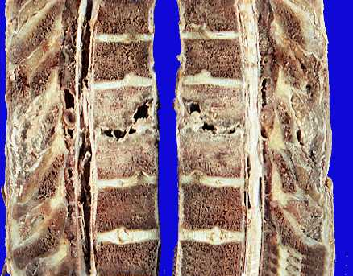
Gross pathology of T.B. Osteomyelitis
of the vertebral spines (Pott’s Disease)
Path. Dept , KSU
Ms-Sk Block

Slide 39
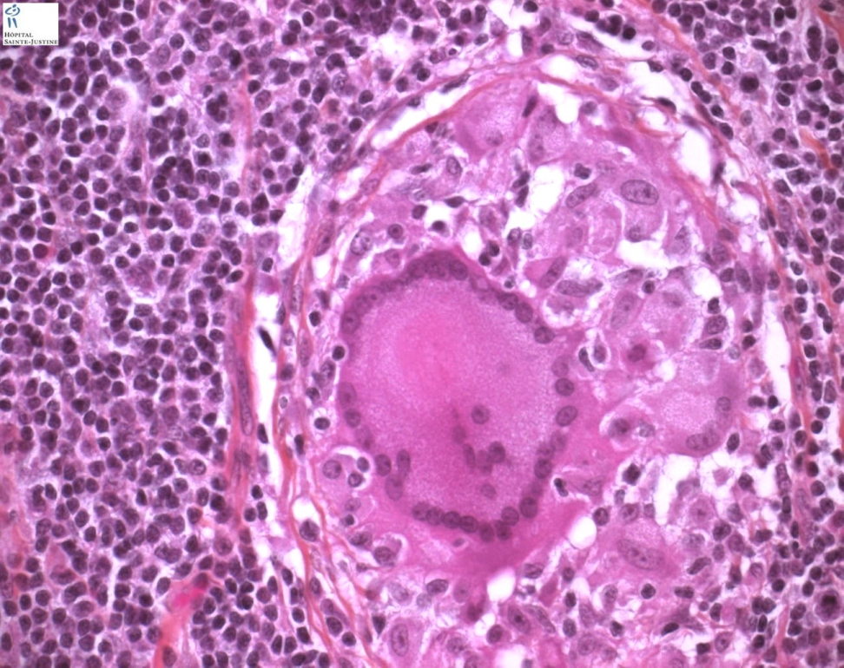
foreign body-type giant cell
Langhans-type giant cell
Bone section shows Epithelioid cells fuse to form giant cells containing 20 or more nuclei. The nuclei arranged either peripherally (Langhans-type giant cell) or haphazardly (foreign body-type giant cell). These giant cells can be found either at the periphery or the center of the granuloma.
Path. Dept , KSU
Ms-Sk Block

Slide 40
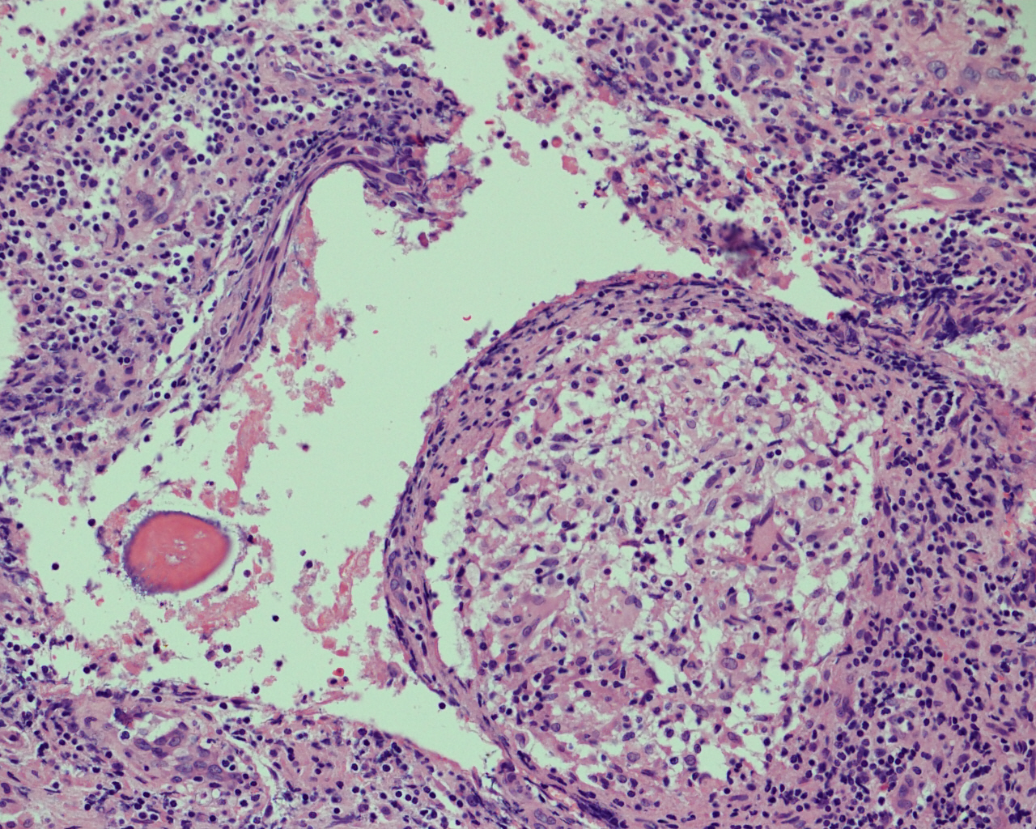
Section of bone shows granuloma formation with epithelioid like cells , langhans-type giant cells and rim of lymphocytes
Path. Dept , KSU
Ms-Sk Block

Slide 41
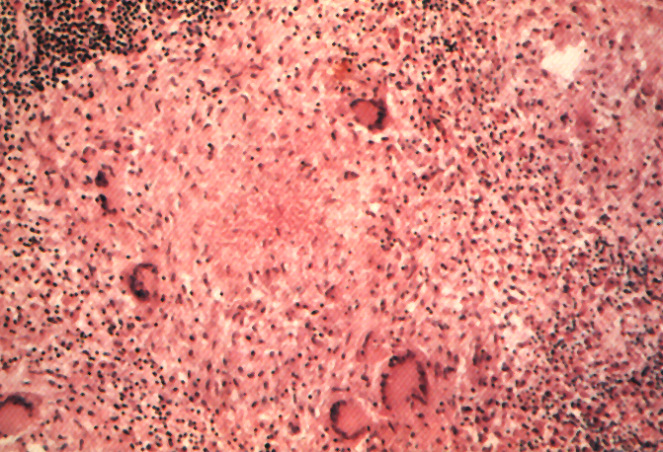
Lymphocytic Rim
Langhans Giant Cell
Lymphocytic Rim
Caseous Necrosis
Caseous Necrosis
Epithelioid Macrophage
Epithelioid Macrophage
Section of bone shows granuloma formation with epithelioid like cells ,
langhans-type giant cells and rim of lymphocytes
Path. Dept , KSU
Ms-Sk Block

Slide 42
BONE TUMORS
Path. Dept , KSU
Ms-Sk Block

Slide 43
Osteochondroma
(osteochondroma exostosis)
Path. Dept , KSU
Ms-Sk Block

Slide 44
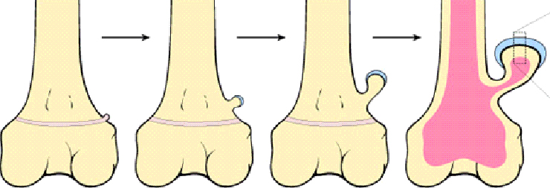
Osteochondroma
(osteochondroma exostosis)
The solitary osteochondroma is the most common benign bone tumors
Seen in patients aged from 10-30 years
Arise during skeletal growth
Equally in males and females
Etiology is unknown
Path. Dept , KSU
Ms-Sk Block

Slide 45
Case # 7
A 16 -year-old male was found to have a small swelling protruding from upper part of his leg with local pain .
Path. Dept , KSU
Ms-Sk Block

Slide 46
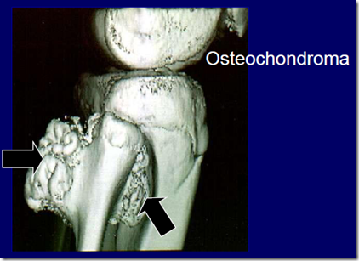
MRI picture showing two osteochondromatous exostosis which are arising from the upper third of fibula .
Path. Dept , KSU
Ms-Sk Block

Slide 47
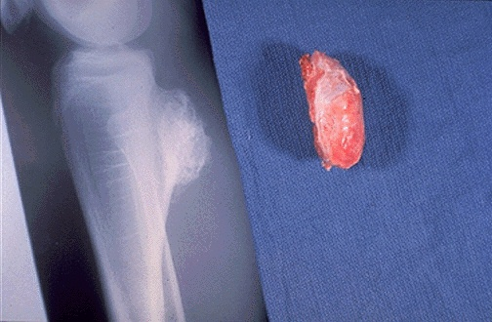
Osteochondroma: Gross & X-ray
Osteocartilagenous protrusion arising from the upper tibial bone
Most are solitary, incidental lesions that may be excised if they cause local pain. There is a rare condition of multiple osteochondromatosis marked by bone deformity and by a greater propensity for development of chondrosarcoma.
Path. Dept , KSU
Ms-Sk Block

Slide 48
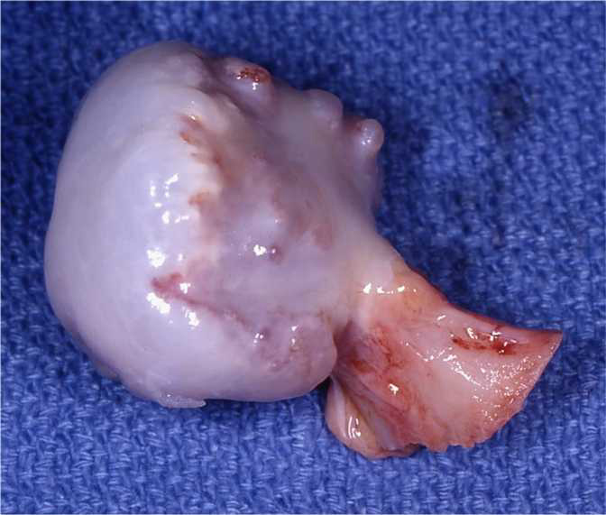
Osteochondroma - Gross
Solitary osteochondroma. Gross osteochondroma specimen at the time of resection. Bone stalk and overlying membrane on cartilage cap.
Path. Dept , KSU
Ms-Sk Block

Slide 49
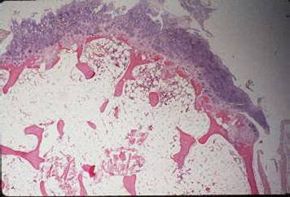
Osteochondroma - LPF
Fibrous cap
Cartilagenous layer
- Bone
The microscopic appearance of an osteochondroma displays the benign cartilagenous cap at the upper and the bony cortex at the left lower.
Prognosis is Excellent Possible complication : - Chondrosarcoma may occur if these lesions are multiple
Ms-Sk Block

Slide 50
Osteosarcoma
Path. Dept , KSU
Ms-Sk Block

Slide 51
Osteosarcoma, Primary Malignancy
Weight bearing
Long bones
Young people
Osteoblast is malignant cell
Genetics of tumor being unraveled
Path. Dept , KSU
Ms-Sk Block

Slide 52
Case # 8
An 18-year-old female presented to the rheumatology clinic with 2 months history of pain and swelling in her upper thigh with weight loss .
Path. Dept , KSU
Ms-Sk Block

Slide 53
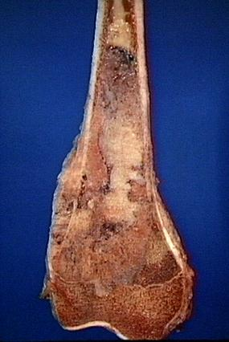
2nd most common primary bone tumor
Malignant tumor of mesenchymal origin
Osteosarcoma of the upper end of the tibia.
The tan-white tumor fills most of the medullary cavity of the metaphysis and proximal diaphysis. It has infiltrated through the cortex, lifted the periosteum, and formed soft tissue masses on both sides of the bone.
Path. Dept , KSU
Ms-Sk Block

Slide 54
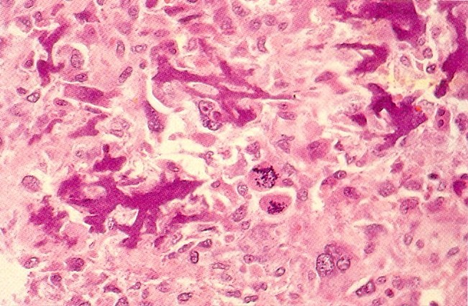
Osteosarcoma - HPF
Spindle shaped cells that produce osteoid
Path. Dept , KSU
Ms-Sk Block

Slide 55
THE END

