Slide 1

Non-steroidal anti-inflammatory drugs

Slide 2
OBJECTIVES
At the end of the lecture the students should :
Define NSAIDs
Describe the classification of this group of drugs
Describe the general mechanism of actions
Define the following terms :
Analgesic
Antipyretics

Slide 3
Objectives ( continue)
Anti-inflammatory
Anti-platelet
Describe the general pharmacological actions
Describe the general therapeutic uses
Describe the general adverse effects
Describe the general contraindications
Know some examples of each group of NSAIDs
Know the difference between the selective & non-selective NSAIDs

Slide 4
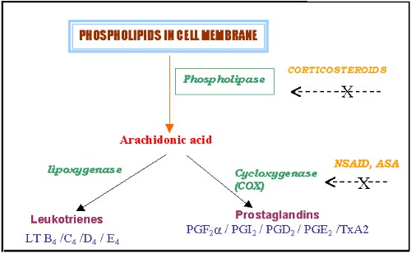
MECHANISM OF ACTION OF NSAIDS

Slide 5
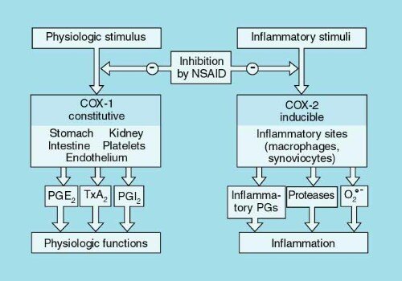
Cycl-oxygenase Isozymes

Slide 6
COX inhibitors
NSAIDs
Nonselective
COX-1/COX-2
Inhibitors .Diclofenac
  COX-2
  inhibitors
  Selective (Coxibs)
  Preferential
  (Meloxicam)
COX-3
inhibitors
Paracetamol

Slide 7
Pharmacodynamic Effects

Slide 8
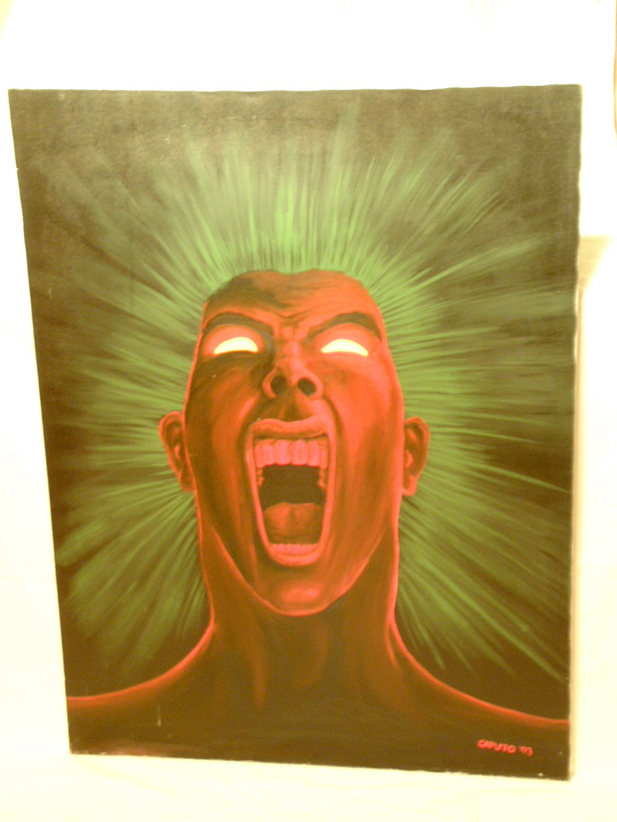
1-ANALGESIC
NSAIDs
Prostaglandins
pGE2 pGF2
Factors
+
Bradrkinin
histamine
Nerve ending of pain
block prostaglandins production
Sites of action: peripheral tissue
Pain

Slide 9
2-ANTIPYRETIC
Prostaglandins
PGE2
Pyrogen
NSAIDs
Thermoregulatory center
Antipyretic Mechanism
Block prostaglandins production
Sites of action: Central Nervous System
Set point ↑
Heat production ↑
Heat dissipation ↓
Fever

Slide 10
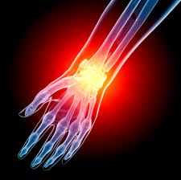
3-Antiinflammatory
NSAIDs
Prostaglandins
pGE2 pGF2
Inflammatory factors
+
Bradrkinin
Histamine
5-HT
Symptoms of inflammation
Block prostaglandins production
Sites of action: peripheral tissue
Red, swelling,
Heating, Pain

Slide 11
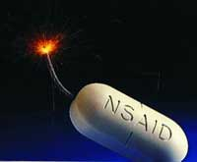
Pharmacokinetics
Oral administration
Most metabolized in liver (oxidation & conjugation)
95% bound to plasma-protein (high bioavailability)
Most NSAIDs are weak acid (absorbed well in stomach and intestinal mucosa)

Slide 12
THERAPEUTIC USES SHARED BY NS-NSAIDs
Fever.
Analgesic
Headache, Migraine,
Dental pain, Dysmenorrhea
Common cold.
Rheumatoid arthritis / myositis or other forms of inflammatory conditions.

Slide 13
SHARED ADVERSE EFFECTS
GIT upsets ( nausea, vomiting)
GIT bleeding & ulceration
Bleeding
Hypersensitivity reaction
Inhibition of uterine
contraction
Salt & water retention

Slide 14
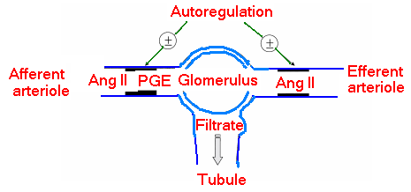

Adverse renal effects

Slide 15
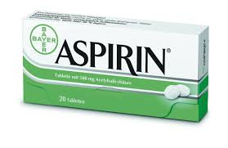
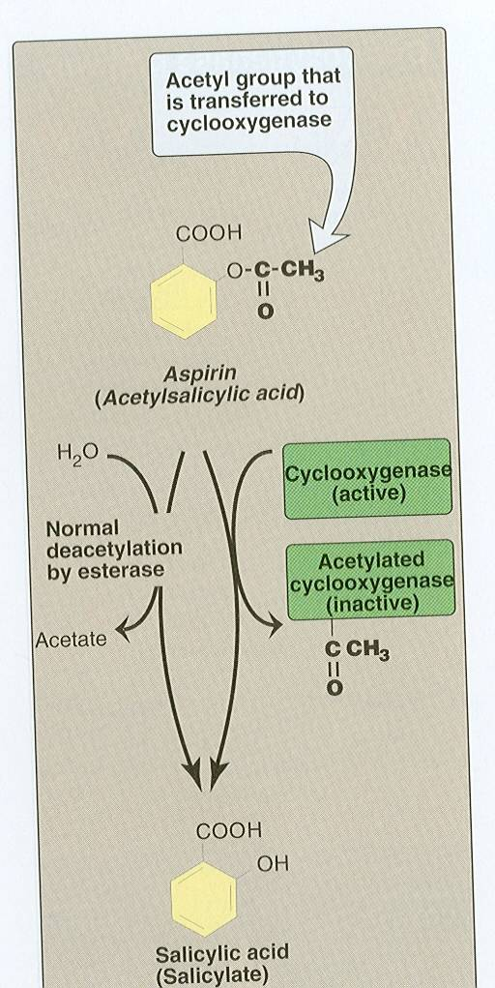

Slide 16
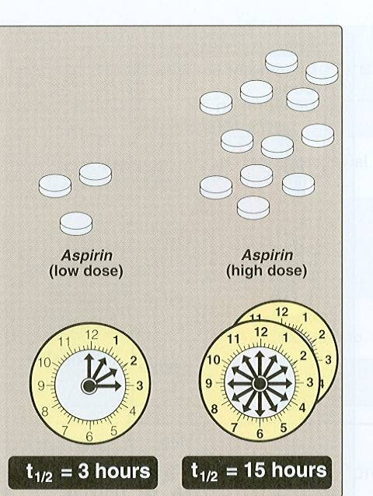
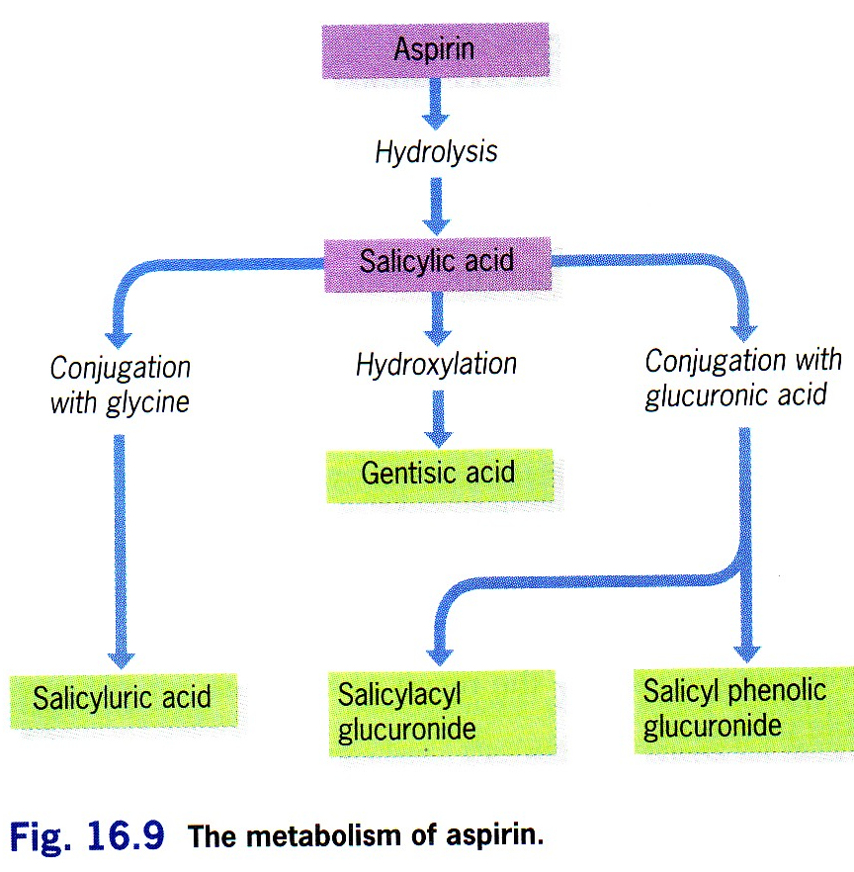
Pharmacokinetics

Slide 17
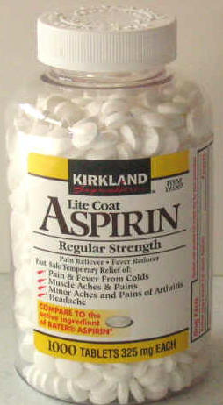
Clinical uses
Acute rheumatic fever
Reducing the risk of myocardial infarction ( cardioprotective)
Prevention of pre-eclampsia
Chronic use of small doses ,
reduce the incidence of
colon cancer

Slide 18
Adverse Effects Related to Therapeutic Doses Of Aspirin
Hypersensitivity
Acute Gouty arthritis
Reye's syndrome
Impaired
haemostasis

Slide 19
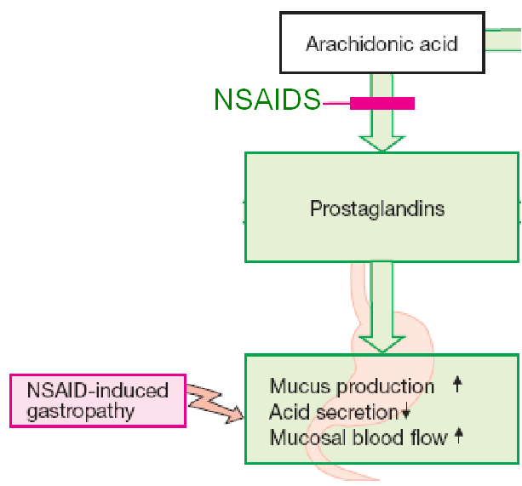
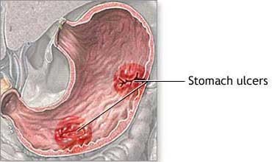
GIT side effects, dyspepsia, nausea,
vomiting, mucosal damage→ hemorrhage

Slide 20
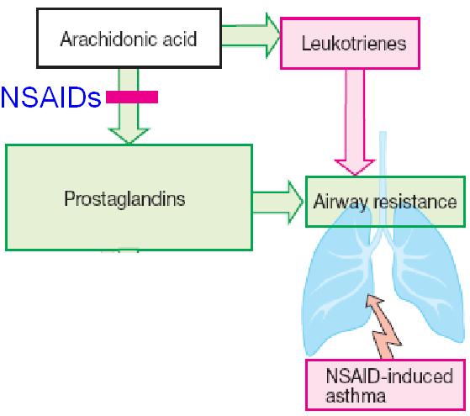
Bronchospasm in aspirin- sensitive asthmatics

Slide 21
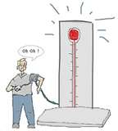
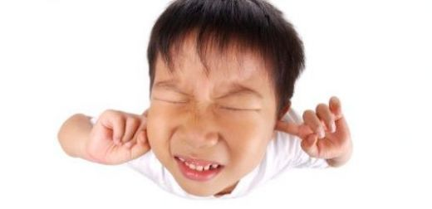
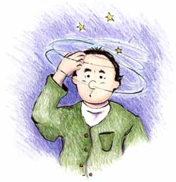
ADVERSE EFFECTS RELATED TO TO LARGE DOSES OF ASPIRIN
Salicylism ( ringing of ear , vertigo)
Hyperthermia
Gastric ulceration & bleeding

Slide 22
Contraindications
Peptic ulcer
Pregnancy
Hemophilic patients
Patients taking anticoagulants
Children with viral infections
Gout ( small doses )

Slide 23

PARACETAMOL
Pharmacokinetics:-
-Given orally , well absorbed.
-Drug is inactivated in the liver, conjugated with glucuronic & sulphuric acid ,t½=2-4h

Slide 24
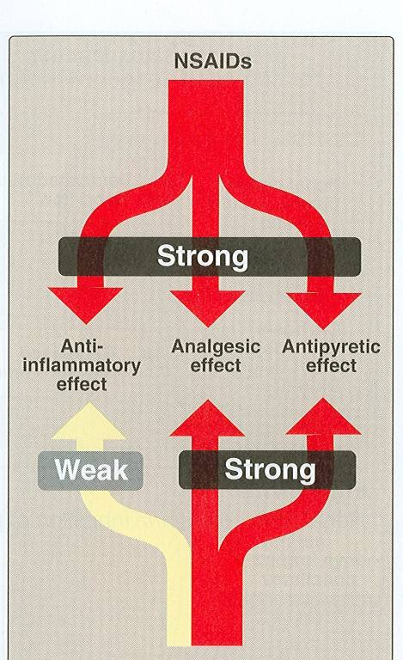

Slide 25
Clinical uses
Commonly used analgesic antipyretic
instead of aspirin in cases of:-
Peptic or gastric ulcers.
Bleeding tendency.
Allergy to aspirin.
Viral infections in children .
Pregnancy.

Slide 26
Adverse Effects
Mainly on liver due to
its active metabolite
Therapeutic doses
elevate liver enzymes
In large doses it is metabolized
into N- acetyl-p-benzoquinone, which
causes liver damage.
Treatment of toxicity of paracetamol is by
N- acetylcysteine to neutralize the toxic metabolite

Slide 27
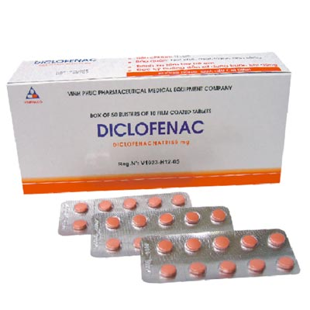
Clinical uses
Analgesic
Antipyretic
Anti-inflammatory
Acute gouty arthritis
Locally to prevent post-opthalmic inflammation

Slide 28
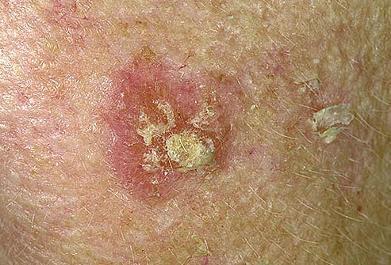
Preparations of Diclofenac
Diclofenac with misoprostol decreases upper gastrointestinal ulceration ,but result in diarrhea.
Diclofenac with omeprazole to prevent recurrent bleeding.
0.1% ophthalmic preparation for postoperative ophthalmic inflammation.
A topical gel 3% for solar keratoses.
Rectal suppository as analgesic
Oral mouth wash.
Intramuscular preparations.

Slide 29
Selective COX-2 inhibitors
General advantages :
Potent anti-inflammatory
Antipyretic & analgesic
Lower incidence of gastric upset
No effect on platelet aggregation ( COX-1)

Slide 30
General adverse effects
Renal toxicity
Dyspepsia & heartburn
Allergy
Cardiovascular ( do not offer the cardioprotective effects of non-selective group).

Slide 31
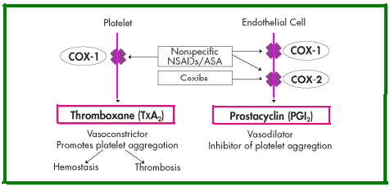

Slide 32
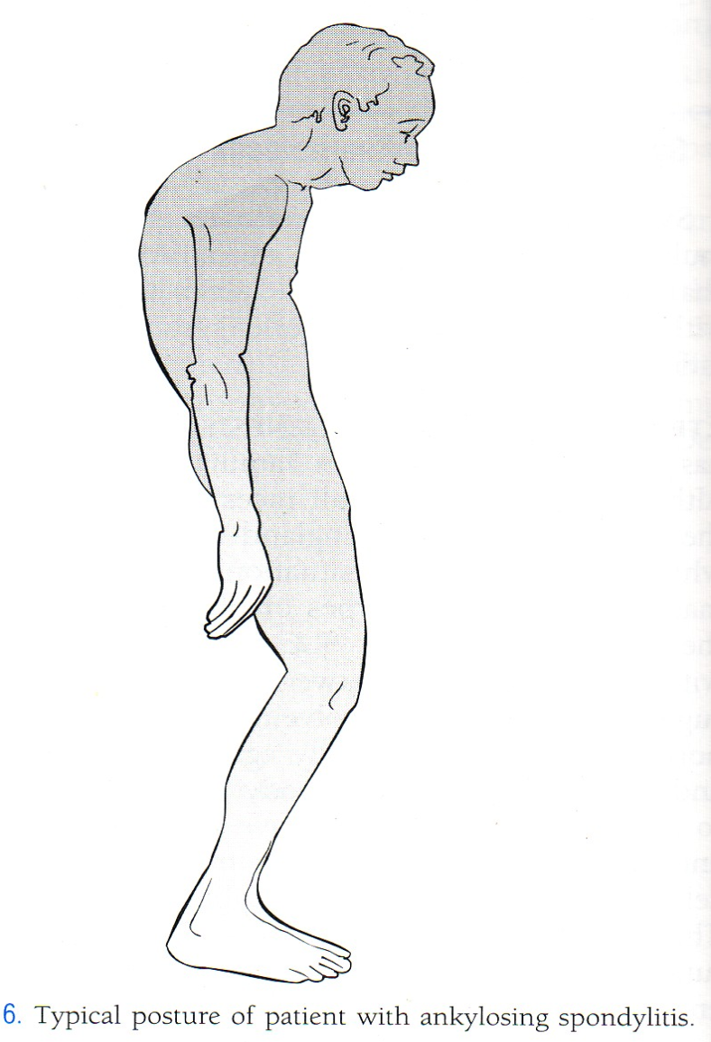
GENERAL CLINICAL USES
Short-term use in postoperative patients
Acute gouty arthritis
Acute musculoskeletal
pain
Ankylosing spondylitis

Slide 33
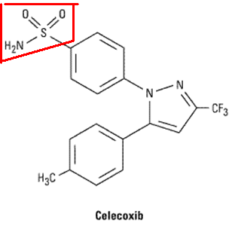
Celecoxib
Half-life 11 hours
Food decrease its absorption
Highly bound to plasma proteins

