Slide 1
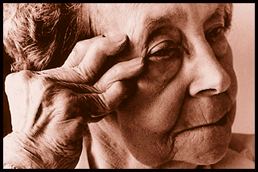
Disease –Modifying Antirheumatic drugs
( Slow Acting
Anti-inflammatory Drugs )

Slide 2
OBJECTIVES
At the end of the lecture the students should
Define DMARDs
Describe the classification of this group of drugs
Describe the general advantages & criteria of this group of drugs
Describe the general clinical uses

Slide 3
OBJECTIVES ( Continue)
Know some examples of drugs related to DMARDS.
Describe the mechanism of action , specific clinical uses , adverse effects &
contraindications of individual drugs.

Slide 4
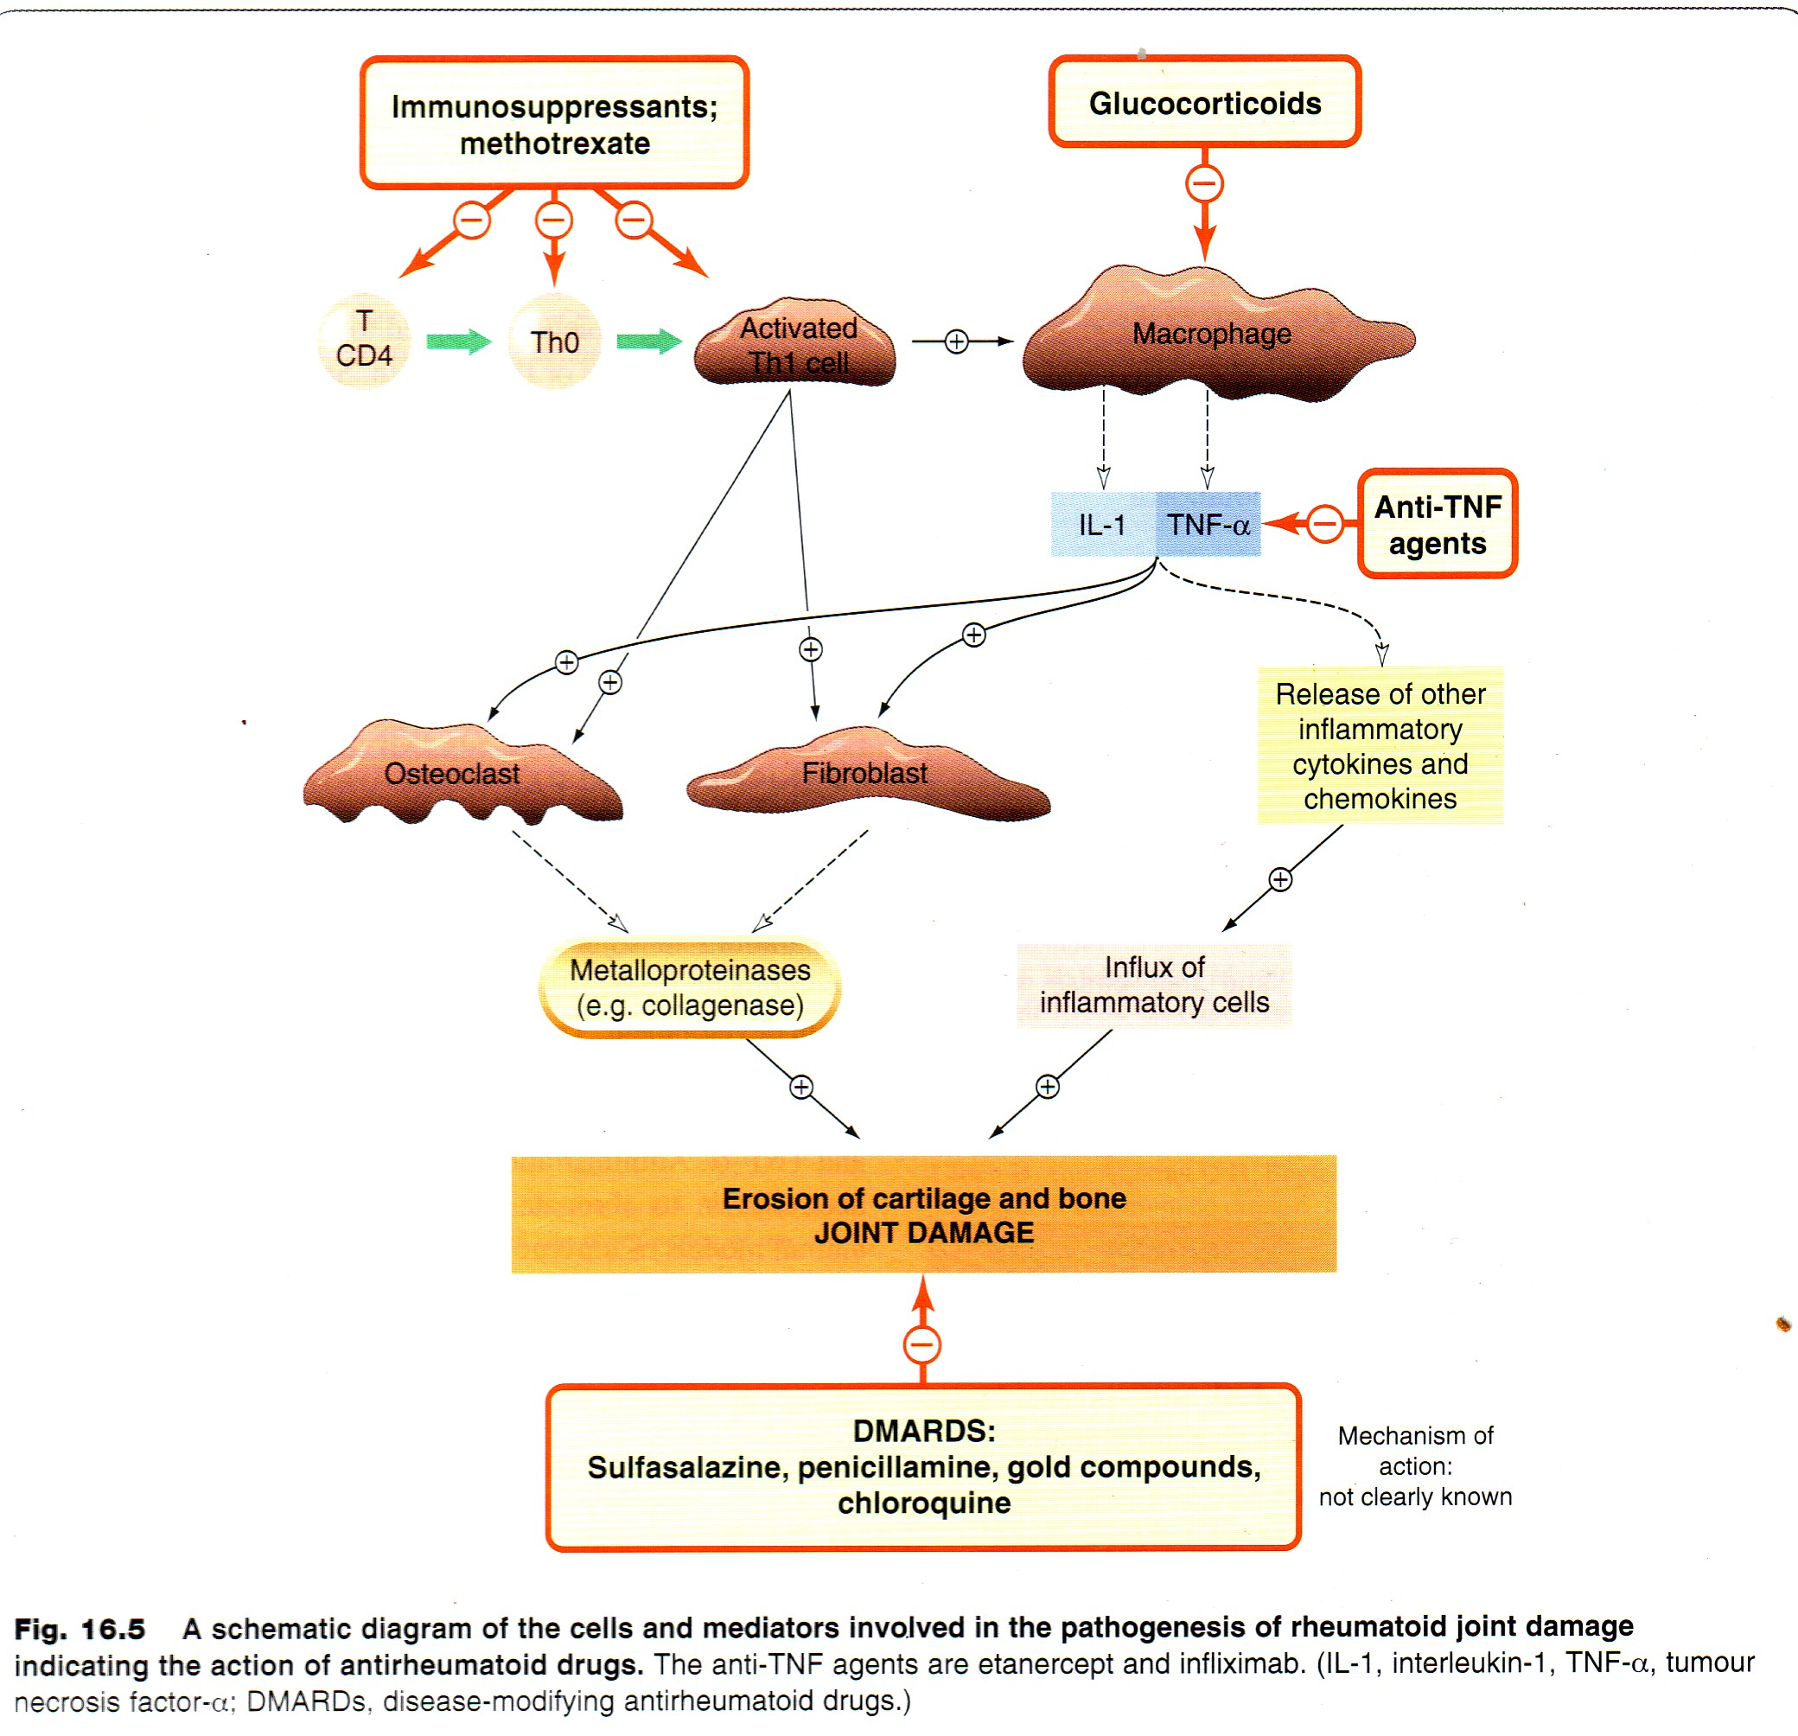

Slide 5
Classification
DMARDs
Biologic
Non-biologic
Infliximab
Tocilizumab
Methotrexate
Hydroxychloroquine

Slide 6
General Features
Low doses are commonly used early in the course of the disease
Used when the disease is progressing & causing deformities
Can not repair the existing damage , but prevent further deformity
Have no analgesic effects
Their effects take from 6 weeks up to 6 months to be evident

Slide 7
Hydroxychloroquine
Mechanism of action :
Stabilization of lysosomal enzyme activity
Trapping free radicals
Suppression of T lymphocyte cells

Slide 8
Nausea & vomiting
Irreversible retinal damage
ADVERSE EFFECTS
Corneal deposits

Slide 9
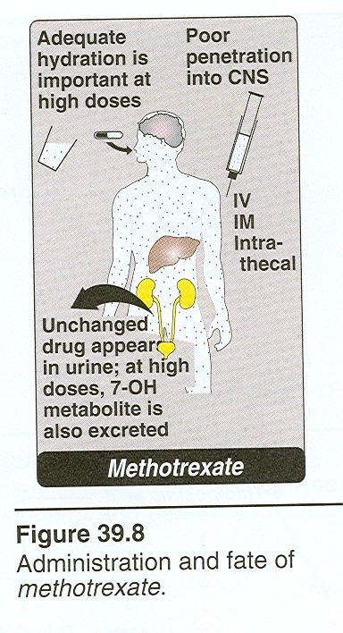
Methotrexate
Mechanism of action :
Inhibition of polymorphonuclear
chemotaxis
Inhibition of T-Cells
( cell-mediated immune reactions)

Slide 10
Bone marrow depression
Mucosal ulcers
ADVERSE EFFECTS
Hepatotoxicity

Slide 11
Biologic disease modifiers
Genetically engineered drugs that are used to modify imbalances of the immune system in autoimmune diseases.
Some of these agents block, or modify the activity of selected cells in the immune system, while others –including tocilizumab work by blocking certain messenger proteins known as cytokines , that send signals between those cells.

Slide 12
Classification of biologic disease modifiers
T-cell modulating drug ( abatacept )
B-cell cytotoxic agent ( rituximab )
Anti-IL-6 receptor antibody ( tocilizumab)
TNF- blocking agents ( infliximab)

Slide 13
Tocilizumab
IL-6 receptor inhibitor
Binds to membrane IL-6 receptors ,blocking the activity of IL-6 in mediating signals
Half-life is dose- dependent
Dose is adjusted according to patient’s weight
Given as monthly IV
Used as monotherapy in adult with rheumatoid arthritis or in children over 2 years with systemic juvenile arthritis

Slide 14
Cont.
In combination with methotrexate or other non biologic anti-rheumatic drugs in patients with active rheumatoid arthritis not responding to TNF blockers or other biologic drugs

Slide 15
Side effects
Infusion reactions
Serious infections ( bacterial, tuberculosis ,fungal )
Increase in cholesterol level
Increase in liver enzymes
Decrease in WBCs
Blood tests will be used monthly for increase in cholesterol, liver enzymes & decrease in WBCs

Slide 16
Drug Interaction
IL-6 inhibits CYP450
Tocilizumab restore the activity of the enzyme ( essential for the metabolism of some drugs such as cyclosporine, warfarrin ).

Slide 17
Tumor necrosis factor –α( TNF-α) blocking agents
Infliximab
A chimeric antibody ( 25% mouse, 75% human)

Slide 18
Monoclonal Antibody directed against TNF-alpha: Infliximab (Remicade ®), Adalimumab (Humira®)
Soluble TNF-Receptors serve as a balance to TNF
Engineered Soluble TNF Receptor Etanercept (Enbrel®)
TNF
SIGNAL

Slide 19
Role of Tumor Necrosis Factor in Rheumatoid Arthritis
TNFα
bone resorption
joint
inflammation
cartilage
degradation
bone erosion
pain/joint
inflammation
joint space
narrowing

Slide 20
Mechanism of action
Binds to human TNF-α resulting in inhibition of macrophage & T cell function

Slide 21
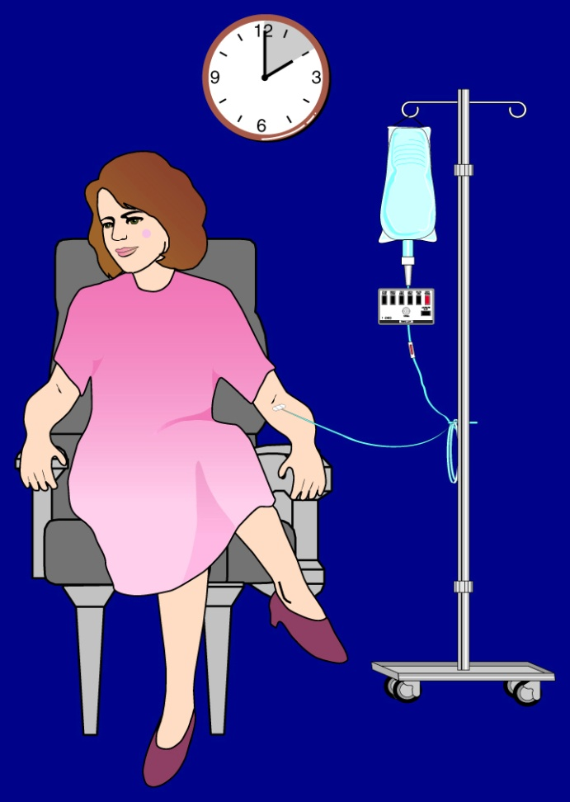
Infliximab ( continue)
Given by IV infusion
Half-life 8-12 days
Concurrent therapy with methotrexate decreases the prevalence of human antichimeric antibodies

Slide 22
Upper respiratory tract infections
Headache
Adverse effects
Cough
Activation of latent tuberculosis
Infusion site reaction

Slide 23
Comparison between NSAIDs & DMARDs
DMARDs
NSAIDs
Slow onset of action
Arrest progression of the disease
Prevent formation of new deformity
Used in chronic cases when deformity is existing
Rapid onset of action
No effect
Can not stop formation of new deformity
Used in acute cases to relief inflammation & pain

Slide 24
SUMMARY
DMARDs are used mainly in chronic cases of rheumatoid arthritis , when the disease is progresssing and forming deformity.
They do not remove the existing damage but prevent further formation of deformities.
They have no analgesic effect.

Slide 25
SUMMARY ( Continue)
They are slow in onset needs weeks to manifest their effects .
Hydroxychloroquine acts mainly through suppression of the activity of lysosomal enzymez and trapping free radicals .
Its main adverse effects is irreversible retinal damage & hepatic toxicity.

Slide 26
CONTINUE
Methotrexate acts mainly through suppression of phagocytic cells & T cells
Its adverse effects are bone marrow depression & mucosal ulceration
Infliximab is a chimeric TNF-α blocking agent.
Given with methotrexate to reduce antichimeric effect

Slide 27
CONTINUE
Its main adverse effects are upper respiratory tract infections & reactivation of latent TB,

Slide 28
CONTINUE
Methotrexate acts mainly through suppression of phagocytic cells &

