Slide 1
Muscle adaptation to exercise

Slide 2
Objective
Strength, power, and endurance of muscles
Effect of athletic training on muscles and muscle performance
Muscle hypertrophy
Fast-twitch and slow-twitch muscle fibers
Respiration in exercise
Oxygen consumption and pulmonary ventilation in exercise
Effect of training on vo₂ max
Cardiovascular system in exercise
Work output, oxygen consumption, and cardiac output during exercise
Effect of training on heart hypertrophy and on cardiac output
Role of stroke volume and heart rate in increasing the cardiac output
Body heat in exercise & heatstroke

Slide 3
Strength, Power, And Endurance Of Muscles
Muscles Strength: Refers to the amount of force a muscle can produce
Size of muscles influence by a maximal contractile force, Normally 3 -4 kg/cm²
E.g a cross-sectional area 150 cm² cause maximal contractile strength of 525 kilograms
Mechanical work of muscle = force applied by the muscle X distance

Slide 4
Strength, Power, And Endurance Of Muscles
Muscles Power : amount of work that the muscle performs in period of time ( kg-m/min)
The maximal power achievable by all the muscles in the body of a highly trained athlete with all the muscles working together is approximately the following:
Guyton & Hall12E

Slide 5
Strength, Power, And Endurance Of Muscles
Muscles Endurance: Ability of muscles to sustain repeated contractions against a resistance for period of time.
depends on glycogen stored in the muscle

Slide 6
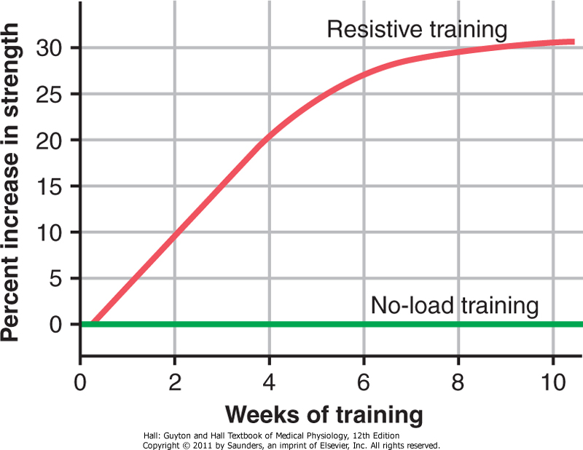
Effect of Training on Muscles and Muscle Performance
Maximal Resistance Training:
6 maximal muscle contractions X sets 3 days X one week increase in muscle strength, and muscle mass (muscle hypertrophy)
Muscles function under
no load little in strength

Slide 7
Muscle Hypertrophy:
With training muscles hypertrophied 30- 60 %
Due to diameter of the muscle fibers ??
number of fibers ????
Changes in hypertrophied muscle:
myofibrils
120 % in mitochondrial enzymes( tricarboxylic acid)
ATP and phosphocreatine
50 % in stored glycogen
75 -100 % in stored triglyceride
oxidation rate 45 %

Slide 8
Fast-Twitch and Slow-Twitch Muscle Fibers
fast-twitch fibers: forceful and rapid contraction
E.G gastrocnemius muscle
slow-twitch muscle: for prolonged muscle activity
E.G leg muscle
fast-twitch fibers deliver power seconds to a minute slow-twitch fibers provide endurance, prolonged strength of contraction minutes to hours.

Slide 9
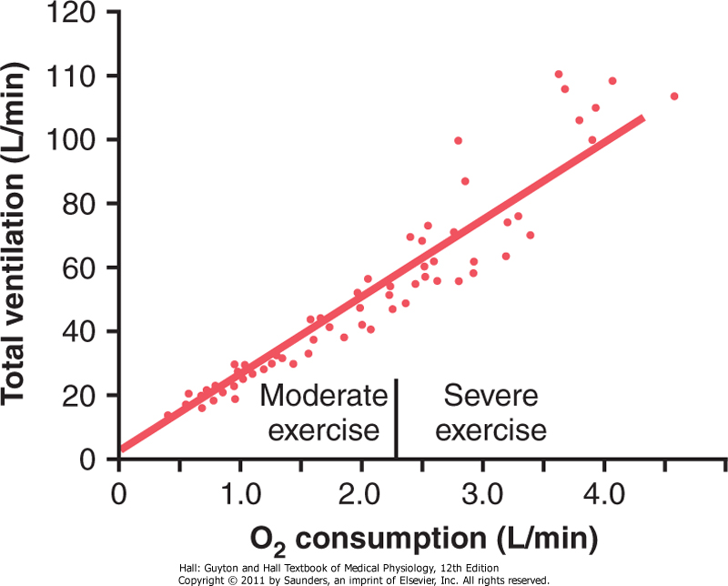
Respiration In Exercise
Oxygen Consumption VO2 and Pulmonary Ventilation VE in Exercise
VO2 at rest is about 250 ml/min , However !!! at Maximal efforts
VO2 and VE increase about 20-fold between the resting state and maximal intensity
F Effect of exercise on oxygen consumption and ventilatory rate. (Redrawn from Gray JS: Pulmonary Ventilation and Its Physiological Regulation. Springfield, Ill: Charles C Thomas, 1950.)

Slide 10
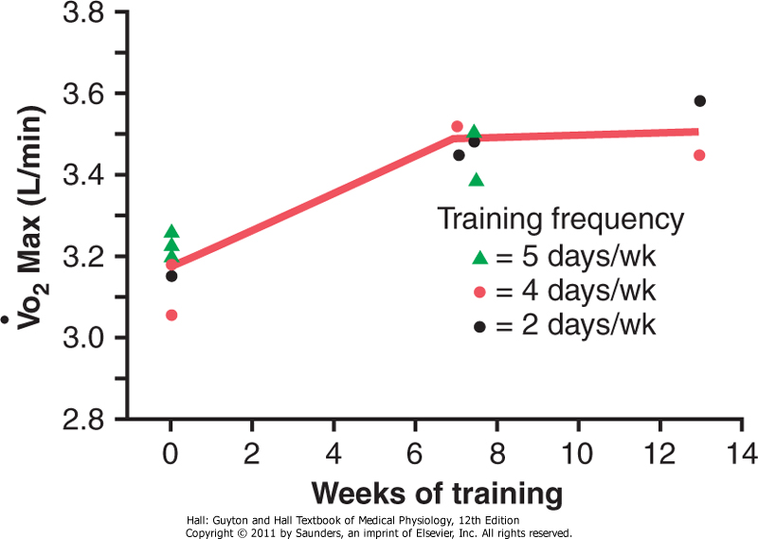
Effect of Training on Vo₂ Max
In below study Vo₂Max increased only about 10 percent by training, Moreover other factors !!!
Chest sizes in relation to body size
Increase respiratory muscles
For more
information check
Guyton & Hall12E
Increase in Vo2 Max over a period of 7 to 13 weeks of athletic training. (Redrawn from Fox EL: Sports Physiology. Philadelphia: Saunders College Publishing, 1979.)

Slide 11
Oxygen-Diffusing Capacity of Athletes.
The oxygen diffusing capacity is a measure of the rate at which oxygen can diffuse from the pulmonary alveoli into the blood.

Slide 12
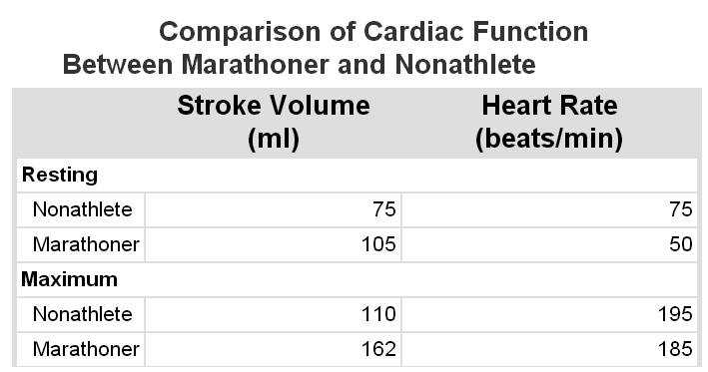
Cardiovascular System in Exercise
Work Output, Oxygen Consumption, and Cardiac Output During Exercise
All these are directly related to one another, muscle work output increases oxygen consumption, and increased oxygen consumption in turn dilates the muscle blood vessels, thus increasing venous return and cardiac output C.O .
Effect of Training on Heart Hypertrophy and on Cardiac Output:
Training increase C.O about 40 % greater than untrained persons SO,
heart chambers of marathoners enlarge about 40 percent in contrast to non trained
Heart size of marathoner larger than normal person

Slide 13
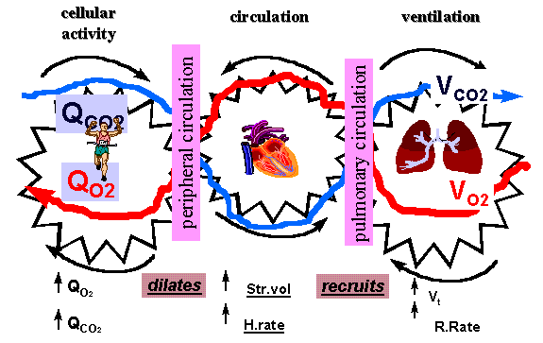
Cardiovascular System in Exercise cont…
Role of Stroke Volume and Heart Rate in Increasing the Cardiac Output

Slide 14
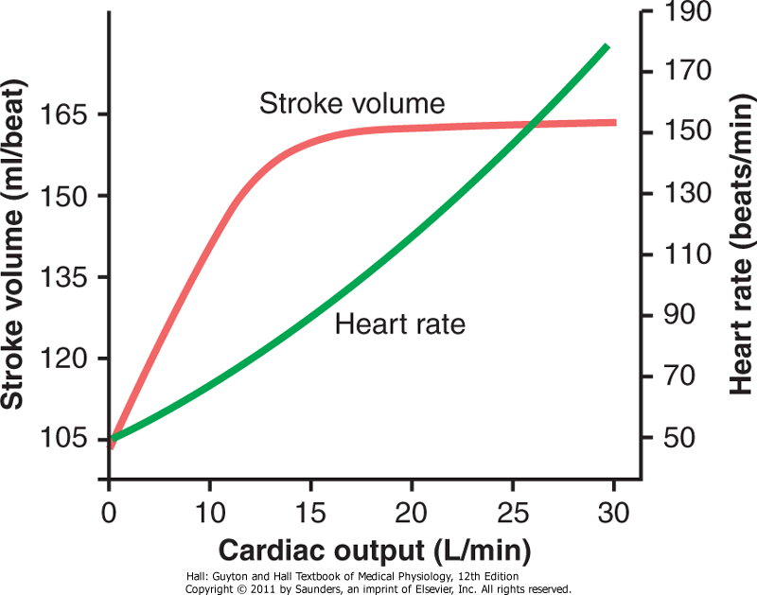
Cardiovascular System in Exercise cont…
The cardiac output increases from its resting level of about 5.5 L/min to 30 L/min.
The stroke volume increases from 105 to 162 milliliters, an increase of about 50 percent
Whereas the heart rate increases from 50 to 185 beats/min, an increase of 270 percent.
The heart rate increase a greater proportion of the increase in cardiac output than does the increase in stroke volume why ?????
Approximate stroke volume output and heart
rate at different levels of cardiac output in a
marathon athlete.

Slide 15
Body Heat In Exercise
Almost all the energy released by the body's metabolism of nutrient is converted into body heat.
Working muscle use only 20 - 25 %.
Remainder of nutrient is converted into heat.
Almost all the energy that goes into creating muscle work still becomes body heat because small portion of this energy is used for:
(1) Overcoming resistance to the movement of the muscles and joints.
(2) Overcoming friction of the blood flowing through the blood vessels, and
All of which convert the muscle contractile
energy into heat... What will happen during hot and humid condition if sweating mechanism cannot eliminate the heat ????

Slide 16
Heatstroke
During endurance training body temperature rises 98.6° to 102° or 103°F (37° to 40°C)
hot and humid conditions body temperature rise to 106° to 108°F (41° to 42°C)
Consequently, temperature destructive tissue cells mainly (brain cells) and symptoms !!! :
Body weakness, exhaustion, headache, dizziness, nausea (disgust), sweating, confusion, uncontrolled gait, collapse, and unconsciousness.
And may lead to death

Slide 17
Treatment of heatstroke
The most practical way :
Remove all clothing
Maintain a spray of cool water on all surfaces of the body or continually sponge the body.
Blow air over the body with a fan.
Physicians prefer total immersion of the body in water containing a mush of crushed ice if available.

