Slide 1
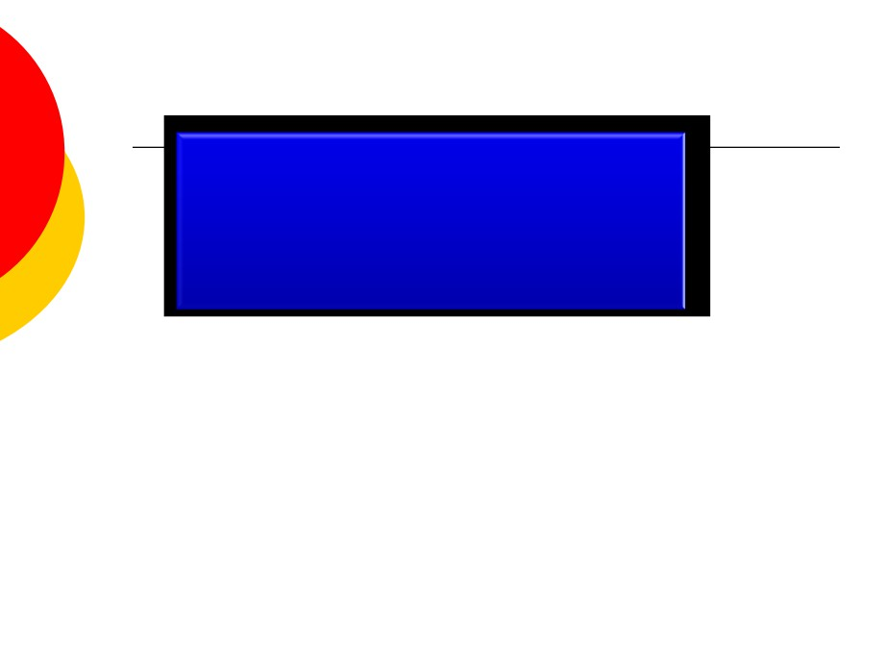
Physical and
Physiological Factors
Affecting Muscle
Performance

Slide 2
The objectives of this lecture are:-
At the end of this lecture the student should be able to:-
1-Know the physiological 3 metabolic systems which are exceedingly important in understanding the limits of physical activity 2- Describe the recovery of the aerobic system after exercise and physiology of O2 dept. 3-Recognize the Effects of smoking on pulmonary ventilation in exercise &effect of heart disease on physical activity 4-Know the effect of some drugs on athelets performance as anabolics,caffeine,amphetamine..ets. 5- Know the effect of some psychological factors on athelets performance 6- Recognize physical effects of overtraining syndrome

Slide 3
There are 3 metabolic systems
exceedingly important in
understanding the limits of physical
activity.
These are:
1- Phosphagen energy system (ATP
and PCr) 2- Glycogen-lactic acid system 3- Aerobic system

Slide 4
Phosphagen energy system
1-Adenosine Triphosphate (ATP):-
-Adenosine-PO3 ˜ PO3 ˜PO3
-Each one of the last 2 high energy phosphate bonds store 7300 calories , used to energize the muscle contractile process.
-Removal of one bond converts ATP to ADP then removal of one more forms AMP
-All ATP in muscle is sufficient for only 3 seconds of muscle power (enough for one half of a 50-meter dash)
-It is essential to form new ATP continuously even during performance of short athletic events.

Slide 5
2-Phosphocreatine system (PCr)
(Creatine ˜ Po3)
- Contains high energy phosphate bond has 10300 calories/mole
- PCr provides enough energy to reconstruct high energy bond of ATP
-Most muscle cells have 2- 4 times as much PCr as ATP
-Energy transfer from PCr to ATP occurs within a small fraction of a second .
- Energy of muscle PCr is instantously available for contraction just as stored energy of ATP.

Slide 6
Phosphagen energy system
Phosphagen energy system:-
-Formed of combined amounts of cell
ATP+PCr
-Together provide maximal muscle power for 8-10 seconds (enough for 100 meter run)

Slide 7
3-Glycogen-lactic acid system
a-Anaerobic metabolism ( glycolysis):-
-During glycolysis :- glycogen of the muscle split into glucose without use of O2
-Then each glucose split into:_
2 pyruvic acid + energy to form 4 ATP for each one glucose molecule
- Pyruvic acid in the mitochondria in presence of O2 will
form more ATP (Oxidative stage)
- When there is insufficient O2 most of pyruvic acid converts into lactic acid which diffuse to blood stream

Slide 8
Characteristics of Glycogen-lactic acid system
-Glycogen-lactic acid system can form ATP molecules ( - anaerobically) 2.5 times as rapidly as can oxidative mechanism of mitochondria
- Anaerobic glycolysis can provide large ATP amounts - needed for short to moderate periods of muscle contraction ( ½ as rapid as phosphagen system)
- Glycogen-lactic acid system provide 1.3-1.6 minutes of maximal muscle activity

Slide 9
Aerobic process:-
- Oxidation of foodstuffs glucose, A.A, F.A in the mitochondria in presence of O2 produces energy that coverts AMP to ADP to ATP

Slide 10
S
ystem
Moles of ATP/min
Endurance time
1-phosphagen
(4 ) moles
8-10 seconds
system
2-Glycogen-lactic acid system
(2.5 ) moles
1.3-1.6 minutes
3-Aerobic system
(1)
(unlimited time as
long as nutrients
last)

Slide 11
Recovery after exercise

Slide 12
1-Recovery of muscle metabolic systems after exercise:-
-Energy from PCr reconstitute ATP
-Energy from glycogen-lactic acid system reconstitute both
PCr & ATP
- Energy from oxidative metabolism of aerobic system
reconstitute all other systems:-glycogen-lactic acid system & PCr&ATP
-Reconstitution of Lactic acid system( removal of lactic acid):- Lactic acid causes fatigue so it should be removed by:-
1-portion converted into pyruvic acid which is oxidated by all body tissues
2-remaining is changed into glucose in liver to replenish
glycogen stores of muscles

Slide 14
2-Recovery of aerobic system after exercise:-
-Oxygen Dept: -
This is approximately about 11.5 Litres of O2 should be repaid after exercise is over.
-These are:-
a- 2 Litres of stored O2 (0.5 L in lungs + 0.25 L dissolved in body
fluids
+
1 L
combined with Hb +
0.3 L stored in muscle myoglobin)
-This is used within a minute of heavyexercise or for aerobic metabolism& replenished by breathing extra amounts of O2 above the normal needs.
b- 9 Litres more O2 must be consumed to reconstitute phosphagen & lactic acid system
-At first O2 uptake is high & fast to replenish stored O2 & phosphagen system ( this is called alactacid O2 dept = 3.5L)
- The later portion of O2 dept takes 40 minutes for lactic acid system removal, it is of lowerlevel breathing , it is called (lactic acid O2 dept =8L)

Slide 15
3-Recovery of muscle glycogen
-Depletion of glycogen stores by heavy exercise needs days to be replenished
-On high CHO diet , recovery occurs in 2 days
-On high fat, high protein or on no food all show very little recovery
Message:_
1- athlete should have high CHO diet before exercise
2- not to participate in exhausting exercise during 48
hours preceding the event

Slide 18
Effects of heart disease and old age on athletic performance:-
-Cardiac disease reduce C.O& reduce muscle power
-patient with CHF can not climb the bed
-There is 50% decrease in C.O between 18-80
years & decrease in breathing capacity,
muscle mass & power with age

Slide 20
Drugs and athletes
1- Caffeine increase athletes performance
2- Unusual androgens (male sex hormone)
& anabolic steroids intake increase
athletes performance in men & women but they increase risk of heart attacks due to hypertension
-In males, male sex hormones decrease testicular functions & decrease natural testosterone secretion
- Women develop facial hair, stoppage of menses, ruddy skin and bass voice

Slide 22
Overtraining Syndrome and Athletes
Overtraining syndrome frequently occurs in athletes who are training for competition or a specific event and train beyond the body's ability to recover.
Common Signs and Symptoms of Overtraining Syndrome:
Washed-out feeling, tired, drained, lack of energy
Mild leg soreness, general aches and pains
Pain in muscles and joints
Sudden drop in performance
Insomnia
Headaches
Decreased immunity (increased number of colds, and sore throats)
Decrease in training capacity / intensity
Moodiness and irritability
Depression
Loss of enthusiasm for the sport
Decreased appetite

