Slide 1
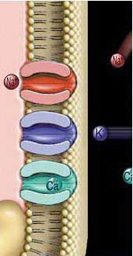
Resting Membrane Potential (Voltage)
TEXTBOOK OF MEDICAL PHYSIOLOGY
GUYTON & HALL 11TH EDITION
UNIT II CHAPTER 5
Dr.Mohammed Alotaibi
MRes, PhD (Liverpool, England)
Department of Physiology
College of Medicine
King Saud University

Slide 2
Q : What are Excitable tissues?
A: They are nerve and muscle
Q: What property do excitable tissues have that makes them different from other body tissues ?
A: Their membrane acts as an electric capacitor storing opposite charges on the opposite sides of the membrane.

Slide 3
Q : What is the membrane potential ( MP )?
It is the difference in potential ( voltage ) between the inner side & outer side of the membrane (nerve or muscle membranes)
Q : What are the states of MP ?
(1) Resting Membrane Potential ( RMP) : value of MP in
a “ resting ” state (unstimulated excitable membrane).
(2) Graded Potential (Local Response) : MP in a stimulated cell that is producing a local , non-propagated potential
(an electrical change which is measurable only in the immediate vicinity of the cell but not far from it) .
(3) Action potential ( AP) : MP in case of a nerve that is generating a propagated electrical potential after stimulation by effective stimulus (an electrical potential which can be measured even at long distances far from the cell-body of the nerve)

Slide 4
Q: What are the types of membrane ionic channels ?
1) Leak (Diffusion , Passive ) channels
2) Voltage-gated channels
3) Chemically-gated (ligand-gated ) channels

Slide 5
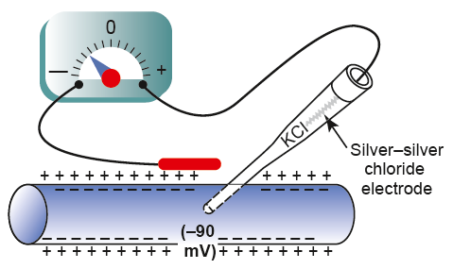
Measuring Membrane Potential
•VOLTMETER
To measure very small membrane potential difference between inside & outside as resting membrane potential . How?
• A small filled pipette (microelectrode) containing electrolyte solution is inserted inside the nerve fiber & another electrode is placed in the outside & membrane potential difference between inside & outside is measured using the voltmeter
All excitable cells exhibit an electrical potential (voltage) called resting cell membrane potential (-70 to -90mV)

Slide 6
Ion Concentration

Slide 7
K⁺
Na⁺
Cl⁻
Na⁺
Na⁺
Cl⁻
Na⁺
Na⁺
Cl⁻
Na⁺
Cl⁻
+
+
K⁺
Cl⁻
+
_
+
Cl⁻
_
Proteins⁻
_
Na⁺
K⁺
Na⁺
Cl⁻
Na⁺
K⁺
K⁺
Cl⁻
K⁺
Cl⁻
Proteins⁻
Na⁺
+
K⁺
K⁺
_
+
Na⁺
_
Cl⁻
Proteins⁻
K⁺
K⁺
Na⁺
K⁺
Cl⁻
Proteins⁻
Na⁺
K⁺
_
+
K⁺
Proteins⁻
K⁺
K⁺
3Na⁺
+
_
K⁺
Proteins⁻
Na⁺
Proteins⁻
K⁺
Na⁺/K⁺ ATPase Pump
K⁺
K⁺
K⁺
K⁺
2K⁺
+
_
Proteins⁻
K⁺
K⁺
K⁺
_
Cl⁻
_
+
K⁺
Na⁺
+
Cl⁻
_
_
Na⁺
+
+
Na⁺
+
Cl⁻
Na⁺
K⁺
Cl⁻
Na⁺
K⁺
Cl⁻
Na⁺
Cl⁻
Na⁺

Slide 8
RESTING MEMBRANE POTENTIAL
Given:
Concentration of ions inside and outside the cell as shown
Only K⁺ can diffuse across the cell membrane
100 K⁺
100 Na⁺
K⁺
100 A⁻
100 A⁻
100 Na⁺
150 mM/L K⁺
Concentration ∆
5 mM/L K⁺
99 K⁺
Concentration ∆
Electrical ∆
1 K⁺
Electrical ∆
A⁻
_
A⁻
+
100 A⁻
_
100 A⁻
+
Equilibrium Potential

Slide 9
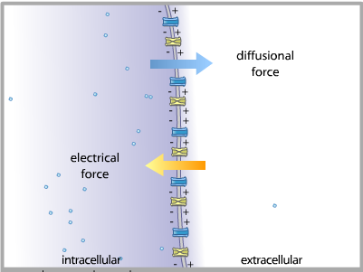
Opposing Forces Acting on Ions
- Only electrolytes are important because they are electrically charged.
- Oxygen, Carbon dioxide ?
K⁺
K⁺
K⁺
K⁺

Slide 10
NERNST EQUATION
Nernst calculated the level of concentration potential of ions across the membrane that prevent net diffusion of ions to inside or outside
Nernst made a hypothesis which said that if we suppose that
(1) The ECF and ICF contained ONLY potassium ion ,
(2) And that the cell-membrane was freely permeable to K+
→ Then K+ will diffuse down its concentration (chemical) gradient ( via the K+ leak channels ) from inside the cell to outside , carrying with it +ve charges to the outside
The Potassium Nernst ( Equilibrium ) Potential

Slide 11
*When this electrical gradient ( electrical force ) , which tends to keep K+ inside equals (=), the concentration gradient (which tends to push K+ outside ) → there will be no net K+ movement across the membrane .
The membrane potential (MP ) in that case is called:-
Nernst Potential for K+ (or K+ Equilibrium or Diffusion Potential)
E.M.F (mV) = + 61 log K+ Conc. Inside = -94 mV K+
Conc outside

Slide 12
Nernst made a hypothesis which said that if we suppose that:-
(1) the ECF and ICF contained ONLY sodium ions
(2) and that the cell membrane was freely permeable to Na+
→ Then Na+ will diffuse down its concentration gradient to the Inside of the cell, carrying with it +ve charges , and progressively decreasing the negativity inside the cell.
When this electrical gradient ( force ) , which tends to drive (PUSH) Na+ outside equals = the concentration gradient ( which tends to push Na+ in ) → there will be no Na+ movement across the membrane .
Nernst Potential for Na+ ( or Na+ Equilibrium or Diffusion Potential ) = +61 mV
The Sodium Nernst ( Equilibrium ) Potential

Slide 13
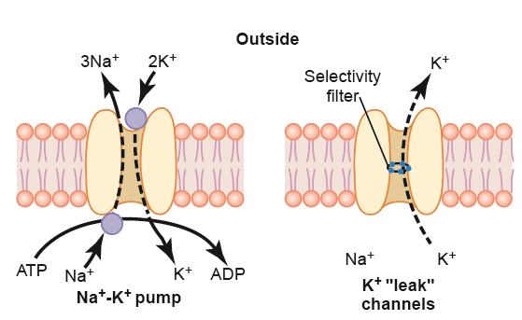
Origin of RMP:
1- Contribution of K diffusion potential:-
K+ leak channels → more K+ diffuses to outside than Na+ to inside
Outside
The ratio of potassium ions from inside to outside the membrane is 35, and this gives a calculated Nernst potential for the inside of the membrane of -94 millivolts.

Slide 14
2- Contribution of Na diffusion potential:-
The ratio of sodium ions from inside to outside the membrane is 0.1, and this gives a calculated Nernst potential for the inside of the membrane of +61 millivolts.
Using this value in the Goldman equation gives a potential inside the membrane of −86 millivolts,

Slide 15
3- Contribution of Na/K PUMP:-
- This is a powerful electrogenic pump on the cell membrane.
- It Pump 3 Na to outside & 2 K to inside, causing → net loss of +ve ions ,loss of + ve charge from inside , create negativity about - 4mV inside
Outside

Slide 16
So NET MEMBRANE POTENTIAL will be :-
Diffusion potential (caused by K & Na diffusion) + Electrogenic Na/K pump
(-86 mV ) + (- 4mV) = -90 mV
4- Effect of Large intracellular anions(negative ions) (proteins , sulphates & phosphates ), very low effect.

Slide 17
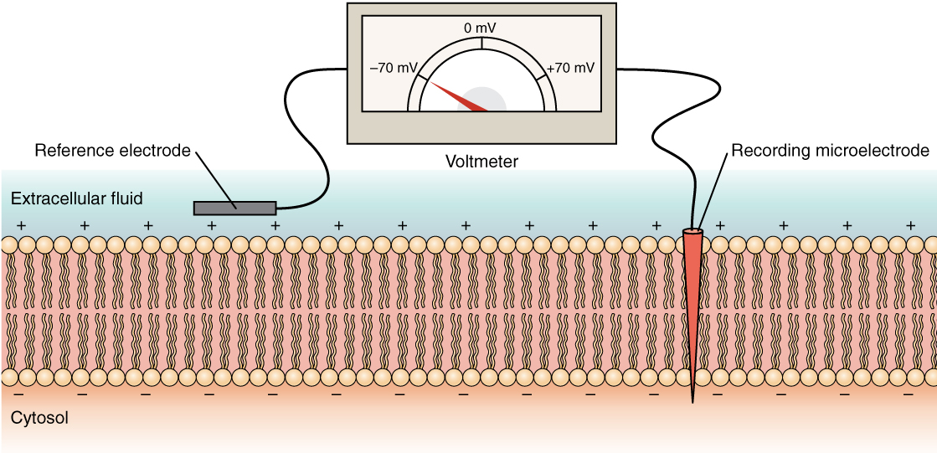
RESTING MEMBRANE POTENTIAL
DIF:- It is a potential difference across cell membrane during rest (without stimulation)
Value:- -90 mV in large nerve fibers ( -ve inside) (ranges between -70 mV TO -90 mV)
- It is determined by the K ions

