Slide 1
LOWER LIMB RADIOLOGY ANATOMY

Slide 2
PELVIS

Slide 3
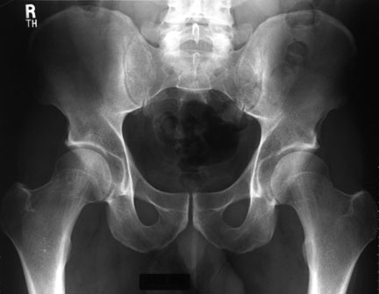
Iliac crest
L5
Sacroiliac joint
sacrum
Iliac bone
Acetabulum
Greater trochanter
Superior pubic ramus
Femur head
Femur neck
Pubic body
Symphysis pubis
Inferior pubic
ramus
Obturator canal
Lesser trochonter

Slide 4
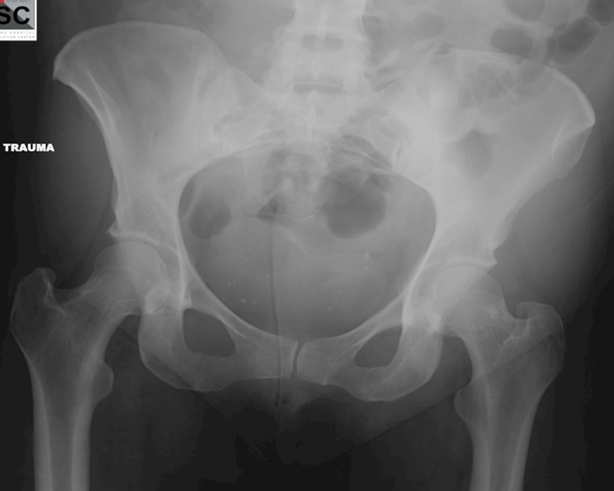
9
5
2
1
3
6
8
7
4
11
10

Slide 5
9
5
2
1
3
6
8
7
4
1- Sacroiliac joint
2- Sacrum
3- Sacral neural foramen
4- Iliac bone
5- Femur head
6- Symphysis pubis
7- Ischium
8- Greater trochanter
9- Femur neck
10- Pubic bone (inferior ramus)
11-Femur shaft
11
10

Slide 6
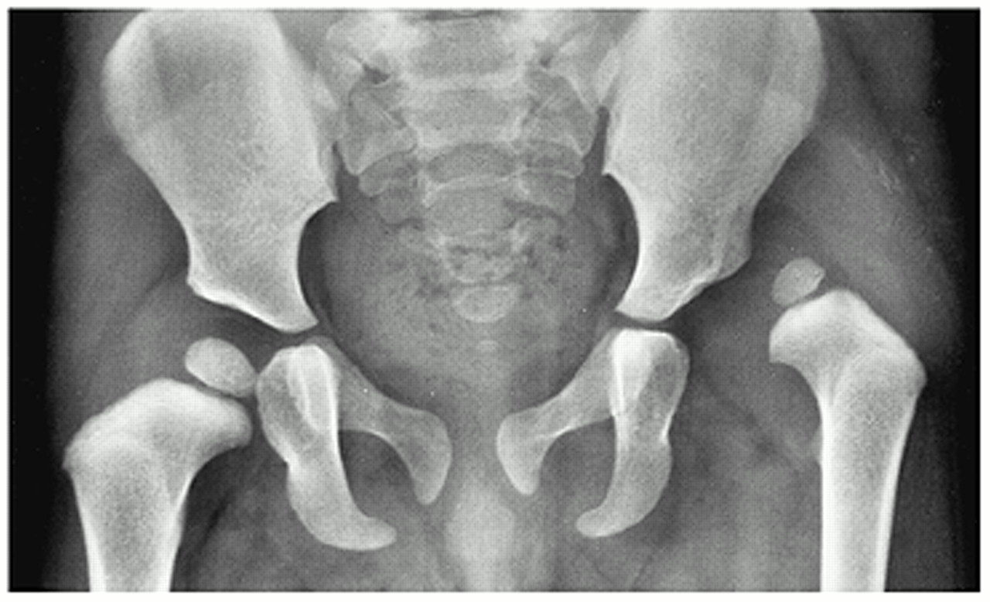
CONGENITAL HIP DISLOCATION

Slide 7
KNEE

Slide 8
1
9
1- Femur
2- Lateral condyle
3- Medial condyle
4- Patella
5- Tibia
6- Fibula
7- Lateral tibial spine
8- Medial tibial spine
9- Intercondyle notch
4
2
3
7
8
5
6

Slide 9
1
1-Femur
2- Femur condoyle
3- Patella
4- Tibia
5- Fibula
6- Tibial teberosity
7- Tibial spine
7
2
3
5
4
6

Slide 10
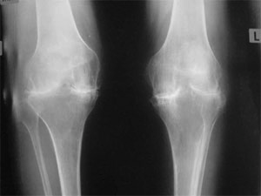
SEVERE OSTEOARTHRITIS

Slide 11
THIGH

Slide 12
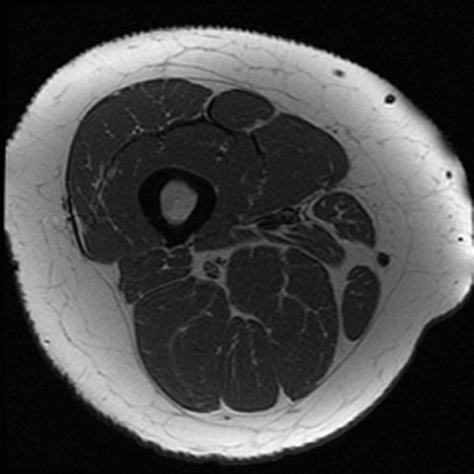
MRI
CT
1
4
5
3
13
6
7
12
9
8
11
10

Slide 13
1- Vastus lateralis muscle
2- Vastus intermedius muscle
3- Vastus medialis muscle
4- Rectus femoris muscle
5- Sartorius muscle
6- Gracilie muscle
7- Adductor magnus muscle
8- Adductor longus muscle
9- Semimemranous muscle
10- Semitendinousus Muscle
11- Biceps femoris muscle
12- Femur
13- Femoral artery
1
4
13
2
3
12
5
8
11
7
6
10
9

Slide 14
ANKLE

Slide 15
3
1
1- Tibia
2- Medial malleolus
3- Fibula
4- Lateral melleolus
5- Dome of talus
2
4
5

Slide 16
2
1- Fibula
2- Tibia
3- Talus
4- Calcenous
5- Navicular
1
3
5
4

Slide 17
FOOT

Slide 18
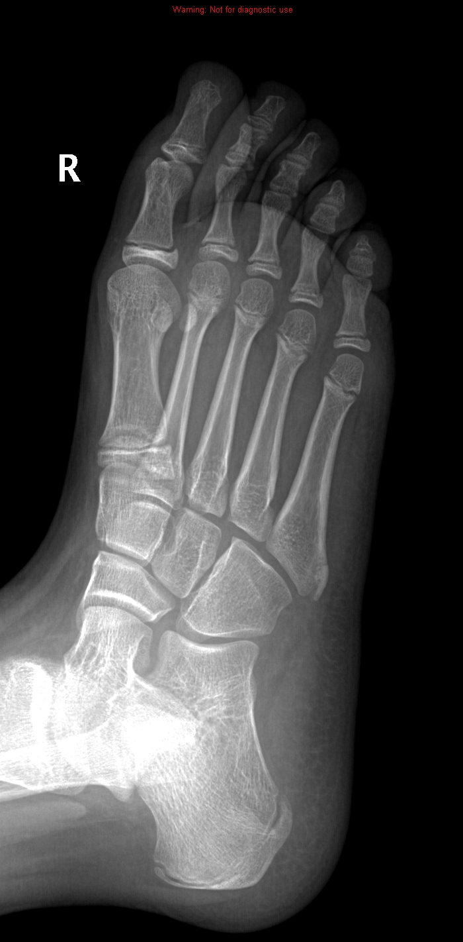
10
9
1-Medial cuneiform bone
2- Intermediate cuneiform bone
3- Lateral cuneiform bone
4- Cuboid bone
5- Navicular bone
6- Calceneal bone
7- Talus
8- Metatarsal bone (1st toe)
9- Proximal phalanx (1st toe)
10- Distal phalanx (1st toe)
8
1
2
3
5
4
7
6

Slide 19
LOWER LIMB ARTERIES

Slide 20
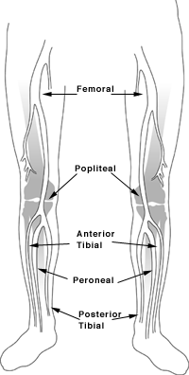

Slide 21
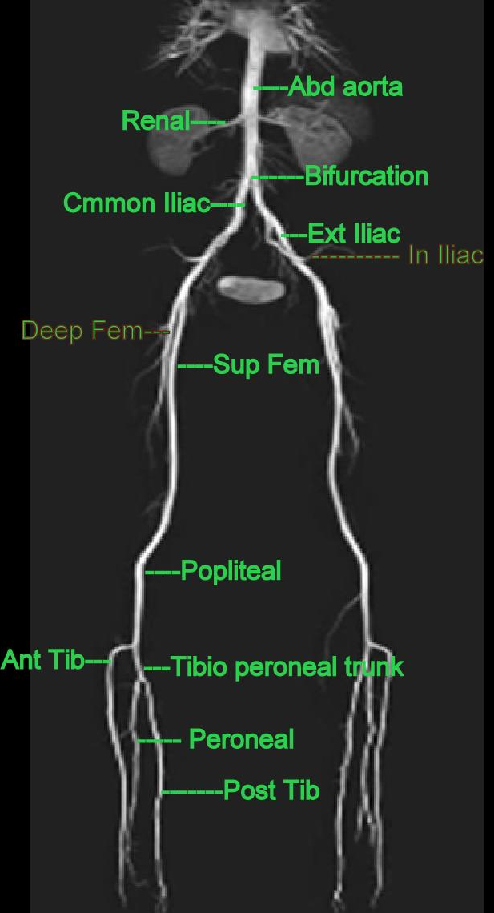

Slide 22
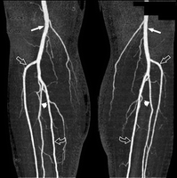
1
2
3
4

Slide 23
1
2
1- Popliteal artery
2- Anterior tibial artery
3- Peroneal artery
4- Posterior tibial artery
3
4

Slide 24
THE END

