Slide 1
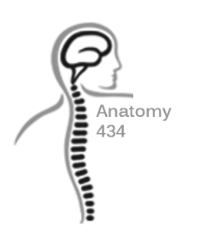
Forearm
Anatomy Team 434
Color Index:
Important Points
Helping notes
Explanation
If you have any complaint or suggestion please don’t hesitate to contact us on:
AnatomyTeam434@gmail.com

Slide 2
OBJECTIVES
List the names of the Flexors Group of Forearm (superficial & deep muscles).
Identify the common flexor origin of flexor muscles and their innervation & movements.
Identify supination and pronation and list the muscles produced these 2 movements.
List the names of the Extensor Group of Forearm (superficial & deep muscles).
Identify the common extensor origin of extensor muscles and their innervation & movements.

Slide 3
Introduction
The forearm
Interosseous membrane
It extends from elbow to wrist
It posses two bones radius laterally & Ulna medially.
This membrane allows movement of Pronation and Supination .
Also, it gives origin for the deep muscles.
The ulna and radius are connected by three structures: superior radioulnar joint, inferior radioulnar joint and the interosseous membrane.
Anterior compartment visual video:
http://youtu.be/BjIab-huqgU
Posterior compartment visual video:
http://youtu.be/7F4dHDwwvhQ
Notes:
-For these topic the origin and insegne are not required but everything else such as the name of the muscle, nerve supply and action are extremely important

Slide 4
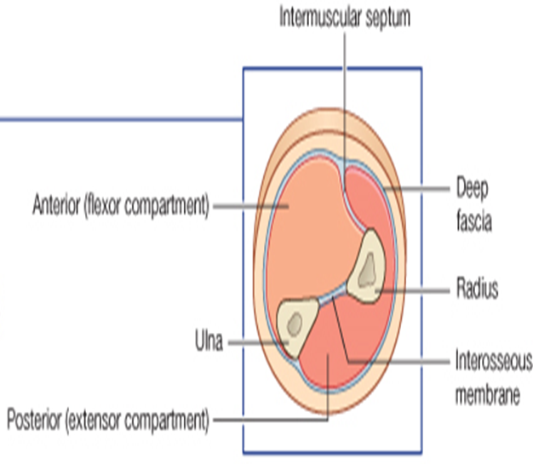
Fascial Compartments of the Forearm
This fascial sheath, together with the interosseous membrane & fibrous intermuscular septa, divides the forearm into several compartments, each having its own
The forearm is enclosed in a sheath of deep fascia, which is attached to the posterior border of the ulna
Muscles
Nerves
Blood supply

Slide 5
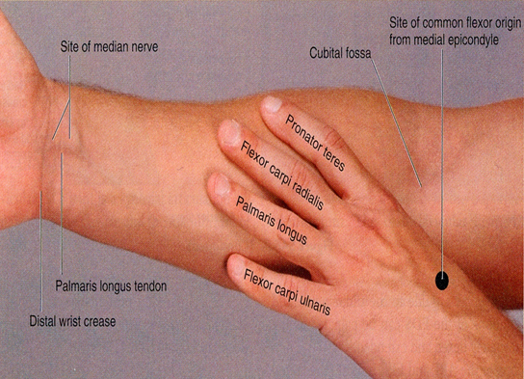
Flexor group
These muscles: 8
Act on the elbow & wrist joints and those of the fingers.
Form fleshy masses in the proximal part and become tendinous in the distal part of the forearm.
Arranged in three groups:
Superficial: 4
Pronator teres
Flexor carpi radialis
Palmaris longus
Flexor carpi ulnaris
Intermediate: 1
Flexor digitorum superficialis
Deep: 3
Flexor digitorum profundus
Flexor pollicis longus
Pronator quadratus
Notes:
Prof. Saeed Abuel Makarem advised us to use the image on slide 5 to memorise the superficial flexor group

Slide 6
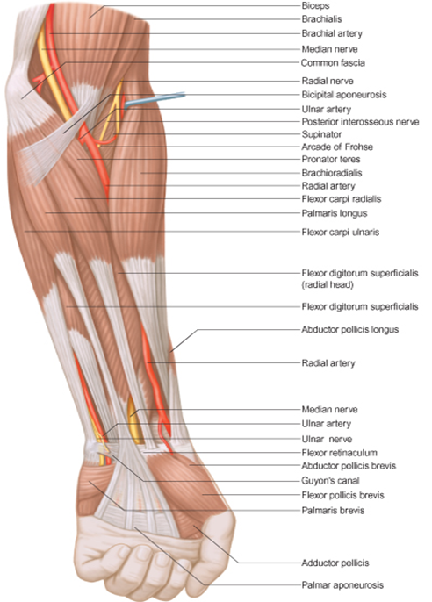
Superficial Flexors
All cross the wrist joint except one, pronator teres
All are supplied by median nerve except one, flexor carpi ulnaris, FCU (ulnar)
They arise from common flexor origin (front of medial epicondyle)

Slide 7
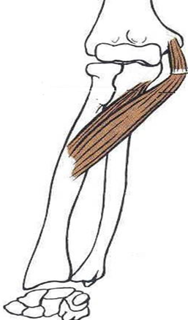
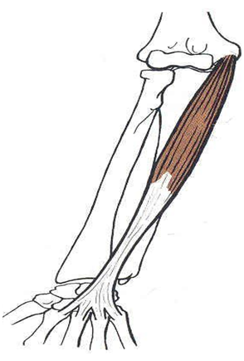
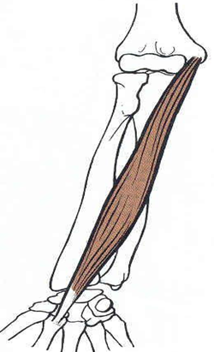
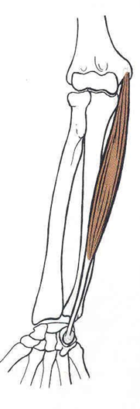
Superficial Flexors
Pronator teres
Insertion: middle of lateral surface of radius
Action: pronation & flexion of forearm
Flexor Carpi Ulnaris Insertion: Pisiform, hook of hamate 5th metacarpal bone.
Action: Flexion and adduction of the hand.
Flexor Carpi Radialis Insertion: Base of 2nd metacarpal bone
Action: Flexion & abduction of the hand
n Palmaris Longus Insertion: into the flexor retinaculum & palmar aponeurosis.
Action: Flexes hand & tightens palmar aponeurosis
May be absent
Radialis ----> Abduction
Ulnaris ----> Adduction

Slide 8
Intermediate Flexor
Flexor Digitorum Superficialis
Origin:
•Common flexor origin,
•Coronoid process of ulna
•Anterior surface of radius
Insertion: base of middle phalanges of medial 4 fingers.
Action: Flexes middle and proximal phalanges of the medial 4 fingers, and the hand
Digitorum: 4 tendons Flexor Digitorum superficialis: middle flexor Digitorum profundus: terminal

Slide 9
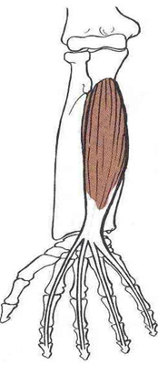
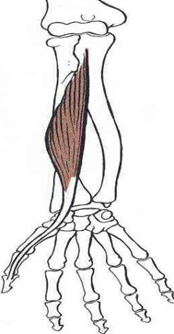
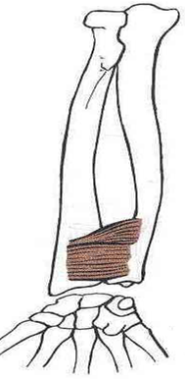
Deep Flexors
Flexor Digitorum Profundus
Insertion: bases of distal phalanges of medial 4 digits
Action: Flexes distal phalanges of medial 4 digits.
Above the ulna
Flexor Pollicis Longus
Insertion: Base of distal phalanx of thumb
Action: flexes interphalangeal, metacarpophalangeal & carpometacarpal joints of thumb.
Above the radius
Pronator Quadratus
Insertion: distal fourth of anterior surface of radius
Action: pronates forearm (prime mover), helps to hold the bones together.
Above the bones

Slide 10
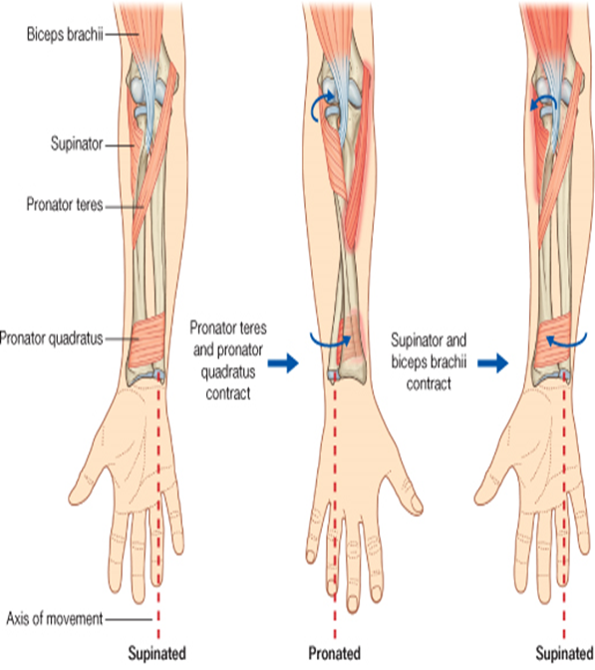
Movement of the Flexors
Supination
Pronation
Muscles that produce supination:
> Biceps brachii
> Supinator
Muscles that produce pronation:
> Pronator teres
> Pronator quadratus
NB. Brachioradialis put the forearm in midprone- position.
It occurs in the superior and inferior radioulnar joints
the biceps produces the supination movement when the elbow is flexed but it does not act to produce the movement when the elbow is extended. The supinator muscle does the movement in this case.
Biceps brachii is a strong supinator
On supination: radius and ulna parallel to each other On pronation: radius across ulna
Notes:
-the biceps prudosis the supination movement when the elbow is flexed but it does not act to produce the movement when the elbow is extended. the supinator muscle does the movement in this case (Very Very important)
biceps brachii is strong supinator
on supination : radius and ulna parallel to each other
on pronotion : radius across ulna انو الريدديس تسير على الالنا

Slide 11
Posterior compartment
Superficial group (7)
Superficial Lateral group (2)
> Brachioradialis
> Extensor carpi radialis longus
Superficial group (5)
> Radialis brevis > Extensor digitorum
> Extensor digiti minimi > Extensor carpi ulnaris > Anconeus
Common Extensor Origin
(front of lateral epicondyle)

Slide 12
Superficial Group
All arises from the common extensor origin, EXCEPT, 2 (BR & ECRL).
Superficial group: (7) muscles
(from lateral to medial) :
1/ Brachioradialis, (BR). 2/ Extensor carpi radialis longus, (ECRL).
3/ Extensor carpi radialis brevis, (ECRB).
4/ Extensor digitorum, (ED).
5/ Extensor digiti minimi, (EDM).
6/Extensor carpi ulnaris, (ECU). 7\Anconeus, (An).
Deep branch of radial = posterior interosseous nerve
عشان نربط مع المحاضرة السابقة radial nerve found with the triceps and half of brachialis in the arm
All cross the wrist EXCEPT, one, brachioradialis.
All supplied by deep branch of radial nerve, EXCEPT ABE are supplied by the radial nerve
A, Anconeus
B, Brachioradialis
E, Extensor carpi radialis longus
Notes:
deep branch of radial = posterior interosseous nerve
-brachioradialis stopon steloid process of radius and doesnot cross the wrist
عشان نربط مع المحاضرة السابقة الريديل نيرف موجود في triceps and half of brachilis in arm

Slide 13
Superficial Lateral group
Brachioradialis
Origin: Lateral supracondylar ridge of humerus
Insertion: Base of styloid process of radius
Action: Flexes forearm; (elbow).
Rotates forearm to the midprone position.
Extensor Carpi radialis longus
Origin: Lateral supracondylar ridge of humerus
Insertion: Posterior surface of base of 2nd metacarpal bone
Action: Extends and abducts hand at wrist joint
Brachioradialis is the only one that does flexion from the extensors

Slide 14
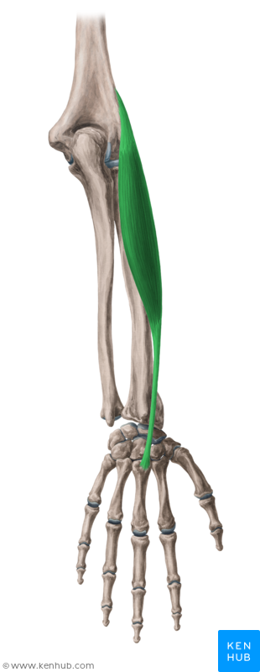
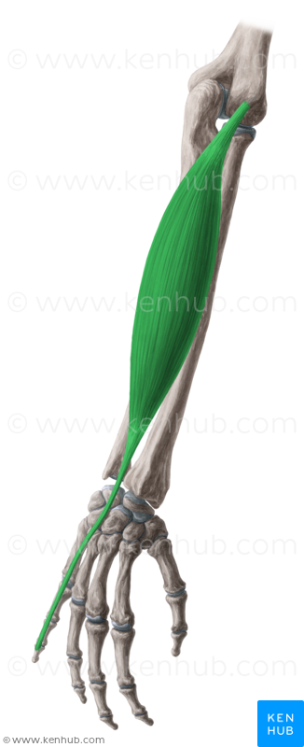
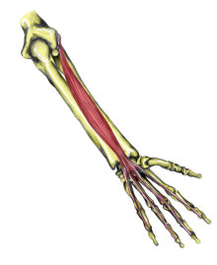
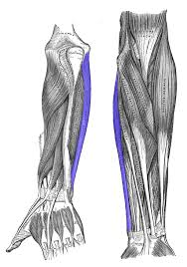
Insertion of the Superficial Group
Extensor carpi radialis brevis
Base of 3rd metacarpal bone.
Extensor digiti minimi
Extensor expansion of the little finger
Extensor digitorum
Extensor expansion of the medial 4 fingers
Extensor carpi ulnaris
Base of 5th metacarpal bone.
Anconeus wasn’t mentioned

Slide 15
Deep Group
5 muscles (3 to thumb + 1 to index + supinator)
1- Abductor pollicis longus, (APL).
2- Extensor pollicis brevis, (EPB).
3- Extensor pollicis longus, (EPL).
4- Extensor indicis (EI).
5- Supinator.
All back muscles of forearm are supplied by posterior interosseous nerve except, ABE by Radial nerve

Slide 16
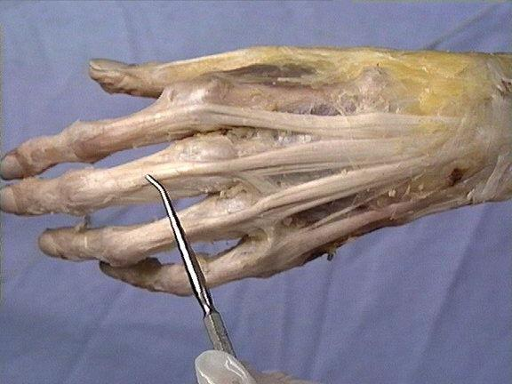
Dorsal Extensor Expansion
It is formed on the dorsum of medial 4 fingers by: the union of the tendons of: Extensor digitorum, Extensor digiti minimi, Extensor indicis, palmar and dorsal interossei and lumbricals muscles.
All these tendons unite to form one tendon which divides into 3 slips, a median one attached to middle phalanges and 2 lateral attached to the terminal phalanges.

Slide 17
MCQ
Answers:
1) D
2) D
3) B
4) B
5) A
6) A
7) D
8) D
5) The Common Extensor Origin is ?
A- front of lateral epicondyle
B- front of medial epicondyle
C- back of medial epicondyle
D- back of lateral epicondyle
6- What is the action of Flexor Carpi Ulnaris ?
A-Flexion and adduction of the hand.
B-pronation & flexion of hand.
C-Flexion & abduction of the hand.
D-Extends and abducts hand at wrist joint.
7- Which muscle is supplied by median nerve ?
A- Anconeus.
B- Brachioradialis.
C- Extensor carpi radialis longus.
D- Flexor digitorum superficialis.
8- What is the action of extensor carpi radialis longus in hand at wrist joint ?
A- extension and adduction
B- flexion and abduction
C- flexion and adduction
D- extension and abduction
1- Which muscle is related to common flexor origin ?
A. Flexor digitorum profundus.
B. Flexor pollicis longus.
C. Pronator quadratus.
D. Pronator teres.
2- Which muscle supply by the ulnar nerve ?
A- Pronator teres
B- Flexor carpi radialis
C-Palmaris longus
D-Flexor carpi ulnaris
3- all these muscle cross the wrist joint except ?
A- Flexor carpi ulnaris
B- Pronator teres
C- Flexor carpi radialis
D- Palmaris longus
4- All back muscles of forearm are supplied by posterior interosseous nerve except ?
A- EPL by Radial nerve
B- ABE by Radial nerve.
C- EI by ulnar nerve.
D- EPL by ulnar nerve

Slide 18
