Slide 1
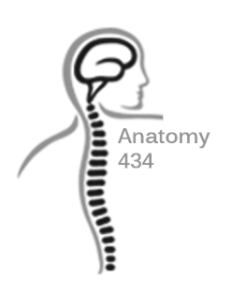
Sacrum and Pelvis
Anatomy Team 434
Color Index:
Important Points
Helping notes
Explanation
If you have any complaint or suggestion please don’t hesitate to contact us on:
AnatomyTeam434@gmail.com

Slide 2
OBJECTIVES
Describe the bony structures of the pelvis.
Describe in detail the hip bone, the sacrum, and the coccyx.
Describe the boundaries of the pelvic inlet and outlet.
Identify the articulations of the bony pelvis.
List the major differences between the male and female pelvis.
List the different types of female pelvis.

Slide 3
Bony Pelvis
Structure:
Pelvis can be regarded as a basin with holes in its walls. The structure of the basin is composed of four bones which are joined by four joints.
The pelvis is a region of the trunk that lies below the abdomen.
Bony pelvis is the bowl shaped bony structure that forms the skeleton of that region.
The skeleton of the pelvis is a basin-shaped ring of bones connecting the vertebral column to both femora.
Compared to the shoulder girdle, the pelvic girdle is stronger and heavier.
Coccyx: It is a small bone that forms the lower part of posterior wall
The bones are:
Two Hip Bones: These form the lateral and anterior walls of the bony pelvis.
Sacrum: It forms most of the posterior wall.

Slide 4
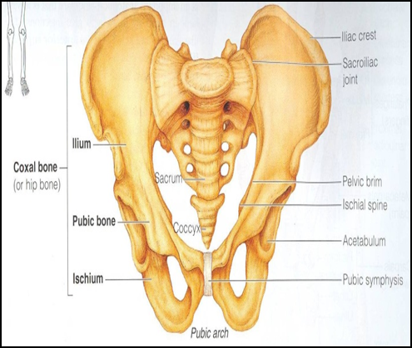
Bony Pelvis
Primary functions:
1. bear the weight of the upper body when sitting and standing; transfer that weight from the axial skeleton to the lower appendicular skeleton when standing and walking.
2. provide attachments for and withstand the forces of the powerful muscles of locomotion and posture.
Secondary functions:
1.contain and protect the pelvic and abdomino-pelvic viscera.
2. provide attachment for external reproductive organs and associated muscles and membranes.

Slide 5
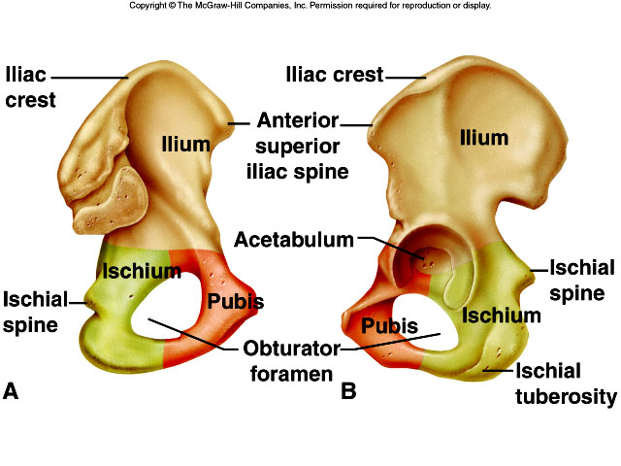
Pelvic Girdle
Composed of Two Hip Bones (large irregular bone).
Hip bone:
Ilium(upper)
Pubis(Anterior)
Ischium(Posteroinferior)
They are joined at a deep socket (the Acetabulum)
During childhood, these sections are separate bones, joined by Y shaped cartilage.
During puberty, they fuse together to form a single bone.

Slide 6
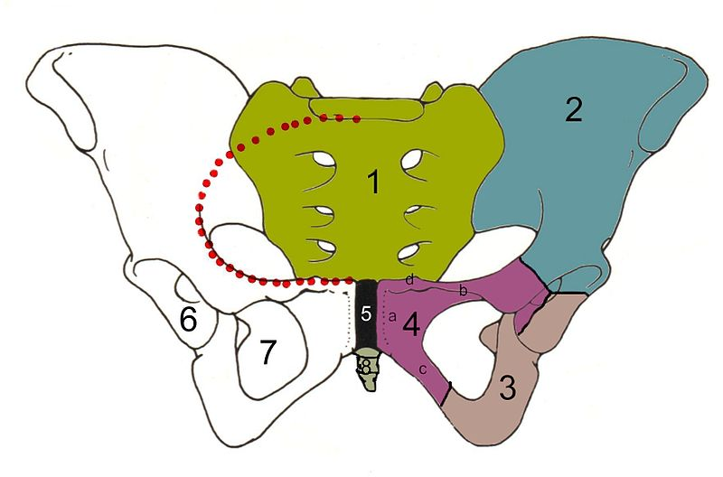
Pelvic Girdle
Sacrum
Ilium
Ischium is thick to bear the body weight.
Pubic bone
Pubic symphysis
Acetabulum
Obturator foramen
Coccyx
Red line: Terminal line/pelvic brim

Slide 7
Ilium
the Upper Flattened Part of the hip bone. there is bone marrow
It Possesses:
Iliac Crest: it is an important anatomical landmark below the waist. It runs between the Anterior and Posterior Superior Iliac Spines. Below are the corresponding Anterior and Posterior Inferior Iliac Spines. it is subcutaneous
-The Outer Surface:
rough and has three Gluteal Lines. for attachment of gluteal muscles
-The Inner surface shows:
Iliac Fossa (forms false pelvis)
Aauricular surface( for articulation with the sacrum).looks like the ear
Iliopectinial (Arcuate) Line:runs Downwards & Forwards, it separates between the False & the True pelvis . it is between the ilium and ischium

Slide 8
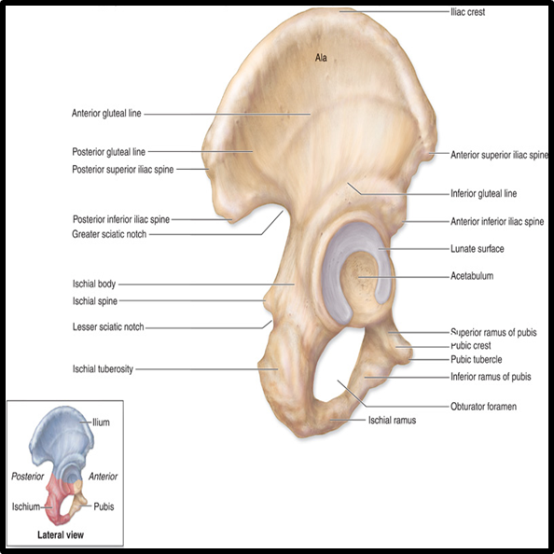
Pubis
Forms the Anterior & inferior part.
Body; bears the Pubic Crest and Pubic Tubercle
Two pubic Rami: Superior & Inferior.They bound the Obturator Foramen, it is closed partially by the obturator membrane
The obturator canal is for transportation of vessel nerves, etc… to the outside of pelvis

Slide 9
Ischium
Forms the Inferior and Posterior part.
Lesser sciatic notch
Ischial Tuberosity:
It is a roughened area that receives body weight in sitting but we do not feel that it is a bone because it has muscles on it.
Greater sciatic notch
Ischial Spine:
Superior to the tuberosity, it is important landmark in pregnant women.
The ischial spine separates the greater and lesser sciatic notches which produce the foramen in the living human by two ligaments: (sacral ligaments & sacrospines)
*Greater and lesser sciatic notches are converted into foramina by ligaments (sacrospinous and sacrotuberous ligaments)

Slide 10
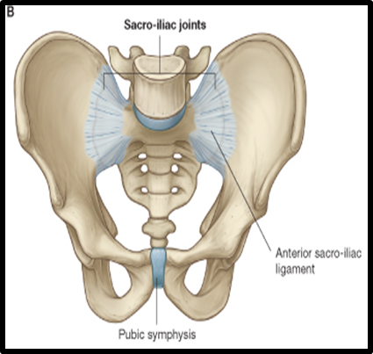
Hip bone Articulations
Symphysis Pubis:
A secondary Cartilaginous joint between the two pubic bones
Sacroiliac Joints
Strong synovial joints, between the auricular surfaces of ilium and sacrum. (TWO)
Hip Joints:
The acetabulum articulates with the head of the femur. (TWO)

Slide 11
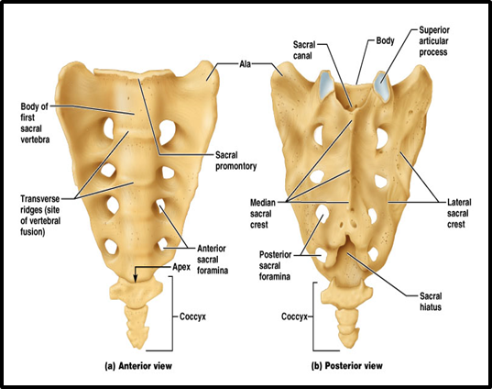
Sacrum
A Single Wedge shaped bone conic shape.(consists of Five rudimentary vertebrae fused together)
Sacral Promontory:
The anterior and upper margin.
It is tilted forward forming the lumbosacral angle. L5 + promontory that is tilted forward
The anterior and posterior surfaces possess on each side four Sacral Foramina.
The fused vertebral foramina form the Sacral Canal.
Its lower limit is the Sacral Hiatus .

Slide 12
Coccyx
Consists of 4 vertebrae fused together forming a single Triangular piece
Articulations of Sacrum:
Sacrococcygeal joint:
The inferior part articulates with the Coccyx
Lumbosacral joint:
The upper border articulates with the 5th Lumbar vertebra
Sacroiliac joints:
Lateral with the Hip bones.

Slide 13
Foramina in bony pelvis
The holes of the basin are called foramina.
Important foramina:
Anterior sacral foramina: | Greater and lesser sciatic foramina: | Obturator foramen:
-These are present on the anterior surface of the sacrum (which forms the posterior surface of the bony pelvis). -Through these foramina pass the anterior rami of the sacral spinal nerves. | These are the major foramina of the pelvis. In the bony pelvis. they are present as greater and lesser sciatic notches but they are converted into foramina by ligaments ( sacrospinous and sacrotuberous ligaments). From these foramina various structures enter and leave the pelvis. | it is a large hole in the lateral wall of the pelvis,In living subjects, this hole is closed by the obturator membrane except for a small opening, which represents the foramen; (Obturator canal) Obturator nerve passes through this small opening.

Slide 14
Foramina in bony pelvis
Foramina Of The Pelvis
Anterior sacral foramina
These are present on the anterior surface of the sacrum. Through these foramina pass the anterior rami of the sacral spinal nerves.
Obturator foramen
Greater and lesser
sciatic foramina
the major foramina of the pelvis. From these foramina various structures enter and leave the pelvis

Slide 15
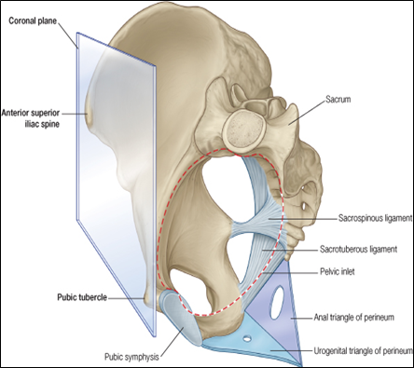
Orientation of the Pelvis
The Correct Position of the bony pelvis relative to the trunk (in the anatomical position) :
1.The anterior-superior iliac spine and the pubic tubercles are in the same vertical plane.
2. The coccyx is in the same horizontal plane as the upper margin of the pubic symphysis.
3. The axis of the pelvic cavity running through the central point of the inlet and the outlet almost parallels the curvature of the sacrum.

Slide 16
Orientation of the Pelvis
In the position mentioned before : The anterior surface of the Sacrum is directed forward and downward while the pelvic surface of symphysis pubis faces upward and backward.
important notes:
orientation can be normal or abnormal
in correct position of bony pelvis:
1- the superior anterior iliac spine and pubic tubercle are in same line in sagittal cut.
2- axis between central points of inlet and outlet is parallel to sacrum curvature.
in this correct position the sacrum is facing downward and forward and the pelvic surface is facing upward and backward.
symphysis has two surfaces one is rough and the other is smooth ( ناحية التجويف)

Slide 17
Fractures of the Bony Pelvis
Pelvic Fractures:
- can result from direct trauma to the pelvic bones as occurs in car accidents or by forces transmitted to these bones from the lower limbs during falls on the feet.
- may cause injury to the pelvic soft tissues, blood vessels, nerves and organs such as the urinary bladder.
-The weakest parts of the bony pelvis are:
Pubic rami.
Acetabula
Alae of the ilium.
Region of sacroiliac joint.

Slide 18
Subdivision of the Bony Pelvis
Divided into two parts by the Pelvic Brim.
The brim is formed posteriorly by the sacral promontory, laterally by the iliopectineal line and anteriorly by the symphysis pubis.
the pelvic brim separates between above false pelvis and the below true pelvis.
Above the pelvic brim lies the false pelvis, which is not of much clinical importance.
Below the brim is the true pelvis

Slide 19
True & False Pelvis
False pelvis
True Pelvis
Lies inferior to the pelvic brim.
Encloses the pelvic cavity.
Contains the pelvic organs.
It has :
Lies superior to the pelvic brim.
Enclosed by the Fossae of the iliac bones
Forms the inferior region of the abdominal cavity.
Houses the Inferior abdominal organs
Outlet Pelvic walls
Inlet Pelvic walls

Slide 20
Pelvic Inlet (pelvic Brim) & Pelvic Outlet
-Pelvic Inlet (pelvic Brim)
-Pelvic Outlet
Bounded by:
- Sacral promontory
- Iliopectineal lines.
- Symphysis pubis.
Bounded by:
- Coccyx
- Ischial tuberosities.
- Pubic arches.

Slide 21
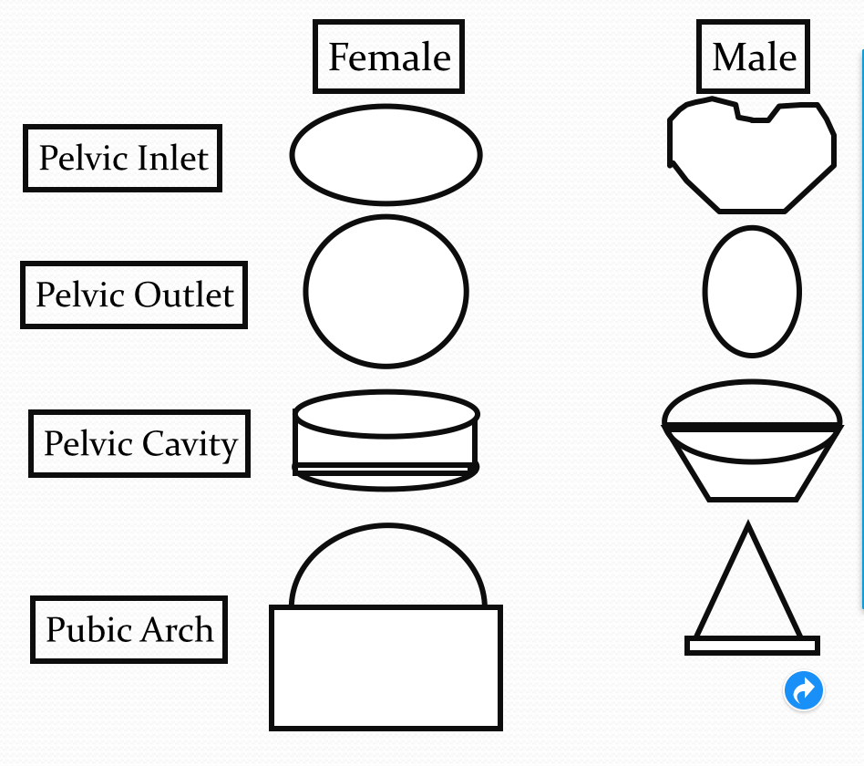
Forensic Medicine & Bony Pelvis
For identification of human skeletal remains, the bony pelvis is of prime focus of attention because sexual differences are clearly visible.
Even parts of the pelvis are useful in making a diagnosis of sex.
Important notes:
iliac fossa is deeper in males
sacrum in males is directed outward because it is curved
subpubic angle in females: greater than 90 degrees and because of that obturator foramina are oval ( they are away from each other)
subpubic angle in males: acute angle .
ischial spines are away from each other in females.
pelvic bones in females has special adaptations.
obturator foramina are oval ( they are away from each other)
bony pelvis is important in determining sex in forensic medicine.

Slide 22
Bony Pelvis
Bony pelvis | Male | Female
General structure | Thick & heavy | Thin, Smaller & lighter
False (major) pelvis | Deep | Shallow
True (lesser) pelvis | Narrow & Deep | Wide & Shallow
Pelvic inlet | Heart shaped | Oval or Rounded
Pelvic outlet | Small | larger because of the everted ischial tuberosities
Pubic arch & subpubic angle | Narrow | Wide
Obturator foramen | Round | Oval
acetabulum | Large | Small

Slide 23
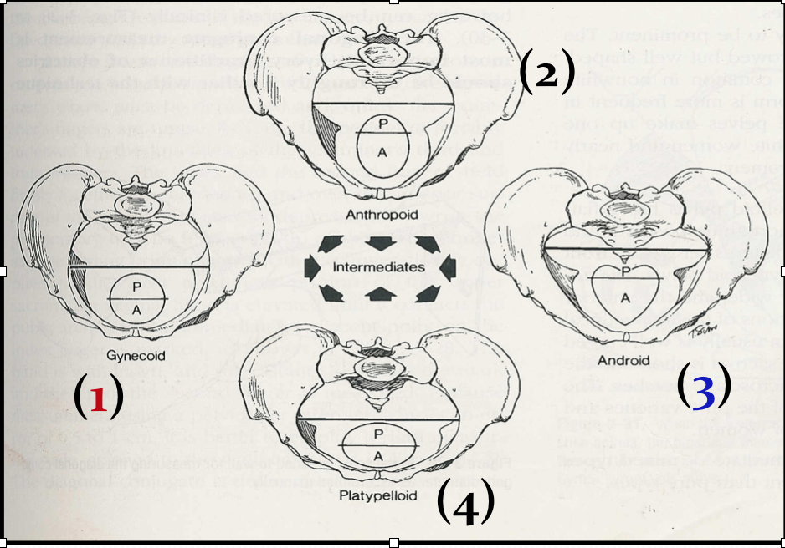
Types of Obstetrical Female Pelvis
(1) Gynaecoid:
it is the typical female type
(2) Anthropoid;
long narrow and oval shaped.
anthropoid type is better than android but gynaecoid is the best type.
(3) Android :
it is funnel shaped with contracted outlet.
(it causes hazards to normal vaginal delivery)
(4) Platypelloid Least common:
wide , flattened at the brim, with forward promontory.

Slide 24
Mind Map
Sacrum
Primary
Ilium
Function
Coccyx
Structure
Ischium
Secondary
Pelvic Girdle
(Two hip bones)
Pubis
Foramina
Bony Pelvis
Subdivision
Hip Joints
Anterior sacral
Symphysis Pubis
of hip bone
Fractures
Greater and lesser sciatic
Sacroiliac joints
Articulation
Obturator
Lumbsacral joint
of sacrum
Sacrococcygeal joint
Types of Obstetrical Female Pelvis
orientation

Slide 25
Articulation of Bony Pelvis
Articulation of Bony Pelvis
of hip bone | Hip Joints | The acetabulum articulates with the head of the femur.
 | Symphysis Pubis | A secondary Cartilaginous joint between the two pubic bones
 | Sacroiliac joints | Strong synovial joints, between the auricular surfaces of ilium and sacrum
of sacrum
 | Lumbosacral joint | The upper border articulates with the 5th Lumbar vertebra
 | Sacrococcygeal joint | The inferior part articulates with the Coccyx

Slide 26
MCQ
1- During childhood the sections of bones are separate in :_
A- Sacrum
B- Hip bone
C- coccyl
D- Femur
2- The number of lines in outer surface of ilium of hip bone :-
A- 3
B- 4
C- 5
D-6
3- Which of the following bone will be prominent during pregnancy :-
A- iliac fossa
B- Pubic tubercle
C-Ischial tuberosity
D-Ischial spine
4- The anterior rami pass through :-
A- Posterior sacral foramina
B- Greater sciatic notch
C_ Lesser sciatic notch
D-Anterior sacral foramina
5- Anterior and posterior superior iliac spine are connected by :-
A- arcuate line
B- Pubic symphysis
C- pelvic inlet
D- Iliac cryst
6- Houses the inferior abdominal organs :-
A- Tue pelvis
B- False pelvis
C- Both of them
D-None of them
7- Which of the following is true :-
A- Sacrum in male is equal to female
B- Sacrum in female longer
C- Sacrum in male wider
D- Sacrum is less curved in women
8-Which of the following female pelvis resemble male pelvis :-
A- Gynaecoid
B-Anthropoid
C- Android
D-Platypelloi
Answers
1-B
2-A
3-D
4-D
5-D
6-B
7-D
8-B

Slide 27
More Explanation
I hope you will find helpful video on the beautiful picture below:

Slide 28
