Slide 1
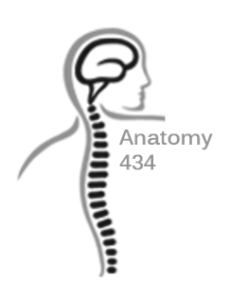
Pectoral Region and Axilla
Anatomy Team 434
Color Index:
Important Points
Helping notes
Explanation
If you have any complaint or suggestion please don’t hesitate to contact us on:
AnatomyTeam434@gmail.com
We do advise you to read everything

Slide 2
OBJECTIVES
Identify and describe the muscles of the pectoral region.
Pectoralis major.
Pectoralis minor.
Subclavius.
Serratus anterior.
Describe and demonstrate the boundaries and contents of the axilla.

Slide 3
Pectoralis Major
- ORIGIN: It has two heads of Origin they are:
1- Clavicular head:
Which is attached to the MEDIAL HALF of the ANTERIOR ( front) part of the CLAVICLE
2- SternoCostal head:
Which is attached to
A- Sternum
B- the upper 6 costal cartilages
C- Aponeuroses of the external oblique
- NERVE SUPPLY: it has two nerve supply
Medial and lateral pectoral nerves
- ACTION
1- Adduction of the arm
2- medial rotation of the arm
3- “the Clavicular head” helps in flexion of the arm ( shoulder joint )
- INSERTION: It has only one insertion
The Lateral lip of the Bicipital groove ( intertubercular of the humerus )
Aponeuroses are layers of flat broad tendons.it has similar action to latissimus dorsi
“ تمارين العقلة “ or climbing. the insertion becomes the origin and the origin becomes the insertion
The bicipital groove has 3 muscles
1- latissimus dorsi
2-pectoralis major
3- teres major

Slide 4
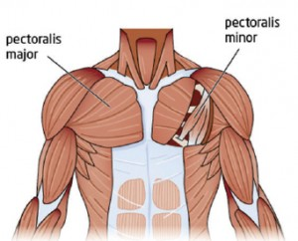
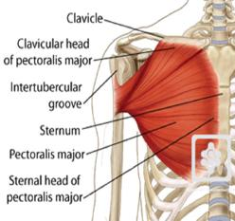
Pectoralis Major

Slide 5
Pectoralis Minor
- LOCATION: behind (deep) the Pectoralis major
- INSERTION: it has only one insertion and it’s the Coracoid process ( of the scapula )
- NERVE SUPPLY: one nerve supply
Medial pectoral nerve
- ORIGIN: it has only one origin from The 3rd 4th and 5th Ribs near their Costal Cartilages
- ACTION:
1- Depression of the Shoulder “ the insertion and the origin become near to each other”
2- Draw the ribs upwards and outwards during deep inspiration ( breathing in* )
the insertion becomes the origin and the origin becomes the insertion
Pectoralis major & minor (helpful video)

Slide 6
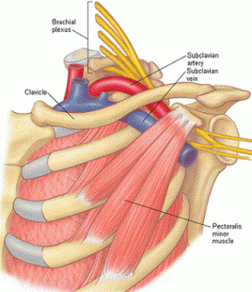
Pectoralis Minor

Slide 7
Subclavius
- LOCATION: Under (inferior) the clavicle
- INSERTION: attaches to the SUBCLAVIUS GROOVE at the inferior surface of the ⅓ middle part of the clavicle
- ACTION: Steadies the CLAVICLE during movement of the Shoulder joint
- ORIGIN : From the 1st rib at its junction with the 1st costal cartilage ( arrises from the first Costochondral junction )
- NERVE SUPPLY: from the upper trunk of the brachial plexus
-the region between the subclavius and the pectoralis minor (over the 2nd rib) is called the costocoracoid membrane or clavipectoral fascia.it spreads to cover both muscles
- costo : rib
- chondro : cartilage
-the insertion can be called 1st costochondral junction
Subclavius (helpful video)

Slide 8
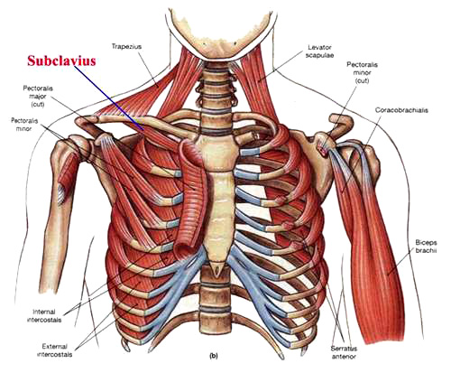
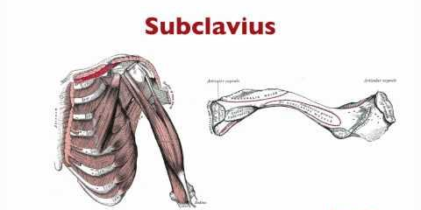
Subclavius

Slide 9
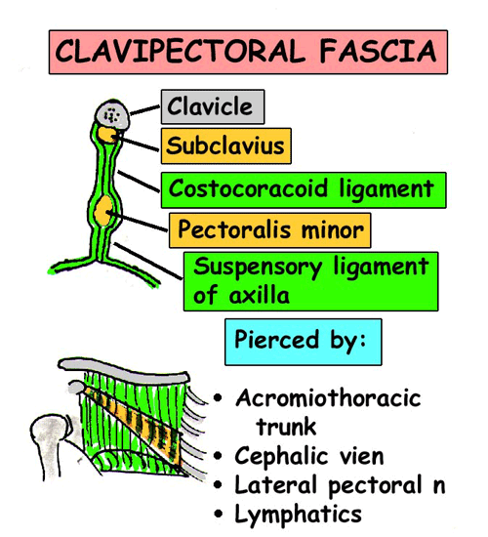
Clavipectoral Fascia
It is also called costocoracoid membrane
It is a thickened membrane of deep fascia located between the subclavius and the pectoralis minor
Let The Cat Free “ MNEMONIC”
- it is pierced “ مخرومة” with :
1- Lateral pectoral nerve
2- Thoraco-acromial artery
3- Cephalic vein
4- Few lymph nodes
( it splits to enclose the subclavius “superiorly” and the pectoralis minor “inferiorly” ) and it is attached to coracoid process “ laterally” and to the costal cartilage “ medially”

Slide 10
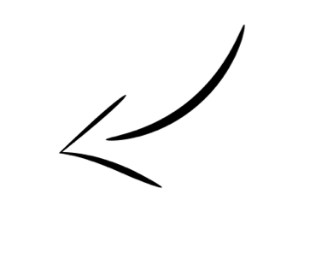
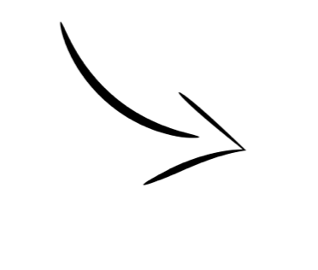
Clavipectoral Fascia
* it is the region between the subclavius and the pectoralis minor (over the 2nd rib is) & spreads to cover both muscles .
* it is a tough membrane .
It is also called costocoracoid membrane
it is a thickened membrane of deep fascia located between the subclavius and the pectoralis minor
( it splits to enclose the subclavius “superiorly” and the pectoralis minor “inferiorly” ) and it is attached to coracoid process “ laterally” and to the costal cartilage “ medially”
“ MNEMONIC”
It is pierced “ مخرومة” with
Let The Cat Free
Lateral pectoral nerve
Thoraco-acromial artery
Cephalic vein
Few lymph nodes

Slide 11
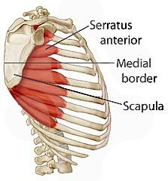
Serratus anterior
المسننة الأمامية
Serratus anterior (helpful video)
- ORIGIN: Upper eight ribs
Here the origin is from the same ribs but pectoralis minor are from their costal cartilage meaning they are not from the same ribs
if we pay attention that this is in anterior of the scapula. but the 1 rhomboid major and minor 2 levator scapula in posterior of scapula
- INSERTION: attaches to the ventral aspect ( الجزء الأمامي ) of the medial border and inferior angle of the SCAPULA
- NERVE SUPPLY: Long thoracic nerve which is also called ( nerve of bell or nerve to serratus anterior )
- ACTION:
1- Draws the scapula forward (during Protrusion ) in boxing “لما الملاكم يجي يضرب “
2- Rotates the scapula outwards ( when rising the arm above 90 degrees)
3- Keep the scapula adherent to the chest wall.

Slide 12
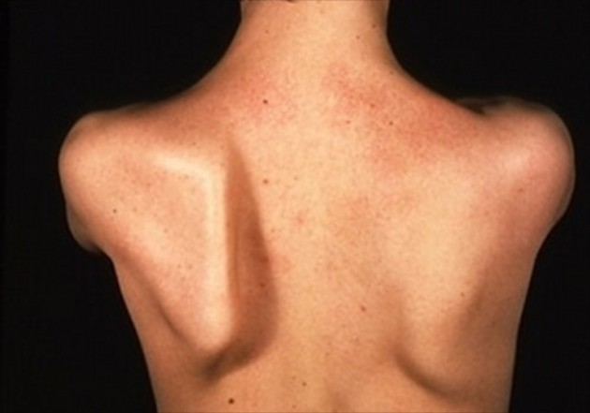
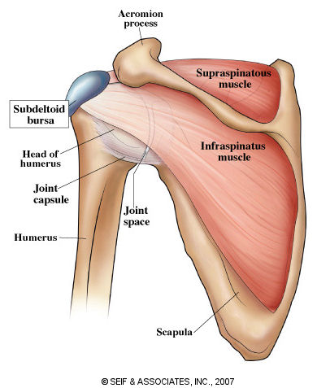
Winged Scapula
This occurs when the thoracic long nerve is injured or damaged or the serratus anterior, Due to either
1- Radical mastectomy
2- operations
3- damage to the chest
-Winging of the scapula happens when the long thoracic nerve is cut or the serratus anterior muscle is injured
The long thoracic nerve is located on the anteroLateral chest wall “usually”
Clinical appearance : Winging of the scapula “تبرز للخارج كأنها جناح “
Dr abualmakaram mentioned that they always get a question like :
Q: A Soldier was shot on the chest and the shot has effected a nerve , what might happen to him?
A:Winging of the scapula

Slide 13
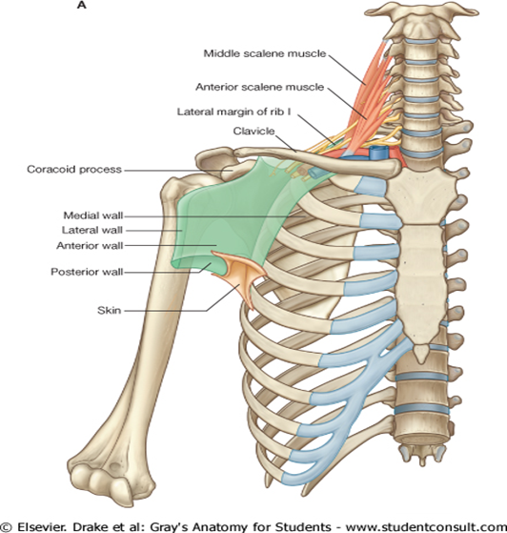
AXILLA
It is a PYRAMIDAL shaped spaced, located between the upper arm and side of the chest
*
major neurovascular structures pass between neck, thorax and upper limb, through the Axilla. (Neurovascular bundles go through the axilla to go to the upper limbs)
It has:
1- Apex “ is upward and medial”
2- Base
3- Four Walls
منطقة الإبط*

Slide 14
Boundaries of the Axilla
1- Apex:( Cervico-axillary canal):
it is Directed upwards and medially into the root of the neck ,it is bounded by 3 bones :
1- clavicle “anteriorly” ( so it can protect the neurovascular bundles of the upper limbs )
2- upper border of the scapula “posteriorly”
3- the outer border of the 1st rib “Medially”
2- Base:
Formed by skin stretching between the anterior and posterior walls.it’s bounded by:
In front by the anterior axillary fold (formed by the lower border of the Pectoralis major).
Behind by the posterior axillary fold (formed by the tendons of latissimus dorsi and teres major muscles).
Medially by upper 4 or 5 ribs and the chest wall.

Slide 15
Boundaries of the Axilla (cont..)
3-Four walls:
A) The anterior wall: it is formed by all the muscles of pectoral region except serratus anterior.
- Pectoralis major
- Pectoralis minor
- Subclavius
- Clavipectoral fascia
C)The medial wall:It is wide and formed by:
- Serratus anterior.
- Upper 4-5 ribs and Intercostal muscles .
D)The lateral wall:It is narrow and formed by:
- Coracobrachialis.(muscle)
- Biceps brachii. (muscle)
- Bicipital groove ( intertubercular groove) of the humerus.
B)The posterior wall Is formed by:
- Subscapularis.
- Latissimus dorsi.
- Teres major muscles.

Slide 16
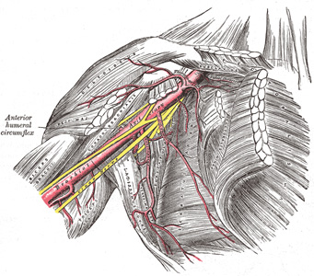
Content of the Axilla
Cords and branches of the brachial plexus.
Axillary artery and its branches.
Axillary vein and its tributaries.(1)
Axillary lymph nodes.
Axillary fat.
Loose connective tissue.
All the neurovascular(2) structure are enclosed in a connective tissue sheath, called ‘axillary sheath’
1) tributaries= branches
2) neurovascular = nerves + vessels

Slide 17
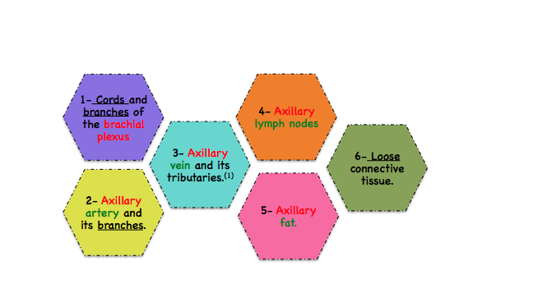
AXILLA
It is a PYRAMIDAL shaped spaced located between the upper arm and side of the chest “ الإبط”
major neurovascular structures pass between neck, thorax and upper limb, through the Axilla.
(Through the apex, the axillary vessels and their accompanying nerves pass from the neck to the arm. The axilla is bounded medially by the upper ribs and their intercostal muscles and by the serratus anterior; it is limited laterally by the intertubercular groove of the humerus)
Content of AXILLA
All the neurovascular structure are enclosed in a connective tissue sheath, called ‘axillary sheath’
Axilla (helpful video)

Slide 18
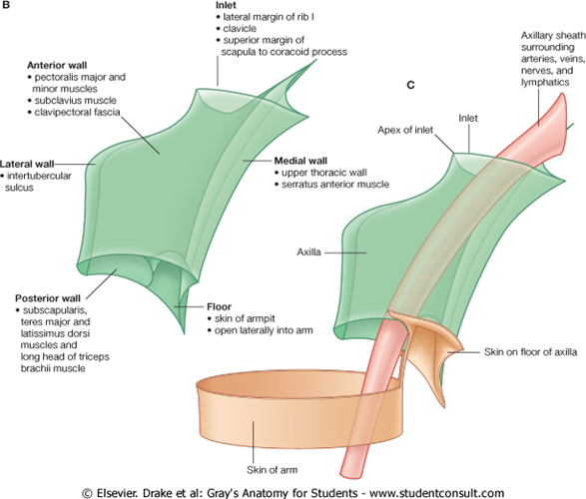
AXILLA

Slide 19
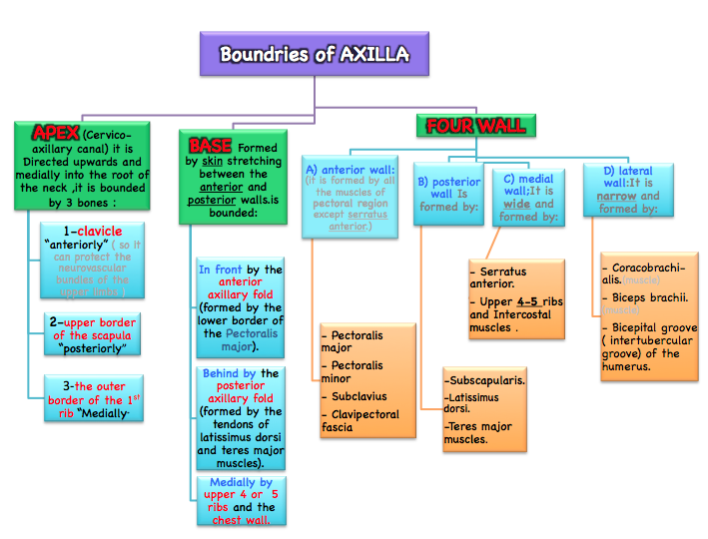

Slide 20
Brachial Plexus
- What is a brachial plexus?
- Brachial Plexus is a network of nerves that present at the root of the neck to enter the upper limb.
- the plexus can be divided into 5 stages:
- Roots: in the posterior triangle
- Trunks: in the posterior triangle
- Divisions: behind the clavicle (in cervico-axillary canal)
- Cords: in the axilla
- Branches: in the axilla
- Location and formation:
- Brachial Plexus is present in the posterior triangle of the neck & axilla.
- It is formed by the union of the anterior Rami of the C 5th, 6th, 7th & 8th and the 1st thoracicspinal nerve.
remember: spinal vertebrates of the cervical region are 7, but there are 8 spinal nerves coming out of them.

Slide 21
Brachial Plexus (cont..)
- Roots:
- Roots of C5 & C6 unite to form the upper trunk.
- Root of C7 continuous as the middle trunk
- Roots of C8 & T1 unite to form the lower trunk
- Trunks:
These roots merge to form three trunks:
- superior (C5-C6)
- middle (C7)
- inferior (C8, T1)
important :nerve supply for the long thoracic nerve is from the roots of brachial plexus,C5,6,7).
- Divisions:
Each trunk then splits in two, to form six divisions:
- anterior divisions of the upper, middle, and lower trunks
- posterior divisions of the upper, middle, and lower trunks

Slide 22
Brachial Plexus (cont..)
- Cords: (The cords are named by their position with respect to the axillary artery.)
These six divisions regroup to become the three cords:
- The posterior cord is formed from the three posterior divisions of the trunks (C5-C8,T1)
- The lateral cord is the anterior divisions from the upper and middle trunks (C5-C7)
- The medial cord is simply a continuation of the anterior division of the lower trunk (C8,T1)
- Branches:
Lateral cord (3)
-Lateral pectoral nerve.
-Musculocutaneous nerve.
-Lateral root of Median nerve
Medial cord (5)
-Medial pectoral nerve.
-Medial root of Median nerve
-Medial cutaneous n. of arm
-Medial cutaneous n. of forearm
-Ulnar nerve.
Posterior cord(5)
-Upper subscapular n.
-Lower subscapular n.
-Thoracodorsal or nerve to latissimus dorsi
-Axillary nerve.
-Radial nerve.
Mnemonics:
lateral cord: (LML)
medial cord (M U)
posterior cord (ULTRA)
4
Love My Life
Brachial plexus (helpful video)

Slide 23
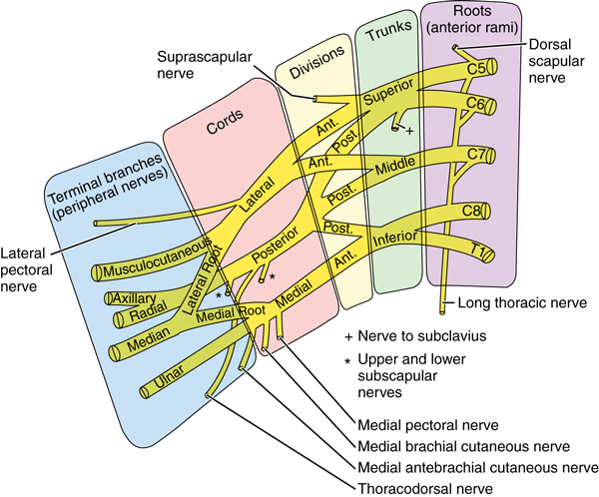
Brachial Plexus (cont..)

Slide 24
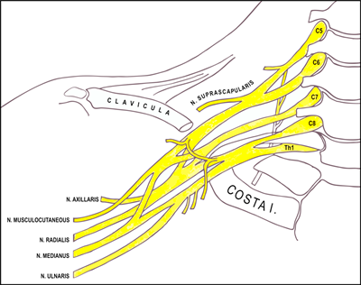
Brachial Plexus (cont..)

Slide 25
MCQ
Answers
1-c
2-d
3-a
4-c
5-b
6-c
7-c
8-d
9-b
10-a
The apex of the axilla is bounded posteriorly by?
The base of the axilla is bounded in the front by?
One of the following is a muscle of the anterior wall muscles of the axilla:
The roots of brachial plexus are from:
Which of the following is true?
1) What is the origin of pectoralis minor?
Coracoid process
Clavicular head
3rd, 4th and 5th ribs
First rib
Clavicle
Outer border of the first rib
Upper border of the scapula
C4 transverse process
2) The nerve supply of serratus anterior is?
Medial pectoral nerve
Lateral pectoral nerve
Nerve to subclavius
Nerve of bell
The lower border of pectoralis major
The tendons of latissimus dorsi
Teres major muscles
Upper 4 ribs and the chest wall
Subscapularis
Coracobrachialis
Teres major
Subclavius
3) The action of subclavius is?
Steadies the clavicle
Flexion of the shoulder
Depression of the shoulder
Medial rotation of the shoulder
Posterior rami of C5-T1 spinal nerve
Anterior rami of C5-T1 spinal nerve
Anterior rami of C3-T1 spinal nerve
Anterior rami of C1-T1 spinal nerve
4) The clavipectoral fascia is pierced by which artery?
Popliteal artery
Coracoid artery
Thoracoacromial artery
Lateral circumflex artery
All of the posterior divisions join to form the posterior cord
All of the anterior divisions join to form the lateral cord
The anterior division of the middle trunk continues to form the medial cord
The anterior division of the upper and middle trunks unite to form the medial cord
5) The nerve supply of pectoralis major is?
Nerve of bell
Medial and lateral pectoral nerves
Nerve to subclavius
Obturator nerve

