Slide 1
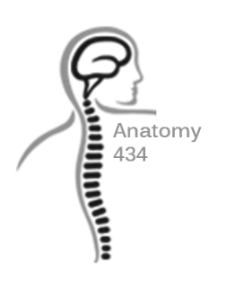
Arm and Elbow
Anatomy Team 434
Color Index:
Important Points
Helping notes
Explanation
If you have any complaint or suggestion please don’t hesitate to contact us on:
AnatomyTeam434@gmail.com

Slide 2
OBJECTIVES
Describe the attachments, actions and innervations of:
Biceps brachii
Coracobrachialis
Brachialis
Triceps brachii
Demonstrate the following features of the elbow joint:
Articulating bones
Capsule
Lateral & medial collateral ligaments
Synovial membrane
Demonstrate the movements : flexion and extension of the elbow.
List the main muscles producing the above movements.
Define the boundaries of the cubital fossa and enumerate its contents

Slide 3
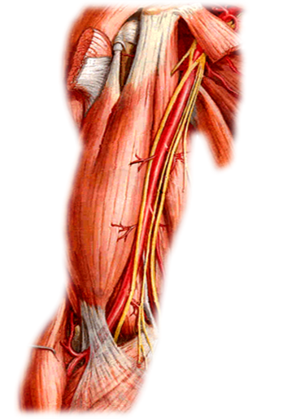
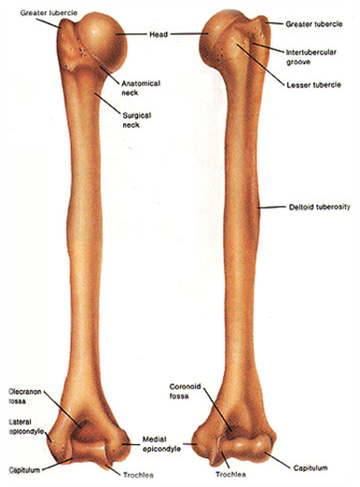
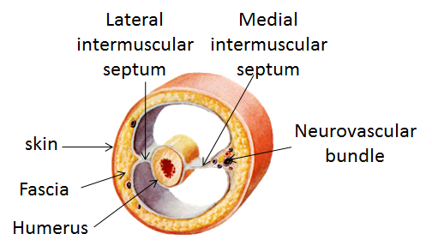
Introduction
Shoulder
Elbow
The lateral and medial intermuscular septa divide the distal part of the arm into two compartments:
-Anterior
-Posterior
Arm
Humerus
Elbow Anatomy
This video explains the whole lecture!

Slide 4
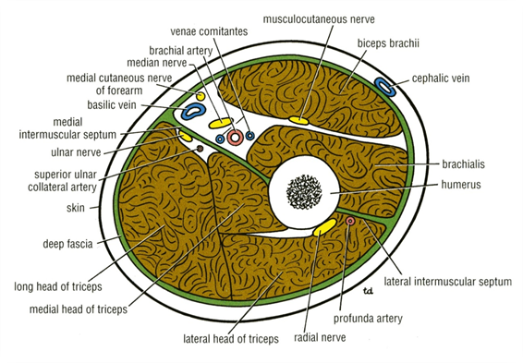
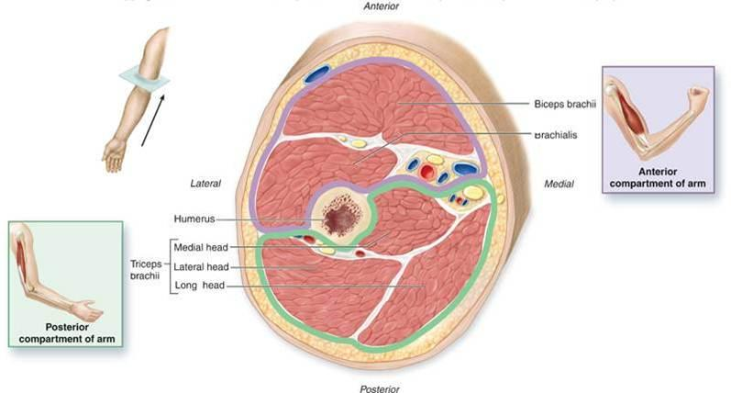
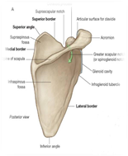
Anterior Fascial Compartment Contents
Muscles of the Anterior Compartment
Coracobrachialis
Muscles:Biceps brachii, Coracobrachialis &Brachialis.
Blood Vessels: Brachial artery & Basilic vein.
Nerves: Musculocutaneous, Median, Radial & Ulnar.
Brachialis
Bicepts trachi
important notes:
front muscles are 3 : biceps, coracobrachialis and brachialis that lies below them.
posterior compartment contains triceps muscle.

Slide 5
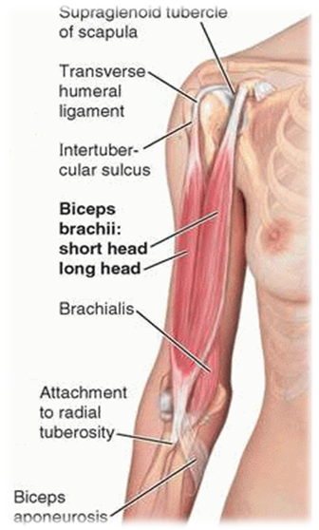
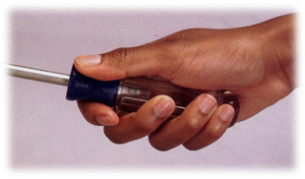
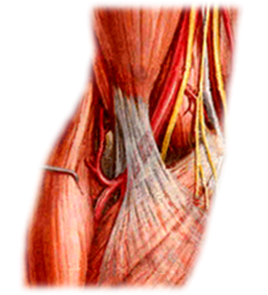
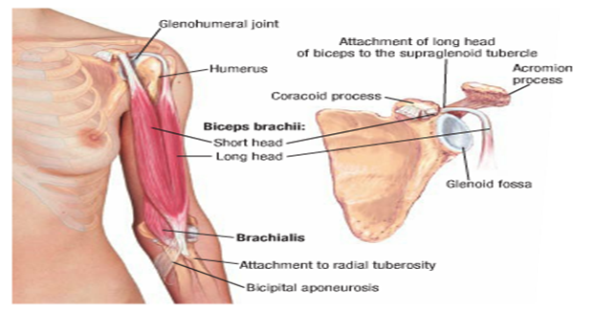
Biceps Brachii
Coracoid process
Tendon inserted to radial tuberosity
Biceps brachii
Origin: Two heads:
Long Head (lateral head) from supraglenoid tubercle of scapula (intracapsular)
Short Head from the tip of coracoid process of scapula
v The two heads join in the middle of the arm
important notes:
biceps muscle has two heads short and long (lateral)
insertion: tendon to radial tuberosity into radius + to deep fascia of forearm.
supination= lateral rotation of forearm.
Insertion:
in the posterior part of the radial tuberosity.
into the deep fascia of the medial aspect of the forearm through bicipital aponeurosis.
Nerve supply: Musculocutaneous
Action: Strong supinator of the forearm, used in screwing.
Powerful flexor of elbow
Weak flexor of shoulder

Slide 6
Biceps Brachii
Action
Strong supinator of the forearm, used in screwing.
Powerful flexor of elbow
Weak flexor of shoulder
Biceps brachii
Nerve supply
Musculocutaneous
Origin
Insertion
in the posterior part of the radial tuberosity.
into the deep fascia of the medial aspect of the forearm through bicipital aponeurosis.
Long Head
Short Head
from supraglenoid tubercle of scapula (intracapsular)
from the tip of coracoid process of scapula
The two heads join in the middle of the arm

Slide 7
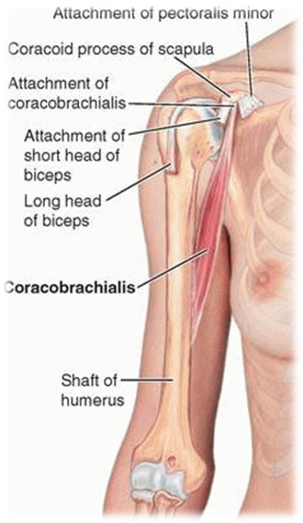
Coracobrachialis
Origin:
Tip of the coracoid process of scapula (with short head of bicepes brachii ).
Insertion:
Middle of the medial side of the shaft of the humerus
Nerve supply: Musculocutaneous
Action: Flexor & a weak adductor of the arm

Slide 8
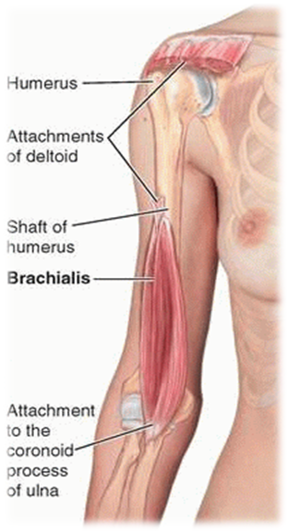
Brachialis
Origin:
Front of the lower half of humerus
Insertion:
Anterior surface of coronoid process of ulna
Action:
Strong flexor of the forearm
Nerve supply:
Musculocutaneous & Radial
important notes:
brachialis muscle has a double innervation form musculocutaneous and radial nerve.
brachialis muscle continues to ulna.

Slide 9
Coracobrachialis & Brachialis
Action
Flexor & a week adductor of the arm
Coracobrachialis
Nerve supply
Musculocutaneous
Insertion
Origin
Middle of the medial side of the shaft of the humerus
Tip of the coracoid process of scapula
Brachialis
Action
Strong flexor of the forearm
Nerve supply
Musculocutaneous & Radial
Insertion
Origin
Anterior surface of coronoid process of ulna
Front of the lower half of humerus

Slide 10
Coracobrachialis, Biceps brachii, & Brachialis
 | Biceps brachii |  | Coracobrachialis | Brachialis
Origin | Long Head | from supraglenoid tubercle of scapula (intracapsular) | Tip of the coracoid process of scapula | Front of the lower half of humerus
 | Short Head | from the tip of coracoid process of scapula
Insertion | in the posterior part of the radial tuberosity. into the deep fascia of the medial aspect of the forearm through bicipital aponeurosis. |  | Middle of the medial side of the shaft of the humerus | Anterior surface of coronoid process of ulna
Nerve supply | Musculocutaneous |  | Musculocutaneous | Musculocutaneous & Radial
Action | -Strong supinator of the forearm, used in screwing. -Powerful flexor of elbow -Weak flexor of shoulder |  | Flexor & a weak adductor of the arm | Strong flexor of the forearm

Slide 11
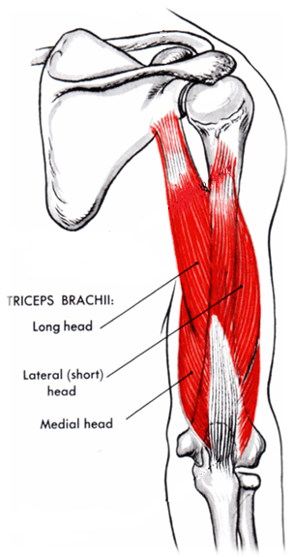
Posterior Fascial Compartment Contents
Muscles of the Posterior Compartment
Triceps brachii
Muscles: Triceps
Vessels: Profunda brachii & Ulnar collateral arteries
Nerves: Radial & Ulnar

Slide 12
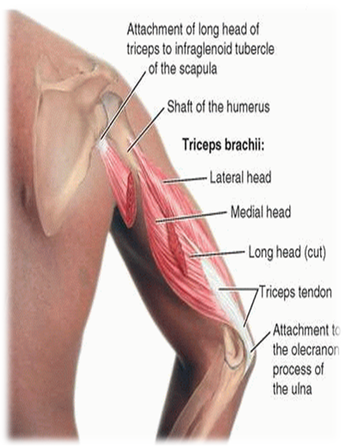
Triceps
Origin: Three heads:
Long Head from infrglenoid tubercle of the scapula
Lateral Head from the upper half of the posterior surface of the shaft of humerus above the spiral groove
Medial Head from the lower half of the posterior surface of the shaft of humerus below the spiral groove
Insertion:
Common tendon inserted into the upper surface of the olecranon process of ulna
Nerve supply:
Radial nerve
Action:
Strong extensor of the elbow joint
important notes:
supraglenoid tubercle of scapula is intracapsular (inside capsule)
long head’s origin is the infraglenoid tubercle.
lateral and medial heads origins are on posterior surface of humerus.
medial head is below radial groove in lower half .
lateral head is above radial groove in upper half.

Slide 13
Triceps
Action
Strong extensor of the elbow joint
Triceps
Nerve supply
Radial nerve
Origin
Insertion
Common tendon inserted into the upper surface of the olecranon process of ulna
Medial Head
Lateral Head
from the lower half of the posterior surface of the shaft of humerus below the spiral groove
Long Head
from the upper half of the posterior surface of the shaft of humerus above the spiral groove
from infraglenoid tubercle of the scapula

Slide 14
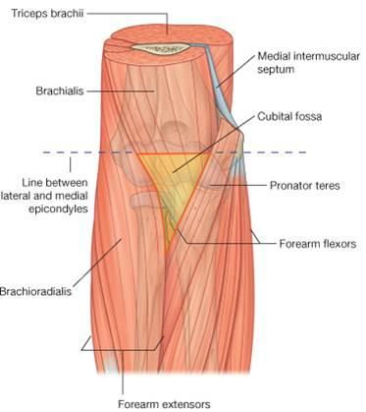
Cubital Fossa
Boundaries of Cubital Fossa
Content of Cubital Fossa
The Cubital fossa is a triangular depression on the anterior
aspect of the elbow.
Cubital fossa has three boundries
Boundaries of Cubital fossa
Base: line through
the two epicondyles of humerus
Laterally : barachioadilis
Medially: Pronator Teres
# Roof: Skin, superficial & deep fascia and bicipital aponeurosis
# Floor: Brachialis medially and supinator laterally
important notes:
brachial artery passes through cubital fossa ( that’s why we can measure blood pressure at cubital fossa)
base is line between epicondyles.

Slide 15
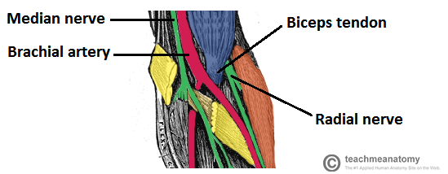
Cubital Fossa
Content of Cubital Fossa
1. Median nerve.
2. Brachial artery divides into radial & ulnar arteries.
3. Biceps brachii tendon.
4. Deep branch of radial nerve.

Slide 16
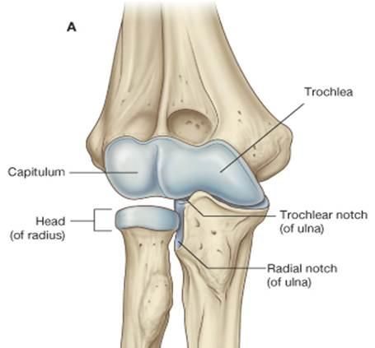
Elbow Joint
Elbow joint is sorted as Synovial Hinge joint .
The articular surfaces are covered by Hyaline cartilage.
# Articulations:
1- Trochlea and capitulum of the humerus (Above)
2- Trochlea notch of ulna and the head of radius (Below)
important notes:
dislocation of elbow joint= posterior displacement of olecranon process from trochlea.
dislocations occur mainly in children because their bones are less developed.
avulsion=separation

Slide 17
Capsule
 | Anteriorly | Posteriorly
Above | To the upper margins of the coronoid and radial fossae, And to the front of the epicondyles “medial and lateral”. | To the margins of the olecranon fossa of the humerus
Below | To the margin of the coronoid process of the Ulna and to the anular ligament (surround head of the Radius) | the upper margin and sides of the olecranon process of the ulna and to the annular ligament
important notes:
behind medial epicondyle is ulnar nerve which is related directly to bone.
the ulnar nerve is the largest unprotected nerve.
anterior ligament limits extension.

Slide 18
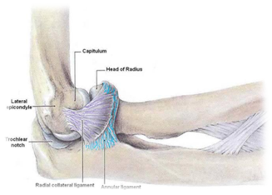
Ligaments ( Lateral and Medial )
Features of the Lateral (Radial Collateral) Ligament:
1- Triangular in shape
2- Apex attached to lateral epicondyle of Humerus.
3- Base attached to the upper margin of annular ligament.
important notes:
annular ligament is around the head of radius and it connects radius with ulna.
lateral ligament is triangular in shape.
base is attached to annular ligament.
medial ligament is very strong.
ligament helps stability of joint.
medial ligament is strong because of the anterior band.

Slide 19
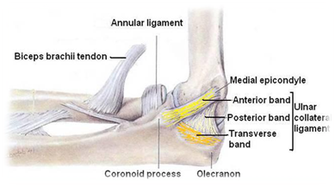
Medial (Ulnar Collateral) Ligament composed of three bands :
1- Anterior strong cord-like band:
Between medial epicondyle and the coronoid process of ulna.
2- Posterior weaker fan-like band:
Between medial epicondyle and the olecranon process of ulna
3- Transverse band:
Passes between the anterior and posterior bands.

Slide 20
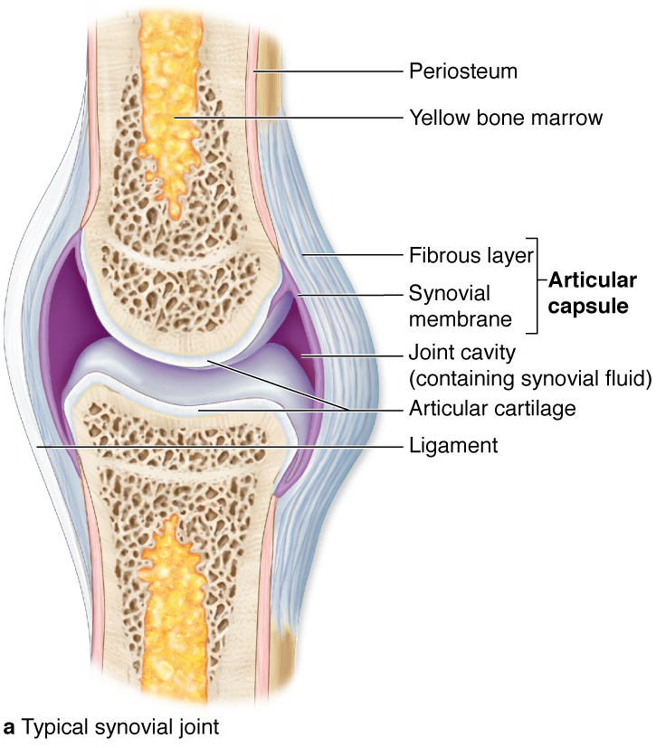
Synovial Membrane
Synovial Membrane does two functions :
1- lines the capsule.
2- covers the fatty acids pads in the floors of
the coronoid,radial, and olecranon fossae.
# Is continuous below with synovial membrane of the
superior radio-ulnar joint.
important notes:
henge= movement around axis only.
articular surfaces are covered by hyaline cartilages.
capsule above humerus.
synovial membrane of elbow continues down
bursa=sac
bursa= synovial membrane

Slide 21
Relations & Movement
Relations:
1- Anterior: Brachialis, tendon of biceps, median nerve and brachialartery.
2- Posterior: Triceps muscle and Small bursa intervening.
3- Lateral: common extensor tendon and The supinator.
4- Medial: Ulnar nerve.
The joint is supplied by branches from the median,
ulnar, musculocutaneous, and radial nerves.
Movement:
Flexion | Extension
is limited by the anterior surfaces of the forearm and arm coming into contact. | is limited by the tension of the anterior ligament and brachialis muscle.

Slide 22
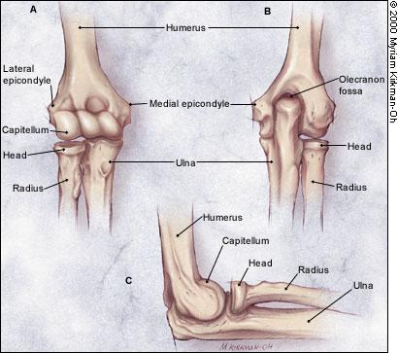
Carrying Angle
Articulation & Applied Anatomy
# Carrying angle is the angle between the long axis of the extended forearm and the long axis of the arm.
# it opens laterally.
# it is 170 degrees in male and 167 degrees in females.
# it disappears when the elbow joint is flexed.
# it allows The forearms to clear the hips in swinging movements during walking
and is important when carrying objects.
important notes:
the carrying angle opens laterally.
male’s angle is larger than females’
angle disappears with flexion.

Slide 23
MCQ
1- Which of the following is presenting in the anterior fascial compartment: A- Musculocutaneous nerve. B- Ulnar nerve. C- Axillary nerve. D- Radial nerve. 2- When the coracoid process has fractured, which muscle may affected: A- Pectoralis major. B- coracobrachialis. C- brachialis. D- None of the above. 3- Which of these muscles related to anterior fascial compartment is supplied by radial nerve: A- Biceps brachii. B- coracobrachialis. C- Triceps D- Brachialis.
4- Muscle that Origin from the posterior surface of the humerus below the spiral groove: A- Medial head of triceps. B- Long head of triceps. C- Lateral head of triceps. D- B and C 5- lateral boundary of the cubital fossa: A- Pronator teres. B- Two epicondyles of humerus. C- Brachioradialis. D- Brachialis. 6- Which of these content of cubital fossa of you cut it, you will lost abduction of thumb? A- Ulnar artery. B- Median nerve. C- Ulnar nerve. D- Radial artery.
7- Which of these joint is bounded three bones together: A- Elbow joint. B- Knee joint.
C- Wrist joint. D- Shoulder joint.
8- The articular surface of elbow joint is covered with: A- Elastic cartilage. B- Hyaline cartilage. C- Fibrocartilage. D- Both B and C. 9- The capsule attached to the margins of the of the coronoid process of the ulna from: A- Anteriorly above. B- Posteriorly above. C- Anteriorly below. D- Posteriorly below. 10- Which band of the ulnar collateral ligaments is strong cord-like band: A- Anterior band. B- Posterior band. C- Transverse band. D- Annular ligament.
11- Which nerves is considered the largest unprotected nerve in the body: A- Median nerve. B- Radial nerve. C- Axillary nerve. D- Ulnar nerve.
8-B 9-C 10-A 11-D
4-A 5-C 6-B 7-A
1-A 2-B 3-D

Slide 24
