Slide 1
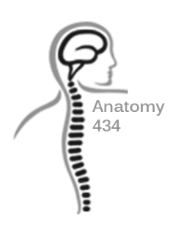
Axillary and Median Nerve
Anatomy Team 434
Color Index:
Important Points
Helping notes
Explanation
If you have any complaint or suggestion please don’t hesitate to contact us on:
AnatomyTeam434@gmail.com

Slide 2
OBJECTIVES
•Describe the origin, course, relations, branches and distribution of the axillary & median nerves
•Describe the common causes and effects of injury to the axillary and an median nerves

Slide 3
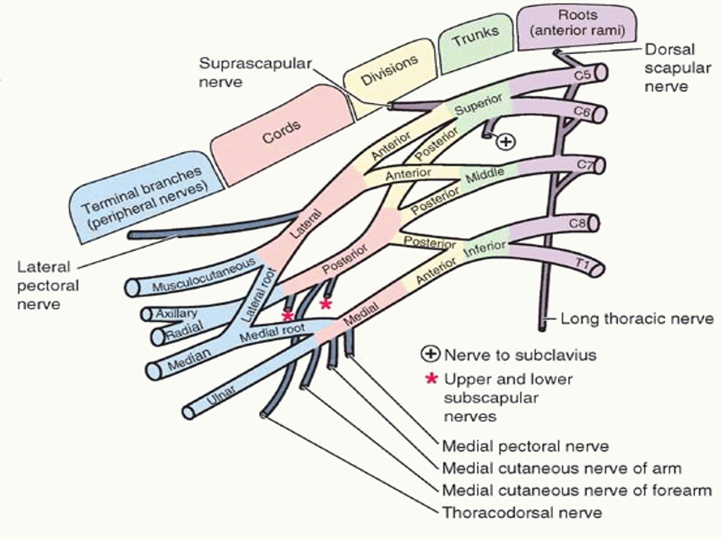
Brachial plexus
http://www.youtube.com/watch?v=fk1hyToHSC4
http://www.youtube.com/watch?v=1O790dApog4
as known by now both Axillary Nerve and median nerves come from brachial plexus which the collection and branching of spinal nerves C5-T1.
whenever you hear Posterior cord think of the word STARS
Subscapular (upper)
Thoracodorsal
Axillary
Radial
Subscapular (lower)
two S refers to( upper &l ower ) subscapular

Slide 4
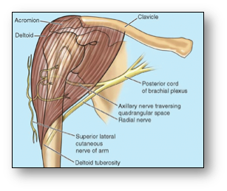
Axillary Nerve
Axillary Nerve
Origin: (C 5 & 6).
The Axillary nerve originates from the posterior cord of the brachial plexus
Course:
It passes inferiorly and laterally along the posterior wall of the axilla to exit
Then, it passes posteriorly around the surgical neck of the humerus.
It is accompanied by the posterior circumflex humeral artery.
Motor to the deltoid and teres minor muscles.
Branches:
Sensory superior lateral cutaneous nerve of arm that loops around the posterior margin of the deltoid muscle to innervate skin in that region.

Slide 5
Axillary Nerve Lesion
The axillary nerve is usually injured due to:
1.Fracture of surgical neck of the humerus.
2.Downward dislocation of the shoulder joint
3.Compression. from the incorrect use of crutches.
Effects Of Axillary Nerve Lesion .
Motor:
Paralysis of the deltoid and teres minor muscles.
Impaired abduction of the shoulder (30-90˚).
The paralyzed deltoid wastes rapidly.
As the deltoid atrophies, the rounded contour of the shoulder is flattened compared to the uninjured side.
Sensory:
Loss of sensation over the lateral side of the proximal part of the arm.
When the axillary is injured it might not be able to function

Slide 6
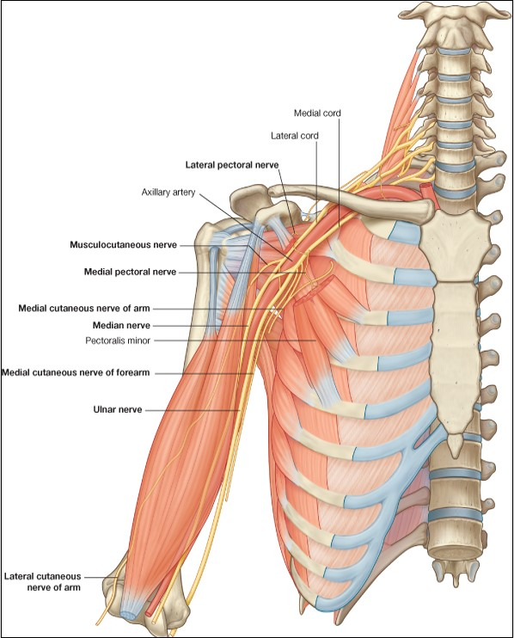
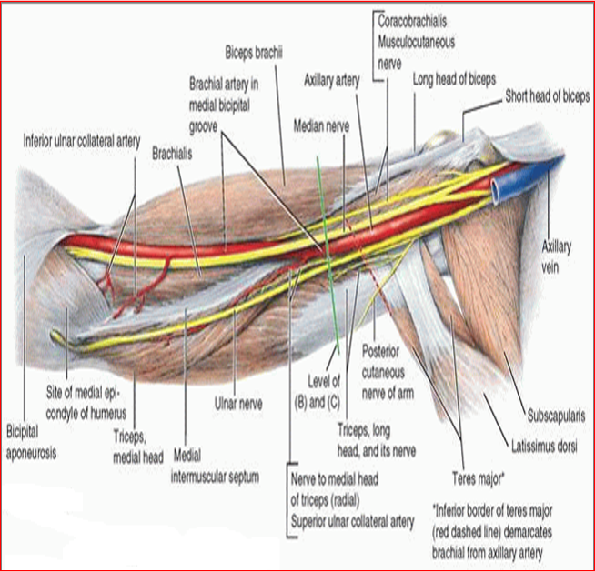
Median Nerve
Median Nerve in the Arm
Highly recommended video
>>>> Median Nerve
origin:(C5,6,7, 8, T1) basically all the ones of Brachial plexus.
The median nerve is formed anterior to the third part of the axillary artery by the union of lateral and medial roots originating from the lateral and medial cords of the brachial plexus.
The median nerve is lateral to the 3rd part of the axillary artery
It enters the arm from the axilla at the inferior margin of the teres major muscle.
It passes vertically down the medial side of the arm in the anterior compartment and is related to the brachial artery
throughout its course:
in proximal regions it lies immediately lateral to the brachial artery.
in more distal regions it crosses to the medial side of the brachial artery and lies anterior to the elbow joint.
has no major branches in the arm but a branch to one of the muscles of the forearm, the (Pronator Teres) this branch may originate from the nerve immediately proximal to the elbow joint.

Slide 7
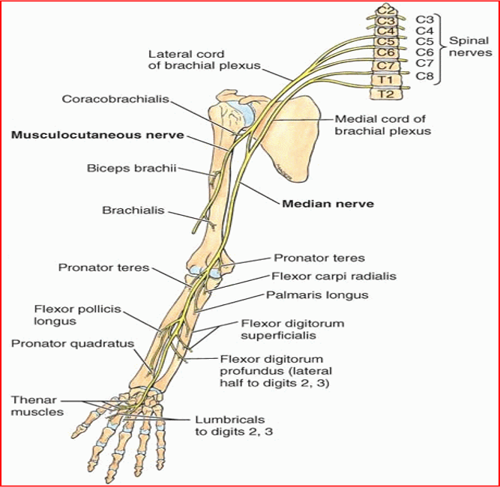
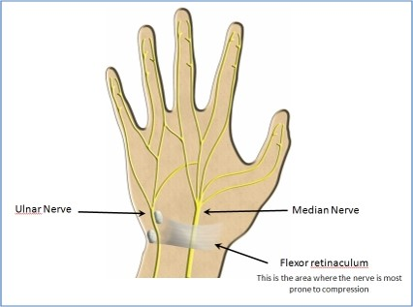
Median Nerve in the Forearm
Median Nerve in the Hand
Median nerve passes into the forearm anterior to elbow joint, where it innervates most of the muscles in the anterior compartment of the forearm Except for the Flexor Carpi Ulnaris and the medial half of the Flexor Digitorum Profundus, which are innervated by the ulnar nerve. (one and a half)
The hand is supplied fairly by three nerves : (Medial, Ulnar, Radial)
The median nerve continues into the hand by passing deep to the flexor retinaculum.
It innervates:
Three thenar muscles associated with the thumb
Lateral 2 lumbrical muscles associated with movement of the index and middle fingers; and Skin over the palmar surface of the lateral three and one-half digits and over the lateral side of the palm and middle of the wrist.

Slide 8
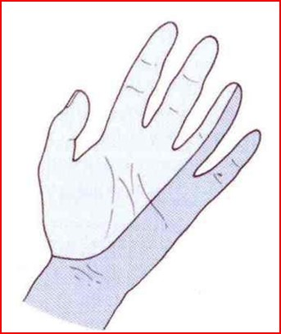
Median Nerve Lesions
Median Nerve Lesion in the Elbow Region
Injury of median nerve at different levels cause different syndromes:
Median nerve can be damaged in:. elbow region . At the wrist above the flexor retinaculum . In the carpal tunnel
The most serious disability of median nerve injuries is the:
Loss of opposition of the thumb: The delicate pincer-like action is not possible
Loss of sensation :from the thumb and lateral 2½ fingers & lateral ⅔ of the palm
median nerve is usually not injured by trauma in :
arm because of its relatively
forearm deep position.
Damaged in supracondylar fracture of humerus Muscles affected are: Pronator muscles of the forearm
All long flexors of the wrist and fingers except flexor carpi ulnaris and medial half of flexor digitorum profundus
Motor Effects: Loss of pronation Hand is kept in supine position Wrist shows weak flexion, and ulnar deviation Loss of flexion on the interphalangeal joints of the index and middle fingers Weak flexion of ring and little fingers Thumb is adducted and laterally rotated, with loss of flexion of terminal phalanx and loss of opposition
Wasting of thenar eminence
Hand looks flattened and “apelike”, and presents an inability to flex the three most radial digits when asked to make a fist.
Sensory Effects: Loss of sensation from: The radial side of the palm Palmer aspect of the lateral 3½ fingers Distal part of the dorsal surface of the lateral 3½ fingers Trophic Changes:Dry and scaly skin ,Easily cracking nails ,Atrophy of the pulp of the fingers.

Slide 9
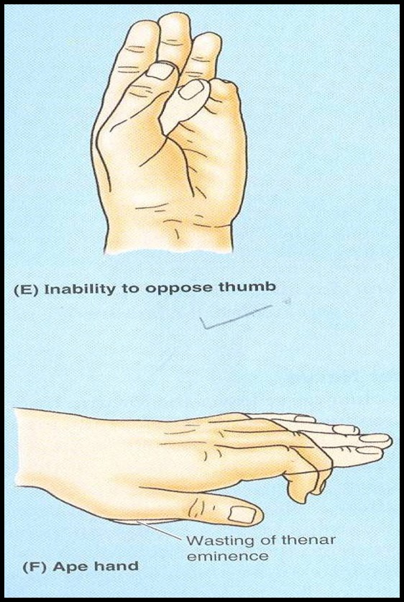
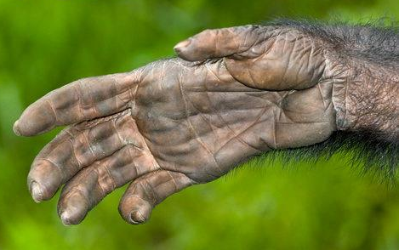
Median Nerve Lesion at the Wrist
Often injured by penetrating wounds (stab wounds or broken glass) of the forearm
Motor:Thenar muscles are paralyzed and atrophy in time so that the thenar eminence becomes flattened
Opposition and abduction of thumb are lost, and thumb and lateral two fingers are arrested in adduction and hyperextension position. “Apelike hand”
Sensory & trophic changes are the same as in the elbow region injuries

Slide 10
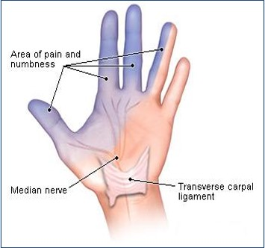
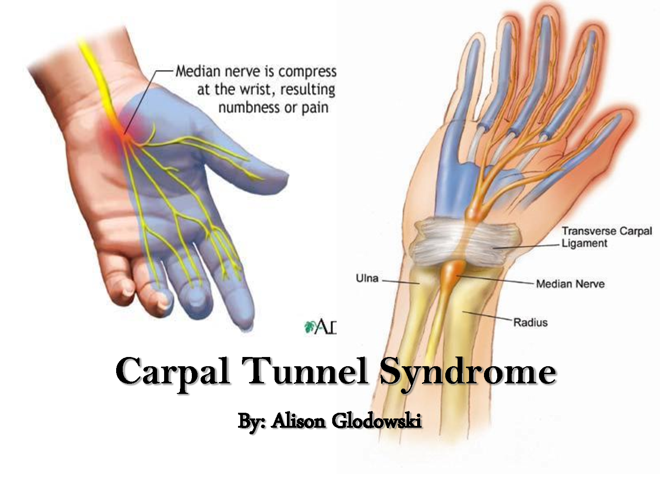
Carpal Tunnel Syndrome
The commonest neurological problem associated with the median nerve is compression beneath the flexor retinaculum at the wrist
Sensory: Burning pain or ‘pins and needles’ along the distribution of median nerve to lateral 3½ fingers
No sensory changes over the palm as the palmer cutaneous branch is given before the median nerve enters the carpal tunnel
Motor: Weak motor function of thumb, index & middle fingers

Slide 11
MCQ
Q1: Which of the following muscles is innervated by the axillary nerve?
a- pectoralis minor b- teres minor c-triceps d-trapezius
Q2: The nerve that has NO branches in the arm is?
a-axillary nerve b-ulnar nerve c-median nerve d-musculocutaneous nerve
Q3: The lateral half of the flexor digitorum profundus is innervated by?
a-axillary nerve b-median nerve c-ulnar nerve d-radial nerve
Q4: Incorrect use of crutches causes injury to?
a-ulnar nerve b-median nerve c-radial nerve d-axillary nerve
Q5:Loss of sensation in the radial side of the palm is related to an injury in ?
a- radial nerve b-ulnar nerve, c-median nerve, d-musculocutaneous nerve
1-b
2-c
3-b
4-d
5-c

Slide 12
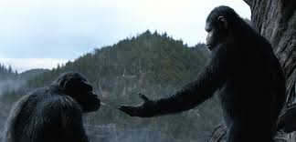
REMEMBER
THERE IS NO BETTER WAY TO THANK GOD FOR . YOUR SIGHT THAN BY GIVING A HELPING HAND TO . .SOME ONE IN THE DARK

