Slide 1
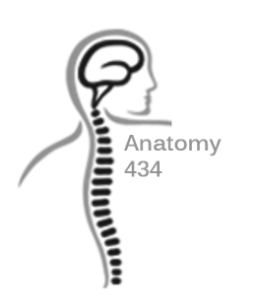
Muscles of the Lower Limb
"Revision"
Anatomy Team 434
Color Index:
Important Points
Helping notes
Explanation
If you have any complaint or suggestion please don’t hesitate to contact us on:
AnatomyTeam434@gmail.com

Slide 2
Muscles of gluteal (SUPERFICIAL) region
Muscle | ORIGIN | INSERTION | ACTION | NERVE
Gluteus Maximus | Back of sacrum, coccyx & Sacrotuberous ligament | iliotibial tract & Gluteal tuberosity | -Extension & Lateral rotation of hip joint -Stabilizing femur on tibia through iliotibial tract | Inf. Gluteal nerve
Gluteus Medius | Mid. Part of Gluteal surface of ileum | Lateral greater trochanter | -Abduction & medial rotation of hip joint -Prevent tilt of pelvis | Sup. Gluteal nerve
Gluteus Minimus | Ant. Part of Gluteal surface of ileum | Ant. Part of greater trochanter

Slide 3
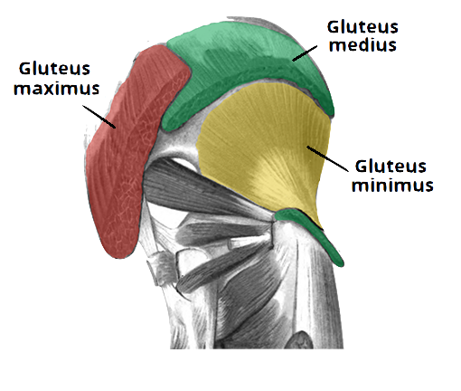
Muscles of gluteal (SUPERFICIAL) region
All the pictures are taken from [ http://teachmeanatomy.info/ ] ..

Slide 4
Muscles of gluteal (DEEP) region
Muscle | ORIGIN | INSERTION | ACTION | NERVE
Piriformis | Pelvic surface of Mid. 3 sacral vertebrae | Upper border of the greater trochanter | Lateral Rotation of Hip joint | Anterior rami of S1, S2
Obturator Internus | Inner surface of the sidewall of the pelvis | Mid. surface of the greater trochanter |  | Nerve to obturator internus
Superior Gemelli | Upper part of lesser sciatic notch | Upper & lower parts into tendon of obturator internus
Quadratus Femoris | Lateral border of the ischial tuberosity | Quadrate tubercle & intertrochanteric crest |  | Nerve to Quadratus Femoris
Inferior Gemelli | Lesser part of lesser sciatic notch | Upper & lower parts into tendon of obturator internus

Slide 5
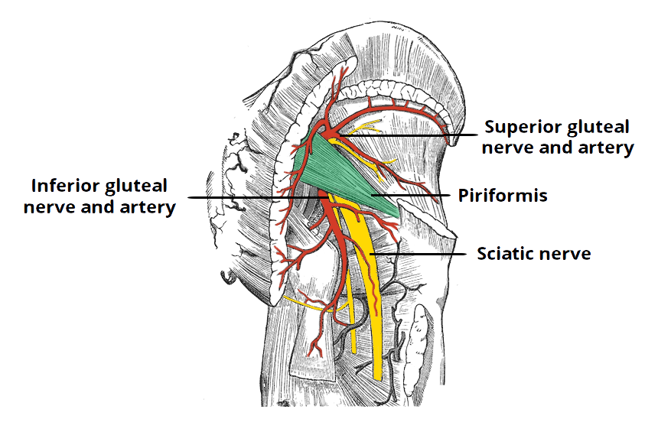
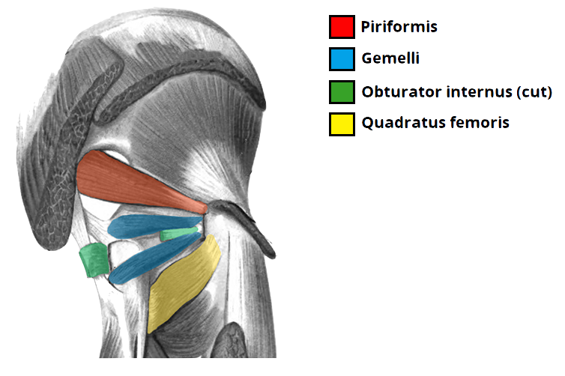
Muscles of gluteal (DEEP) region
All the pictures are taken from [ http://teachmeanatomy.info/ ] ..

Slide 6
Muscles of thigh (HAMSTRING) region
Muscle | ORIGIN | INSERTION | ACTION | NERVE
Biceps Femoris | - The long head from the ischial tuberosity - The short head from the linea aspera | Head of the fibula | -Flexion of the knee -Lateral Rotation of flexed leg *Long Head: Extension of hip | -The long head is supplied by the tibial part of the sciatic -The short head is supplied by the common peroneal part of the sciatic
Semitendinosus | Ischial tuberosity | Medial surface of tibia > SGS | -Flexion&medial rotation of the leg at knee joint -Exten. Of hip joint | Tibial portion of sciatic nerve
Semimembranosus |  | Medial condyle of tibia | -It forms the Oblique Popliteal ligament -Flexion & medial rotation of the leg at knee joint -Exten. Of hip joint
Ischial part of Adductor Magnus |  | Adductor tubercle of the medial condyle of the femur | Exten. Of hip joint

Slide 7
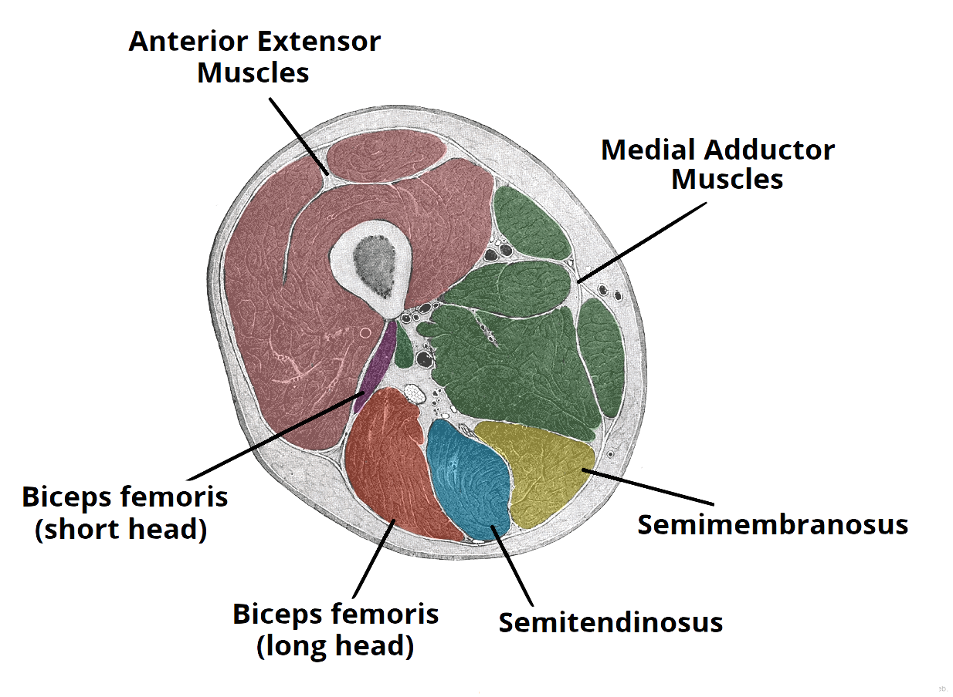
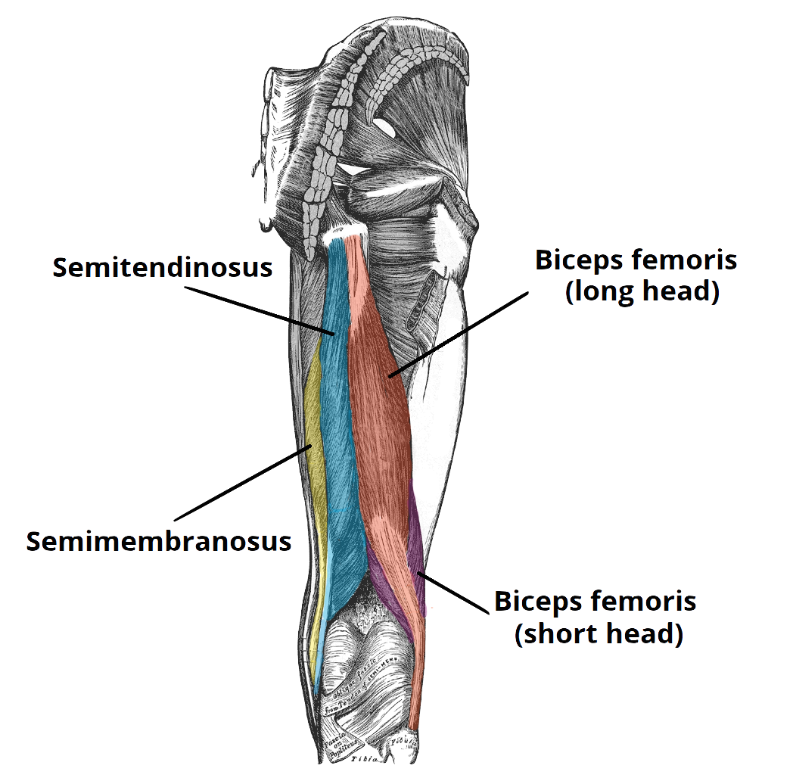
Muscles of thigh (HAMSTRING) region
All the pictures are taken from [ http://teachmeanatomy.info/ ] ..

Slide 8
Muscles of thigh (ANTERIOR) region
Muscle | ORIGIN | INSERTION | ACTION | NERVE
Sartorius | Anterior superior iliac spine | Medial surface of tibia | -Flexion, abduction & lateral rotation of hip joint -Flexion of knee joint | Femoral nerve
Pectineus | Sup. Pubic ramus | Back of femur | Flexion & Adduction of hip joint
Iliacus | Iliac fossa | Lesser trochanter | Flexion of hip joint
Psoas major | T12 & lumbar vertebrae
Quadriceps Femoris | -Rectus Femoris: Ant. Inf. Iliac spine -Vastus Medialis + Vastus Lateralis: Posterior border of femur -Vastus intermedialis: Front shaft of femur | -Patella -From patella to tibial tuberosity through ligamentum patellae | Extension of knee joint

Slide 9
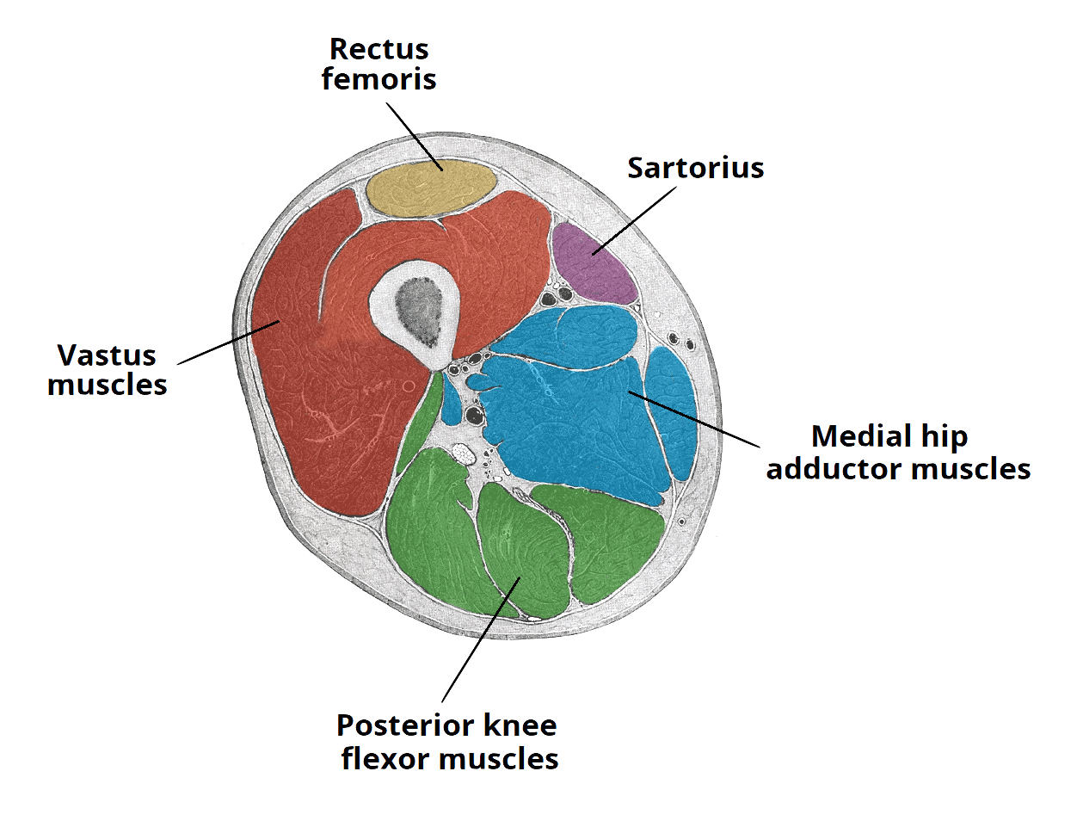
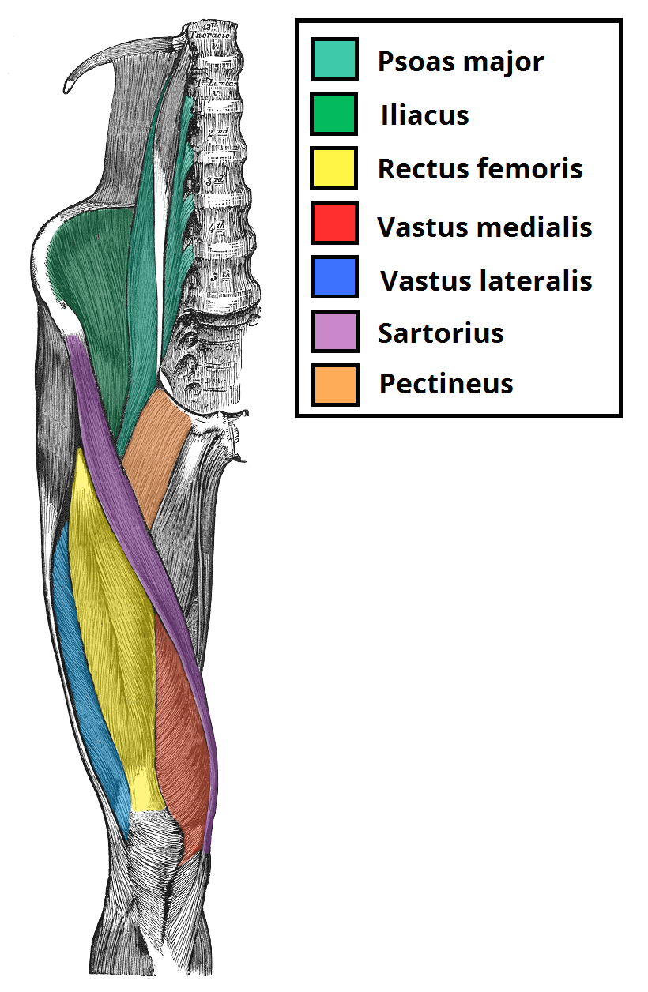
Muscles of thigh (ANTERIOR) region
All the pictures are taken from [ http://teachmeanatomy.info/ ] ..

Slide 10
Muscles of thigh (ADDUCTOR) region
Muscle | ORIGIN | INSERTION | ACTION | NERVE
Adductor Longus | Body of pubis | Linea aspera | Adduction of hip joint | Obturator nerve
Adductor Brevis | Body of pubis & inferior ramus
Adductor Magnus | Inferior pubic ramus & ischial ramus
Gracilis |  | Mid. Surface of tibia | Adduction of hip joint & flexion of knee joint

Slide 11
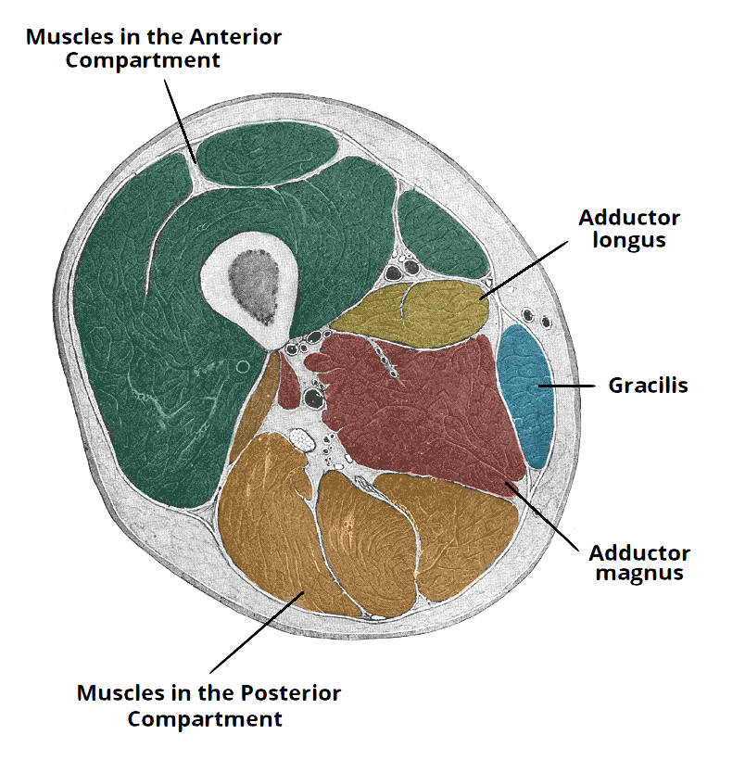
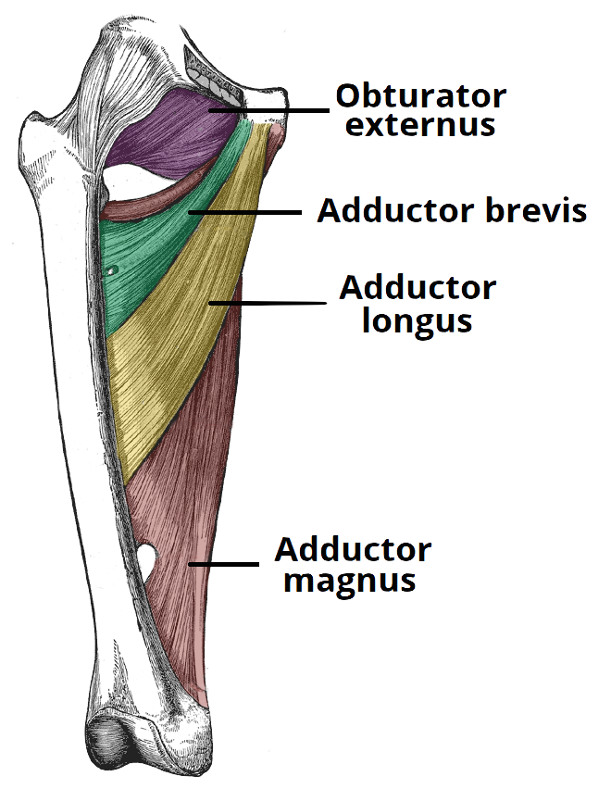
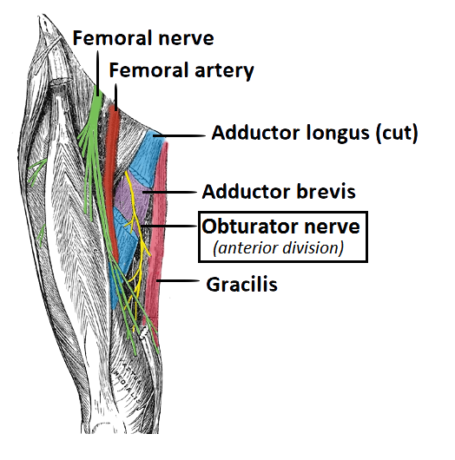
Muscles of thigh (ADDUCTOR) region
All the pictures are taken from [ http://teachmeanatomy.info/ ] ..

Slide 12
Muscles of Posterior Compartment of the leg (SUPERFICIAL)
Muscle | ORIGIN | INSERTION | ACTION | NERVE
Gastrocnemius | -Lateral head lateral condyle of femur -Medial head above medial condyle | Post. Surface of calcaneus via. Tendocalcaneus | Plantar flexion at ankle joint Flexion knee joint | Tibial portion of sciatic nerve
Soleus | Shaft of tibia & fibula |  | Powerful plantar flexor of ankle joint; provides main propulsive force in walking and running
Plantaris | Lateral ridge of femur | Posterior surface of calcaneus | Plantar flexes foot at ankle joint; flexes knee joint

Slide 13
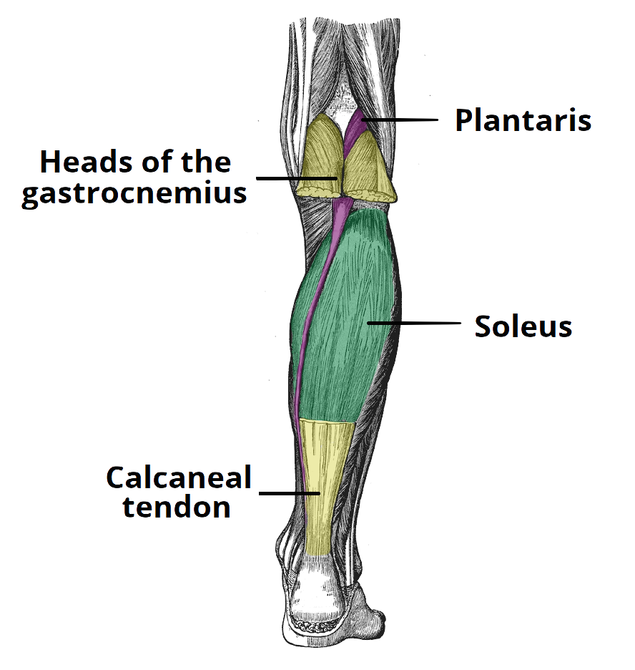
Muscles of Posterior Compartment of the leg (SUPERFICIAL)
All the pictures are taken from [ http://teachmeanatomy.info/ ] ..

Slide 14
Muscles of Posterior Compartment of the leg (DEEP)
Muscle | ORIGIN | INSERTION | ACTION | NERVE
Popliteus | Lateral surface of lateral condyle of femur (intracapsular) | Post. Surface of shaft of tibia (above soleal line) | Flexion of leg at knee joint & unlocking the joint by lateral rotation of femur on tibia | Tibial portion of sciatic nerve
Flexor digi. longus | Post. Surface of shaft of tibia | Base of distal phalanx of lateral 4 toes | -Flexes distal phalanges of lateral four toes; -plantar Flexes foot at ankle joint; -Supports medial and lateral longitudinal arches
Flexor hallucis longus | Post. Surface of shaft of fibula | Base of distal phalanx of big toe | -Flexion of big toe -Plantar flexion at ankle joint -Support medial longitudinal arch
Tibialis post. | Post. Surface of tibia & fibula & interosseous memb | Navicular tuberosity and neighboring bones | -Plantar flexion at ankle joint -Invert foot at subtalar & transverse tarsal joints -Support medial longitudinal arch

Slide 15
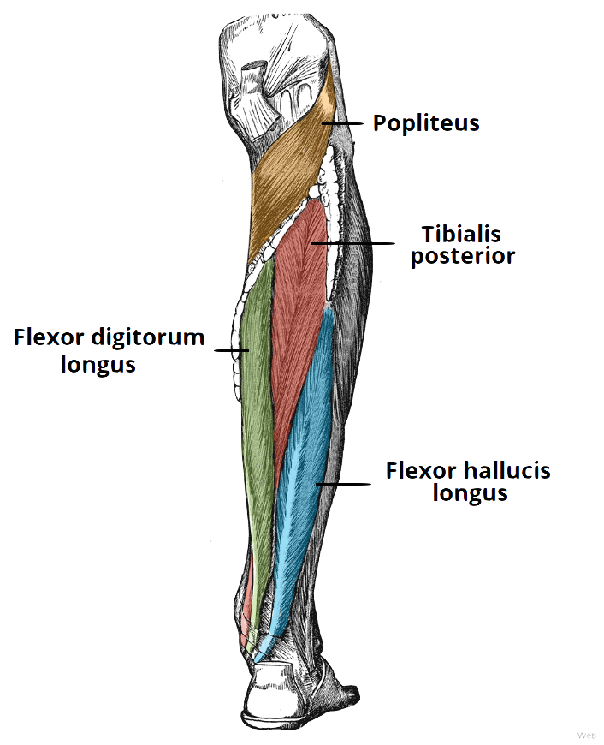
Muscles of Posterior Compartment of the leg (DEEP)
All the pictures are taken from [ http://teachmeanatomy.info/ ] ..

Slide 16
Muscles of Anterior Compartment of the leg
Muscle | ORIGIN | INSERTION | ACTION | NERVE
Tibialis Ant. | Lateral surface of shaft of tibia & interosseous membrane | Medial cuneiform & base of 1st metatarsal | -Extension at ankle joint -Inverts foot -Holds medial long. Arch | Deep peroneal nerve
Extensor digi. longus | Ant. Surface of shaft of fibula | Extensor expansion of 4 lateral toes | -Extension of toes -Dorsi flexion at ankle joint
Peroneus Tertius |  | Base of 5th metatarsal | -Dorsi flexion at ankle joint -Everts foot
Extensor hallucis long. |  | Base of distal phalanx of big toe | -Dorsi flexion of ankle -Extends big toe -Inverts foot

Slide 17
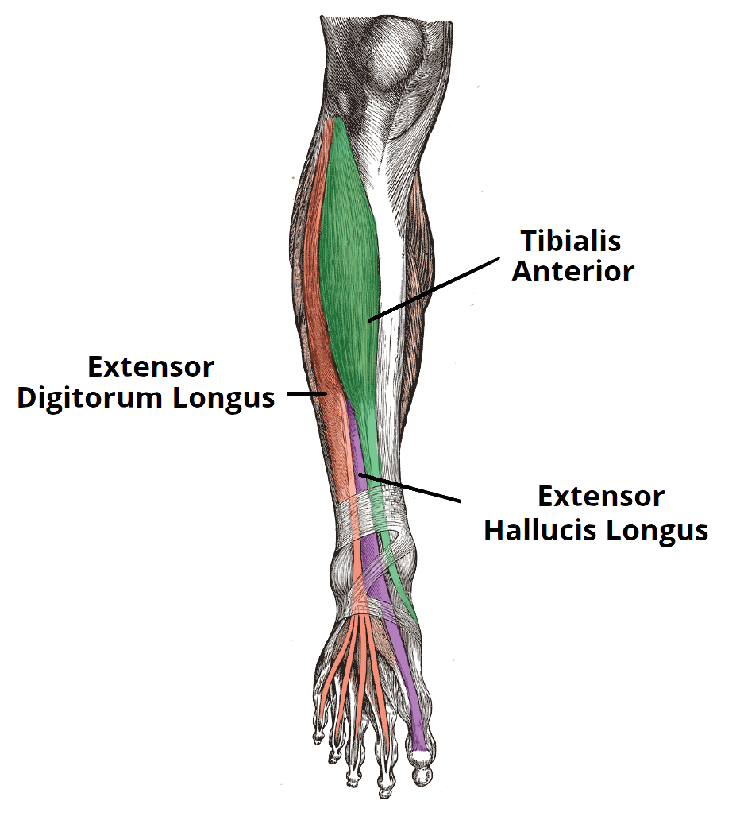
Muscles of Anterior Compartment of the leg
All the pictures are taken from [ http://teachmeanatomy.info/ ] ..

Slide 18
Muscles of Lateral Compartment of the leg
Muscle | ORIGIN | INSERTION | ACTION | NERVE
Peroneus Long. | Lateral surface of shaft of fibula | Medial cuneiform & base of 1st metatarsal | -Plantar flexion -Everts foot -Support lateral long. & Transverse arches | Superficial peroneal nerve
Peroneus Brevis |  | Base of 5th metatarsal | -Plantar flexion -Everts foot -Support lateral long arch

Slide 19
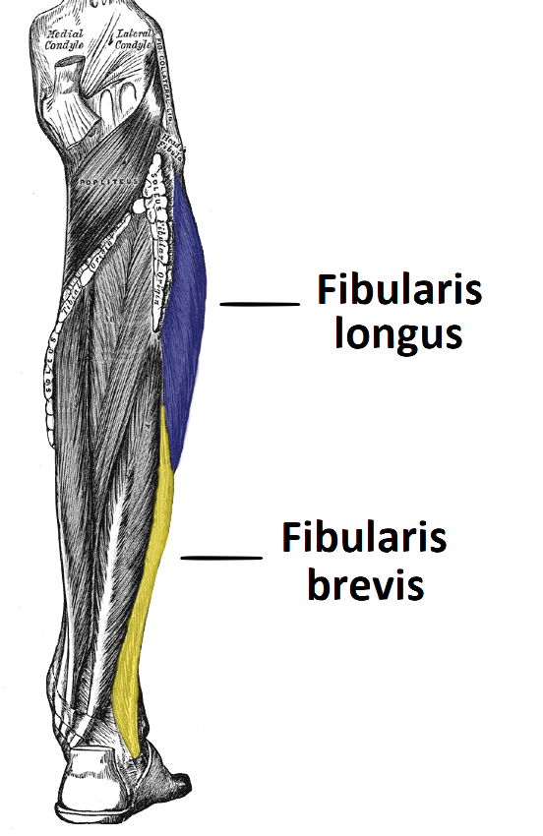
Muscles of Lateral Compartment of the leg
(Peroneus Longus)
(Peroneus Brevis)
All the pictures are taken from [ http://teachmeanatomy.info/ ] ..

Slide 20
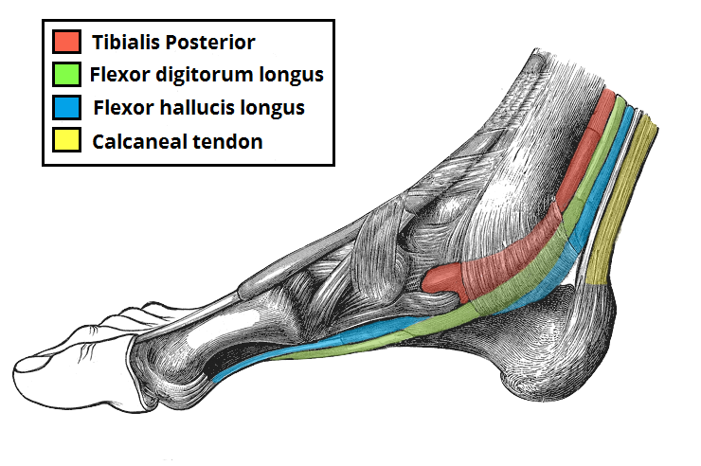
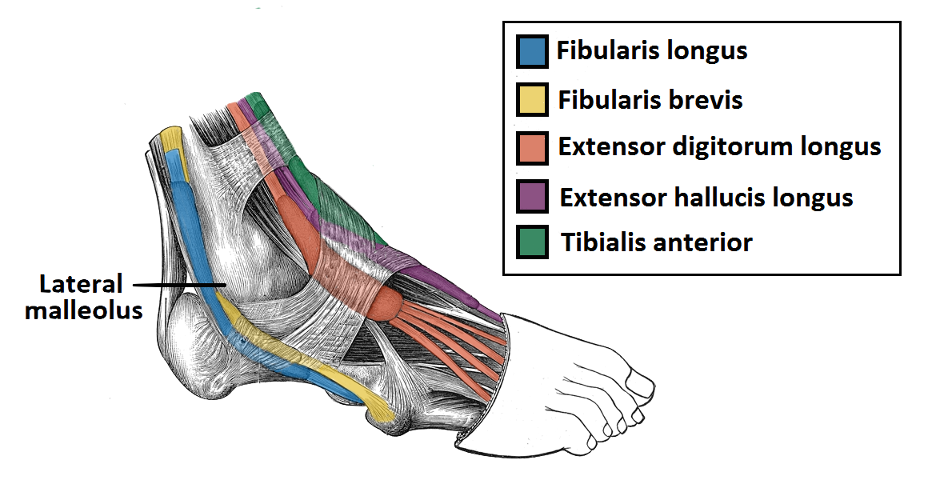
Continuation of the Tendons of Leg Muscles
(Peroneus Longus)
(Peroneus Brevis)
All the pictures are taken from [ http://teachmeanatomy.info/ ] ..

Slide 21
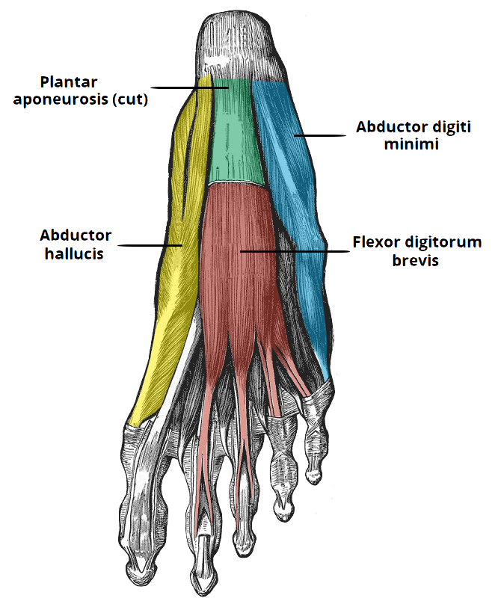
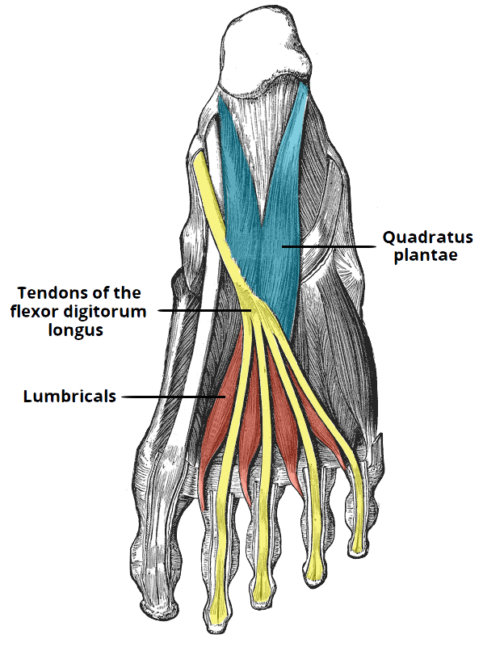
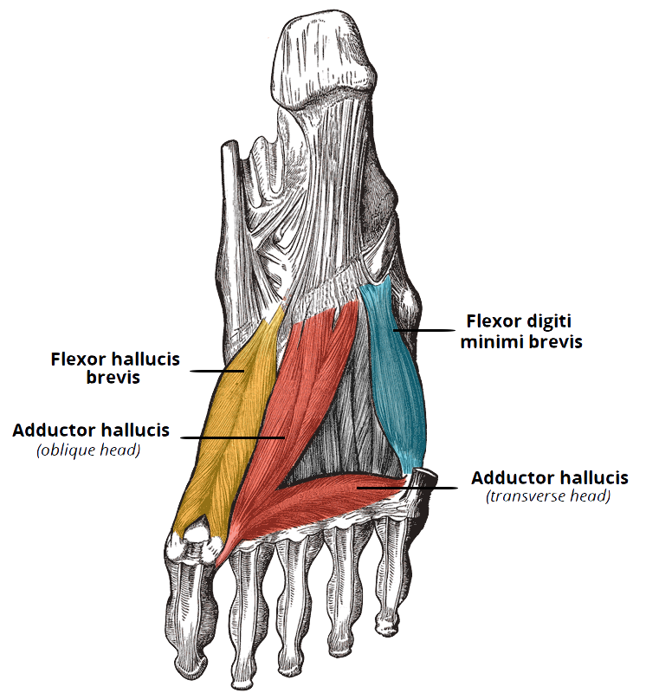
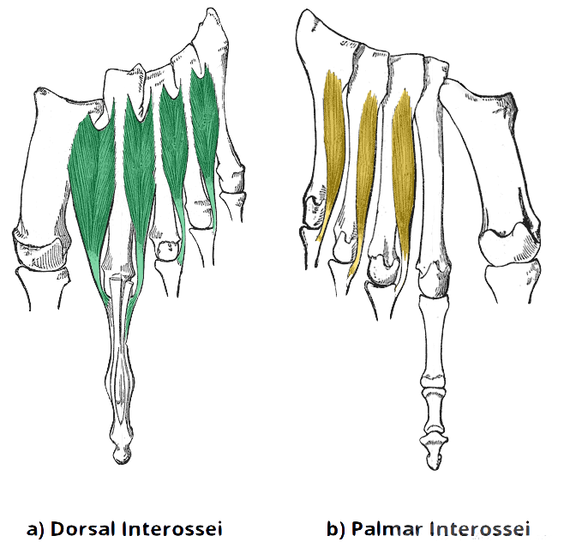
Muscles of Foot Posterior Compartment
1st layer:
1. Abductor hallucis,
2. Flexor digitorum brevis,
3. Abductor digiti minimi
2nd layer:
1. Quadratus plantae
2. Lumbricals
3. Flexor digitorum longus tendon
4. Flexor hallucis longus tendon
3rd layer:
1. Flexor hallucis brevis
2. Adductor hallucis
3. Flexor digiti minimi brevis
4th layer:
1. Interossei, (3 plantar + 4 dorsal)
2. Peroneus longus tendon,
3. Tibialis posterior tendon
All the pictures are taken from [ http://teachmeanatomy.info/ ] ..

Slide 22
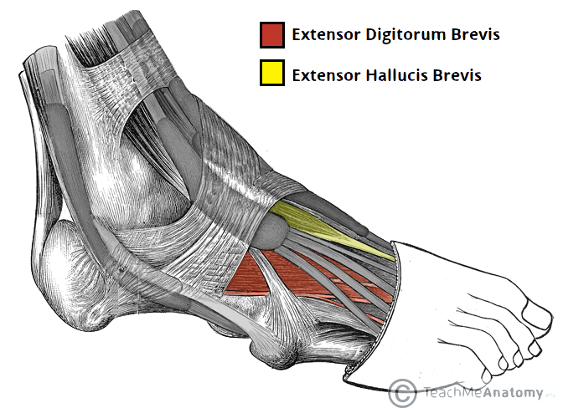
Muscles of Foot Dorsal Aspect
Muscle | ORIGIN | INSERTION | ACTION | NERVE | BLOOD SUPPLY
Extensor Digitorum Brevis | Anterior Part of upper surface of the calcaneus and from inferior extensor retinaculum | By four tendons into the proximal phalanx of big toe and second, third, and fourth toes | Extension of toes | Deep & superficial peroneal nerve | Dorsalis Pedis

Slide 23
Done by:
Noha AlGwaiz & Tariq AlHassan

