Slide 1
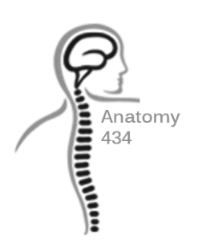
Vertebral Column & Muscles of The Back
"Revision"
Anatomy Team 434
Color Index:
Important Points
Helping notes
Explanation
If you have any complaint or suggestion please don’t hesitate to contact us on:
AnatomyTeam434@gmail.com

Slide 2
Cervical vertebra
Vertebra | Body | Superior articular process | Inferior articular process | Transverse process | Vertebral foramen | Spinous process
Typical cervical (C3-C4-C5-C6) | small, longer horizontally than antero -posterior | small facets (upward and backward) | facets (downward and forward) | 2 tubercles, one placed in front of the foramen transversarium and the other behind. | large, triangular | short, bifid
Atypical cervical C1 “Atlas” | no body | two occipital condyles (kidney shape) | circular |  |  | no spine
Atypical cervical C2 “Axis” | body of the atlas that has fused with the axis | circular | facets (downward and forward) |  |  | short, bifid
Atypical cervical C7 “Prominence vertebrae” | small, longer horizontally than antero -posterior | small facets (upward and backward) | facets (downward and forward) | large | small | long spinous process which is not bifid

Slide 3
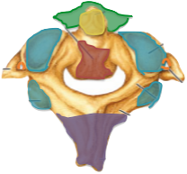
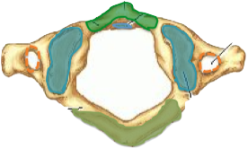
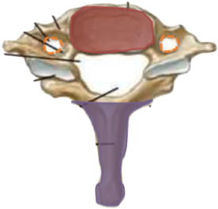
Atypical Cervical Vertebra
Atlanto-Occipital Joint (Flexion, Extension, Lateral Flexion “YES”)
Odontoid Process (Dens)
Anterior Arch
Atlanto-Axial Joint (Lateral Rotation “NO”)
Superior Articular Surface
Transverse Foramen
Inferior Articular Surface
Posterior Arch
Body
Atlas (C1)
Axis (C2)
Spinous Process
Cervica Prominens (C7)

Slide 4
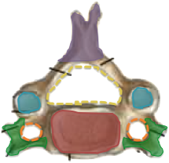
Typical Cervical Vertebra
Spinous Process
(short bifid)
Vertebral Foramen
Superior Articular Facet
Transverse Foramen
Transverse Process
(C3, 4, 5, 6)
Body

Slide 5
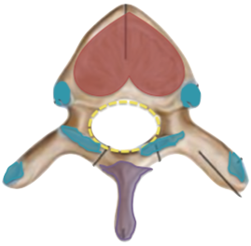
Thoracic vertebra
Spinous Process
(long, downward)
Costal Facets (Transverse Process)
(articulate with tubercles of ribs)
“EXCEPT T11, T12”
Superior Articular Processes
(backward, laterally)
Vertebral Foramen
(small, circular)
Inferior Articular Processes
(forward, medially)
“T12 laterally like Lumbar”
Costal Facets (Sides of Body)
(articulate with head of ribs)
Body
(medium, heart)

Slide 6
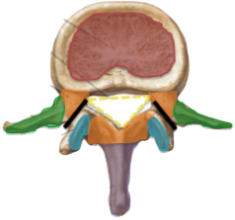
Lumbar vertebra
Spinous Process
(short, flat, quadrangular, backward)
Vertebral Arch
Laminae
(thick)
Superior Articular Processes
(medially)
Pedicles
(strong, backward)
Inferior Articular Processes
(laterally)
Vertebral Foramen
(triangular)
Transverse Process
(long, slender)
Spondylolysis
(L5 is common site and
largest of movable vertebrae)
Body
(large, kidney)

Slide 7
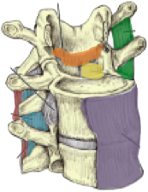
Ligaments
Ligamentum Flavum
(laminae)
Intertransverse
(transverse processes)
Posterior Longitudinal
(weak, narrow)
Supraspinous
(tips of spines)
Anterior Longitudinal
(wide, strong)
Interspinous
(spines)

Slide 8
Muscle of back- according to layers
Muscle group | Characteristic- in general | Muscle within the groups | Innervation
Deep (intrinsic muscles) | -Attached to the vertebral column and head. -Movement of the vertebral column and head (extensors and rotators) -Responsible for maintenance of normal curve of vertebral column. -Extend from sacrum to skull. | The largest muscle is “erector spinae” which is formed of 3 vertical columns (from lateral to medial: iliocostalis, longissimus & spinalis). | - Supplied by posterior rami
Intermediate (extrinsic muscles) | - Attached to & moves ribs. - Separated from the deep group by (thoracolumbar fascia). | 1- Serratus posterior superior (rib elevator). 2- Serratus posterior inferior (rib depressor). | Supplied by anterior rami of thoracic spinal nerves.
superficial (extrinsic muscles) | Attached and move the upper limb. | -Muscles connecting vertebral column to scapula : Trapezius, Levator scapulae, Rhomboid minor and Rhomboid major. -Muscle connecting vertebral column to humerus:Latissimus dorsi. | Supplied by anterior rami (EXCEPT trapezius: 11th cranial nerve).

Slide 9
Superficial group of the back muscle
MUSCLE | ORIGIN | INSERTION | ACTION | NERVE
Trapezius | Spines of cervical & thoracic vertebrae | Lateral 1/3 of clavicle + acromion & spine of scapula. | Rotation of scapula during abduction of humerus above horizontal. 1.Upper fibers: elevate scapula. 2.Middle fibers: retract scapula 3.Lower fibers: depress scapula. | Spinal part of accessory (11th cranial) nerve.
Latissimus dorsi | Spines of thoracic vertebrae. | Bicipital groove of humerus. | Extension, adduction & medial rotation of humerus (arm, shoulder joint). | Thoracodorsal nerve.
Levator scapulae | Cervical transverse processes | Medial border of scapula. | Elevates scapula. | Dorsal scapular nerve.
Rhomboid major & minor | Thoracic spines |  | Retract scapula.

Slide 10
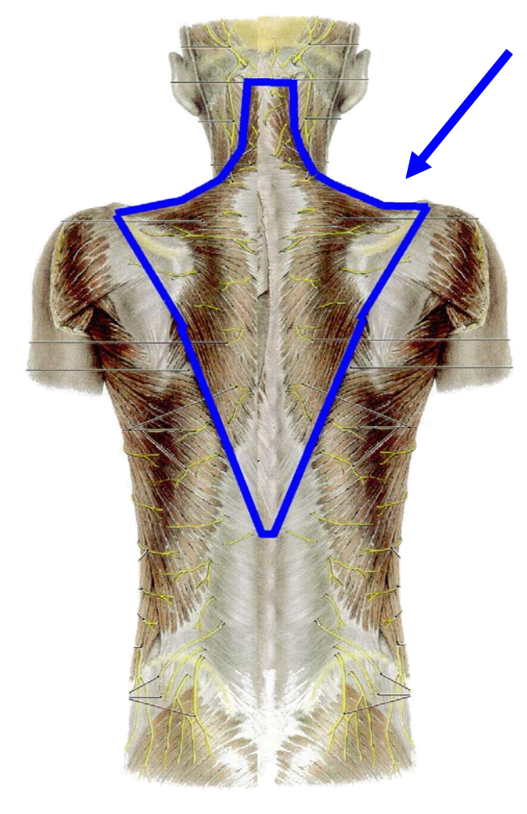
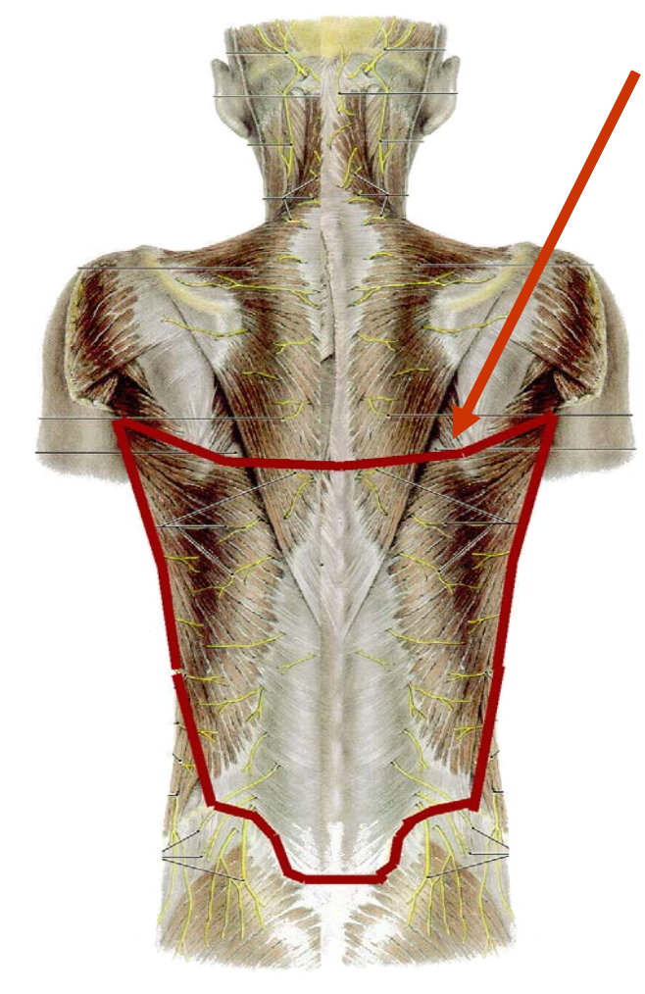
Superficial group
Trapezius
Latissimus dorsi

Slide 11
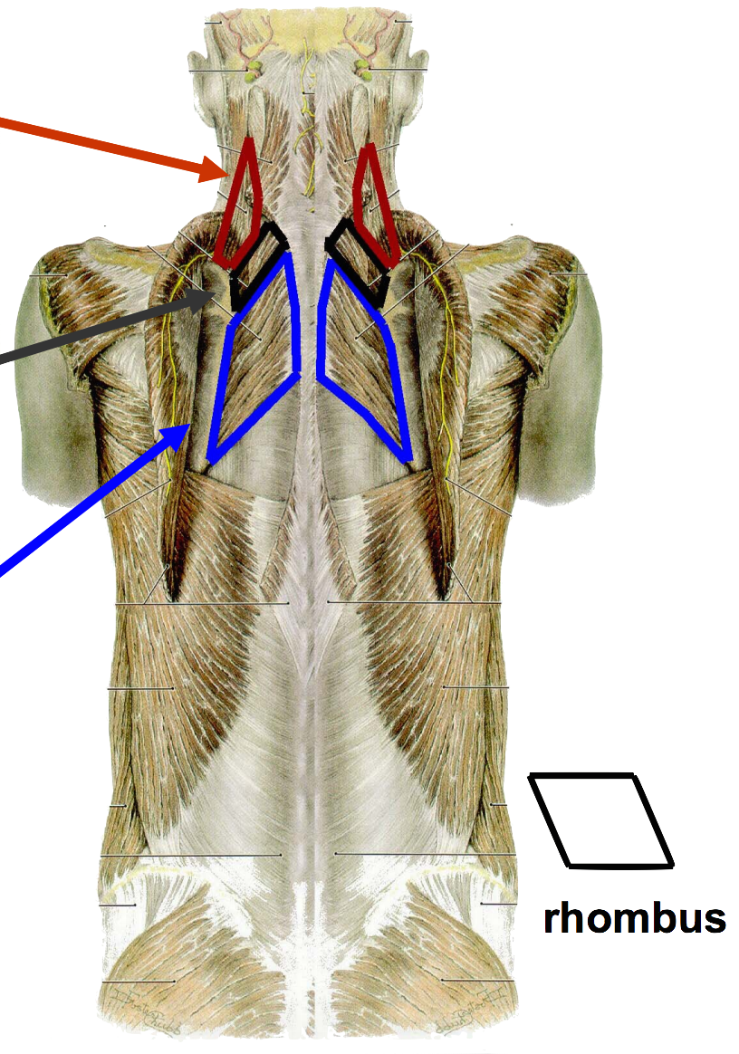
Superficial group
Levator scapulae
Rhomboid minor
Rhomboid major

Slide 12
Intermediate group of the back muscle
MUSCLE | ORIGIN | INSERTION | ACTION | NERVE
Serratus posterior superior | Vertebral column (spinous processes of C7-T3) | Upper border of ribs (from 2 to 5) | Lead to movement of ribs and help in respiratory function (no movement for the back) | Anterior rami of thoracic spinal nerves (upper thoracic nerves T2-T5)
Serratus posterior inferior | Vertebral column (spinous processes of T11-L3) | Lower border of ribs (from 9 to 12) |  | Anterior rami of thoracic spinal nerves (lower thoracic nerves T9-T12)

Slide 13
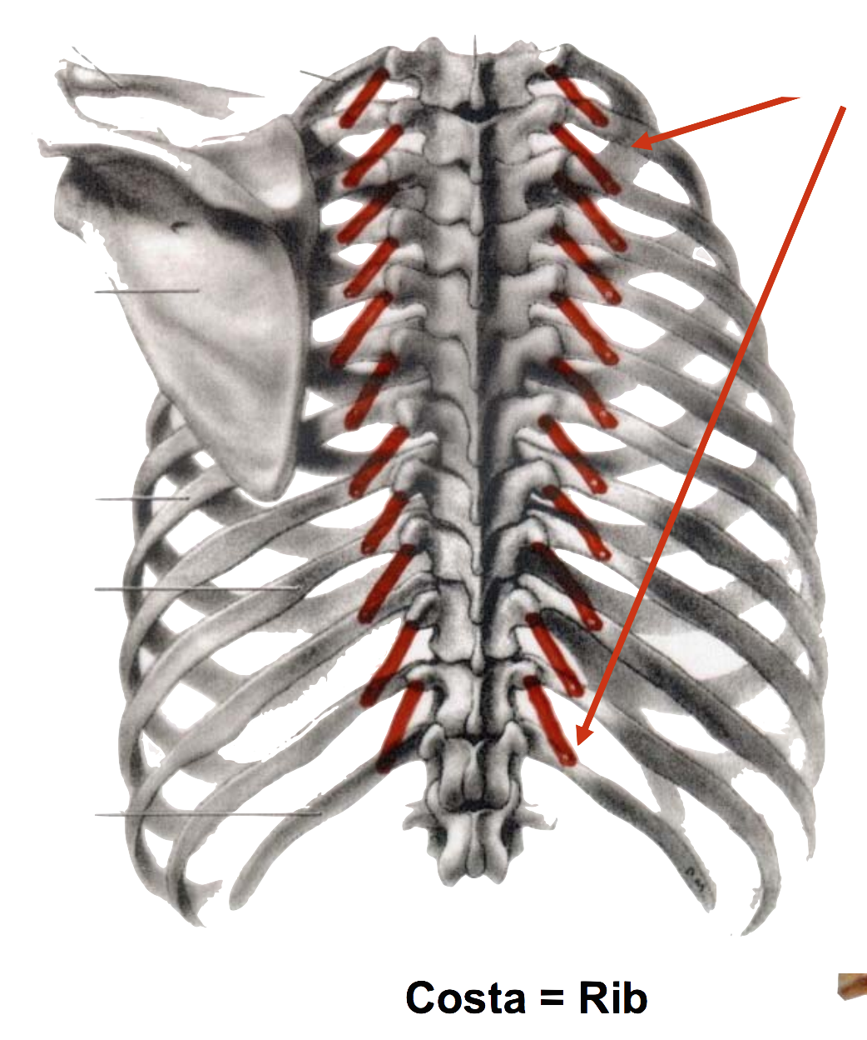
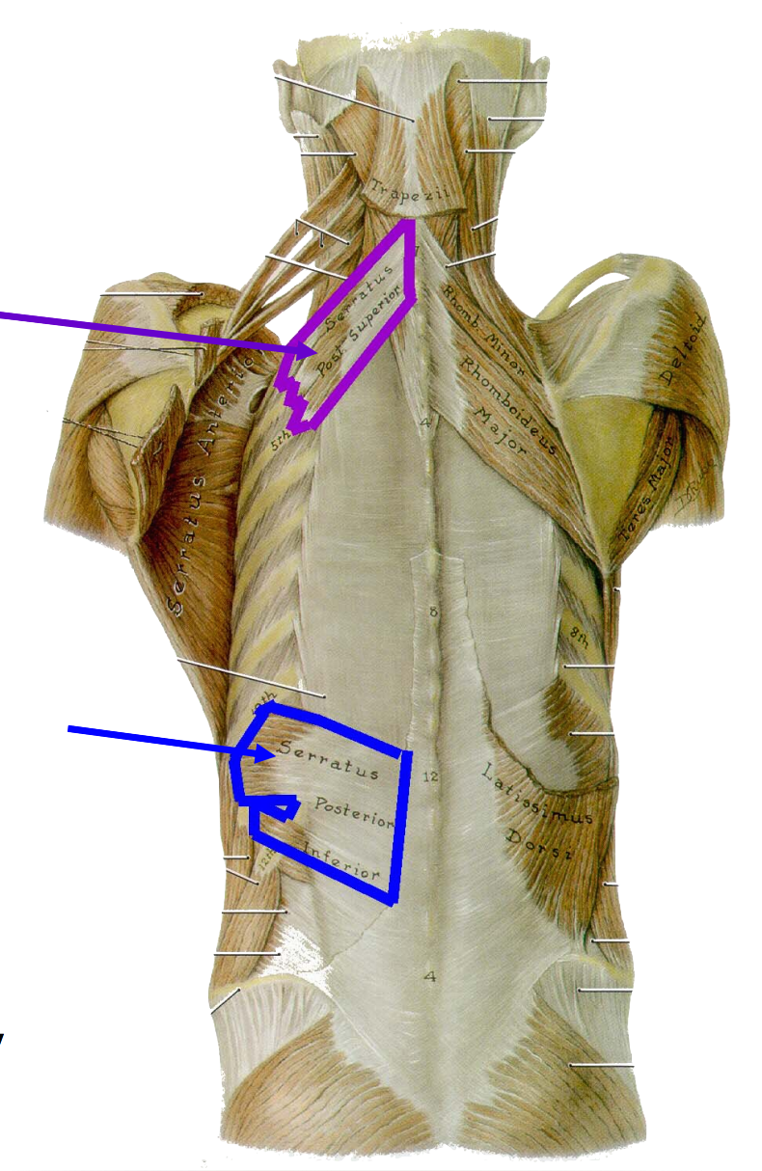
Intermediate group
Levatores costarum
Serratus posterior
superior
Serratus posterior
inferior

Slide 14
Deep group of the back muscle
MUSCLE |  | ORIGIN | INSERTION | ACTION | NERVE
Splenius | Splenius capitis | Spinous processes of C7-T4 | Skull | Extension & rotation of the neck | Posterior rami middle cervical nerves
 | Splenius cervicis | Spinous processes of T3-T6 | Transverse processes of C1-C3 |  | Posterior rami lower cervical nerve
Erector spinae | Iliocostalis | Vertebral column |  | -Extensors and rotators of head & vertebral column -Maintenance of normal curvature of vertebral column | Posterior rami of the spinal nerves
 | Longissimus
 | Spinalis

Slide 15
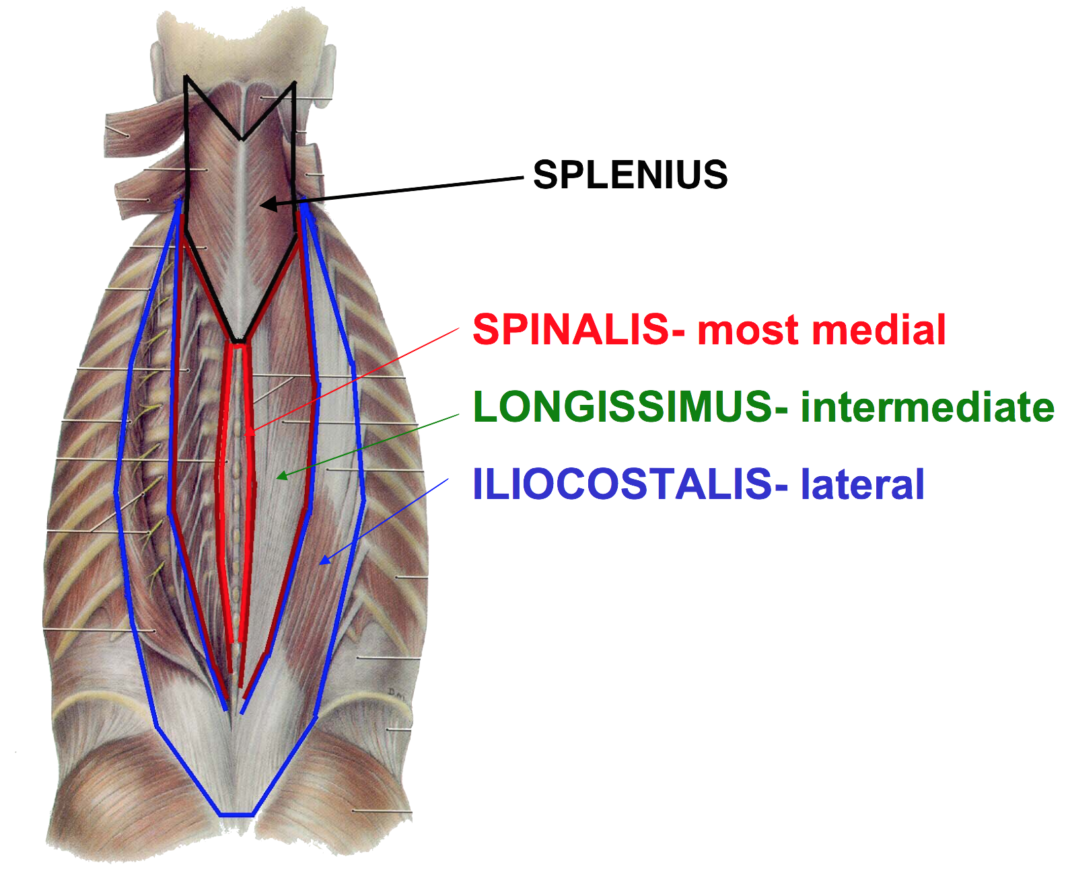
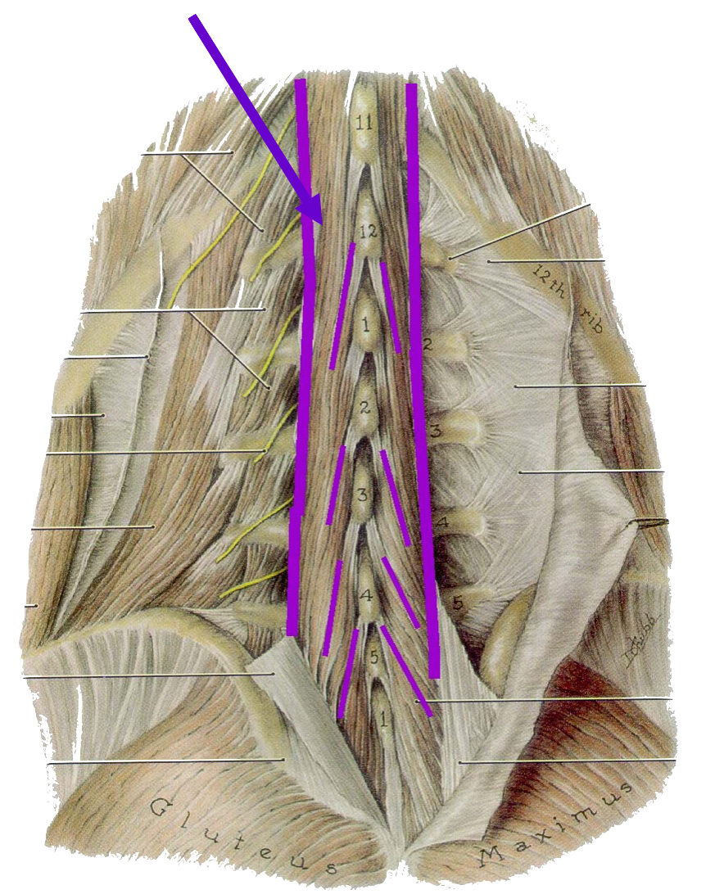
Deep muscle group
Transversospinalis

Slide 16
Muscular triangles of the back
Muscular triangle of the back | Role | Boundaries
Auscultatory Triangle | Site on back where breath sounds are most easily heard with a stethoscope. | latissimus dorsi, trapezius, and medial border of scapula.
Lumbar Triangle | Site where pus may emerge from the abdominal wall. | latissimus dorsi, posterior border of external oblique muscle of the abdomen, and iliac crest.

Slide 17
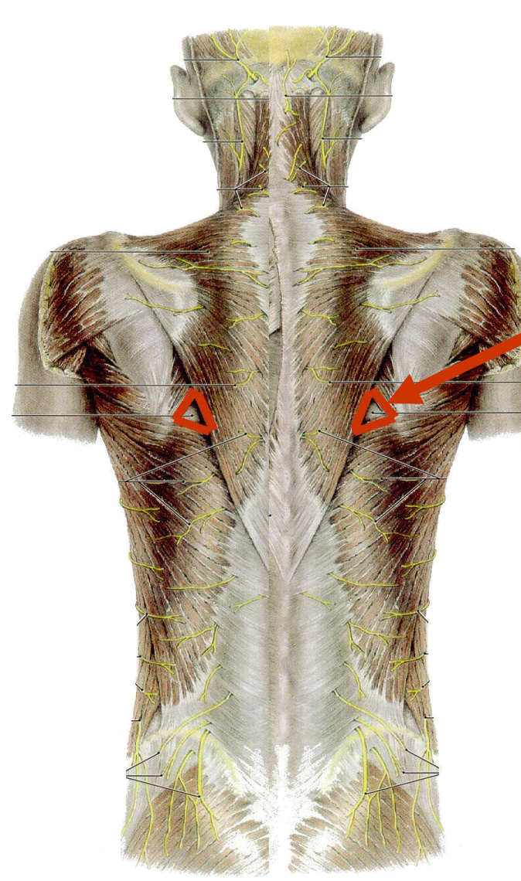
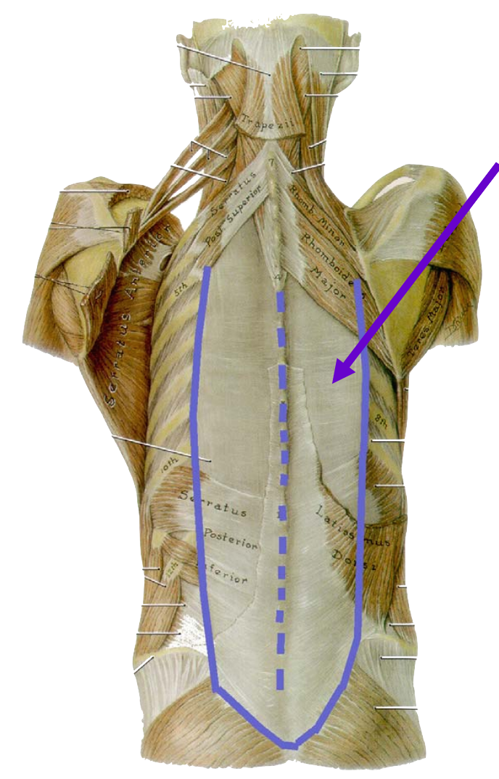
Muscular triangular of the back & Thoracolumbar fascia
Thoracolumbar fascia
Auscultatory triangle
Lumbar triangle

Slide 18
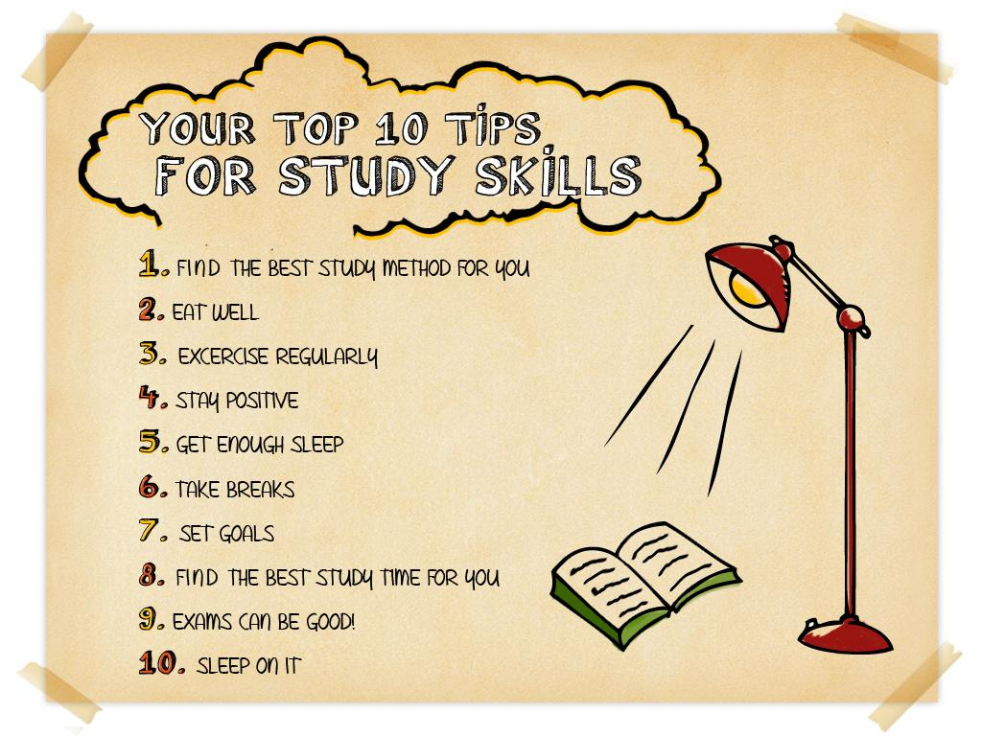
Done by:
Noha AlGwaiz & Tariq AlHassan

