Slide 1
INDIRECT CHOLINOMIMETICS
Musculoskeletal block
Team434

Slide 2
What students should know:
Classification of indirect acting cholinomimetics
Mechanism of action, kinetics, dynamics and uses of
anticholinesterases
Adverse effects & contraindications of anticholinesterases
Symptoms and treatment of organophosphates toxicity.

Slide 3
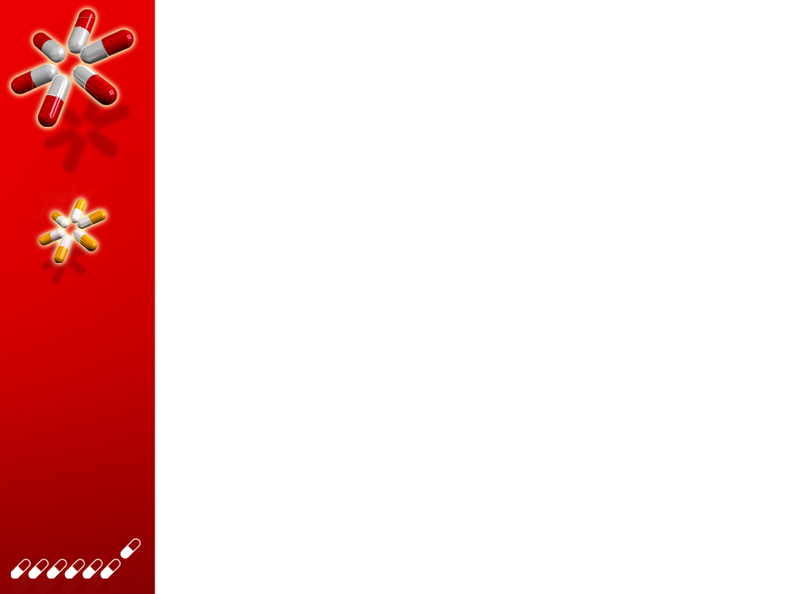
anticholinesterases
Reversible anticholinesterases
Short acting
Intermediate acting
Irreversible anticholinesterases
Long acting
-alcohol
-forms weak hydrogen bond with cholinesterase
edrophonium
-Carbamates esters
-binds to two sites of cholinesterase enzyme
Physostigmine
Pyridostigmine
Neostigmine
All polar except physostigmine
-Phosphate esters
-very long duration of action
-form very stable covalent bond with cholinesterase
Ecothiophate
Isoflurophate
All phosphates are lipid soluble except ecothiophate which is polar.

Slide 4
Indirect cholinomimetics (also called anticholinesterases)
Mechanism of action:
Anticholinesterases prevent hydrolysis of Ach by inhibiting acetyl cholinesterase thus increase Ach concentrations and actions at the cholinergic receptors (both nicotinic and muscarinic).
Anticholinesterases are similar in structure to Ach so combine with cholinesterase instead of Ach
Ach
Nicotinic
receptors
&
Muscarinic
receptors
Anticholinesterases
cholinesterase
Effects
Choline + Acetate

Slide 5
Pharmacological effects of anticholinesterases
ALL Anticholinesterases have muscarinic and nicotinic actions (N & M actions) and some have CNS effects (only lipid soluble drugs).
Nicotinic actions | CNS actions
Neuromuscular junction Therapeutic dose: muscle contraction Toxic dose: relaxation or paralysis of skeletal muscles. Ganglia: stimulation of sympathetic and parasympathetic ganglia Adrenal medulla release of catecholamines (adrenaline, noradrenaline and dopamine). | (excitation, convulsion, respiratory failure, coma). only for lipid soluble anticholinesterases e.g. physostigmine & phosphate ester. (except ecothiophate that is polar).

Slide 6
Muscarinic actions
Cholinergic actions | Organs
Contraction of circular muscle of iris (miosis)(M3) Contraction of ciliary muscles for near vision (M3) Decrease in intraocular pressure | Eye
bradycardia (heart rate ) (M2) Release of NO (EDRF) | Heart endothelium
Constriction of bronchial smooth muscles Increase bronchial secretion M3 | Lung
Increased motility (peristalsis) Increased secretion Relaxation of sphincter M3 | GIT
Contraction of muscles Relaxation of sphincter M3 | Urinary bladder
Increase of sweat, saliva, lacrimal, bronchial, intestinal secretions M3 | Exocrine glands

Slide 7
Reversible anticholinesterases
Uses | Kinetics | Actions | Drug
for diagnosis of myasthenia gravis (MG). NOT absorbed orally (given by injection). | (5-15 min.) -alcohol -Polar. | Nicotinic & muscarinic (M, N) | Edrophonium
Myasthenia gravis treatment Paralytic ileus Urinary retention Curare toxicity | 3-6 Polar | Nicotinic & muscarinic (M, N) | Pyridostigmine (Carbamate esters)
Myasthenia gravis treatment | 4-8 polar | Nicotinic & muscarinic (M, N) | Ambenonium (Carbamate esters)

Slide 8
Reversible anticholinesterases
Uses | Kinetics | Actions | Drug
Myasthenia gravis treatment Paralytic ileus Urinary retention Curare toxicity (prominent on GIT & urinary tract). | 0.5-2hr Polar (Can be used orally) | Nicotinic & muscarinic M, N (No CNS effect) | Neostigmine (Carbamate esters) (Quaternary ammonium comp.)
Glaucoma Atropine toxicity(atropine is anticholinergic drug) | 0.5-2hr Lipid soluble(non polar) (Good oral absorption) | Nicotinic & muscarinic M, N, & CNS | Physostigmine (Carbamate esters) (Tertiary ammonium comp.)

Slide 9
Indirect Cholinomimetics
(Organophosphorous compounds)
Mechanism
Irreversible anticholinesterase
Binds to cholinesterase by strong covalent bond.
Have very long duration of action
Aging make bond extremely stable
All are highly lipid soluble except ecothiophate
Used for glaucoma
Organophosphates toxicity
(Pesticide Toxicity)
Sever bradycardia, hypotension.
Bronchospasm.
Increased GIT motility → cramps & diarrhea.
CNS effects → convulsion, coma and respiratory failure.
Initial twitching of skeletal muscles → muscle weakness & paralysis.

Slide 10
Treatment of organophosphate toxicity
Support respiration
Cholinesterase reactivators (Oximes)
Atropine (to block muscarinic actions & CNS effects).
Donepezil
Anticholinesterase drugs.
Given orally.
used for treatment of dementia of
Alzheimer’s disease.
OXIMES
Pralidoxime (PAM)
Cholinesterase reactivator
acts by regeneration of cholinesterase enzyme.
reactivates recently inhibited enzymes before aging.
Uses
I.V. → over 15-30 min for organophosphate intoxication.

Slide 11
Summary
Antichollenistrases increase due to increase Ach.
All Anticholinesterases have muscarinic and nicotinic actions (N & M actions) and some have CNS effects (only lipid soluble drugs).
Anticholinesterases classified into tow classes: 1- Reversible: Short or intermediate action.
2- Irreversible is Long action.
• All the reversible Intermediate acting anticholinesterase are polar except physostigmine.

Slide 12
Summary
The irreversible very long acting are phosphate esters (or Organophosphates) and all of them are lipid soluble except ecothiophate which is polar.
Only lipid soluble drugs will have affect on the CNS e.g. Physostigmine.
Organophosphates toxicity causes severe bradychardia and hypotension, effects on CNS manifest as coma and convulsion, it causes diarrhea due to increased GIT motility.

Slide 13
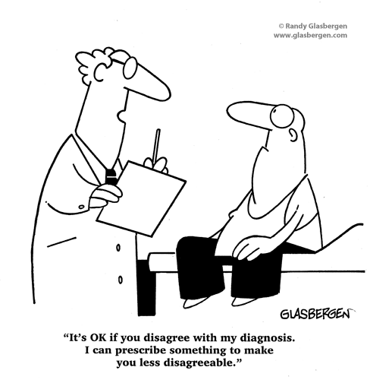
☺ اختبر زاتك ☺
Click here to start QUIZ >>>

