Slide 1
Vertebrae
* Notes

Slide 2
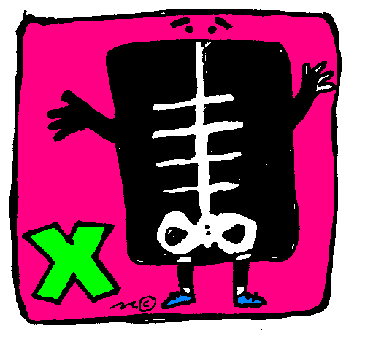
X-ray
•X-ray can be used to check the alignment of the vertebral column
•Intervertebral discs appear as black area in the x-ray image
•Odontoid process is better seen in a picture of and opened mouth
•Dorsal spine is the thoracic spine.

Slide 3
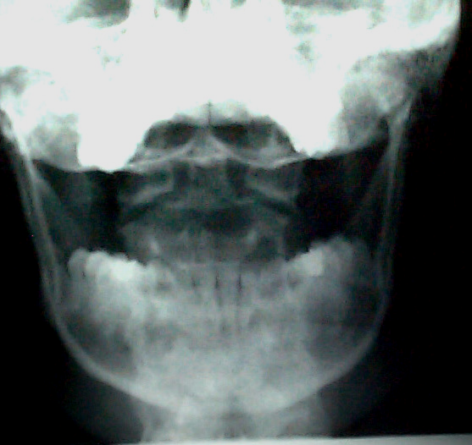
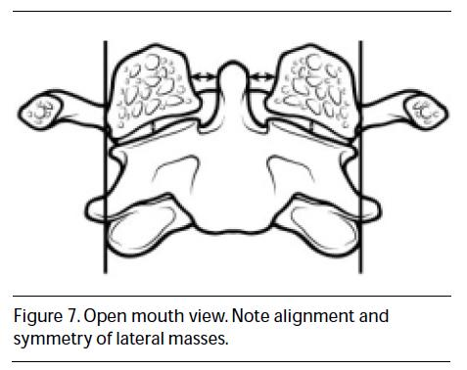
1- > C2 (axis) 2- > C1(atlas)
1
1
2

Slide 4
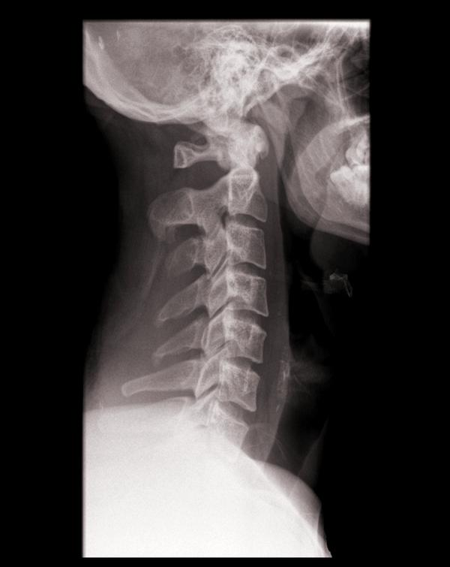
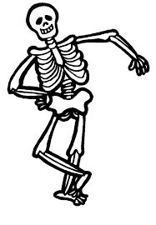
Cervical Spine
1
C1
C2
C3
Intervertebral disc
Spinous process of C4
Facet joint
2
6
3
5
4

Slide 5
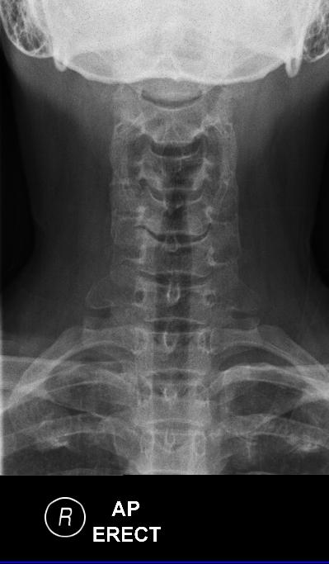
Vertebral body C5
Spinous process
Transverse process
First rib
1
3
2
4

Slide 6
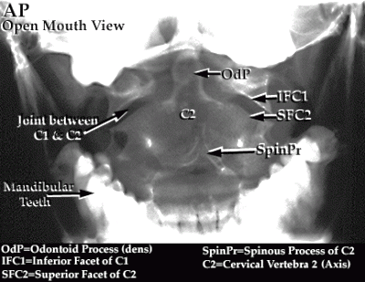

Slide 7
Dorsal Spine

Slide 8
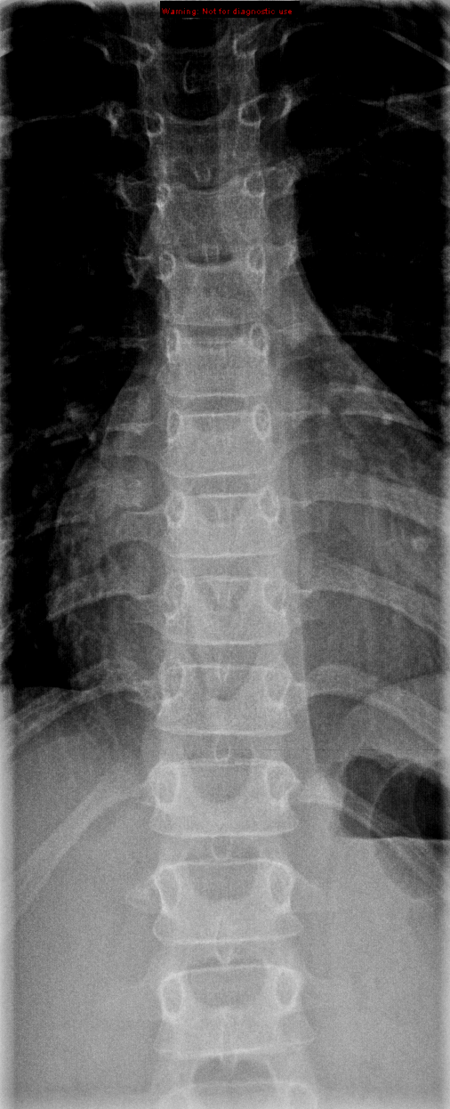
2
1
Vertebral body
Spinous process
Transverse process
Pedicle
Rib
3
4
5

Slide 9
Vertebral body
Intrvertebral disc
Pedicle
Rib
1
2
3
4

Slide 10
Lumbar Spine

Slide 11
Vertebral body
Transverse process
Pedicle
Spinous process
Sacrum
2
1
4
3
5

Slide 12
3
1
4
Vertebral body L3
Intrvertebral disc
Spinous process
Neural foramen
Sacrum
2
5

Slide 13
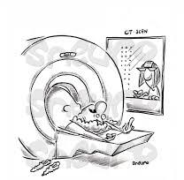
CT scan
•CT scan is used for detecting trauma
•In a CT scan picture we cannot see the spinal cord clearly

Slide 14
Cervical spine

Slide 15
cervical spine
3
5
1
4
Vertebral body
Spinous process
Pedicle
Lamina
Transverse foramen
2

Slide 16
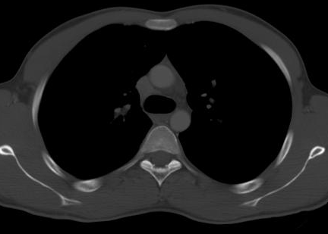
Dorsal spine
7
4
5
6
Vertebral body
Neural foramen
Lamina
Pedicle
Transverse process
Spinous process
Rib
1
2
3

Slide 17
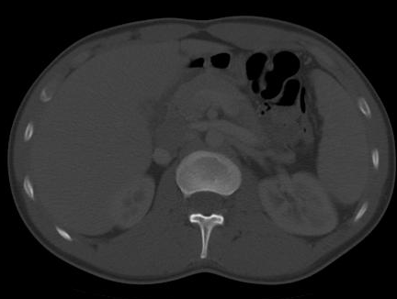
1
Lumbar spine
2
3
Vertebral body
Neural foramen
Spinous process
Pedicle
Transverse process
4
5

Slide 18
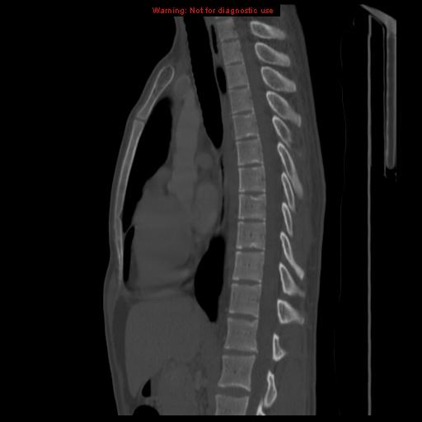
Dorsal spine
1
3
4
2
Vertebral body
Intervertebral disc
Spinous process
Pedicle
Neural foramen
5

Slide 19
Lumbosacral spine
1
3
2
5
4
6
Vertebral body
Intrvertebral disc
Spinous process
Sacrum
Pedicle
Neural foramen

Slide 20
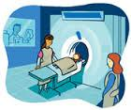
MRI
-MRI is stand for "magnetic resonance imaging"
-MRI is more useful with very clear details about the spinal
cord better than X-Ray in evaluation of traumas.
- MRI gives you a 3D Picture unlike the X-Ray with 2D picture
and also the nuclear medicine.
Many patients undergo CT scan and then MRI

Slide 21
Lumbar spine
1
2
3
Vertebral body
Neural foramen
Spinous process
Thecal sac
Para-spinal muscles
4
5

Slide 22
Cervical spine
1
C2(axis)
Intervertebral Disc
Spinal cord
Spinous process
2
4
3

Slide 23
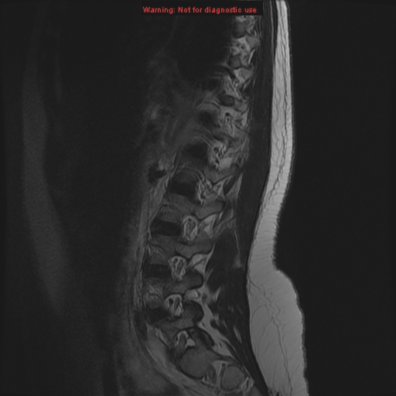
Lumbosacral spine
1
2
3
4
5
Spinal cord
Intervertebral Disc
Vertebral body
Sacrum
Neural foramen
Pedicle
6

Slide 24
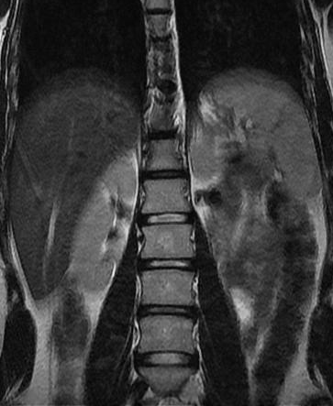
Lumbar spine
Vertebral body
Intervertebral disc
1
2

Slide 25
Nuclear scan

Slide 26
1
2
Ribs
Vertebral body
Intervertebral Disc
sacrum
3
4

Slide 27
ULTRASOUND
ultraSound information is limited result but it's more specific
In the ultrasound you can see the things moving like the blood
(يعطيك تصوير مباشر يعني تشوف الجسم مباشر مو زي الاكس راي وال ام ار أي اللي هي مجرد صور)
Ultrasound is not fit with the pregnant women.
It is used for infants.

Slide 28
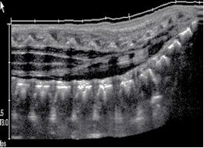
3
4
2
1
Vertebral body
Intervertebral Disc
Spinous process
Spinal cord

Slide 29
Done By RADIOLOGY TEAM 434 ..
عبدالرحمن الكاف ابتهال آل مشاوي
سلمان القزلان الهام الغامدي
عبدالله السهلي لينة الجرف
عبدالله الهويدي سارة السلمان
هديل السلمي

