Slide 1
upper limb
Notes

Slide 2
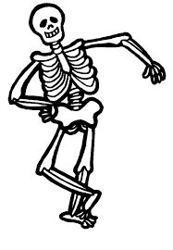
Medical techniques
Modality | Bone | Soft tissue
X-Ray | ++++ | ___
CT scan | +++++ | ++
MRI | ++ | +++++
Note that : 1-CT scan results is very rapid to get it,so it useful in accident and other severe damage.
2- X-ray can not used for detecting soft tissue

Slide 3
Shoulder Region
2
1
X-ray
3
1- clavicle
2- acromion
3-Greater tuberosity
4-lesser tuberosity
5-Glenoid cavity
6- coracoid process
7-scapula
6
4
5
7

Slide 4
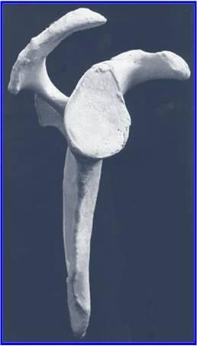
Y View
1
5
2
4
1-acromion
2-spine
3-scapula
4-coracoid
5-humeral head
6-humerus shaft
3
3
6

Slide 5
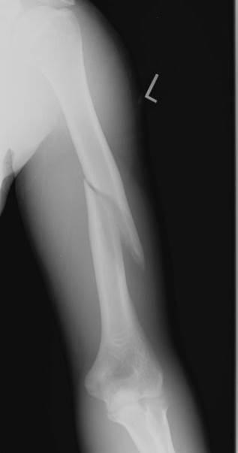
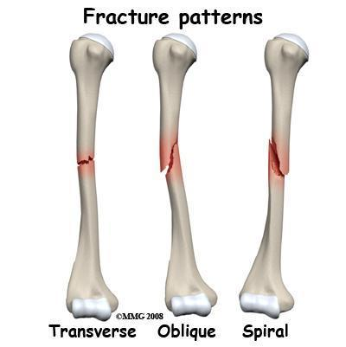
humerus fracture

Slide 6
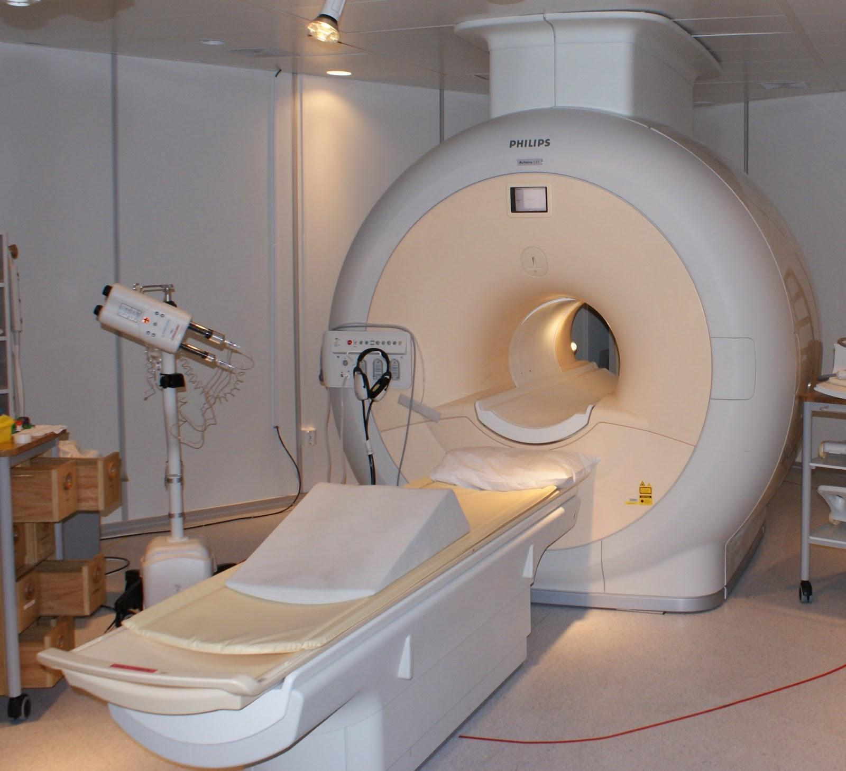
shoulder Region
MRI

Slide 7
5
6
Note : MRI can display soft tissue while x-ray can’t.
1
1-supraspinatus muscle
2- glenoid cavity
3-humeral head
4-deltoid muscle
5-acromion
6-clavicle
7-subscapularis muscle
8-teres minor
3
4
2
7
8

Slide 8
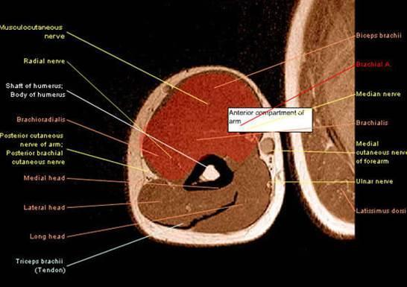
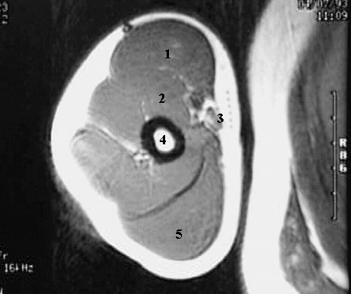
Arm
MRI
1- Biceps brachii muscle
2-- Brachialis muscle
3-Brachial artery
4- Humerus
5-Triceps muscle

Slide 9
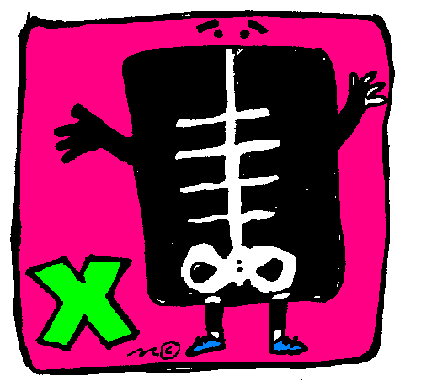
Elbow
X-Ray

Slide 10
8
7
1
2
1- lateral epicondyle
2- capitulum.
3- radial head
4- radial tuberosity
5- ulna
6- trochlea
7- medial epicondyle
8- olecranon fossa
6
3
4
5

Slide 11
Note : Radial will appear bigger than ulna in x-ray
1
2
1- humerus
2- coronoid process **
3- Radial head
4- Radial tuberosity
5- olecranon
6- olecranon fossa
7- Ulna
3
4
6
7
5

Slide 12
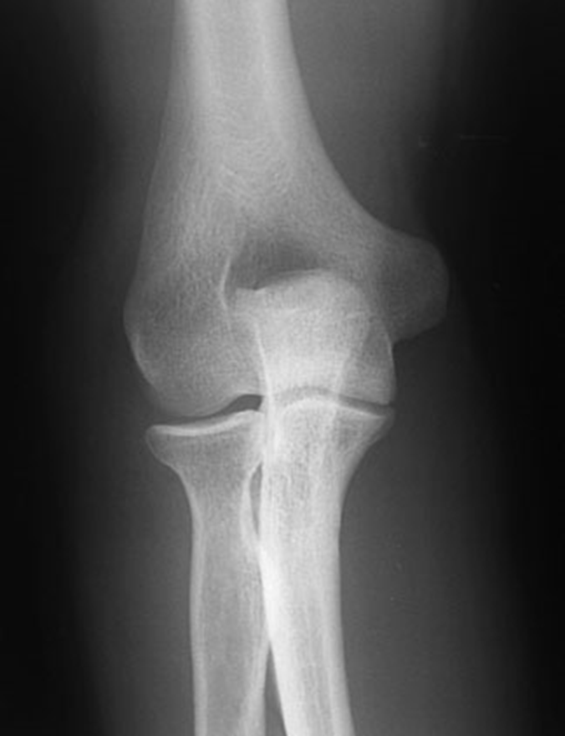
Child
(as you can see there is no carpal bones)
Adult

Slide 13
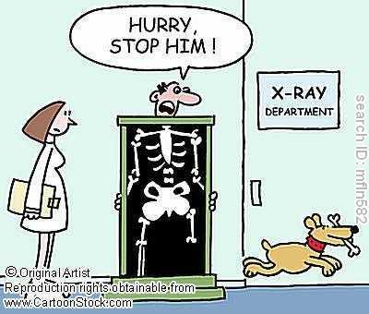
Hand
X-ray

Slide 14
1- Scaphoid. (navicular)
2- Lunate.
3- Triquetrum.
4- Pisiform.
5- Hamate.
6- Hook of Hamate.
7- Capitate.
8- Trapezoid.
9- Trapezium.
10- Radius.
11- Ulna.
12- Ulnar styloid process.
13- 1st metacarpal.
2nd metacarpal ( and so on from lateral to medial )
13
6
8
4
3
7
9
5
12
2
1
11
10

Slide 15
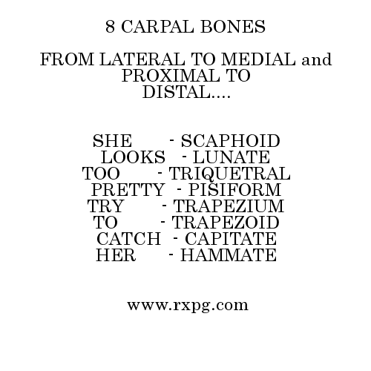
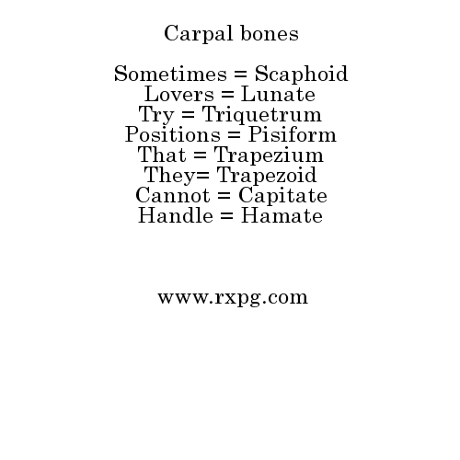
TO
HELP
YOU

Slide 16
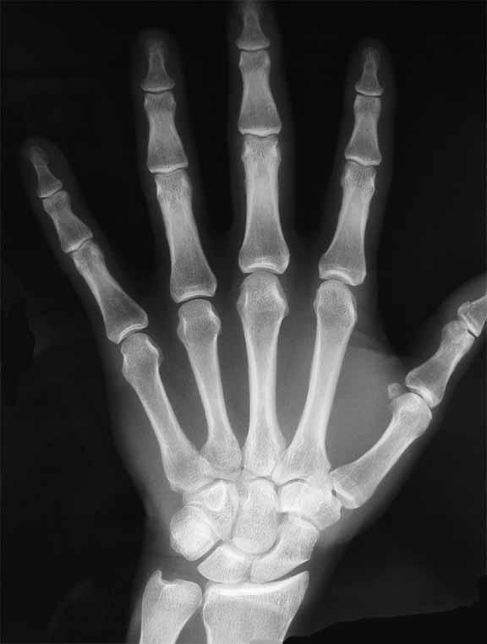
4
1
1- Distal phalanx.
2- Middle phalanx.
3- Proximal phalanx.
4- Distal interphalangeal joint.
5. Proximal interphalangeal joint.
6- metacarpophalangeal joint.
2
5
3
6

Slide 17
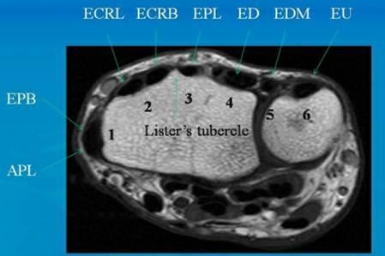
MRI

Slide 18
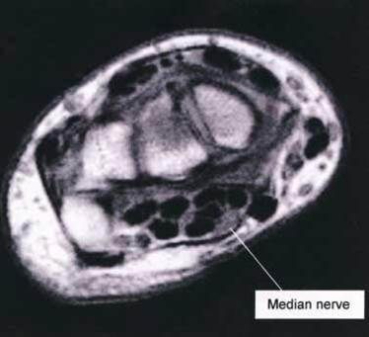

Slide 19
Done By RADIOLOGY TEAM 434 ..
عبدالرحمن الكاف ابتهال آل مشاوي
سلمان القزلان الهام الغامدي
عبدالله السهلي لينة الجرف
عبدالله الهويدي سارة السلمان
هديل السلمي

