Slide 1
RESPIRATORY BLOCK
PROF. AHMED FATHALLA IBRAHIM

Slide 2
NASAL CAVITY
Soft palate
Hard palate

Slide 3
NASAL CAVITY

Slide 4
LARYNX, TRACHEA
-Level of beginning
and termination
of larynx, trachea and
pharynx
-Cartilages of larynx

Slide 5
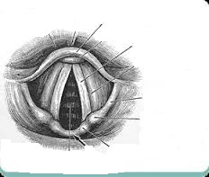
Identify the following labelled structures :
a ………………………….
b…………………………..
c……………………………..
d……………………………….
e……………………………….
a
b
c
d
Answer
epiglottis.
Vocal cord.
Aryepiglottic fold.
Cuniform cartilage.
Corniculate cartilage.
e

Slide 6
NASAL CAVITY, LARYNX, PHARYNX, TRACHEA
Frontal air sinus
Nasal septum
Sphenoidal air sinus
Hard palate
Opening of pharyngo-
tympanic tube
Epiglottis
Palatine tonsil
Trachea
N.B.: Site of drainage of
the sinuses – important
structures in the wall of
pharynx- blood sypply –
lymphatic drainage

Slide 7
TRACHEA & BRONCHI

Slide 8
LUNG & PLEURA
Nerve supply- Surface Anatomy
Cervical

Slide 9
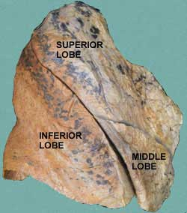
LUNG & PLEURA
Transverse (horizontal) fissure
Oblique fissure
Surface anatomy of fissures and cardiac notch

Slide 10
RIGHT LUNG
S
V
C
Superior lobar bronchus
Transverse fissure
Inferior lobar bronchus
Superior pulmonary
vein
Pulmonary artery
I
V
C
Inferior pulmonary
vein
Esophagus
Cardiac impression
Oblique fissure

Slide 11
LEFT LUNG
Aortic arch
Pulmonary artery
Bronchus
Superior pulmonary
vein
Inferior
pulmonary vein
Cardiac impression
Pulmonary ligament
Area related to
diaphragm
Oblique fissure
Lingula

Slide 12
RADIOLOGY
Trachea
Clavicle
Aortic
knuckle
Scapula
Apex of heart
(left ventricle)
Cardiophrenic angle
Left dome
of diaphragm
Right dome
of diaphragm
Right atrium

Slide 13
RADIOLOGY
T
B

Slide 14
RADIOLOGY
Barium swallow
Esophagus

Slide 15
MEDIASTINUM Contents

Slide 16
MEDIASTINUM Contents

Slide 17
MEDIASTINUM Contents
N.B.:
LEVEL OF T4
Descending aorta

Slide 18
MUSCLES INVOLVED IN RESPIRATION Action- Nerve supply

Slide 19
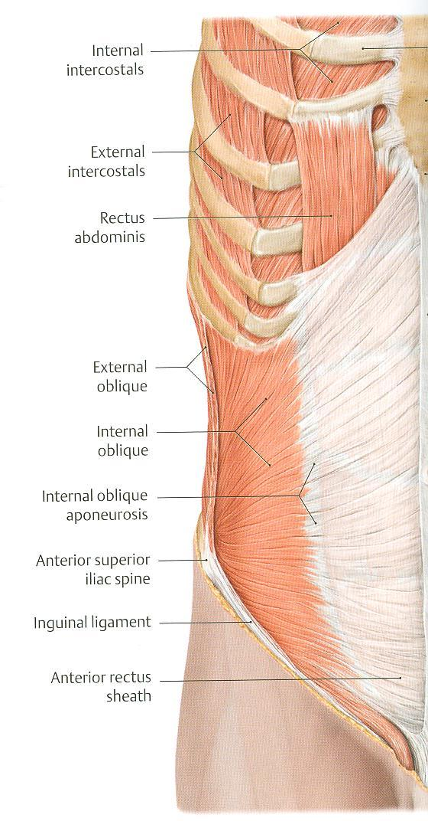
MUSCLES INVOLVED IN RESPIRATION Action- Nerve supply

Slide 20
MUSCLES INVOLVED IN RESPIRATION Action- Nerve supply

Slide 21
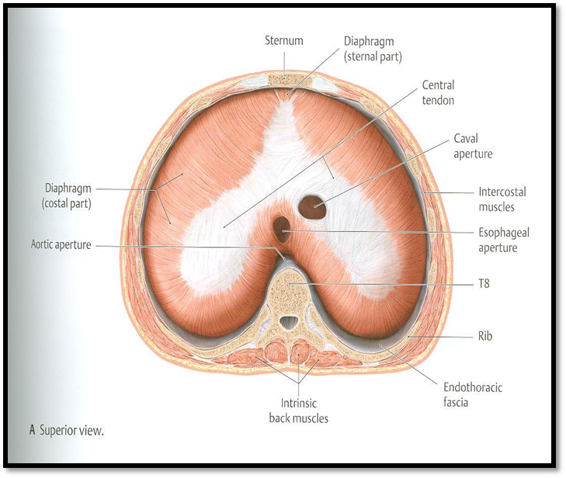
DIAPHRAGM Action- Nerve supply
Major openings of diaphragm

Slide 22
Please note that these figures are not necessarily
those present in the exam
THANK YOU

