Slide 1
Respiratory Tract Infection
DR MONA BADR
Assistant Professor & Consultant Microbiologist College of Medicine & KKUH

Slide 2
Viral Infection of Respiratory Tract
Virus infection of the respiratory tract are the commonest of human infection and cause a large amount of morbidity and loss of time at work.
1-Influenza virus Orthomyxoviridae
2-Rhinovirus Picornaviridae family
3-Coronavirus Coronaviridae family
4-Para influenza viruses Paramyxoviridae family
5-Respiratory Synctial viruses Paramyxoviridae
6-Adenovirus Adenoviridae family.

Slide 3
Viral Infection of the Respiratory Tract
Virus infection of the respiratory tract are the commonest of human infection and cause a large amount of morbidity and loss of time at work.
The common respiratory viruses.
Name of the virus | Family
1 Influenza virus | Orthomyxoviridae
2 Parainfluenza virus | Paramyxoviridae
3 Respiratory syncytial virus | Paramyxoviridae
4 Rhinovirus | Picornaviridae
5 Coronavirous 6-Adenovius | Coronaviridae Adenoviradia

Slide 4
Past Antigenic Shifts
1918 H1N1 “Spanish Influenza” 20-40 million deaths
1957 H2N2 “Asian Flu” 1-2 million deaths
1968 H3N2 “Hong Kong Flu” 700,000 deaths
1977 H1N1 Re-emergence No pandemic
At least 15 HA subtypes and 9 NA subtypes occur in nature. Up until 1997, only viruses of H1, H2, and H3 are known to infect and cause disease in humans.

Slide 5
1-Orthomyxoviruses Influenza Virus
1) Single, Stranded negative sense RNA with 8 helical segments, This virus is highly susceptible to mutations and rearrangements within the infected host. egmenteRNA.
2) Helical capsid symmetry
3) Enveloped viruses which contains 2 projecting glycoprotein spikes.
Heamagglutinin HA attachment.
The virus can agglutinate certain erythrocyte.
Neuroamindase NA an enzyme help in releasing progeny virus formation from infected cell.

Slide 6
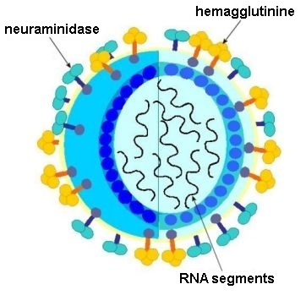

Slide 7
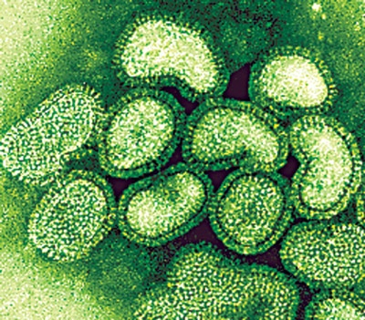

Slide 8
Influenza Virus
Epidemiology:
Winter months mostly
Influenza A can cause epidemic and pandemic which is usually associated with Antigenic shift, while Influenza B can cause outbreaks & epidemic which associated only with Antigenic drift.
.

Slide 9
Types of Influenza Viruses
Influenza A
Influenza B
Influenza C
Infect human and
animals.
Infect human
Infect human only
Cause outbreaks&epidemic
Cause mild illness
Can cause epidemic
and pandemic
epizootic.
Antigenic drift
Antigenic drift only
antigenic shift.

Slide 11
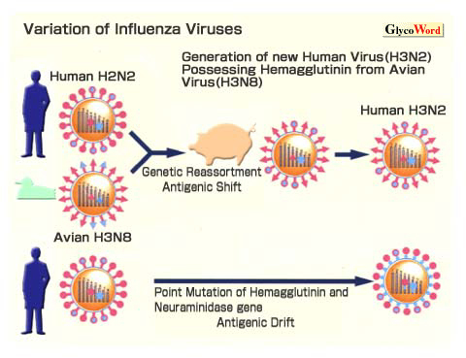

Slide 12
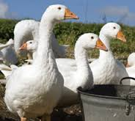
Avian flu

Slide 13
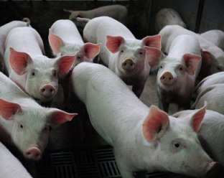
Swine flu

Slide 14
Pathogenesis & Immunity:
Influenza virus establish a local upper respiratory tract infection.
According to the immunity of the host, it can cause localized infection or spread to the lower respiratory tract infection.
Viremia usually& occurs (fever) .
Influenza infection is self limiting condition in Immunocompetent person.

Slide 15
Clinical Syndrome:
Transmission inhalation of respiratory secretion
Incubation period 1 - 4 days
Seasonal variation usually in winter
prognosis self limiting disease
Symptoms: Sudden onset of fever
Malaise – Headache
Sneezing – sore throat - It takes 3 days.
Non-productive cough

Slide 16
Complication of Influenza:
Primary Influenza Pneumonia.
2ndbacterial-pneuomonia Strep. pneumoniae, H.influenzae
Myositis (inflammation of the muscle).
Post influenza encephalitis.
Bronchial Asthma.
Sinusitis.
.

Slide 17
Laboratory Diagnosis:
Clinical diagnosis.
Laboratory investigation done to distinguish influenza viruses from
other respiratory viruses and to identify the type and strain.
Specimen: Nasopharyngeal aspirate, nasal washing
Culture: on primary Monkey Kidney cytopathic effect occur 2- 3
days.
Rapid and direct detection of influenza virus A or B from nasopharyngeal aspirate by immunofluorescence and ELISA. This is the most common laboratory diagnosis.
RT-PCR (Nucleic acid testing)

Slide 18
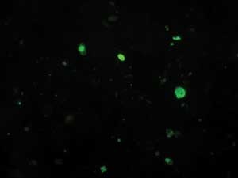
Rapid antigen immunofluorescence assay
Assay performed on cells from a nasopharyngeal aspirate, showing typical nuclear and cytoplasmic “apple-green” fluorescence after staining with monoclonal antibodies specific for influenza A.

Slide 19
Treatment:
Amantadine: Is only effective against influenza A virus.
inhibiting the un coating step of influenza A virus.
It has both therapeutic and prophylactic .
It significantly reduced the duration of fever and
illness is given to high risk group of patients who are
not vaccinated because they have allergy from egg.

Slide 20
Oseltamivir (Tamiflu) :
It is Neuraminidase inhibitor that act by blocking the viral enzyme neuraminidase which help the influenza virus invade respiratory tract cells.
It has to be given within the first 48 hours after the exposure of cases or appearance of symptoms.
Recommended dose is 75 mg twice daily for 5 days.

Slide 21
INFLUANZA VACCINE
Tow types of vaccine ,both contain the current influenza A & B .
Vaccine should be given in October or November ,before the influenza season begins.
Yearly booster dose recommended.

Slide 22
1-The Flu shot vaccine
Inactivated (Killed vaccine),
Given to people older than 6 months, including healthy people as well as high risk groups (elderly, patients with chronic pulmonary or cardiac diseases).

Slide 23
2-The Nasal spray flue vaccine (Flu mist)
This is a live attenuated vaccine.
Approved for use in healthy people only between 5- 49 years age.

Slide 24
2-RHINOVIRUSES.
Common cold accounts for 1/3 to of all acute respiratory infections in humans.
Rhinoviruses are responsible for 60% of common colds cases,
Common cold is a self-limited illness.
More than 100 serologic types of rhinoviruses No vaccine available.
Transmitted directly from person to person by respiratory droplet.
RHINOVIRUSES is one of PICORNAVIRUS family,
small non enveloped virus(20-30 nm),SS-RNA virus.
RHINOVIRUS are acid labile(sensitive).

Slide 25
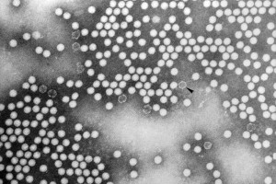
Rhinovirus
Family: Picornaviridae.
Structural features: Unenveloped virus with ss-RNA genome, more than 100 serotypes available.
Transmission: Inhalation of infectious aerosol droplets.
Clinical symptoms: Common cause of common cold.
Lab diagnosis: Direct detection of the Ag from NPA by direct I.F.
Treatment and prevention: Usually self-limiting disease, no specific treatment, and no vaccine available.

Slide 26
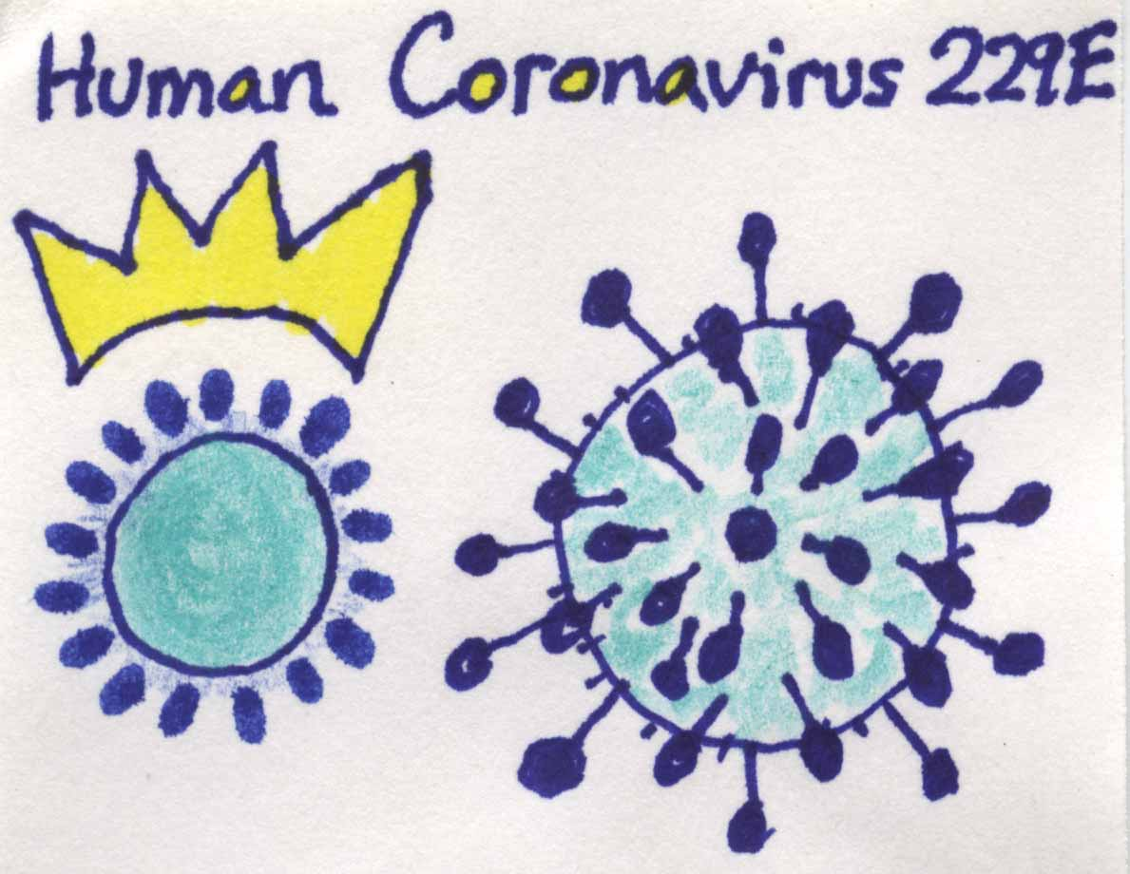

Slide 27
3-Coronaviruses
The name Coronavirus means Crown
(when viewed with an electron microscope).
ssRNA enveloped with positive polarity.
Coronavirus are the second cause of common cold .

Slide 28
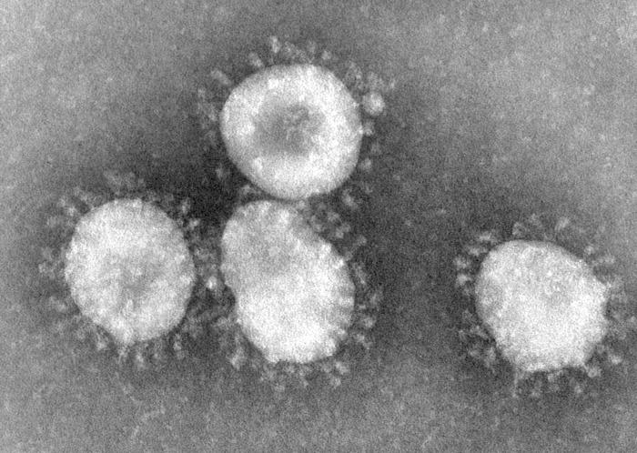
Coronavirus
Family: Coronaviridae.
Structural features: Enveloped virus with ss-RNA genome.
Transmission: Inhalation of infectious aerosol droplets.
Clinical symptoms: The 2nd cause of common cold.
*Severe Acute Respiratory Syndrome (SARS)
In winter of 2002, a new respiratory disease known as (SARS) emerged in China.
A new mutation of coronavirus, a zoonosis disease the animal reservoir may be cat and cause atypical pneumonia with difficulty in breathing.
Treatment and prevention: No specific treatment or vaccine available.

Slide 29
Clinical presentation of common cold:
Symptoms runny nose, sneezing and nasal obstruction, mild sore throat, headache and malaise that last for one week.
Complication: Usually due to secondary bacterial infection
Acute sinusitis 2) Acute otitis media.
3) Exacerbation of chronic bronchitis ,bronchial asthma.
Laboratory Diagnosis:
Usually no need.
Treatment and Prevention:
No specific treatment.
No vaccine available.

Slide 30
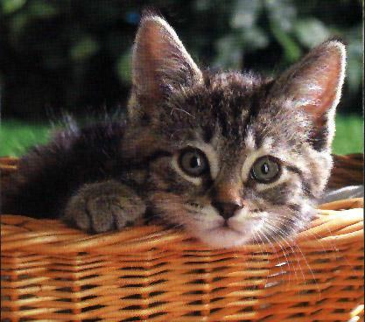

Slide 31
Severe Acute Respiratory Syndrome SARS
SARS is a viral infection, causes Atypical pneumonia, can infect all age groups, and can lead to death especially among people with existing chronic condition.
SARS suspected to be originated in China and Hong Kong.
What we know about the causative agent of SARS?
A new mutation of coronavirus, apparently a zoonosis of which the animal reservoir may be the cat.
Coronavirus is difficult to isolate and not easily grown in tissue culture.
Coronavirus is able to survive in dry air for up to 3 hours, but can be
killed by exposure to ultra-violet light.

Slide 32
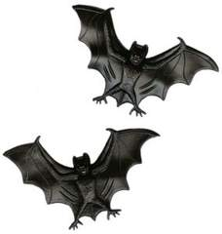

Slide 33
3- Coronavirus
In September 2012 ,a case of novel coronavirus infection was reported involving a man in Saudi Arabia who was admitted to a hospital with pneumonia and acute kidney injury.
This virus has been named as Middle East respiratory syndrome coronavirus (MERS-CoV) ,virus closely related to several bat coronaviruses.
MERS-CoV infected several human cells , including lower but not upper respiratory, kidney ,intestinal, and liver cells.

Slide 34
4-Para – Influenza Viruses
paramyxoviridae family
Enveloped SS RNA,.
There are four para–influenza viruses: 1, 2, 3, 4
Para - influenza virus infection occur mainly in winter.
Transmitted by respiratory droplets.
Envelop surface projection presents as Heamagglutinin HA , Neuroamindase NA,
F-glucoprotins which cause cell TO cell membrane to fuse syncytia

Slide 35
Clinical Syndromes:
1- Croup or Acute Laryngotracheobronchitis:
parainfulenza Type I,II seen in infants & young children < 5 years.
Harsh cough, inspiratory stridor with Hoarse voice and difficult inspiration which can lead to airway obstruction which need hospitalization to do tracheotomy.
2- Bronchiolitis and pneumonia:
Sometime parainfluenza type 3 can cause bronchiolitis and pneumonia in young children.
3- Common Cold:
Seen in older children and adult.
4- Immunocompromized:
Parainfluenza type 3 very dangerous, especially in bone marrow transplant patient.

Slide 36
Laboratory Diagnosis:
A-Direct detection of parainfluenza virus from
nasopharyngeal aspirate by direct immunofluorescent.
B-Culture :
Isolation of the virus from nasopharyngeal aspirate OR mouth wash in cell culture will appear as multinucleated giant cell (syncitia).
Treatment and Prevention:
Hospital admission for infant having Croup for careful
monitoring of upper airway (endotracheal intubation and tracheotomy)
No specific antiviral treatment, no vaccine available.

Slide 37
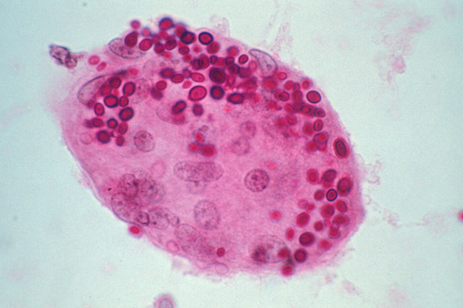
Viral protein that mediates fusion of an infected cell with neighboring cells leading to the formation of multi-nucleate enlarged cells called syncytia. Usually these syncytia are the result of expression of a viral fusion protein at the host cell membrane during viral replication. Viruses such as para-influenza virus are known to induce the formation of syncytia.

Slide 38
5-Respiratory Syncytial Virus (RSV)
One of the paramyxoviridae family.
Enveloped ,ss RNA .
The virus transmitted by respiratory droplets, RSV virus is
very contagious with( I.P. 3-6 days) infection mainly in winter.
The importance of RSV lies in its tendency to invade the lower respiratory tract of infant <6 months
Bronchiolitis & pneumonia ,,

Slide 39
Clinical Syndromes:
RSV can cause any respiratory tract illness from common cold pneumonia
In old children and adult can cause common cold .
Bronchiolitis an important and life –threatening disease in infant especially under 6 months of life, started with fever, nasal discharge, rapid breathing, respiratory distress and cyanosis, it may be fatal in premature infant or infant with underlying disease or immunocompromised infant, also can lead to chronic lung disease in later life.
Pneumonia: also an important and life threatening disease in infant with case fatality rate of 2-5% .

Slide 40
Laboratory Diagnosis:
Isolation of the virus from nasopharyngeal aspirate OR mouth wash in cell culture will appear as multinucleated giant cell (syncitia).
ELISA and immunofluorescent for direct detection from
nasopharyngeal aspirate.

Slide 41
Viral protein that mediates fusion of an infected cell with neighboring cells leading to the formation of multi-nucleate enlarged cells called syncytia. Usually these syncytia are the result of expression of a viral fusion protein at the host cell membrane during viral replication. Viruses such as RSV are known to induce the formation of syncytia.

Slide 42
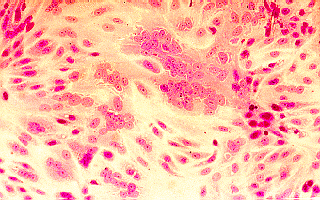
Isolation in cell culture
(multinucleated giant cells or syncytia)

Slide 43
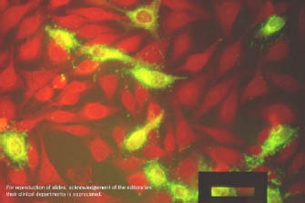
Immunoflurescence on smears of respiratory secretions immunofluorescent for direct detection from
nasopharyngeal aspirate.

Slide 44
Treatment and Prevention:
Infant will be hypoxic and need hospitalization
(oxygen inhalation).
Ribavirin given by inhalation to treat severe
Bronchiolitis and pneumonia.
Passive immunization with anti-RSV immunoglobulin is
available for premature infant.
Hospital staff caring for these isolated infants have to follow
control measure as hand washing, wearing of gowns, goggles and
mask.
No vaccine is available.

Slide 45
6-Family Adenoviridae (Adenoviruses)
dsDNA, non-enveloped viruses with 47serogroup,
, grouped into 6 group from A –F.
Adenoviruses infect epithelial cells lining respiratory tract,
conjunctiva, gastrointestinal tract, and genital tract
Viremia may occur after this local replication of the viruses
so virus can spread to other visceral organs… e.g. Urinary bladder
The Adenoviruses have the tendency to become latent in
lymphoid tissue and can be reactivated if immunity become low.

Slide 46
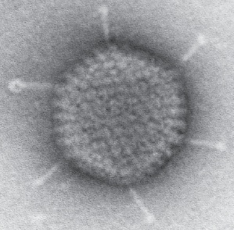
Adenovirus
nom
Adenovirus infects epithelial cell lining respiratory tract, Conjunctiva, urinary tract, gastrointestinal tract and genital tract.
Clinical syndrome:
Phrayngitis and tonsilitis.
Pharyngio conjunctivitis
Kerato conjunctivitis (serous infection).
Pneumonia: in preschool children.
Gastroenteritis.
Acute hemorrhagic cystitis.
Cervicitis and urethritis.
Treatment and prevention: No specific treatment or vaccine.

Slide 47
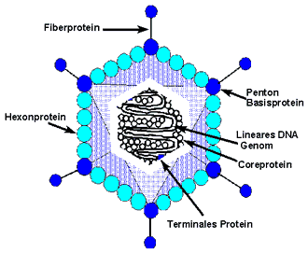
The fibers possess hemagglutinating activity and mediate the attachment of the virus to cellular receptors.

Slide 48
Spread and Transmission:
Fecal – oral route by fingers, fomit and poorly chlorinated
swimming pool.
Respiratory – via respiratory droplets.
Contaminated instruments at eye – clinics.
Adenovirus has been cultured from semen, so can be spread by
sexual transmission??

Slide 49
Clinical Syndrome:
Adenovirus primary infect children and less commonly infect adult.
Reactivation occur if the patient become immunocompromised in children or adult.
The main clinical syndromes:
1) Acute Febrile pharyngitis: Occur in preschool children , fever nasal congestion and cough (URTI) .
Conjunctivitis: Follicular conjunctivitis, can occur as sporadic cases or as an outbreaks .
Pharyngo-conjunctival fever: It occurs more often in children and presents with pharyngitis& conjunctivitis and fever

Slide 50
Clinical Syndrome: (Continued)
Keratoconjunctivitis: (Infection of Cornea and Conjunctiva) It is due to irritation of the eye by a foreign bodies, dust or debris, or contaminated instruments at eye – clinic.
Acute respiratory tract disease: Fever, cough, pharyngitis and cervical adenitis it is mainly occur in Military recruits serotype 4,7).
Pneumonia: Particularly type 3-7 are a significant cause of pneumonia in preschool children which can be followed by residual lung damage.
Viral gastro-entrites : diarrhea mainly in young children and infant (serotypes 40 and 41).
Mesenteric adenitis and intussusceptions : mainly in children.

Slide 51
Clinical Syndrome: (Continued)
9) Acute hemorrhagic cystitis, dysuria and heamaturia.
10) Cervicitis and urethritis ? Sexually Transmitted.
11) Systemic infection in immunocompromised patient.
In these group of patient infection become severe as pneumonia or hepatitis it can be primary exogenous infection or reactivation.

Slide 52
Laboratory Diagnosis:
Specimens: nasopharyngeal aspirate ( respiratory cells), Conjunctival swab and Stool.
Mainly the diagnosis by direct detection of viral antigen by
Immunofluorescence and ELISA.
.
Treatment, Prevention and Control
No specific treatment available
Live Oral vaccine used to prevent acute respiratory tract
infection for Military recruits [adenovirus serotype 4 –7].

Slide 53
Good luck

