Slide 1
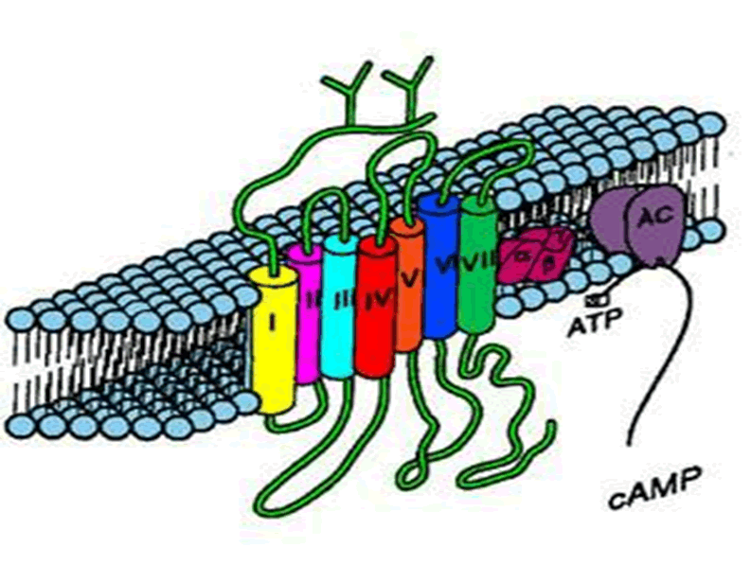
PHARMACOLOGY OF SNS

Slide 2
Adrenoceptor Blockers
Adrenolytics
Adrenergic Neuron Blockers Sympatholytics
Alpha & beta- adrenergic receptor blockers

Slide 3
ADRENERGICS STIMULANTS [AGONISTS]
Direct Sympathomimetics
Indirect Sympathomimetics
Dual Sympathomimetics

Slide 4
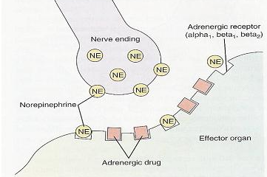
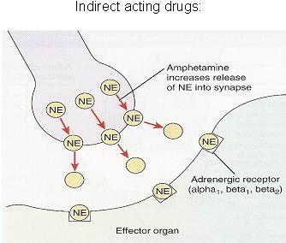
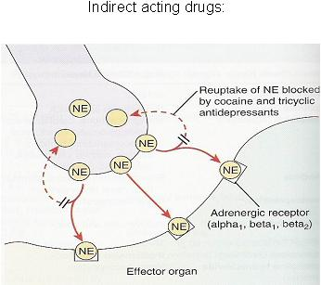
ADRENERGIC STIMULANTS
According to mode of action;
Direct; Stimulate adrenergic receptors directly.
e.g. adrenaline, noraderanaline, dopamine, isoprenaline, phenylephrine, clonidine, dobutamine, salbutamol….etc
Indirect;
Release of NE from presynaptic stores at adrenergic terminals. e.g. amphetamine
Inhibit uptake its availability in synapse. e.g. Cocaine
Dual; Direct and indirect stimulation of adrenergic receptors
e.g. ephedrine, pseudoephedrine

Slide 5
ADRENERGIC STIMULANTS
According to spectrum of action;
Non-Selective;
norepinephrine, epinephrine, dopamine, isoprenaline, ephedrine,…etc
Selective;
α₁; Phenylephrine
α₂; Clonidine
β₁; Dobutamine
β₂; Salbutamol

Slide 6
ADRENERGICS AGONISTS
Direct Sympathomimetics

Slide 7
ADRENERGIC STIMULANTS
DIRECT Acting Sympathomimetics
ADRENALINE
Naturally released from adrenal medulla  2^{ndry} to stress, hunger, fear
Inactivated by intestinal enzymes, so given parentral & by inhalation
Acts on all ADR; β =/> α .
Pharmacological actions see physiological actions of the SNS
Heart  stimulate properties of heart (β₁)
BP  (β₁) & (α₁) /  (β₂)
Vascular SMC; constrict skin + peripheral (α₁) / dilate coronary+skeletal (β₂)
Non vascular SMC;
Lung  bronchiodilatation (β₂)
GIT  motility (β₂) / contract sphincter (α₁)
Bladder   detrusor m. (β₂) / contract trigone & sphincter (α₁)
Pregnant uterus  tocolytic (β₂)
Eye  mydriasis (α₁) /  no effect on accommodation or intraocular P
Metabolism insulin (α₂) , glucagon (β₂),  liver glycogenolysis + sk. m. glycolysis (β₂) /   adipose lipolysis (β₃ /β₂)
CNS little, headache, tremors & restlessness

Slide 8
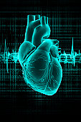
ADRENALINE
Indications
Used locally; as haemostatic (in epistaxsis)
with local anesthetics  its absorption  toxicity & prolong action +  bleeding from incision
Used systemically for treatment of
Allergic reactions  drug of choice in anaphylactic shock, angioneurotic edema as it is the physiological antagonist of histamine
i.e.  BP & cause vasoconstriction
In status asthmatics  given parentally  bronchodilatation (β₂) +  mucosal edema (α₁)
N.B. Selective β₂ are better by inhalation
In cardiac arrest  direct
but now through central line
N.B. Selective β₁ are better

Slide 9
ADRENALINE
ADRs
Tachycardia, palpitation, arrhythmias, angina pains
Headache, weakness, tremors anxiety and restlessness.
Hypertension  cerebral hemorrhage and pulmonary edema.
Coldness of extremities
Tissue necrosis and gangrene if extravasation
Nasal stuffiness  rebound congestion
Contraindications
CHD, hypertension, peripheral arterial disease.
Hyperthyroidism.

Slide 10
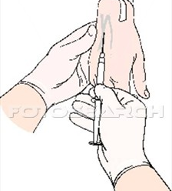
ADRENERGIC STIMULANTS
Direct Acting Sympathomimetics
NOREPINEPHRINE = NORADRENALINE
Naturally released from postganglionic adrenergic fibres
Not much used  severe vasoconstriction
Acts on α > β₁
Only administered IV - Not IM or Subcutaneous necrosis
It  BP [ systolic & diastolic]  reflex bradycardia (vagal stimulation)
Indications
Used systemically; hypotensive states (in spinal anesthesia, in septic shock, if fluid replacement and inotropics fail) !!!
Used topically; as a local haemostatic
with local anesthetic !!!???
ISOPRENALINE
Synthetic; show no presynaptic uptake nor
breakdown by MOA  longer action. Acts on β > > α
10 times > broncho-dilatation Was used by inhalation in acute asthma
Used in cardiac arrest but contraindicated in hyperthyroidism & congestive heart failure [CHD]

Slide 11
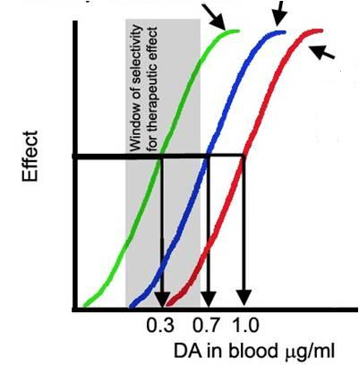
ADRENERGIC STIMULANTS
Direct Acting Sympathomimetics
DOPAMINE
Heart β₁  force + diuresis
Kidney D₁ vasodilatation
Natural CNS transmitter.
Released from postganglionic
adrenergic fibres (> renal vessels)
Releases NE from postganglionic adrenergic fibres
Acts on D₁ > β₁ > α₁
Vessels α₁ vasoconstriction
On heart 
Inotropic
On BP  According to dose;
first  D₁
then  due to β₁
followed by α₁ effect

Slide 12
ADRENERGIC STIMULANTS
Direct Acting Sympathomimetics
DOPAMINE
Given parentrally by infusion
Indications
It is the drug of choice in treatment of SHOCK septic, hypovolaemic (after fluid replacement), cardiogenic
It  BP & CO (β₁), without causing renal impairment (D₁)
Can be given in acute heart failure (HF) but better dobutamine

Slide 13
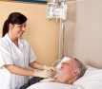
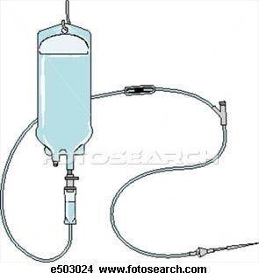
ADRENERGIC STIMULANTS
Direct Acting Sympathomimetics
DOBUTAMINE
Synthetic. Given IV.
Acts on β₁ > β₂ > > > α₁
On heart  Inotropic with little chronotropic effect
On BP  Hardly any effect; β₁ & β₂ counterbalance + no α₁
Indications
Given parentrally by infusion for short term management of cardiac decompensation after cardiac surgery, in acute heart failure [AHF].
It does not  oxygen demand

Slide 14
ADRENERGIC STIMULANTS
Direct Acting Sympathomimetics
PHENYLPHERINE
Synthetic
Given orally & has prolonged duration of action.
Acts as selective α₁
MIDODRINE
Peaks in 20 min.
t_{½} 30 min.
On heart  reflex bradycardia
On BP   due to vasoconstriction (α₁ )
Indications
In Hypotension
Systemically; Pressor agent in hypotensive states. Infusion
Terminate atrial tachycardia (reflex bradycardia)
Nasal decongestant. Oral
Topically; Local Haemostatic, with Local anesthesia.
Decongestant (nasal & ocular)

Slide 15
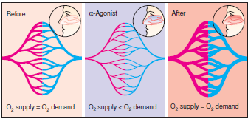
ADRENERGIC STIMULANTS
Direct Acting Sympathomimetics
Pseudoephedrine
Nasal & Ocular Decongestants
Phenylephrine
Methoxamine
Naphazoline
Oxymetazoline HCI (Afrin)
Xylometazoline HCI (Otrivine)
Used for treatment of nasal stuffiness
But can cause Rebound nasal stuffiness
CLONIDINE
Synthetic, Given orally or as patch.
Selective on presynaptic α₂   BP (at nucleus tractus solitarius to  sympathetic outflow)  Antihypertensive agent ???
N.B. Brimonidine  α₂ agonist used in glucoma

Slide 16
ADRENERGIC STIMULANTS
Direct Acting Sympathomimetics
SALBUTAMOL
Synthetic. Given orally, by inhalation or parentral.
Selective on β₂  on bronchi.
Bronchodilater  asthma & chronic obstructive airway disease (COPD)
N.B. Salmeterol & Formoterol are longer acting preparations
Other selective β₂ agonists :
Terbutaline; Bronchodilator & Tocolytic
Ritodrine; Tocolytic  postpone premature labour
(labour that begins before the 37th week of gestation).

Slide 17
ADRENERGICS STIMULANTS [AGONISTS]
Indirect Sympathomimetics
AMPHETAMINE
It acts indirectly;
Release NE from adrenergic nerve endings
Because it depletes vesicles of stored NE tachyphylaxsis
Acts on α& β + CNS stimulant effects;
 euphoria  causes its abuse…..
◉ Weight   appetite
 increase energy expenditure
No more used  induces psychic & physical dependence

Slide 18
ADRENERGICS STIMULANTS [AGONISTS]
Dual Sympathomimetics
EPHEDRINE
Mixed sympathomimetic;
Prolonged direct action on receptors  receptor down regulation
Release NE from adrenergic nerve endings depletes stores
 tachyphylaxsis
Absorbed orally, not destroyed by MAO or COMT  prolonged action
Acts on α& β
+ > facilitate neuromuscular transmission & retention of urine
+ has CNS stimulant effects less than amphetamine
Abused by athletes and prohibited during games.

Slide 19
Agents specifically indicated for hypotension
Midodrine, Phenylephrine, Norepinephrine, Phenylpropanolamine
Agents specifically indicated for cardiogenic shockAHF
Dobutamine, Dopamine, Epinephrine
Agents specifically indicated for shock
Dopamine, Norepinephrine
Agents specifically indicated for cardiac arrest Dobutamine, Epinephrine, Norepinephrine
Agents specifically indicated for bronchial asthma
Salbutamol, Salmeterol, Formoterol, Terbutaline, Isoprenaline
Agents specifically indicated for premature labour
Ritodrine, Terbutaline
Agents specifically indicated for nasal decongestion
Pseudoephedrine, Naphazoline, Oxymetazoline, Phenylephrine, Xylometazoline
Agents specifically abused in sports  Ephedrine, Amphetamine

Slide 20
GOOD LUCK

