Slide 1
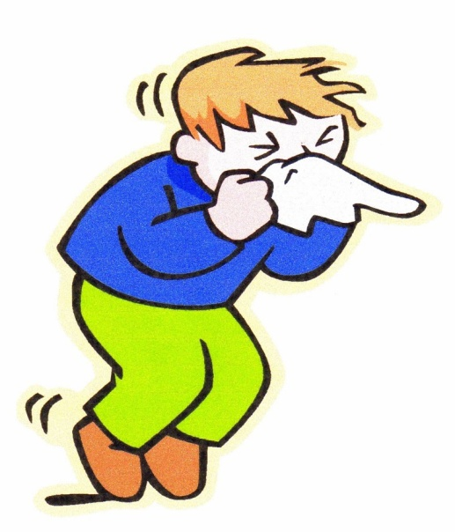
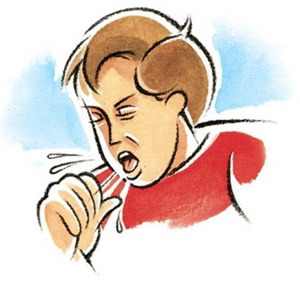
TREATMENT OF
RHINITIS & COUGH
ILOs
Classify types of rhinitis
Specify preventive versus pharmacotherapeutic strategies
Expand on the pharmacology of different drug groups used in treatment as antihistamines, anti-allergics, corticosteriods, decongestants and anti-cholinergics
Differentiate between productive versus dry irritant cough
Compare pharmacology of different expectorants & mucolytics drugs used in treatment of productive cough
Contrast between peripherally and centrally acting antitussives

Slide 2
RHINITIS
Irritation &/or inflammation
of the mucous membranes
inside the nose
Non - Inflammatory
Inflammatory
Infectious
Allergic
NON-ALLERGIC
ALLERGIC
Seasonal
Perennial
HAY FEVER
ACUTE RHINITIS (7- 14 DAYS)
CHRONIC RHINITIS (> 6 WEEKS)

Slide 3
Runny nose (rhinorrhea)
Stuffy Blocked nose
Sneezing
Nasal congestion
Post-nasal drip
Itching
Catarrh (other m. membrane involvement )……
RHINITIS
+
Systemic
Manifestations
TREATMENT
PREVENTIVE THERAPY
1- Environmental Control
2- Allergen Immunotherapy
PHARMACOTHERAPY
1- H₁ receptor antagonists; Antihistamines
2- Anti-allergics
Mast Cell Stabilizer; Cromolyn
Leukotriene receptor antagonists; Montelukast
3- Corticosteroids
4- Decongestants; α-Adrenergic agonists
5- Anticholinergics
6- Antibiotics
7- Mycolytics…..
In infection, with chronicity & more if it is rhinosinusitis

Slide 4
1- ANTIHISTAMINES
H₁ receptor blockers
CLASSIFICATION [Chemical / Functional] USES vs ADVERSE EFFECTS
First GENERATION Second GENERATION Third GENERATION
1) ALKYLAMINES Chlorpheniramine 2) ETHANOLAMINES Dimenhydrinate Diphenhydramine 3) ETHYLENEDIAMINES Antazoline` 4) PHENOTHIAZINES Promethazine 5) PIPERAZINE Cyclizine Cetirizine Levocetirizine
6) PIPERIDINES Azatidine Fexofenadine
Loratidine Desoloratidine
Ketotifen 7) MISCELLANEOUS Cyproheptadine
Short duration
Longer duration = better control
Interactions; with enzyme inhibitors
[ macrolides, antifungals, calcium antagonists]
+ additive pharmacodynamic ADRs
No drug interactions & minimal ADRs
All are used systemic or topical

Slide 5
ANTIHISTAMINES
First GENERATION Second GENERATION Third GENERATION
Chlorpheniramine Dimenhydrinate Diphenhydramine Antazoline` Promethazine Cyclizine Cetirizine Levocetirizine
Azatidine Fexofenadine
Loratidine Desoloratidine
Ketotifen Cyproheptadine
ANTIHISTAMINIC ACTION Non-selective Selective More Selective
Lipophylic Non-lipophylic Non-lipophylic
Cross BBB poor cross BBB not cross BBB
SEDATING NON - SEDATING NON - SEDATING
> efficacy +ANTIALLERGIC > > efficacy>ANTIALLERGIC
Little / Major side effects Rare side effects
Insomnia
Sleep aid
Vertigo
Anxiety
Cough
In Children
Excitation
Agitation
Convulsions
Itching
In Allergic Conditions
Are “drying agents”;  secretions & localized inflammation
Act more on Upper > Lower airways
SEDATION is either used Therapeutically or avoided ; being a Side Effect

Slide 6
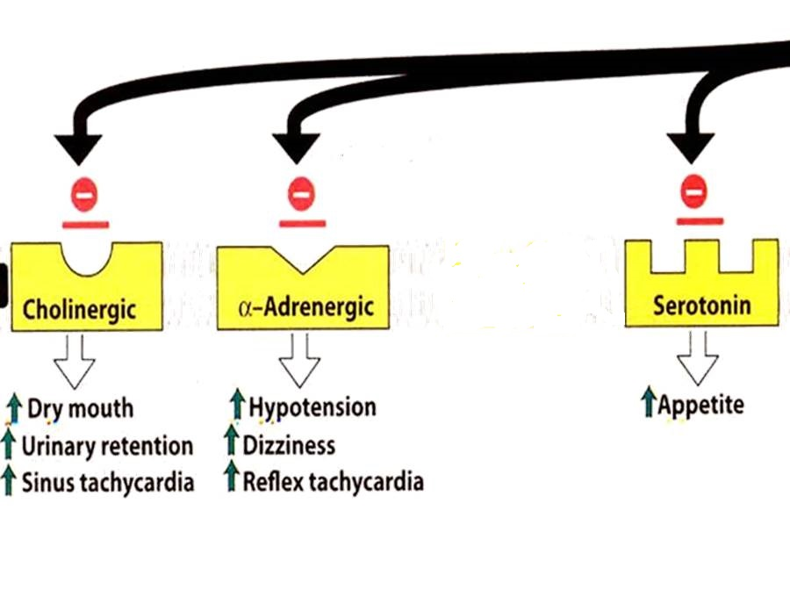
GOOD CONTROL of Rhinitis, Conjunctivitis, Urticaria, Flu (cough & sneezing)
ALLERGIES
POOR CONTROL of Asthma, Otitis, Anaphylaxis, Sinusitis, Atopic dermatitis
INDICATIONS linked to H1 block
ITCHING
Even if
non-allergic
INDICATIONS not linked to H1 block
ANTIHISTAMINES
Others
Insomnia
Sleep aid
Vertigo
Anxiety
Cough
Side Effects
Interactions
Side Effects
Interactions
Side Effects
Interactions

Slide 7
ANTIHISTAMINES
INDICATIONS not linked to H1 block
1. Vertigo & Motion sickness Dimenhydrinate, Diphenhydramine, Promethazine
◉ firing from internal ear to vomiting center
2. Anti-emetic Promethazine
◉ firing to vomiting center + Anticholinergic
3. Anti-parkinsonism Chlorpheniramine, Dimenhydrinate , Promethazine
by anticholinergic action Extra-pyramidal effects
4. Increase appetite !!! Cyproheptadine
by 5-HT modulation
Sedation
5. Anti-arrhythmic actions !!! Promethazine, Antazoline
by Na channel blocking action & local anesthetic effects

Slide 8
2-ANTI-ALLERGICS
CROMOLYN & NEDOCROMYL
◉ Histamine release [mast cell stabilizer by inhibiting Cl channels] i.e. can act only prophylactic; it does not antagonize released histamine
Used more in children for prophylaxis of perennial allergic rhinitis [ nasal drops] > than allergic or exercise induced asthma [as inhaled powder or neubilized solution]
Should be given on daily base and never stop abruptly.
Can induce cough, wheezes, headache, rash, …etc.
LEUKOTRIENE RECEPTOR ANTAGONISTS
Block leukotriene actions
For prophylaxis of lower respiratory [i.e perennial allergen, exercise or aspirin-induced asthma] > upper respiratory allergies [chronic rhinosinusitis]
ADRs; as in asthma
3-CORTICOSTERIODS
Anti-inflammatory blocks phospholipase A₂ 
arachedonic a. synthesis   prostaglandins & leukotrienes
Topical; steroid spray; beclomethasone, budesonide, & fluticasone
Given if severe intermittent or moderate persistent symptoms
ADRs; Nasal irritation, fungal infection, hoarseness of voice

Slide 9
4. DECONGESTANTS
α-Adrenergic agonists
For treatment of nasal stuffiness
SYSTEMIC
TOPICAL
PSEUDOEPHEDRINE
PHENYLETHYLAMINES
IMIDAZOLINE
Phenylephrine
Methoxamine
Naphazoline
Oxymetazoline HCI
Xylometazoline HCI
Can cause nervousness, insomnia, tremors, palpitations, hypertension.
Better avoided in hypertension, heart failure, angina pectoris, hyperthyroidism glaucoma
But can cause Rebound nasal stuffiness (repeated administration (10 days -2 weeks)
5. ANTICHOLINERGICS
Ipratropium
Given as nasal drops to control rhinorrhea (excess nasal secretion & discharge) So very effective in vasomotor rhinitis (watery hyper-secretion).
Its indication as bronchiodilator in asthma and ADRs  see asthma

Slide 10
Effectiveness of different drug groups in controlling symptoms of RHINITIS
Drug Groups | Main Symptom
 | Sneezing | Blockage Stuffiness | Secretions Rhinorrhea
Anti-histamines | ++ | - | +
Anti-allergics (cromolyns) | + | + | +
Topical corticosteroids | ++ | ++ | ++
Decongestant | - | ++ | -
Anticholinergics | - | - | ++

Slide 11
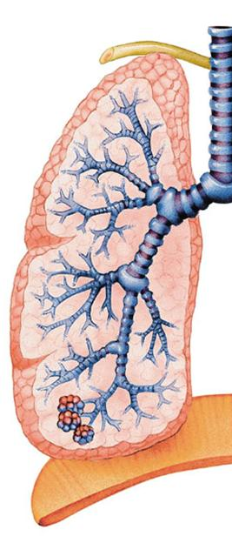
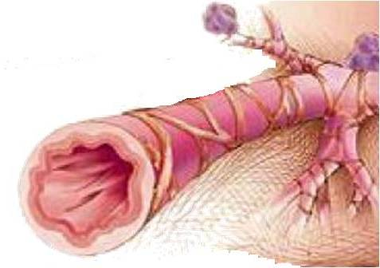
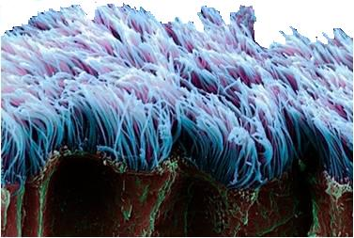
DRUGS USED
IN TREATMENT OF COUGH

Slide 12
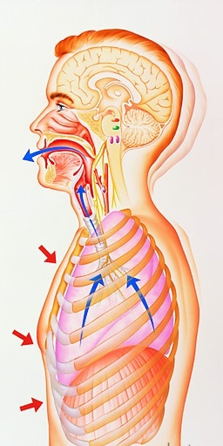
is protected mainly by
The respiratory tract
1. MUCOCILIARY CLEARANCE  ensures optimum tracheobronchial clearance by forming sputum (in optimum quantity & viscosity ) exhaled by ciliary movement s.
2. COUGH REFLEX  exhales sputum out, if not optimally removed by the mucociliary clearance mechanisms
Coughing is sudden expulsion of air from the lungs through the epiglottis at an amazingly fast speed (~100 miles/ hr) to rid breathing passage ways of unwanted irritants. Abdominal & intercostal muscles contract, against the closed epiglottis  pressure   air is forcefully expelled to dislodge the triggering irritant.
Cough is meant to be useful “wet or productive”
May not be useful & annoying 2ndry to irritant vapors, gases, infections, cancer “dry or irritant”
EXPECTORANTS
MUCOLYTICS
For Productive Cough
TREATMENT
ANTITUSSIVE AGENTS
For Non-productive (dry) Cough

Slide 13
EXPECTORANTS
Act by removal of mucus through
Reflex stimulation
Irritate GIT  stimulate gastropulmonary vagal reflex  loosening & thinning of secretions  Guaifenesin
ADRs ; Dry mouth, chapped lips, risk of kidney stones(uric a. excretion)
Direct stimulation
Stimulate secretory glands   respiratory fluids production  Iodinated glycerol, Na or K iodide / acetate , Ammonium chloride, Ipecacuahna
ADRs; Unpleasant metallic taste, hypersensitivity, hypothyroidism, swollen of salivary glands( overstimulation of salivary secretion), & flare of old TB.
INDICATIONS
Final outcome is that cough is indirectly diminished
Common cold
Bronchitis
Laryngitis
Pharyngitis
Influenza
Measles
Chronic paranasal sinusitis
Pertussis

Slide 14
MUCOLYTICS
Act by altering biophysical quality of sputum becomes easily exhaled by mucociliary clearance or by less intense coughing
MECHANISM OF ACTIONS
Mucolysis occurs by one or more of the following;
◉ Viscoelasticity by water content; Hypertonic Saline & NaHCO₃
◉ Adhesivness; Steam inhalation
Breakdown S-S bonds in glycoproteins by its reducing SH Gp  less viscid mucous; N-Acetyl Cysteine
Synthesize serous mucus (sialomucins of smaller-size) so it is secretolytic + activate ciliary clearance & transport; Bromohexine & Ambroxol
Cleavage of extracellular bacterial DNA, that contributes to viscosity of sputum in case of infection; rhDNAase (Pulmozyme)
INDICATIONS
Most mucolytics  effective as adjuvant therapy in COPD, asthma, bronchitis, …etc. (when there is excessive &/or thick mucus….)
In bronchiectasis, pneumonia & TB  they are of partial benefit
Hardly any benefit in cystic fibrosis & severe infections  Give rhDNAase

Slide 15
1. N-Acetylcysteine
It is also a free radical scavenger  used in acetominophin overdose
ADRs; Bronchospasm, stomatitis, rhinorrhea, rash, nausea & vomiting
2. Bromhexine & its metabolite Ambroxol
They also immuno defence so  antibiotics usage
They also  pain in acute sore throat
ADRs; Rhinorrhea, lacrymation, gastric irritation, hypersensitivity
3. Pulmozyme (Dornase Alpha or DNAse)
 A recombinant human deoxyribo-nuclease-1 enzyme that is neubilized .
Full benefit appears within 3-7 days
ADRs;
Voice changes, pharyngitis, laryngitis, rhinitis, chest pain, fever, rash

Slide 16
ANTITUSSIVE AGENTS
Stop or reduce cough by acting either primarily on the peripheral or CNS components of cough reflex.
1. PERIPHERALLY ACTING ANTITUSSIVES
A. Inhibitors of airway stretch receptors
In Pharynx  Use Demulcents  form a protective coating
Lozenges & Gargles
In Larynx  Use Emollients  form a protective coating
menthol & eucalyptus.
In Tracheobronchial Airway Use aerosols or inhalational of hot steam tincture benzoin compound & eucalyptol
During bronchoscopy or bronchography  Use local anaesthetic aerosols, as lidocaine, benzocaine, and tetracaine
B. Inhibitors of pulmonary stretch receptors in alveoli
Benzonatate   sensitivity (numbing) of receptors by local anesthetic action.
ADRS; drowsiness, dizziness, dysphagia, allergic reactions
Overdose  mental confusion, hallucination, restlessness & tremors

Slide 17
ANTITUSSIVE AGENTS
2. CENTRALLY ACTING ANTITUSSIVES
A. OPIOIDS
activating µ opioid receptors
e.g. Codeine & Pholcodine
B. NON-OPIODS
Antihistaminics (>sedating)
Dextromethorphan
It  threshold at cough center. It has benefits over opiods in being 
1. As potent as codeine.
2- But no drowsiness.
3- Less constipating
4- No respiratory depression.
5- No inhibition of mucociliary clearance.
6- No addiction.
ADRs
Nausea, vomiting, dizziness, rash & pruritis in normal doses
In high doses, hallucinations + opiate like side effects on respiration & GIT

Slide 18
GOOD LUCK

