Slide 1
بسم الله الرحمن الرحيم

Slide 2
Phospholipid Compounds of Physiological Importance
By
Amr S. Moustafa, M.D.; Ph.D.

Slide 3
Objectives
Selected members of phospholipids
Physiological importance of phospholipids
Plospholipases:
    Phospholipases A1, A2, C and D
    Lysosomal phospholipase: Sphingomyelinase

Slide 4
Functions of Phospholipids
Membrane-bound phospholipids:
Structural: Predominant lipids of cell membranes
Anchoring: Attaching some proteins to membranes
Signaling: Source of PI3 and DAG
Myelin sheath: insulator and speeds up transmission of nerve impulses

Slide 5
Functions of Phospholipids
CONT’D
(B) Non-membrane-bound phospholipids:
Easy re-inflation of alveoli by air: Lung surfactant
Detergent effect: Essential component of bile
Solubilize cholesterol, preventing gall stones
Emulsifying lipids, helping lipid digestion
Structural: Coat of lipoproteins

Slide 6
Background: Lipid Compounds
Heterogeneous group
Relatively water-insoluble (? Exception)
Soluble in non-polar solvents

Slide 7
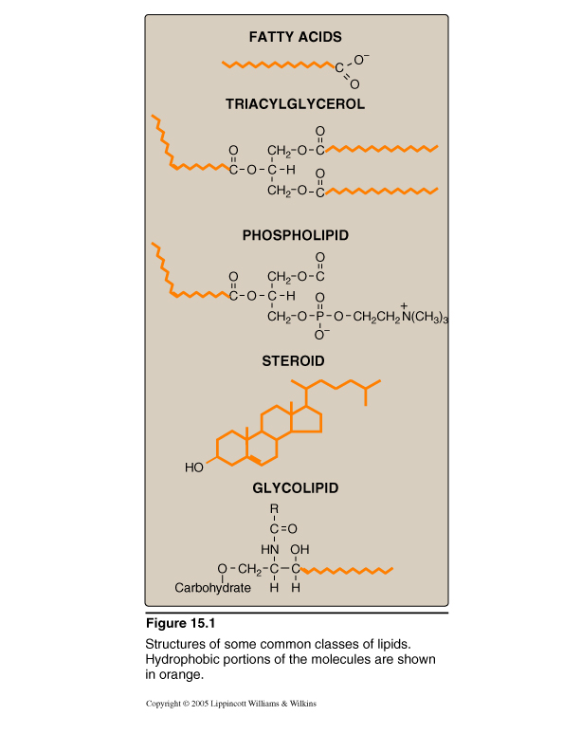
Lipid Compounds:
Heterogeneous Group
A. Simple Lipids:
Fatty acids
Ketone bodies
Triacylglycerol
Cholesterol
B. Complex Lipids:
Phospholipids
Lipoproteins
Glycolipids

Slide 8
Phospholipids
A. Glycerophospholipids
Glycerol-containing phospholipids
B. Sphingo-phospholipids:
Sphingosine-containing phospholipids

Slide 9
Phospholipids
A. Glycerophospholipids:
1. Phosphatidylcholine (Lecithin)
e.g., Surfactant (Dipalmitoylecithin)
2. Phosphatidylinositol
(Signaling and anchoring molecule)

Slide 10
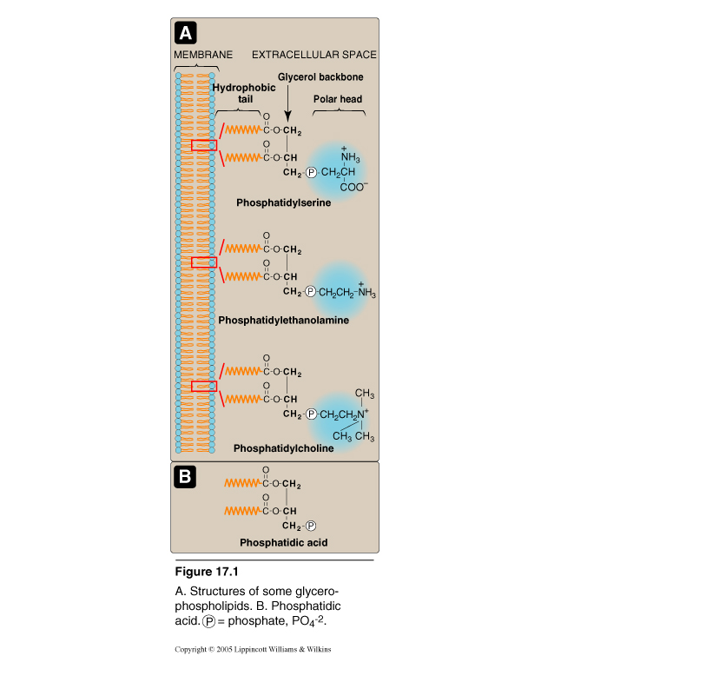
Phospholipids:
A. Glycerophospholipids
Members:
1. Phosphatidylcholine
(Lecithin)
e.g., Surfactant
(Dipalmitoylecithin)
Parent Compound
Phosphatidic acid

Slide 11
Phospholipids: A. Glycerophospholipids
1. Dipalmitoylecithin (Lung surfactant)
Synthesis and secretion: by granular pneumocytes
Major lipid component (65%) of lung surfactant
(Remainining 35%: Other phospholipids, cholesterol & proteins)
Surfactant decreases surface tension of fluid layer
lining of alveoli, reducing the pressure needed for their
inflation by air, and preventing alveolar collapse
(atelectasis)
Congenital Respiratory distress syndrome (RDS):
Insufficient production of lung surfactant
(especially in pre-term babies) neonatal death

Slide 12
Congenital Respiratory distress syndrome (RDS)
Pre-natal diagnosis by:
Lecithin/sphingomyelin (L/S) ratio in amniotic fluid
Ratio of 2 or above indicates lung maturity and no RDS
(i.e., shift from sphingomyelin to lecithin synthesis by
pneumocytes that normally occurs by 32 weeks of gestatioin)
Prevention:
    Glucocorticoids to the pregnant mother with
    low L/S ratio shortly before delivery
  Treatment:
  Intratracheal administration of surfactant to
  pre-term infants with RDS

Slide 13
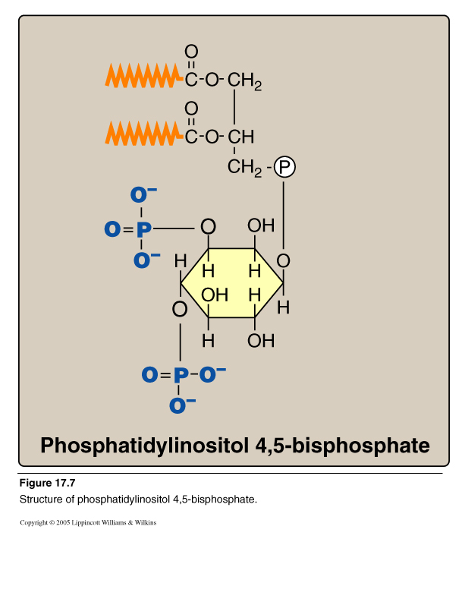
Phospholipids: A. Glycerophospholipids
2. Phosphatidylinositol 4,5 bisphosphate (PI)

Slide 14
Calcium/Phosphatidylinositol System
Diacylglycerol
(DAG)
Inositol Trisphosphate
(IP₃)
Phospholipase C

Slide 15
Phosphatidylinositol System
Signal: Hormones or neurotransmitters
e.g., Acetylcholine, antidiuretic hormone (V1- receptor) and catecholamines (α₁ actions)
Receptor: G-protein coupled receptor
Effects: *Activation of phospholipase C
Hydrolysis of phosphatidylinositol 4,5-bisphosphate
Production of IP3 ( Ca²⁺) and DAG
Activation of protein kinase C
Phosphorylation of cellular proteins
  * Please refer to activation of adenylyl cyclase and guanylyl cyclase for production of second messengers in other G-protein coupled signaling pathways
Response: Biological responses to hormones

Slide 16
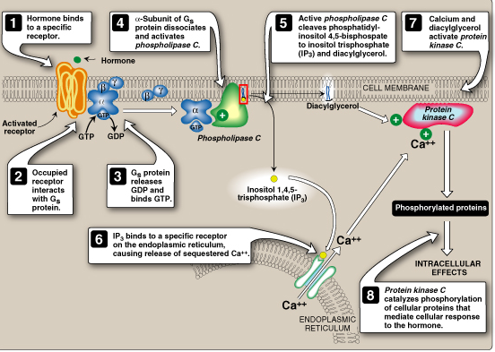
*
*
Acetylcholine
Antidiuretic hormone (ADH)
Catecholamines
Intracellular Signaling by Inositol trisphosphate

Slide 17
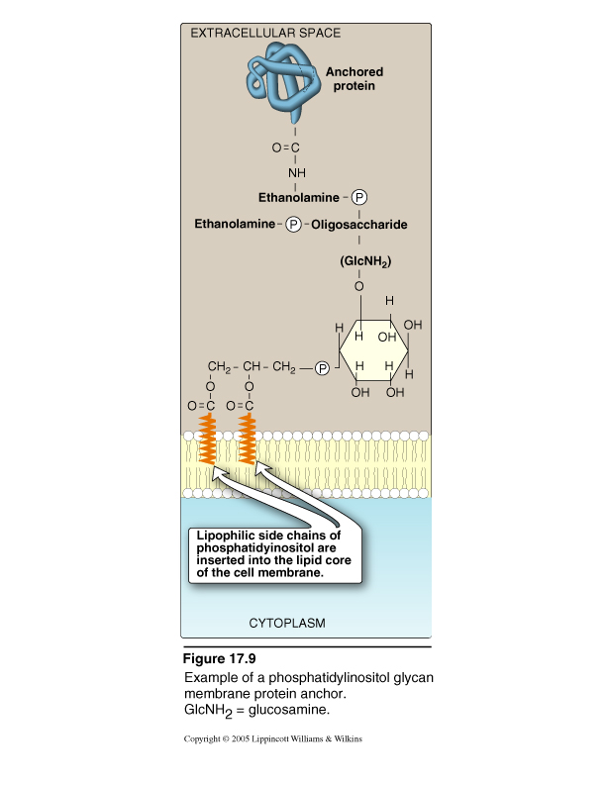
PI- Protein Anchoring
Anchoring of proteins to membranes
via
Carbohydrate-Phosphatidylinositol
Bridge
Examples of anchored proteins:
  1. Alkaline phosphatase
  (to the surface of small intestine)
  2. Acetylcholine esterase
  (to postsynaptic membrane)
These proteins can be cleaved from
their attachment to the membranes
by phospholipase C

Slide 18
Phospholipids
B. Sphingo-phospholipids:
Sphingosine-containing phospholipids:
e.g., sphingomyelin (Myelin sheath)

Slide 19
Phospholipids:
B. Sphingo-phospholipids
Sphingomyelin
CH₃ (CH₂)₁₂ CH CH CH CH CH₂O
Phosphorylcholine
OH
NH
CH₃
(CH₂)_{n}
C
O
Long Chain Fatty acid

Slide 20
Sphingosine
CH₃ (CH₂)₁₂ CH CH CH CH CH₂OH
OH
NH₂
Long chain, unsaturated amino alcohol

Slide 21
Ceramide: Parent Sphingolipid Compound
CH₃ (CH₂)₁₂ CH CH CH CH CH₂OH
OH
NH
CH₃
(CH₂)_{n}
C
O
Long Chain Fatty acid

Slide 22
Sphingomyelin
CH₃ (CH₂)₁₂ CH CH CH CH CH₂O
Phosphorylcholine
OH
NH
CH₃
(CH₂)_{n}
C
O
Long Chain Fatty acid

Slide 23
Structure & Function of Myelin Sheath
Glycolipids (mainly)
Myelin structure: Lipids (80%)
Sphingomyelin
Proteins (20%)
Myelin sheath insulates the nerve axon to avoid signal leakage
and greatly speeds up the transmission of impulses along axons
Direction of nerve impulse

Slide 24
Lipoprotein Structure
Outer part (coat):
Apoproteins or apolipoproteins
Phospholipids (Why?)
Free cholesterol
(Relatively hydrophilic, allowing transport of lipid particles of the core in the aqueous plasma)
Inner part (core):
  According to the type of lipoproteins
  Different lipid components in various combinations

Slide 25
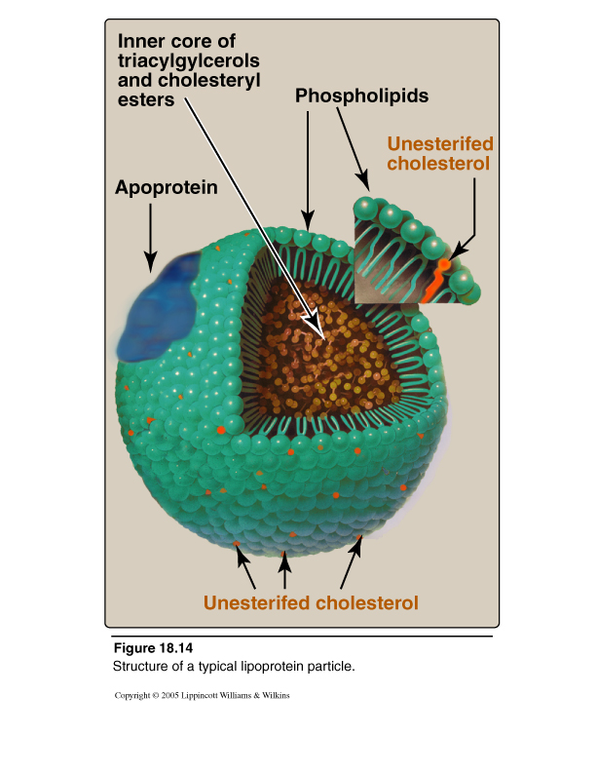
Lipoprotein Structure

Slide 26
Phospholipases
    (1) For glycerophospholipids:
    Phospholipases A1, A2, C and D
    Present in all tissues and pancreatic juice
    Present in snake venoms and bacterial toxins
    (2) For sphingophospholipids:
    Lysosomal phospholipase
    Sphingomyelinase
    Sphingomyelin Ceramide + Phosphocholine

Slide 27
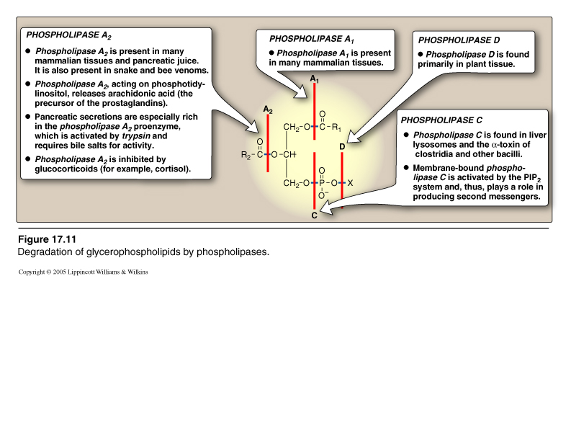
Glycero-phospholipases

Slide 28
Functions of Phospholipases
    (1) Degradation of phospholipids
    Production of second messengers
    Digestion of phospholipids by pancreatic juice
    Pathogenic bacteria degrade phospholipids of membranes and causing spread of infection
    (2) Remodeling of phospholipids:
    Specific phospholipase removes fatty acid from phospholipid
    Replacement of fatty acid by alternative fatty acid using fatty acyl CoA transferase
    e.g., Binding of 2 palmitic acids in: Dipalmitoylphosphatidylcholine (DPPC)
    Binding of arachidonic to carbon 2 of PI or PC

Slide 29
Take Home Message
Phospholipids are Complex lipids
Phospholipids have important physiological functions:
A. Membrane-bound:
Structural
Signalling & anchoring: e.g., PI
Myelin sheath: e.g., sphingomyelin
B. Non-membrane bound:
Structural: Lipoprotein coat
Alveolar re-inflation: Lung surfactant
Detergent effect: Phospholipids of bile

Slide 30
Take Home Message
CONT’D
Phospholipases:
Phospholipases A1, A2, C and D
Lysosomal Phospholipase: Sphingomyelinase
Function of phospholipases:
    Degradation of phospholipids
    e.g., production of second messengers
    Remodeling of phospholipids
    e.g., production of DPPC (lung surfactant)

