Slide 1
Viral infections of the respiratory tract
Lucture 3

Slide 2
The commonest of human infection
1-Influenza virus >Orthomyxoviridae
2-Rhinovirus>Picornaviridae family
3-Coronavirus>Coronaviridae family
4-Para influenza viruses> Paramyxoviridae family
5-Respiratory Synctial viruses >Paramyxoviridae
6-Adenovirus> Adenoviridae family.

Slide 3
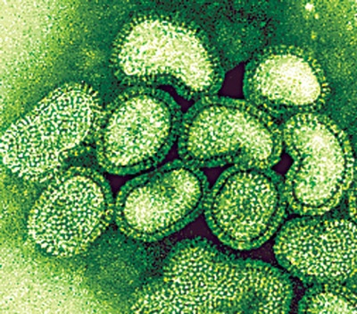
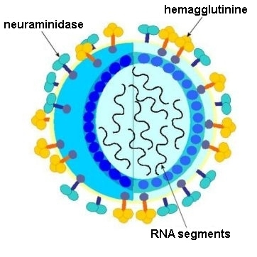
1-Orthomyxoviruses
Influenza Virus
1)Single, Stranded negative sense RNA with 8 helical segments, This virus is highly susceptible to mutations and rearrangements within the infected host.
2)Helical capsid symmetry
3)Enveloped viruses which contains 2 projecting glycoprotein spikes.
Heamagglutinin HA attachment.
The virus can agglutinate certain erythrocyte.
Neuroamindase NA an enzyme help in releasing progeny virus formation from infected cell.

Slide 4
*Very Important
Types of Influenza Viruses
Influenza A
Influenza B
Influenza C
Hard to control it
Infect human and
animals.
Infect human
Infect human only
Cause outbreaks&epidemic
Cause mild illness
Can cause epidemic
and pandemic
Antigenic drift only
pandemic
epizootic.
Antigenic drift
epidemic
antigenic shift.
Out
break

Slide 5
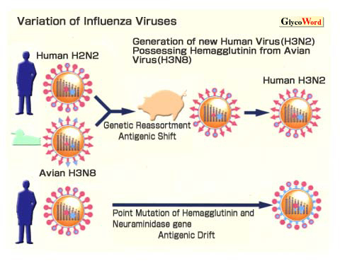

Slide 6
Pathogenesis & Immunity:
local upper respiratory tract infection.
According to the immunity, it can cause localized infection or spread to the lower respiratory tract infection.
Viremia usually& occurs (fever) .
self limiting condition in Immunocompetent person.
Complication of Influenza:
Primary Influenza Pneumonia.
2ndbacterial-pneuomonia > Strep. pneumoniae, H.influenzae
Myositis (inflammation of the muscle).
Post influenza encephalitis.(brain)
Bronchial Asthma.
Sinusitis.

Slide 7
Clinical Syndrome:
Transmission inhalation of respiratory secretion
Incubation period 1 - 4 days
Seasonal variation usually in winter
prognosis self limiting disease
Symptoms: Sudden onset of fever
Malaise – Headache
Sneezing – sore throat It takes 3 days.
Non-productive cough

Slide 8
Laboratory Diagnosis:
Clinical diagnosis.
Laboratory investigation done to distinguish influenza viruses from
other respiratory viruses and to identify the type and strain.
Specimen: Nasopharyngeal aspirate, nasal washing
Culture: on primary Monkey Kidney cytopathic effect occur 2- 3 days.
Rapid and direct detection of influenza virus A or B from nasopharyngeal aspirate by immunofluorescence and ELISA(most common laboratory diagnosis)
Rapid antigen immunofluorescence assay :Assay performed on cells from a nasopharyngeal aspirate, showing typical nuclear and cytoplasmic “apple-green” fluorescence after staining with monoclonal antibodies specific for influenza A.
RT-PCR (Nucleic acid testing)

Slide 9
Treatment:
Amantadine: Is only effective against influenza A virus(inhibiting the un coating step of influenza A virus.)
It has both therapeutic and prophylactic .It significantly reduced the duration of fever and illness is given to high risk group of patients who are not vaccinated because they have allergy from egg.

Slide 10
Oseltamivir (Tamiflu) :
It is Neuraminidase inhibitor which help the influenza virus invade respiratory tract cells.
It has to be given within the first 48 hours after the exposure.
INFLUANZA VACCINE
Tow types of vaccine ,both contain the current influenza A & B .
Vaccine should be given in October or November ,before the influenza season begins.
Yearly booster dose recommended.
1-The Flu shot vaccine
Inactivated (Killed vaccine),
Given to people older than 6 months, including healthy people as well as high risk groups.
2-The Nasal spray flue vaccine (Flu mist)
This is a live attenuated vaccine,Approved for use in healthy people only between 5- 49 years age.

Slide 11
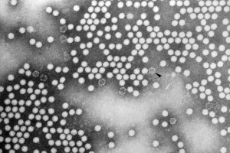
2-RHINOVIRUSES.
Common cold accounts for 1/3 to of all acute respiratory infections in humans.
Rhinoviruses are responsible for 60% of common colds cases,
Common cold is a self-limited illness.
More than 100 serologic types of rhinoviruses, No vaccine available.
Transmitted directly by respiratory droplet.
RHINOVIRUSES (PICORNAVIRUS family)
small non enveloped virus(20-30 nm),SS-RNA virus.
RHINOVIRUS are acid labile(sensitive).

Slide 12
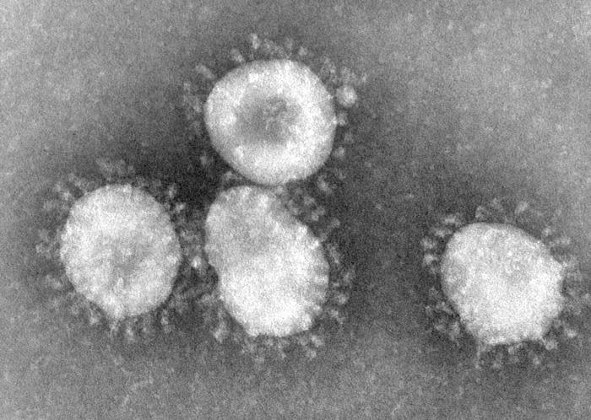
3-Coronaviruses
ssRNA enveloped with positive polarity.
second cause of common cold .
Clinical presentation of common cold:
Symptoms runny nose, sneezing and nasal obstruction, mild sore throat, headache and malaise that last for one week. NO FEVER
Complication: Usually due to secondary bacterial infection
Acute sinusitis 2) Acute otitis media.
3) Exacerbation of chronic bronchitis ,bronchial asthma.
Laboratory Diagnosis:
Usually no need.
Treatment and Prevention:
No specific treatment.
No vaccine available.
infect several human cells , including lower but not upper respiratory, kidney ,intestinal, and liver cells.
Severe Acute Respiratory Syndrome SARS
SARS is a viral infection, causes Atypical pneumonia, can infect all age groups, and can lead to death especially among people with existing chronic condition.
causative agent of SARS
A new mutation of coronavirus.Coronavirus is difficult to isolate and not easily grown in tissue culture.
Coronavirus is able to survive in dry air for up to 3 hours, but can be killed by exposure to ultra-violet light.

Slide 13
4-Para – Influenza Viruses
paramyxoviridae family
Enveloped SS RNA,.
There are four para–influenza viruses: 1, 2, 3, 4 (occur mainly in winter.)
Transmitted by respiratory droplets.
Envelop surface projection presents as Heamagglutinin HA , Neuroamindase NA,
F-glucoprotins which cause cell TO cell membrane to fuse syncytia
Clinical Syndromes:
1-Croup or Acute Laryngotracheobronchitis: a56rhom
parainfulenza Type I,II seen in infants & young children < 5 years.
Harsh cough,difficult inspiration which can lead to airway obstruction which need hospitalization to do tracheotomy.
2-Bronchiolitis and pneumonia: Sometime parainfluenza type 3 can cause bronchiolitis and pneumonia in young children.
3-Common Cold: Seen in older children and adult.
4-Immunocompromized: Parainfluenza type 3 very dangerous, especially in bone marrow transplant patient.

Slide 14
Laboratory Diagnosis:
nasopharyngeal aspirate by direct immunofluorescent.
Isolation of the virus from nasopharyngeal aspirate OR mouth wash in cell culture will appear as multinucleated giant cell (syncitia).
Treatment and Prevention:
Hospital admission for infant having Croup for careful monitoring of upper airway (endotracheal intubation and tracheotomy), No specific antiviral treatment, no vaccine available.

Slide 15
5-Respiratory Syncytial Virus (RSV)
paramyxoviridae family.
Enveloped ,ss RNA .
The virus transmitted by respiratory droplets, RSV virus is very contagious with( I.P. 3-6 days) infection mainly in winter.
The importance of RSV lies in its tendency to invade the lower respiratory tract of infant <6 months causing >Bronchiolitis & pneumonia.
Clinical Syndromes:
RSV can cause any respiratory tract illness from common cold>(0-6m)pneumonia
In old children and adult can cause common cold .
Bronchiolitis an important and life –threatening disease in infant especially under 6 months of life, started with fever, nasal discharge, rapid breathing, respiratory distress and cyanosis, it may be fatal in premature infant or infant with underlying disease or immunocompromised infant, also can lead to chronic lung disease in later life.
Pneumonia: also an important and life threatening disease.

Slide 16
Laboratory Diagnosis:
Isolation of the virus from nasopharyngeal aspirate OR mouth wash in cell culture will appear as multinucleated giant cell (syncitia).
ELISA and immunofluorescent for direct detection from nasopharyngeal aspirate.
Treatment and Prevention:
Infant (oxygen inhalation).
Ribavirin given by inhalation to treat severe Bronchiolitis and pneumonia.
Passive immunization with anti-RSV immunoglobulin is available for premature infant.
Hospital staff have to follow control measure
No vaccine is available.

Slide 17
6-Family Adenoviridae (Adenoviruses)
dsDNA, non-enveloped viruses with 47serogroup, grouped into 6 group from A –F.
infect epithelial cells lining respiratory tract,conjunctiva, gastrointestinal tract, and genital tract.
Viremia may occur after this local replication of the viruses so virus can spread to other visceral organs… e.g. Urinary bladder
have the tendency to become latent in lymphoid tissue, can be reactivated if immunity is low.
Spread and Transmission:
Fecal – oral - Respiratory – via respiratory droplets. -Contaminated instruments at eye – clinics. - has been cultured from semen, so can be spread by sexual transmission.
Clinical Syndrome:
infect children and less commonly infect adult.
Reactivation occur if the patient become immunocompromised in children or adult.

Slide 18
The main clinical syndromes:
Acute Febrile pharyngitis: Occur in preschool children , fever nasal congestion and cough (URTI) .
Conjunctivitis: Follicular conjunctivitis, can occur as sporadic cases or as an outbreaks .
Pharyngo-conjunctival fever: It occurs more often in children and presents with pharyngitis& conjunctivitis and fever
Keratoconjunctivitis: (Infection of Cornea and Conjunctiva) It is due to irritation of the eye by a foreign bodies, dust or debris, or contaminated instruments at eye – clinic.
Acute respiratory tract disease: Fever, cough, pharyngitis and cervical adenitis it is mainly occur in Military recruits serotype 4,7).
Pneumonia: Particularly type 3-7 are a significant cause of pneumonia in preschool children which can be followed by residual lung damage.
Viral gastro-entrites : diarrhea mainly in young children and infant (serotypes 40 and 41).
Mesenteric adenitis and intussusceptions : mainly in children.
Acute hemorrhagic cystitis, dysuria and heamaturia.
Cervicitis and urethritis ? Sexually Transmitted.
Systemic infection in immunocompromised patient.
In these group of patient infection become severe as pneumonia or hepatitis it can be primary exogenous infection or reactivation.

Slide 19
Laboratory Diagnosis:
Specimens: nasopharyngeal aspirate ( respiratory cells), Conjunctival swab and Stool.
Mainly the diagnosis by direct detection of viral antigen by
Immunofluorescence and ELISA.
Treatment, Prevention and Control
No specific treatment available
Live Oral vaccine used to prevent acute respiratory tract
infection for Military recruits [adenovirus serotype 4 –7].

Slide 20
MCQs
1.Which one of the following is considered as first cause of common cold?
Rhinovirus b. Coronavirus c. Adenovirus
2.Which one of the following is structurally non-enveloped?
Parainfluenza b. Coronavirus c. Rhinovirus
3.Which one of the following is the only virus with dsDNA?
Adenovirus b. Influenza c. Respiratory Syncitial
4.Avian flu do not usually infect humans.
a. T b. F
1.A
2.C
3.A
4.A

Slide 21
Good Luck
Done by :
Microbiology Team
contact us: microbiology434@gmail.com

