Slide 1
MERS-CoV & other viruses transmitted by respiratory system

Slide 2
Objectives:
Introduction to severe respiratory viral infections and examples of childhood fever
Characteristics of MERS-CoV, Measles, Mumps, Parvovirus B19 viruses
Mode of transmission
Clinical features
Lab diagnosis
Management & treatment

Slide 3
Severe forms of Coronavirus
SARS-CoV
MERS-CoV
Family: Coronaviridae.
Structural features: Enveloped virus with +polarity ss-RNA genome.
Transmission: inhalation of infectious aerosol droplets.
Clinical symptoms: the 2nd cause of common cold.
(Coronavirus also causes zoonotic disease "the virus is capable of infecting humans and animals including birds, camels and others")

Slide 4
SARS-CoV
Severe Acute Respiratory Syndrome (SARS)
In 2002 (SARS) emerged in China after a new mutation of Coronavirus.
The disease spread worldwide due to traveling.
The animal reservoir may be cats.
SARS starts with high fever followed by cough with difficulty in breathing (atypical pneumonia).
Associated with high mortality due to respiratory failure.

Slide 5
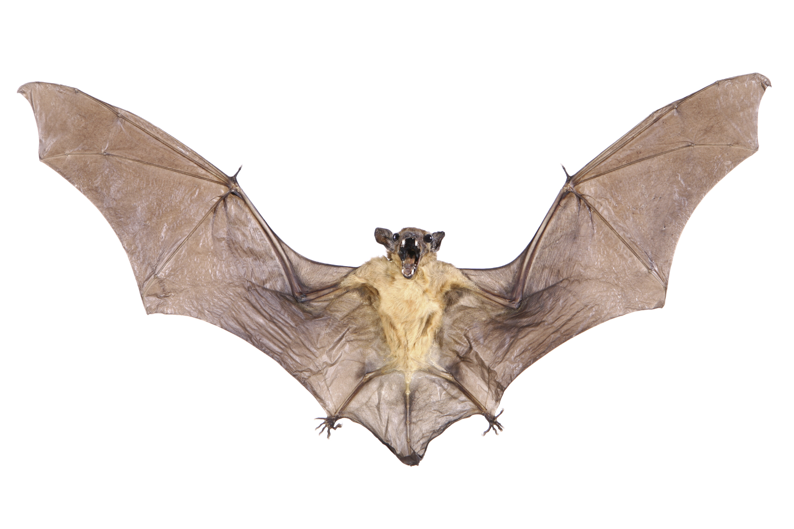
MERS-CoV
In September 2012 a new case of Coronavirus infection was reported involving a man in Saudi Arabia who was admitted to a hospital with pneumonia and acute kidney failure.
The virus has been named as Middle East Respiratory Syndrome Coronavirus (MERS-CoV).
Virus closely related to several bat Coronaviruses.
It infected several human cells, including lower but not upper respiratory, kidney, intestinal, and liver cells.
Epidemiology:
So far, all the cases have been linked to countries in and near the Arabian Peninsula.
Highly infectious, peak in winter.
Incubation period 2-14 days.
Transmission:
This virus spread from ill people to others through close contact, such as caring for or living with an infected person.
There is no evidence of sustained spreading in community settings.
Evidence also suggested that the virus can be acquired from direct close contact with animals.

Slide 6
Con. MERS-CoV
Lab diagnosis:
Detection of viral nucleic acid by PCR.
Serology by detection of IgM.
Isolation of the virus from Nasopharyngeal aspiration (NPA) by cell culture.
Clinical features:
Most people develop:
Severe acute respiratory illness.
Fever.
Cough.
Shortness of breath.
Some people also had Gastrointestinal symptoms including diarrhea and nausea/vomiting.
Some people had mild symptoms (such as cold-like symptoms). Or no symptoms at all and they recovered completely.
Complications:
Severe complications include pneumonia and kidney failure.
About 30% of people with MERS-CoV died.
Most of people who died had an underlying medical condition.
People who are at a higher risk for getting MERS-CoV or having a severe case:
People with pre-existing medical conditions (co morbidities).
Individuals with weakened immune systems.
Treatment:
No specific antiviral treatment. For severe cases, current treatment includes care to support vital organ functions.
Prevention:
Wash hands, use alcohol-based hand sanitizer.
Cover your nose and mouth with a tissue when you cough or sneeze.
Avoid touching your eyes, nose and mouth with unwashed hands.
Avoid personal contact with sick people.
Clean and disinfect frequently touched surfaces.

Slide 7
Measles Virus
Family
Structural Features
Transmission
Paramyxovidae
Enveloped virus with ss-RNA genome.
Inhalation of infectious aerosol droplets.
Epidemiology and pathogenesis
Clinical Features
I.P.: 7- 14 days.
Prodromal symptom: Fever, cough, conjunctivitis and running nose
Koplik’s spot: Small white papule appear in buccal mucosa.
Rash: Maculopapular rash first on face trunk then extremities.
Recovery complete in normal children with life long immunity.
Complication also can occur.
Most cases in preschool children, very infectious cases mainly in winter and spring.
Virus infects first epithetical cells of respiratory tract then virus spread to the blood causing vireamia the virus widely disseminated to the skin with maculopopular rash.

Slide 8
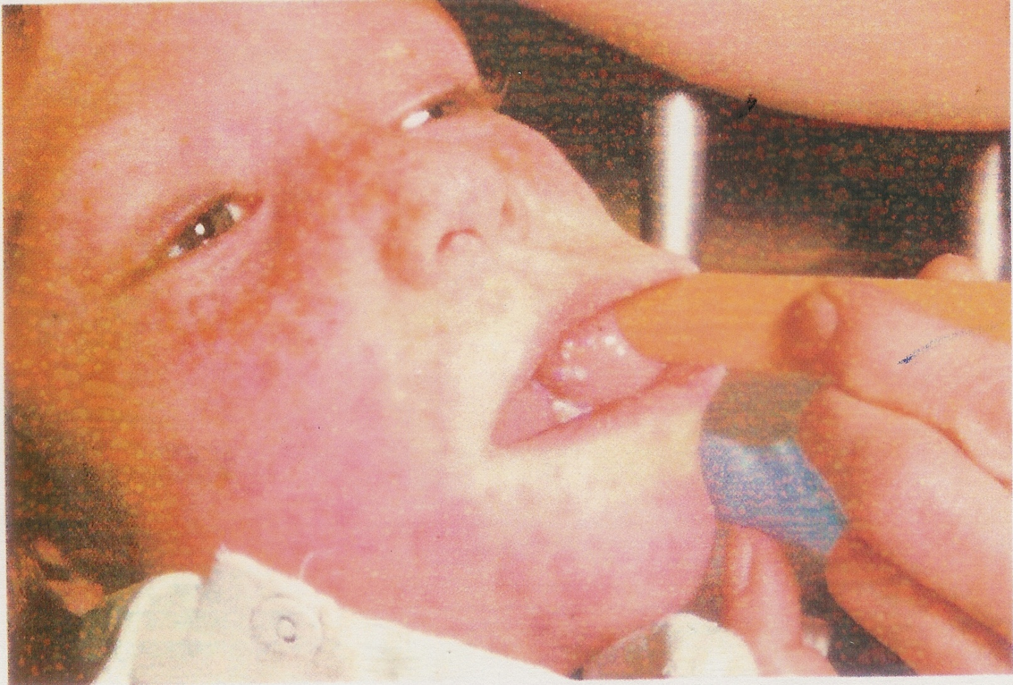
Measles Virus
Complication
Encephalitis:
Acute or Subacute sclerosing pan encephalitis (SSPE)
Giant cell pneumonia:
Rare in immunocompromised children due to direct invasion of measles virus to the lung tissue.
Lab diagnosis
Treatment and prevention
Measles virus infects human only.
Serology by detection of IgM Ab, and in case of SSPE detection of measles antibodies in CSF.
No specific treatment, Prevention by giving the live attenuated vaccine (MMR) for Measles, Mumps and Rubella (given to all children 15 month and booster dose at school entry. Give excellent long last protection.
Koplik’s Spot
Measles

Slide 9
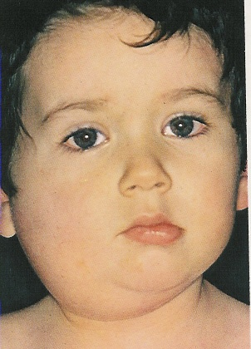
Mumps Virus
Mumps
Is an acute benign viral parotids. Parotids (painful inflammation and swelling of salivary gland).
it is a disease of children (5-15 years), but also can be seen in young adult with more complicated feature.
Virology Aspect
Family
Structural Features
Transmission
Paramyxoviridae
Enveloped virus with ss-RNA genome
Inhalation of infectious aerosol droplets
Mumps virus infect only human

Slide 10
Epidemiology and pathogenesis
Clinical Features
Complications
Highly infectious, peak in winter.
Long incubation period 18-21 days.
Infection started in the epithelial cells of upper respiratory tract, then virus spread by Vireamia to parotid gland mainly and to other organs as: testes, ovary, pancreas and CNS.
Classic mumps
Sudden onset of fever and painful swelling of parotid gland.
Self-limiting disease resolve within one week.
Solid and long life immunity occurs.
Aseptic meningitis: rare presentation.
Seen mainly if infection occur in young adult as:
Orchitis bilateral can lead to sterility
Oophoritis, Thyroditis, Meningitis
Lab diagnosis
Serology by detection of IgMAb, viral culture and isolation from saliva or CSF.
No specific antiviral treatment
MMR: Live attenuated vaccine for Measles, Mumps and Rubella given to all children 15 month and booster dose at school entry. Give excellent long last protection.
Treatment and prevention

Slide 11
Parvovirus B19
Family
Structural Features
Transmission
Epidemiology and target group
Parvoviridae
Small unenveloped ss-DNA with icosahedral capsid. One antigenic type.
IP: 4-10 days.
Inhalation of respiratory droplets. Blood transfusion, mother to baby.
Worldwide and mostly in winter and spring, Children (5-10 years).
The virus causes slapped cheek, erythema infectiosum, fifth disease.
Pathogenesis
Lab diagnosis
The virus infects the endothelial cells of the blood vessels in the skin, and the red blood cells precursors (erythroblast) in the bone marrow, which account for aplastic anemia.
Immunocomplexes may attribute to the development of the rash.
Detection of Ig-M antibody by ELISA or PCR
Prevention
There is no vaccine available
Treatment
There is no specific antiviral drug therapy

Slide 12
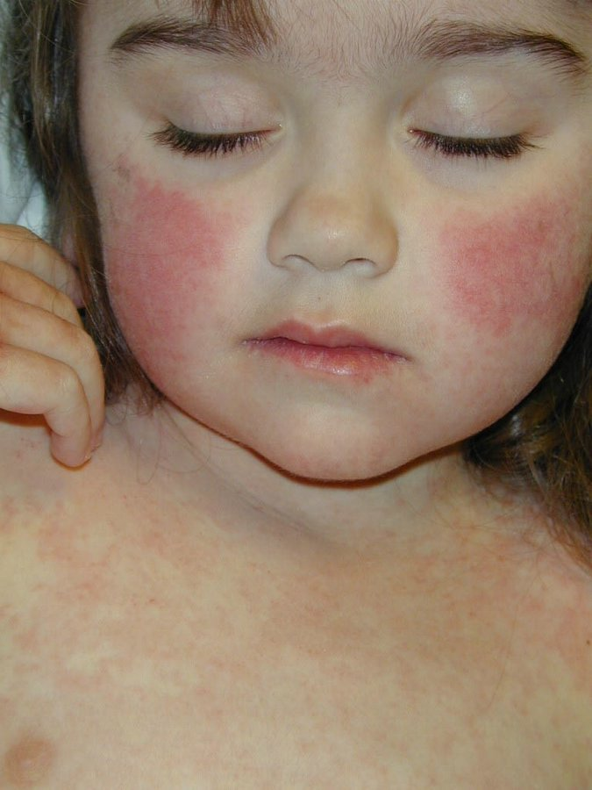
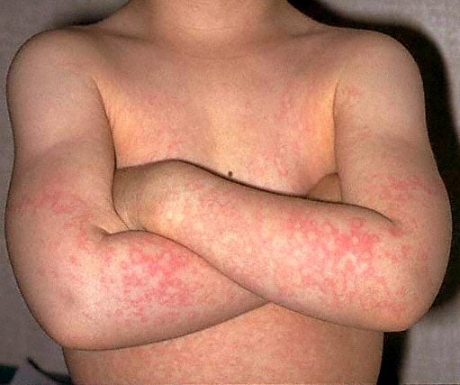
Clinical features
Clinical features
Recovery
The disease starts with fever, sneezing and coughing.
Followed by the development of the maculopapular rash.
The rash is red, confluent, fine, most intense on the cheek.
The rash may appear on the trunk and limbs.
Lesions fades from the center leaving the periphery red, developing characteristic reticular or lace-like pattern.
There is mild generalized lymphadenopathy.
Arthralgia with swelling and pain in the joints are seen in women.
Aplastic crisis sudden and temporary disappearance of erythroblasts from the bone marrow, seen in patients with hemolytic anemia. The bone marrow does not produce RBC.
Chronic anemia occurs in the immunocompromised when the immune system is unable to produce antibodies to neutralize the virus.
Hydrops fetalis occurs during pregnancy when the mother become infected with parvovirus B19
Is complete

Slide 13
Good luck
Done By:
Daherah AlJohani
Aya AlDayel
Jawaher AlOmran
Contact us: microbiology434@gmail.com

