Slide 1
Respiratory Fungal Infection

Slide 2
Respiratory fungal infection
Etiology
YEAST | MOULD FUNGI | DIMORPHIC FUNGI
Opportunistic |  | Primary Infectious
Candidiasis (Candida and other yeast) | Aspergillosis (Aspergillus species) | Histoplasma capsulatum
 |  | Paracoccidioides brasiliensis
Cryptococcosis Cryptococcus neoformans, C. gattii | Zygomycosis (Zygomycetes, e.g. Rhizopus, Mucor) | Blastomyces dermatitidis
 | Other Mould | Coccidioides immitis
EXAMPLES

Slide 3
Primary Systemic mycosis
  Infections of the respiratory system, (Inhalation )
  Dissemination seen in immunocompromised hosts
  Common in North America and to a lesser extent in South America. Not common in other parts of the World.
Found in: In nature found in soil of restricted habitats
Highly Infectious, and they are primary pathogen.
Dimorphic Fungi
Histoplasmosis
Blastomycosis
Coccidioido-mycosis
Paracoccidioido-mycosis

Slide 4
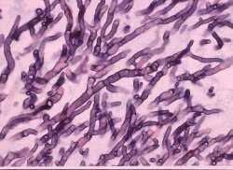
Aspergillosis
Aspergillosis is a spectrum of diseases of humans and animals caused by members of the genus Aspergillus.
These diseases include:
Mycotoxicosis
  Mycotoxicosis
  Allergy
  Colonization (without invasion and extension ) in preformed cavities
  Invasive disease of lungs
  Systemic and disseminated disease.
Risk Factors
Transplant Patients “e.g. bone marrow”
Malignancy “leukemia, lymphoma”
AIDS
Diabetes
And many others

Slide 5
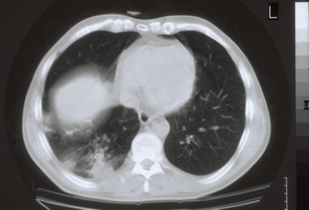
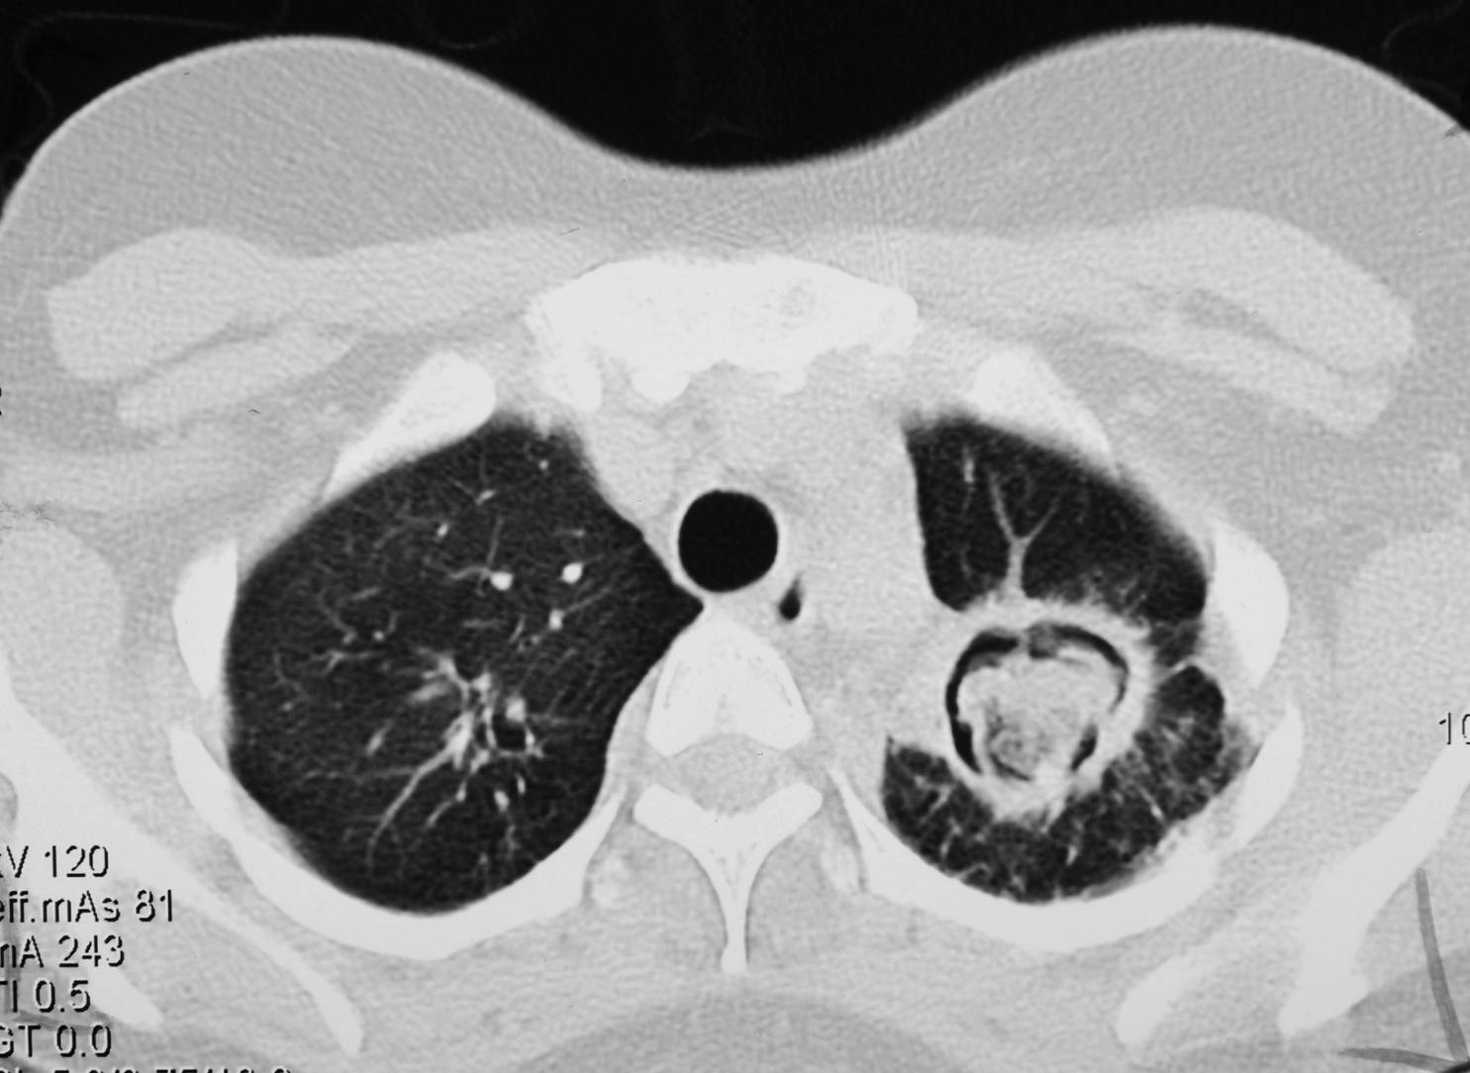
classification of Aspergillosis
Invasive Aspergillosis
Signs: Cough , hemoptysis, fever, Leukocytosis
Radiology will show lesions with halo sign
Chronic Aspergillosis
Aspergilloma OR Aspergillus fungus ball
Signs include: Cough, hemoptysis, variable fever
Allergic Aspergillosis
Allergic bronchopulmonary (ABPA)
Allergic Aspergillus sinusitis
Radiology will show mass in the lung , radiolucent crescent
Invasive Aspergillosis
Single Aspergilloma

Slide 6
Aspergillosis
Etiology:
Aspergillus species, common species are:
  A. fumigatus “ Invasive”
  A. flavus, “Allergic””
  A. niger
  A. terreus and
  A. nidulans
Treatment
Antifungal: Voriconazole “Drug of choice”
  Alternative therapy: Amphotericin B, Itraconazole, Caspofungin
Diagnosis
  -Speciemen:
  Respiratory specimens: Sputum, BAL, Lung biopsy, Other samples: Blood
  -Microscopiy: Giemsa Stain, Grecott methenamine silver stain (GMS)
  Will show fungal septate hyphae
  -Culture: on SDA
  -Serology: Test for Antibody , ELISA test for galactomannan Antigen
  -PCR: Detection of Aspergillus DNA in clinical samples
Aspergillus niger
Aspergillus fumigatus

Slide 7
Allergic broncho-pulmonary aspergillosis
Clinical Features: “Symptoms of Asthma”
  Bronchial obstruction
  Fever, malaise
  Eosinophilia
  Wheezing +/-
Also:
  Skin test reactivity to Aspergillus
  Serum antibodies to Aspergillus
  Serum IgE > 1000 ng/ml
  Pulmonary infiltrates

Slide 8
Fungal siinusitis
Clinical Features:
Nasal polyps – and other symptoms of sinusitis
In immunocompromised, Could disseminate to – eye craneum (Rhinocerebral)
Aspergillus sinusitis has the same spectrum of Aspergillus disease in the lung
Etiology:
Common in KSA is Aspergillus flavus
“In addition to Aspergillus, there are other fungi that can cause fungal sinusitis”
Treatment
Depends on the type and severity of the disease and the immunological status of the patient
Diagnosis
  -Clinical and Radiology
  -Histology
  -Culture
  -Precipitating antibodies useful in diagnosis
  -Measurement of IgE level, RAST test

Slide 9
Zygomycosis
Pulmonary Zygomycosis
Rhinocerebral Zygomycosis
Risk Factors
Transplant Patients
Malignancy
AIDS
Diabetic Ketoacidosis
And many others

Slide 10
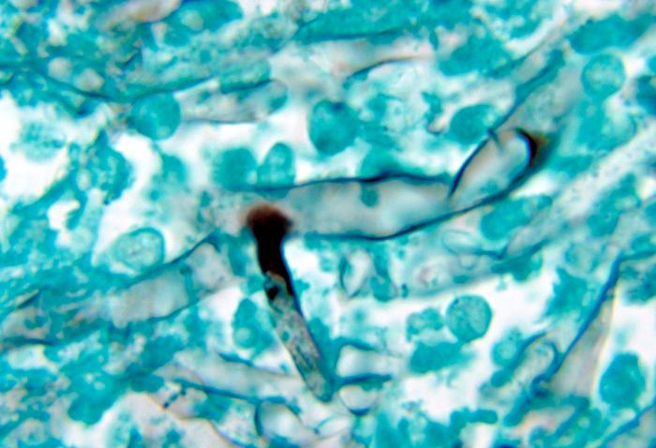
Pulmonary zygomycosis
Acute disease
Features include: Consolidation, Nodules, pleural effusion, hemoptysis
Infection may extend to chest wall, diaphragm and pericardium causing:
  Pulmonary Infarctions and hemorrhage
  Rapid evolving clinical course
Etiology:
  Zygomycetes , Non-septate hyphae. e.g. Rhizopus
Treatment
  Amphotericin B
  Surgery
Diagnosis
  -Speciemen: Respiratory specimens: Sputum, BAL, Lung biopsy,
  -Microscopiy: Giemsa, Grecott methenamine silver stain (GMS) Will show broad non- septate fungal
  -Culture: on SDA “No cycloheximide”

Slide 11
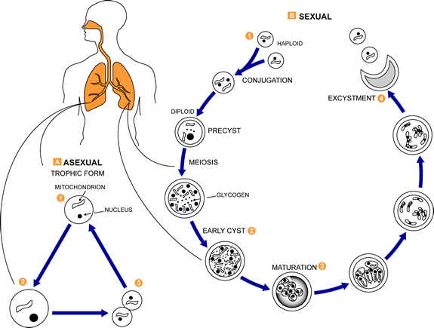
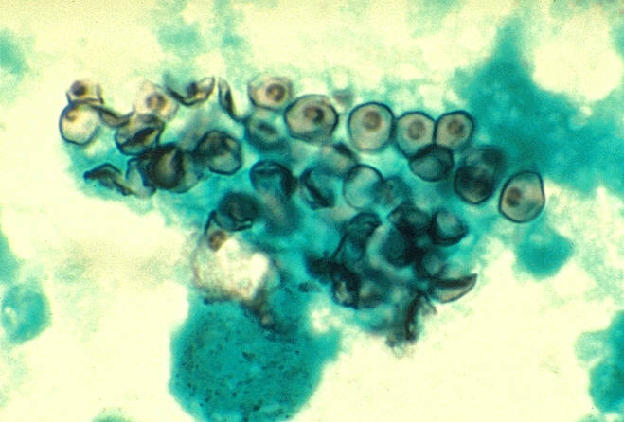
Pneumocystosis “Pneumocystis pneumonia”
It’s interstitial pneumonia of alveolar area
Affect immuno-compromised patients, especially AIDS patient.
Etiology:
    Pneumocystis jiroveci
“Previously thought to be protozoan parasite, but later has proven to be a fungus”
Treatment
- Trimethoprim-sulfamethoxazole
- Dapsone
Diagnosis
Speciemen: Bronchoscopic specimens (B.A.L.), Sputum, Lung biopsy tissue.
Histological sections or smears stained by GMS stain
Immunofluorescence have better sensitivty, positive result will show cysts of hat-shape, cup shape, crescent
Found In
rodents (rats), other animals (goats,horses),
Humans may contract it during childhood

Slide 12
Done by microbiology team
CONTACT US: MICROBIOLOGY434@GMAIL.COM
Good Luck

