Slide 1
Biochemical Markers of
Myocardial Infarction
Cardiovascular Block
Dr .Rana Hasanato

Slide 2
Overview
Myocardial infarction
Time-course of plasma enzyme changes
Cardiac troponins I and T
Creatine kinase (CK-MB)
Myoglobin

Slide 3
Myocardial infarction (MI)
Myocardial infarction is due to:
Occlusion of coronary arteries →
Restricted blood supply (oxygen) to heart tissue (ischemia)→
Damage to heart tissue (infarction) →
Release of enzymes and other proteins into the blood (markers)

Slide 4
AMI : Gross necrosis of the myocardium as a result of interruption of the blood supply to an area of cardiac muscle .
Cardiac marker: a clinical laboratory test useful in cardiac disease , most commonly for detecting AMI or myocardial injury .

Slide 5
Biochemical markers of AMI
OBSOLETE MARKERS
Aspartate Transaminase(AST)
Lactate dehydrogenase (LDH)
CURRENT CARDIAC MARKERS
Troponins (I, T)
CK-MB
Myoglobin

Slide 6
Markers of diagnostic value in MI:
Cardiac troponins T and I
Creatine kinase (CK-MB)
Myoglobin

Slide 7
Features of an ideal cardiac marker
High concentration in the myocardium
Absence from non-myocardial tissue( high specificity)
Rapid release into plasma following myocardial injury
Correlation between blood level and extent of myocardial injury for prognosis
Can be measured by rapid, simple and automated methods
Detectable by low concentration in blood (high sensitivity)

Slide 8
Features of an ideal cardiac marker
The ideal marker in myocardial injury would persist in circulation for several days to provide a late diagnostic time window for patient who arrived late after the event .
The CARDIAC TROPONINS meet these criteria .

Slide 9
Troponins
Troponins are structural proteins in cardiac myocytes and in skeletal muscle
Involved in the interaction between actin and myosin for contraction
cTns are mainly bound to proteins, with small amount soluble in the cytosol
Two main cardiac troponins (cTn):
cTnI: inhibitory protein
cTnT: binds to tropomyosin

Slide 10
cTns are structurally different from muscle troponins
Highly specific markers for detecting MI
Appear in plasma in 3-4 h after MI
Remain elevated for up to 10 days
cTns measurements are useful in excluding AMI after 12 h following chest pain or other symptoms

Slide 11
After a MI, cytosolic troponins
(soluble)are released rapidly into the blood (first few hours)
Structurally bound troponins(insoluble) are released later for several days which account for the prolonged plateau of troponin release.
Under normal circumstances there is no cardiac troponin T or I detectable in blood .

Slide 12
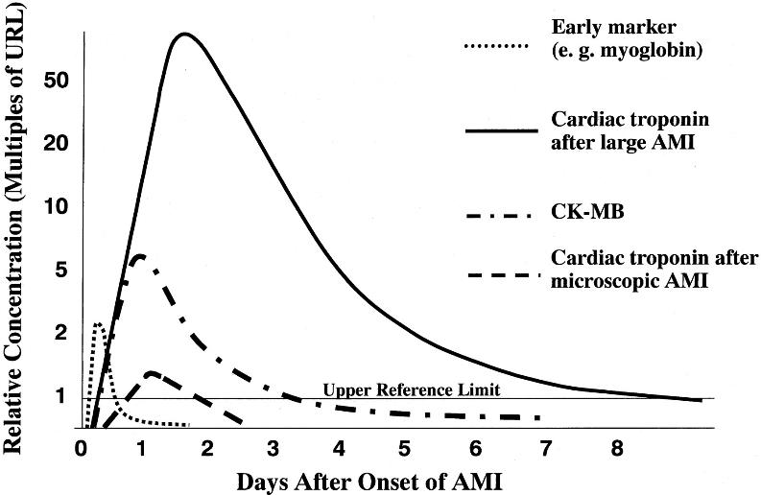

Slide 13
Creatine kinase (CK)
Three main CK isoenzymes with two polypeptide chains B or M
Type | Composition | Comment
Skeletal Muscle | 98% CK-MM 2% CK-MB | Elevated in muscle disease
Cardiac muscle | 70-80% CK-MM 20-30% CK-MB | Cardiac muscle has highest amount of CK-MB
Brain | CK-BB
Plasma | Mainly CK-MM

Slide 14
CK-MB
CK-MB is more sensitive and specific for MI than total CK
It rises and falls transiently after MI
Appears in blood within 4-6 hours of heart attack
Peak 12 - 24 hours
Returns to normal within 2-3 days
Relative index = CK-MB mass / Total CK x 100
More than 5 % is indicative for MI

Slide 15
CK-MB
Advantages:
Useful for early diagnosis of MI
Useful for diagnosis of re-infarction
Disadvantages:
Not significant if measured after 2 days of MI (delayed admission)
Not highly specific (elevated in skeletal muscle damage)

Slide 16
MI marker changes in plasma
Enzyme / Protein | Detectable (hours) | Peak value (hours) | Duration (days)
CK-MB | 3-10 | 12-24 | 1.5-3
Total CK | 5-12 | 18-30 | 2-5
Cardiac troponins | 3-4 | 12-24 | upto 10

Slide 18
Myoglobin
Myoglobin is an oxygen binding protein of cardiac and skeletal muscle .
It is a sensitive index of myocardial damage
It Appears in blood earlier than other CK-MB (within 1-4 hours) due to its low molecular weight and cytoplasmic location
There is no difference in the myoglobin found in heart versus skeletal muscle ( not specific)
It is elevated due to
Muscle disease/injury
Acute and chronic renal failure
AMI

Slide 19
Time-course of plasma enzyme changes
Plasma enzymes follow a pattern of activities after MI
The initial lag phase lasts for about 3 hours
Enzymes rise rapidly to peak levels in 18-36 hours
The levels return to normal based on enzyme half-life
Rapid rise and fall indicates diagnostic value

Slide 20
Blood samples collected after MI:
Baseline (upon admission)
Between 12 and 24 hours after the onset of symptoms

Slide 22
B-type natriuretic peptide (BNP)
BNP is a peptide hormone produced by the ventricles of the heart in response to:
Myocardial stretching and ventricular dysfunction.
It causes vasodilation, sodium and water excretion and reduces blood pressure
It is used for diagnosis of congestive heart failure (CHF)

Slide 23
MI Marker Recommendations
Measurement of plasma MI markers
Upon admission of patient
Serially thereafter
Use of fast and robust test methods for marker detection
Types of markers:
Early markers (myoglobin)
Highly specific markers (cardiac troponins)
CK-MB is the second choice after troponins

Slide 24
Diagnosis of AMI
Recommended by the European Society of Cardiology and American College of Cardiology
Requires presence of at least two of the following characteristics:
Ischemic symptoms
Typical rise and fall pattern of a cardiac marker in plasma
Typical rise and gradual fall of cardiac troponins or
More rapid rise and fall of CK- MB
Typical ECG pattern(changes)

Slide 25
It was rare for a diagnosis of AMI to be made in the absence biochemical evidence of myocardial injury .
The guidelines recognized the reality that neither the clinical presentation nor the ECG had adequate sensitivity and specificity .
This guideline does not suggest that all increase of these biomarkers should elicit a diagnosis of AMI, only those associated with the appropriate clinical and /or ECG findings.

Slide 26
Take home message
cTns have high sensitivity and specificity, they remain elevated in plasma longer than CK-MB
CK-MB is useful for diagnosis of re-infarction .
myoglobin is important as an early marker to diagnose AMI

Slide 27
Case
66 yr old man had experienced central chest pain on exertion for some months , but afternoon of the day prior to admission he had a severe episode of pain ,
Which come on without any exertion and lasted for about one hour .
On admission there were no abnormalities on examination and ECG was normal. Tn was clearly detectable .
Has he suffered a myocardial infarction???

Slide 28
Comments on the case
He has an elevated troponin plus a typical history .
This s sufficient to diagnose a MI by the most recent definition , even in the absence of ECG changes

