Slide 1
Myocarditis and Pericarditis
Dr .Ali. M Somily
Prof . Hanan A. Habib
Department of Pathology

Slide 2
Objectives
Describe the epidemiology, risk factor for myocarditis.
Explain the pathogenesis of myopericarditis.
Differential between the various types of myocarditis and pericarditis.
Name various etiological agents causing myocarditis and pericarditis.
Describe the clinical presentation and differential diagnosis of myocarditis and pericarditis.
Discuss the microbiological and non microbiological methods for diagnosis of myocarditis and pericarditis.
Explain the management ,complication and prognosis of patient with myocarditis and/or pericarditis.

Slide 3
Myocarditis
Myocarditis is inflammatory disease of the heart muscle.
Mild & self-limited with few symptoms OR severe with progression to congestive heart failure & dilated cardiac muscle.
localized or diffuse
Myocarditis can be due to a variety of infectious and non infectious causes.
Viral infection is the most common cause
Others like toxins ,drugs and hypersensitivity immune response.

Slide 4
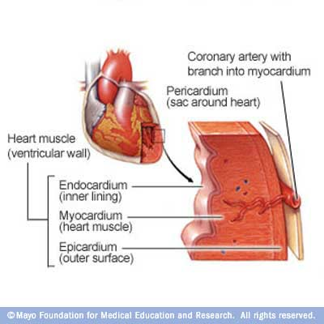

Slide 5
Myocarditis

Slide 6
Epidemiology ,Etiology and Risk Factors
Epidemiology : no accurate estimate of incidence as many cases are mild & brief and diagnosis is not made.
Coxsackie virus B is the most common cause of myocarditis
Other virus like Coxsackie virus A, Echoviruses, Adenoviruses ,Influenza, EBV, Rubella, Varicella, Mumps, Rabies, Hepatitis viruses and HIV.
Bacterial causes include Corynebacterium diphtheriae, Syphilis ,Lyme disease or as a complication of bacterial endocarditis.

Slide 7
Parasitic cause includes Chagas diseases, Trichinella spiralis, Taxoplasma gondii and Echinococcus.
Others organisms includes Rickettsiae, Fungi, Chlamydia, enteric pathogens, Legionella and Mycobacterium tuberculosis.
Giant cell myocarditis due to Thymoma, SLE (systemic lupus erythromatosis ) or Thyrotoxicosis.

Slide 8
Infectious | Noninfectious
Viruses Coxsackie B HIV | Systemic Diseases SLE Sarcoidosis Vasculities(Wegener’s disease) Celiac disease
Bacterial 1. Corynebacterium diphtheriae (diphtheria) | Neoplastic infiltration
Protozoan 1. Trypanosoma cruzi (Chagas disease) | Drugs & Toxins Ethanol Cocaine Radiation Chemotherapeutic agents - Doxorubicin
Spirochete Borrelia burgdorferi ( Lyme disease)

Slide 9
Clinical Presentation
Highly variable ; days to weeks after onset of acute febrile illness or with heart failure without any known antecedent symptoms .
Fever, headache, muscle aches, diarrhea, sore throat and rashes similar to any viral infection
Chest pain, arrhythmias ,sweating , fatigue and may present with congestive heart failure.

Slide 10
Differential Diagnosis
Acute Myocarditis
Vasculitis
Cardiomyopathy ( due to drugs or radiation)

Slide 11
Diagnosis
WBCs, ESR, Troponin and CK-MB usually elevated
ECG (nonspecific ST-T changes and conduction delays are common)
Blood cultures
Viral serology and other specific test for Lyme disease, diphtheria and Chagas disease may be indicated on a case by case basis.
Chest X-rays : show cardiomegaly
Radiology : MRI and Echocardiogram
Heart muscle biopsy

Slide 12
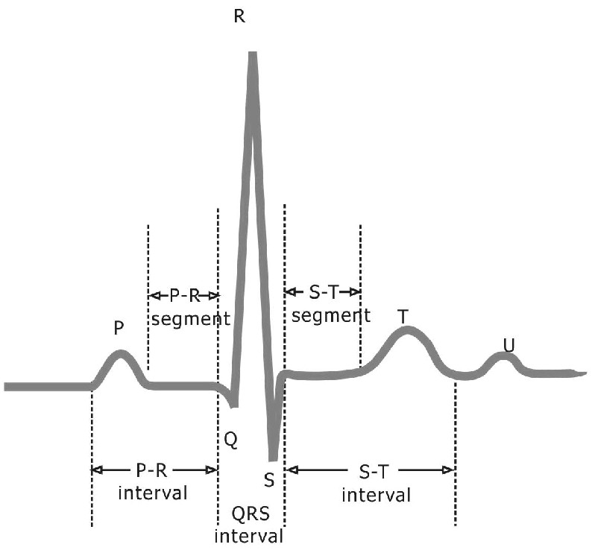
ECG of normal heart

Slide 13
Endomyocardial Diagnosis
Pathologic exam may reveal lymphocytic inflammatory response with necrosis, but this is not sensitive because of the patchy areas of distribution.
“Dallas” criteria for histopathologic diagnosis
“Giant cells” may be seen.

Slide 14
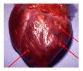
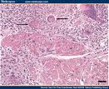
Giant cells-myocarditis

Slide 15
Management
Often supportive;
Restricted physical activity in heart failure.
Specific antimicrobial therapy is indicated when an infecting agent is identified.
Treatment of heart failure arrhythmia
Other drugs indicated in special situations like anticoagulant, NSAID (nonsteroidal antiinflammatory drugs) , steroid or immunosuppressive immunomodulatory agents.
Heart transplant
Notes:
Heart transplant in patient with intractable heart failure and cardiomyopathy.

Slide 16
Management
Most cases of viral myocarditis are self limited.
One third of the patients are left with lifelong complications, ranging from mild conduction defects to severe heart failure.
Patient should be followed regularly every 1-3 months.
Sudden death may be the presentation of myocarditis in about 10% of cases.

Slide 17
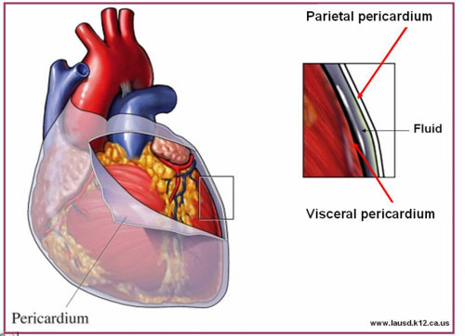
Acute Pericarditis

Slide 18
Pericarditis
Pericarditis is an inflammation of the pericardium usually of infectious etiology ( viruses, bacterial, fungal or parasitic)
Viral Pericarditis:
Coxsackievirus A and B, Echovirus are the most common causes.
Other viruses includes Herpes viruses, Hepatitis B , Mumps, Influenza, Adenovirus ,Varicella and HIV.

Slide 19
Pathophysiology
Contiguous spread
lungs, pleura, mediastinal lymph nodes, myocardium, aorta, esophagus, liver.
Hematogenous spread
septicemia, toxins, neoplasm, metabolic
Lymphangetic spread
Traumatic or irradiation

Slide 20
Pathophysiology
Inflammation provokes a fibrinous exudate with or without serous effusion
The normal transparent and glistening pericardium is turned into a dull, opaque, and “sandy” sac
Can cause pericardial scarring with adhesions and fibrosis.

Slide 21
Bacterial Pericarditis usually a complication of pulmonary infections (e.g. pneumonia ,empyema):
S. pneumonia, M. tuberculosis, S. aureus, H. influenzae, K. pneumoniae & Legionella.
HIV patients may develop pericardial effusions (M.tuberculosis , M. avium complex).
Disseminated fungal infection (Histoplasma, Coccidioides)
Parasitic infections (disseminated toxoplasmosis, contagious spread of Entamoeba histolytica )are rare causes.

Slide 22
Types of Pericarditis
Caseous Pericarditis commonly tuberculous in origin.
Serous Pericarditis due to autoimmune diseases (rheumatoid arthritis, SLE).
Fibrous Pericarditis a chronic pericarditis usually suppurative, caseous, or encased in a thick layer of scar tissue.

Slide 23
Types of Effusive Fluid
Serous
Transudative - heart failure
Suppurative
Pyogenic infection with cellular debris and large number of leukocytes
Hemorrhagic
Occurs with any type of pericarditis especially with infections and malignancies
Serosanguinous

Slide 24
Constrictive Pericarditis
Idiopathic
Radiotherapy
Cardiac surgery
Connective tissue disorders
Dialysis
Bacterial infection

Slide 25
Clinical presentation
Patients with pericarditis will present with sudden pleuretic chest pain, fever, dyspnea and a friction rub.
Patient with tuberculous pericarditis has insidious onset of symptoms.
On examination exaggerated pulses , paradoxus JVP and tachycardia.
As the pericardial pressure increases, palpitations , presyncope or syncope may occur.
Notes:
Common characteristics of the pain
retrosternl or precordial with raditaion to the neck, back, left shoulder or arm
Special characteristics (pericarditis)
more likely to be sharp and pleuritic
↑ with coughing, inspiration, swallowing
worse by lying supine, relieved by sitting and leaning forward

Slide 26
Tuberculous Pericarditis
Incidence of pericarditis in patients with pulmonary TB ranges from 1 – 8 %
Physical findings: fever, pericardial friction rub, hepatomegaly
Tuberculin skin test usually positive
Fluid smear for AFB often negative
Pericardial biopsy more definitive

Slide 27
Acute Pericarditis Differential Diagnosis
Acute myocardial infarction
Pulmonary embolism
Pneumonia
Aortic dissection

Slide 28
Diagnosis
ECG will show ST elevation, PR depression and T-wave inversion may occur later.
Blood culture
Leukocytosis and an elevated ESR are typical
Other routine testing : urea and creatinine.
Tuberculin skin test is usually positive in tuberculous pericarditis.
Chest x-ray may show enlarged cardiac shadow or calcified pericardium and CT scan show pericardial thickening >5mm.
Pericardial fluid or pericardial biopsy specimens for fungi, antinuclear antibody tests and Histoplasmosis complement fixation indicated in endemic area.

Slide 29
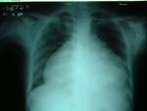
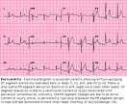

Slide 30
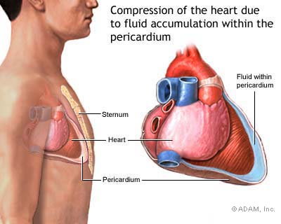

Slide 31
Management
Management is largely supportive for cases of idiopathic and viral pericarditis including bed rest , NSAIDS and Colchicine.
Corticosteroid is controversial and anticoagulants usually contraindicated.
Specific antibiotics must include activity against S. aureus and respiratory bacteria.
Antiviral:
Acyclovir for Herpes simplex or Varicella . Ganciclovir for CMV .

Slide 32
Management
Pericardiocentesis to relief tamponade.
Patients who recovered should be observed for recurrence.
Symptoms due to viral pericarditis usually subsided within one month.

Slide 33
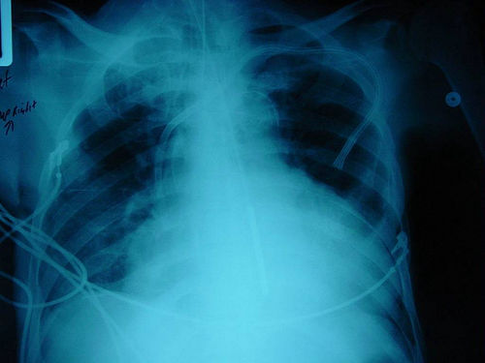
Pericardiocentesis

