Slide 1
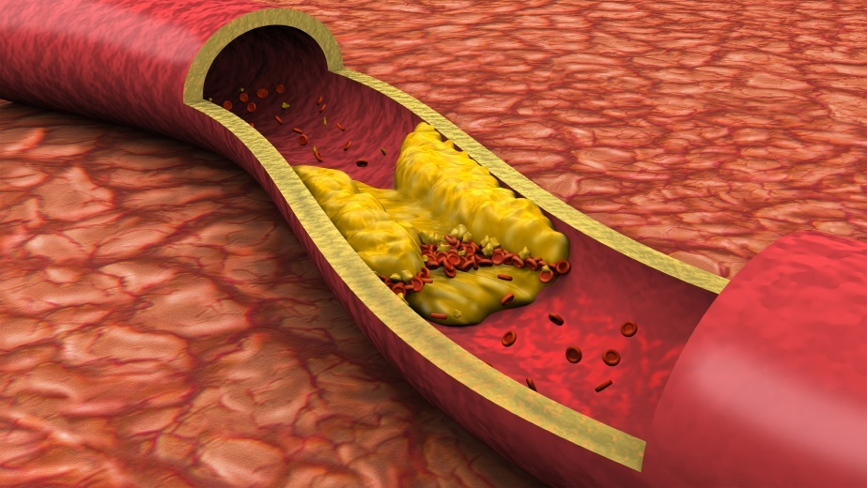
ATHEROSCLEROSIS
Sufia Husain.
Pathology.
KSU. Riyadh.
March 2015

Slide 2
Normal Blood Vessels
Large (elastic) arteries
  aorta, common carotid, iliac
  lots of elastic fibers
Medium (muscular) arteries
  coronary, renal arteries
  mostly smooth muscle cells
Small arteries/arterioles
  all smooth muscle cells
  blood pressure controlled here
Capillaries
  diameter of RBC
  thin walls, slow flow
  great for exchanging oxygen, nutrients
Venules/veins
  large diameter, thin walls
  compressible, penetrable by tumor
  Have valves
Lymphatics
  drain excess interstitial fluid
  pass through nodes

Slide 3
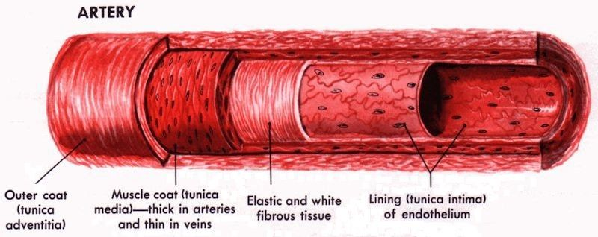
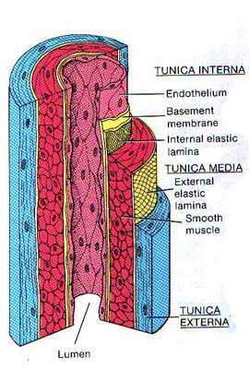
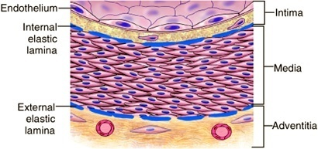
Artery
www.full-health.com
www.mananatomy.com

Slide 4
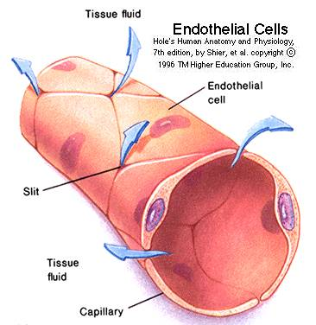
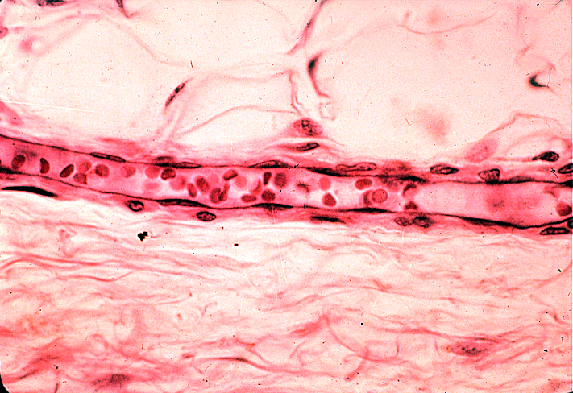
ENDOTHELIAL CELLS
The endothelium is a single cell thick lining of endothelial cells and it is the inner lining of the entire cardiovascular system (arteries, veins and capillaries) and the lymphatic system.
It is in direct contact with the blood/lymph and the cells circulating in it.
Endothelial structural and functional integrity is fundamental to the maintenance of vessel wall homeostasis and normal circulatory function.
www.udel.edu

Slide 5
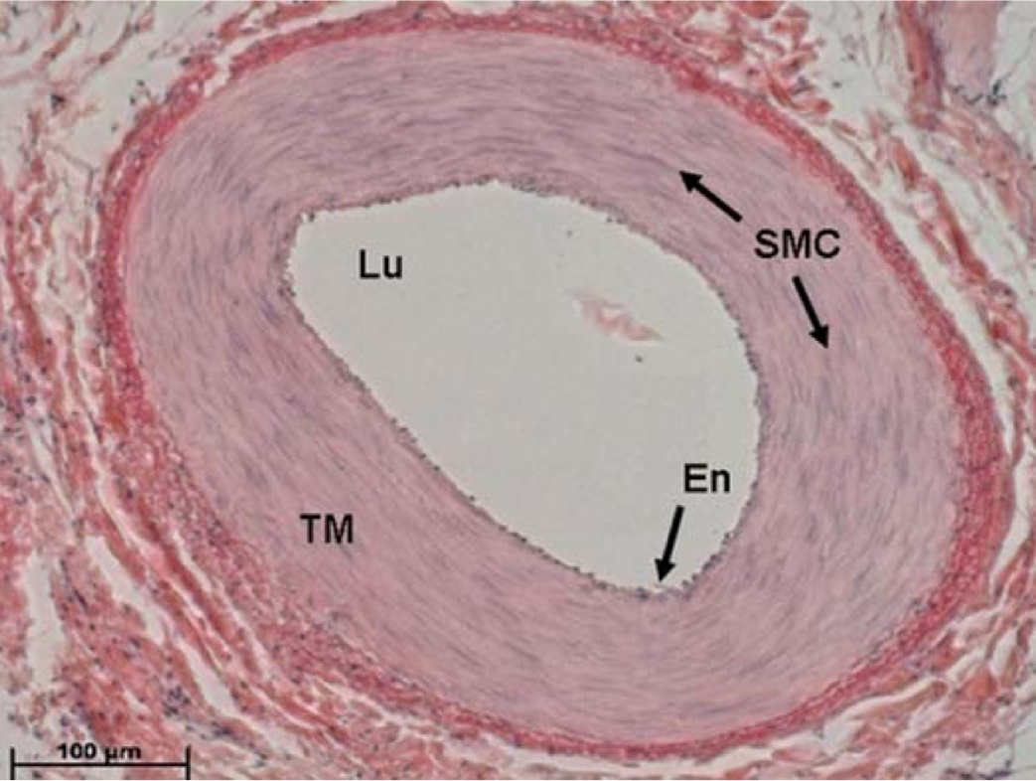
Smooth muscle cells (SMC)
SMCs are present in the vascular media
SMCs are responsible for vasoconstriction and dilation in response to normal or pharmacologic stimuli.
Any vascular injury or dysfunction stimulates SMCs. On stimulation they:
  They migrate from the media to the intima.
  In the intima they lose the capacity to contract and gain the capacity to divide. So they multiply/proliferate as intimal SMCs.
  They synthesize collagen, elastin etc and deposit extracellular matrix (ECM).

Slide 6
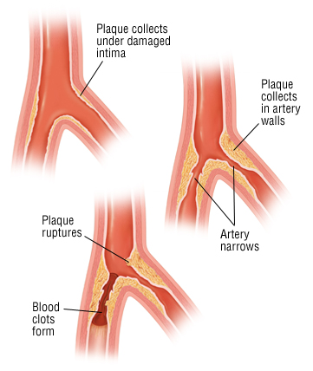
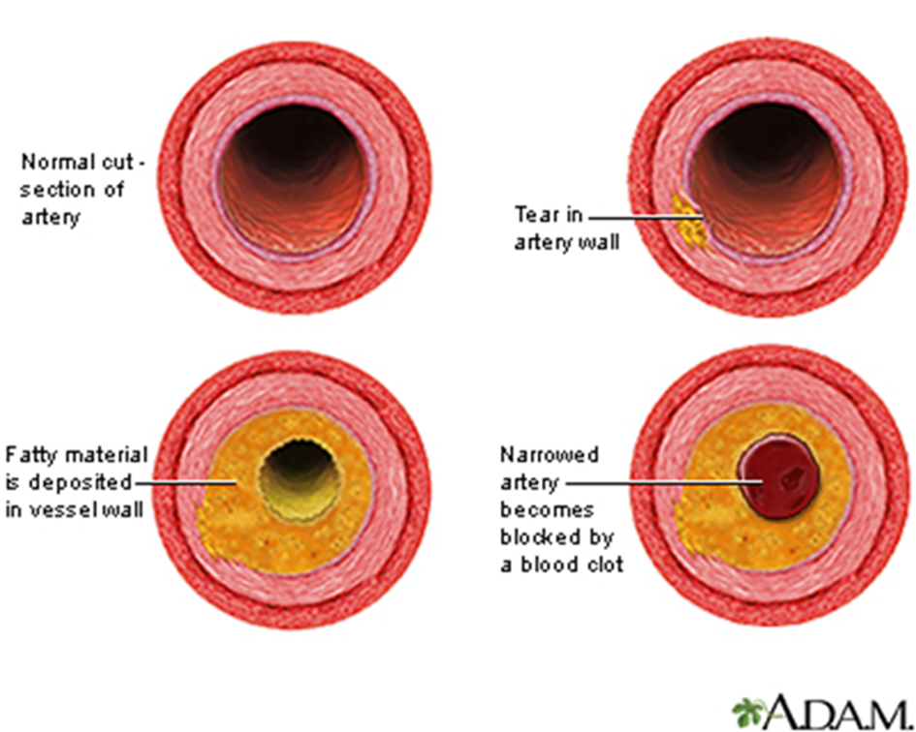
Atherosclerosis (AS)
Atherosclerosis is characterized by intimal lesions called atheromas/ atheromatous/ fibrofatty plaques, which protrude into and obstruct vascular lumens and weaken the underlying media.
They may lead to serious complications like Coronary artery disease (angina & MI) and Carotid atherosclerotic disease (stroke)
The most heavily involved vessels are the abdominal aorta then coronary arteries, the popliteal arteries, the internal carotid arteries, and the vessels of the circle of Willis.

Slide 7
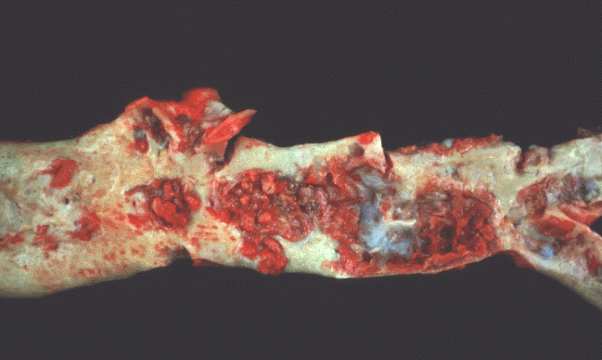
Gross morphology of atheroma/atheromatous plaque
The key processes in AS is intimal thickening and lipid accumulation.
The atheromatous plaques impinge on the lumen of the artery. They vary in size.
atheromatous plaques usually involve only a partial circumference of the arterial wall ("eccentric" lesions) and are patchy and variable along the vessel length.
www.med.uottawa.ca

Slide 8
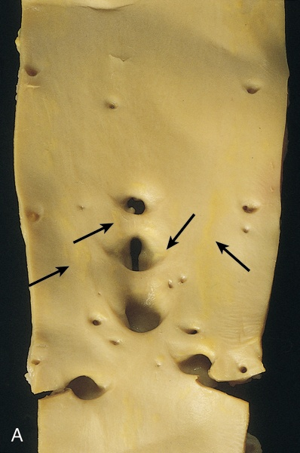
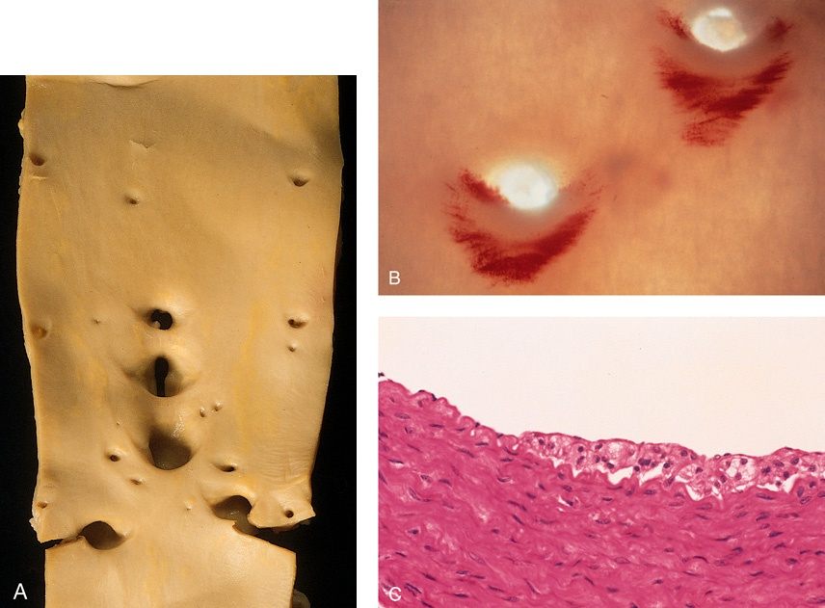
Atherosclerosis:
Aorta with fatty streaks ( arrows).
Fatty streaks are the earliest lesion of atherosclerosis they are a collection of lipid laden foam cells in the intima.
They do not cause any disturbance in blood flow.
Fatty streaks begin as multiple yellow, flat spots less than 1 mm in diameter that coalesce into elongated streaks, 1 cm long or longer. They contain T lymphocytes and extracellular lipid in smaller amounts than in plaques.
Photomicrograph of fatty streak in an experimental hypercholesterolemic rabbit, demonstrating intimal macrophage-derived foam cells ( arrow).

Slide 9
Atherosclerosis:
Microscopic morphology
An atheroma consists of a raised focal lesion in the intima, with a soft, yellow, grumous core of lipid (mainly cholesterol and cholesterol esters), covered by a firm, white fibrous cap. Atherosclerotic plaques have three principal components:
Cells: SMCs, macrophages, lymphocytes and foam cell
Extracellular matrix: including collagen, elastic fibers, and proteoglycans
Lipid: Typical atheromas contain relatively abundant lipid both intracellular and extracellular lipid .
Foam cells are large, lipid-laden macrophages derived from blood monocytes, but SMCs can also imbibe lipid to become foam cells.

Slide 10
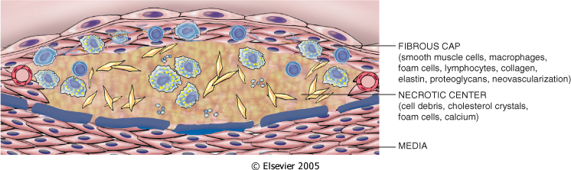
Atherosclerosis: microscopic morphology
Typically, the superficial fibrous cap is composed of SMCs and extracellular matrix. With some macrophages and T lymphocytes.
Below the fibrous cap is a necrotic core, containing a lipid deposits (primarily cholesterol and cholesterol esters), cholesterol clefts, debris from dead cells, foam cells, fibrin.

Slide 11
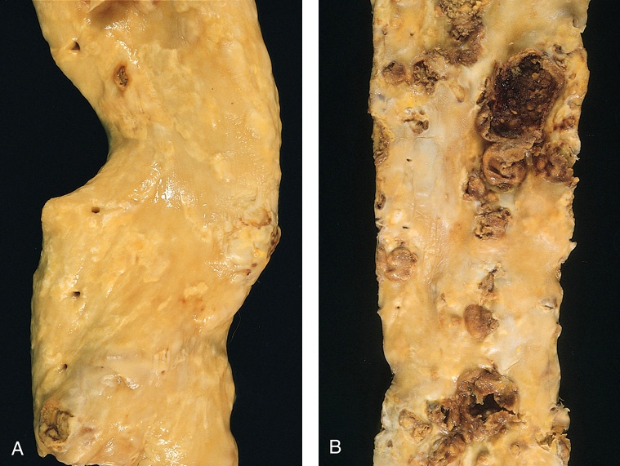
Gross views of atherosclerosis in the aorta.
A. Mild atherosclerosis composed of fibrous plaques, one of which is denoted by the arrow.
B. Severe disease with diffuse and complicated lesions.
Slide 12.7

Slide 12
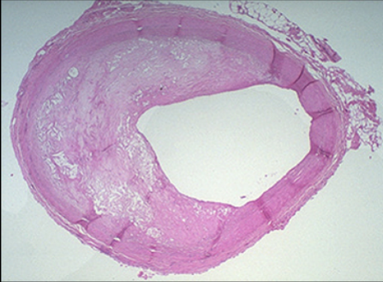
Overall architecture demonstrating an eccentric lesion with a fibrous cap and a central lipid core with typical cholesterol clefts. The lumen is moderately narrowed.
http://sphweb.bumc.bu.edu/otlt/MPH-Modules/PH/PH709_Heart/PH709_Heart3.html

Slide 13
PATHOLOGICAL COMPLICATIONS
The advanced lesion of atherosclerosis is at risk for the following pathological changes that have clinical significance:
Focal rupture, ulceration, or erosion of the luminal surface of atheromatous plaques which may induce thrombus formation or discharge of debris into the bloodstream, producing microemboli composed of lesion contents (cholesterol emboli or atheroemboli).
Hemorrhage into a plaque (especially when atheroma in the coronary arteries) due to rupture of the overlying fibrous cap or the capillaries in the plaque. The hematoma may expand the plaque or induce plaque rupture
Superimposed thrombosis, the most feared complication, usually occurs on disrupted lesions (those with rupture, ulceration, erosion, or hemorrhage) the thrombus can lead to partial or completely occlusion of the lumen. The thrombus can also embolize.
Wall weakening with aneurysmal dilation. Atheroma can induced atrophy of the underlying media, with loss of elastic tissue, causing weakness, aneurysm and potential rupture
Calcifications: Atheromas often undergo calcification.

Slide 14
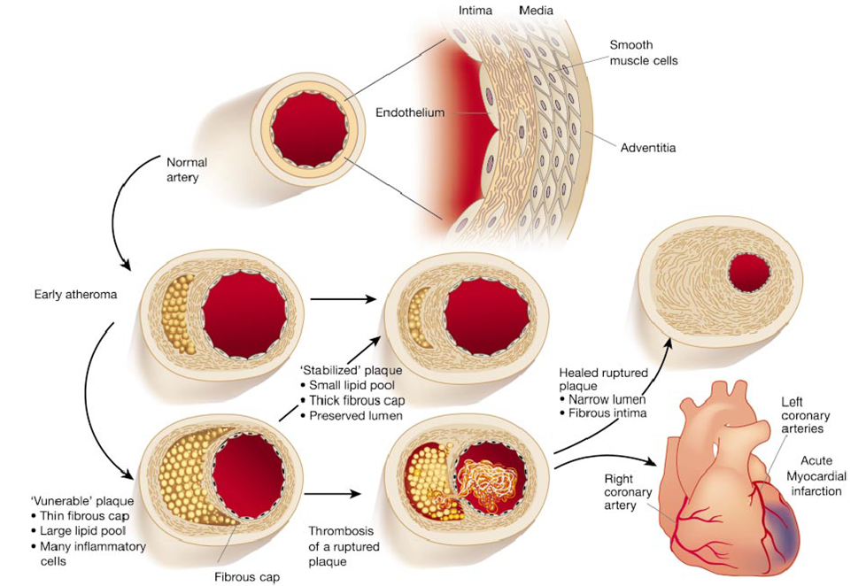
Illustration from from Libby P: Inflammation in Atherosclerosis. Nature 202;420:868

Slide 15
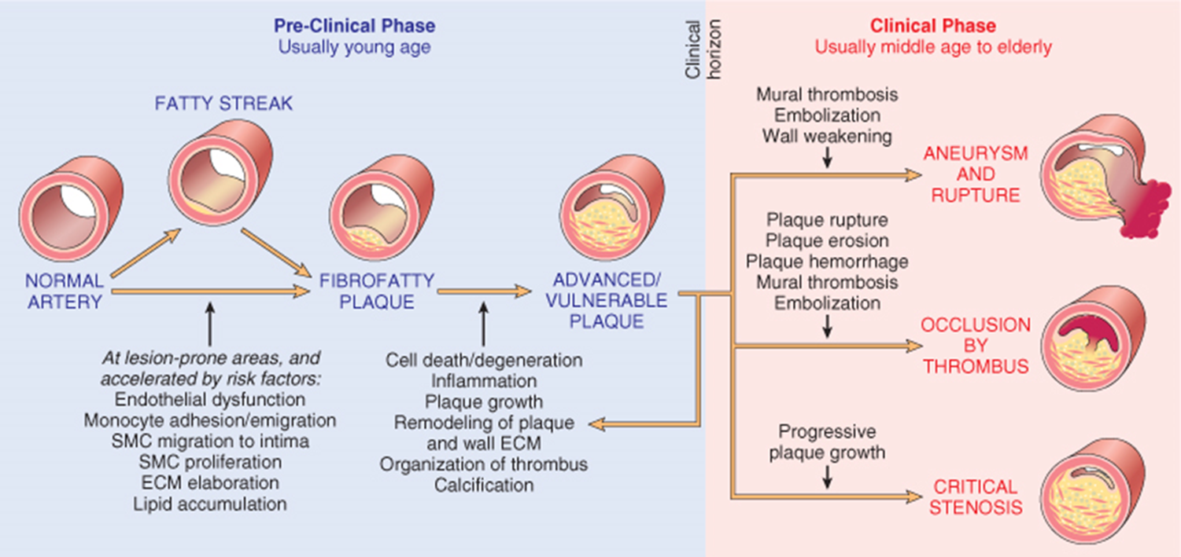
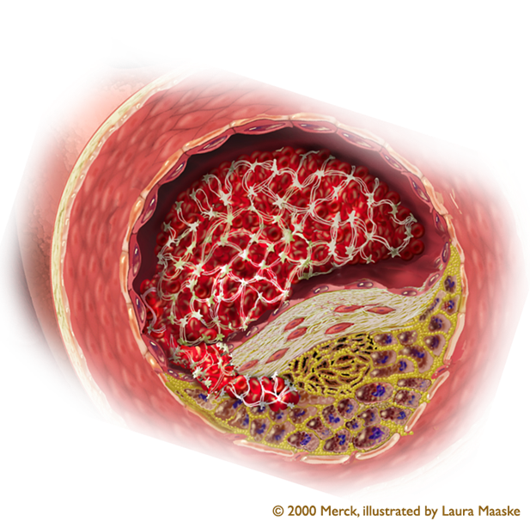


Slide 16
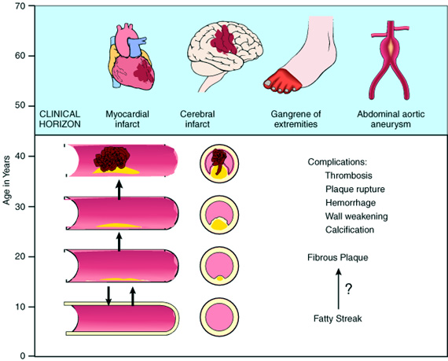
Natural history of atherosclerosis
Slide 12.5
Notes:
Natural history of atherosclerosis. Plaques usually develop slowly and insidiously over many years, beginning in childhood or shortly thereafter. As described in the text, they may progress from a fatty streak to a fibrous plaque and then to a complicated plaque that is likely to lead to clinical effects.

Slide 17
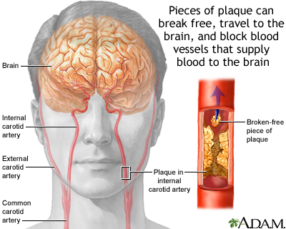
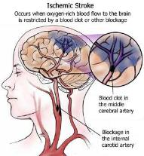
Stroke/ cerebrovascular accident
healthcaredir.com -

Slide 18
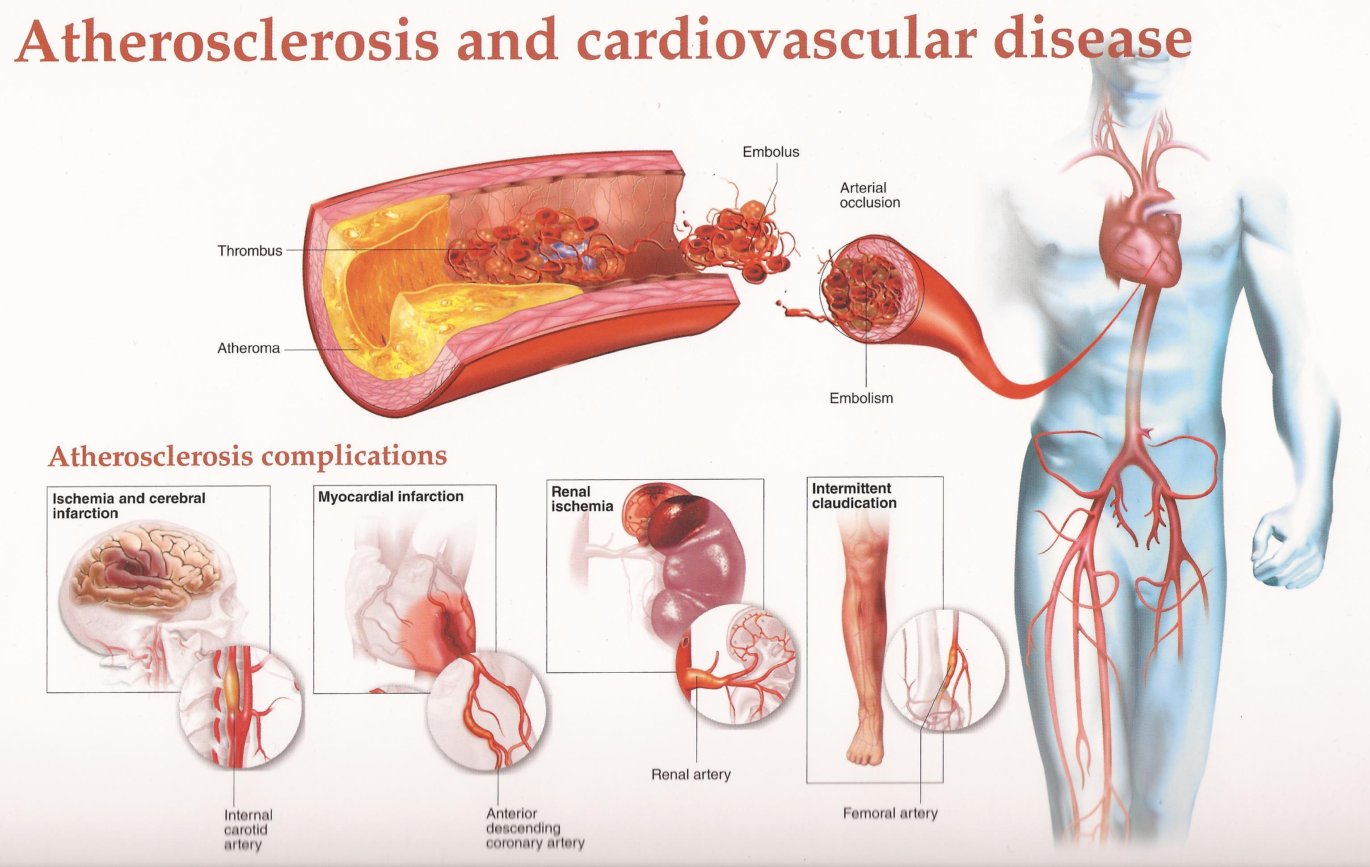
cardiologydoc.wordpress.com

Slide 19
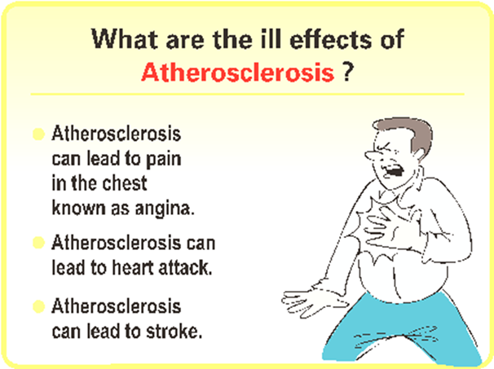
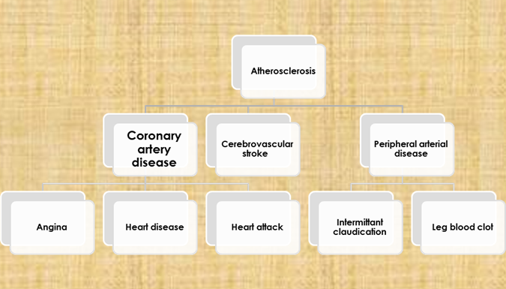

Slide 20
Risk Factors for Atherosclerosis
MINOR/UNCERTAIN/NONQUANTITATED RISK FACTORS
Obesity
Physical inactivity
Stress ("type A" personality)
Postmenopausal estrogen deficiency
High carbohydrate intake
Alcohol
Lipoprotein Lp(a)
Hardened (trans)unsaturated fat intake
Chlamydia pneumoniae
MAJOR RISK FACTORS
NON-MODIFIABLE | POTENTIALLY MODIFIABLE
Increasing age | Hyperlipidemia
Male gender | Hypertension
Family history | Cigarette smoking
Genetic abnormalities | Diabetes

Slide 21
Importance of types of lipoproteins in hypelipidemia
Low-density lipoproteins (LDLs):
When too much LDL (bad) cholesterol circulates in the blood, it promote atherosclerosis and therefore contributes to heart disease.
Very-low-density lipoproteins (VLDLs): is also considered to be a type of bad cholesterol and it promote atherosclerosis
Chylomicrons also promote atherosclerosis.
High-density lipoproteins (HDLs): is known as “good” cholesterol, because high levels of HDL protects against heart attack. Low levels of HDL also increase the risk of heart disease. HDLs help to reverse the effects of high cholesterol.

Slide 22
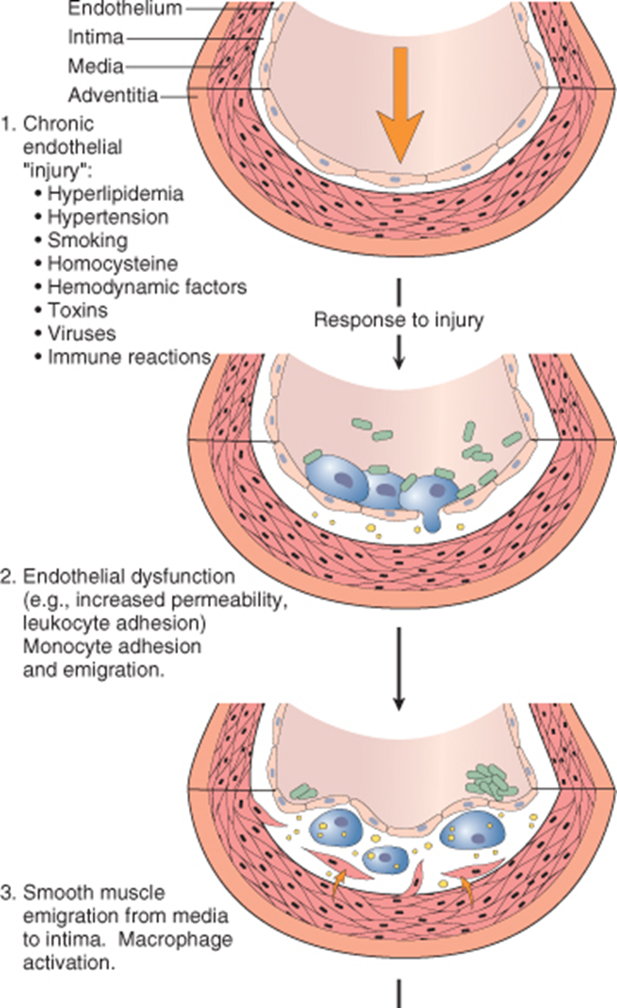
PATHOGENESIS: response to injury hypothesis
Central to this hypothesis are the following:
Accumulation of lipoproteins (mainly LDL with its high cholesterol content) in the vessel wall
Subtle Chronic endothelial injury
Increased permeability, leukocyte adhesion, and thrombotic potential.
Adhesion of blood monocytes (and other leukocytes) to the endothelium, followed by migration of monocytes into the intima and transformation into macrophages and foam cells
Adhesion of platelets

Slide 23
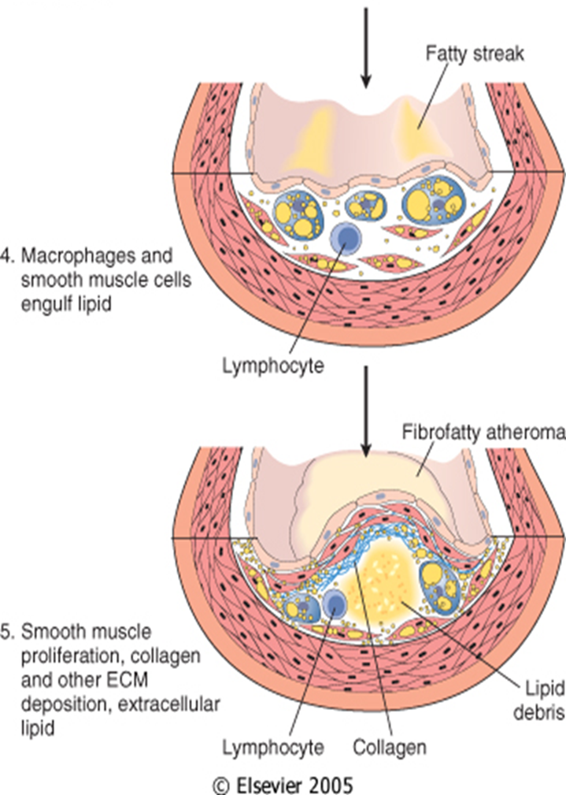
PATHOGENESIS: response to injury hypothesis
Release of factors from activated platelets, macrophages, or vascular cells that cause migration of SMCs from media into the intima
Proliferation of smooth muscle cells in the intima, and elaboration of extracellular matrix, leading to the accumulation of collagen and proteoglycans
Enhanced accumulation of lipids both within cells (macrophages and SMCs) and extracellularly.

Slide 24
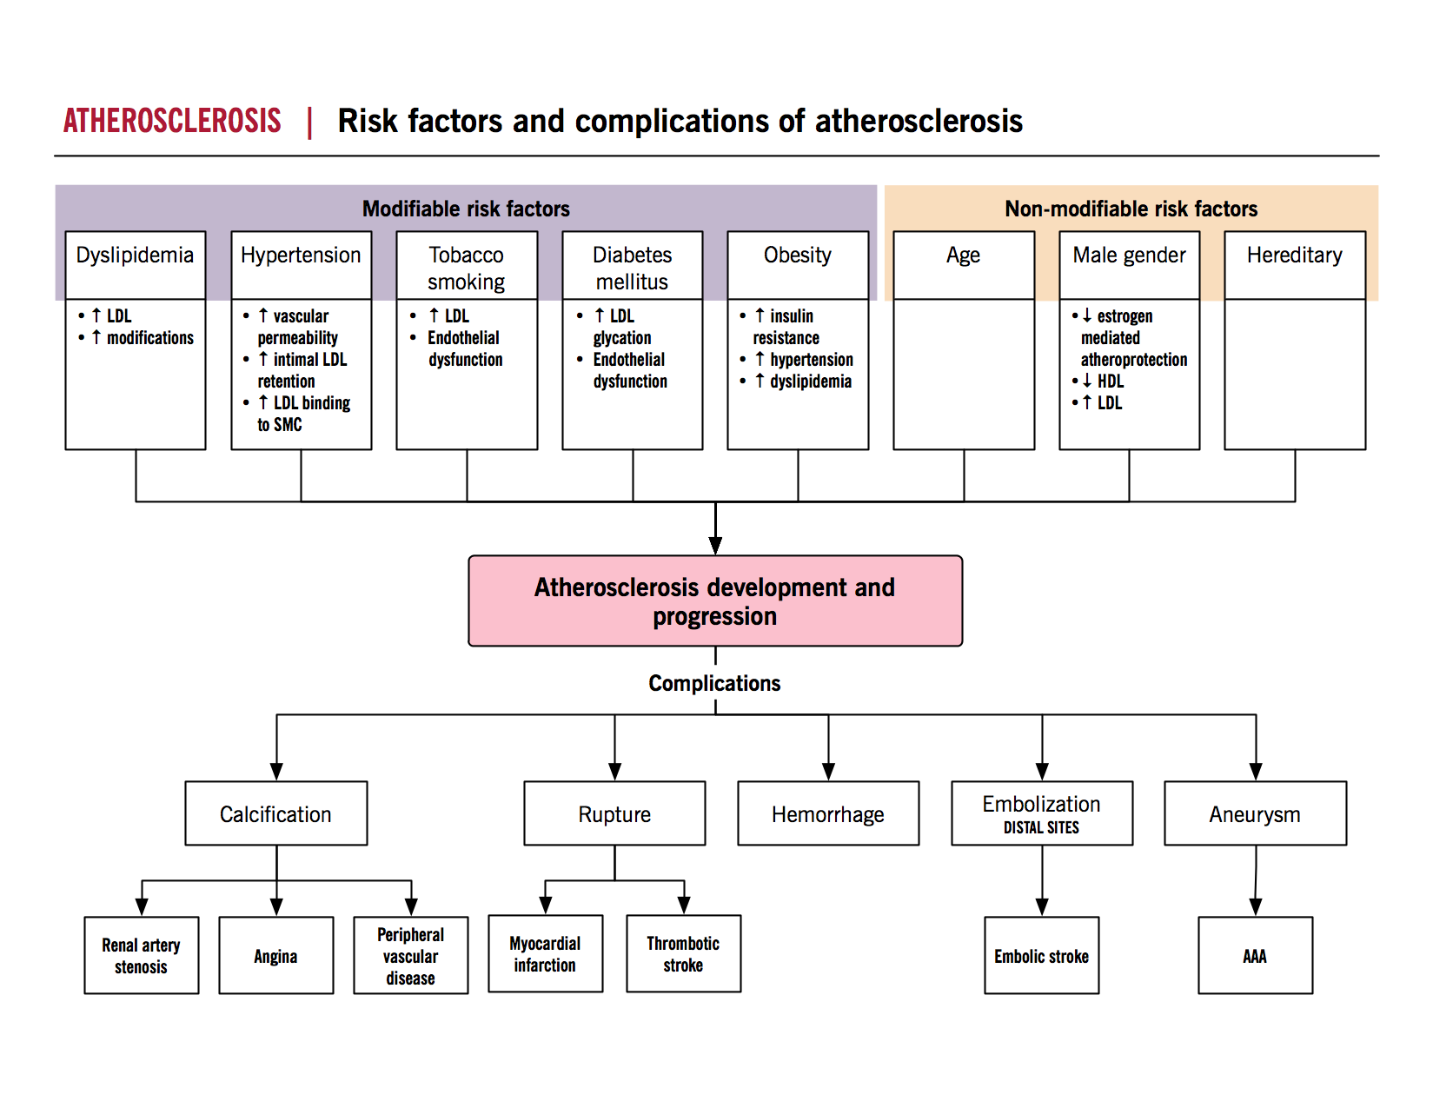
SUMMARY
http://www.pathophys.org/

Slide 25
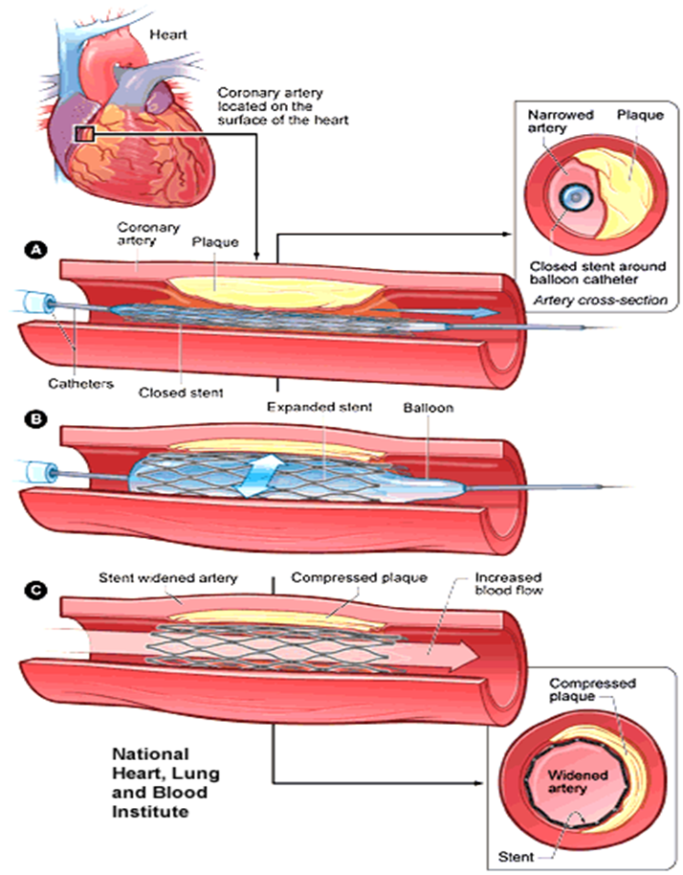
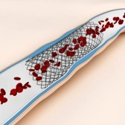
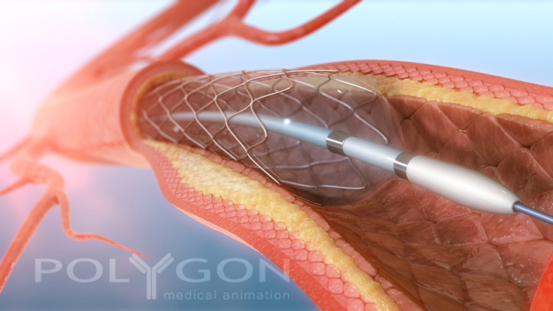

Angioplasty
www.flickr.com

Slide 26


