Slide 1
HEART FAILURE
Pathology Dept, KSU
CVS- Block

Slide 2
Right Sided Heart Failure
Chronic venous congestion of the liver
Pathology Dept, KSU
CVS- Block

Slide 3
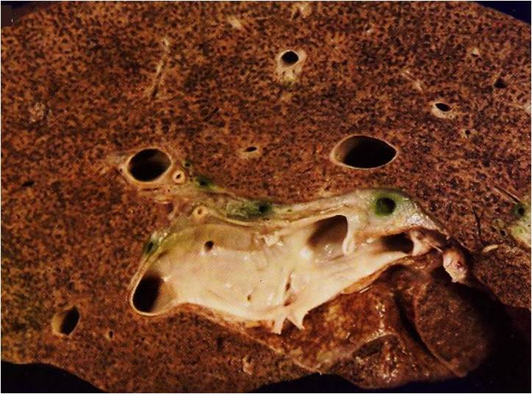
NUTMEG LIVER – Cut surface
Section of liver showing alternating pale and dark areas with a nutmeg like appearance possibly due to passive congestion secondary to right sided
heart failure.
Pathology Dept, KSU
CVS- Block

Slide 4
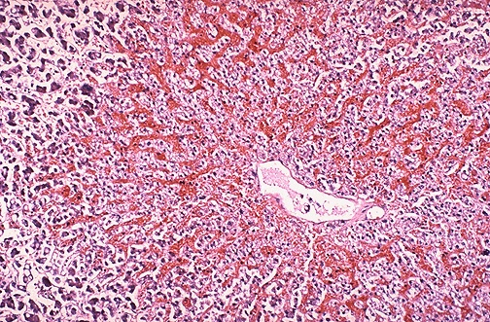
Chronic Congestion of the Liver - LPF
The central portion of liver lobules shows congestion
and dilatation of central veins and blood sinusoids,
with atrophy and necrosis of liver cells.
Pathology Dept, KSU
CVS- Block

Slide 5
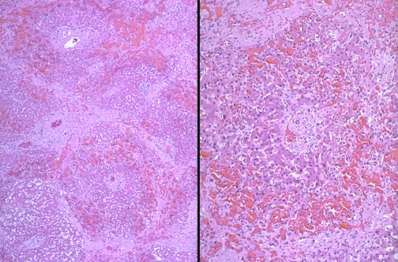
Chronic Congestion of the Liver - LPF
Central veins dilated and congested , necrotic hepatocytes , kupffer cells and steatosis
Pathology Dept, KSU
CVS- Block

Slide 6
Left Sided Heart Failure
Chronic venous congestion of the lung
Pathology Dept, KSU
CVS- Block

Slide 7
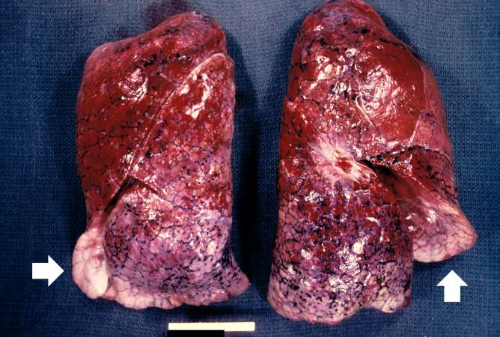
Chronic venous congestion of the lung - Gross
This is a gross photograph of lungs that are distended and red. The reddish coloration of the tissue is due to congestion. Some normal pink lung tissue is seen at the edges of the lungs (arrows).
Pathology Dept, KSU
CVS- Block

Slide 8
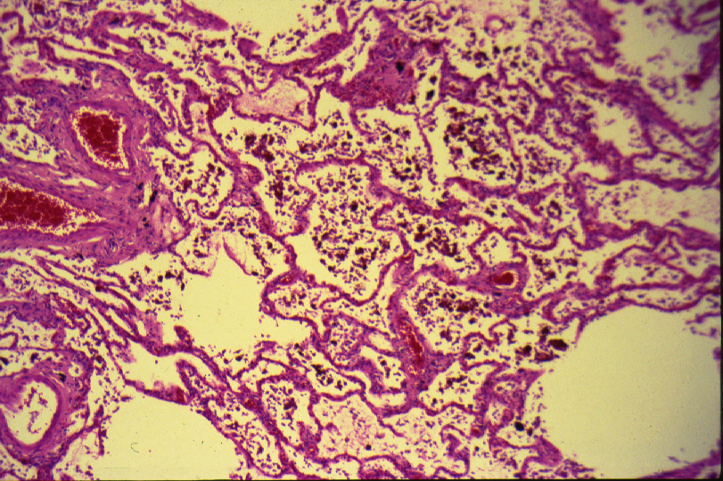
Chronic venous congestion of the lung - LPF
The alveolar walls are thickened by dilated and engorged capillaries.
Pathology Dept, KSU
CVS- Block

Slide 9
Chronic venous congestion of the lung - HPF
The alveoli contain edematous fluid, red blood cells and large alveolar macrophages (heart failure cells), which are filled with haemosiderin pigment derived from red cells breakdown.
Pathology Dept, KSU
CVS- Block

Slide 10
PRACTICAL - 2
Pathology Dept, KSU
CVS- Block

Slide 11
MYOCARDIAL HYPERTROPHY
The ventricle is working against high pressure, or “pumping” higher than normal volume leading to myocardial hypertrophy.
Pathology Dept, KSU
CVS- Block

Slide 12
Causes of ventricular hypertrophy
Left ventricular hypertrophy :
Systemic hypertension
Aortic valve stenosis
Right ventricular hypertrophy:
Pulmonary hypertension
– asthma, COPD
– pulmonary thromboembolic disease
– primary pulmonary hypertension
Pulmonary valve stenosis
Left-to-right shunts (volume overload)
Pathology Dept, KSU
CVS- Block

Slide 13
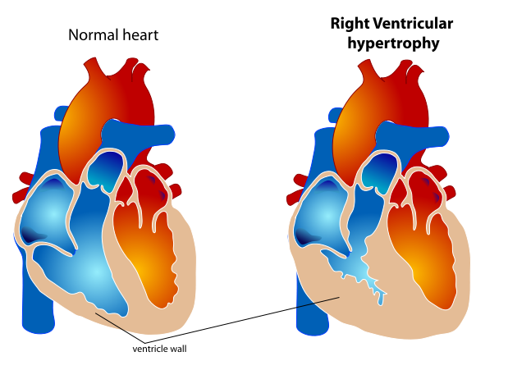
Right ventricular hypertrophy
Pathology Dept, KSU
CVS- Block

Slide 14
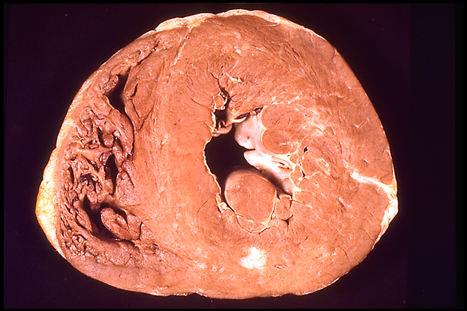
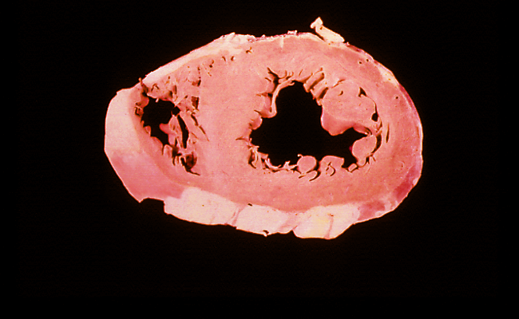
Normal and hypertrophied left ventricle –
cross section
Left ventricular hypertrophy
Normal ventricles
Pathology Dept, KSU
CVS- Block

Slide 15
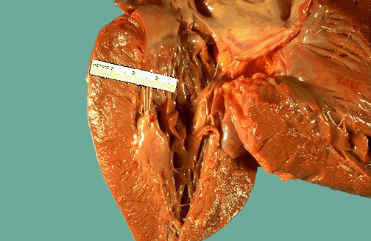
Left ventricular hypertrophy - Gross
Heart from a hypertensive patient. The left ventricle is very thick (over 2 cm). However the rest of the heart is fairly normal in size as is typical for hypertensive heart disease. The hypertension creates a greater pressure
load on the heart to induce the hypertrophy
Pathology Dept, KSU
CVS- Block

Slide 16
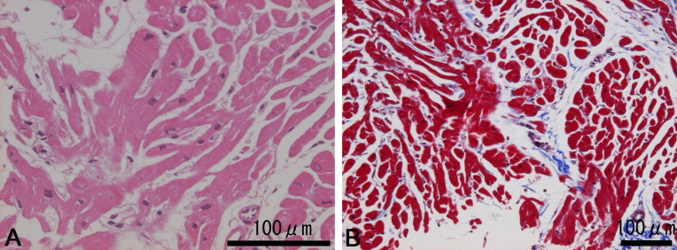
Hypertrophic Cardiomyopathy - LPF
haematoxylin-eosin stain
Masson's trichrome stain
Histopathology of heart sections of ventricular septum showing significant myofiber disarray and slight interstitial fibrosis indicating hypertrophic cardiomyopathy (HCM).
Pathology Dept, KSU
CVS- Block

Slide 17
Myocardial Infarction
Pathology Dept, KSU
CVS- Block

Slide 18
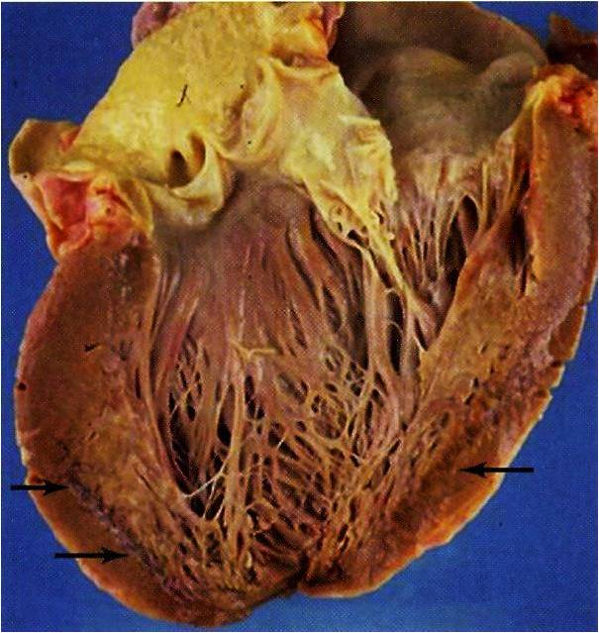
Myocardial Infarction - CS
Pathology Dept, KSU
CVS- Block

Slide 19
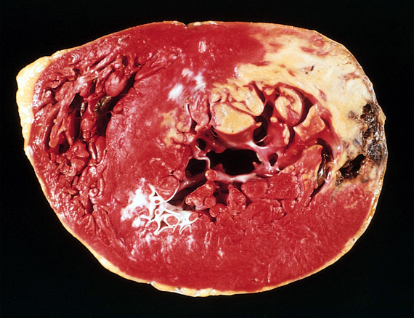
Myocardial Infarction - CS
Cross section of the left and right ventricles shows:
- Fibrosis in both right and left ventricles.
- Haemorrhage.
Pathology Dept, KSU
CVS- Block

Slide 20
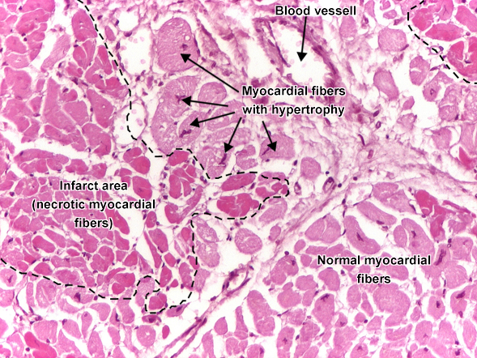
Myocardial Infarction - LPF
Myocardial infarct - circumscribed area of ischemic necrosis - coagulative necrosis. In the first 12 - 24 hours, myocardial fibers are still well delineated, with intense eosinophilic (pink) cytoplasm, but lost their transversal striations and the nucleus (left side of the picture). Notice a few myocardial fibers showing hypertrophy (increased size of the fiber, irregular shape of the nuclei)
Pathology Dept, KSU
CVS- Block

Slide 21
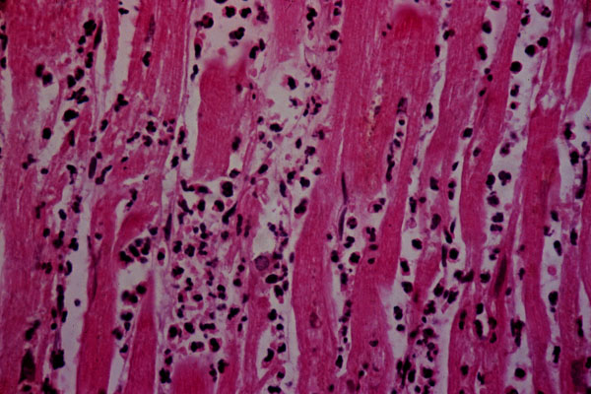
Myocardial Infarction - HPF
Acute myocardial infarct, histology. This 3-4 day old infarct showing:
- Myocardial fibred necrosis. (Coagulative necrosis)
Infiltration by polymorphonuclear leukocytes.
If patient dies at this stage, cause is usually cardiac arrest secondary to complicated acute myocardial infarction

Slide 22
Acute myocardial infarction can be complicated by
Cardiac Arrhythmias.
- Myocardial rupture and haemopericardium.
- Ventricular aneurysm.
- Heart failure.

Slide 23
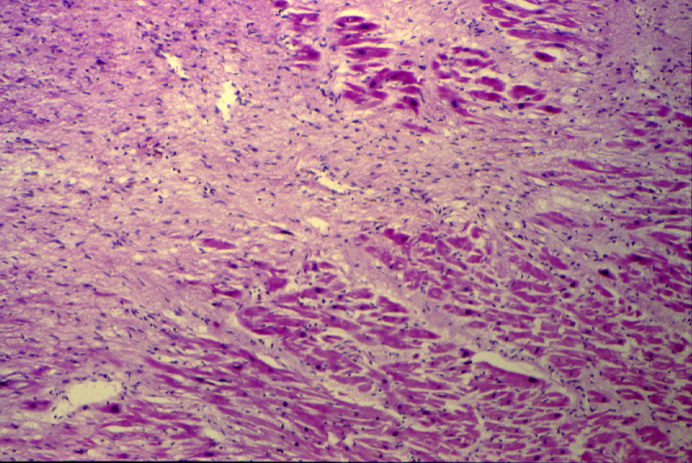
Myocardial Infarction - LPF
3
2
1
1- Patchy coagulative necrosis of myocardial fibers. The dead muscle fibers are structureless and hyaline with loss of nuclei and striations.
2- Chronic ischemic fibrous scar replacing dead myocardial fibers .
3- The remaining myocardial fibers show enlarged nuclei due to ventricular hypertrophy .
Pathology Dept, KSU
CVS- Block

Slide 24
Thromboembolism / Vasculitis
Pathology Dept, KSU
CVS- Block

Slide 25
Thromboangitis oblitrans (Buerger’s disease)

Slide 26
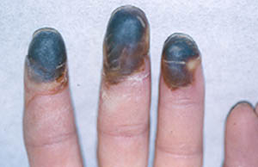
Thromboangitis oblitrans
(Buerger`s disease)
Black discoloration of the patient’s finger and toes caused by ischaemia
The main predisposing factors for this condition are:
- Smoking habits.
- Certain HLA haplotypes (Genetic predisposition).
CVS- Block

Slide 27
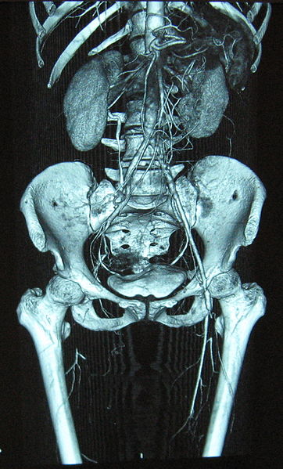
Thromboangitis obliterans (Buerger’s disease)
Pathologic findings of an acute inflammation and thrombosis (clotting) of arteries and veins of the hands and feet (the lower limbs being more common)
Complete occlusion of the right and stenosis of the left femoral artery
Pathology Dept, KSU
CVS- Block

Slide 28
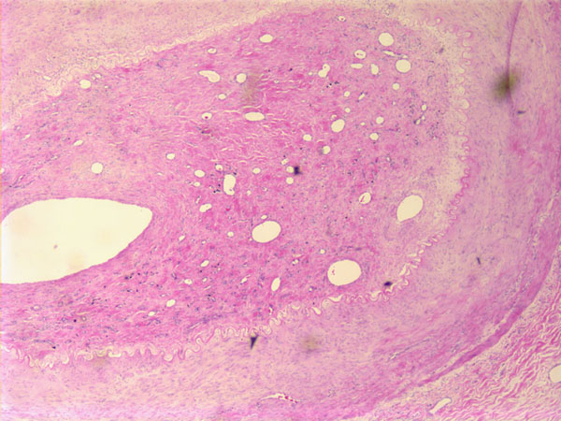
Thromboangitis obliterans (Buerger’s disease) - LPF
Thromboangiitis obliterans (Buerger’s disease) is a non atherosclerotic, segmental, inflammatory, vaso-occlusive disease that affects the small- and medium-sized arteries and veins of the upper and lower extremities.
Pathology Dept, KSU
CVS- Block

Slide 29
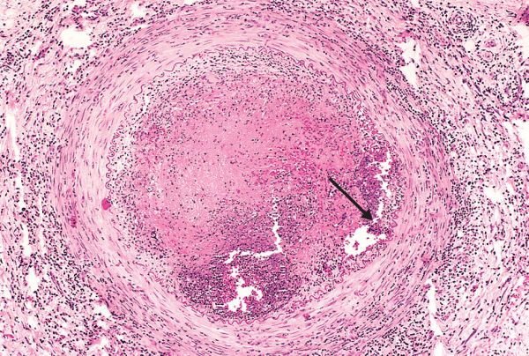
Thromboangitis obliterans (Buerger’s disease) - HPF
The lumen is occluded by a thrombus in lumen (arrow)
The vessel wall is infiltrated with leukocytes.
Pathology Dept, KSU
CVS- Block

Slide 30
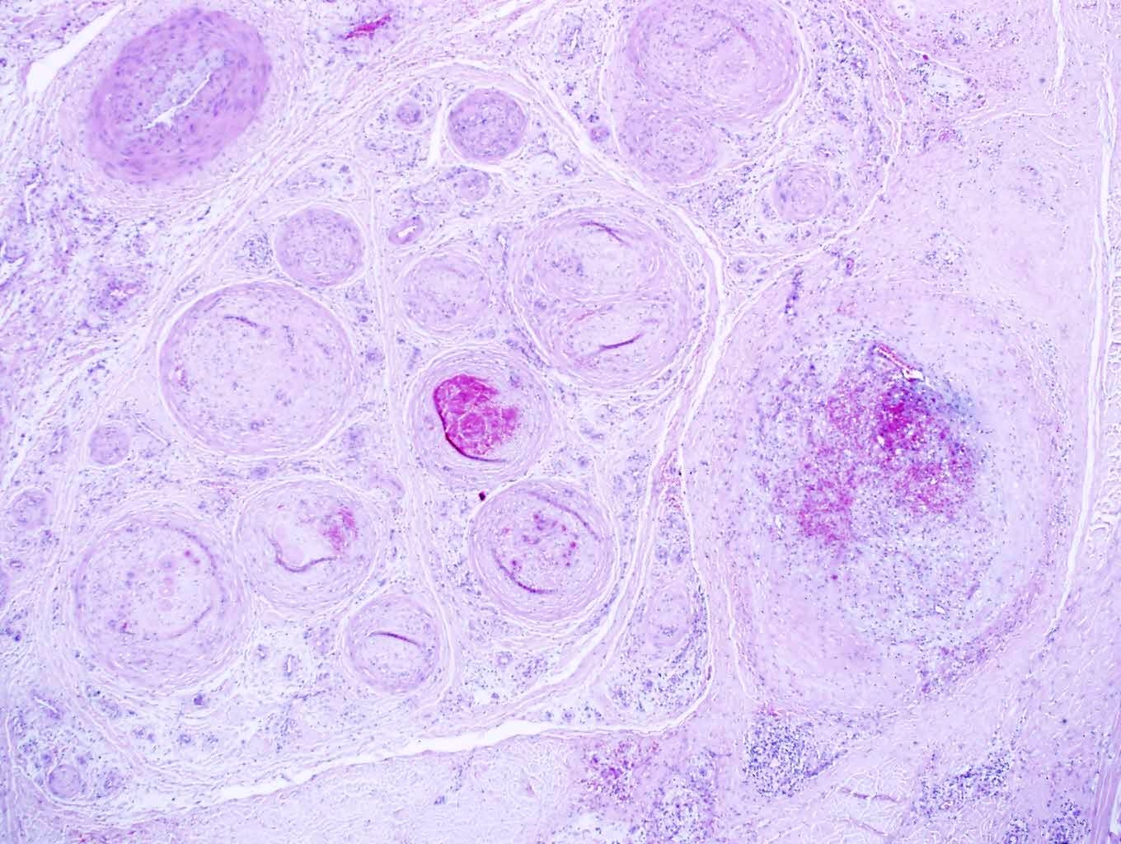
Thromboangitis obliterans (Buerger’s disease)- HPF
Some blood vessels show recent organizing thrombi
while others show infiltration of the wall and surrounding tissue by chronic inflammatory cells
Pathology Dept, KSU
CVS- Block

Slide 31
Giant cell (temporal) arteritis
Pathology Dept, KSU
CVS- Block

Slide 32
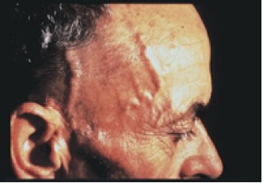
GIANT CELL / TEMPORAL ARTERITIS
Tender and thickened scalp veins
Pathology Dept, KSU
CVS- Block

Slide 33
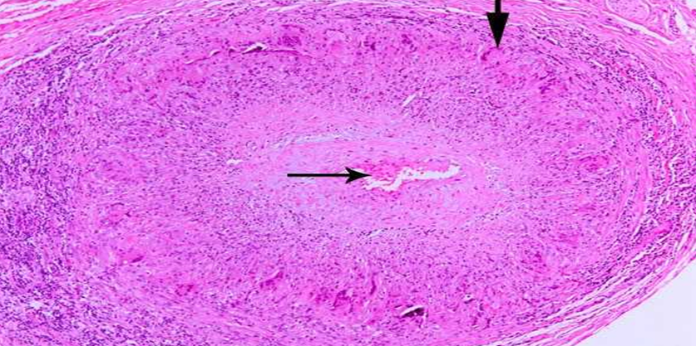
GIANT CELL / TEMPORAL ARTERITIS - LPF
Circumferential involvement of the vascular media is present (vertical arrow pointing downward). Also note the presence of chronic lymphocytic inflammation in the media and adventitia.
Reactive intimal fibroplasias lead to luminal stenosis with <10% of its original luminal diameter (thin arrow in the center).
Pathology Dept, KSU
CVS- Block

Slide 34
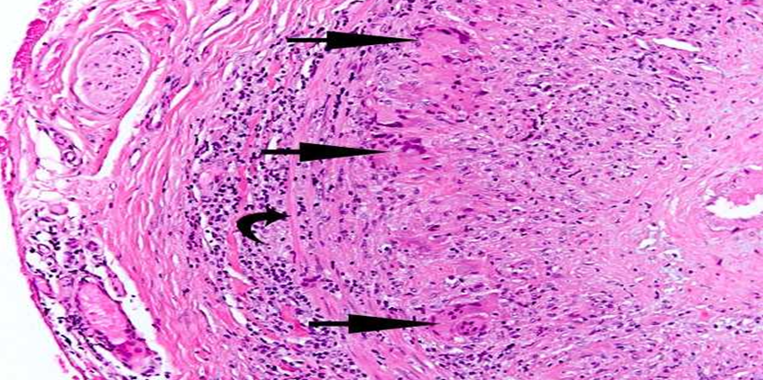
GIANT CELL / TEMPORAL ARTERITIS - HPF
Giant cells can be of Langhans type or foreign-body type (three arrows) and may show fragments of disrupted internal elastic lamina. Note the presence of dense chronic lymphocytic inflammation traversing through circumferential smooth muscle fibers (curved arrow) of vascular media.
Pathology Dept, KSU
CVS- Block

Slide 35
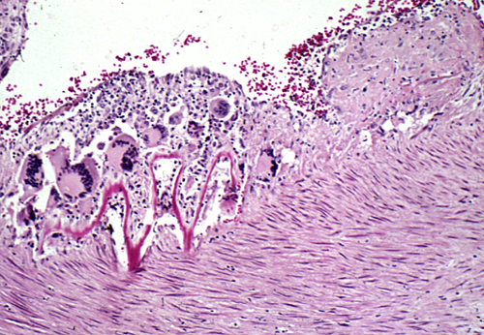
GIANT CELL (TEMPORAL) ARTERITIS - HPF
Disruptions of the elastic lamina with inflammation and giant cells.
Segmental inflammatory lesions with intimal thickening , medial granulomatous inflammation with giant cells and chronic inflammatory cells and internal elastic lamina fragmentation
Pathology Dept, KSU
CVS- Block
Notes:
.

Slide 36
Leukocytoclastic vasculitis/ hypersensitivity vasculitis / microscopic polyangitis / Henoch- Schönlein purpura.
Pathology Dept, KSU
CVS- Block

Slide 37
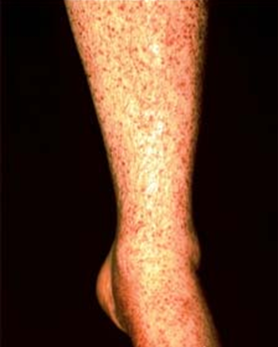
Hypersensitivity vasculitis – Clinical sign
Hypersensitivity vasculitis might be complicated with glomerulonephritis and hemoptysis due to pulmonary capillaritis
Pathology Dept, KSU
CVS- Block

Slide 38
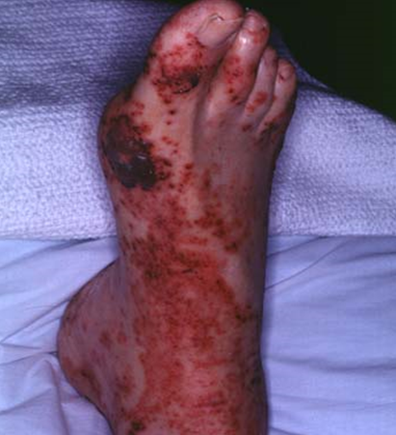
Leukocytoclastic vasculitis - Clinical sign
Leukocytoclastic vasculitis
- Erythematous and purpuric skin rash affecting the right foot
(Purpura:- Subcutaneous bleeding.)
CVS- Block

Slide 39
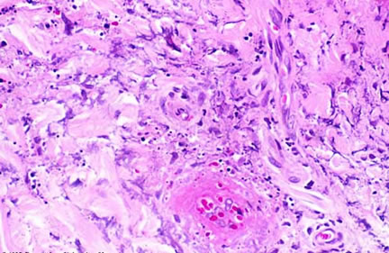
Leukocytoclastic vasculitis - HPF
The main predisposing conditions are:
-Fibrinoid vascular necrosis.
- Nuclear debris.
- Neutrophilic (polymorphonuclear) infiltration.
Pathology Dept, KSU
CVS- Block

Slide 40
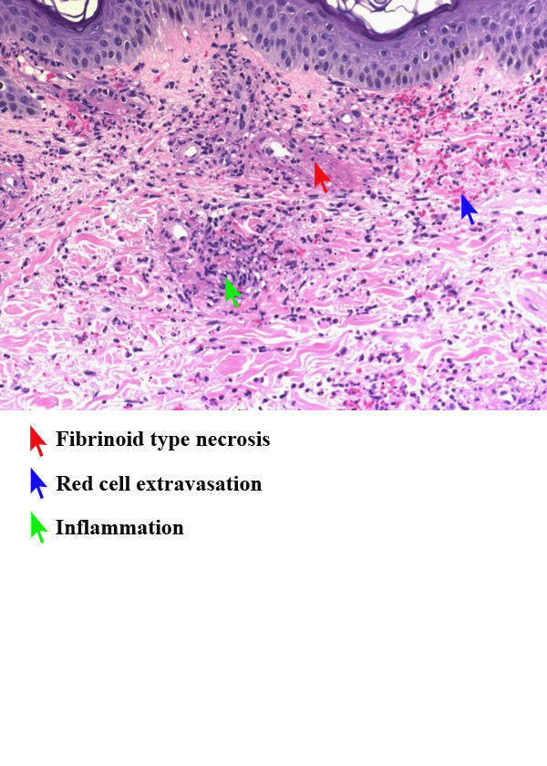
Leukocytoclastic vasculitis - HPF
Complications that might occur as a result of this condition.
- Necrotizing Glomerulonephritis.
- Pulmonary capillaritis.
- Gastrointestinal vasculitis.
- CNS and muscle involvement.
CVS- Block

Slide 41
THE END

