Slide 1
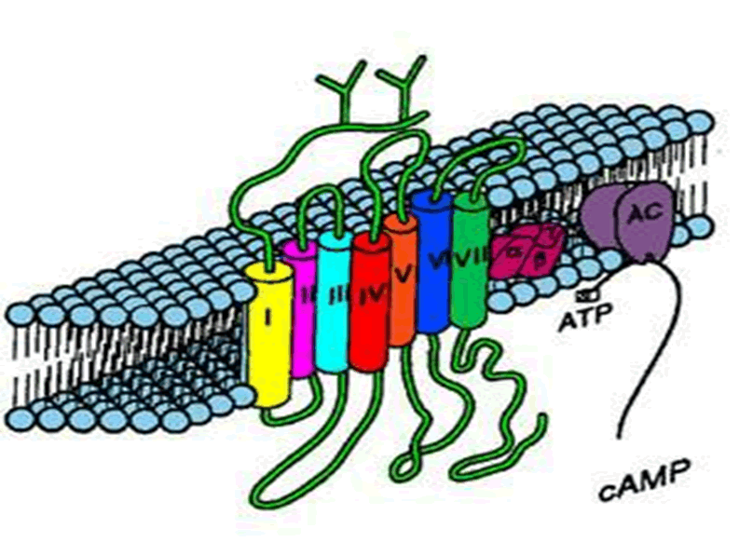
PHARMACOLOGY OFADRENERGICS
Agonists
Antagonist

Slide 2
Adrenergic Neuron Blockers Sympatholytics
Adrenoceptor Blockers
Adrenolytics
Form False Transmitters
Deplete Storage
Inhibit Release & Enhance Uptake
Alpha & beta- adrenergic receptor blockers

Slide 3
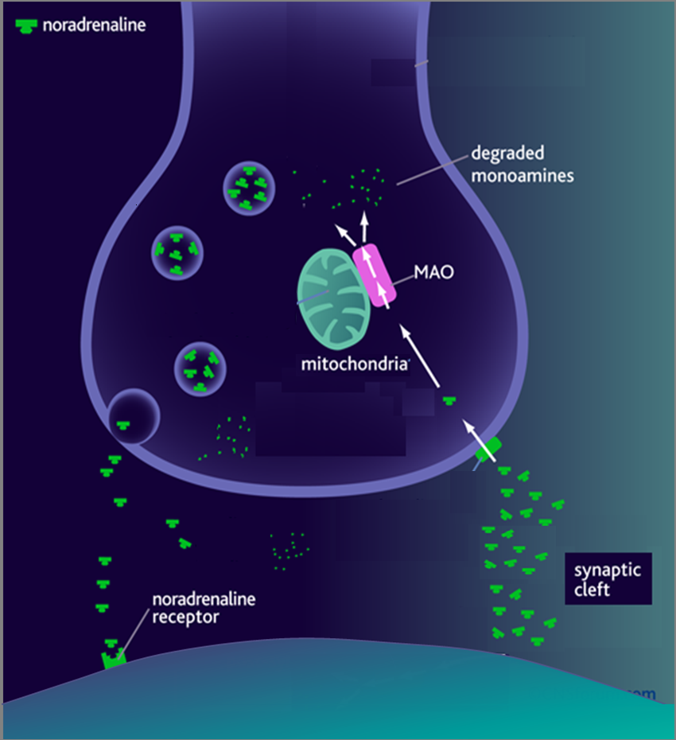
1. Adrenergic Neuron Blockers [SYMPATHOLYTICS]
1. METHYLDOPA
α-methyl tyrosine
Norepinephrine (NE)
Na
Dopa
Tyrosine
False Transmitters
Tyrosine
◉
Antihypertensive in PREGNANCY
DA
2. RESERPINE
NE
Depletes Stores
α₂
NET
3. Gaunthidine
○ Inhibit Release
○ Enhance Uptake
2. Adrenoceptor Blockers [ADRENOLYTICS]
α₁
β₁
β₂
COMT

Slide 4
ADRENERGICS DEPRESSANTS
Adrenolytics
ADRENERGIC ANTAGONISTS
Adrenergic Receptor Blockers

Slide 5
α₁ blocker
α ADRENOCEPTOR BLOCKERS
Blocks α₂
Yohimbine
Non-Selective
Blocks α₁& α₂
Blocks α₁
Selective
Release
NE & ADH / Aphrodisiac
Prazosin & Doxazosin
Tamsulosin
Irreversible
Short acting
Long acting
Uroselective
Phenoxybenzamine
Indications
Long acting
Raynaud’s disease:
induce peripheral vasodilatation
Benign prostatic hypertrophy (BPH)
Rarely in hypertension & HF
1. In Irreversible shock
2. Before removal of Pheochromocytoma 
to prevent
Hypertensive crisis
ADRs
Contracts bladder wall
hypotension,
syncope,
fluid retention,
head-ache,
nasal stuffiness,
ejaculation, ?? impotence
Reversible
only
Phentolamine
Short acting
BPH
Relaxes bladder neck
& opens sphincter

Slide 6
β ADRENOCEPTOR BLOCKERS
Pharmacodynamic Classification
1
According to extent of blocked of each type they are either
Non-Selective
Selective
Block β₁& β₂  Propranolol, Timolol,
Pindolol
Block β₁>> β₂  Atenolol, Bisoprolol,
Metoprolol
Block β & α₁  Labetalol, Carvedilol
2
According to presence of agonistic/antagonistic action (ISA) = PARTIAL AGONISTS or only antagonistic action
Without ISA
With ISA
Propranolol, Timolol,
Atenolol, Bisoprolol,
Labetalol
Carvedilol

Slide 7
β ADRENOCEPTOR BLOCKERS
Pharmacokinetic Classification
According to their lipid solubility
 | Lipophylic | Hydrophilic
Oral absorption | Complete | Irregular
Liver metabolism | Yes | No
t _{1/2} | Short | Long
CNS side effects | High | low
 | Propranolol, Pindolol, Timolol. Metoprolol Labetalol > Carvedilol | Atenolol, Bisoprolol

Slide 8
PROPRANOLOL
Dynamics
Kinetics
1. Non-Selective Blocker of β₁ & β₂
2. Has membrane stabilizing action
3. Has sedative action
Completely absorbed
70% destroyed during 1st pass hepatic metabolism,
90-95% protein bound,
cross BBB
Actions
Heart; by block β₁
Inhibit heart properties   cardiac output
Has anti -ischemic action   cardiac work +  O₂ consumption
Has anti-arrhythmic effects  excitability, automaticity & conductivity + by membrane stabilizing activity
BP; by block β₁ & β₂
Has antihypertensive action by
Inhibiting heart properties   cardiac output
Vasoconstriction to kidney BV:  RASS system
Presynaptic inhibition of NE release from adrenergic nerves
Inhibiting sympathetic outflow in CNS

Slide 9
PROPRANOLOL
Actions
Cont.
Blood Vessels [BV]; by block β₂
Vasoconstriction  blood flow specially to muscles, other organs except brain  cold extremities + intermittent claudications
Bronchi: by block β₂
Bronchospasm specially in susceptible patients
Intestine: by block β₂
 Intestinal motility
Metabolism: by block mainly β₂
In liver;  Glycogenolysis  Hypoglycaemia
In pancreas;  Glucagon secretion
In adipocytes;  Lipolysis
In skeletal muscles; glycolysis
On peripheral & central nervous systems:
Has local anesthetic effect
◉ tremors &  anxiety

Slide 10
PROPRANOLOL
INDICATIONS
Hypertension
Arrhythmias; Ventricular > atrial
Angina
Myocardial infarction  infarct size Cardioprotectivedeath
◉ myocardial O₂ demand.
 Redistribution of blood flow in the myocardium.
free fatty acids.
Anti-arrhythmic action.
◉ incidence of sudden death
Migraine [Prophylaxis]
Pheochromocytoma; used with α-blockers (never alone)
Chronic glaucoma;  IOP  by  secretion of aqueous humor
Tremors
Anxiety; (specially social & performance type)
Hyperthyroidism; Controls tachycardia, tremors, sweating
Protects heart against sympathetic over-stimulation.
Lowers conversion rate of T4 into T3

Slide 11
PROPRANOLOL
ADR
Due to block of cardiac β₁-receptors:
Heart failure
Bradycardia
Hypotension
Due to blockade of β₂- receptor: (only with non-selective β-blockers)
Asthma, emphysema, chronic bronchitis
Cold extremities & intermittent claudication
Erectile dysfunction - impotence
Hypoglycemia &  triglycerides
All β-blockers mask hypo-glycaemic manifestationstreated diabetics can develop hypoglycaemic COMA
Depression, nightmares, vivid dreams and hallucinations.
Gastrointestinal disturbances.
Sodium retention
Hypersensitivity reactions: skin rash and fever.
Selective
Safer in : Asthma / Diabetes & Dyslipidemias Rauynald’s phenomenon & vascular diseases
Only (β₁)

Slide 12
PROPRANOLOL
Better in patients;
that exhibit excessive bradycardia
non compliant for fear of sudden stoppage
Not useful in patients with AMI, angina & tachyarrhythmias
With ISA
Partial agonist
Sudden stoppage will give rise to a withdrawal manifestations:
Rebound angina, arrhythmia, myocardial infarction & hypertension WHY ?  Up-regulation of β-receptors.
So drug must be withdrawn gradually  to prevent its happening
Contraindications
Depressed myocardial functions [Uncompensated HF, Heart Block, Massive Myocardial Infarction.
Hypotension
Bronchial Asthma (safer with cardio-selective β-blockers).
Peripheral vascular disease (safer with cardio-selective β-blockers).
Diabetic patients > (Type I) (specially on Insulin)
for fear of hypoglycaemia

Slide 13
Interactions
PROPRANOLOL
Pharmacodynamic Interactions
Bradycardia / heart block  with verapamil both induce A.V block
Rebound hypertension & impaired tissue perfusion  if used with cocaine, amphetamine or α-blocker overdose
Attenuation of hypertensive effect  with NSAIDs  because they  formation of vasodilating prostaglandins.
HF  with other cardiac depressants as quinidine.
Claudications, parasthesia, …etc with ergot alkaloids in migraine.
Enhanced neuromuscular blockade  Tubocurarine
Hypoglycaemia  with anti-diabetic drugs ( insulin > sulfonylureas) > Non selective β-blockers

Slide 14
LABETALOL
Blocks β & α₁
Rapid acting, non-selective with little ISA & local anesthetic effect
Do not alter serum lipids or blood glucose
Used in  Severe hypertension in pheochromocytoma
May be used pregnancy-induced hypertension
ADR; Orthostatic hypotension, sedation & dizziness
CARVEDILOL
Blocks β > α₁ (so more vasodialating)
Non-selective with no ISA & no local anesthetic effect.
Has antioxidant action
Favorable metabolic profile.
Used effective in  congestive heart failure  reverses its patho- physiological changes
ADR; Edema

Slide 15
Agents specifically indicated for hypertension
Atenolol, Bisoprolol > Metoprolol, Propranolol
Agents specifically indicated for cardiac arrhythmia
Propranolol > Atenolol
Agents specifically indicated for congestive heart failure Carvedilol, Bisoprolol, Metoprolol
Agents specifically indicated for myocardial infarction
Atenolol, Metoprolol, Propranolol
Agents specifically indicated for glaucoma
Timolol
Agents specifically indicated for migraine prophylaxis
Timolol, Propranolol

Slide 16
GOOD LUCK

