Slide 1
Drug Treatment
of
heart failure

Slide 2
Prof. Abdulrahman
Almotrefi
Prof. Azza
El-Medani

Slide 3
Learning objectives
By the end of this lecture, students should be able to:
- Describe the different classes of drugs used for treatment of acute & chronic heart failure and their mechanism of action
Understand their pharmacological effects, clinical
uses, adverse effects and their interactions with
other drugs.

Slide 4
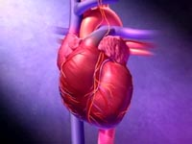
HEART FAILURE
?
Inability of the heart to maintain an adequate cardiac output to meet the metabolic demands of the body.

Slide 5
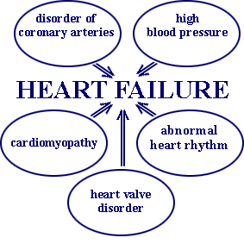
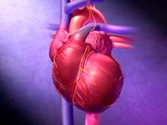
CAUSES OF HEART FAILURE

Slide 6
Heart failure symptoms
- Tachycardia
- Decreased exercise tolerance (rapid fatigue)
- Dyspnea ( pulmonary congestion)
- Peripheral edema
- Cardiomegaly

Slide 7
Dyspnea
l l l
l l l
Oedema of lower limbs

Slide 8
↓ Force of contraction
Low C.O.
↓ Carotid sinus firing
↓ Renal blood flow
Activate renin-angiotensin-
Aldosterone system
Activate sympathetic system
↑ Sympathetic discharge
ALDOST.
Remodeling
Ag. II
Salt & Water
Retention
Volume expansion
Vasoconstriction
↑ Force of
Cardiac .cont.
Venous VC
Arterial VC
↑ HR .
↑ Preload
↑ Preload
↑ After load
↑ C.O. Via
compensation
Pathophysiology of CHF

Slide 9
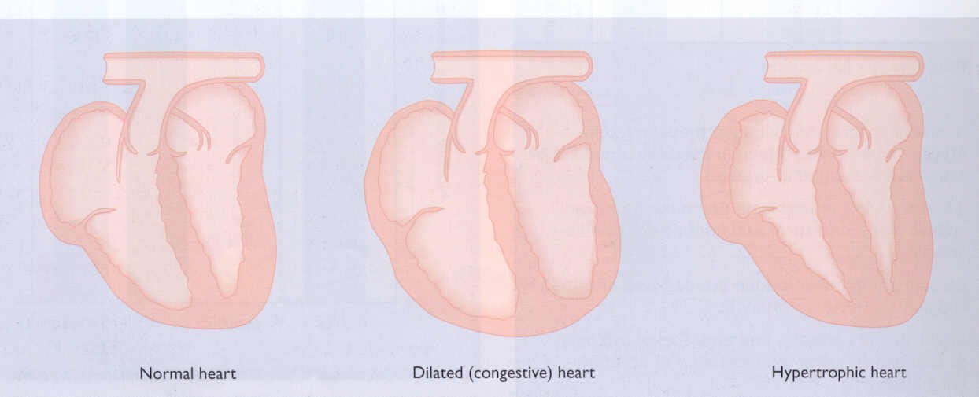

Slide 10
Factors affecting cardiac output and
Heart Failure
1- Cardiac contractility
2- Preload
3- Afterload
4- Heart rate

Slide 11
Drugs used in the treatment of heart failure
Drugs that increase contractility
Cardiac glycosides
Phosphodiesterase inhibitors
β- adrenoceptor agonists

Slide 12
Drugs that decrease preload
Diuretics
Venodilators

Slide 13
Drugs that decrease afterload
Arteriolodilators

Slide 14
Drugs that decrease preload & afterload
Combined arteriolo- and venodiators:
Angiotensin converitng enzyme (ACE) inhibitors
Angiotensin receptor antagonists
α₁-adrenoceptor antagonists
Direct vasodilators

Slide 15
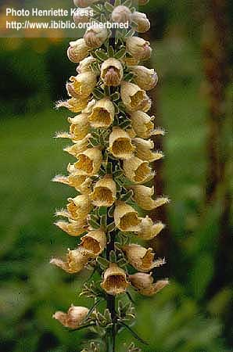
CARDIAC GLYCOSIDES
Digitalis Lanata
Digoxin / Digitoxin / Ouabain

Slide 16
CARDIAC GLYCOSIDES
Mechanism of action
- Inhibit Na⁺ / K⁺ ATPase enzyme

Slide 17
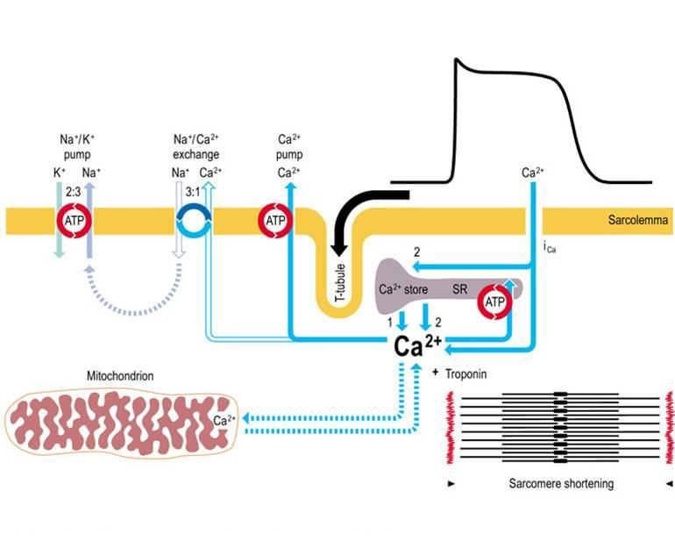
MECHANISM OF ACTION

Slide 18
CARDIAC GLYCOSIDES
PHARMACOLOGICAL ACTIONS:
1- Increase the force of myocardial contraction (+ve inotropic)
leading to decrease in:
heart size , venous pressure and edema
2- Slow heart rate ( -ve chronotropic ) by vagal stimulation

Slide 19
CARDIAC GLYCOSIDES
Therapeutic uses:
- Congestive heart failure
Atrial arrhythmias:
- Atrial flutter
- Atrial fibrillation
- Supraventricular tachycardia

Slide 20
CARDIAC GLYCOSIDES
Digoxin /
PHARMACOKINETICS
Drug has narrow therapeutic index
Absorption: orally : 40-80% leading to variable bioavailability
I.V. acts within 15 min-3hrs
25% protein bound
85% is excreted unchanged in the urine

Slide 21
CARDIAC GLYCOSIDES
Cardiac adverse effects :
- digitalis-induced arrhythmias
can cause any type of arrhythmia especially:
- extrasystoles
- coupled beats (Bigeminal rhythms )
- ventricular tachycardia or fibrillation
- A.V.block,
- cardiac arrest.

Slide 22
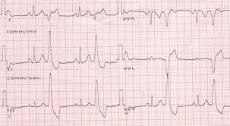
Coupled beats (Bigeminal rhythms )

Slide 23
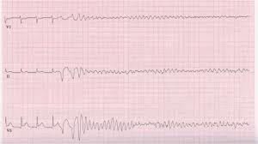
ventricular fibrillation

Slide 24
CARDIAC GLYCOSIDES
Extra cardiac adverse effects :
GIT :
common ( the earliest signs of toxicity ): Anorexia ,nausea, vomiting, diarrhea
CNS:
Headache, visual disturbances, drowsiness

Slide 25
CARDIAC GLYCOSIDES
Factors that increase digitalis toxicity:
- Small Lean body mass
- Renal diseases
- Hypothyroidism
- Hypokalemia
- Hypomagnesemia
- Hypercalemia

Slide 26
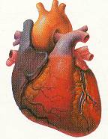
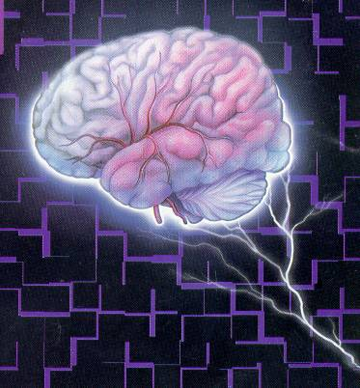
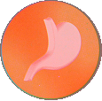
Treatment OF ADVERSE EFFECTS
HEART
CNS
Vision
GIT
???
Atropine
Antiarrythmics
K supplements
FAB fragment
Digoxin , diuretic

Slide 27
β-Adrenoceptor agonists
Dobutamine :
Selective β₁ agonist
Uses : Treatment of acute heart failure in
cardiogenic shock

Slide 28
Phosphodiesterase Inhibitors
Bipyridines : e.g. Amrinone and Milrinone
Mechanism of action:
Inhibit phosphodiesterase isozyme 3 in cardiac & smooth muscles → :↑ cAMP which cause :
- Increase myocardial contraction
- Dilatation of both arteries & veins
( causing reduction of both preload & afterload )

Slide 29
Phosphodiesterase Inhibitors
Therapeutic uses:
- Used only intravenously for management of
acute heart failure

Slide 30
Phosphodiesterase Inhibitors
Adverse effects:
- Nausea ,vomiting
- Arrhythmias ( less than digitalis )
- Thrombocytopenia
- Liver toxicity
( Milrinone has less hepatotoxic and less bone marrow depression than amrinone )

Slide 31
- Drugs that decrease preload
1- Diuretics
2- Venodilators

Slide 32
Diuretics
- first-line agents in heart failure therapy.
- used to treat the signs and symptoms of volume overload ( pulmonary and/ or peripheral edema )
Act by reducing salt and water retention → ↓ventricular preload and venous pressure.
- This effect helps in reduction of cardiac size
which improve cardiac performance

Slide 33
Diuretics
- Hydrochlorothiazide
used in mild congestive heart failure
- Spironolactone
- a potassium sparing diuretic used in
congestive heart failure

Slide 34
Diuretics
- Furosemide
a potent diuretic used for immediate reduction of the pulmonary congestion & severe edema associated with :
- acute heart failure
- moderate & severe chronic failure

Slide 35
Venodilators
Nitroglycerine is used IV for severe heart failure when the main symptom is dyspnea due to pulmonary congestion.
Dilate venous blood vessels and reduce preload.

Slide 36
Reduction of Afterload
Arteriolodilators
Hydralazine:
- used when the main symptom is rapid fatigue due to low cardiac output.
- Reduce peripheral vascular resistance

Slide 37
Reduction of preload and afterload
ACE Inhibitors & Angiotensin Receptor Blockers
- Along diuretics are now considered as first-line drugs for heart failure therapy

Slide 38
Angiotensin converting enzyme inhibitors
MECHANISM OF ACTION
VASOCONSTRICTION
VASODILATATION
ALDOSTERONE
VASOPRESSIN
SYMPATHETIC
Angiotensinogen
RENIN
BRADYKININ
Angiotensin I
A.C.E.
Inhibitor
ACTIVATION
ANGIOTENSIN II

Slide 39
ACE Inhibitors
Pharmacokinetics
- Captopril, enalapril and ramipril
All are rapidly absorbed from GIT after oral administration.
- Food reduce their bioavailability.
- Enalapril , ramipril are prodrugs, converted to their active metabolites in the liver
- Have a long half-life & given once daily
- Enalaprilat is the active metabolite of enalapril given i.v. in hypertensive emergency.

Slide 40
Angiotensin receptor blockers
Mechanism of action
- block AT₁ receptors
- decrease action of angiotensin II
Examples : Losartan, Valsartan, Irbesartan

Slide 41
Effects of ACE Inhibitors & Angiotensin
Receptor Blockers
↓Peripheral resistance ( Afterload )
↓Venous return ( Preload)
↓sympathetic activity
↓remodeling ( cardiac & vascular) →↓mortality rate

Slide 42
Direct acting vasodilators
Sodium nitroprusside
- given I.V. in acute or severe refractory heart failure, acts immediately and effects lasts for 1-5 minutes.

Slide 43
β-Adrenoceptor Antagonists used in heart failure
Second generation:
cardioselective ( β₁ receptors)
e.g. Bisoprolol, Metoprolol
- Third generation:
have vasodilator actions ( α blocking effect)
e.g. carvedilol

Slide 44
β-Adrenoceptor Antagonists used in heart failure (cont…)
- reduce the progression of chronic heart failure.
not used in acute heart failure
( may precipitate acute decompensation
of cardiac function)

Slide 45
β-Adrenoceptor Antagonists used in heart failure
Mechanism of action
Reduce remodeling through inhibition of the
mitogenic activity of catecholamines
Reduce mortality in patients with hypertrophic
cardiomyopathy
- Decrease heart rate
- Decrease renin release

Slide 46
Management of chronic heart failure
Reduce work load of the heart
Limits patient activity
Reduce weight
Control hypertension
Restrict sodium
Diuretics
ACEI or ARBs

Slide 47
Management of chronic heart failure (Cont.)
Digitalis
β- blockers
Direct vasodilators

Slide 48
Management of acute heart failure
Volume replacement
Diuretics
Positive inotropic drugs
Vasodilators
Antiarrhythmic drugs
Treatment of myocardial infarction

Slide 49
Thank you

