Slide 1
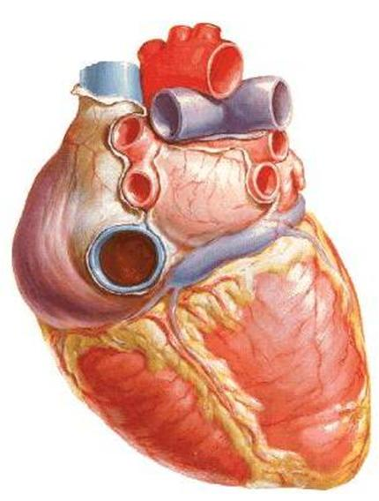
Anatomy of the Heart
DR. SAEED VOHRA
DR. SANAA AL-SHAARAWI

Slide 2
OBJECTIVES
At the end of the lecture, the student should be able to :
Describe the shape of heart regarding : apex, base, sternocostal and diaphragmatic surfaces.
Describe the interior of heart chambers : right atrium, right ventricle, left atrium and left ventricle.
List the orifices of the heart :
Right atrioventricular (Tricuspid) orifice.
Pulmonary orifice.
Left atrioventricular (Mitral) orifice.
Aortic orifice.
Describe the innervation of the heart
Briefly describe the conduction system of the Heart

Slide 3
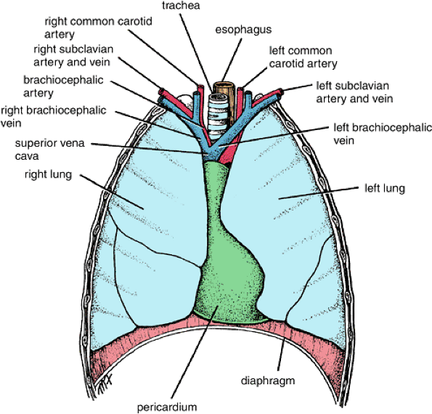
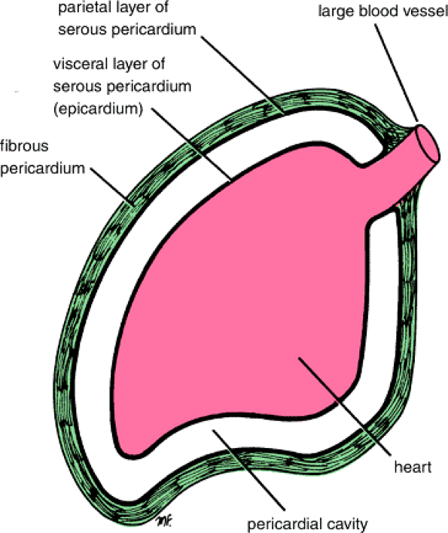
The Heart
It lies in the middle mediastinum.
It is surrounded by a fibroserous sac called pericardium which is differentiated into an outer fibrous layer (Fibrous pericardium) & inner serous sac (Serous pericardium).
The Heart is somewhat pyramidal in shape, having:
Apex
Sterno-costal (anterior surface)
Base (posterior surface).
Diaphragmatic (inferior surface)
It consists of 4 chambers, 2 atria (right& left) & 2 ventricles (right& left)

Slide 4
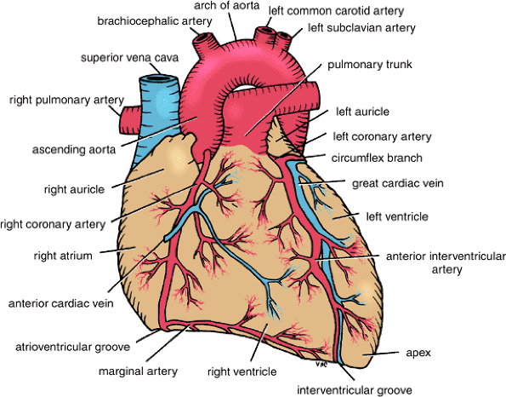
Apex of the heart
Directed downwards, forwards and to the left.
It is formed by the left ventricle.
Lies at the level of left 5th intercostal space 3.5 inch from midline.
Note that the base of the heart is called the base because the heart is pyramid shaped; the base lies opposite the apex. The heart does not rest on its base; it rests on its diaphragmatic (inferior) surface

Slide 5
Sterno-costal (anterior)surface
This surface is formed mainly by the right atrium and the right ventricle
Divided by coronary (atrio-ventricular) groove into :
Atrial part, formed mainly by right atrium.
Ventricular part , the right 2/3 is formed by right ventricle, while the left l1/3 is formed by left ventricle.
The 2 ventricles are separated by anterior interventricular groove, which lodges :
Anterior interventricular artery (branch of left coronary).
Great cardiac vein.
The coronary groove lodges the right coronary artery.

Slide 6
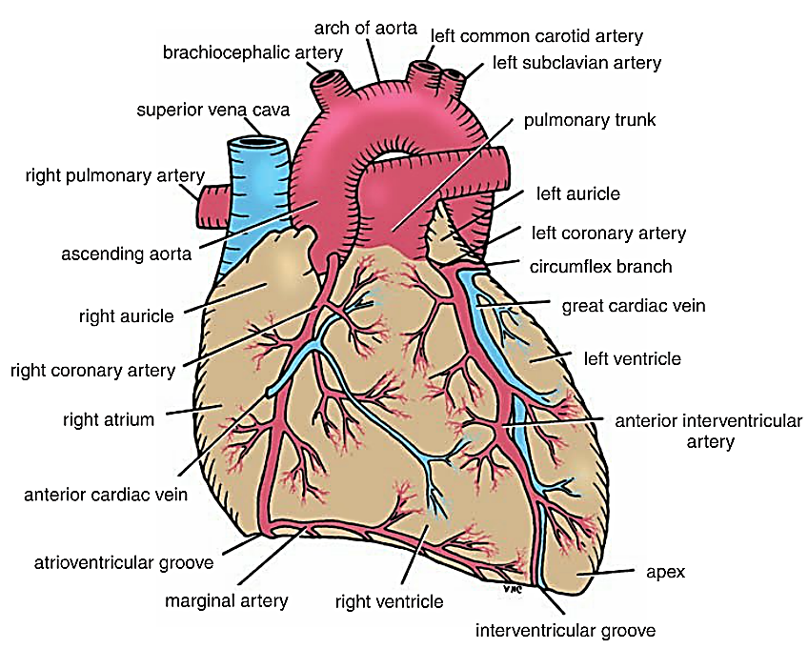
Sterno-costal (anterior)surface
It is formed mainly by the right atrium & the right ventricle, which are separated from each other by the vertical atrioventricular groove. superior and inferior borders of the heart. The right ventricle is separated from the left ventricle by an anterior interventricular groove.

Slide 7
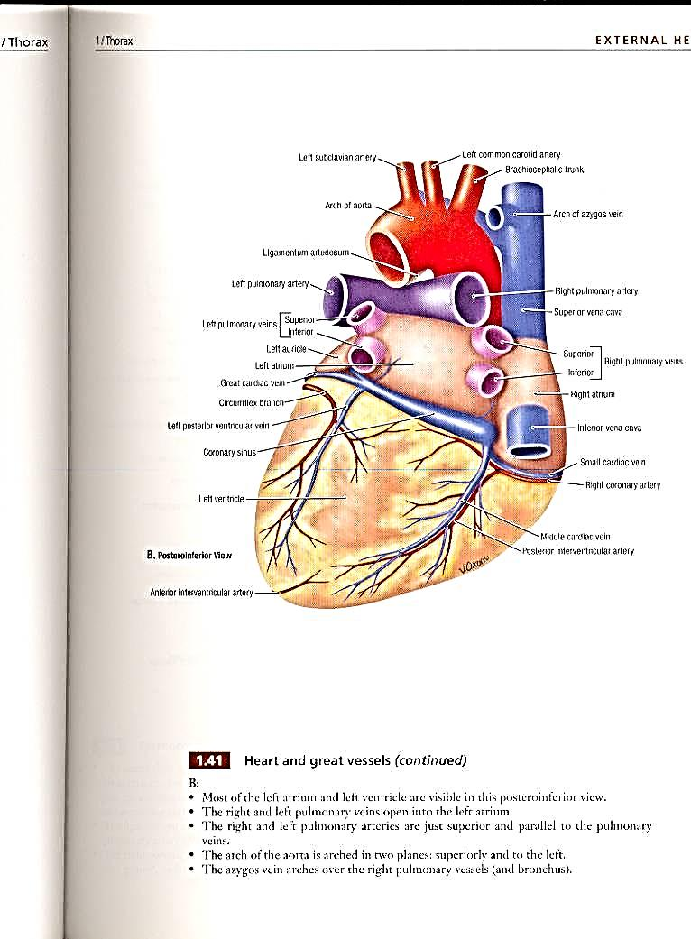
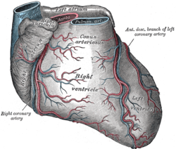
Diaphragmatic (Inferior)surface
Formed by the 2-ventricles, mainly left ventricle(left 2/3).
Slightly concave as it rests on diaphragm.
Directed inferiorly & backward.
Separated from base of heart by posterior part of coronary sulcus
The 2-ventricles are separated by posterior interventricular groove which lodges:
Posterior interventricular artery
Middle cardiac vein

Slide 8
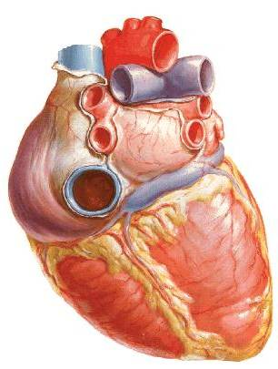
Base of the Heart (posterior surface)
It is formed by the 2 atria, mainly left atrium, into which open the 4 pulmonary veins.
It is directed backwards.
Lies opposite middle thoracic vertebrae(5-7)
Is separated from the vertebral column by descending aorta, esophagus and oblique sinus of pericardium
Bounded inferiorly by post part of coronary sulcus , which lodges the coronary sinus

Slide 9
Borders of the Heart
Upper border:
Is formed by the 2 atria.
It is concealed by ascending aorta & pulmonary trunk.
Right border:
Is formed by right atrium
Lower border:
Is formed mainly by right ventricle + apical part of left ventricle.
Left border:
Is formed mainly by left ventricle + auricle of left atrium.

Slide 10
Chambers of the Heart
The heart is divided by vertical septa into four chambers: the right and left atria and the right and left ventricles. The right atrium lies anterior to the left atrium, and the right ventricle lies anterior to the left ventricle.

Slide 11
Right Atrium
The right atrium consists of a main cavity and a small out pouching, the auricle. On the outside of the heart at the junction between the right atrium and the right auricle is a vertical groove, the sulcus terminalis, which on the inside forms a ridge, the crista terminalis.

Slide 12
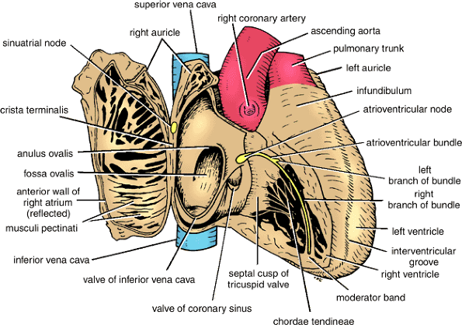
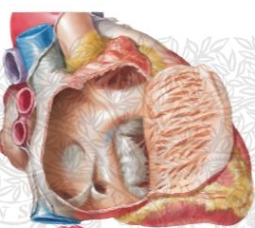
Cavity of Right Atrium
Crista terminalis divides right atrium into:
1- Anterior part: rough and trabeculated by bundles of muscle fibres (musculi pectinati).
2- Posterior part (sinus venarum) is smooth.
The interatrial septum carries an oval depression called Fossa ovalis The margin of this depression is called Anulus ovalis
The blood leaves right atrium to right ventricle via tricuspid valve.

Slide 13
Cavity of Right Atrium
Openings in right atrium:
SVC --- has no valve
IVC --- guarded by a valve
Coronary sinus : has a well-defined valve
Right atrioventricular orifice lies anterior to IVC opening , it is surrounded by a fibrous ring which gives attachment to the tricuspid valve
Small orifices of small veins

Slide 14
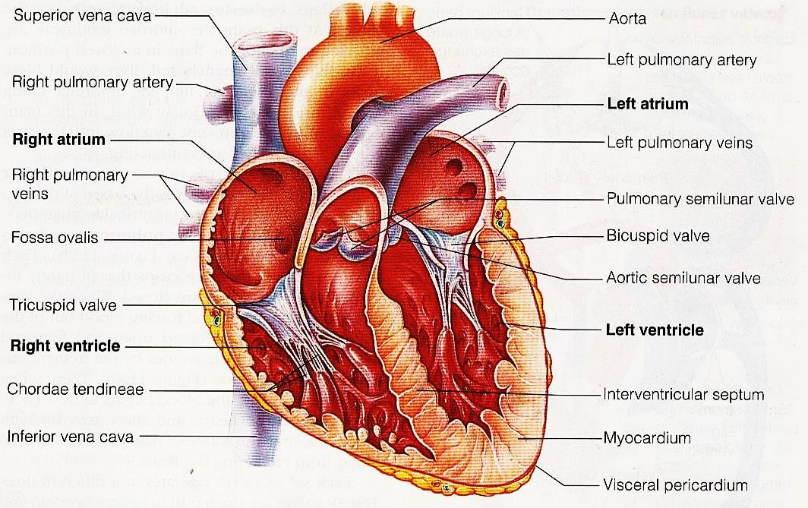
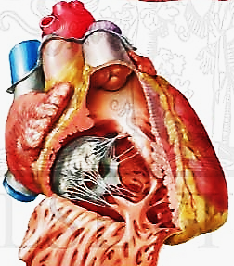
Right ventricle
The right ventricle communicates with the right atrium through the atrioventricular orifice and with the pulmonary trunk through the pulmonary orifice. As the cavity approaches the pulmonary orifice it becomes funnel shaped, at which point it is referred to as the infundibulum.

Slide 15
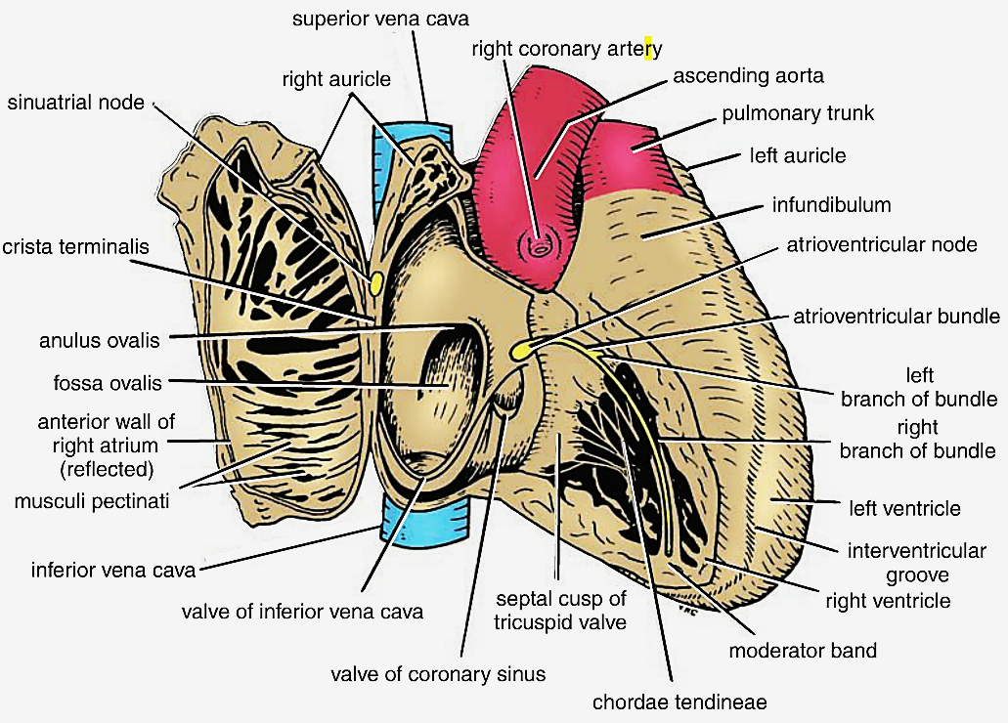
Cavity of right ventricle
Its wall is thinner than that of left ventricle
Its wall contains projections called trabeculae carnae.
The right ventricle communicates with right atrium through right atrioventricular orifice & with pulmonary trunk through pulmonary orifice
Large projections arise from the walls called papillary muscles
Anterior papillary muscle
Posterior papillary muscle
Septal papillary muscle

Slide 16
Cavity of right ventricle
Each papillary muscle is attached to the cusps of tricuspid valve by tendinous threads called chordae tendinae.
Blood leaves the right ventricle to pulmonary trunk through pulmonary orifice.
The wall of infundibulum is smooth and contains no trabeculae.
Interventricular septum is connected to anterior papillary muscle by a muscular band called moderator band

Slide 17
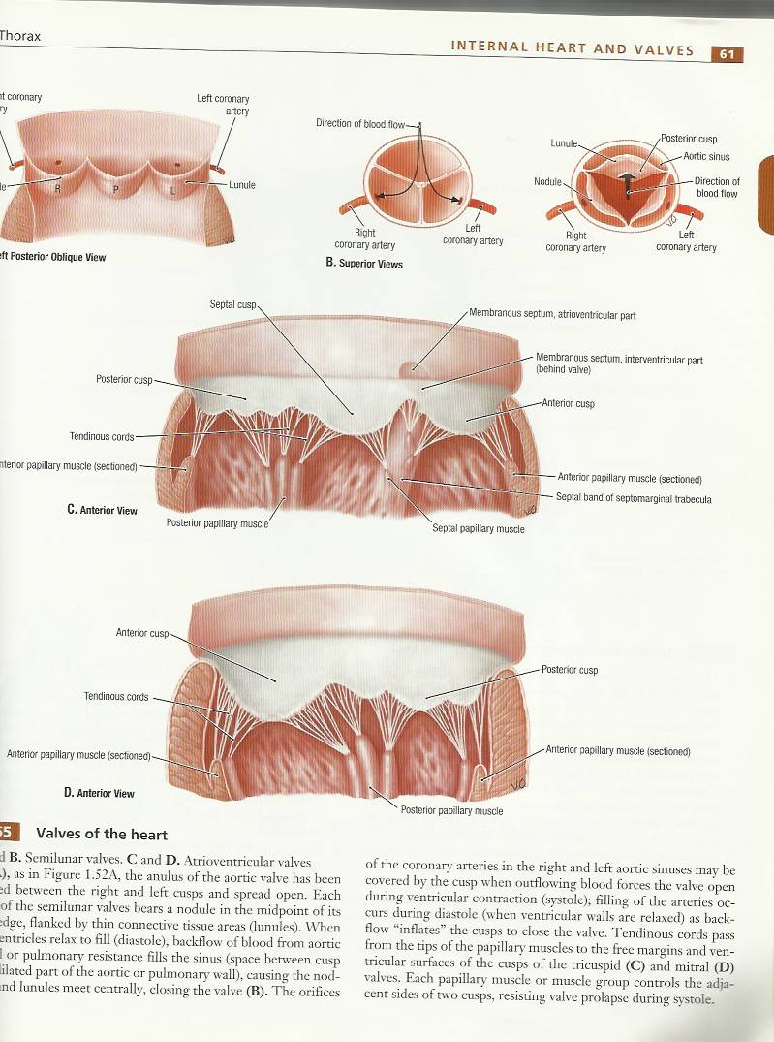
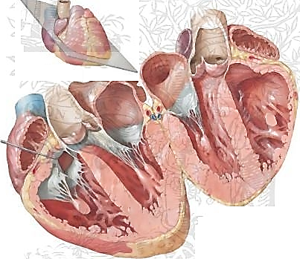
Right atrio-ventricular (tricuspid) orifice
About one inch wide, admitting tips of 3 fingers.
It is guarded by a fibrous ring which gives attachment to the cusps of tricuspid valve.
It has 3-cusps (anterior-posterior-septal or medial).
The atrial surface of the cusps are smooth, while their ventricular surfaces give attachment to the chordae tendinae.

Slide 18
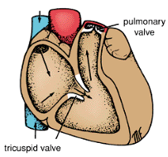
Pulmonary orifice
Surrounded by a fibrous ring which gives attachment to the cusps of the pulmonary valve.
The valve is formed of 3 semilunar cusps 2 anterior and one posterior which are concave superiorly and convex inferiorly.
No chordae tendineae or papillary muscles are attached to these cusps

Slide 19
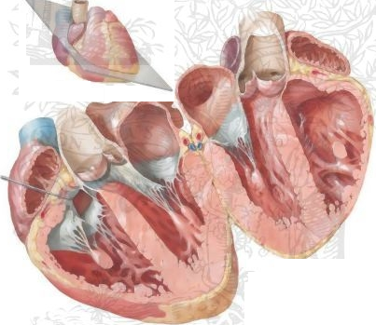
Left atrium of the heart
The left atrium communicates with the left ventricle through the atrioventricular orifice and with the aorta through the aortic orifice.
It forms the greater part of base of heart.
Its wall is smooth except for small musculi pectinati in the left auricle.
Recieves 4 pulmonary veins which have no valves.
Sends blood to left ventricle through the left atrioventricular orifice which is guarded by mitral valve.

Slide 20
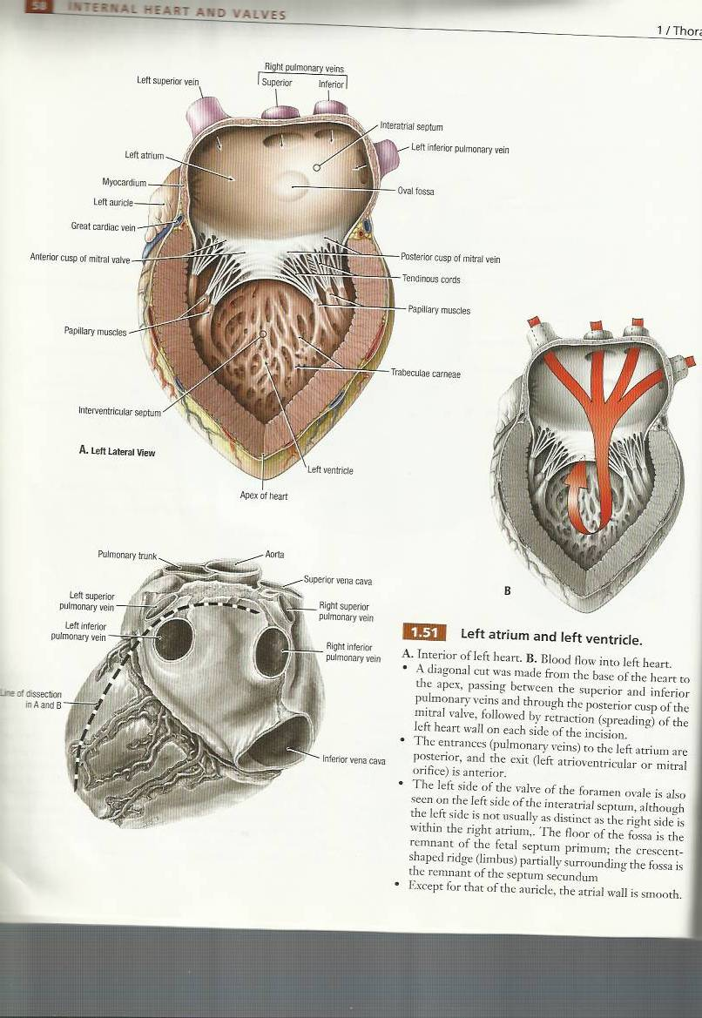
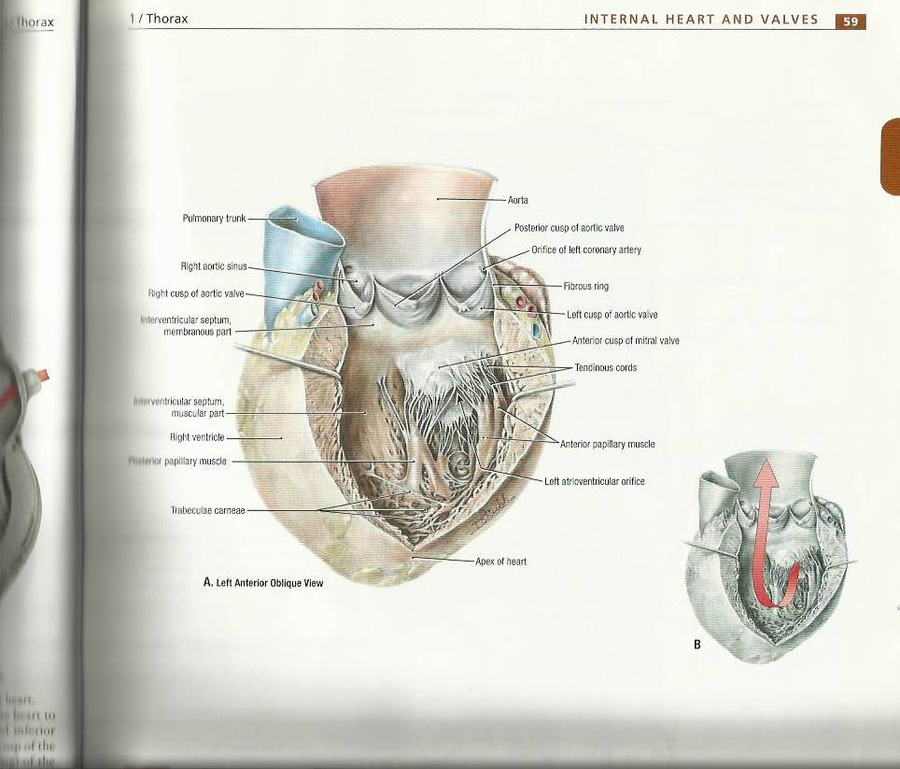
Left ventricle of the heart
Its wall is thicker than that of right ventricle.
It receives blood from left atrium through left atrio-ventricular orifice which is guarded by mitral valve.
Its wall contains trabeculae canae.
Its wall contains 2 large papillary muscles (anterior & posterior). They are attached by chordae tendinae to cusps of mitral valve.

Slide 21
Left ventricle of the heart
The blood leaves the left ventricle to the ascending aorta through the aortic orifice.
The part of left ventricle leading to ascending aorta is called aortic vestibule. The wall of this part is fibrous and smooth.

Slide 22
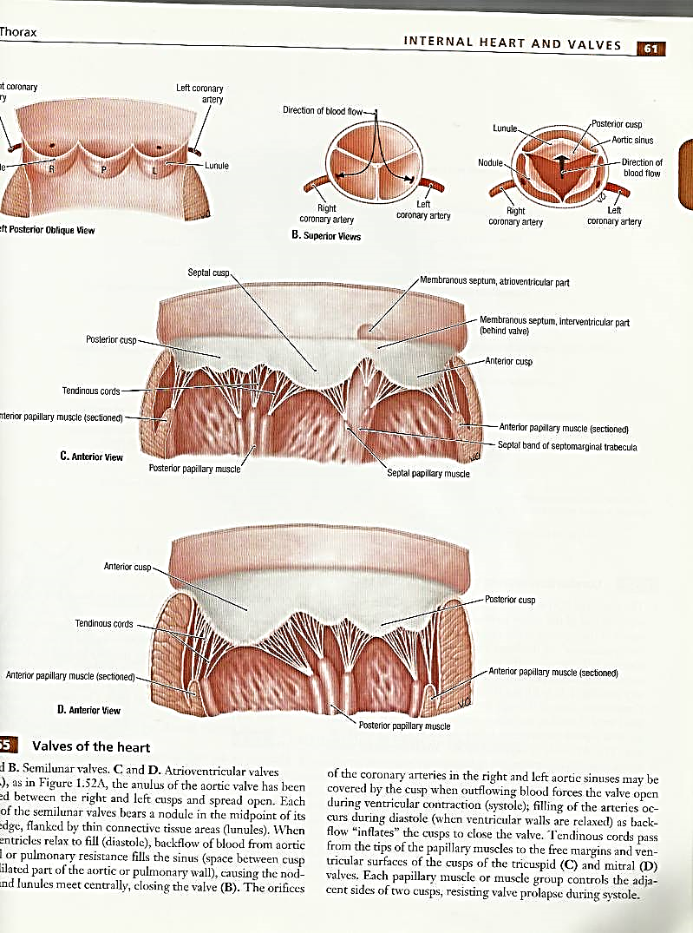
Left atrio-ventricular (mitral) orifice
Smaller than the right, admitting only tips of 2 fingers.
Guarded by a mitral valve.
Surrounded by a fibrous ring which gives attachment to the cusps of mitral valve.
Mitral valve is composed of 2 cusps:
Anterior cusp : lies anteriorly and to right.
Posterior cusp : lies posteriorly and to left.
The atrial surfaces of the cusps are smooth, while ventricular surfaces give attachment to chordae tendinae.

Slide 23
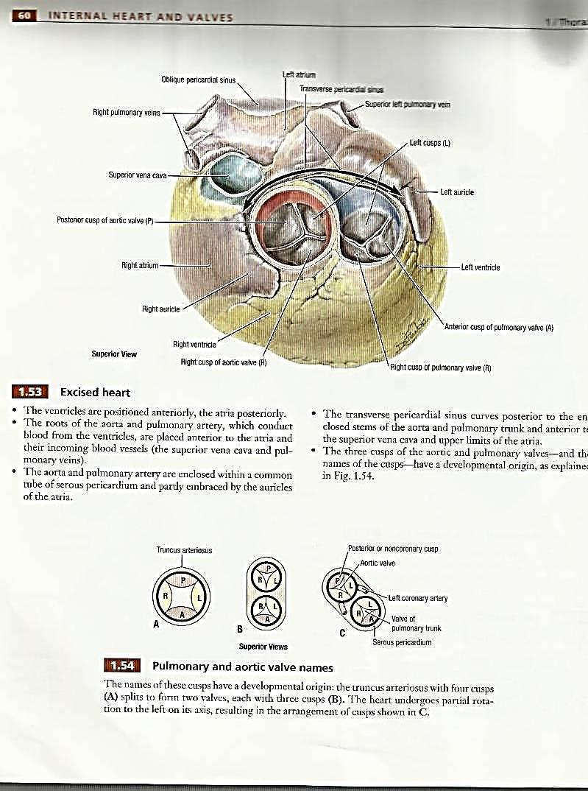
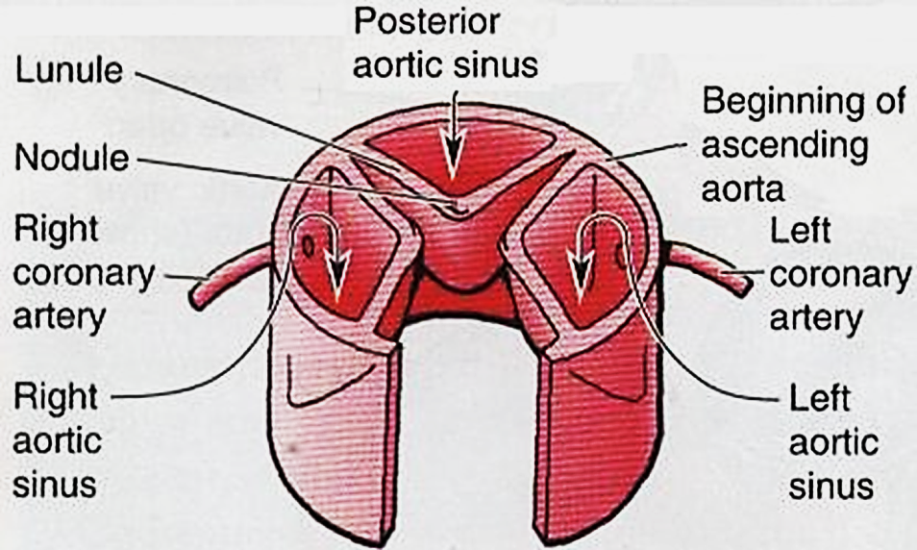
Aortic orifice
Surrounded by a fibrous ring which gives attachment to the cusps of aortic valve.
Aortic valve is formed of 3 semilunar cusps which are similar to those of pulmonary valve, but the position of the cusps differs being one anterior and 2 posterior.

Slide 24
Nerve supply of the heart
By sympathetic & parasympathetic fibers via the cardiac plexus situated below arch of aorta.
The sympathetic fibres arise from the cervical & upper thoracic ganglia of sympathetic trunks.
The parasympathetic fibres arise from the vagus nerves.
Postganglionic fibres reach heart along – SAN, AVN & nerve plexus around coronary arteries.
Symp. Fibers--- accelerate heart rate but Parasymp. Fibers --- slow heart rate (constriction of coronay arteries)

Slide 25
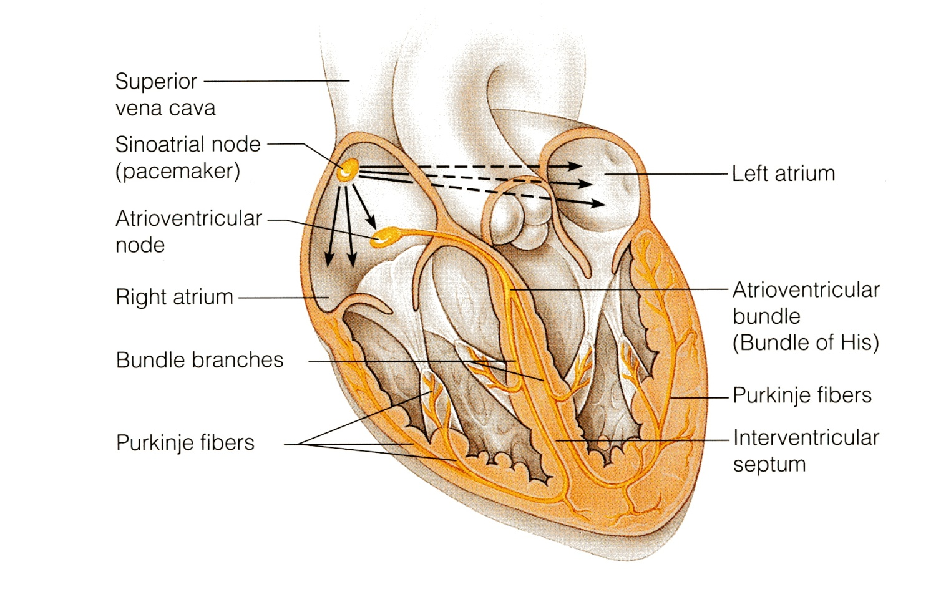
Conduction system of the heart
The beating of the heart is regulated by the intrinsic conduction (nodal) system
Its function is to ensure that the chambers of the heart contract in the proper rhythm and sequence:
The main center is the sinoatrial (SA) node, located in the right atrium
The atrioventricular (AV) node is located at the junction of the atria and the ventricles

Slide 26

Conduction system of the heart
The atrioventricular (AV) bundle (bundle of His) is located in the interventricular septum
The Purkinje fibers are located inside the walls of the ventricles
the SA node is called the pacemaker of the heart, because it generates the impulse

Slide 27
THANK YOU

