Slide 1
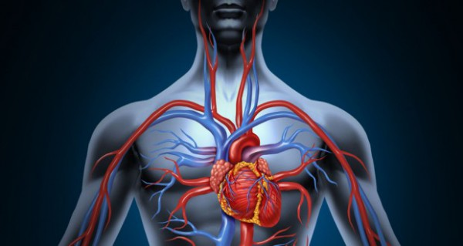
Major Blood Veins
Khaleel Alyahya, PhD, MEd
College of Medicine, KSU
@khaleelya

Slide 2
OBJECTIVES
At the end of the lecture, the student should be able to:
Define veins and understand the general principle of venous system.
Describe the superior & inferior Vena Cava.
Formation and their tributaries
List major veins and their tributaries in;
Head & neck
Thorax & abdomen
Upper & lower limbs
Describe the Portal Vein.
Formation & tributaries.

Slide 3
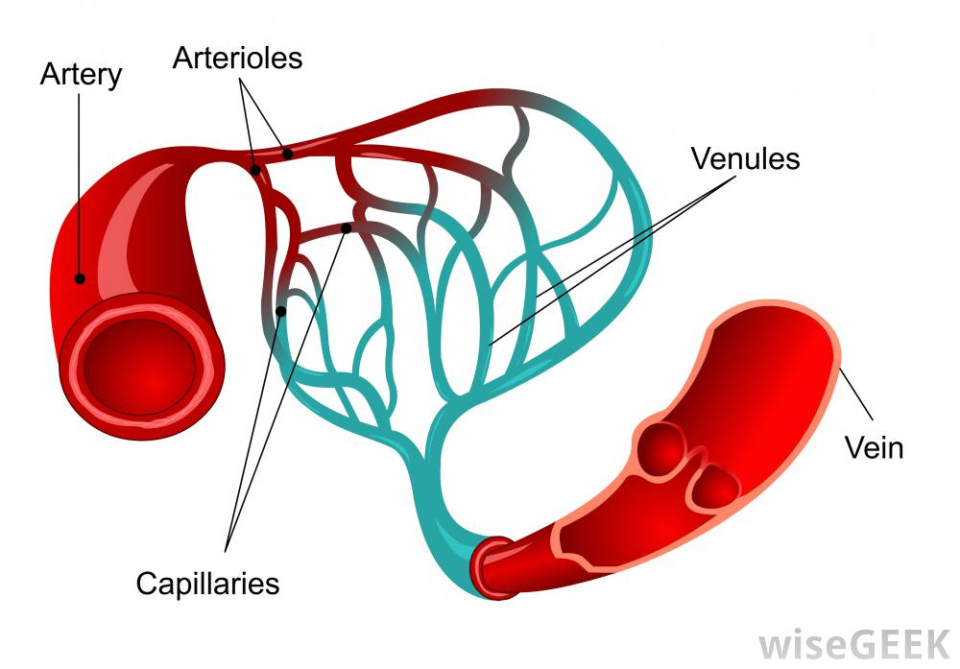
review
Blood vessels are the part of the circulatory system that transports blood throughout the human body.
There are three major types of blood vessels:
Arteries, which carry the blood away from the heart.
Capillaries, which enable the actual exchange of water and chemicals between the blood and the tissues.
Veins, which carry blood from the capillaries back toward the heart.
The word vascular, meaning relating to the blood vessels, is derived from the Latin vas, meaning vessel.
Avascular refers to being without (blood) vessels.

Slide 4
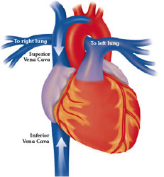
VEINS
Veins are blood vessels that bring blood back to the heart.
All veins carry deoxygenated blood
With the exception of the pulmonary veins and umbilical veins
There are two types of veins:
Superficial veins: close to the surface of the body
NO corresponding arteries
Deep veins: found deeper in the body
WITH corresponding arteries
Veins of the systemic circulation:
Superior and inferior vena cava with their tributaries
Veins of the portal circulation:
Portal vein

Slide 5
VEINS Vs. arteries

Slide 6
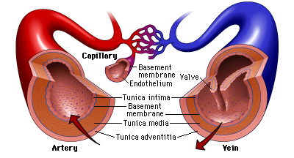
histology
The arteries and veins have three layers, but the middle layer is thicker in the arteries than it is in the veins:
Tunica Intima (the thinnest layer): a single layer of simple squamous endothelial cells.
Tunica Media (the thickest layer in arteries): is made up of smooth muscle cells and elastic tissue.
Tunica Adventitia: (the thickest layer in veins) entirely made of connective tissue.
Capillaries consist of little more than a layer of endothelium and occasional connective tissue.

Slide 7
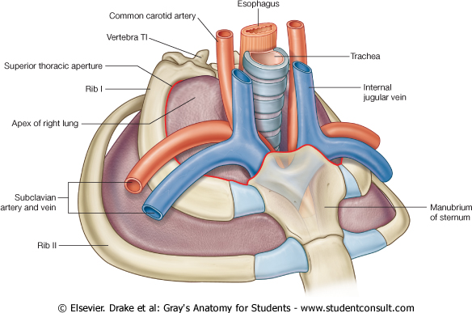
Superior Vena Cava
Formed by the union of the right and left Brachiocephalic veins.
Brachiocephalic veins are formed by the union of internal jugular and subclavian veins.
Drains venous blood from:
Head, neck, thoracic wall & upper limbs
It Passes downward and enter the right atrium.
Receives azygos vein on the posterior aspect just before it enters the heart.

Slide 8
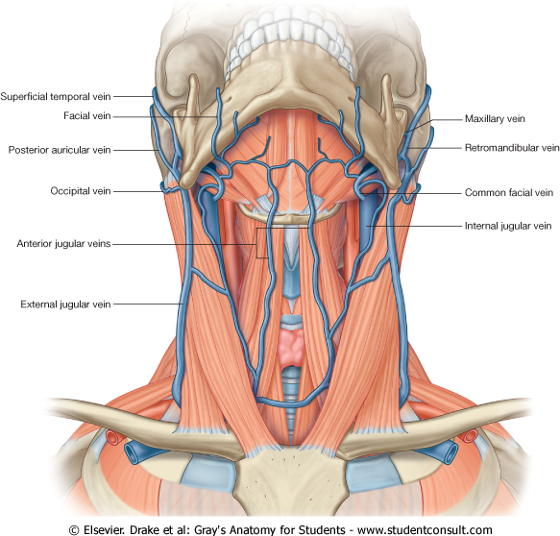
Veins of Head & Neck
Two Divisions:
Superficial Veins
External Jugular Veins
Anterior Jugular Veins
Deep Veins
Internal Jugulars Veins.

Slide 9
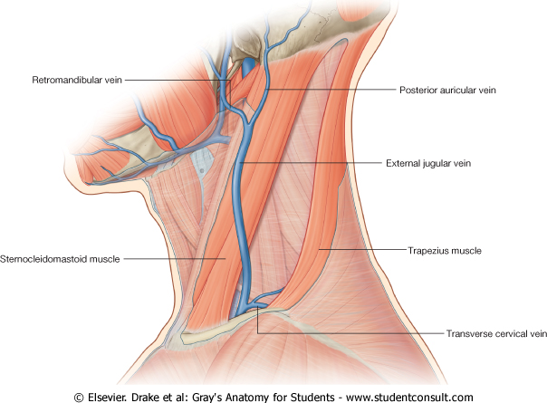
Superficial Veins of Head & Neck
External Jugular Veins:
Lies superficial to the sternomastoid muscle
It passes down the neck and it is the only tributary of the subclavian vein.
It drains blood from:
Outside of the skull
Deep parts of the face.

Slide 10
Superficial Veins of Head & Neck
Anterior Jugular Veins:
It begins in the upper part of the neck by the union of the submental veins.
It descends close to the median line of the neck, medial to the sternomastoid muscle.
At the lower part of the neck, it passes laterally beneath that muscle to drain into the external jugular vein.
Just above the sternum the two anterior jugular veins communicate by a transverse vein to form the jugular arch.

Slide 11
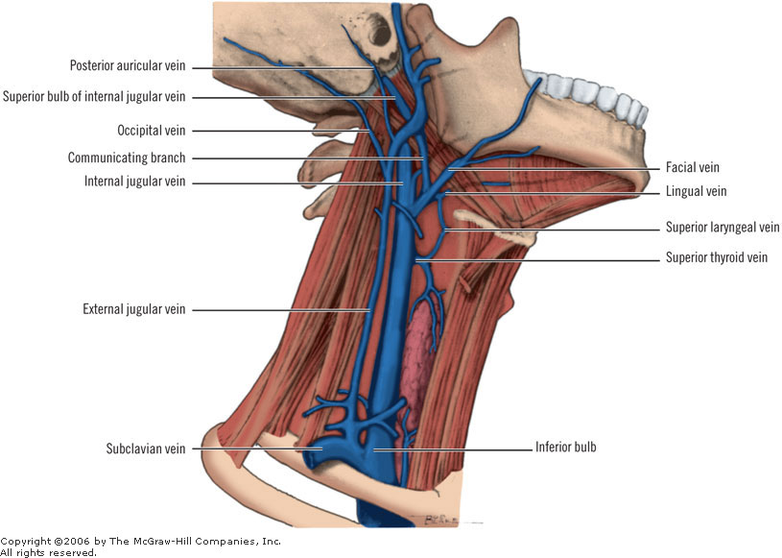
Deep Veins of Head & Neck
Internal Jugulars Vein:
Drains blood from the head, brain, face & neck.
It descends in the neck along with the internal and common carotid arteries and vagus nerve, within the carotid sheath.
Joins the subclavian vein to form the brachiocephalic vein.
Tributaries:
Superior thyroid
Lingual
Facial
Occipital veins
Dural venous sinuses

Slide 12
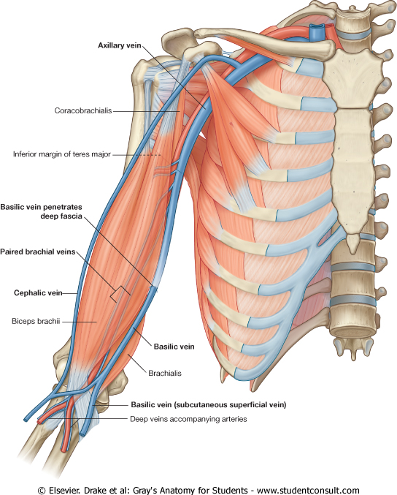
Veins of Upper Limbs
Two Divisions:
Superficial Veins
Deep Veins

Slide 13
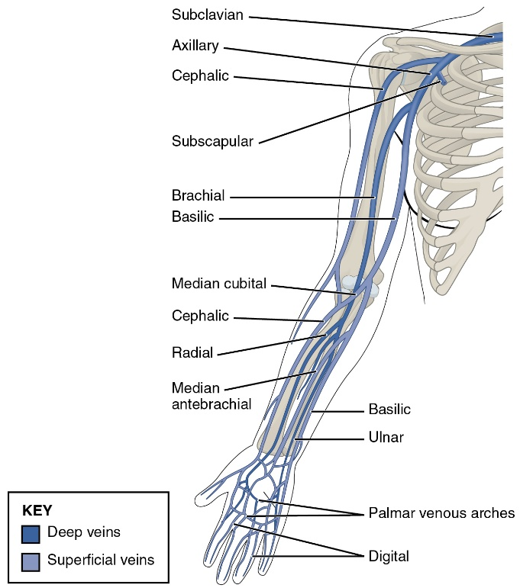
Veins of Upper Limbs
Superficial Veins
Cephalic Vein
Ascends in the superficial fascia on the lateral side of the biceps.
Drains into the Axillary vein.
Basilic Vein
Ascends in the superficial fascia on the medial side of the biceps.
Halfway up the arm, it pierces the deep fascia
At the lower border of the teres major it joins the venae comitantes of the brachial artery to form the Axillary vein.

Slide 14
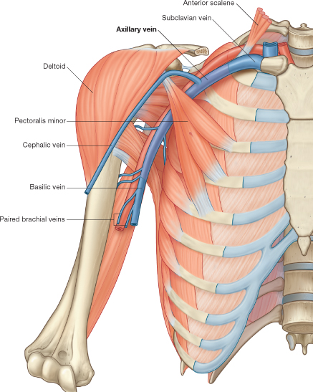
Veins of Upper Limbs
Deep Veins
Venae Commitantes
Which accompany all the large arteries, usually in pairs.
Brachial vein
Axillary Vein
Formed by the union of basilic vein and the venae comitantes of the brachial artery.

Slide 15
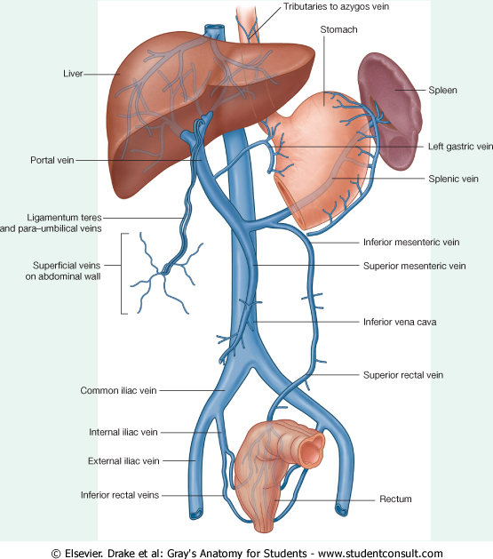
Inferior Vena Cava
Drains most of the blood from the body below the diaphragm to the right atrium.
Formed by the union of the two common iliac veins behind the right common iliac artery at the level of the 5th lumbar vertebra.
Ascends on the right side of the aorta
Pierces the central tendon of diaphragm at the level of the 8th thoracic vertebra.

Slide 16
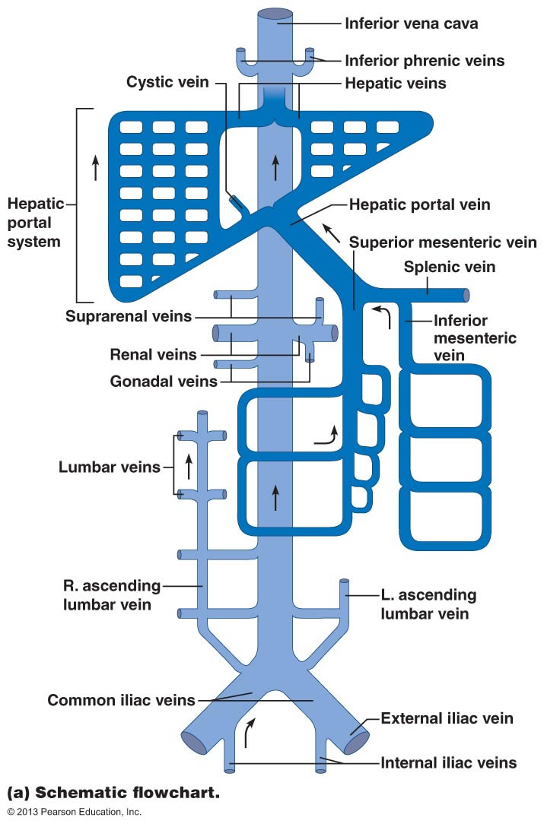
Tributaries of Inferior Vena Cava
Two common iliac veins
Median sacral vein
Four paired lumbar veins
Right gonadal vein
The left vein drains into the left renal vein
Paired renal veins
Right suprarenal vein
The left vein drains into the left renal vein
Hepatic veins
Paired inferior phrenic vein

Slide 17
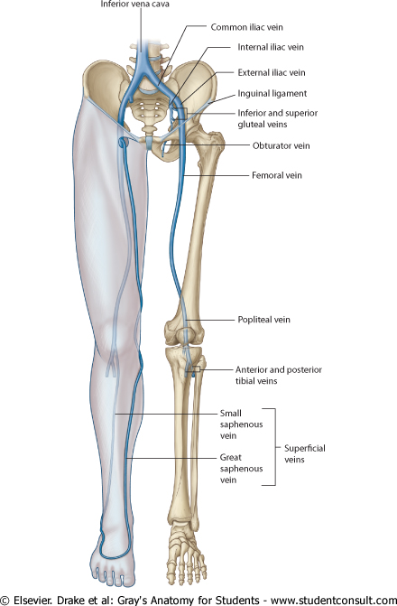
Veins of Lower Limbs
Two Divisions:
Superficial Veins
Deep Veins

Slide 18
Veins of Lower Limbs
Superficial Veins
Form a network in the subcutaneous tissue
Pattern is variable
They are the tributaries of the:
Great (long) saphenous vein
Small (short) saphenous vein

Slide 19
Great Saphenous Vein
The longest vein
Begins from the medial end of the dorsal venous arch of the foot.
Passes upward in front of the medial malleolus with the saphenous nerve.
Then it ascends in accompany with the saphenous nerve in the superficial fascia over the medial side of the leg.

Slide 20
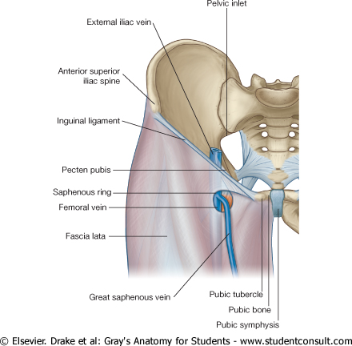
Great Saphenous Vein
Ascends obliquely upwards, and lies behind the medial border of the patella.
Passes behind the knee and curves forward around the medial side of the thigh.
Hooks through the lower part of the saphenous opening in the deep fascia to joins the femoral vein about 1.5 in. (4 cm) below and lateral to the pubic tubercle.

Slide 21
Great Saphenous Vein
It is connected to the small saphenous vein by one or two branches that pass behind the knee.
Numerous perforating veins connect the great saphenous vein with the deep veins.
The perforating veins have valves which allow blood flow from superficial to deep veins.

Slide 22
Small Saphenous Vein
Arises from the lateral end of the dorsal venous arch.
Ascends behind the lateral malleolus in company with the sural nerve.
Follows the lateral border of the tendocalcaneus and then runs up to the middle of the back of the leg.
Pierces the deep fascia in the lower part of the popliteal fossa
Drains into the popliteal vein
Has numerous valves along its course.
Anastomosis freely with great saphenous vein.

Slide 23
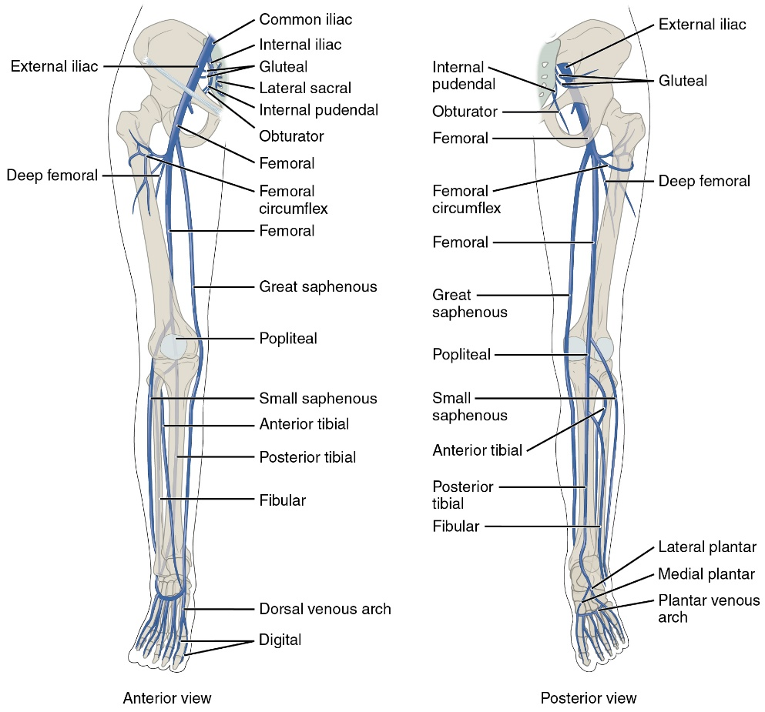
Veins of Lower Limbs
Deep Veins
Comprise the venae comitantes, which accompany all the large arteries, usually in pairs.
Venae comitantes unite to form the popliteal vein, which continues as the femoral vein.
Receive blood from superficial veins through perforating veins.

Slide 24
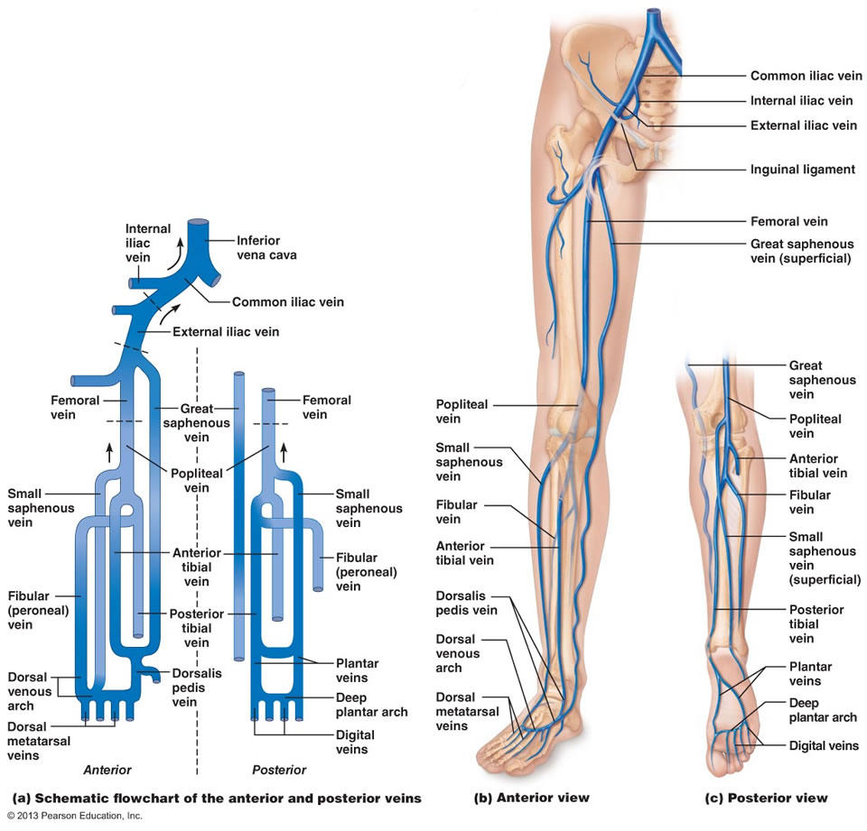
Mechanism of Venous Return from Lower Limb
Venous return (VR) is the flow of blood back to the heart.
Much of the saphenous blood passes from superficial to deep veins through the perforating veins
The blood is pumped upwards in the deep veins by the contraction of the calf muscles (calf pump).
This action of calf pump is assisted by the tight sleeve of deep fascia surrounding these muscles.
Vericose Veins: If the valves in the perforating veins become incompetent, the direction of blood flow is reversed and the veins become varicosed. Most common in posterior & medial parts of the lower limb, particularly in old people.

Slide 25
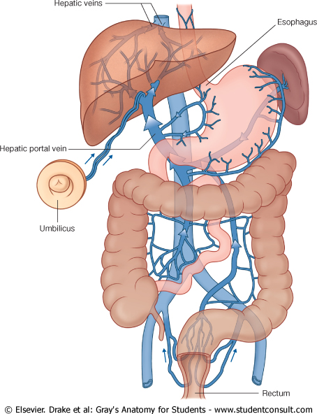
Portal Circulation
A portal venous system is a series of veins or venules that directly connect two capillary beds.
Examples of such systems include the hepatic portal vein and hypophseal portal system.

Slide 26
Hepatic Portal Vein
Drains blood from the gastrointestinal tract and spleen
It is formed by the union of the superior mesenteric and splenic veins.
Immediately before reaching the liver, the portal vein divides into right and left that enter the liver.
Tributaries: Gastric and cystic veins

Slide 27
Portocaval Anastomosis
A portacaval anastomosis (also known as portal systemic anastomosis) is a specific type of anastomosis that occurs between the veins of portal circulation and those of systemic circulation.
The anastomotic channels become dilated (varicosed) in case of portal hypertension.

Slide 28
QUESTION?

