Slide 1
Biochemical Markers of
Myocardial Infarction
Cardiovascular Block
Dr. Usman Ghani

Slide 2
Overview
Myocardial infarction
Time-course of plasma enzyme changes
Cardiac troponins I and T
Creatine kinase (CK-MB)
Myoglobin

Slide 3
Myocardial infarction (MI)
Myocardial infarction is due to:
Occlusion of coronary arteries →
Restricted blood supply (oxygen) to heart tissue (ischemia)→
Damage to heart tissue (infarction) →
Release of enzymes and other proteins into the blood (markers)

Slide 4
Diagnosis of MI
Recommended by the European Society of Cardiology and American College of Cardiology
Requires presence of at least two of the following characteristics:
Typical heart attack symptoms
Characteristic rise and fall pattern of a cardiac marker in plasma
Rise and gradual fall of cardiac troponins
More rapid rise and fall of creatine kinase MB
Typical ECG pattern

Slide 5
Features of an ideal cardiac marker
High concentration in the myocardium
Absence from non-myocardial tissue
High sensitivity and specificity
Rapid release into plasma following myocardial injury
Correlation between plasma level and extent of myocardial injury for prognosis
Detectable by rapid, simple and automated assay methods

Slide 6
Plasma MI markers
OBSOLETE MARKERS
Aspartate Transaminase
Lactate dehydrogenase (LDH) and its isoenzymes
CURRENT MARKERS
Creatine kinase (CK) and CK-MB
Troponin T
Troponin I
Myoglobin
MARKERS UNDER ASSESSMENT (with potential for clinical use)
CK-MB isoforms
High sensitivity c-reactive protein (CRP)
B-type natriuretic peptide

Slide 7
Markers of diagnostic value in MI:
Cardiac troponins T and I
Creatine kinase (CK-MB)
Myoglobin
B-type natriuretic peptide

Slide 8
Time-course of plasma enzyme changes
Plasma enzymes follow a pattern of activities after MI
The initial lag phase lasts for about 3 hours
Enzymes rise rapidly to peak levels in 18-36 hours
The levels return to normal based on enzyme half-life
Rapid rise and fall indicates diagnostic value

Slide 9
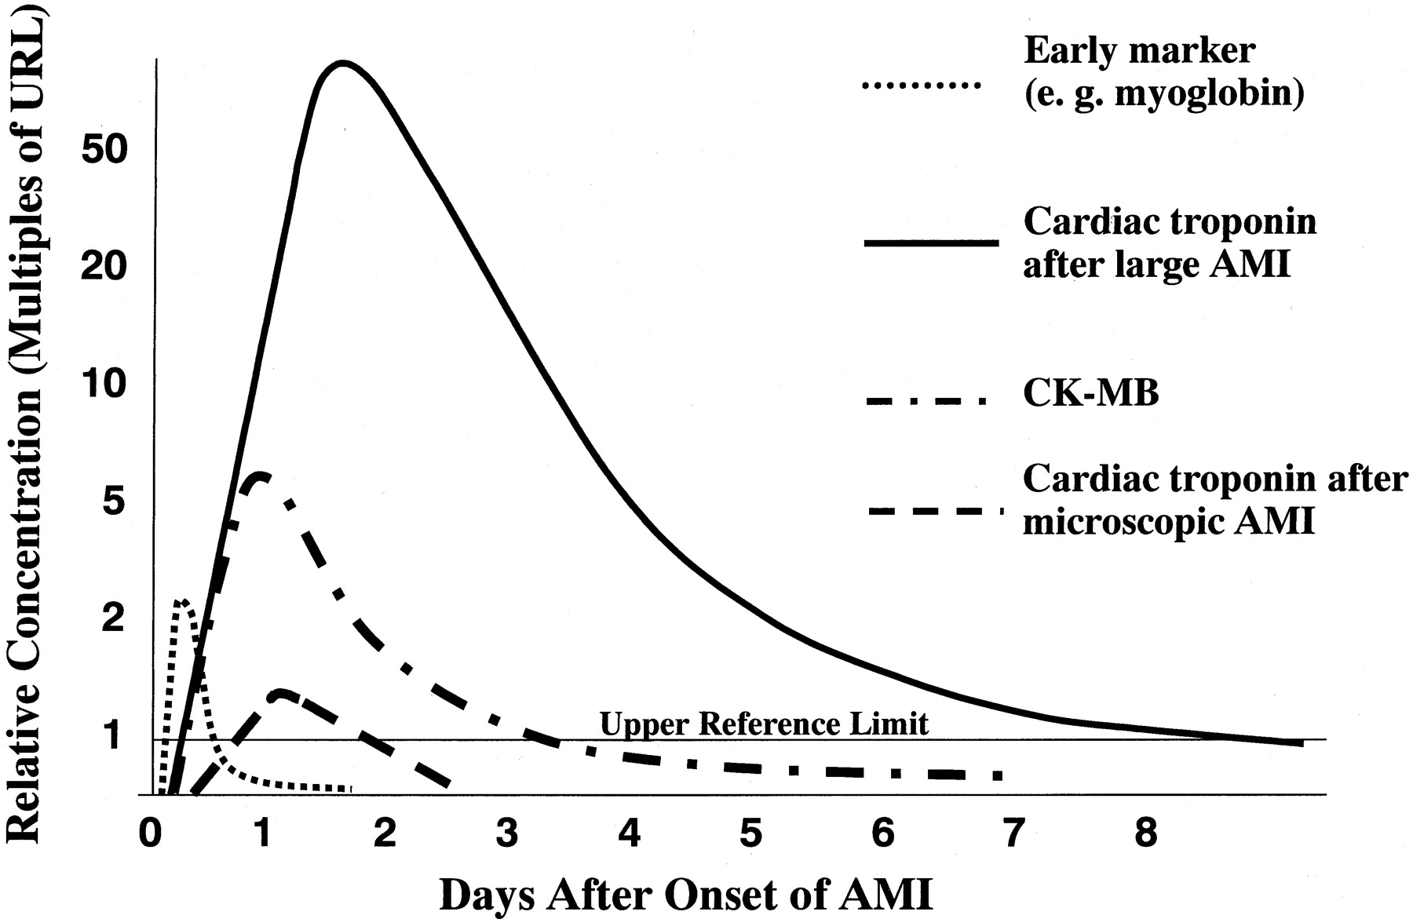

Slide 10
Blood samples collected after MI:
Baseline (upon admission)
Between 12 and 24 hours after the onset of symptoms

Slide 11
Troponins
Troponins are structural proteins in cardiac myocytes and in skeletal muscle
Involved in the interaction between actin and myosin for contraction
cTn are mainly bound to proteins, with small amount soluble in the cytosol
Two main cardiac troponins (cTn):
cTnI: inhibitory protein
cTnT: binds to tropomyosin

Slide 12
cTn are structurally different from muscle troponins
Highly specific markers for detecting MI
Appear in plasma in 3-4 h after MI
Remain elevated for up to 10 days

Slide 13
After a MI, cytosolic troponins are released rapidly into the blood (first few hours)
Structurally bound troponins are released later for several days

Slide 14
MI marker changes in plasma
Enzyme / Protein | Detectable (hours) | Peak value (hours) | Duration (days)
CK-MB | 3-10 | 12-24 | 1.5-3
Total CK | 5-12 | 18-30 | 2-5
Cardiac troponins | 3-4 | ~48 | upto 10

Slide 16
Creatine kinase (CK)
Three main CK isoenzymes with two polypeptide chains B or M
Type | Composition | Comment
Skeletal Muscle | 98% CK-MM 2% CK-MB | Elevated in muscle disease
Cardiac muscle | 70-80% CK-MM 20-30% CK-MB | Cardiac muscle has highest amount of CK-MB
Brain | CK-BB
Plasma | Mainly CK-MM

Slide 17
CK-MB
CK-MB is more sensitive and specific for MI than total CK
It rises and falls transiently after MI
Appears in blood within 4-6 hours of heart attack
Peak 12 - 24 hours
Returns to normal within 2-3 days
Relative index = CK-MB mass / Total CK x 100
More than 5 % is indicative for MI

Slide 18
CK-MB
Advantages:
Useful for early diagnosis of MI
Useful for diagnosis of re-infarction
Disadvantages:
Not significant if measured after 2 days of MI (delayed admission)
Not highly specific (elevated in skeletal muscle damage)

Slide 20
Myoglobin
Myoglobin is a sensitive marker of cardiac damage
Appears in blood earlier than other markers (within 1-4 hours)
It rises very rapidly after the MI at about the same rate as CK-MB
It is non-specific because it is elevated in:
Muscle disease/injury
Acute and chronic renal failure

Slide 21
B-type natriuretic peptide (BNP)
BNP is a peptide hormone produced by the ventricles of the heart in response to:
Myocardial stretching and ventricular dysfunction after MI
It causes vasodilation, sodium and water excretion and reduces blood pressure
Half-life is ~ 20 min.

Slide 22
MI Marker Recommendations
Measurement of plasma MI markers
Upon admission of patient
Serially thereafter
Use of fast and robust test methods for marker detection
Types of markers:
Early markers (myoglobin)
Highly specific markers (cardiac troponins)
CK-MB is the second choice after troponins

Slide 23
Take home message
cTn are highly specific to heart muscle damage
They remain elevated in plasma longer than CK-MB
They have higher sensitivity and specificity than CK-MB
They are measured in combination with myoglobin and CK-MB

