Slide 1
Hypertension
Hisham Al Khalidi

Slide 3
Hypertension
Common problem (25% of population)
Asymptomatic until late- Silent Killer – painless –
Leading risk factor – MI & Stroke
Complications alert to diagnosis but late…

Slide 4
Hypertension Definition
No rigid definition
However, hypertension (HTN) is usually considered when there is :
A sustained diastolic pressure greater than 89 mm Hg
OR
A sustained systolic pressure in excess of 139 mm Hg

Slide 6
Hypertension Risk factors *
Hereditary
Race. African-Americans
Gender. Men & postmenopausal women
Age
Genetic factors
Obesity
Environmental factors including diet, particularly sodium intake
Other factors associated with HTN include:
Heavy alcohol consumption
Diabetes
Use of oral contraceptives
Sedentary or inactive lifestyle
Notes:
List not in robbins

Slide 8
Hypertension Types and causes
Essential Hypertension (90-95%)
Secondary Hypertension

Slide 9
Hypertension Types and causes
Secondary Hypertension
Renal:
Acute glomerulonephritis
Chronic renal disease
Polycystic disease
Renal artery stenosis
Renal vasculitis
Renin-producing tumors
Endocrine:
Adrenocortical hyperfunction (Cushing syndrome, primary aldosteronism, congenital adrenal hyperplasia which is an example of gene defect affecting aldosteron metabloism)
Exogenous hormones (glucocorticoids, estrogen [including pregnancy-induced and oral contraceptives] and sympathomimetics)
Pheochromocytoma
Acromegaly
Hypothyroidism (myxedema)
Hyperthyroidism (thyrotoxicosis)
Pregnancy-induced

Slide 10
Hypertension Types and causes
Cardiovascular:
Coarctation of aorta
Polyarteritis nodosa (or other vasculitis)
Increased intravascular volume
Increased cardiac output
Rigidity of the aorta
Neurologic
Psychogenic
Increased intracranial pressure
Sleep apnea
Acute stress, including surgery

Slide 11
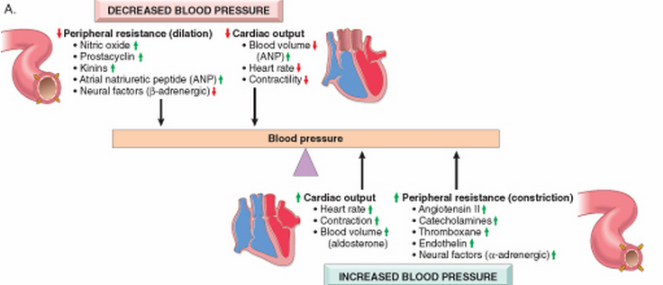
Blood pressure regulation
Blood pressure is a function of cardiac output and peripheral vascular resistance → two hemodynamic variables that are influenced by multiple genetic, environmental, and demographic factors
Notes:
Peripheral resistance is regulated predominantly at the level of the arterioles
Resistance vessels also exhibit autoregulation, whereby increased blood flow induces vasoconstriction to protect tissues against hyperperfusion
Moreover, lower volumes or pressures result in a reduced glomerular filtration rate in the kidney with increased resorption of sodium by proximal tubules
atrial natriuretic peptide, secreted by heart atria in response to volume expansion (e.g., in heart failure) inhibits sodium reabsorption in distal tubules and causes global vasodilation.

Slide 12
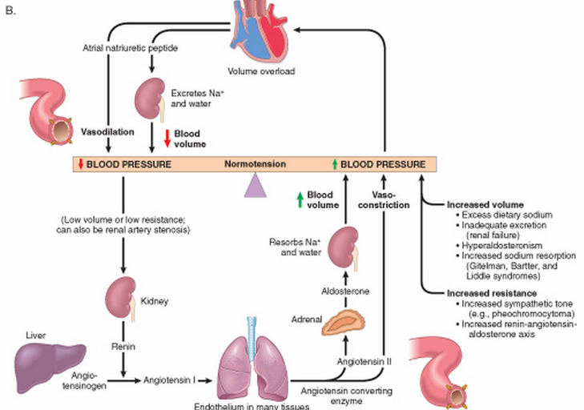
Renin-angiotensin-aldosterone and atrial natriuretic peptide rule

Slide 13
Postulated mechanisms of Essential Hypertension
1.Defect in sodium excretion
2.Defect in cell membrane function:
-Na/Ca transport
-Increased vasoconstrictive response
3.Increased sympathetic response

Slide 14
Hypertension Remember!
Peripheral resistance is regulated predominantly at the level of the arterioles
Reduced renal sodium excretion in the presence of normal arterial pressure is probably a key initiating event; it is a final common pathway for the pathogenesis of most forms of hypertension

Slide 16
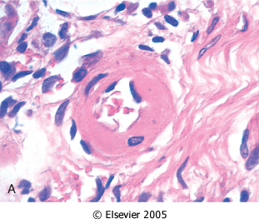
Hypertension Vascular pathology
Accelerate atherogenesis
Aretrioscelrosis (particularly in the kidney), lead to thick wall and narrow lumen
It can be either:
Hyaline
Hyperplastic ( in malignant
HTN)

Slide 17
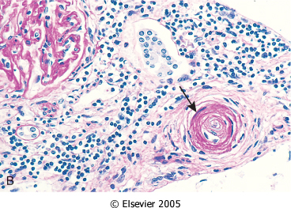
Notes:
Hyperplastic, in malignant, Basement membrane duplicated and SMC proliferation and necrotizin arterolitis

Slide 18
Malignant hypertension
A clinical syndrome
5% of hypertensive persons
diastolic pressure over 120mmHg, with:
renal failure
retinal hemorrhages and exudates, with or without papilledema
Leads to death in 1 or 2 years if untreated.

Slide 20
Hypertension Major complications *
Coronary heart disease
Cerebrovascular accidents
Cardiac hypertrophy and heart failure (hypertensive heart disease)
Aortic dissection
Renal failure
Retinopathy
Notes:
Third the death of HTN patients is due to CHF patients
Reduction of blood pressure dramatically reduces the incidence and death rates from IHD, heart failure, and stroke

Slide 21
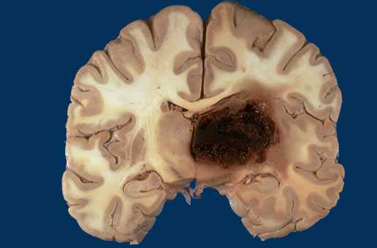
Cerebral Hemorrhage

Slide 23
Hypertension Systemic hypertensive cardiac disease
History of hypertension or extracardic anatomical evidence of HTN
LVH: concentric with absence of other cause of LVH
The free LV wall is > 2cm and the weight of the heart is > 500 grams
Long-term: dilatation and wall thinning
Treatment of HTN helps recovery
Notes:
Myocyte can not divide

Slide 24
