Slide 1
Vasculitis
Hisham Alkhalidi

Slide 2
Vasculitis
Vascular inflammatory injury,
often with necrosis

Slide 3
Vasculitis Causes
immune-mediated :
Immune complex deposition
Antineutrophil cytoplasmic antibodies (ANCAs)
Anti-endothelial cell antibodies
Autoreactive T cells
invasion of vascular walls by infectious pathogens
Physical and chemical injury
Notes:
Immun complex: Hepatitib-B & AB in PAN, Drugs like penicillin (foreign material or durg modified self protiens)
Circulating immune (antigen-antibody) complexes may also be seen-for example, DNA-anti-DNA complexes in systemic lupus erythematosus (SLE)-associated vasculitis
Infections can also indirectly induce a noninfectious vasculitis, for example, by generating immune complexes or triggering cross-reactivity
Antiendothelial : Kawasaki

Slide 4
Summary of Vasculitides
Vessel | Disease | Notes
Large | Giant-cell arteritis | >50. Arteries of head.
 | Takayasu arteritis | F <40. “Pulseless disease”
Medium | Polyarteritis nodosa | Young adults. Widespread.
 | Kawasaki disease | <4. Coronary disease. Lymph nodes.
Small | Wegener granulomatosis | Lung, kidney. c-ANCA.
 | Churg-Strauss syndrome | Lung. Eosinophils. Asthma. p-ANCA.
 | Microscopic polyangiitis | Lung, kidney. p-ANCA.

Slide 5
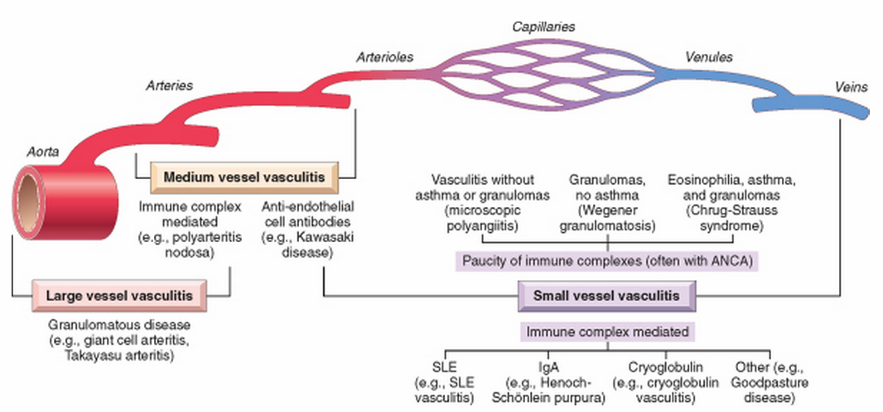

Slide 7
Giant-Cell (Temporal) Arteritis
The most common
Chronic, typically granulomatous inflammation of large to small-sized arteries
Principally affects the arteries in the head-especially the temporal arteries
Rarely the aorta (giant-cell aortitis)
Notes:
-but also the vertebral and ophthalmic arteries

Slide 8
Giant-Cell (Temporal) Arteritis
Unknown cause
Likely immune origin, T cell-mediated
Notes:
An immune origin is supported by the characteristic granulomatous response with associated helper T cells, a correlation with certain major histocompatibility complex (MHC) class II haplotypes, and a therapeutic response to steroids.
The extraordinary predilection for a single vascular site (temporal artery) remains unexplained

Slide 9
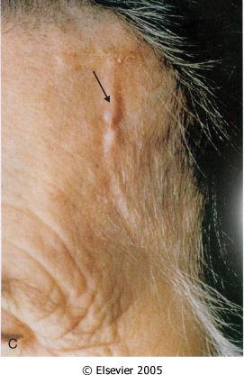
Notes:
Nodularity, thickness and firm vessel
Can be segmental process

Slide 10
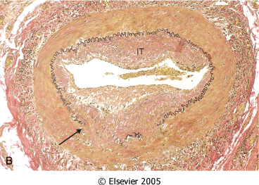
Notes:
The granuloma is centered on the interanl elastic lamina

Slide 11
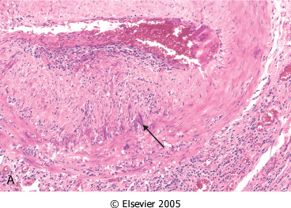
Notes:
Nodular intimal thickness
Can be healed (remember ATCHscle) , you don’t have to see granuloma

Slide 12
Giant-Cell (Temporal) Arteritis Clinical features
> 50 years of age
Vague symptoms:
Fever, fatigue and weight loss
May involve facial pain or headache
Most intense along the course of the superficial temporal artery, which is painful to palpation
Notes:
Ocular symptoms (associated with involvement of the ophthalmic artery) abruptly appear in about 50% of patients
Female predominance
these range from diplopia to complete vision loss.
Plymyalgaia rheumatica association: myalgia, arhtaralgia and fever

Slide 13
Giant-Cell (Temporal) Arteritis
- Definite diagnosis depends on:
biopsy of an adequate segment and histological confirmation
- Treatment: corticosteroids
Notes:
However, because temporal arteritis is extremely segmental, adequate biopsy requires at least a 2- to 3-cm length of artery; even then, a negative biopsy result does not exclude the diagnosis

Slide 15
Polyarteritis Nodosa
Systemic
Small or medium-sized muscular arteries
But not arterioles, capillaries, or venules
Typically involving renal and visceral vessels but sparing the pulmonary circulation

Slide 16
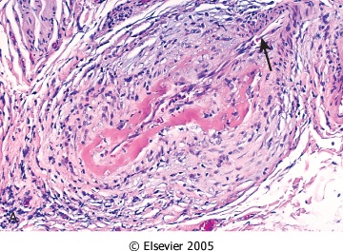
Notes:
Biopsy is needed for Dx
with a mixed infiltrate of neutrophils, eosinophils, and mononuclear cells, frequently accompanied by fibrinoid necrosis
Thrombosis, transmural
arrow NOT involved
Sharply demarcated

Slide 17
Polyarteritis Nodosa
all stages of activity (from early to late) may coexist in different vessels or even within the same vessel
Notes:
Later, the acute inflammatory infiltrate is replaced by fibrous (occasionally nodular) thickening of the vessel wall that can extend into the adventitia
Can lead to an aneurysm
suggesting ongoing and recurrent pathogenic insults

Slide 18
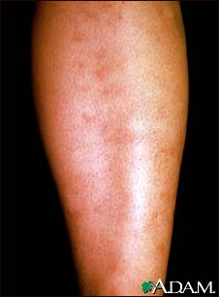
Polyarteritis Nodosa Clinical picture
Largely young adults
Typically episodic, with long symptom-free intervals
Because the vascular involvement is widely scattered, the clinical findings may be varied and puzzling
Notes:
The course can vary from acute to chronic

Slide 19
Polyarteritis Nodosa Clinical picture
Fever and weight loss
Examples on systemic involvement:
Renal (arterial) involvement is common and a major cause of death
Hypertension, usually developing rapidly
Abdominal pain and melena (bloody stool)
Diffuse muscular aches and pains
Peripheral neuritis
Biopsy is often necessary to confirm the diagnosis
Notes:
caused by vascular GI lesions

Slide 20
Polyarteritis Nodosa
No association with ANCA
Some 30% of patients with PAN have hepatitis B antigenemia
If untreated, the disease is fatal in most cases
Therapy with corticosteroids and other immunosuppressive therapy results in remissions or cures in 90%

Slide 21
Polyarteritis Nodosa Complications
Vessel rupture
Impaired perfusion:
Ulcerations
Infarcts
Ischemic atrophy (not infarction)
Haemorrhages in the distribution of affected vessels may be the first sign of disease
Notes:
Like other vasculitis

Slide 23
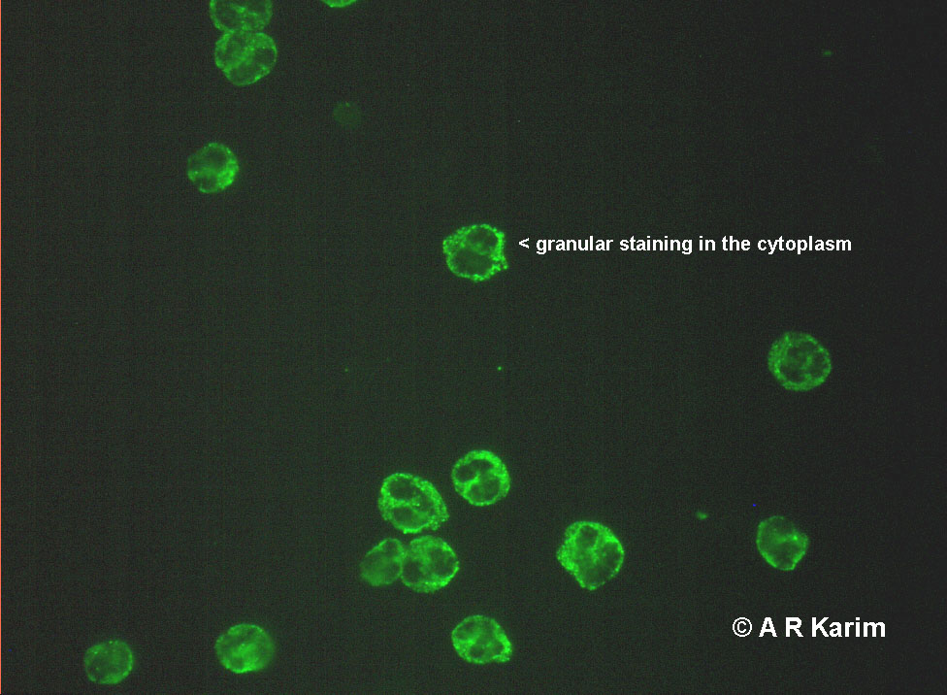
c-ANCA

Slide 24
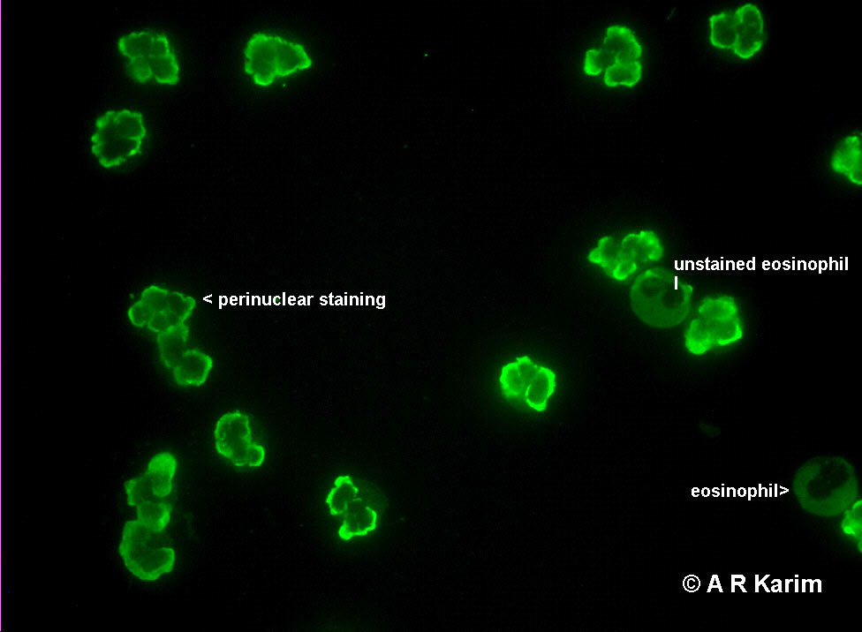
p-ANCA

Slide 25
Antineutrophil Cytoplasmic Antibodies
Cytoplasmic localization (c-ANCA) -> the most common target antigen is proteinase-3 (PR3)
typical of Wegener granulomatosis
Perinuclear localization (p-ANCA) -> most of the autoantibodies are specific for myeloperoxidase (MPO)
microscopic polyangiitis and Churg-Strauss syndrome
ANCAs serve as useful diagnostic markers for the ANCA-associated vasculitides
Their levels can reflect the degree of inflammatory activity
Notes:
A plausible mechanism for ANCneutrophil A vasculitis is:
Neutrophil release of PR3 and MPO (e.g., in the setting of infections) incites ANCA formation in a susceptible host. Some underlying disorder (e.g., infection, endotoxin exposure, etc.) elicits inflammatory cytokines, such as TNF, that result in surface expression of PR3 and MPO on neutrophils and other cell types. ANCAs react with these cytokine-primed cells and either cause direct injury (e.g., to endothelium) or induce activation (e.g., in neutrophils). ANCA-activated neutrophils degranulate and also cause injury by the release of reactive oxygen species, engendering EC toxicity and other direct tissue injury.

Slide 27
Microscopic Polyangiitis
Necrotizing vasculitis that generally affects capillaries as well as arterioles and venules of a size smaller than those involved in PAN
Rarely, larger arteries may be involved
All lesions of microscopic polyangiitis tend to be of the same age in any given patient
Necrotizing glomerulonephritis (90% of patients) and pulmonary capillaritis are particularly common
Notes:
skin, mucous membranes, lungs, brain, heart, GI tract, kidneys, and muscle can all be involved
Disseminated vascular lesions of hypersensitivity angiitis can also occur as a presentation of other disorders (e.g., Henoch-Schönlein purpura, essential mixed cryoglobulinemia, and vasculitis associated with connective tissue disorders).

Slide 28
Microscopic Polyangiitis Pathogenesis
In many cases, an antibody response to antigens such as drugs (e.g., penicillin), microorganisms (e.g., streptococci), heterologous proteins, or tumor proteins is the presumed cause
This can result in immune complex deposition, or it may trigger secondary immune responses
p-ANCAs are present in more than 70% of patients
Notes:
. Recruitment and activation of neutrophils within a particular vascular bed are probably responsible for the manifestations of the disease.

Slide 29
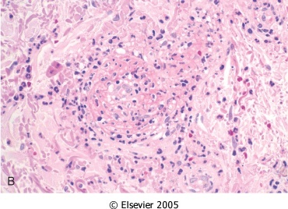
Notes:
granulomatous inflammation is absent

Slide 30
Microscopic Polyangiitis
Depending on the organ involved, major clinical features include:
Hemoptysis
Hematuria and proteinuria
Bowel pain or bleeding
Muscle pain or weakness
Palpable cutaneous purpura

Slide 32
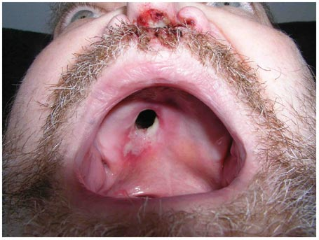
Wegener Granulomatosis
Triad:
Acute necrotizing granulomas of the upper and lower respiratory tract (lung), or both
Necrotizing or granulomatous vasculitis affecting small to medium-sized vessels (most prominent in the lungs and upper airways)
Focal necrotizing, often crescentic, glomerulitis
Notes:
No causative agent, although immune complexs occasionally seen
clinically, this resembles PAN except that there is also respiratory involvement.
Kidney severity is variable

Slide 33
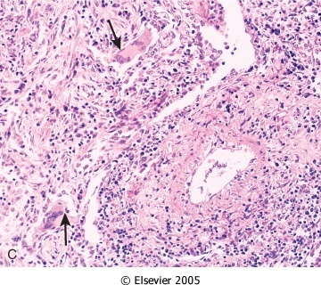

Slide 34
Wegener Granulomatosis
40-50 years
Without Rx -> 80% die
With Rx -> 90% live (not cured)
The Rx -> immunosuppression
Notes:
M>F

Slide 36
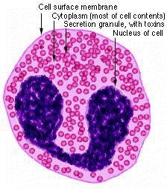

Slide 37
Churg-Strauss syndrome Additional reading
Eosinophil-rich and granulomatous inflammation involving the respiratory tract and necrotizing vasculitis affecting small vessels
Associated with asthma and blood eosinophilia
Associated with p-ANCAs.
Notes:
Lung and splenic vessels

Slide 39
Thromboangiitis Obliterans (Buerger Disease)
Unknown eitology
Results in severe vascular insufficiency and gangrene of the extremities
Focal sharply segmental acute and chronic inflammation of medium-sized and small arteries, especially the tibial and radial arteries, associated with thrombosis
Almost exclusively in heavy tobacco smokers and usually develops before age 35

Slide 40
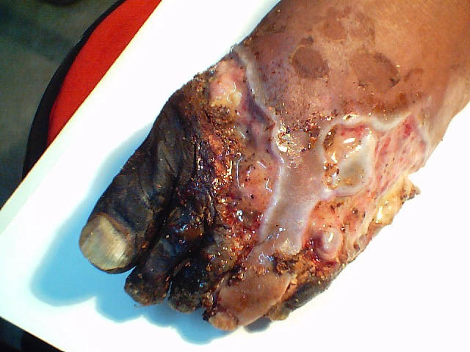
Thromboangiitis Obliterans (Buerger Disease)
In early stages, mixed inflammatory infiltrates are accompanied by luminal thrombosis; small microabscesses, occasionally rimmed by granulomatous inflammation
The inflammation often extends into contiguous veins and nerves (a feature that is rare in other forms of vasculitis)

Slide 41
Thromboangiitis Obliterans (Buerger Disease)
Clinical features
cold-induced Raynaud phenomenon
instep foot pain induced by exercise (instep claudication)
a superficial nodular phlebitis (venous inflammation)
Chronic extremity ulcerations can develop, progressing over time to frank gangrene
Smoking abstinence in the early stages of the disease often can ameliorate further attacks; however, once established, the vascular lesions do not respond to smoking abstinence.

Slide 42
Homework
HENOCH SCHONLEIN PURPURA

