Slide 1
Cardiovascular
pharmacology

Slide 2
- Antiarrhythmic drugs
- Drugs in heart failure
- Antihypertensive drugs
- Antianginal drugs
- Antihyperlipidemic drugs

Slide 3
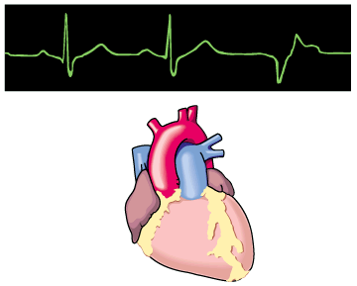
Antiarrhythmic Drugs

Slide 4
Prof. Abdulrahman
Almotrefi
Prof. Azza
El-Medani

Slide 5
Learning objectives
By the end of this lecture, students should be able to:
Understand definition of arrhythmias and their
different types
- describe different classes of Antiarrhythmic drugs
and their mechanism of action
understand their pharmacological effects, clinical
uses, adverse effects and their interactions with
other drugs.

Slide 6
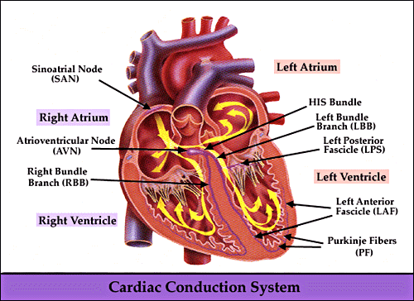

Slide 7
CARDIAC CONDUCTION SYSTEM
- S.A. node
- Inter-nodal pathways
- A.V. node
- Bundle of His and branches
- Purkinje fibers

Slide 8
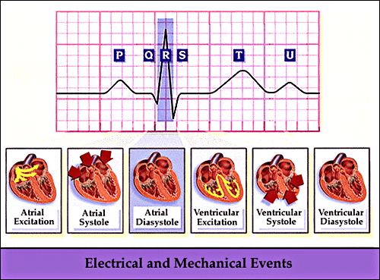

Slide 9
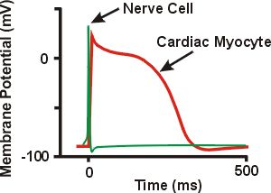
CARDIAC ACTION POTENTIAL

Slide 10
CARDIAC ACTION POTENTIAL
DEFENITIONS
Depolarization
Repolarization
Resting membrane potential
Inward current
Outward current

Slide 11
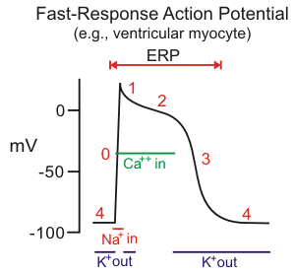

Slide 12
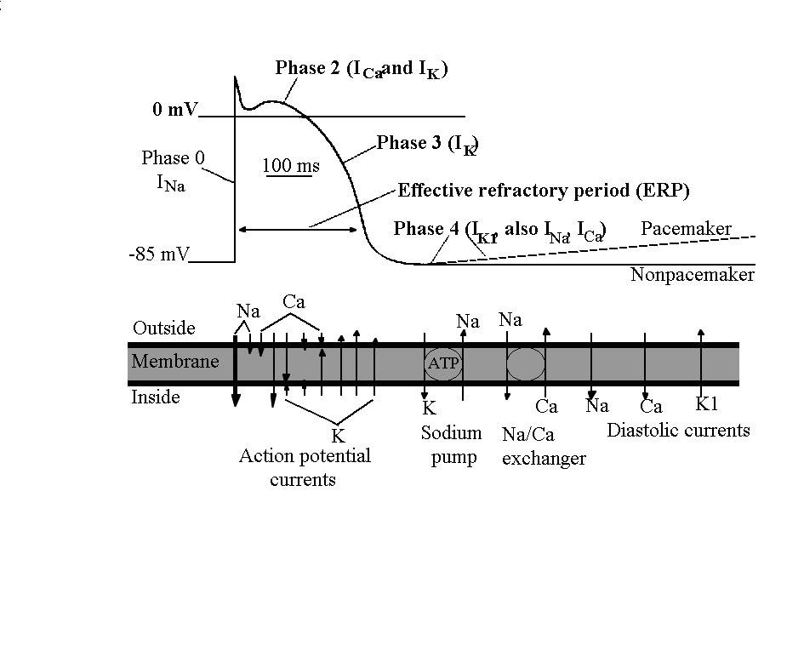
T-Ca²⁺ kanál

Slide 13
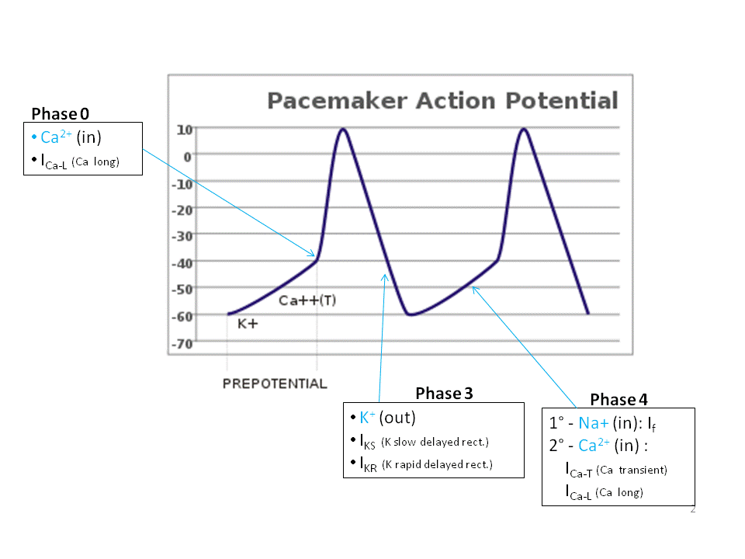

Slide 14
WHAT IS ARRHYTHMIA?
An Abnormality in the :
■ rate ............... high= tachycardia
low = bradycardia

Slide 15
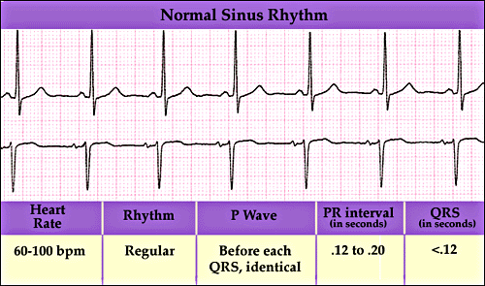

Slide 16
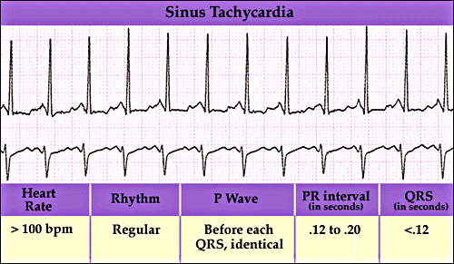

Slide 17
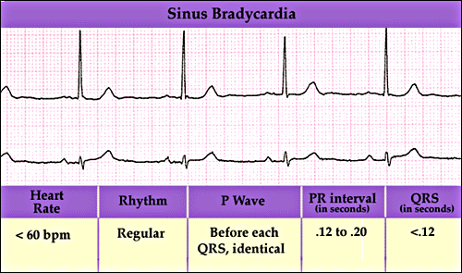

Slide 18
WHAT IS ARRHYTHMIA?
An Abnormality in the :
■ rate ............... high= tachycardia
low = bradycardia
■ regularity ..... Extrasystoles
(PAC, PVC)

Slide 19
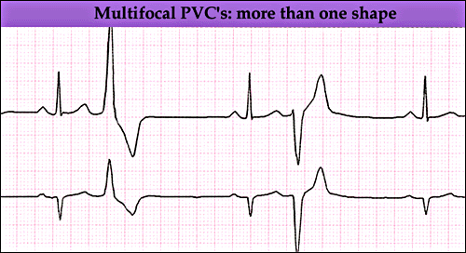

Slide 20
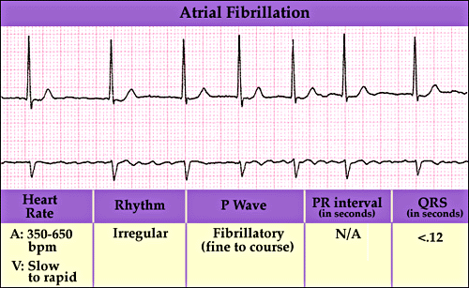

Slide 21
WHAT IS ARRHYTHMIA?
An Abnormality in the :
■ rate ............... high= tachycardia
low = bradycardia
■ regularity ..... extrasystoles
■ site of origin ... ectopic pacemakers
■ or disturbance in conduction

Slide 22
GENESIS OF ARRHYTHMIA
TWO THEORIES
1) ALTERED AUTOMATICITY
2) ALTERED CONDUCTION
( RE-ENTRY or Circus Movement )

Slide 23
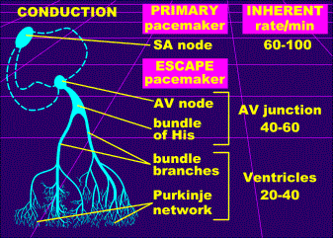

Slide 24
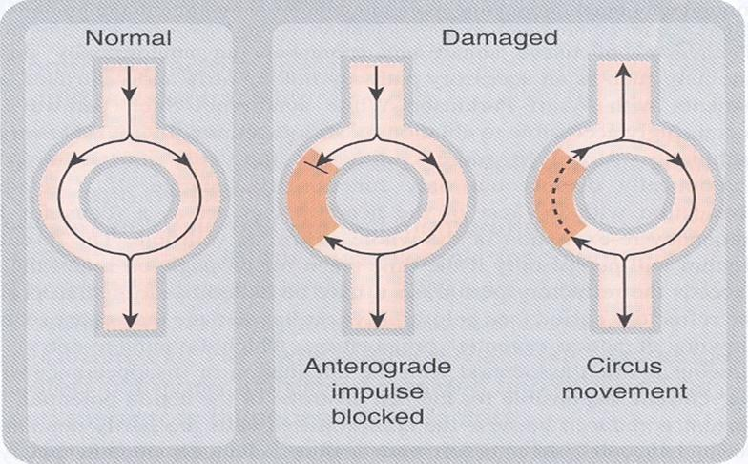
Circus Movement

Slide 25
Therapeutic use & Rationale of antiarrhythmic drugs
The ultimate goal of antiarrhythmic drugs therapy is to restore normal rhythm & conduction
When it is possible to revert to normal sinus rhythm , drugs are used to prevent more serious & lethal arrhythmias.

Slide 26
How they produce these effects?
Antiarrhythmic drugs produce these effects By :
⬆ or ⬇ conduction velocity
Altering the excitability of cardiac cells by changing the effective refractory period
Suppressing abnormal automaticity

Slide 27
CLASSIFICATION
OF
ANTIARRHYTHMIC DRUGS

Slide 28
Vaughn Williams classificatin
CLASS 1
Na+ channel blockers
( membrane stabilizing drugs)
CLASS II:
β- adrenoceptor blockers
CLASS III:
drugs that prolong action potential duration
CLASS IV:
calcium channel blockers

Slide 29
CLASS 1
Drugs that block the rapid inflow of Na+ ions and thus:
decrease the rate of rise of depolarization ( Phase O )
decrease phase 4 diastolic depolarization ( suppress pacemaker activity )
(membrane stabilizing effect)

Slide 30
T-Ca²⁺ kanál

Slide 31
CLASS 1
At high concentration they have local anaesthetic effect
-Ve inotropic effect
( cardiac depression )

Slide 32
CLASS 1
SUBCLASSIFIED INTO :
1A.. prolong action potential duration
e.g.
quinidine
procainamide

Slide 33
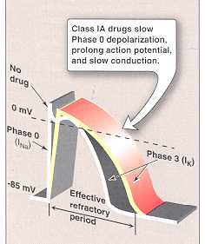

Slide 34
QUINIDINE
► Isomer of quinine
EFFECTS:
Membrane stabilizing effect
Block potassium channels leading to prolongation of action potential duration
which causes:
Prolongation of atrial and ventricular
refractory period

Slide 35
QUINIDINE ( continue )
  Anticholinergic effect.
- Increase conduction through the A.V. node
May lead to high ventricular rate in
atrial flutter. Can be prevented by prior
administration of a drug that slow A.V.
conduction such as digoxin, β-blockers calcium channel blockers.
Depress cardiac contractility

Slide 36
QUINIDINE ( continue )
ECG changes:
- prolongation of P-R and Q-T interval
- widens QRS complex
Cause α-adrenergic blocking effect which
cause vasodilatation and reflex sinus
tachycardia
This effect is seen more after i.v. dose

Slide 37
Clinical uses of quinidine
In almost all types of arrhythmias
Common uses: atrial flutter & fibrillation
Can be used for ventricular tachycardia
Maintaining sinus rhythm after D.C cardioversion

Slide 38
Adverse effects of quinidine
GIT:
anorexia, nausea, vomiting, diarrhea
CARDIAC:
quinidine syncope: episodes of fainting
due to torsades de pointes (twisting of the spikes) developing at therapeutic plasma levels
may terminate spontaneously or lead to fatal ventricular fibrillation

Slide 39
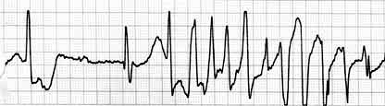
Torsades de pointes

Slide 40
Adverse effects ( continue)
Anticholinergic adverse effects
Cinchonism:
( tinnitus , headache & dizziness)
Hypotension

Slide 41
Adverse effects ( continue)
At toxic concentrations, can precipitate arrhythmia and produce asystole
( cardiac arrest ) if serum concentrations
exceed 5 µg/ml or in high potassium
levels ( > 5mmol/L).

Slide 42
QUINIDINE
Drug interactions:
- Increase concentration of digoxin:
- Displacement from plasma proteins
- Inhibition of digoxin renal clearance
GIVEN ORALLY ....rarely given I.V. because
of toxicity and hypotension due to α-blocking effect.

Slide 43
PROCAINAMIDE
Similar to quinidine except :
1- less toxic on the heart...
can be given I.V.
2- more effective in ventricular than in
atrial arrhythmias
3- less depression of contractility
4- No anticholinergic or α-blocking actions

Slide 44
PROCAINAMIDE
Therapeutic uses:
- Effective against most atrial
and ventricular arrhythmias
Second choice ( after lidocaine ) in ventricular arrhythmias after acute
myocardial infarction

Slide 45
ADVERSE EFFECTS
In long term therapy it cause reversible lupus erythematosus-like syndrome in 5-15% of patients
Hypotension
Torsades de pointes
Hallucination & psychosis

Slide 46
CLASS 1 B
Shorten action potential duration
e.g.
lidocaine
mexiletine

Slide 48
LIDOCAINE
USES :
treatment of ventricular arrhythmias in
emergency ..e.g.
cardiac surgery , acute myocardial infarction
- NOT effective in atrial arrhythmias
- NOT effective orally (3% bioavailability)
- GIVEN I.V. bolus or slow infusion

Slide 49
ADVERSE EFFECTS :
hypotension
Like other local anesthetics, neurological
adverse effects such as: paresthesia, tremor, dysarthria (slurred speech), hearing
disturbances, confusion and convulsions
T1/2 = 2hrs

Slide 50
MEXILETINE
- EFFECTIVE ORALLY
USES :
1- ventricular arrhythmia
2- digitalis-induced arrhythmias
3- chronic pain e.g. diabetic neuropathy and
nerve injury
ADVERSE EFFECTS :
1- nausea , vomiting
2- tremor , drowsiness, diplopia
3- arrhythmias & hypotension
t_{1/2} = 10 hr

Slide 51
CLASS 1C
have no or little effect on action potential duration
e.g.
flecainide
propafenone

Slide 52
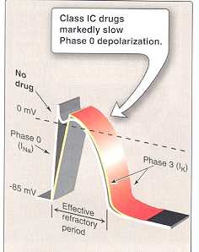

Slide 53
FLECAINIDE
USES :
used in supraventricular arrhythmias in
patients with normal hearts
- Wolff-Parkinson-White syndrome
- very effective in ventricular arrhythmias, but
very high risk of proarrhythmia
- should be reserved for resistant arrhythmias

Slide 54
Wolff-Parkinson-White syndrome
Pre-excitation of the ventricles due to an accessory pathway known as the Bundle of Kent.
This accessory pathway is an abnormal electrical communication from the atria to the ventricles

Slide 55
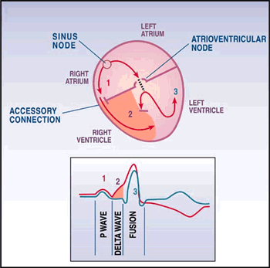

Slide 56
ADVERSE EFFECTS :
1- CNS : dizziness, tremor, blurred
vision, abnormal taste sensations, paraesthesia
2- arrhythmias
3- heart failure due to -ve inotropic effect

Slide 57
OTHER CLASS 1C DRUGS :
PROPAFENONE:
- Chemical structure similar to propranolol
- has weak beta-blocking action
- cause metallic taste and constipation

Slide 58
CLASS II DRUGS
β- ADRENOCEPTOR BLOCKERS
PHARMACOLOGICAL ACTIONS :
block β₁- receptors in the heart → reduce
the sympathetic effect on the heart causing :
- decrease automaticity of S.A. node and
ectopic pacemakers
- prolongation of refractory period ( slow conduction ) of the A.V node this helps prevent re-entry arrhythmias

Slide 59
CLASS II DRUGS
β- ADRENOCEPTOR BLOCKERS
CLINICAL USES :
1- atrial arrhythmias associated with emotion,
exercise and thyrotoxicosis
2- WPW
3- digitalis-induced arrhythmias

Slide 60
Clinical uses (Continued…)
Esmolol: a very short acting , given I.V. for acute arrhythmias
Propranolol, atenolol, metoprolol are commonly used as prophylactic therapy in patients who had myocardial infarction to reduce the incidence of sudden death due to ventricular arrhythmias.

Slide 61
Class III
Prolong the action potential duration & refractory period .
Prolong phase 3 repolarization.

Slide 62
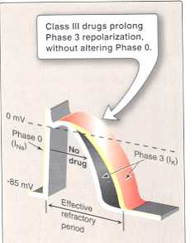

Slide 63
CLASS III
AMIODARONE
PHARMACOLOGICAL ACTIONS :
Main effect is to prolong action potential duration and therefore prolong refractory period
( useful in re-entry arrhythmias )
additional class 1a, 2 & 4 effects,
vasodilating effects
( due to its α- and β-adrenoceptor blocking effects
and its calcium channel blocking effects )

Slide 64
AMIODARONE
USES :
1- main use : serious resistant ventricular arrhythmias,
- use has expanded because its very effective in many types of arrhythmias
2- maintenance of sinus rhythm after D.C. cardioversion of atrial flutter and fibrillation
3- resistant supraventricular arrhythmias
e.g. WPW

Slide 65
ADVERSE EFFECTS
1-bradycardia & heart block, heart failure
2- pulmonary fibrosis
3- hyper- or hypothyroidism
4- photodermatitis ( in 25%) and skin deposits, patients should avoid exposure to the sun.
5- may cause bluish discoloration of the skin

Slide 66
ADVERSE EFFECTS (continued…)
5- tremor, headache, ataxia, paresthesia
6- constipation
7- corneal microdeposits
8- hepatocellular necrosis
9- peripheral neuropathy

Slide 67
AMIODARONE
Pharmacokinetics:
extremely long t_{1/2} = 13 - 103 DAYS
Drug Interactions:
reduce clearance of several drugs e.g.
quinidine, warfarin, procaiamide, flecainide

Slide 68
PURE CLASS III
Ibutilide
Given by a rapid I.V. infusion
Used for the acute conversion of atrial flutter or atrial fibrillation to normal sinus rhythm.
Causes QT interval prolongation , so it precipitates torsades de pointes.

Slide 69
Class 1V calcium channel blockers
Verapamil, Diltiazem
Their main site of action is A.V.N & S.A.N (slow conduction & prolong effective refractory period ).

Slide 70
CALCIUM-CHANNEL BLOCKERS
USES :
1- atrial arrhythmias
2- re-entry supraventricular arrhythmias
e.g.WPW
3- NOT effective in ventricular arrhythmias

Slide 71
CLASS V
MISCELLENIOUS ANTIARRHYTHMIC DRUGS
ADENOSINE
DIGITALIS

Slide 72
ADENOSINE
- naturally occurring nucleoside
half-life= less than 10 sec.
Mechanism of action :
Binds to type 1 (A1) receptors which are coupled to
Gi- proteins , activation of this pathway cause :
1 - Opening of potassium channels
(hyperpolarization)

Slide 73
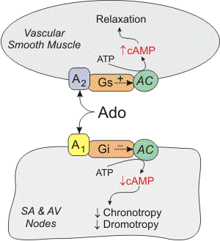

Slide 74
Mechanism of action : ( continued….)
2 - Decrease cAMP which inhibits L-type calcium channels (⬇ calcium influx ) causing decrease in conduction velocity
( negative dromotropic effect ) mainly at AVN.
3- In cardiac pacemaker cells ( SAN) , inhibits pacemaker current, which ⬇ the slope of phase 4 of pacemaker action potential ( ⬇ spontaneous firing rate {negative chronotropic effect})

Slide 75
ADENOSINE
■ drug of choice for acute management of
paroxysmal supraventricular tachycardia
■ preferred over verapamil – safer
and does not depress contractility
■ given 6 mg I.V. bolus followed by 12 mg if
necessary

Slide 76
ADENOSINE
Adverse effects:
■ flushing in about 20% of patients
■ shortness of breath and chest burning in 10% of patients ( bronchospasm)
■ brief AV block ( contraindicated in heart block)
■ rarely: hypotesion, nausea, paresthesias,headache

Slide 77
BRADYARRHYTHMIAS
ATROPINE
■ can be used in sinus bradycardia after myocardial infarction and in heart block
■ in emergency heart block isoprenaline may be combined with atropine ( caution )

Slide 78
NONPHARMACOLOGIC THERAPY OF ARRHYTHMIAS
Implantable Cardiac Defibrillator (ICD)
can automatically detect and treat fatal
arrhythmias such as ventricular fibrillation

Slide 79
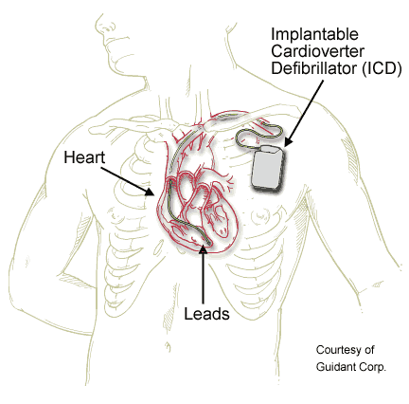

Slide 80

Thank you

