Slide 1
Antianginal Drugs
Learning outcomes
Recognize variables contributing to a balanced myocardial supply versus demand
Identify etiopathogenic cascades contributing to ischemic heart disease
Expand on the drugs used to alleviate acute anginal attacks versus those meant for prophylaxis & improvement of survival
Detail the pharmacology of nitrates, other vasodilators, and other drugs used as antianginal therapy

Slide 2
Calcium channel blockers
Classification
Selectivity
Dihydropyridines:-
Nifedipine , Nicardipine, Amlodepine
Nifedipine ,
Vascular smooth muscle
Verapamil
Cardiomyocytes
Phenylalkylamines:-
Verapamil
Diltiazem
Intermediate
Benzthiazepines:-
Diltiazem

Slide 3
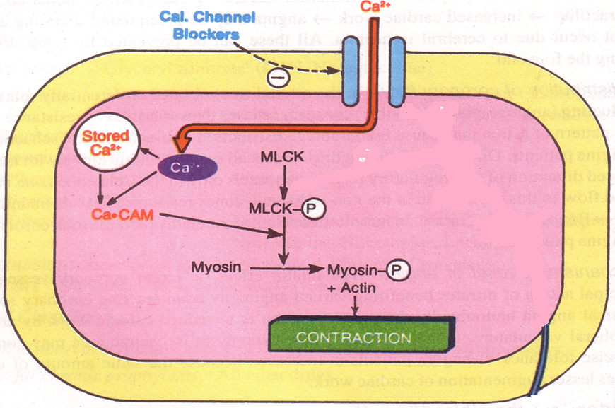
Mechanism of Action
Binding of calcium channel blockers [CCBs] to the L-type Ca channels  their frequency of opening
in response to depolarization
entry of Ca   Ca release from internal stores  No Stimulus-Contraction Coupling  RELAXATION

Slide 4
Antianginal Action
◉ Cardiomyocyte Contraction  cardiac work through their –ve inotropic & chronotropic action (verapamil & diltiazem)  myocardial oxygen demand
VSMC Contraction   After load  cardiac work  myocardial oxygen demand
Coronary dilatation  myocardial oxygen supply

Slide 5
Therapeutic Uses
 Attacks prevented (> 60%) / sometimes variably aborted
IN VARIANT ANGINA
Short acting dihydropyridine should be avoided ??
Can be combined to β-AR blockers???
IN UNSTABLE ANGINA;
Seldom added in refractory cases
Can be combined with nitrates???
IN STABLE ANGINA;
Dihydropyridenes useful antianginal if with CHF??
Regular prophylaxis
Verapamil & diltiazem useful as antianginal in case of hypotension??

Slide 6
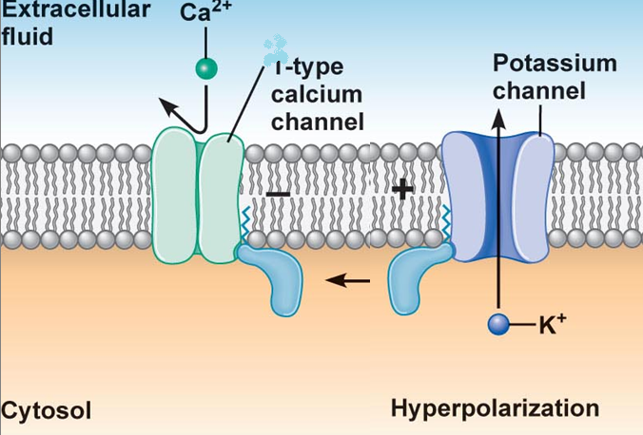
Potassium channel openners
Nicorandil
Mechanism
It has dual mechanism of action;
1. Opens K_{ATP} channels (> arteriolar dilator)
2. NO donner as it has a nitrate moiety (> venular dilator
L

Slide 7
Pharmacodynamic Effects
As K channel openner
As nitric oxide donor
On vascular smooth muscles opening of K channels hyperpolarization  vasodilatation
NO  cGMP/PKG  vasoditation
On cardiomyocytes opening of K channels repolarization  cardiac work

Slide 8
Indications
Prophylactic 2nd line therapy in stable angina & refractory variant angina
ADRs
Flushing, headache,
Hypotension, palpitation, weakness
Mouth & peri-anal ulcers, nausea and vomiting.

Slide 9
Beta Adrenoceptor Blockers
Examples Atenolol, Bisoprolol, Metoprolol (β₁ – Selective )
Antianginal Mechanism

Slide 10
Indications in Angina pectoris
IN STABLE ANGINA
Cardioselective are prefered?
Prolong use reduces incidence of sudden death?
IN UNSTABLE ANGINA
Halts progression to AMI, improve survival
IN VARIANT ANGINA
Contraindicated?
IN AMI
Reduce infarct size, reduce morbidity & mortality

Slide 11
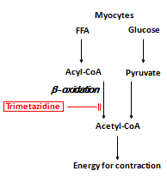
Metabolically Acting Agents
e.g. Trimetazidine
O2 requirement of glucose pathway is lower than FFA pathway
During ischemia, oxidized FFA levels rise, blunting the glucose pathway
Reduces O2 demand without altering hemodynamics

Slide 12
Trimetazidine
Indications
Used as an add on therapy
ADRs
GIT disturbances
Contrindications
Hypersensitivity reaction
Pregnancy & lactation

Slide 13
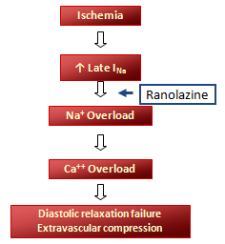
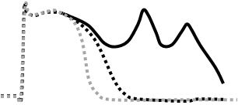
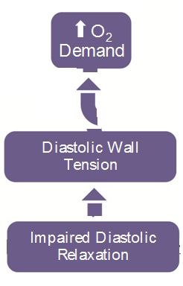
Ranolazine
Inhibits the late sodium current which increases during ischemia
It prolongs the QT interval so contraindicated with; Class Ia & III antiarrhthmics
Toxicity develops due to interaction with CYT 450 inhibitors as; diltiazem, verapamil, ketoconazole, macrolide antibiotics, grapefruit juice

Slide 14
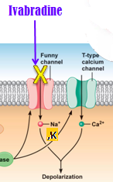
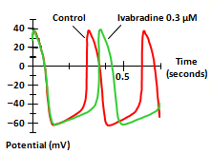
Ivabradine
Ivabradine Selectively blocks I_{f}
Ivabradine reduces slope of depolarization, slowing HR,reducing myocardila work & O2 demand
I_{f} current is an inward Na+/K+ current that activates pacemaker cells of the SA node

Slide 15
Agents that improve prognosis
-Aspirin / other
antiplatelet agents
-ACE inhibitors
-Statins
-β -blockers
Halt progression
Prevent acute insult
Improve survival

Slide 16
Summary of Anti-Anginal Drugs Effects on Myocardial Oxygen Supply & Demand
Drug/Class | HR | BP | Wall Tension | Contract-ility | O₂ Supply
Beta-blockers | ⇓ | ⇓ | ⇔/⇑ | ⇓ | ⇔
CCBs Verap/Dilt Dihydropyridines | ⇓ ⇔/⇑ | ⇓ ⇓ | ⇓ ⇓ | ⇓ ⇓ | ⇑ ⇑
Nitrates | ⇑ | ⇔/⇓ | ⇓ | ⇔ | ⇑
Ranolazine | ⇔ | ⇔ | ⇓ | ⇔ | ⇔

