Slide 1
Drug Therapy
of
heart failure

Slide 2
Prof. Abdulrahman
Almotrefi
Prof. Azza
El-Medani

Slide 3
Learning objectives
By the end of this lecture, students should be able to:
- Describe the different classes of drugs used for treatment of acute & chronic heart failure and their mechanism of action
Understand their pharmacological effects, clinical
uses, adverse effects and their interactions with
other drugs.

Slide 4
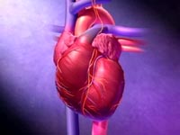
HEART FAILURE
?
Inability of the heart to maintain an adequate cardiac output to meet the metabolic demands of the body.

Slide 5
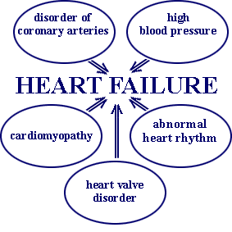
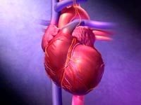
CAUSES OF HEART FAILURE

Slide 6
Heart failure symptoms
- Tachycardia
- Decreased exercise tolerance (rapid fatigue)
- Dyspnea ( pulmonary congestion)
- Peripheral edema
- Cardiomegaly

Slide 7
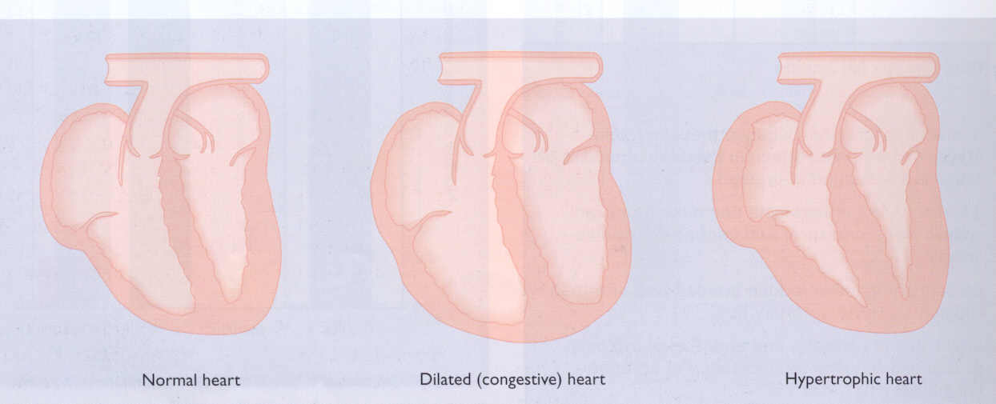

Slide 8
↓ Force of contraction
Low C.O.
↓ Carotid sinus firing
↓ Renal blood flow
Activate renin-angiotensin-
Aldosterone system
Activate sympathetic system
↑ Sympathetic discharge
ALDOST.
Remodeling
Ag. II
Salt & Water
Retention
Volume expansion
Vasoconstriction
↑ Force of
Cardiac .cont.
Venous VC
Arterial VC
↑ HR .
↑ Preload
↑ Preload
↑ After load
↑ C.O. Via
compensation
Pathophysiology of CHF

Slide 9
Factors affecting cardiac output and
Heart Failure
1- Cardiac contractility
2- Preload
3- Afterload
4- Heart rate

Slide 10
Drugs used in the treatment of heart failure
- Drugs that increase contractility
  1- Cardiac glycosides
  2- Phosphodiesterase inhibitors
  3- β- adrenoceptor agonists

Slide 11
- Drugs that decrease preload
1- Diuretics
2- Venodilators

Slide 12
- Drugs that decrease afterload
arteriodilators

Slide 13
- Drugs that decrease preload and afterload
Combined arteriolo- and venodilators:
1- Angiotensin converting enzyme (ACE) inhibitors
2- Angiotensin receptor antagonists
3- α₁-adrenoceptor antagonists
4- Direct vasodilators

Slide 14
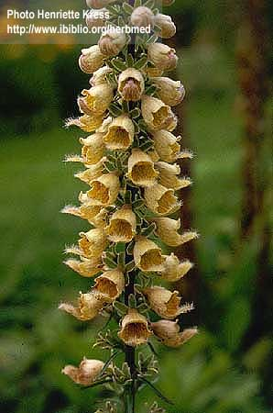
CARDIAC GLYCOSIDES
Digitalis Lanata
Digoxin / Digitoxin / Ouabain

Slide 15
CARDIAC GLYCOSIDES
Mechanism of action
- Inhibit Na⁺ / K⁺ ATPase enzyme

Slide 16
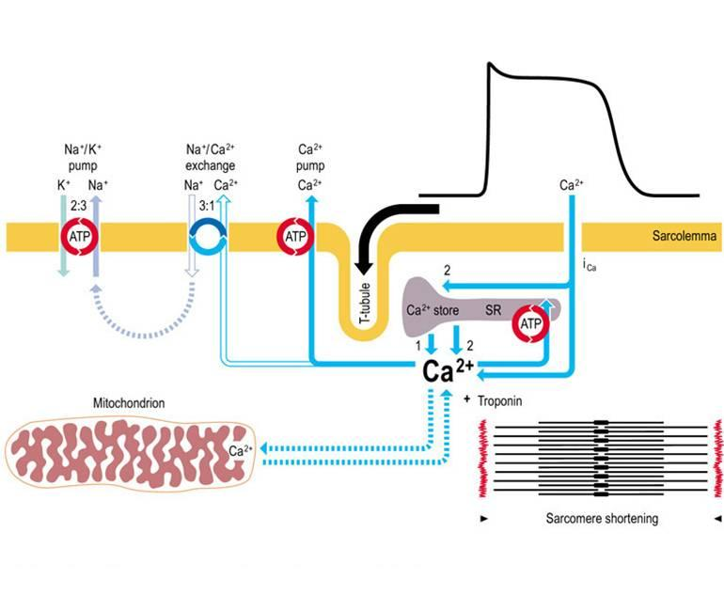
MECHANISM OF ACTION

Slide 17
CARDIAC GLYCOSIDES
PHARMACOLOGICAL ACTIONS:
1- Increase the force of myocardial contraction (+ve inotropic)
leading to decrease in:
heart size , venous pressure and edema
2- Slow heart rate ( -ve chronotropic ) by vagal stimulation

Slide 18
CARDIAC GLYCOSIDES
Therapeutic uses:
- Congestive heart failure
Atrial arrhythmias:
- Atrial flutter
- Atrial fibrillation
- Supraventricular tachycardia

Slide 19
CARDIAC GLYCOSIDES
PHARMACOKINETICS OF DIGOXIN:
- has narrow therapeutic index
oral absorption: 40-80% leading to variable
bioavailability
- I.V. acts within 15 min-3hrs
- 25% protein bound
- 85% is excreted unchanged in the urine

Slide 20
CARDIAC GLYCOSIDES
Cardiac adverse effects :
- digitalis-induced arrhythmias
can cause any type of arrhythmia especially:
- extrasystoles
- coupled beats (Bigeminal rhythms )
- ventricular tachycardia or fibrillation
- A.V.block,
- cardiac arrest.

Slide 21
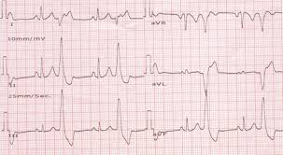
Coupled beats (Bigeminal rhythms )

Slide 22
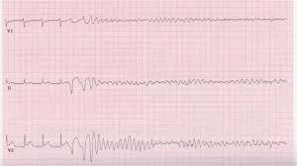
ventricular fibrillation

Slide 23
CARDIAC GLYCOSIDES
Extra cardiac adverse effects :
GIT :
common ( the earliest signs of toxicity ): Anorexia ,nausea, vomiting, diarrhea
CNS:
Headache, visual disturbances, drowsiness

Slide 24
CARDIAC GLYCOSIDES
Factors that increase digitalis toxicity:
- Small Lean body mass
- Renal diseases
- Hypothyroidism
- Hypokalemia
- Hypomagnesemia
- Hypercalemia

Slide 25
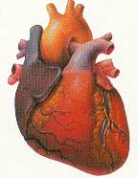
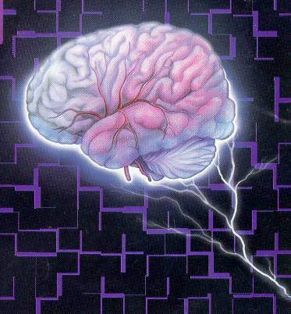

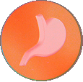
Treatment OF ADVERSE EFFECTS
HEART
CNS
Vision
GIT
???
Atropine
Antiarrythmics
K supplements
FAB fragment
Digoxin , diuretic

Slide 26
β-Adrenoceptor agonists
Dobutamine :
Selective β₁ agonist
Uses : Treatment of acute heart failure in
cardiogenic shock

Slide 27
Phosphodiesterase Inhibitors
Bipyridines : e.g. Amrinone and Milrinone
Mechanism of action:
Inhibit phosphodiesterase isozyme 3 in cardiac & smooth muscles → :↑ cAMP which cause :
- Increase myocardial contraction
- Dilatation of both arteries & veins
( causing reduction of both preload & afterload )

Slide 28
Phosphodiesterase Inhibitors
Therapeutic uses:
- Used only intravenously for management of
acute heart failure

Slide 29
Phosphodiesterase Inhibitors
Adverse effects:
- Nausea ,vomiting
- Arrhythmias ( less than digitalis )
- Thrombocytopenia
- Liver toxicity
( Milrinone has less hepatotoxic and less bone marrow depression than amrinone )

Slide 30
- Drugs that decrease preload
1- Diuretics
2- Venodilators

Slide 31
Diuretics
- first-line agents in heart failure therapy.
- used to treat the signs and symptoms of volume overload ( pulmonary and/ or peripheral edema )
Act by reducing salt and water retention → ↓ventricular preload and venous pressure.
- This effect helps in reduction of cardiac size
which improves cardiac performance

Slide 32
Diuretics
- Hydrochlorothiazide
used in mild congestive heart failure
- Spironolactone
- a potassium sparing diuretic used in
congestive heart failure

Slide 33
Diuretics
- Furosemide
a potent diuretic used for immediate reduction of the pulmonary congestion & severe edema associated with :
- acute heart failure
- moderate & severe chronic failure

Slide 34
Venodilators
  - Nitroglycerine
  - used I.V. for severe heart failure when the main symptom is dyspnea due to pulmonary congestion.
  - dilates venous blood vessels and reduce preload.

Slide 35
Reduction of Afterload
Arteriodilators
Hydralazine:
  - used when the main symptom is rapid fatigue due to low cardiac output.
  - Reduce peripheral vascular resistance

Slide 36
Reduction of preload and afterload
ACE Inhibitors & Angiotensin Receptor Blockers
- Along diuretics are now considered as first-line drugs for heart failure therapy

Slide 37
Angiotensin converting enzyme inhibitors
MECHANISM OF ACTION
VASOCONSTRICTION
VASODILATATION
ALDOSTERONE
VASOPRESSIN
SYMPATHETIC
Angiotensinogen
RENIN
BRADYKININ
Angiotensin I
A.C.E.
Inhibitor
ACTIVATION
ANGIOTENSIN II

Slide 38
ACE Inhibitors
Pharmacokinetics
- Captopril, enalapril and ramipril
All are rapidly absorbed from GIT after oral administration.
- Food reduce their bioavailability.
- Enalapril , ramipril are prodrugs, converted to their active metabolites in the liver
- Have a long half-life & given once daily
- Enalaprilat is the active metabolite of enalapril given i.v. in hypertensive emergency.

Slide 39
Angiotensin receptor blockers
Mechanism of action
- block AT₁ receptors
- decrease action of angiotensin II
Examples : Losartan, Valsartan, Irbesartan

Slide 40
Effects of ACE Inhibitors & Angiotensin
Receptor Blockers
↓Peripheral resistance ( Afterload )
↓Venous return ( Preload)
↓sympathetic activity
↓remodeling ( cardiac & vascular) →↓mortality rate

Slide 41
α-ADRENOCEPTOR BLOCKERS
Prazosin
- block α- receptors in arterioles and venueles
- reduce blood pressure by decreasing both
afterload & preload which help heart faiulure
patients

Slide 42
Direct acting vasodilators
  Sodium nitroprusside
  - given I.V. in acute or severe refractory heart failure, acts immediately and effects lasts for 1-5 minutes.

Slide 43
β-Adrenoceptor Antagonists
used in heart failure
Second generation:
cardioselective ( β₁ receptors)
e.g. Bisoprolol, Metoprolol
- Third generation:
have vasodilator actions ( α blocking effect)
e.g. carvedilol

Slide 44
β-Adrenoceptor Antagonists
used in heart failure (cont…)
- reduce the progression of chronic heart failure.
not used in acute heart failure
( may precipitate acute decompensation
of cardiac function)

Slide 45
β-Adrenoceptor Antagonists
used in heart failure
Mechanism of action
Reduce remodeling through inhibition of the
mitogenic activity of catecholamines
Reduce mortality in patients with hypertrophic
cardiomyopathy
- Decrease heart rate
- Decrease renin release

Slide 46
Management of chronic heart failure
Reduce work load of the heart
  - Limits patient activity
  - Reduce weight
  - Control hypertension
Restrict sodium
Diuretics

Slide 47
Management of chronic
heart failure (cont….)
ACEI or ARBs
Digitalis
β- blockers
Direct vasodilators

Slide 48
Management of acute heart failure
- Volume replacement
- Diuretics
- Positive inotropic drugs
- Vasodilators
- Antiarrhythmic drugs
- Treatment of myocardial infarction

Slide 49

Thank you

