Slide 1
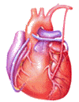
Cardiovascular Block Contractile Mechanism in Cardiac Muscle
Dr. Ahmad Al-Shafei, MBChB, PhD, MHPE
Associate Professor in Physiology
KSU

Slide 2
Learning outcomes
After reviewing the PowerPoint presentation, lecture notes and associated material, the student should be able to:
Describe the general features and overall design of the cardiovascular system.
Describe how the heart accomplishes its function as the central pump of the cardiovascular system.
Outline the structure of a typical myocyte.
Describe excitation-contraction coupling in the heart.
Discuss sliding-filament mechanism of contraction.
Describe cardiac muscle mechanics.
Outline the types of contractions in skeletal and cardiac muscle.
Describe the length-tension curve in cardiac muscle.

Slide 3
Learning Resources
Textbooks :
Guyton and Hall, Textbook of Medical Physiology; 12th Edition; Unit III; Chapters 9 and 14.
Mohrman and Heller, Cardiovascular Physiology; 7th Edition; Chapters 1 and 2.
Ganong’s Review of Medical Physiology; 24th Edition; Sections I & V.
Websites:
http://accessmedicine.mhmedical.com/

Slide 4
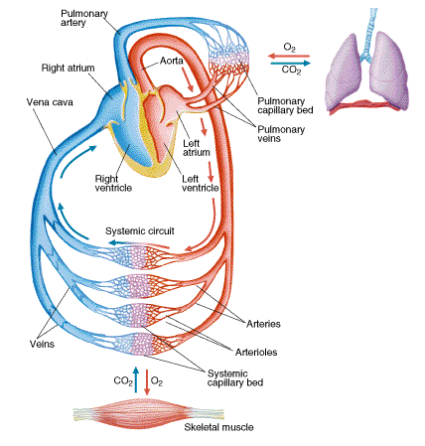
Major components
of the cardiovascular system
The cardiovascular system consists of the heart and blood vessels.
It is a closed system in which blood circulates, hence the synonym ‘circulatory system’.

Slide 5
Main functions of the cardiovascular system
Delivery of O₂, glucose and other nutrients to active tissues.
Removal of CO₂, Lactate and other waste products from active tissues.
Adjustment of oxygen and nutrient supply in different physiologic states.
Transport of metabolites and other substances to and from storage sites.
Transport of hormones, antibodies and other substances to site of action.
Defense.
Thermoregulation.

Slide 6
The heart as the central pump
Aorta
Pulmonary Arteries
Semilunar
valve
LA
RA
Bicuspid (mitral)
Valve
Tricuspid
Valve
LV
Systole
Diastole
Heart beat; cardiac cycle
Valves
RV

Slide 7
The heart as the central pump
Requirements for effective pumping
For effective pumping, the heart must be functioning properly in five basic respects:
1. The contractions of individual cardiac muscle cells (myocytes) must occur at regular intervals and be synchronized (not arrhythmic).
2. The valves must open fully (not stenotic).
3. The valves must not leak (not insufficient or regurgitant).
4. The ventricular contractions must be forceful (not failing).
5. The ventricles must fill adequately during diastole.
Q1. Specify five different mechanisms which can lead to ineffective cardiac pumping.
Q2. Think of five possible cardiac diseases which may precipitate ineffective cardiac pumping.

Slide 8
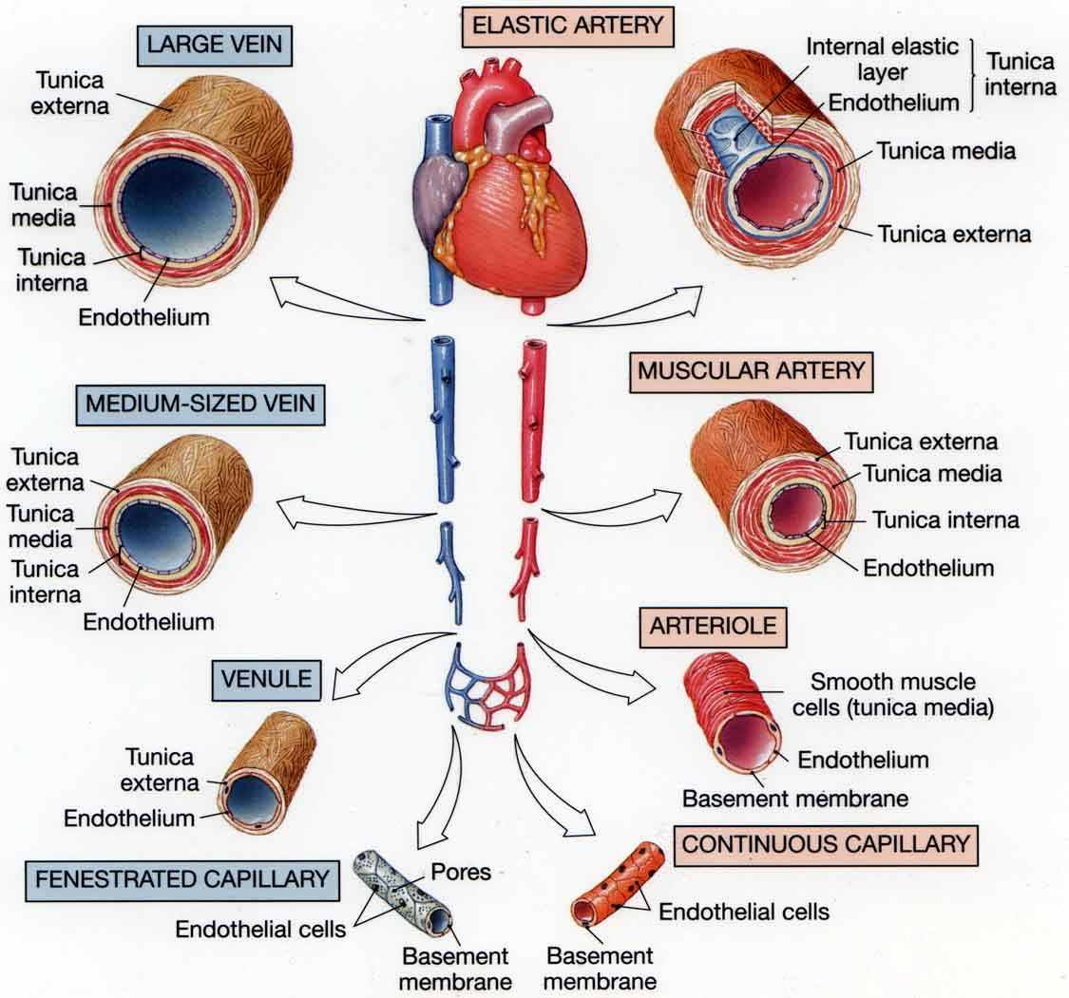
Blood vessels
< 2 cm
All of the blood vessels have a common histological structure

Slide 9
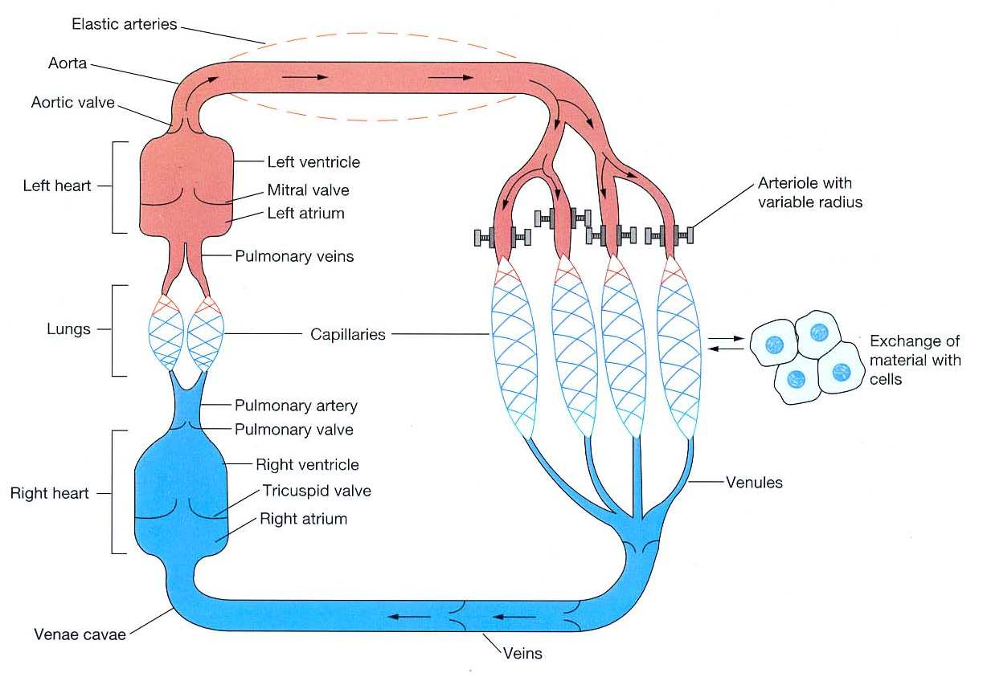
Systemic and pulmonary
circulations

Slide 10
How the heart performs its function?

Slide 11
How the heart
performs its function
as the central pump of the CVS?
The heart has four basic properties which are essential for its functioning as the central pump of the CVS. These are:
1. Autorhythmicity
2. Conductivity
3. Excitability
4. Contractility

Slide 12
Ultrastructure of myocyte
(the contractile, working cell)
The cardiac muscle fibers (cells; myocytes) branch and interdigitate, but each is a complete unit surrounded by a cell (plasma) membrane.
Where the end of one muscle fiber abuts on another, the membranes of both fibers parallel each other through an extensive series of folds. These areas, which always occur at Z lines of the sarcomeres, are called intercalated disks.

Slide 13
Intercalated discs

Slide 14
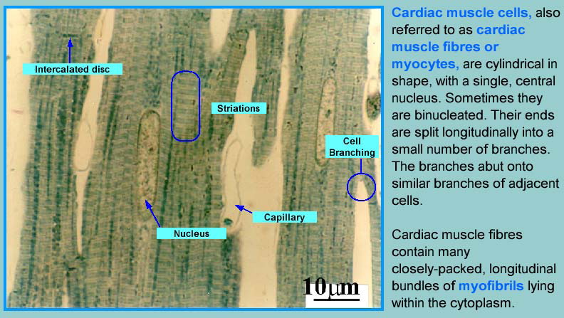

Slide 17
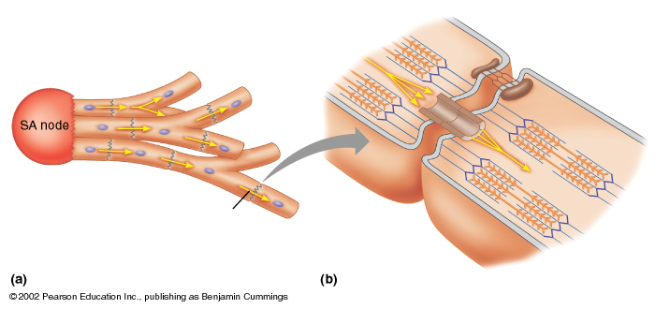
Cardiac muscle cells
are electrically connected
via gap junctions
desmosome
Cardiac Muscle Cells
Gap Junction
desmosome – resist stretching
gap junction – passage of current
Plasma membrane

Slide 18
Mitochondria
Sarcolemma
T-tubule
SR
Fibrils
At the ultrastructural level, cardiac cells (myocytes) typically resemble skeletal muscle in also having specialized transverse tubular and sarcoplasmic reticular membrane systems.
However, the T system in cardiac muscle is located at the Z lines of the sarcomeres rather than at the A–I junction, where it is located in skeletal muscle.
The sarcoplasmic reticulum in myocytes is less developed and it makes complexes with the transverse tubular membrane at dyad rather than triad junctions.

Slide 19
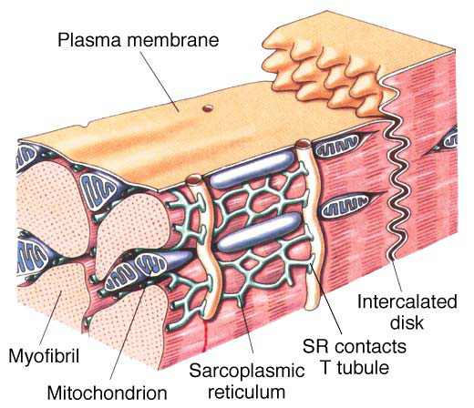
A significant Ca²⁺ influx comes from extracellular space during the plateau phase of the action potential.
The role of Ca²⁺ in excitation–contraction coupling is similar to its role in skeletal muscle.
However, it is the influx of extracellular Ca²⁺ through the voltage-sensitive Dihydropyridine receptors (DHPR) in the T system that triggers calcium-induced calcium release through the ryanodine receptors (RyR) at the sarcoplasmic reticulum.

Slide 20
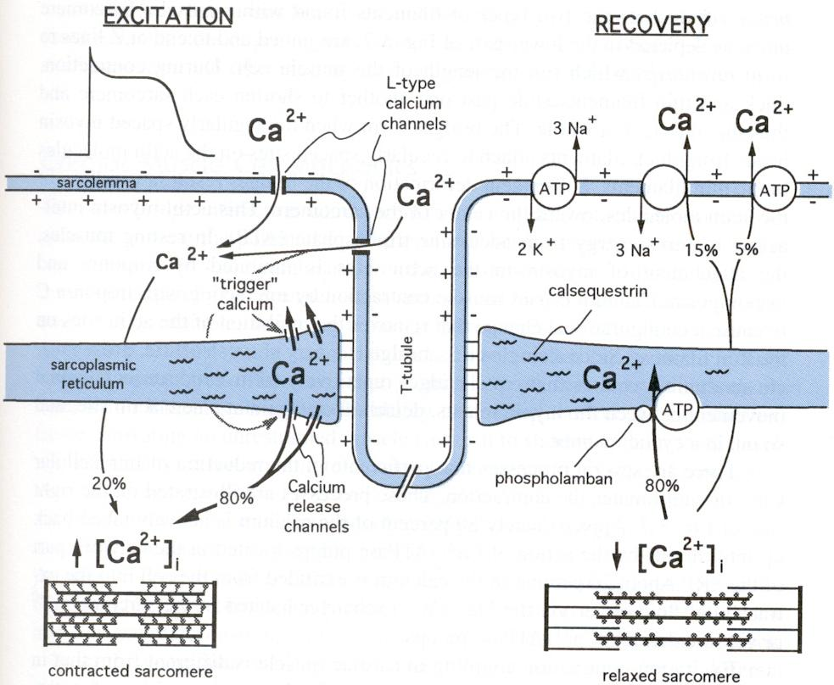
Excitation contraction coupling
The term “excitation-contraction coupling” refers to the mechanism by which the action potential causes the myofibrils of muscle to contract.
Excitation-contraction coupling is similar in cardiac and skeletal muscles.
Increased intracellular Ca²⁺ triggers contraction by binding to troponin on the thin filament.
Tension generation in cardiac, but not in skeletal muscle is profoundly influenced both by extracellular calcium levels and factors that affect the magnitude of the inward calcium current. For example, doubling the extracellular calcium concentration may nearly double the maximum cardiac contractile force.
Drugs which reduce calcium influx have profound negative inotropic effects on the myocardium, but affect skeletal muscle only when present in massive overdose.

Slide 21
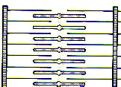
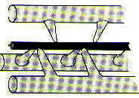
Myocardial fiber
Myofibril
myosin
Myofilaments
actin
relaxed
contracted

Slide 22
Mechanisms maintaining low intracellular Ca²⁺ between successive action potentials
1. Calcium-ATPase pumps
The plasma membrane and the sarcoplasmic reticular membranes contain calcium-ATPase pumps, which translocate calcium ions into both the extracellular fluid and the lumina of the sarcoplasmic reticulum.

Slide 23
Mechanisms maintaining low intracellular Ca²⁺ between successive action potentials 2. Sodium-Calcium exchanger
The plasma membrane also contains a sodium-calcium exchange system drives calcium efflux across the plasma membrane.
The exchanger utilizes the energy from the influx of sodium ions down an electrochemical gradient previously established by the ATPase coupled sodium-potassium pump.
Increases in intracellular sodium concentration decrease this inward electrochemical gradient driving sodium ion entry and result in an increased internal calcium concentration and contractile force.
Mechanism of action of digitalis used in the management of cardiac failure: These agents block the sodium pump and thereby allow such an increase in intracellular sodium concentration.

Slide 24
How do striated muscles work?
Discovering how striated muscles work has been a triumph of collaboration between physiologists, histologists and biochemists over last 50 years.

Slide 25
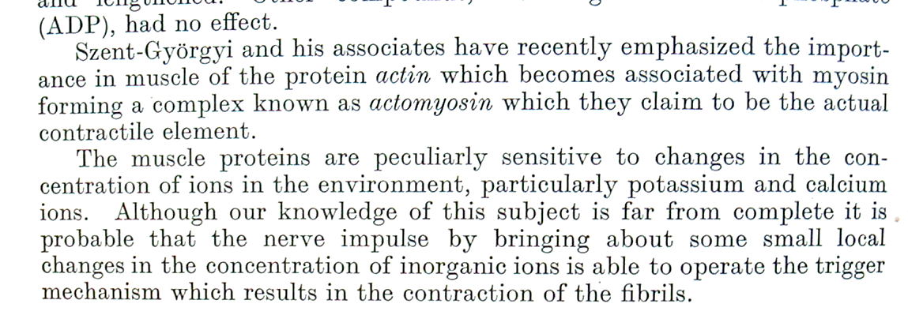
From textbook published in 1950

Slide 26
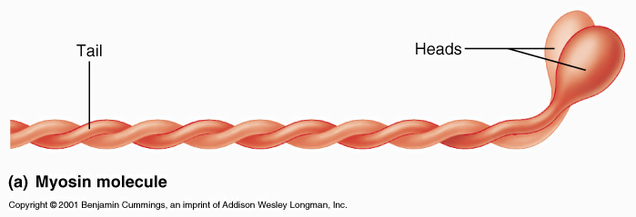
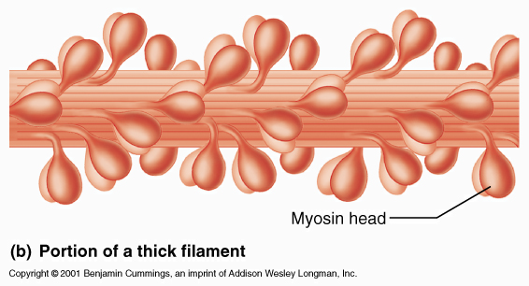
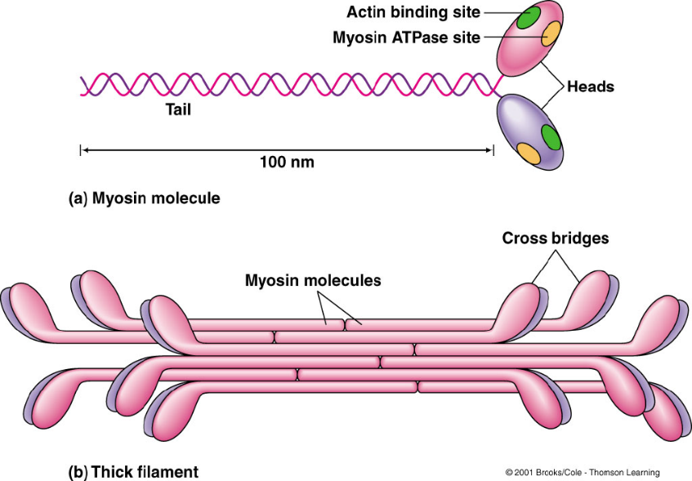
Thick filaments
Individual Myosin molecule with tail and head
Myosin molecules combine to form a Thick filament
KEY POINT: The heads of each myosin molecule have an ACTIN binding site and an ATPase site (splits ATP)

Slide 27
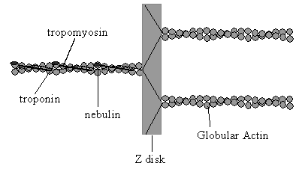
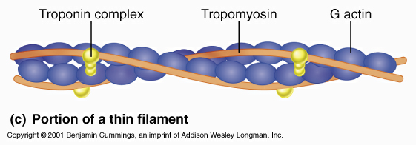
Thin filaments

Slide 28
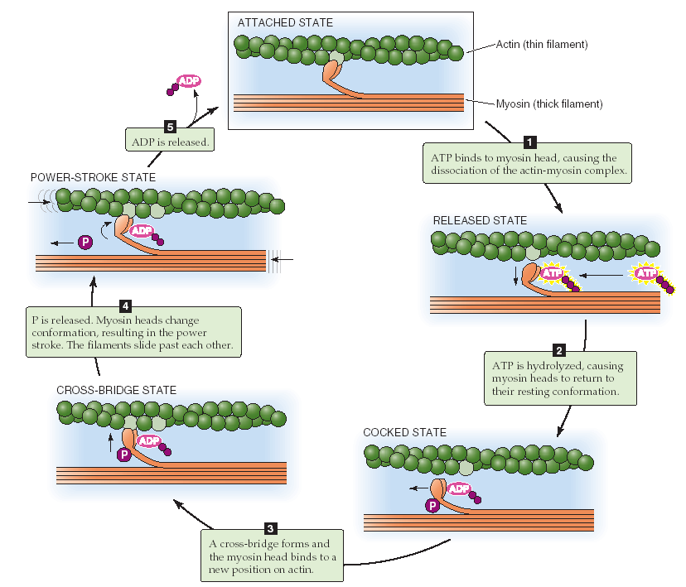
Contraction cycle
By definition, contraction is the continuous cycling of cross-bridges.
Power stroke

Slide 29
Some evidence for the sliding filament theory
Key papers published in Nature in 1954. Both had authors named Huxley.

Slide 30
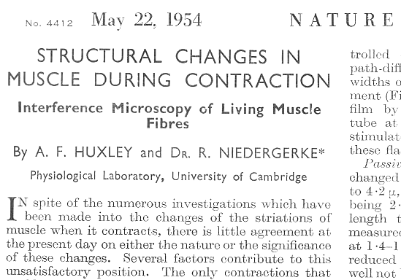

Slide 31
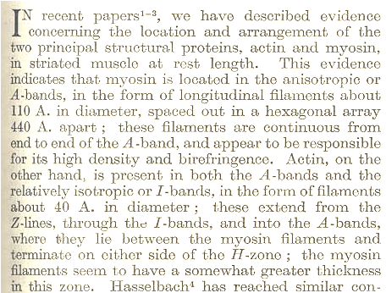

Slide 32
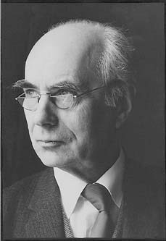
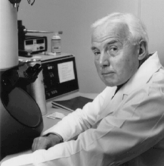
Andrew Huxley
Hugh Huxley

Slide 33
Hence the “Sliding filament” hypothesis!

Slide 34
Determinants of the contractile force
of cardiac muscle
Myocardial
Contractility
Preload
contractile force
of cardiac muscle
Afterload
Heart rate

Slide 35
Preload
In both skeletal and cardiac muscles, preload is the load on the muscle in the relaxed (resting) state. The preload determines the degree of stretch and the resting length of the resting muscle (i.e., before contraction).
Applying preload to muscle does two things:
Causes the muscle to stretch.
Causes the muscle to develop passive tension.
The ventricles of the heart are three dimensional chambers, which get filled with blood from the atria during diastole. Thus, the volume of blood in the ventricle at the end of diastole (end-dastolic volume, EDV) determines the resting length of the ventricle and the degree of its stretch of the myocardial fibers at the end of diastole and constitute the cardiac preload.

Slide 36
Aftereload
In both skeletal and cardiac muscles, afterload is the load on the muscle during contraction.
Left ventricular afterload represents the force that the muscle must generate to eject the blood into the aorta.
The mean aortic pressure is the afterload on the left ventricle.

Slide 37
Types of contractions of skeletal and cardiac muscles
Isometric contractions.
Isotonic contractions without an afterload.
After-loaded isotonic contractions.

Slide 38
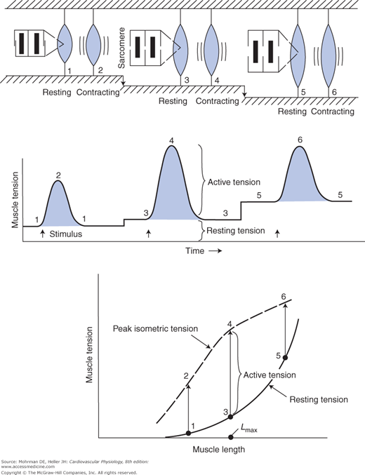
Length-tension relationship
in cardiac muscle
(isometric contraction)
Force is required to stretch a resting muscle to different lengths. This force is called the resting tension (passive tension).
The lower curve in the graph shows the resting tension measured at different muscle lengths and is referred to as the resting length–tension curve.
When a muscle is stimulated to contract (isometrically), i.e., its length is held constant, it develops an additional tension called active or developed tension.

Slide 39
Length-tension relationship
in cardiac muscle
(isometric contraction)
The active (developed) tension developed by the cardiac muscle during isometric contraction depends on the muscle length at which the contraction occurs.
Active tension development is maximal at some intermediate length referred to as L_{max}.
Little active tension is developed at very short or very long muscle lengths.
Normally, the cardiac muscle operates well at lengths below L_{max} so that increasing muscle length increases the active tension developed during an isometric contraction.

Slide 40
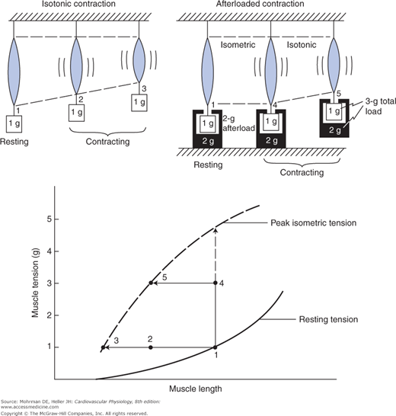
isotonic contraction
When a muscle has contractile potential in excess of the tension required to move a load, it will shorten and contracts isotonically.
Thus, in an isotonic contraction, the muscle shortens and its length decreases at constant tension, as illustrated by the horizontal arrow from point 1 to point 3 in the diagram.

Slide 41
Afterloaded isotonic contraction
This is a complex type of muscle contraction which is typical of the way cardiac muscle cells actually contract in the heart.
In this contraction, the muscle has both preload before contraction and afterload during contraction. The total load = preload + afterload.
In this example, the preload is equal to 1 g, and the afterload is equal is equal to 2 g. The total load thus equals 3 g.

Slide 42
Afterloaded isotonic contraction
If an afterloaded muscle is to shorten and contract isotonically, it must first increase its total active tension to a level equal to the total load (3 g in our example) before it can shorten.
This initial tension will be developed isometrically and can be represented as going from point 1 to point 4 on the length–tension diagram.
Thus, afterloaded isotonic contraction is always preceded by isometric contraction.

Slide 43
Afterloaded isotonic contraction
Since the contractile potential of the muscle still exceeds the total load, it will now shorten isotonically.
This afterloaded isotonic shortening is represented as a horizontal movement on the length–tension curve along the line from point 4 to point 5.
Note that the afterloaded muscle shortens less than the non-afterloaded muscle, even though both muscles began contracting at the same initial length.

Slide 44
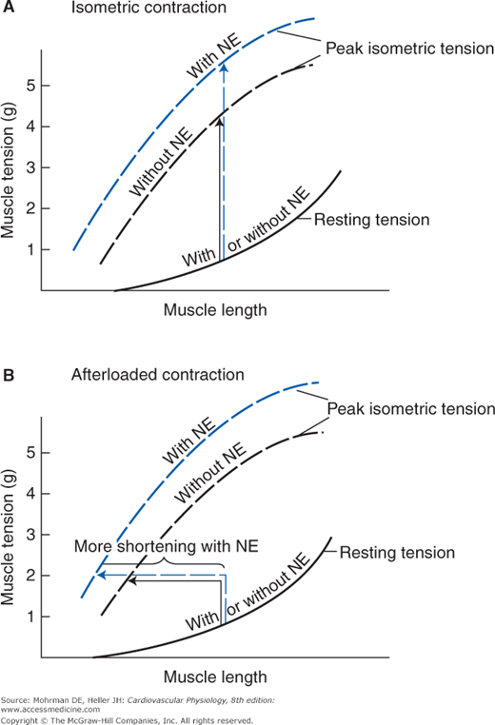
Cardiac muscle contractility
In addition to initial muscle length, a number of factors can affect contractile potential and tension generation of the cardiac muscle.
Any intervention that increases the peak isometric tension that a muscle can develop at a fixed length is said to increase cardiac muscle contractility. Such an agent is said to have a positive inotropic effect on the heart.

Slide 45
Cardiac muscle contractility
The most important physiological regulator of cardiac muscle contractility is norepinephrine.
When norepinephrine is released on cardiac muscle cells from sympathetic nerves, it causes cardiac muscle cells to contract more forcefully and more rapidly.
When norepinephrine is present, the muscle will, at every length, develop more isometric tension when stimulated than it would in the absence of norepinephrine.

Slide 46
Cardiac muscle contractility
Thus, when norepinephrine is present, the isometric length–tension curve is raised up (shifted up).
Thus, when norepinephrine is present, an afterloaded muscle will shorten more when contracting isotonically.
Note that norepinephrine has no effect on the resting length–tension relationship of the cardiac muscle.

