Slide 1
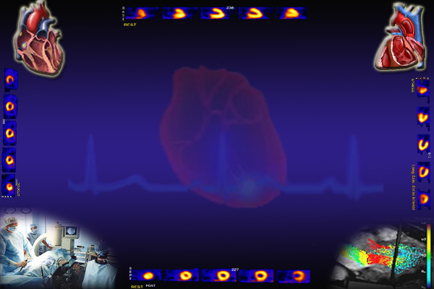
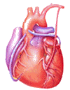
Cardiovascular Block
Arterial Blood Pressure
& Its Regulation
Dr. Ahmad Al-Shafei, MBChB, PhD, MHPE
Associate Professor in Physiology
KSU

Slide 2
Learning outcomes
After reviewing the PowerPoint presentation, lecture notes and associated material, the student should be able to:
Describe systemic and pulmonary vascular resistances.
Define cardiac function in modern physiological terms.
Compare and contrast activity, pressure and volume of the left and right ventricles of the heart.
Discuss structure related to functions of arterial system.
Define arterial pulse and describe its characteristics and clinical significance.
State normative data of arterial blood pressure for pulmonary and systemic circulations.
Compare and contrast measurement of arterial blood pressure in systemic and pulmonary circulations.
Discuss factors affecting systolic and diastolic blood pressures.

Slide 3
Learning outcomes, continued
Discuss regulation of blood pressure:
  The arterial baroreceptors.
  The arterial baroreflex.
  Limits of effectiveness of the arterial baroreceptors.
  Baroreceptors and gravity
  Atrial volume receptors (Bainbridge reflex).
  Arterial chemorecptors
Discuss hormonal and renal regulation of blood pressure.
Define systemic hypertension and state its complications.

Slide 4
Learning Resources
Textbooks :
Guyton and Hall, Textbook of Medical Physiology; 12th Edition.
Mohrman and Heller, Cardiovascular Physiology; 7th Edition.
Ganong’s Review of Medical Physiology; 24th Edition.
Websites:
http://accessmedicine.mhmedical.com/

Slide 5
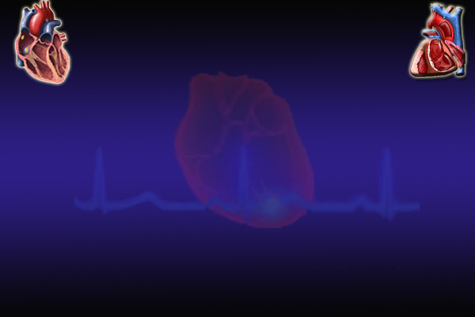
Systemic and pulmonary vascular resistances
As blood flows through the systemic and pulmonary circulations friction develops between the moving fluid and the stationary walls of the blood vessels. Thus, the vessels tend to resist fluid movement through them. Such resistance is known as vascular resistance.
The resistance to the flow of the blood through the systemic circulation is known as systemic vascular resistance and the resistance to the flow of the blood through the pulmonary circulation is known as pulmonary vascular resistance.
The ratio of pulmonary to systemic vascular resistance is approximately 1:6.
It is because the vascular resistance to flow that we need the heart in the cardiovascular system.

Slide 6
Arterial blood pressure (ABP)
Blood pressure is defined as the force exerted by the blood against a vessel wall.
Blood pressure is an important characteristic of our body since it is the force that drives blood along blood vessels after it has left the heart.
Without blood pressure, nutrients, oxygen, and proteins could not travel from the arterial side of the body to the venous side.

Slide 7
In the systemic circulation:
Flow = ΔP/R
CO = The blood pumped per minute (ml/min).
All of the CO flows through the systemic circulation
Therefore, CO = Flow
MAP – Venous Pressure = MAP
MAP drives blood flow in the systemic circulation
Therefore, MAP = ΔP
R = TPR
MAP = mean arterial pressure
CO = cardiac output
TPR = total peripheral resistance
CO = MAP / TPR

Slide 8
In the systemic circulation:
CO = MAP / TPR
MAP = CO X TPR
= SV X HR X TPR
What are the factors affecting vascular resistance?
- Resistance is inversely proportional to r⁴.
- Resistance is directly proportional to viscosity. The viscosity of - blood is dependent on the haematocrit and plasma protein concentration.

Slide 9
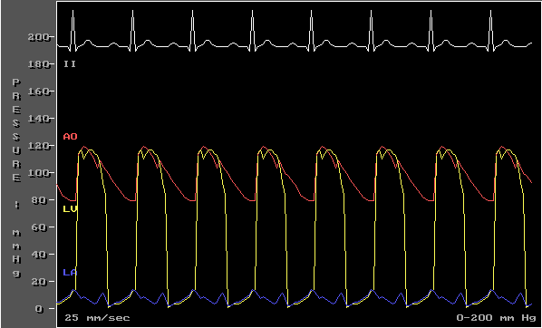
Measurement of arterial blood pressure in the systemic circulation
Direct
Arterial catheter
Indirect
Stethoscope and blood pressure cuff

Slide 10
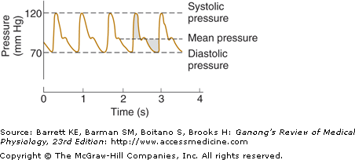
Measurement of arterial blood pressure in the systemic circulation
Direct
Arterial catheter

Slide 11

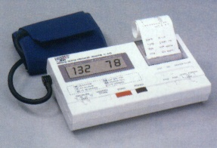

Indirect measurement
of arterial blood pressure
in the systemic circulation

Slide 12
Arterial blood pressure (ABP)
Systolic blood pressure: Is the maximum level of arterial blood pressure. It is reached during the rapid ejection phase of ventricular systole. For a normal adult, it is about 120 mmHg (range of normal: 90-140).
Diastolic blood pressure: Is the minimum level of arterial blood pressure. It is reached during the isometric contraction phase of ventricular systole. For a normal adult, it is about 80 mmHg (range of normal: 60-90).

Slide 13
Mean arterial pressure (MAP)
MAP is the average pressure responsible for driving blood into the tissues throughout the cardiac cycle.
MAP is not halfway between systolic and diastolic pressures because arterial pressure remains closer to diastolic than to systolic pressure for a longer period of each cardiac cycle.
A good approximation of the MAP can be determined using the following formula:
MAP = Diastolic pressure + 1/3 pulse pressure
Mean arterial pressure tends to increase with age because of an age-dependent increase in total peripheral resistance which is controlled primarily by arterioles.

Slide 14
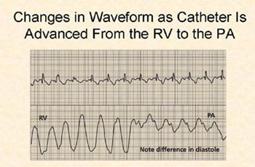
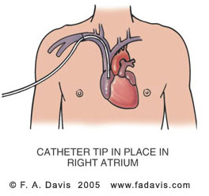
Measurement of arterial blood pressure in the pulmonary circulation
Right Heart Pressures
Swan-Ganz / PA Catheter

Slide 15
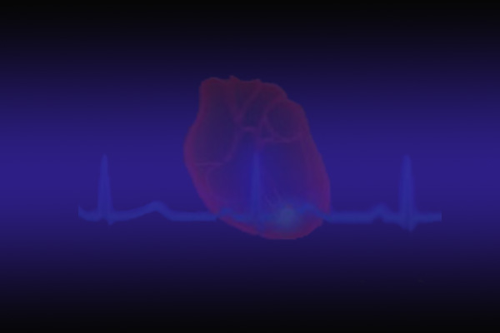
Pressures in in the systemic
and pulmonary circulations
Pressures in the pulmonary circulation | Pressures in the systemic circulation
Right ventricle 25/0 mm Hg | Left ventricle 120/0 mm Hg
Pulmonary artery 25/10 mm Hg | Aorta 120/80 mm Hg
Mean pulmonary artery 15 mm Hg | Mean arterial BP 93 mm Hg
Capillary 7-9 mm Hg | Capillary: skeletal 30 mm Hg renal glomerular 45-50 mm Hg
Pulmonary veins 5 mm Hg | Peripheral veins 7-15 mm Hg
Left atrium 5-10 mm Hg | Right atrium (CVP) 0 mm Hg
Pressure gradient 15-5 = 10 mm Hg | Pressure gradient 93-0 = 93 mm Hg

Slide 16
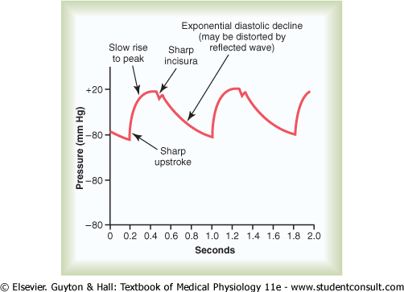
Arterial pressure pulsations
Pulse pressure: Is the difference between the systolic and diastolic blood pressure values. For a normal adult the pulse pressure = 120 – 80 = 40 mmHg.
Pulse pressure is determined by two parameters:
Change in volume (ΔV): could be approximated as stroke volume
Compliance

Slide 17
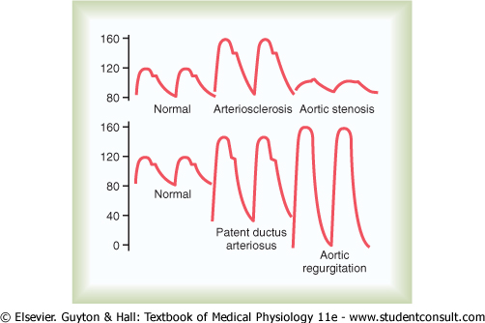
Abnormalities in pulse pressure
Atherosclerosis: Pulse pressure tends to increase with ageing because of a decrease in arterial compliance ("hardening of the arteries").
Aortic regurgitation: in early diastole, blood leaks back into the ventricles. As a results, diastolic pressure falls to very low levels.

Slide 18
Regulation of blood pressure
BP varies over 24 hours:
    lower during sleep
    higher during waking, especially in stress
BP is well regulated – why?
    to provide organs (especially brain) with adequate perfusion pressure
    to optimize cardiovascular work

Slide 19
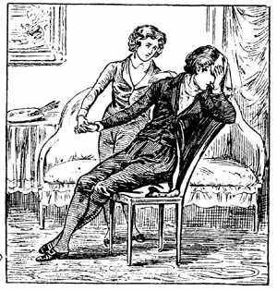
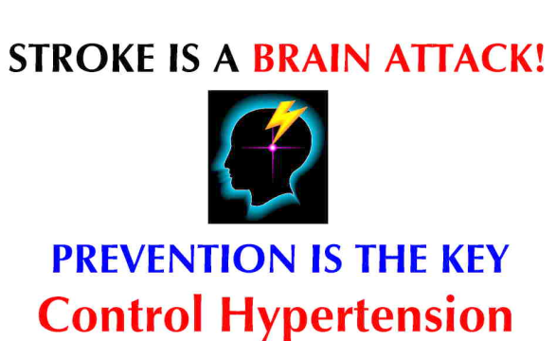
Regulation of blood pressure
Too low a value of arterial blood pressure
hypotension
blood flow to the tissues will be reduced
(for example to the brain and induce a faint)
Too high a value of arterial blood pressure
hypertension
this may cause excessive capillary pressures and damage
e.g., heart (myocardial infarction) kidneys, brain (stroke) and eyes

Slide 20
Regulation of blood pressure
Short term mechanisms (seconds to minutes): are largely neural. They regulate cardiac function and arteriolar diameter.
Long term mechanisms (minutes to days): are largely renal and hormonal. They regulate blood volume.

Slide 21
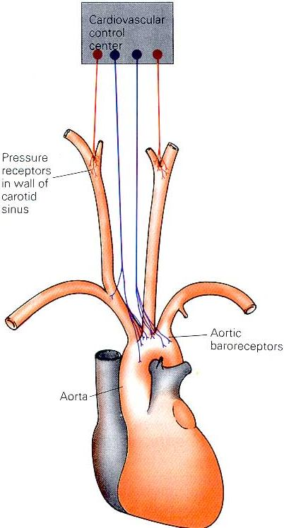
1. The arterial baroreceptors
Changes in MBP are detected by baroreceptors (pressure receptors) in the carotid and aortic arteries.
These receptors provide information to the cardiovascular centres in the medulla oblongata about the degree of stretch because of pressure changes.
Carotid baroreceptors are located in the carotid sinus on both sides of the neck. Aortic baroreceptors are located in the aortic arch.

Slide 22
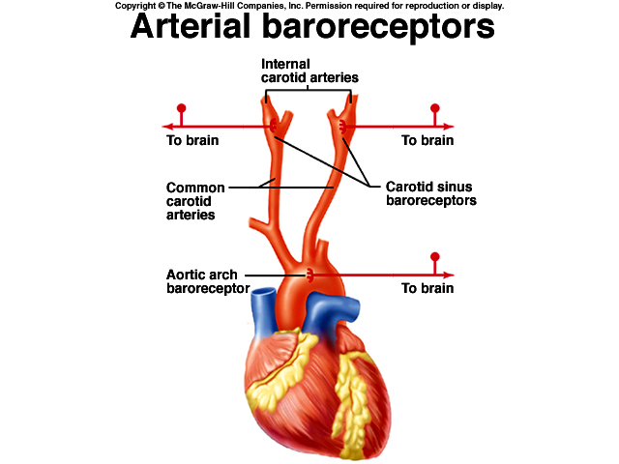
1. The arterial baroreceptors

Slide 23
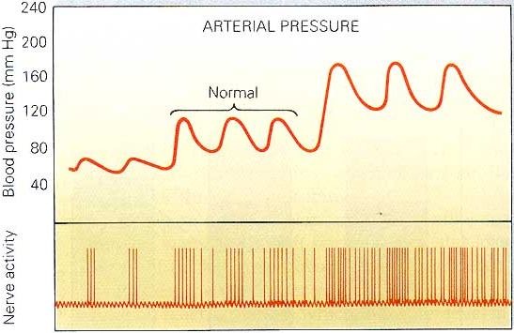
Increased arterial pressure
increases baroreceptor activity
- At normal arterial pressure the baroreceptors are active.
- Increased pressure increases their rate of fire, while decreased pressure decreases the rate of fire.
- They play an important role in maintaining relatively constant blood flow to vital organs (such as brain) during rapid changes in pressure, such as standing up after lying down. That is why they are called “pressure buffers”.

Slide 24
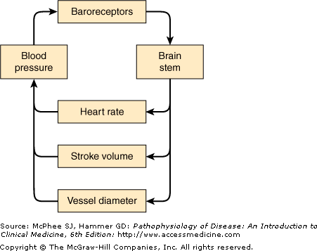

Slide 25
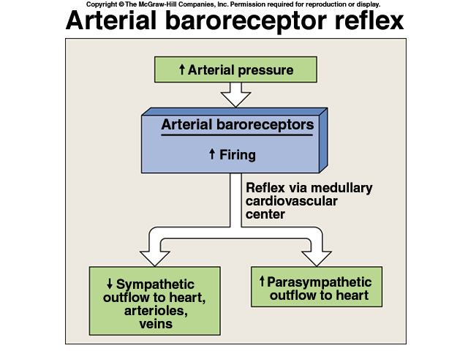

Slide 26
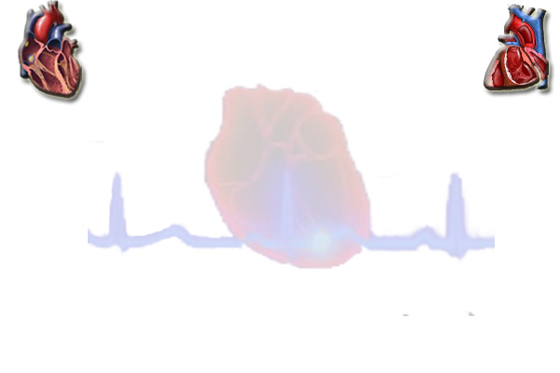
Arterial Baroreceptor Reflex
↑ MAP
Baroreceptors
↑ Parasympathetic
(vagal) activity
↓ Sympathetic
activity
↓ HR
↓ SV
↓ TPR
↓ MAP

Slide 27
Arterial Baroreceptor Reflex
↓ MAP
Baroreceptors
↓ Parasympathetic
(vagal) activity
↑ Sympathetic
activity
↑ HR
↑ SV
↑ TPR
↑ MAP
Flow to the heart and brain is maintained; reductions in flow to other organs.

Slide 28
Arterial Baroreceptor Reflex
↓ MAP
Baroreceptors
↓ Parasympathetic
(vagal) activity
↑ Sympathetic
activity
↑ HR
↑ SV
↑ TPR
↑ MAP
The primary role of the baroreflex is to protect against drastic
decreases in blood flow caused by a decrease in blood volume.

Slide 29
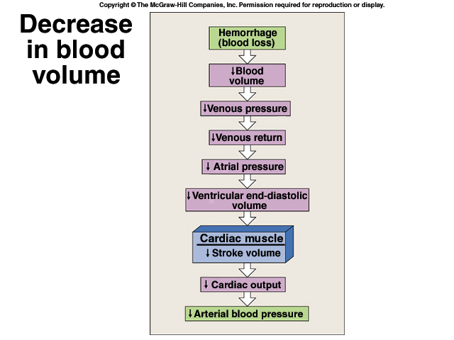
Cardiovascular changes initiated by the baroreflex in hemorrhage

Slide 30
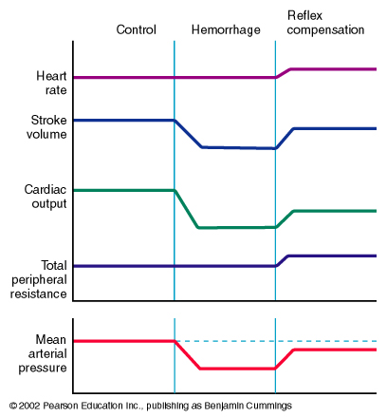
Cardiovascular changes initiated by the baroreflex in hemorrhage
Control
Haemorrhage
Reflex
Compensation
Heart Rate
Stroke Volume
↓ EDV
Cardiac Output
Total Peripheral Resistance
Mean Arterial Pressure
↓ CO

Slide 31
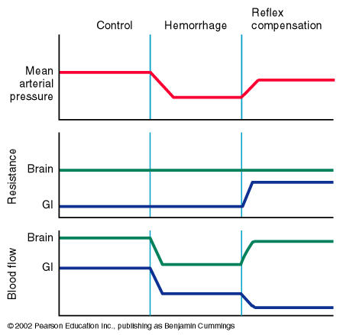
Cardiovascular changes initiated by the baroreflex in hemorrhage
Control
Haemorrhage
Reflex
Compensation
Mean Arterial Pressure
Brain
Resistance
Gut
Brain
Blood Flow
Gut
This can
Become problematic.
Flow to the heart and brain is maintained; reductions in flow to other organs.

Slide 32
Unimportance of arterial baroreceptors
in long-term pressure control
The baroreceptor reflex mechanism functions primarily as a short-term regulator of ABP. It is activated at once by any blood pressure change and attempt to restore blood pressure rapidly toward normal.
Yet, if ABP deviates from its normal operating point for more than a few days, the arterial baroreceptors adapt to this new pressure.
This adaptation of the baroreceptors obviously prevents the baroreflex from functioning as a long-term blood pressure control system.

Slide 33

2. Atrial volume receptors
There are receptors in the very large veins close to the heart and in the walls of the atria.
They are sensitive to blood volume. The following mechanisms occurs to prevent excess elevation in blood pressure upon response to an increase of body fluid volume
An increased blood volume → stretch of atria → activate atrial volume receptors → sensory afferent nerves to medulla →inhibiting the cardiovascular centre → This results into decreased blood volume through:
  (a) → ↓ sympathetic drive to kidney:
  → dilate afferent arterioles → ↑ glomerular capillary hydrostatic pressure →↑ GFR → ↓ blood volume (towards normal).
  ↓ renin secretion (Renin is an enzyme which activates angiotensinogen in blood). Hence inhibition of renin secretion → inhibit RAAS → inhibit aldosterone production → ↓ Blood volume (towards normal)
  (b) → ↓ ADH secretion → ↓ blood volume (towards normal).
  (c) → ↑ Atrial Natriuretic Peptide (ANP) causes loss of blood volume.

Slide 34
3. Arterial chemoreceptors
Supply of O₂ to tissues depends on both respiratory and cardiovascular factors.
Reduced blood flow (due to reduced ABP) stimulates the chemoreceptors through oxygen lack, increased hydrogen ions or carbon dioxide.
Response is excitatory, NOT inhibitory; mainly through activation of sympathetic nervous system.
They reduce blood flow to unessential areas and protect vital tissues like brain and heart.

Slide 35
Hormonal regulation of blood pressure
A. Catecholamines (Adrenaline and Noradrenaline)
↓ MAP
↑ Sympathetic Activity
Splanchnic nerve
Adrenal Medulla
↑ Adrenaline Secretion
↑ HR (SA node) and ↑ SV (ventricular myocardium)

Slide 36
Hormonal regulation of blood pressure
A. Catecholamines (Adrenaline and Noradrenaline)
α-adrenoceptor
β-adrenoceptor
Adrenoceptor = Adrenergic Receptor
(binds adrenaline and noradrenaline)

Slide 37
Hormonal regulation of blood pressure
A. Catecholamines (Adrenaline and Noradrenaline)
α-adrenoceptor
β-adrenoceptor
α-adrenoceptor stimulation promotes vasoconstriction
β -adrenoceptor stimulation promotes vasodilation

Slide 38
Hormonal regulation of blood pressure
A. Catecholamines (Adrenaline and Noradrenaline)
α-adrenoceptor
β-adrenoceptor
Noradrenaline
Noradrenaline
Noradrenaline
Noradrenaline released from the sympathetic nerves binds
primarily to α adrenoceptors.

Slide 39
Hormonal regulation of blood pressure
A. Catecholamines (Adrenaline and Noradrenaline)
α-adrenoceptor
Adrenal Gland
β-adrenoceptor
Kidney
adrenaline
adrenaline
adrenaline
adrenaline
adrenaline
adrenaline
Adrenaline released from the adrenal medulla circulates in the
blood and can bind to both α and β adrenoceptors.

Slide 40
Adrenaline binding to α- and β-ddrenoceptors
Adrenaline has a greater affinity for β-adrenoceptors
than for α-adrenoceptors
At low [Adrenaline]
→ Preferential binding to β-adrenoceptors
→ Vasodilation
At high [Adrenaline]
→ Binding to both α and β-adrenoceptors
→ Vasodilation and/or vasoconstriction??
α: vasoconstriction
β: vasodilation

Slide 41
Vasodilation and/or Vasoconstriction??
In cardiac and skeletal muscle: # β-receptors > # α-receptors
→ Adrenaline promotes vasodilation
In most other tissues: # α-receptors > # β -receptors
→ Adrenaline promotes vasoconstriction
α: vasoconstriction
β: vasodilation

Slide 42
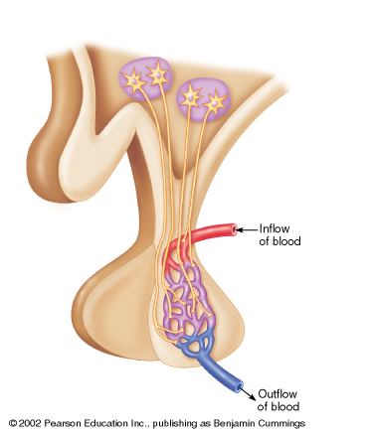
Hormonal regulation of blood pressure
B. Role of vasopressin (Antidiuretic hormone; ADH )
ADH (vasopressin) is synthesized within the
Paraventricular Nucleus of the hypothalamus.
hypothalamus
Paraventricular
nucleus
ADH is stored in the
posterior pituitary.
pituitary
Vasopressin exerts a
pressor effect
(i.e., ↑BP)

Slide 43
Hormonal regulation of blood pressure
B. Vasopressin (Antidiuretic hormone; ADH )
hypothalamus
1. Dehydration or salt ingestion
2. ↑ Blood osmolarity
3. Stimulates osmoreceptors
in the hypothalamus
pituitary
4. Triggers ADH release
from the pituitary
5a. Causes vasoconstriction
→ ↑ TPR
→ ↑ BP
5b. Promotes water retention by the kidney
→ ↑ Blood Volume

Slide 44
Renal regulation
of blood pressure
The baroreceptor reflex and other reflex mechanisms are important for the short term control of blood pressure.
Long term control of blood pressure requires control of blood volume.
Blood volume is controlled by the kidney.

Slide 45
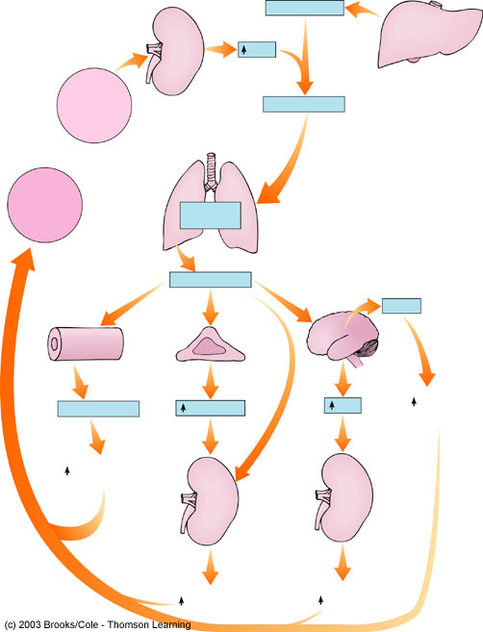
Renal regulation of blood pressure
Low BP
High sympathetic activity
Liver
Angiotensinogen
Kidney
Renin
Angiotensin I
juxtaglomerular
cells
Angiotensin
Converting
Enzyme
Lungs
Angiotensin II

Slide 46
Hypertension
Sometimes blood-pressure control mechanisms do not function properly or unable to completely compensate for changes that have taken place.
Blood pressure may be above the normal range (hypertension if above 14/90 mm Hg) or below normal (hypotension if less than 100/60).
Theoretically, hypertension could result from an increase in cardiac output or in TPR, or both.
In reality, however, the major abnormality in most cases of well-established hypertension is increased TPR, caused by reduced arteriolar radius.

Slide 47
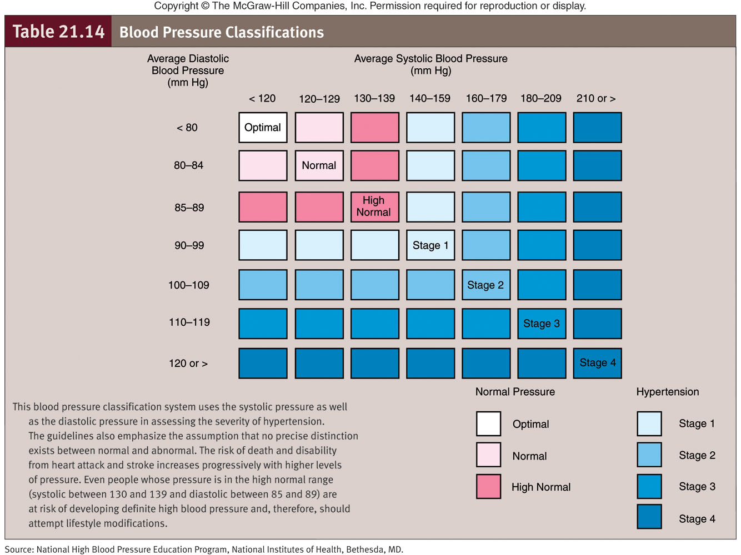

Slide 48
Hypertension
In only a small fraction of cases (only 10% of cases) the cause of arteriolar constriction is known.
Hypertension that occurs secondary to another primary problem is called secondary hypertension.
The underlying cause is unknown in the remaining 90% of hypertension cases. Such hypertension is known as primary (essential or idiopathic) hypertension.

Slide 49
Secondary hypertension
Causes:
1- renal diseases account for over 80% of the case of secondary hypertension.
2- Endocrine causes:
- Conn’s syndrome.
- Adrenal hyperplasia.
- Phaeochromocytoma.
- Cushing’s syndrome.
- Acromegaly.
3. Coarctation of the aorta.
4. Drugs.
5. Pregnancy.

Slide 50
What are the complications of hypertension?

