Slide 1
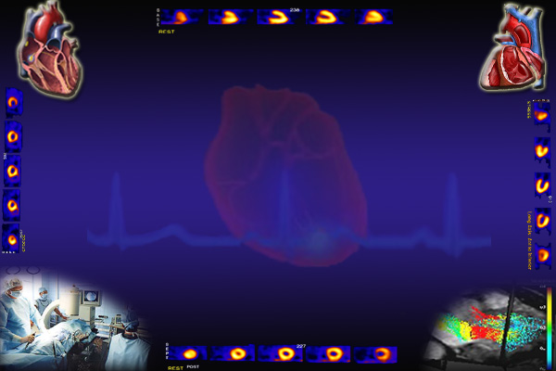
Cardiovascular Block Venous Return
Dr. Ahmad Al-Shafei, MBChB, PhD, MHPE
Associate Professor in Physiology
KSU

Slide 2
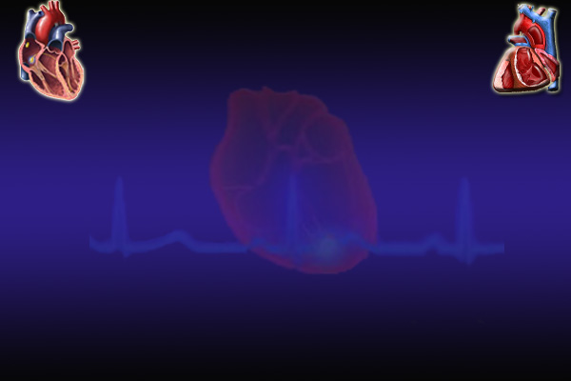
Learning outcomes
After reviewing the PowerPoint presentation, lecture notes and associated material, the student should be able to:
Describe structure related to functions of veins.
Discuss functions of the veins as blood reservoirs.
Describe measurement and discuss significance of central venous pressure (CVP).
Outline determination of cardiac output and venous return by CVP.
Interpret jugular venous pulsation.
Define mean systemic filling pressure and give its normal value.
Discuss determinants of venous return.
Define varicose veins and state its causes.

Slide 3
Learning Resources
Textbooks :
Guyton and Hall, Textbook of Medical Physiology; 12th Edition.
Mohrman and Heller, Cardiovascular Physiology; 7th Edition.
Ganong’s Review of Medical Physiology; 24th Edition.
Websites:
http://accessmedicine.mhmedical.com/

Slide 4
Major components
of the cardiovascular system
HEART
Veins are thin walled vessels with relatively large lumen.
They can accommodate changes in blood volume with little change in pressure until a limit is reached.
Beyond the limit, any change in volume results in change in pressure.
VEINS
CAPACITY
VESSELS
ARTERIES
(LOW COMPLIANCE)
CAPILLARIES

Slide 5
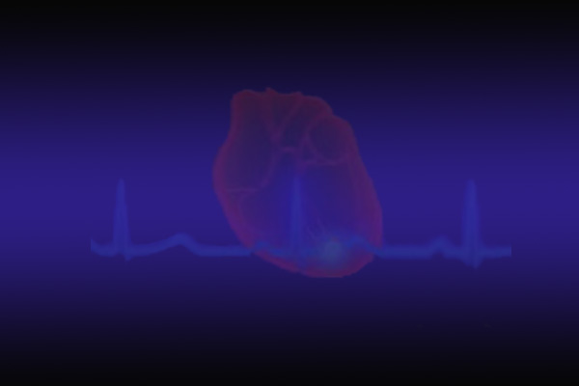
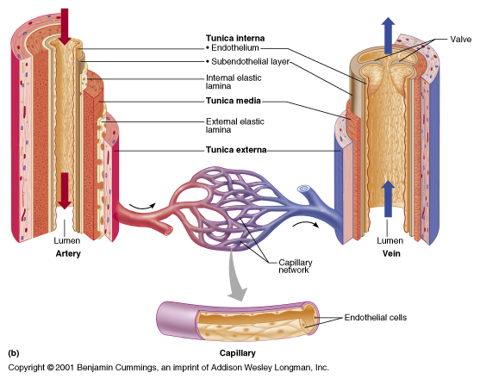
Three layers of blood vessel wall:
Tunica interna (tunica intima) inner layer
Tunica media – middle layer
Tunica externa – outermost layer
Layers of blood vessel wall

Slide 6
Veins
Structure:
all 3 layers are present, but thinner than in arteries of corresponding size (external diameter)
have paired semilunar, bicuspid valves to restrict backflow in lower extremities
varicose veins - blood pools because valves fail causing venous walls to expand

Slide 7
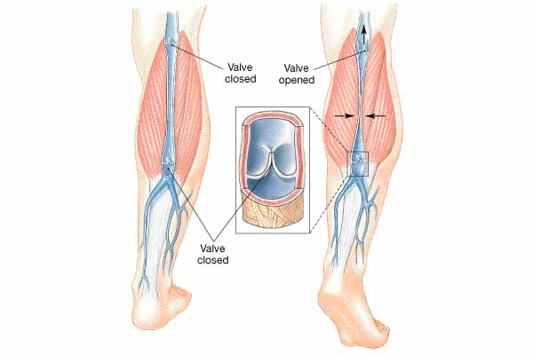

Slide 8
Functions of veins
Capacitance vessels of the circulation:
Venous return to the heart
Variable reservoir of blood with 2/3 blood volume contained in veins

Slide 9
Veins serve as blood reservoirs
Normally all the blood is circulating all the time.
When the body is at rest and many of the capillaries are closed, the capacity of the venous reservoir is increased as extra blood bypasses the capillaries and enters the veins.
When this extra volume of blood stretches the veins, the blood moves forward through the veins more slowly because the total cross sectional area of the veins has increased as a result of the stretching.
Therefore, blood spends more time in the veins.
As a result of this slower transit time through the veins, the veins are essentially storing the extra volume of blood because it is not moving forward as quickly to the heart to be pumped out again.
When the stored blood is needed, such as during exercise, extrinsic factors reduce the capacity of the venous reservoir and drive the extra blood from the veins to the heart so that it can be pumped to the tissues.

Slide 10
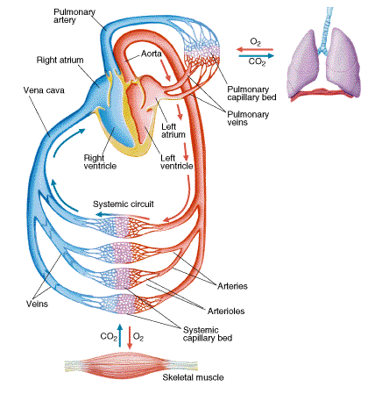
Venous return (VR)
Venous return is determined by the difference in pressure between the venous pressure nearest to the tissues (mean circulatory filling pressure; MCP) and the pressure nearest to the heart (CVP).

Slide 11
Mean circulatory filling pressure (MCP) = Mean systemic filling pressure (MSFP)
It is the pressure nearest to the tissues.
Its normal value is about 7 mm Hg.
It is affected by:
Blood volume (it is directly proportional to blood volume)
Venous capacity (it is inversely proportional to the venous capacity)

Slide 12
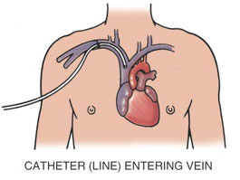
Central venous pressure (CVP)
CVP: is the venous pressure in the right atrium and the big veins of the thorax (= right atrial pressure = jugular venous pressure).
Venous pressure is measured with a catheter in central venous system, usually SVC
Normal range = 0-4 mm Hg provided adequate filling of the right ventricle
It is the force responsible for cardiac filling.
CVP is used clinically to assess hypovolaemia and during IV transfusion to avoid volume overloading.
CVP is raised in right-sided failure.

Slide 13
What is right atrial pressure? What is jugular venous pulse or JVP?

Slide 14
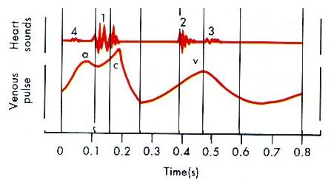
Jugular venous pulse
Wave “a” is due to contraction of the atria.
Wave “c” is due to contraction of the ventricles, probably due to bulging of the AV valves back towards the contracted atria.
The x descent comes with atrial relaxation
Wave “v” is due to filling of the atria while the AV valves are closed, opening of the valves allows the pooled blood to enter the ventricles.
The y descent with opening of the tricuspid valve

Slide 15
Pathologic CVP Waves
Variations on the normal CVP waves can provide information about cardiac pathology:
Atrial fibrillation: a waves will be absent
Tricuspid stenosis: a waves will be dramatically increased as the atrium contracts against a closed tricuspid valve.

Slide 16
Determinants of venous return
Venous return is determined primarily by the difference in pressure between the venous pressure nearest to the tissues (mean circulatory filling pressure; MCP = MCFP) and the pressure nearest to the heart (CVP).

Slide 17
Determinants of venous return
I- Venous capacity
II- Sympathetic activity
III- Skeletal muscle activity
IV- Venous valves
V- Respiratory activity

Slide 18
Determinants of venous return
I- Venous capacity: is the volume of the blood that the veins can accommodate.
It depends on the distensibility of the vein walls and the influence of any externally applied pressure squeezing inward on the veins.
At a constant blood volume, as the venous capacity  → more blood spends a longer time in the veins instead of being returned to the heart → ↓ the effective circulating volume → ↓ VR
As the venous capacity ↓ →  VR

Slide 19
Determinants of venous return
II- Sympathetic activity:
Venous smooth muscle is profusely supplied with sympathetic nerve fibers.
Sympathetic stimulation → venous vasoconstriction → modest  MCP →  VR
Sympathetic stimulation → ↓ venous capacity →  VR
What is the effect of venoconstriction on the resistance to flow?
The veins normally have such a large diameter that the moderate vasoconstriction accompanying sympathetic stimulation has little effect on resistance to flow.

Slide 20
Determinants of venous return
III- Skeletal muscle activity:
Skeletal muscle contraction → external venous compression → ↓ venous capacity →  VR (This is known as skeletal muscle pump)
Skeletal muscle activity also counter the effects of gravity on the venous system.

Slide 21
Determinants of venous return
IV- Venous valves:
These valves permit blood to move forward toward the heart but prevent it from moving back toward the tissues.
These valves also play a role in counteracting the gravitational effects of upright posture.

Slide 22
Venous incompetence
Muscle pump ineffective when venous valves are incompetent
Chronically raised P in veins leads to pathological distension (varicose veins)
Increased capillary filtration leads to swelling (oedema) with trophic skin changes and ulceration (venous ulcers)

Slide 23
Determinants of venous return
V- Respiratory activity (respiratory pump):
As the venous system returns blood to the heart from the lower regions of the body, it travels through the chest cavity. The pressure in the chest cavity is 5 mm Hg less than atmospheric pressure.
The venous system in the limbs and abdomen is subjected to normal atmospheric pressure.
Thus, an externally applied pressure gradient exists between the lower veins and the chest veins, promoting venous return (respiratory pump).
What is the effect of Valsalva maneuver on venous return?

