Slide 1
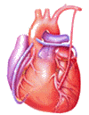
Cardiovascular Block Capillary Circulation
Dr. Ahmad Al-Shafei, MBChB, PhD, MHPE
Associate Professor in Physiology
KSU

Slide 2
Learning outcomes
After reviewing the PowerPoint presentation, lecture notes and associated material, the student should be able to:
Describe the structure of capillary wall: endothelial cells, basement membrane, intercellular clefts, vesicles, pores.
Blood brain barrier to water soluble agents.
Describe structure of liver and renal capillaries.
Compare and contrast diffusion and filtration.
State the Starling forces acting on the capillary wall: capillary blood pressure, interstitial fluid pressure, plasma protein colloid osmotic pressure, interstitial fluid colloid osmotic pressure.
Describe net loss of fluid from capillaries and discuss role of lymphatics.
Discuss importance of filtration giving clinical situations.
Define odema, state its causes and discuss its mechanisms.

Slide 3
Learning Resources
Textbooks :
Guyton and Hall, Textbook of Medical Physiology; 12th Edition.
Mohrman and Heller, Cardiovascular Physiology; 7th Edition.
Ganong’s Review of Medical Physiology; 24th Edition.
Websites:
http://accessmedicine.mhmedical.com/

Slide 4
The microcirculation
The microcirculation refers to the microscopic divisions of the vascular system that function to bring exchange of materials between the blood and various body cells.
Blood flow velocity in the capillaries?

Slide 5
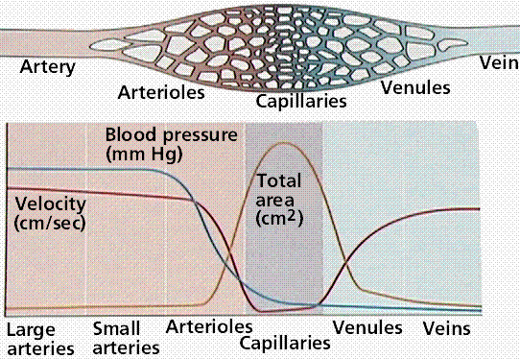

Slide 6
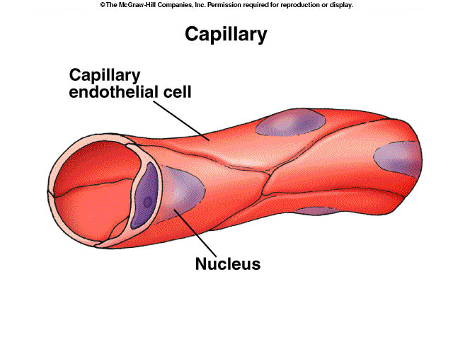
Capillaries
Structure:
They are small blood vessels 0.5-1mm long, 0.01mm diameter. They consist of the tunica interna only with a single layer of endothelial cells surrounded by a basement membrane.
Function:
Sites of exchange between blood and tissues. The arterial system delivers blood to > l billion capillaries throughout the body. Total capillary surface area=1000 m².

Slide 7
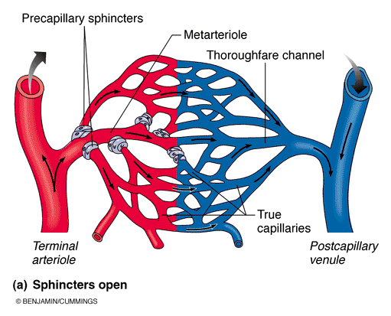
Capillary Beds
There are 10 billion capillaries in the body.
Capillaries tend to be arranged in capillary beds; only about 5% of blood volume is in the capillaries at any time.
The arteriole divides into a number of metarterioles which do not have a continuous smooth muscle coat.
Blood leaves the metarteriole
and enters capillary bed via precapillary sphincters.

Slide 8
Types of body capillaries
Three structural types:
Continuous capillaries
Fenestrated capillaries
Sinusoids

Slide 9
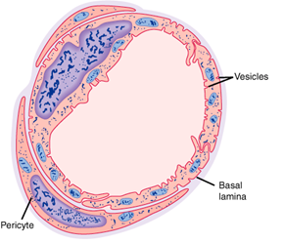
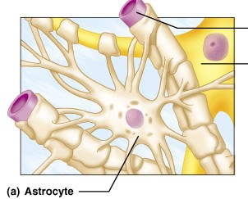
Continuous Capillaries
These capillaries are present in most body tissues, e.g., muscle, lung, and adipose tissue.
They have continuous endothelial lining and adjacent endothelial cells are closely joined together by tight junctions.
There are thin intercellular slits (clefts) 2-10 nm in width in-between the endothelial cells that allow bulk flow of water and water soluble small ions (e.g., Na⁺, Cl⁻, and glucose).
intercellular slits (clefts) are gaps in tight junctions.
tight junctions are continuous in brain and do not allow passage of water soluble molecules. They form part of the blood-brain barrier.
Continuous type of capillary found in skeletal muscle.
Blood brain barrier

Slide 10
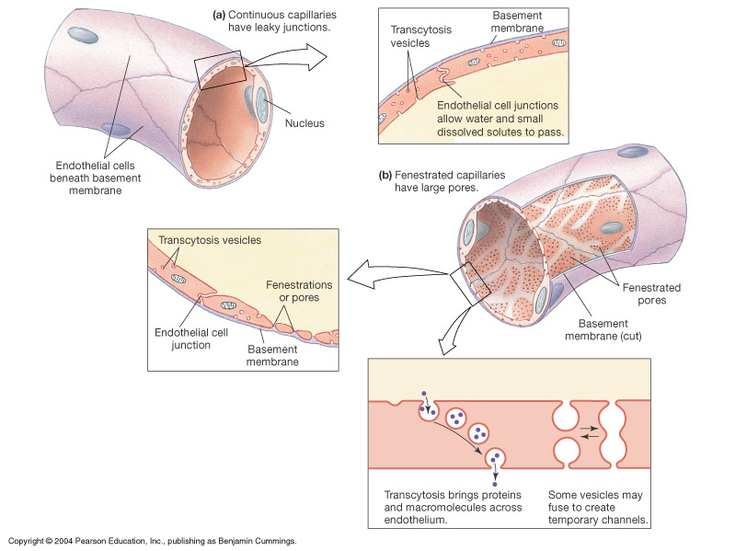
Continuous Capillaries

Slide 11
Blood Brain Barrier

Slide 12
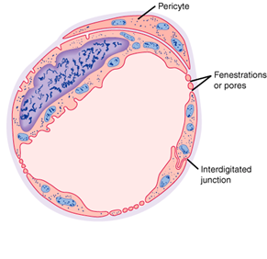
Fenestrated Capillaries
These are found in the kidney glomeruli, small intestine, and endocrine glands.
Some endothelial cells have wide intercellular pores
Very permeable – allow even large substances to pass but not plasma proteins.
Fenestrated type of capillary

Slide 13
Sinusoids
In these capillaries the endothelial cell are widely spaced.
These have large irregular lumens → slows blood flow.
Located in liver, spleen, bone marrow, lymphoid tissue, some endocrine glands.
Few tight junctions → allow large molecules (e.g., proteins) to pass through.

Slide 14
Mechanisms of transcapillary exchange
Transport of substances across the capillary wall occurs by 3 major mechanisms:
1- Diffusion (according to concentration gradient).
2- Filtration (according to pressure gradient).
3- Vesicular transport (transcytosis).
4- Mediated (membrane) transport: This occurs in capillaries of brain only and involves secondary active transport e.g., transport of glucose; moves by co-transporters in cell membrane.

Slide 15
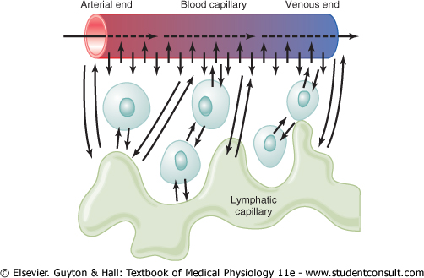
Diffusion
This is the process of movement of particles between the capillaries and interstitium across the capillary membrane according to their concentration (chemical) gradients.
It is the major process by which most nutritional substances and waste products cross the capillary membrane.
The diffusion is dependent on:
- Water & lipid solubility
- Molecular size of the particles
- Concentration gradient
Rate of diffusion for water over the whole body approximately 250 l/min.

Slide 16
Vesicular transport (transcytosis)
This is an active process by which large molecules can be transported across the capillary membrane.
It includes the formation of vesicles from the endothelial membrane to surround the required particle (endocytosis). The vesicle separates and migrates across the cell to release its contents to the other side (exocytosis)
e.g. Peptide hormones are moved this way

Slide 17
Filtration
Filtration is the process by which plasma and its dissolved crystalloids (electrolytes and glucose) can filter across the capillary according to pressure gradient. Filtration is determined by Starling forces.
It is called bulk flow as movement of water drags along with it dissolved substance to which the membrane is permeable.
Although the amount of materials exchanged by filtration are small compared to diffusion (rate of diffusion is 4000 times as the rate of filtration-reabsorption), however, filtration aids diffusion by keeping the fluid across the capillary membrane in a state of continuous motion.

Slide 18
Transcapillary fluid dynamics
Filtration forces
Four pressures are involved in fluid exchange in the capillary bed:
Starling forces:
Capillary hydrostatic pressure tends to force fluid out.
Plasma colloid osmotic pressure: sucks fluid back in.
Interstitial fluid pressure.
Interstitial fluid colloid osmotic pressure: sucks fluid out.

Slide 19
Capillary blood pressure and interstitial blood pressure
The capillary blood pressure (hydrostatic pressure) varies from tissue to tissue. In the renal glomeruli, it is about 60 mm Hg (filtering capillaries). In contrast, it is only about 8-10 mm Hg in those of the intestine and the pulmonary circulation absorptive capillaries).
It is difficult to measure the interstitial fluid hydrostatic pressure. It is either slightly above or slightly below atmospheric pressure. (1 mm Hg above atmospheric pressure).

Slide 20
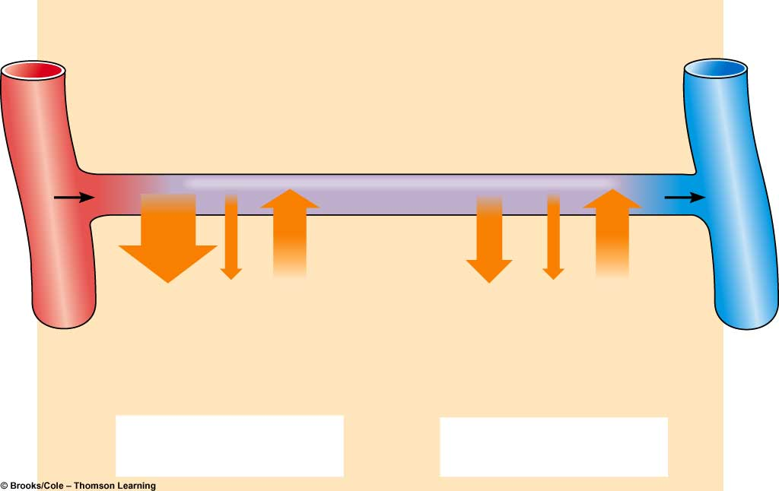
Transcapillary fluid dynamics
Arterial end
of capillary
Venous end
of capillary
Osmotic
pressure
of plasma
(- 28)
Osmotic
pressure
of plasma
(- 28)
Blood
pressure
(+40)
Blood
pressure
(+15)
Osmotic
pressure
of interstitial
fluid
(+3)
Osmotic
pressure
of interstitial
fluid
(+3)
(40 + 3) - 28 = +15
(15 + 3) - 28 = - 10
Net filtration
Net absorption

Slide 21
At arteriolar end
↓
_{Net filtration}
At venular end
↓
Net reabsorption
Via
lymphatics
Filtration Reabsorption
Normally the amount filtered slightly exceeds the amount reabsorbed and is eventually returned to the circulation via the lymphatics
Filtration: (arterial end) reabsorption: (venous end) 20ml fluid/min 18ml fluid/min
Hence: net filtration of about 2ml/min for entire body:
removed by lymphatics (prevent oedema)

Slide 22
Clinical significance
of capillary filtration
In blood loss - vasoconstriction of arterioles → decrease capillary pressure - hence osmotic pressure of plasma proteins favours absorption of interstitial fluid →↑ blood volume.
In congestive heart failure - venous pressure rises → build-up of blood in capillaries →↑ capillary pressure →↑ filtration → oedema.
In hypoproteinemia (e.g. starvation, liver disease) → ↓ plasma protein colloid osmotic pressure → loss of fluid from capillaries → oedema.
In inflammation: the gaps between the endothelial cells increase because of the inflammatory mediators →↑ movement of proteins into the interstitium → oedema .

Slide 23
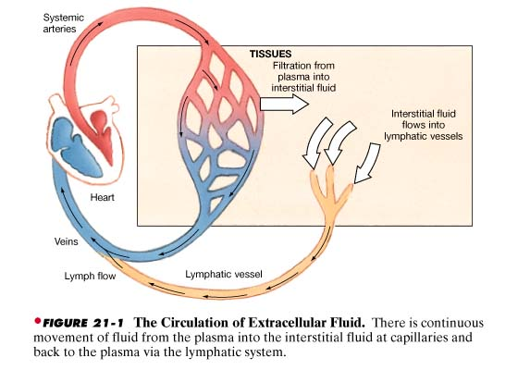
Circulation of ECF
Lymph

Slide 24
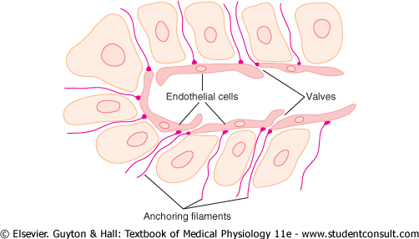
Lymphatic vessels: lymphatic capillaries
Theses are blind sacs that collect excess tissue fluid
They consist of simple squamous epithelium (endothelium)
Cells overlap to form valves within lumen
Cells connected by filaments to structures within tissue
The gaps between the endothelial cells are very large

Slide 25
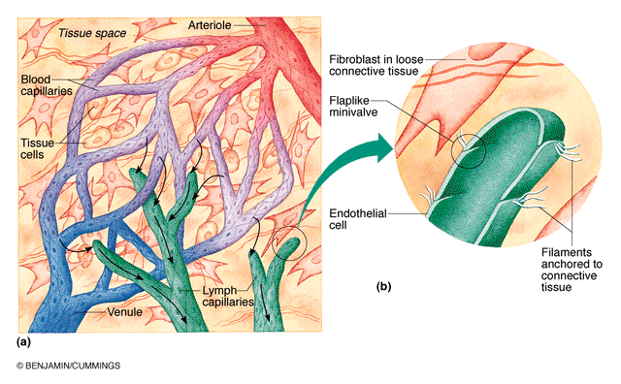

Slide 26
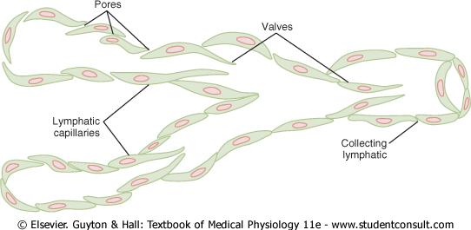
Structure of lymphatic capillaries and a collecting lymphatic, showing also the lymphatic valves

Slide 27
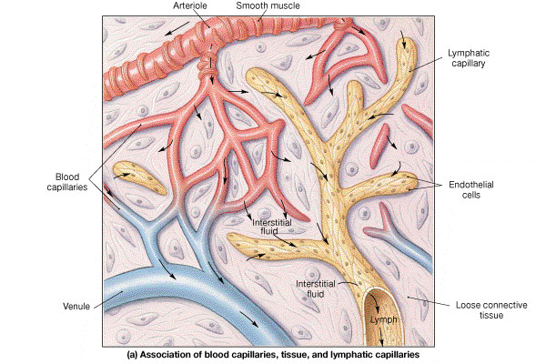

Slide 29
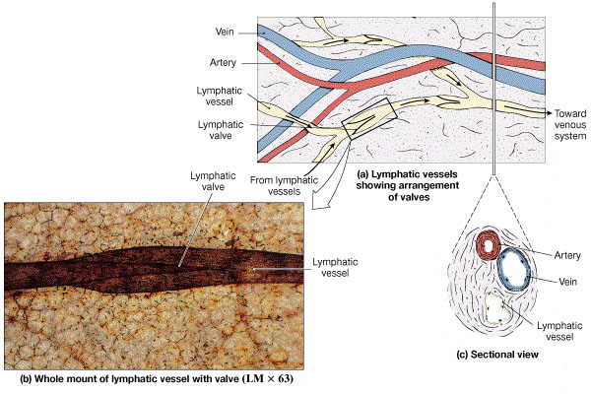

Slide 30
Lymphatic vessels: continued
Lymphatics: These originate as lymph capillaries that unite to form larger vessels
- Resemble veins in structure but with thinner walls, less muscle, less connective tissue, and more valves
- Connect to lymph nodes at various intervals
Lymphatic trunks: These are formed by the union of lymphatics. They carry lymph to lymphatic ducts.
Lymphatic ducts: these are formed by the union of lymphatic trunks. They empty into large veins just before they join the superior vena cava

Slide 31
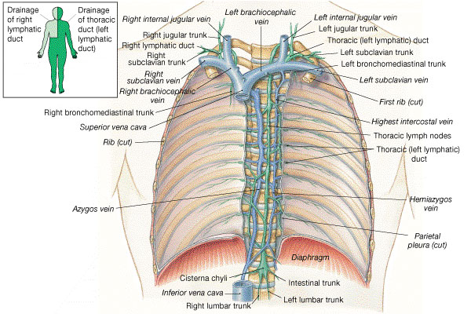

Slide 32
Lymph Circulation
Lymph moves along pressure gradient about 2-4 liters/day
Valves in lymph vessels keep flow moving in one direction
Mechanisms that may contribute to pressure:
“milking” by skeletal muscle (contraction of skeletal muscle puts pressure on lymphatic to move fluid forward)
pressure changes during breathing (inspiration lowers pressure in thoracic cavity, increases pressure in abdominal cavity)
pulsating of neighboring elastic arteries
contraction of smooth muscle in walls of larger lymphatic vessels and ducts

Slide 33
Lymph
Protein: < plasma
Lipids:
cholesterol and phospholipid (lipoproteins)
neutral fat (chylomicrons)
Electrolytes:
similar to plasma
Cells:
lymphocytes of all sizes and maturity
rare monocytes / macrophages
granulocytes following infection

Slide 34
Edema
Edema (swelling in Greek) is abnormal increase in the interstitial fluid volume.
Causes:
1- Increased capillary hydrostatic pressure:
- Congestive hearty failure (cardiac edema); Mechanism (Increased capillary hydrostatic pressure due to increased venous pressure)
- Local arteriolar dilatation
- Local venous occlusion or compression.

Slide 35
Edema
Causes:
2- Decreased capillary colloid osmotic pressure:
- Decreased protein intake (starvation or nutritional edema)
- Liver cirrhosis
- Nephrotic syndrome
3- Increased capillary permeability:
- Destruction of the endothelium (burns)
- Allergic release of histamine
- Infections (bacterial toxins).
4- Impaired lymphatic drainage:
- Destruction of lymphatics (trauma, irradiation)
- Obstruction of lymph flow (e.g., filariasis)

Slide 36
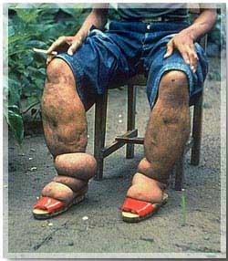
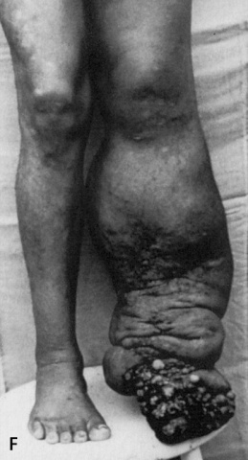
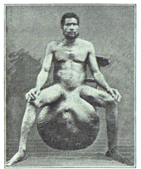
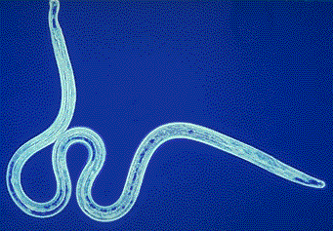
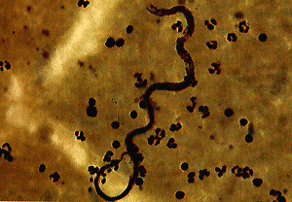
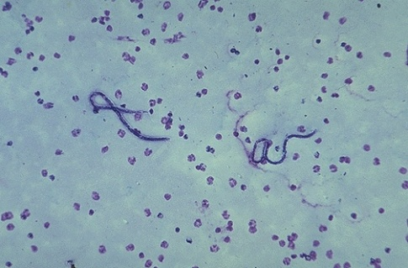
Lymphatic Filariasis
(Elephantiasis)
Parasitic Worms block
the lymphatic system
Transmitted by mosquitoes

