Slide 1
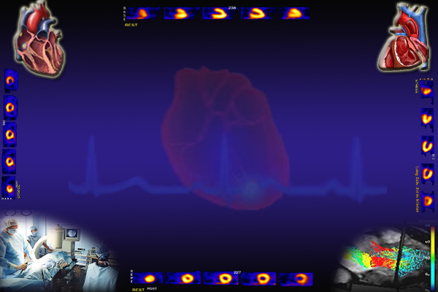
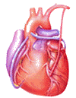
Cardiovascular Block
Coronary Circulation
Dr. Ahmad Al-Shafei, MBChB, PhD, MHPE
Associate Professor in Physiology
KSU

Slide 2
Learning outcomes
After reviewing the PowerPoint presentation, lecture notes and associated material, the student should be able to:
Describe the control of tissue blood flow.
Discuss the importance of control of tissue blood flow.
Describe the distribution of cardiac output during rest and exercise.
Describe pressure-flow relationship in autoregulated vascular beds.
Discuss mechanisms of intrinsic regulation (autoregulation) of tissue blood flow.
Describe extrinsic regulation of tissue blood flow:
    Neural and hormonal control of tissue blood flow.
Discuss the zero flow in areas of left ventricle during systole and increased flow in diastole.
Outline the very high O₂ extraction of the myocardium.
Discuss auto regulation of coronary blood flow.
List metabolites that produce coronary dilatation.
Describe nervous control of coronary blood flow.

Slide 3
Learning Resources
Textbooks :
Guyton and Hall, Textbook of Medical Physiology; 12th Edition.
Mohrman and Heller, Cardiovascular Physiology; 7th Edition.
Ganong’s Review of Medical Physiology; 24th Edition.
Websites:
http://accessmedicine.mhmedical.com/

Slide 4
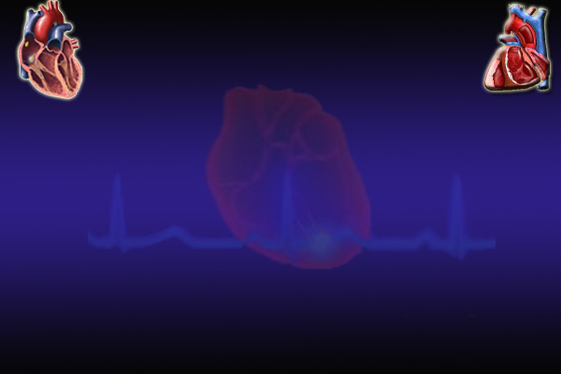
Importance of control of
tissue (local) blood flow
Each tissue receives only a fraction of the total cardiac output.
Each tissue must receive sufficient blood flow for its metabolic needs or necrosis will occur.
Increasing cardiac output increases the work done by the heart to pump blood.
By controlling tissue perfusion so each tissue receives just enough blood, cardiac output and heart work are minimised.

Slide 5
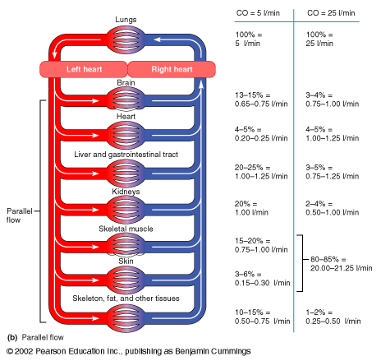
Distribution of cardiac output during rest and exercise
Rest
(5 L/min)
Exercise
(25 L/min)
Brain
Heart
Liver/Gut
Kidneys
Skeletal Muscle
Skin
Skeleton/Fat
13-15%
4-5%
20-25%
20%
15-20%
3-6%
10-15%
3-4%
4-5%
3-5%
2-4%
80-85%
1-2%

Slide 6
Control of tissue (local)
blood flow
Intrinsic regulation of blood flow (autoregulation):
Extrinsic regulation of blood flow: neural and hormonal regulation. Thus, extrinsic regulation of blood flow refers to control by the autonomic nervous system and endocrine system).
Paracrine regulation of blood flow: paracrine regulators are molecules produced by one tissue and help to regulate another tissue of the same region.

Slide 7
Intrinsic regulation of blood flow
(Autoregulation)
Intrinsic mechanisms of control of tissue blood flow are “built-in” mechanisms within individual organs that provide a localized regulation for vascular resistance and blood flow.
The brain and kidneys in particular, utilize these intrinsic mechanisms to maintain relatively constant flow despite fluctuations in blood pressure.

Slide 8
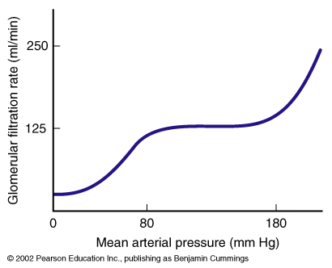
Intrinsic regulation of blood flow
(Autoregulation)

Slide 9
Mechanisms of acute autoregulation
Two main mechanisms have been suggested to explain acute autoregulation.
Myogenic mechanisms.
Local metabolites (metabolic regulation).

Slide 10
I- Myogenic mechanisms or response
This is a direct response of vascular smooth muscle to changes in pressure and can occur in the absence of neural or hormonal influences.
This action is purely myogenic, no mediators required.
This involves stretch sensitive ion channels on the cell membrane.

Slide 11
BP ↑
BP ↓
Smooth muscle contracts
Smooth muscle relaxes
Vessels constrict
Vessels dilate
Protects small vessels
from damage
(important in the brain)
Maintain blood flow

Slide 12
II- Metabolic regulation
(Metabolic Mediators)
Reduced blood flow or increased metabolic rate (MR), allows metabolic products to accumulate.
One or more of the accumulated metabolic products acts as a vasodilator.
Vasodilatation increases local blood flow.
Oxygen may act in the opposite manner, i.e. oxygen acts as a vasoconstrictor.
Reduced blood flow or increased metabolism reduces oxygen concentration.
Reduced oxygen concentration inhibits oxygen mediated vasoconstriction.

Slide 13
II- Metabolic regulation
Effects of oxygen
1. Under resting conditions, O₂ delivered to a tissue by blood is matched by removal to the metabolizing tissue (Steady state O₂ delivery to the tissues)

Slide 14
II- Metabolic regulation
Effects of oxygen
tissues
Extracellular fluid
oxygen
blood flow
capillaries
arteriole
2. Increase in metabolic rate
3. O₂ consumption by the tissues increases.

Slide 15
II- Metabolic regulation
Effects of oxygen
tissues
Extracellular fluid
oxygen
blood flow
capillaries
arteriole
4. O₂ levels in the ECF decrease
5. ↓ [O₂] causes vascular smooth muscle to relax: vasodilation

Slide 16
II- Metabolic regulation
Effects of oxygen
tissues
Extracellular fluid
oxygen
blood flow
capillaries
arteriole
6. Increased blood flow
7. Increased O₂ delivery

Slide 17
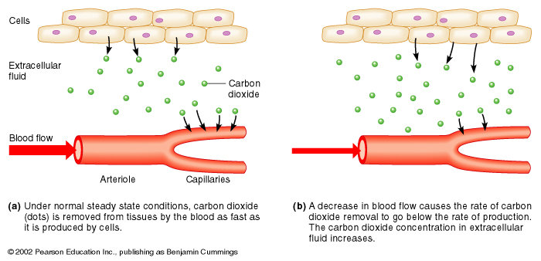
II- Metabolic regulation
Effects of CO₂
Steady State:
CO₂ production = CO₂ removal
Increased MR or ↓ Blood Flow:
CO₂ production > CO₂ removal

Slide 18
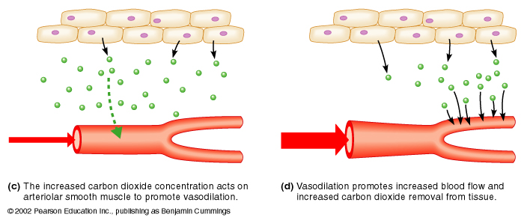
II- Metabolic regulation
Effects of CO₂
↑ [CO₂]: Vasodilation
Increased Blood Flow:
↓ pH; ↑ K⁺; ↑ lactic acid
CO₂ removal increases to
match CO₂ production.
→ vasodilation

Slide 19
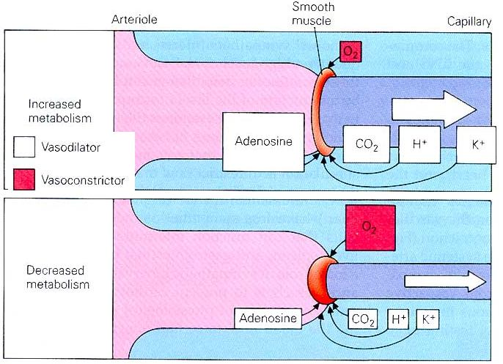
II- Metabolic regulation
Metabolic Mediators

Slide 20
Extrinsic control of tissue blood flow
I - Sympathetic neural control
Most vascular beads are under resting sympathetic constrictor tone.
Increasing the level of sympathetic tone constricts vascular smooth muscle.
Reducing the level of sympathetic tone reduces the level of vascular smooth muscle constriction.
Most sympathetic fibres release noradrenaline that acts on a₁-receptors on the smooth muscle producing contraction.
Thus, stimulation of a₁-receptors by noradrenalin produces vasoconstriction.
The coronary blood vessels and the cerebral vessels in the brain are little altered by sympathetic nerves and are predominantly regulated by local metabolic factors.

Slide 21
Extrinsic control of tissue blood flow
II – Circulating adrenaine
Adrenaline stimulating a₁-receptors contracts vascular smooth muscle.
Blood vessels also contain β₂-receptors which produce vasodilatation when activated.
The blood vessels in most tissues have more a₁-receptors than β₂-receptors so adrenaline (and NA) contracts vascular smooth muscle.
Blood vessels in skeletal muscle have many β₂-receptors so the constrictor actions of adrenaline are minimal.

Slide 22
Unique Characteristics of
cardiac metabolism
The heart of a normal adult utilizes more than 5% of the total body’s consumption of O₂ at rest. Obviously, more amounts are needed during exercise.
Energy production in the heart is almost completely dependent on aerobic metabolism.
The heart extracts a very high fraction (up to 65%) of the O₂ content of the arterial blood flowing through the myocardium even at resting conditions. That is equal to the percentage extracted by skeletal muscles during severe exercise.
Therefore, the heart is characterized by a low venous O₂ reserve.
Thus, the extra O₂ requirements for cardiac work upon stress must be obtained by enhancement of the myocardial blood flow.
In contrast, most other tissues under resting conditions extract only about 25% of the O₂ content of the arterial blood flowing trough them, leaving a considerable O₂ reserve that can be drawn on when a tissue has increased needs.

Slide 23
Control of coronary blood flow (CBF)
Autoregulation:
    Physical factors
    Myogenic.
    Metabolic control
Nervous control:

Slide 24
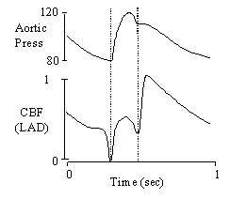
Control of coronary circulation;
coronary blood flow (CBF)
I – Physical Factors
Phasic pattern of coronary flow:
The myocardium receives most of its blood supply during diastole.
Blood supply to the myocardium is substantially reduced during systole for 2 reasons:
1) The major branches of the coronary arteries are compressed by the contractile myocardium.
2) The entrance to the coronary vessels is partially blocked by the open aortic valve.
Thus, most CBF (about 70%) occurs during diastole, driven by the aortic blood pressure, with flow declining as aortic pressure drops. Only about 30% of CBF occurs during systole.

Slide 25
Control of coronary circulation;
coronary blood flow (CBF)
I – Physical Factors
Regional distribution of coronary flow:
Distribution of CBF inside the ventricular wall is also affected by the myocardial compression.
The intra-myocardial pressure is greatest in the inner layers of ventricular wall and declines across the wall toward the outer layers.
Thus, during systole, the sub-endocardial layers of the LV may be deprived of blood flow.
Compensation for this lack of flow during systole is achieved by local vasodilatation of the sub-endocardial vessels during diastole.
Accordingly, the inner region of the myocardium has an equal blood flow to the outer layers under normal conditions.

Slide 26
II – Myogenic coronary autoregulation
The CBF is maintained nearly constant over a range of mean ABP, usually 60 to 140 mm Hg.
Above or below these limits autoregulation fails and CBF increases or decreases in a linear fashion with corresponding increases or decreases in aortic pressure.

Slide 27
III – Metabolic control
The overall flow of blood through the coronary arteries is almost regulated by local intrinsic control of coronary vascular resistance in response to metabolic requirements of the myocardium.
When cardiac work increases, the coronary blood flow is increased and vice versa.
The most important metabolic factor for the heart is O₂.
Coronary vasodilators during increased activity are:
1- Local hypoxia.
2- Adenosine.
3- NO
4- Increased PCO₂.
5- Increased H⁺.
6- Increased K⁺.
7- Prostaglandins.
8- Histamine.

Slide 28
IV – Nervous control
Coronary arteries have both α₁- and β₂-adrenergic receptors.
Stimulation of α₁-receptors cause vasoconstriction, while β₂-receptor activation causes vasodilatation.
Experimental direct stimulation of the cardiac sympathetic fibers causes coronary vasoconstriction, due to the presence of more α- than β- adrenergic receptors in the coronaries.
However, during physiologic conditions of enhanced sympathetic activity, the heart rate and contractility are both activated by sympathetic nerve fibers and blood catecholamines on myocardial β₁-adrenergic receptors. The resulting increase in cardiac metabolites induces vasodilatation that overrides the direct constrictor effect of sympathetic fibers to the vascular wall with a net increased CBF.
Thus, it is evident that such extrinsic control can be overridden by the local cardiac metabolic state.

Slide 29
IV – Nervous control
In cardiac and skeletal muscle: # β-receptors > # α-receptors
→ Adrenaline promotes vasodilation
In most other tissues: # α-receptors > # β -receptors
→ Adrenaline promotes vasoconstriction
α: vasoconstriction
β: vasodilation

