Slide 1
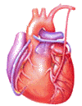
Cardiovascular Block Shock
Dr. Ahmad Al-Shafei, MBChB, PhD, MHPE
Associate Professor in Physiology
KSU

Slide 2
Learning outcomes
After reviewing the PowerPoint presentation, lecture notes and associated material, the student should be able to:
Define shock and state the pathophysiological classification of shock.
Describe cellular effects of adequate tissue perfusion.
Describe changes in blood pressure with hemorrahage.
Discuss the stages of hypovolumeic shock.
Explain how stage III hypovolamic shock might result in major organs failure.
State the different compensatory mechanisms during a hypovolaemic shock.
Explain the role of the arterial barorecptor reflex in maintaining flow to the heart and brain in hemorrhage.
Discuss the endocrine and renal compensatory mechanisms in hypovolaemic shock.

Slide 3
Learning Resources
Textbooks :
Guyton and Hall, Textbook of Medical Physiology; 12th Edition.
Mohrman and Heller, Cardiovascular Physiology; 7th Edition.
Ganong’s Review of Medical Physiology; 24th Edition.
Websites:
http://accessmedicine.mhmedical.com/

Slide 4
Definition of shock
Shock may be defined as a pathophysiological state in which there is widespread, serious reduction of tissue perfusion, which if prolonged, leads to generalized impairment of cellular function.
Reduction of tissue perfusion → decreased availability of oxygen and nutrients → cellular hypoxia and energy deficit → generalized impairment of cellular function → cell death → organ failure → whole body failure → death.

Slide 5
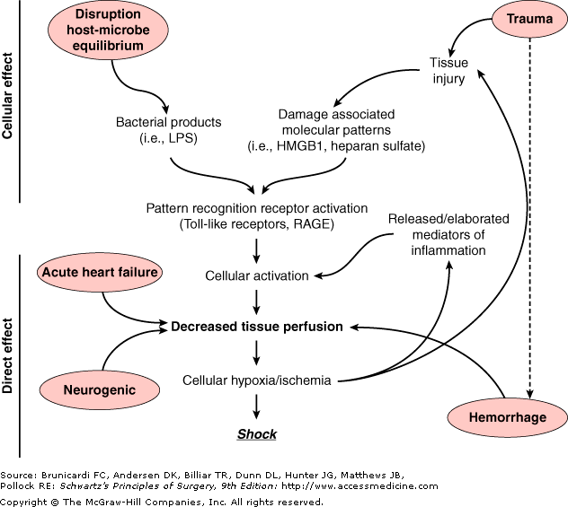
Pathways leading to decreased tissue perfusion and shock
Decreased tissue perfusion can result from hemorrhage/hypovolemia, cardiac failure, or neurologic injury.
Decreased tissue perfusion and cellular injury can then result in immune and inflammatory responses.
Alternatively, elaboration of microbial products during infection or release of endogenous cellular products from tissue injury can result in cellular activation to subsequently influence tissue perfusion and the development of shock.
Endotoxins
endogenous cellular products from tissue injury
Activation of receptors

Slide 6
What drives the blood along the blood vessels after it has left the heart?
Systemic arterial blood pressure.
HEART

Slide 7
Systemic hypotension
NORMAL BP: 120/80
LOW BP < 90/60
Arterial pressure = cardiac output x systemic vascular resistance
Reduction in either component (cardiac output or vascular resistance) without a compensatory elevation of the other will result in hypotension.
DIASTOLE
80 mmHg
120 mmHg
Diastolic BP
Systolic BP
SYSTOLE
Mean systemic arterial BP ~ 93 mmHg

Slide 8
Causes and classification of shock
CLASSIFICATION | CAUSES | SYMPTOMS AND SIGNS
Hypovolaemic shock | Bleeding (internal/external), dehydration → low blood volume → decreased cardiac output → hypotension | hypotension; weak but rapid pulse; cool, clammy skin; rapid, shallow breathing; anxiety, altered mental state
Cardiogenic shock | Heart problems (e.g., myocardial infarction, heart failure) → decreased contractility → decrease in stroke volume → decreased cardiac output → hypotension | as for hypovolaemic shock + distended jugular veins & may be absent pulse
Obstructive shock | Circulatory obstruction (e.g., constrictive pericarditis, cardiac tamponade, pulmonary embolism → reduced blood flow to lungs → decreased cardiac output → hypotension | as for hypovolaemic shock + distended jugular veins & pulsus paradoxus (in cardiac tamponade).
Distributive shock | - Septic shock: infection → release of bacterial toxins → activation of NOS in macrophages → production of NO → vasodilation → decreased vascular resistance→ hypotension - Anaphylatic shock: allergy (release of histamine → vasodilation → decreased vascular resistance→ hypotension - Neurogenic shock: spinal injury → loss of autonomic and motor reflexes → reduction of peripheral vasomotor tone → vasodilation → decrease in peripheral vascular resistance → hypotension | Septic shock: hypotension; fever; warm, sweaty skin Anaphylatic shock: skin eruptions; breathlessness, coughing; localized edema; weak, rapid pulse Neurogenic shock: as for hypovolemic except warm, dry skin

Slide 9
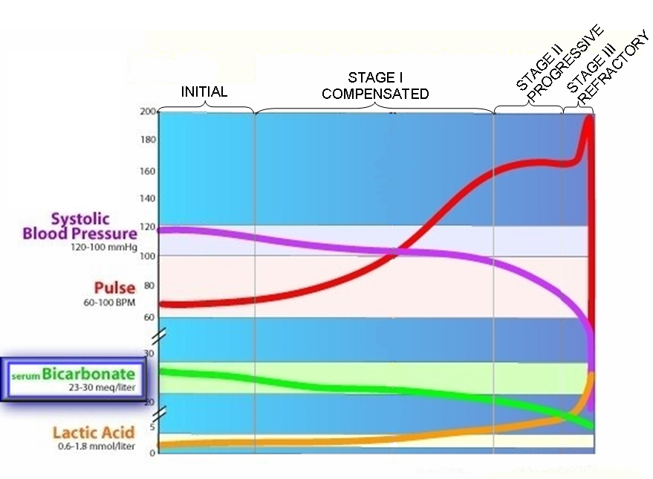
Stages of shock - General

Slide 10
Stages of hypovolaemic shock

Slide 11
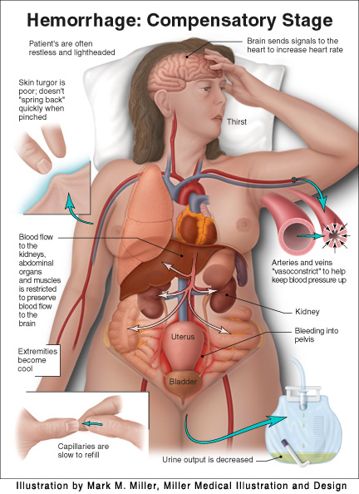
Stages of hypovolaemic shock
STAGE I COMPENSATORY STAGE
10-15% blood loss In healthy individuals, acute blood loss of 10 – 15 % of the normal blood volume (e.g., blood donation) results in activation of the sympathetic nervous system. Compensation is achieved acutely by: Increase in heart rate. Constriction of the arterioles Thus, cardiac output is normal or slightly reduced especially when the patient assumes the erect position Symptoms and signs: Arterial pressure is maintained; pressure decline when the patient assumes the erect position Increase in heart rate Paleness Anxiety See opposite figure.

Slide 12
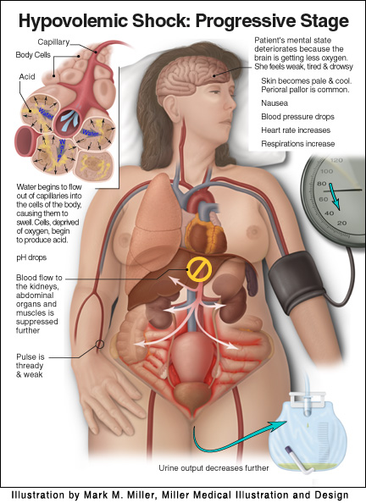
Stages of hypovolaemic shock
STAGE II PROGRESSIVE STAGE (maximal mobilization of compensatory mechanisms)
20 – 40% blood loss When 20-40% of blood volume are lost, cardiac output cannot be maintained and falls markedly, even in the recumbent position. Accordingly, there will be massive activation of the sympathetic nervous system. This results in: → intense arteriolar constriction in the vascular beds of the kidney, gut, and skin → redistribution of blood flow (i.e., centralization of blood flow) with larger fractions going to the vital organs (heart and brain) and smaller fractions going to the kidney, gut, and skin. Despite intense arteriolar constriction, systolic arterial BP declines by 10 to 20 mm Hg. → generalized venoconstriction (increasing blood volume in the central circulation and tending to sustain venous return) Fluid also moves from the interstitial to the intravascular compartment (i.e., reabsorption of tissue fluids).

Slide 13
Stages of hypovolaemic shock
STAGE II PROGRESSIVE STAGE, continued
Symptoms, signs, and complications Systolic arterial blood pressure declines by 10-20 mm Hg Tachycardia (heart rate increases and pulse is thready and weak) Skin is pale and cool (peripheral pallor is common) Deterioration of the mental state because the brain is getting less oxygen. Patient looks weak, tired and drowsy. Patient may show anxiety, aggressiveness, and restlessness. Thirst. Oliguria (urine output is decreased). Angina may occur in patients who have intrinsic coronary vascular disease. pH drops and metabolic acidosis develops due to increased anaerobic glycolysis.

Slide 14
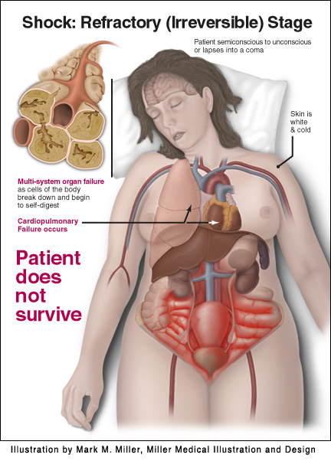
Stages of hypovolaemic shock
STAGE III REFRACTORY STAGE Irreversible stage Decompensated stage
> 40% blood loss The compensatory mechanisms are maximally mobilized in stage II. Thus, small additional losses of blood (>40 %) can result in life-threatening reductions in cardiac output, blood pressure, and tissue perfusion. Blood flow to heart, brain and kidney is further reduced → severe ischemia and irreversible tissue damage → this may result in impaired organ function and death. The severe vasoconstriction may itself become a complicating factor and initiate a vicious cycle. Impaired coronary perfusion → cardiac ischemia → depression of cardiac function → further lowering of cardiac output. Prolonged renal ischemia → acute tubular necrosis → may lead to prolonged post-shock renal insufficiency. Bowel ischemia → breakdown of the mucosal barrier. This may lead to entry of bacteria and toxins into the circulation. Reduced blood flow to the vasomoter centers in the medulla depresses the activity of compensatory reflexes. Thus, stage III is complicated by major organs failure.

Slide 15
Stages of hypovolaemic shock
STAGE III REFRACTORY STAGE, continued
> 40% blood loss The factors that determine the ultimate outcome include: Duration of stage III. Severity of tissue anoxia. Age and condition of the patient.

Slide 16
Compensatory mechanisms during hypovolaemic shock
Cardiovascular.
Respiratory.
Endocrine.
Renal.

Slide 17
Cardiovascular and respiratory compensatory mechanisms during hypovolaemic shock

Slide 18
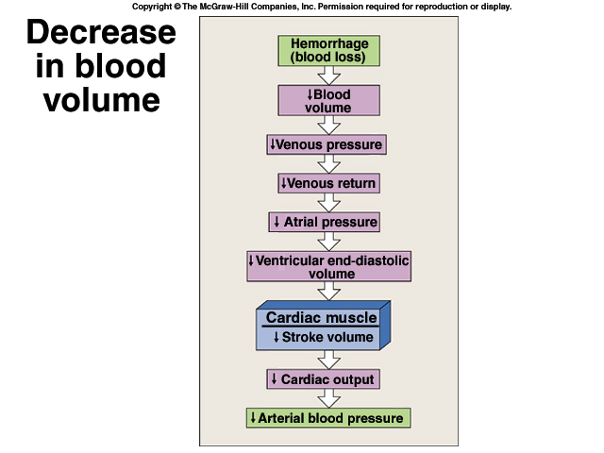
Compensatory mechanisms during hypovolaemic shock
I. Arterial baroreceptor reflex

Slide 19
Compensatory mechanisms during hypovolaemic shock
I. Arterial baroreceptor reflex
Reduction in arterial BP during e.g., a hemorrhage decreases the
stimulation of the baroreceptors in the carotide sinuses and aortic arch
↓ Parasympathetic
(vagal) activity
↑ Sympathetic
activity
↑ HR
↑ SV
↑ TPR
↑ MAP
Flow to the heart and brain is maintained; reductions in flow to other organs.

Slide 20
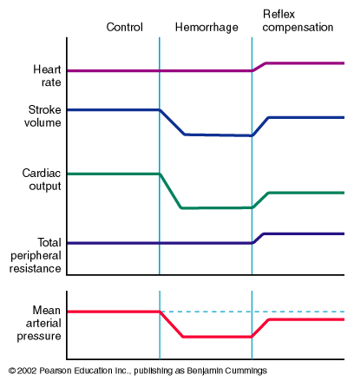
Compensatory mechanisms during hypovolaemic shock
I. Arterial baroreceptor reflex
Control
Haemorrhage
Reflex
Compensation
Heart rate
Stroke volume
↓ EDV
Cardiac output
Total peripheral resistance
Mean arterial blood pressure
↓ CO

Slide 21
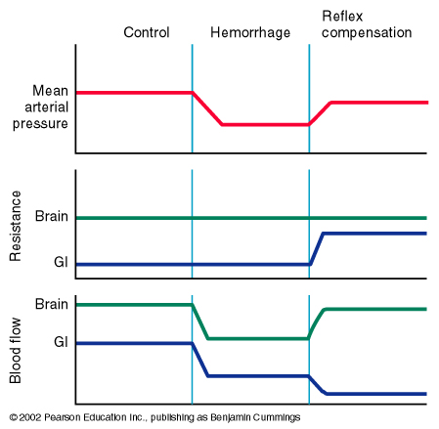
Compensatory mechanisms during hypovolaemic shock
I. Arterial baroreceptor reflex
Control
Haemorrhage
Reflex
Compensation
Mean arterial blood pressure
Brain
Resistance
Gut
Brain
Blood Flow
Gut
This can
Become problematic.
Flow to the heart and brain is maintained; reductions in flow to other organs.

Slide 22
↓ Blood flow to organs other
than the heart and brain
→ ↑ CO₂ levels in the under-perfused tissues
→ Relaxation of vascular smooth muscle
↑ [CO₂]: Vasodilation

Slide 23
Progressive and refractory
hypovolaemic shock
↓ Blood flow to organs other
than the heart and brain
→ ↑ CO₂ levels in the under-perfused tissues
→ Relaxation of vascular smooth muscle
→ Overrides the effects of the sympathetic innervation
→ ↓ Resistance to flow
→ ↓ Mean arterial blood pressure
→ ↓ Blood flow to the heart / brain
→ Death

Slide 24
Compensatory mechanisms during hypovolaemic shock
II. Arterial chemoreceptor reflex
Reductions in mean arterial blood pressure (MABP) below 60 mmHg do not evoke any additional responses through the baroreceptor reflex.
However, low arterial BP indirectly stimulates peripheral chemoreceptors (aortic bodies, carotid bodies, heart) that sense changes in pO2, pCO2, and pH through tissue hypoxia and lactacidosis.
This results in:
Enhancement of the exisiting vasoconstriction
Respiratory stimulation

Slide 25
Endocrine and renal
compensatory mechanisms during hypovolaemic shock

Slide 26
Compensatory mechanisms during hypovolaemic shock
Endocrine and renal compensatory mechanisms
Release of hormones that initiate vasoconstriction.
Renal conservation of salt and water.
Stimulation of hematopoeisis by erythropoietin.

Slide 27
Compensatory mechanisms during hypovolaemic shock
Endocrine and renal compensatory mechanisms
Endocrine and renal compensatory mechanisms
↑ Circulating vasoconstrictors | Stimulation of sympathetic nervous system → release of epinephrine, norepinephrine from the adrenal medulla (sympatho-adrenal axis) . Epinephrin is released almost exclusively from adrenal medulla where as norepinephrin is released from adrenal medulla and sympathetic nerve endings. → Vasoconstriction.
 | ADH is actively secreted by the posterior pituitary gland in response to hemorrhage. Thus, hemorrhage → stimulates posterior pituitary → synthesis and release of vasopressin (ADH). ADH is potent vasoconstrictor. It also stimulates reabsorption of water.
 | ↓ renal perfusion → secretion of renin from juxtaglomerular apparatus → generates angiotensin II → Angiotensin II is a powerful vasoconstrictor
Stimulation of hematopoeisis | ↓ blood volume & hypoxia → synthesis of erythropoeitin (EPO) → hematopoeisis.

Slide 28
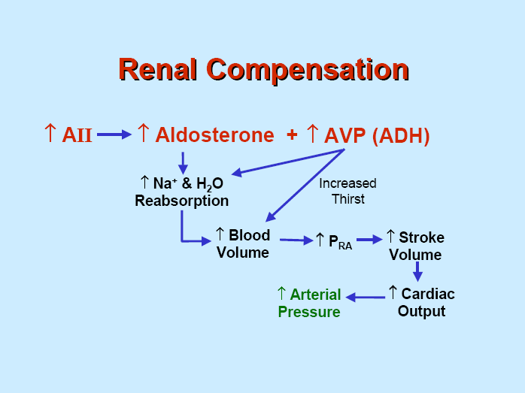
Compensatory mechanisms during hypovolaemic shock
Endocrine and renal compensatory mechanisms
Endocrine and renal compensatory mechanisms
Renal conservation of salt and water | Vasopressin → ↑ water reabsorption → ↑ blood volume → ↑ arterial pressure. Angiotensin II → release of aldosterone → ↑ salt reabsorption → ↑ blood volume → ↑ arterial pressure. ↓ arterial pressure in kidney → ↓ decreases glomerular filtration rates and thereby decreases the excretion of water and electrolytes directly

