Slide 1
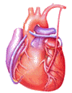
Cardiovascular Block Cardiac Electric Activity
Dr. Ahmad Al-Shafei, MBChB, PhD, MHPE
Associate Professor in Physiology
KSU

Slide 2
Learning outcomes
After reviewing the PowerPoint presentation, lecture notes and associated material, the student should be able to:
State and define the main electrical and mechanical properties of the heart:
Autorhythmicity.
Excitability.
Conductivity.
Contractility.
Describe the structure and function of the different parts of the conducting system of the heart.
Discuss the genesis of the resting membrane potential in the heart.
Compare and contrast the ionic currents during the different phases of the action potential in myocytes.
Compare and contrast fast-response and slow-response action potentials in the heart.
Describe the physiological significance of the plateau phase and refractory period of a ventricular working muscle cell.
Discuss the electrical activity of the pacemaker.
Describe the sequence of normal conduction in the heart.
Define intrinsic heart rate.
Discuss regulation of heart rate under different physiological conditions.

Slide 3
Learning Resources
Textbooks :
Guyton and Hall, Textbook of Medical Physiology; 12th Edition.
Mohrman and Heller, Cardiovascular Physiology; 7th Edition.
Ganong’s Review of Medical Physiology; 24th Edition.
Websites:
http://accessmedicine.mhmedical.com/

Slide 5
How the heart performs its function?
The heart has four basic properties which are essential for its functioning as the central pump of the CVS. These are:
1. Autorhythmicity
2. Conductivity
3. Excitability
4. Contractility

Slide 6
How the heart performs its function?
Contractions in both skeletal & cardiac muscles are triggered by a rapid change in voltage called “action potential”. However, action potentials in cardiac muscle are different from skeletal muscle in that:
They are self-generating
They are conducted directly from cell to cell
They have longer duration

Slide 7
Ultrastructure of myocyte
(the contractile, working cell)

Slide 8
The resting membrane potential
(RMP)
AMP
Voltmeter
To oscilloscope
Cardiac Cell

Slide 9
The intracellular potential of the resting myocyte is found to be –80 mV to –90 mV (i.e., 80 – 90 mV lower than the extra cellular potential). This is called the resting membrane potential (RMP).
In atrial and ventricular cells, this RMP is stable until external stimulation (excitation) is applied.
In the sino-atrial node cells in particular, and many conduction fibers, the RMP is not stable, drifting towards zero with time.

Slide 10
Electrical potentials arise from:
Differences in the concentrations of ions across the membrane.
The presence of selective ion-conducting channels spanning the membrane, namely K⁺, Na⁺, and Ca²⁺.

Slide 11
Characteristics of a resting ventricular muscle
Extracellular
Intracellular
K⁺
4 mM/L
140 mM/L
Na⁺
140 mM/L
10 mM/L
Ca⁺⁺
1.2 mM/L
0.0001 mM/L
Ion pumps and exchangers establish differences in ions concentration across the cell membrane.

Slide 12
Potassium: generator of the resting membrane potential
IN
OUT
K⁺
K⁺
140 mM
4 mM
Negative intracellular ions mainly organic phosphates and intracellular proteins cannot accompany the K⁺ ions.

Slide 13
Potassium: generator of the resting membrane potential
IN
OUT
_
_
_
_
_
_
_
+
+
+
+
+
+
+
K⁺
K⁺
140 mM
4 mM
Negative intracellular ions mainly organic phosphate and intracellular proteins cannot accompany the K ions.

Slide 14
Potassium equilibrium potential
IN
OUT
_
_
_
_
_
_
_
K⁺
K⁺
140 mM
4 mM

Slide 15
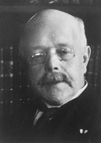
The Nernst equation
Describes the balance of electrical and chemical forces across a cell membrane
Walther Hermann Nernst
Nobel Prize 1920

Slide 16
The Nernst equation
[X]_{e}
E_{m} = 61.5 log₁₀
[X]_{i}
Note the subscript ‘e’ is usually replaced by ‘o’.

Slide 17
Equilibrium Potentials
Cell Membrane
extracellular intracellular
K⁺ = 4mM K⁺ = 140mM
Na⁺ = 140mM Na⁺ = 10mM
Let the membrane be permeable to K⁺
E_{K} = 61.5 log₁₀ 4
140
= -95 mV
Let the membrane be permeable to Na⁺
E_{Na} = 61.5 log₁₀ 140
10
= +71 mV

Slide 18
RMP is not equal to E_{K} due to background currents
EXTRA-CELL.
INTRA-CELL.
+
+
+
+
+
+
+
_
_
_
_
_
_
_
Na⁺
i_{b}
i_{k}
K⁺

Slide 19
Action potential and ionic currents in cardiac cells
Cardiac action potentials can be broadly classified into tow types, termed fast-response and slow-response potentials.
Atrial, ventricular and His-Purkinje cells have fast-response action potentials, and sinus node and atrioventricular (AV) node have slow-response action potentials.

Slide 20
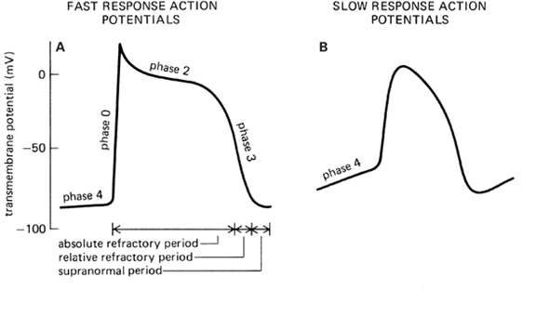
Action potential and ionic currents in cardiac cells
Fast response action potentials are characterized by:
A rapid depolarization (phase 0) with a substantial overshoot (positive inside voltage),
A rapid reversal of the overshoot potential (phase 1),
A long plateau (phase 2), and
A repolarization (phase 3) to
A stable, resting membrane potential (phase 4).
Slow response action potentials are characterized by:
A slower initial depolarization phase,
A lower amplitude overshoot,
A shorter and less stable plateau phase, and
A repolarization to an unstable, slowly depolarizing "resting" potential

Slide 21
Action potentials from different areas of the heart
VENTRICULULAR
CELL
SAN
1
2
0
0
0
3
0
3
-50
-50
4
MEMBRANE POTENTIAL (mV)
4
-100
-100

Slide 22
Fast response action potentials
Phase
Mechanical Response
0 = Rapid Depolarization
(inward Na⁺ current)
1
0
2
1 = partial repolarization
2 = Plateau
(inward Ca⁺⁺ current)
0
MEMBRANE POTENTIAL (mV)
3 = Repolarization
(outward K⁺ current)
3
4 = Resting Potential
4
-90
TIME

Slide 23
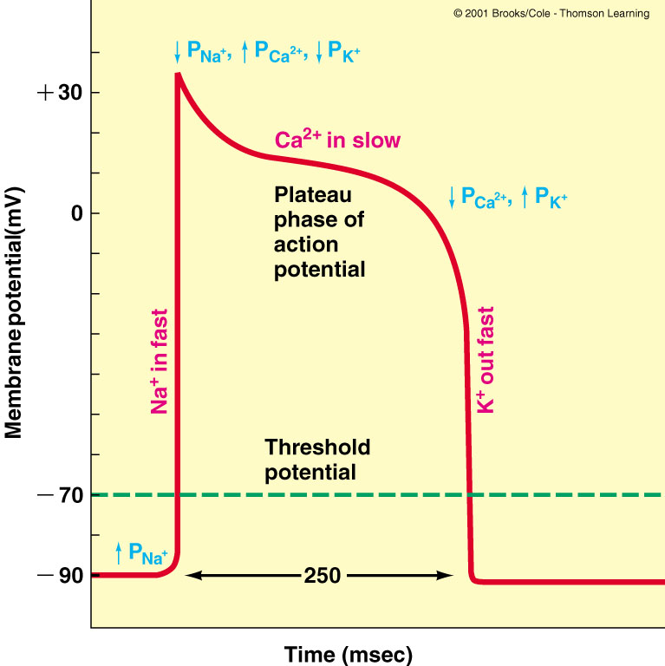
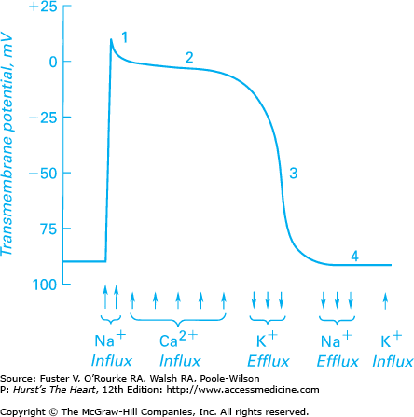

Slide 24
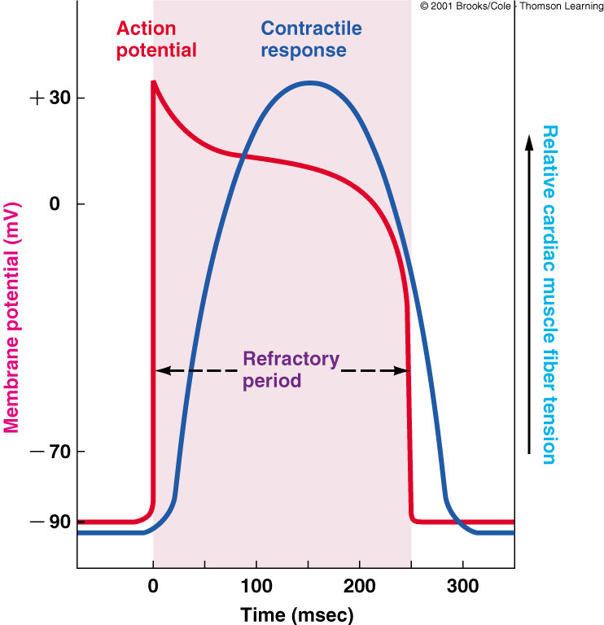
Refractory periods
Importance of the long plateau
Cardiac muscle cannot be tetanized because the duration of the effective refractory period is approximately equal to the duration of the mechanical event.

Slide 25
Electrical activity of the pacemaker

Slide 26
The decay of pacemaker potential with time is caused by:
A small current of Na⁺ flow into the cell. This current may be partly a specialized pace maker current termed i_{f} and partly the inward background current i_{b} (i_{f} and i_{b}).
Membrane permeability to K⁺ gradually falls. As a result the outward background current i_{k} falls progressively allowing the inward currents (i_{f} and i_{b}) to dominate increasingly.
Ca²⁺ current in the later part.

Slide 27
The decay of pacemaker potential with time is caused by:
K⁺
i_{b}
i_{f}
i_{Ca}
OUT
IN
i_{K}
Na⁺
Ca⁺⁺

Slide 28
Pacemaker potential
intracellular
[Na⁺]_{e} high
[K⁺]_{e} low
[Ca²⁺]_{e} high
[Na⁺]_{i} low
[K⁺]_{i} high
[Ca²⁺]_{i} low
extracellular
fluid

Slide 29
Pacemaker potential
1. ↓ P_{K}; ↑ P_{Na}
1.
Closure of K⁺ channels.
Opening of “funny”
channels (Na⁺)
intracellular
[Na⁺]_{e} high
[K⁺]_{e} low
[Ca²⁺]_{e} high
[Na⁺]_{i} low
[K⁺]_{i} high
[Ca²⁺]_{i} low
Na⁺
K⁺
extracellular
fluid

Slide 30
Pacemaker potential
1. ↓ P_{K}; ↑ P_{Na}
1.
2.
Closure of K⁺ channels.
Opening of “funny”
channels
2. ↑ P_{Ca}
Opening of voltage-
gated Ca⁺⁺ channels
(T-type channels)
Closure of funny channels
T channel
Ca⁺
K⁺
Na⁺

Slide 31
Pacemaker potential
1. ↓ P_{K}; ↑ P_{Na}
1.
2.
3.
Closure of K⁺ channels.
Opening of “funny”
channels
2. ↑ P_{Ca}
Opening of voltage-
gated Ca⁺⁺ channels
(T-type channels)
Closure of funny channels
T channel
3. ↑↑ P_{Ca}
Ca⁺
Opening of voltage-
gated Ca⁺⁺ channels
(L-type channels)
K⁺
Na⁺
Closure of T- type Ca⁺⁺ channels
Ca⁺
L channel

Slide 32
1. ↓ P_{K}; ↑ P_{Na}
Pacemaker potential
Closure of K⁺ channels.
Opening of “funny”
channels
1.
2.
3.
4.
2. ↑ P_{Ca}
Opening of voltage-
gated Ca⁺⁺ channels
(T-type channels)
Closure of funny
channels
4. ↑ P_{K;} ↓ P_{Ca}
Opening of voltage-
gated K⁺ channels
Closure of voltage-
dependent Ca⁺⁺
channels (L-type)
Ca⁺
3. ↑↑ P_{Ca}
Opening of voltage-
gated Ca⁺⁺ channels
(L-type channels)
K⁺
Na⁺
Closure of T- type Ca⁺⁺
channels
Ca⁺

Slide 33
Pacemakers
(in order of their inherent rhythm)
Sino-atrial (SA) node
Atrio-ventricular (AV) node
Bundle of His
Bundle branches
Purkinje fibers

Slide 34
Cardiac pacemakers
The sinoatrial has the fastest intrinsic rate (~90-100 beats/min) and is the normal pacemaker
The atrioventricular node is the next fastest (~40-60 beats/min) followed by cells in the bundle of His (15-30).
The fastest pacemaker normally drives the heart and suppresses other pasemakers (overdrive suppression).
A beat generated outside the normal pacemaker is an ectopic beat.
The site that generates an ectopic beat is known as an ectopic focus (foci pl.) or ectopic pacemaker.

Slide 35
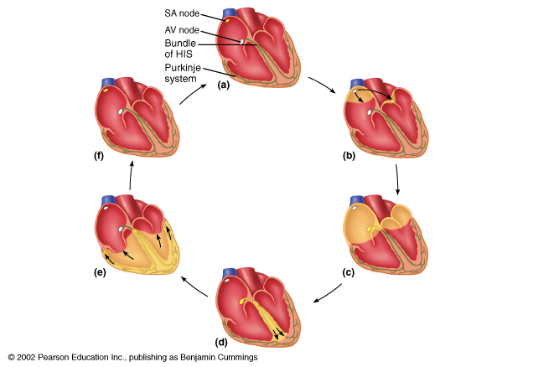
Conduction of the action potential in the heart
a. AP is generated in the SA node

Slide 36
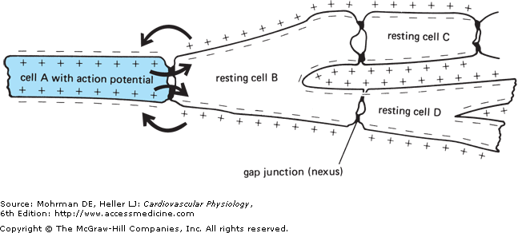
Conduction of the action potential in the heart
(Cell to cell conduction of action potential)

Slide 37
1. AP is initiated in the SA node
2. AP is conducted through the atria.
Very rapid.
Large cells

Slide 38
1. AP is generated in the SA node
2. AP is conducted through the atria.
Very rapid.
Large cells.
b. AP are
conducted
throughout
the atria
very rapid
large cells
Fibrous septum
3. Conduction slows at the AV node and delayed for 0.1 – 0.15 seconds.
- Small cells.
- Effects of sympathetic and parasympathetic stimulation on AV nodal conductivity.
SA node versus AV node
(frequency and refractory period)

Slide 39
1. AP is generated in the SA node
2. AP is conducted through the atria.
Very rapid.
Large cells.
b. AP are
conducted
throughout
the atria
very rapid
large cells
Fibrous septum
3. Conduction slows at the AV node.
-Small cells.
4. AP travels rapidly through the bundle of His and bundle branches
SA node versus AV node
(frequency and refractory period)

Slide 40
1. AP is generated in the SA node
2. AP is conducted through the atria.
Very rapid.
Large cells.
b. AP are
conducted
throughout
the atria
very rapid
large cells
5. AP spreads through the ventricles (bottom to top)
Contraction (apex to top)
Fibrous septum
3. Conduction slows at the AV node.
-Small cells.
4. AP travels rapidly through the bundle of His and bundle branches
SA node versus AV node
(frequency and refractory period)

Slide 41
1. AP is generated in the SA node
2. AP is conducted through the atria.
Very rapid.
Large cells.
6. Rest
b. AP are
conducted
throughout
the atria
very rapid
large cells
5. AP spreads through the ventricles (bottom to top)
Contraction (apex to top)
Fibrous septum
3. Conduction slows at the AV node.
-Small cells.
4. AP travels rapidly through the bundle of His and bundle branches
SA node versus AV node
(frequency and refractory period)

Slide 42
Conduction velocity (CV) in heart
CV depends on current spread, hence, depends on diameter and number of gap junctions between cells (larger diameter, more gap junctions = faster conduction).
Purkinje fibres: very large diameter.
AV node and bundle (Bundle of His): small diameter and few gap junctions.
Approximate CV:
SA node 0.05 m/sec
Atria 0.3m/sec (internodal pathway 1.0m/sec)
AV node 0.05m/sec
Bundle of His: 1 m/sec
Purkinje system: 4 m/sec
Ventricular muscle: 1 m/sec

Slide 43
Cardiac rhythm
The term rhythm refers to the regularity of:
Initiation of cardiac impulses.
Sequence of excitation of the heart.
i.e., regularity of the electrical activity of the heart.
The normal cardiac rhythm is called sinus rhythm.
Any variation from the normal rhythm (sinus rhythm) is termed: a cardiac arrhythmia or dysrhythmia.

