Slide 1
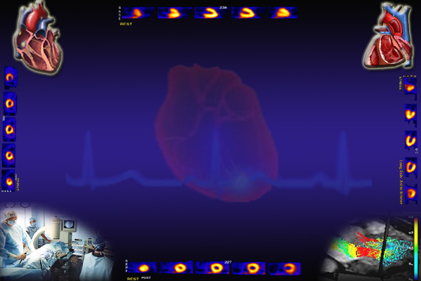
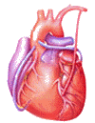
Cardiovascular Block
Electrocardiogram (ECG)
Dr. Ahmad Al-Shafei, MBChB, PhD, MHPE
Associate Professor in Physiology
KSU

Slide 2
Learning outcomes
After reviewing the PowerPoint presentation, lecture notes and associated material, the student should be able to:
Describe the procedure of recording an electrocardiogram.
Define the different ECG leads.
State Einthoven’s law and describe its physiological significance.
Discuss the ECG waves, intervals and segments.
Calculate the electrical axis of the heart and discuss its diagnostic uses.
Discuss usefulness of ECG.
Define and interpret normal sinus rhythm.

Slide 3
Learning Resources
Textbooks :
Guyton and Hall, Textbook of Medical Physiology; 12th Edition.
Mohrman and Heller, Cardiovascular Physiology; 7th Edition.
Ganong’s Review of Medical Physiology; 24th Edition.
Websites:
http://accessmedicine.mhmedical.com/

Slide 4
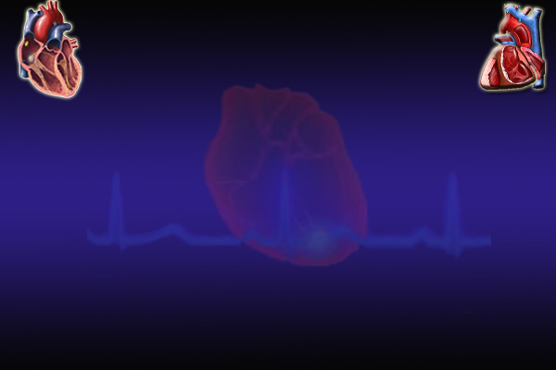
The Electrocardiogram
(ECG/EKG)
The electrocardiogram (ECG) is a record of the electrical activity of the heart from the surface of the body.
This is possible as the body tissues function as electrical conductors because they contain electrolytes.
P
T
Q
S

Slide 5
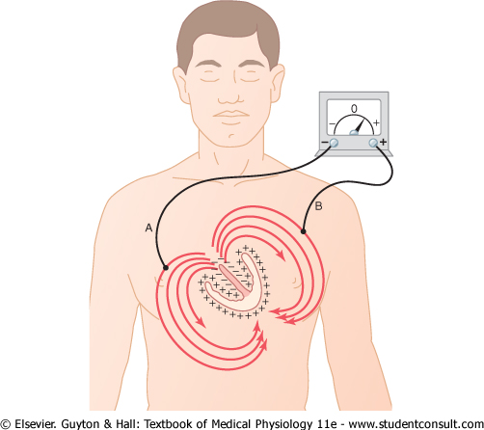
The Electrocardiogram
(ECG/EKG)

Slide 6
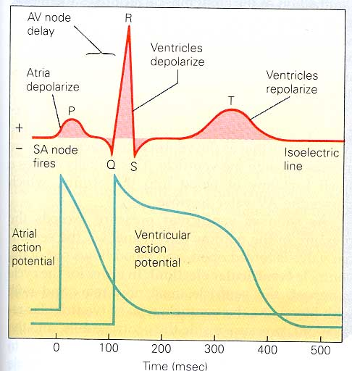
The Electrocardiogram
(ECG/EKG)

Slide 7
The Electrocardiogram
(ECG/EKG)
If a recording electrode is applied on any point on the surface of the trunk, it will detect electrical waves reflecting the electrical activity in the heart. These electrical waves may be as small as 1 mv and are amplified, recorded on ECG paper / monitor / computer and stored.
A positive wave is recorded when depolarization is propagating towards the electrode or when repolarization is propagating away from the electrode.
A negative wave is recorded when depolarization is propagating away from the electrode or when repolarization is propagating towards the electrode.
When there are no propagating potentials, no waves are recorded and the recording needle will be on the line of zero potential, which is called the isoelectric line.

Slide 8
The active
and reference electrodes
For recording an ECG, two electrodes are required.
One of the them is the active electrode (also called searching electrode or exploring electrode) which is applied to a recoding point on the surface of the body.
The other is the reference electrode which serves a reference to the active electrode.

Slide 9
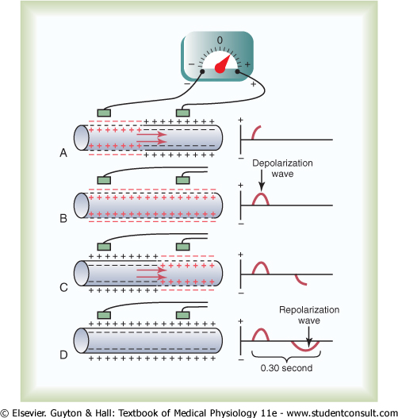

Slide 10
Recording points
on the body surface
By convention, there are nine standard points on the surface of the body from which an ECG should be recorded.
Six points are on the chest wall and the other three points are on the limbs.

Slide 11
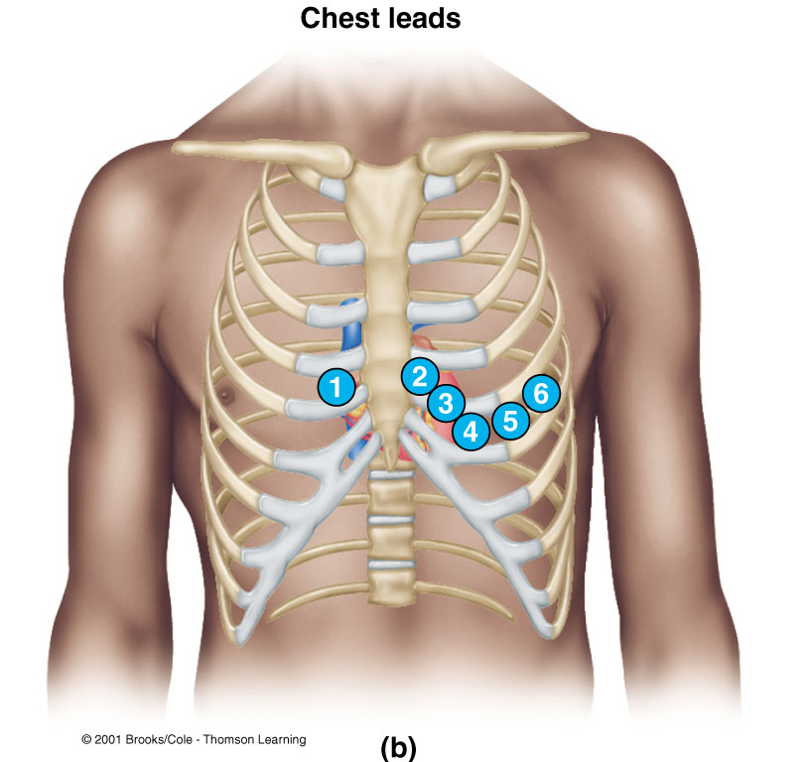
Chest points
V₁: at the right fourth intercostals space near the sternum.
V₂: at the left fourth intercostals space near the sternum.
V₃: midway between V₂ and V₄.
V₄: at the left fifth intercostals space at the midcalvicular line.
V₅: at the left fifth intercostals space at the anterior axillary line.
V₆: at the left fifth intercostals space at the midaxillary line.

Slide 12
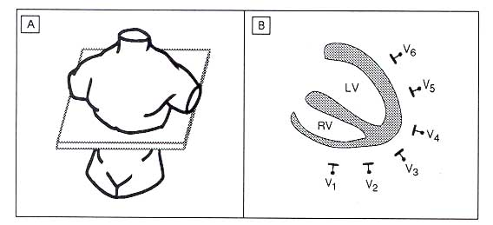
Chest points

Slide 13
Limb points
VL: at the junction of the left arm with the trunk. Any point on the left upper limb has the same potential.
VR: at the junction of the right arm with the trunk. Any point on the right upper limb has the same potential.
VF: at the junction of the left lower limb with the trunk. Any point on the left or right lower limbs has the same potential.

Slide 14
ECG leads
An ECG lead is the ECG record obtained when the recording electrodes are placed at specific points on the body.

Slide 15
Unipolar ECG leads
These are the ECG records obtained when the reference electrode is at zero potential. The active electrode is applied to the recording points on the body surface.
There are six standard unipolar chest leads recorded from the six standard chest points and designated as V1, V2, V3, V4, V5 and V6.
There are other three standard unipolar limb leads recorded from the standard limb points and designated as aVL, aVR, aVF.

Slide 16
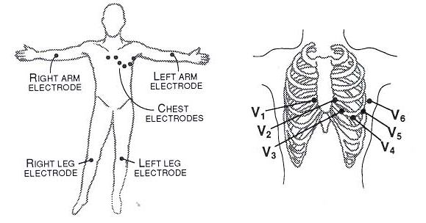
Unipolar ECG leads

Slide 17
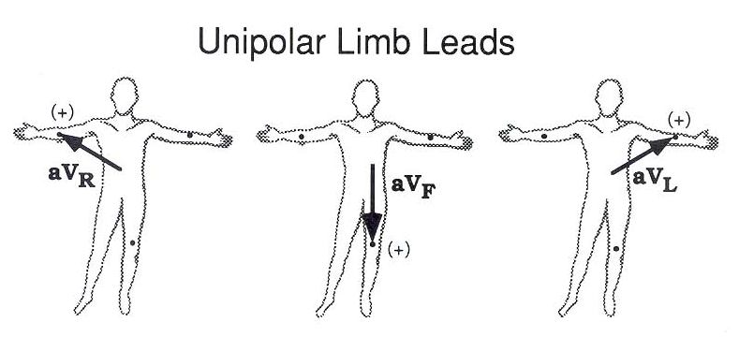
Unipolar ECG leads

Slide 18
Bipolar ECG leads
These are the ECG records obtained when the active electrode is applied to a recording point and the reference electrode is applied to another recording point.
The ECG will be a record of the changes in electrical potential at the active electrode relative to the reference electrode.

Slide 19
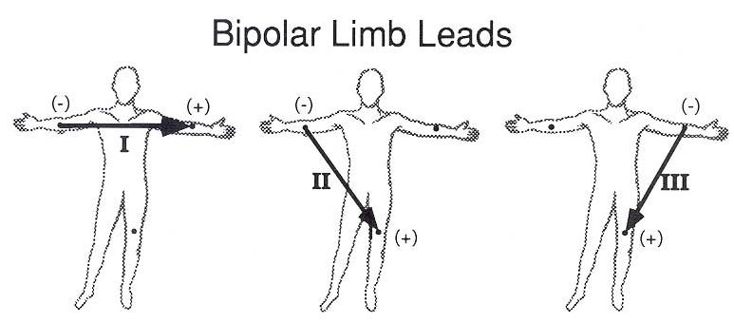
Bipolar ECG leads
Lead I: records the potential between left arm and right arm. The active electrode is at VL and the reference electrode is at VR.
Lead II: records the potential between left leg and right arm. The active electrode is at VF and the reference electrode is at VR.
Lead III: records the potential between left leg and left arm. The active electrode is at VF and the reference electrode is at VL.

Slide 20
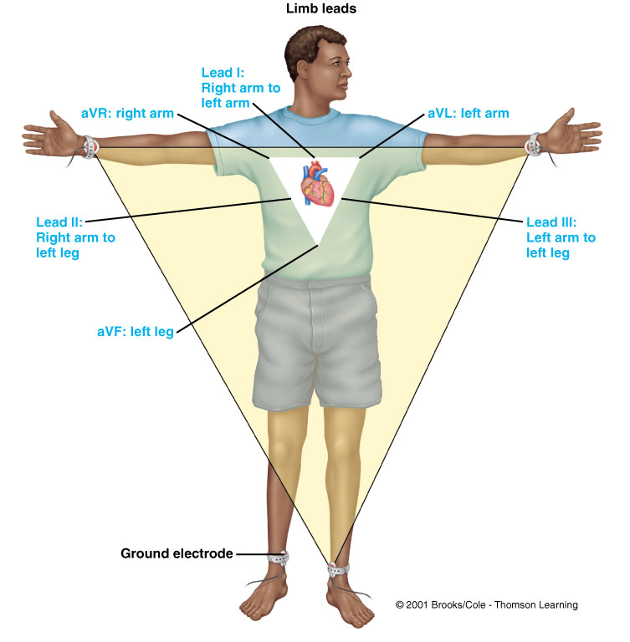

Slide 21
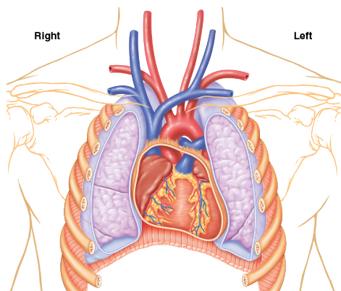
Einthoven’s Law
In the ECG, at any given instant, the potential of any wave in lead II is equal to the sum of the potentials in lead I and III.
Lead I = E_{LA}- E_{RA}
Lead II = E_{LL}- E_{RA}
Lead III = E_{LL}- E_{LA}
E = electrical potential
E_{I} + E_{III} = E_{II}

Slide 22
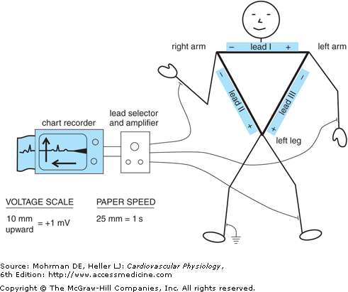
Einthoven’s Law
In the ECG, at any given instant, the potential of any wave in lead II is equal to the sum of the potentials in lead I and III.
If the electrical potentials of any two of the three bipolar limb electrocardiographic leads are known at any given instant, the third one can be determined mathematically by simply summing the first two.

Slide 23
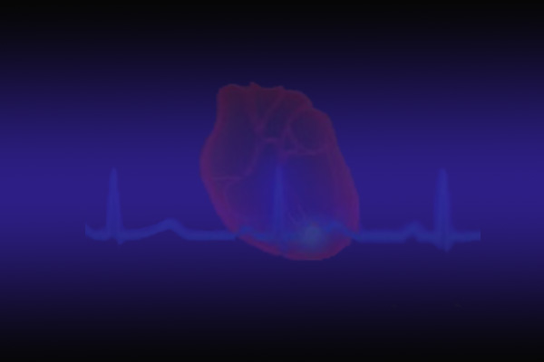
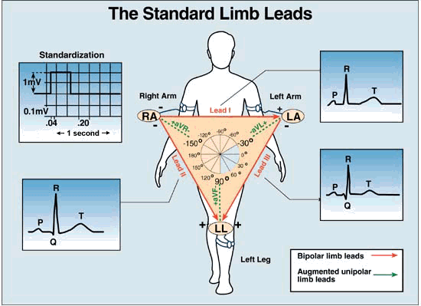

Slide 24
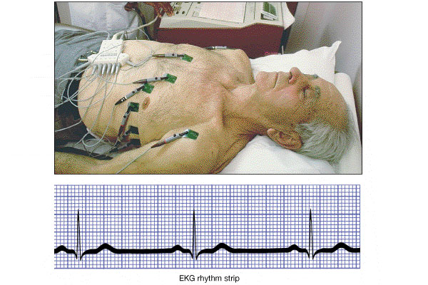
Recording an ECG

Slide 25
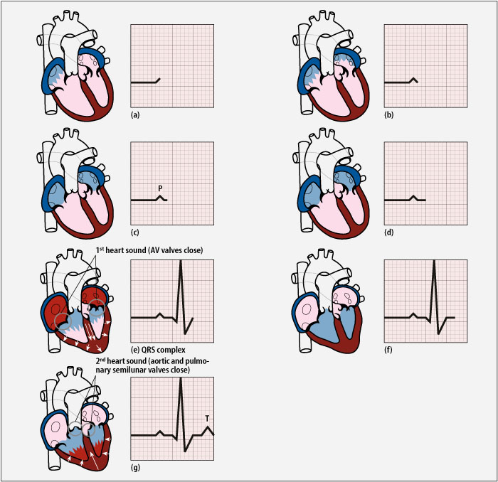
ECG waves
The impulse originates at the SA node and spreads to the atria
Atrial depolarisation generates a ‘P wave’ on the ECG
The impulse is delayed at the
AV node
P

Slide 26
The impulse then spreads to ventricles generating a QRS complex
Ventricles uniformly depolarised - ST segment
R
Q
S
Ventricles repolarize
T wave
T

Slide 27
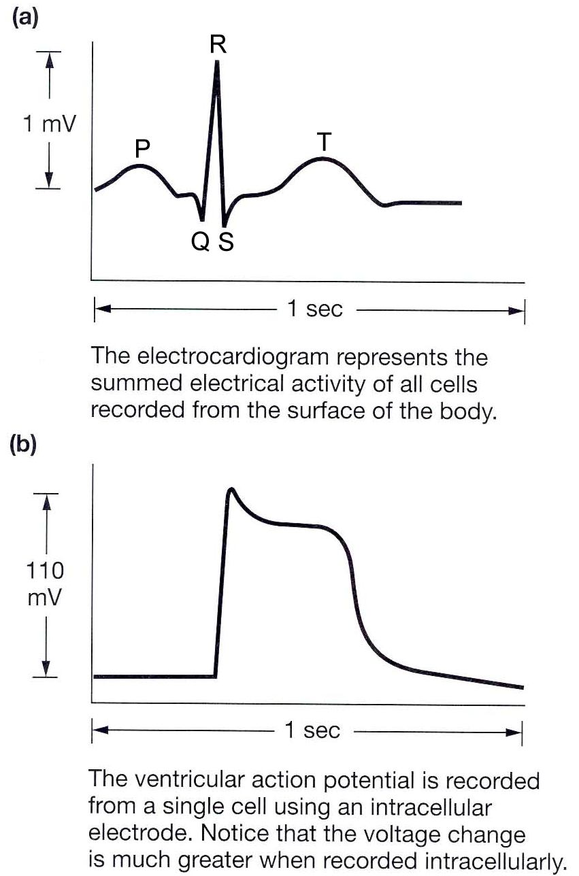
ECG

Slide 28
Question
Why atrial repolarization does not appear in ECG?

Slide 29
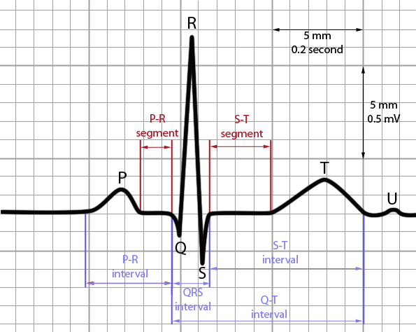
ECG waves
P wave is due to atrial depolarization.
The QRS complex is due to ventricular depolarization.
T wave is Ventricular repolarization.

Slide 30
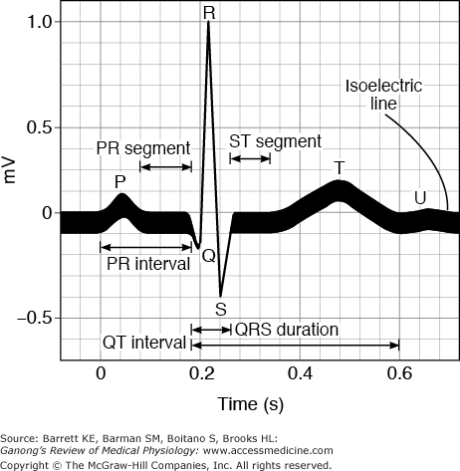
ECG waves
P wave is due to atrial depolarization.
The QRS complex is due to ventricular depolarization.
T wave is Ventricular repolarization.

Slide 31
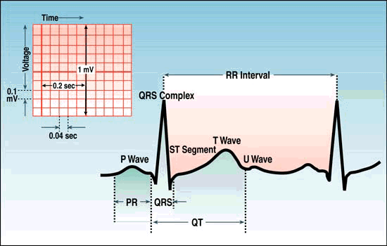
ECG intervals
and segments
P-R interval: Delay between atial and ventricular depolarisation.
QT interval: Roughly approximates the duration of the ventricular myocyte depolarization and thus the period of ventricular stole.
ST segment: No electrical potentials are measured on the body surface; ventricular muscle cells are in the plateau phase of their action potentials.

Slide 32
Normal ECG intervals
P-R interval is normally 0.12 - 0.20 sec, most of this time is delay at the AV node. An increased P-R interval (> 0.28 sec) is characteristic of 1st degree heart block.
QRS complex normally lasts less than 0.10 sec. Increased width of the complex is characteristic of defects in the branch bundles or Purkinje fibres, i.e., bundle branch block.

Slide 33
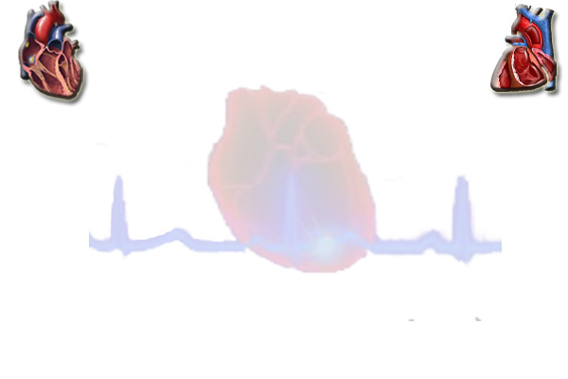
Mean electrical axis
of the ventricles (cardiac axis)
The mean electrical axis of the ventricles describes the net direction and magnitude of current movement during ventricular depolarization.
It is affected by a number of factors, including the position of the heart, heart mass, and conduction time.
It can be calculated by summing the depolarization during the QRS complex in any two leads.

Slide 34
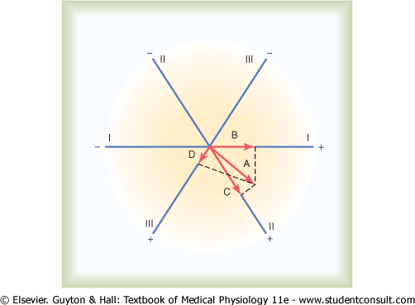

Slide 35
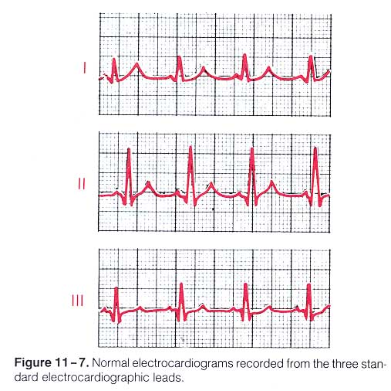
A standard 12-lead ECG

Slide 36
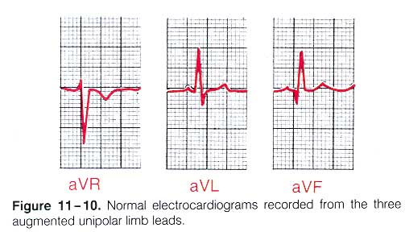
A standard 12-lead ECG

Slide 37
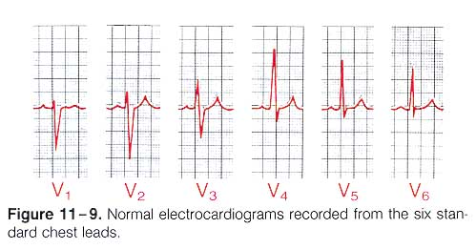
A standard 12-lead ECG

Slide 38
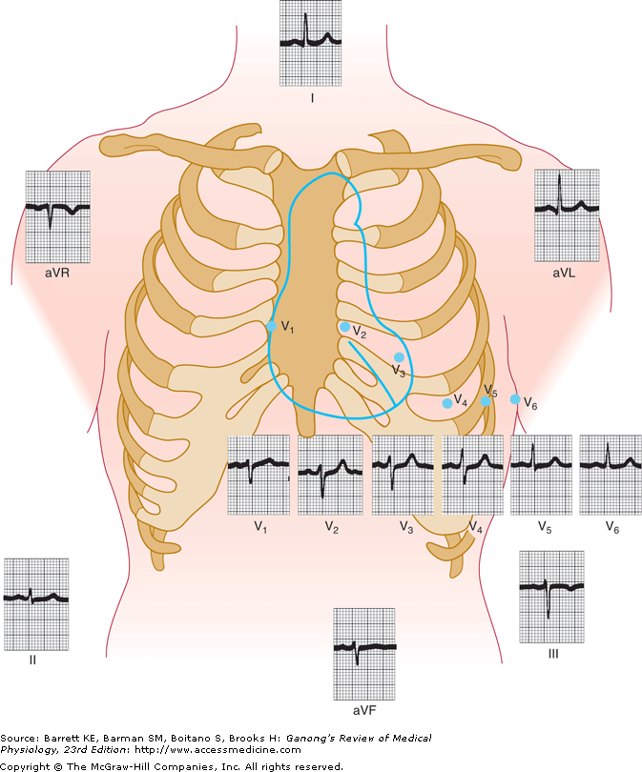
A standard 12-lead Normal ECG

Slide 39
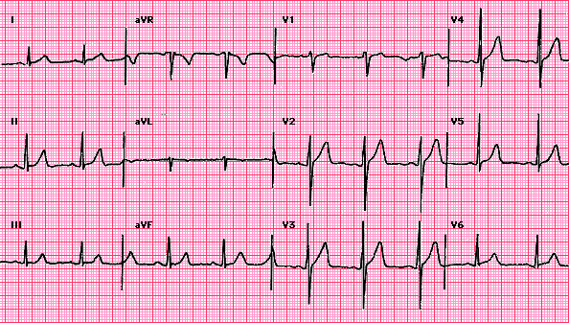
A standard 12-lead Normal ECG

Slide 40
ECG Interpretation
Rate
Rhythm
Axis
Hypertrophy
Myocardial ischemia, injury and Infarction
The ECG provides NO information about pumping or mechanical events in the heart.

Slide 41
Rate and rhythm
Normal rate and rhythm
Sinus arrhythmia
Rate
and rhythm
Normal rate but rhythm is not normal
- Some cases of atrial flutter.
- Accelerated junctional rhythm.
Tachycardia
Bradycardia

Slide 42
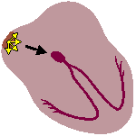
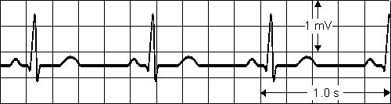
Normal rate and rhythm
Sinus rhythm
Impulses originate in the SA node regularly at a rate
of 60-100 per minute in adults.
P waves upright and of uniform size and contour from beat to beat.
Each P followed by QRS with resulting P:QRS ratio 1:1.
All complexes are evenly spaced

Slide 43


Normal rate and rhythm
Sinus rhythm

Slide 44
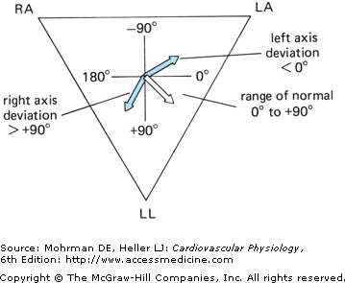
Diagnostic use
of the cardiac electrical axis
Deviation to the Right
Increased Right Ventricular Mass
Chronic obstructive lung disease
Pulmonary embolism
Congenital heart defects
Severe pulmonary hypertension
Deviation to the Left
Increased Left Ventricular Mass
Hypertension
Aortic stenosis
Ischemic heat disease
The normal direction of the mean QRS vector is generally said to be –30 to +110° . Left or right axis deviation is said to be present if the calculated axis falls to the left of –30° or to the right of +110°, respectively.

Slide 45
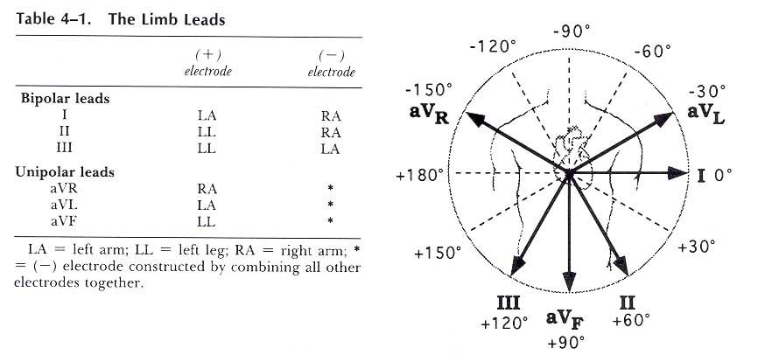
Frontal plane QRS axis
Connection and orientation
of the limb leads

Slide 46
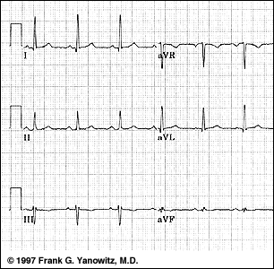
Frontal plane QRS axis
Frontal Plane QRS Axis = +0 degrees

Slide 47
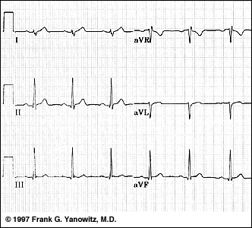
Frontal plane QRS axis = +90 degrees
Lead I is isoelectric;
Perpendiculars to lead I are +90 and -90 degrees;
leads II, III, aVF are positive;
Therefore, the axis must be +90 degrees.

Slide 48
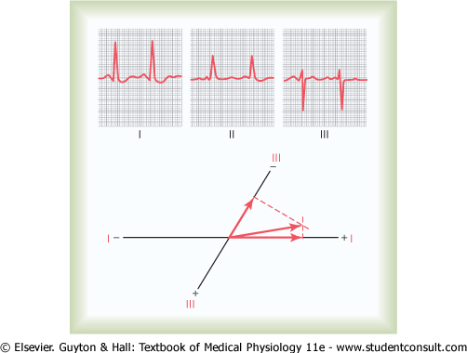
Left axis deviation in a hypertensive heart (hypertrophic left ventricle).
Note the slightly prolonged QRS complex as well.

Slide 49
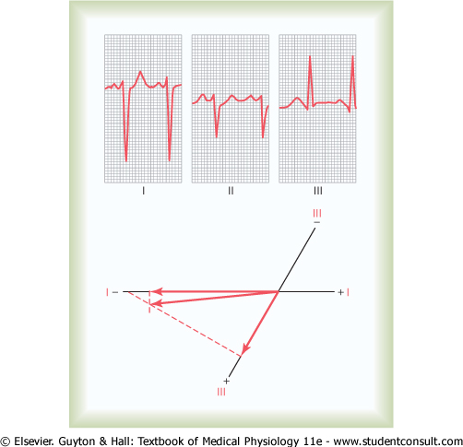
Right axis deviation in a patient with right ventricular hypertrophy.

